Slide 1
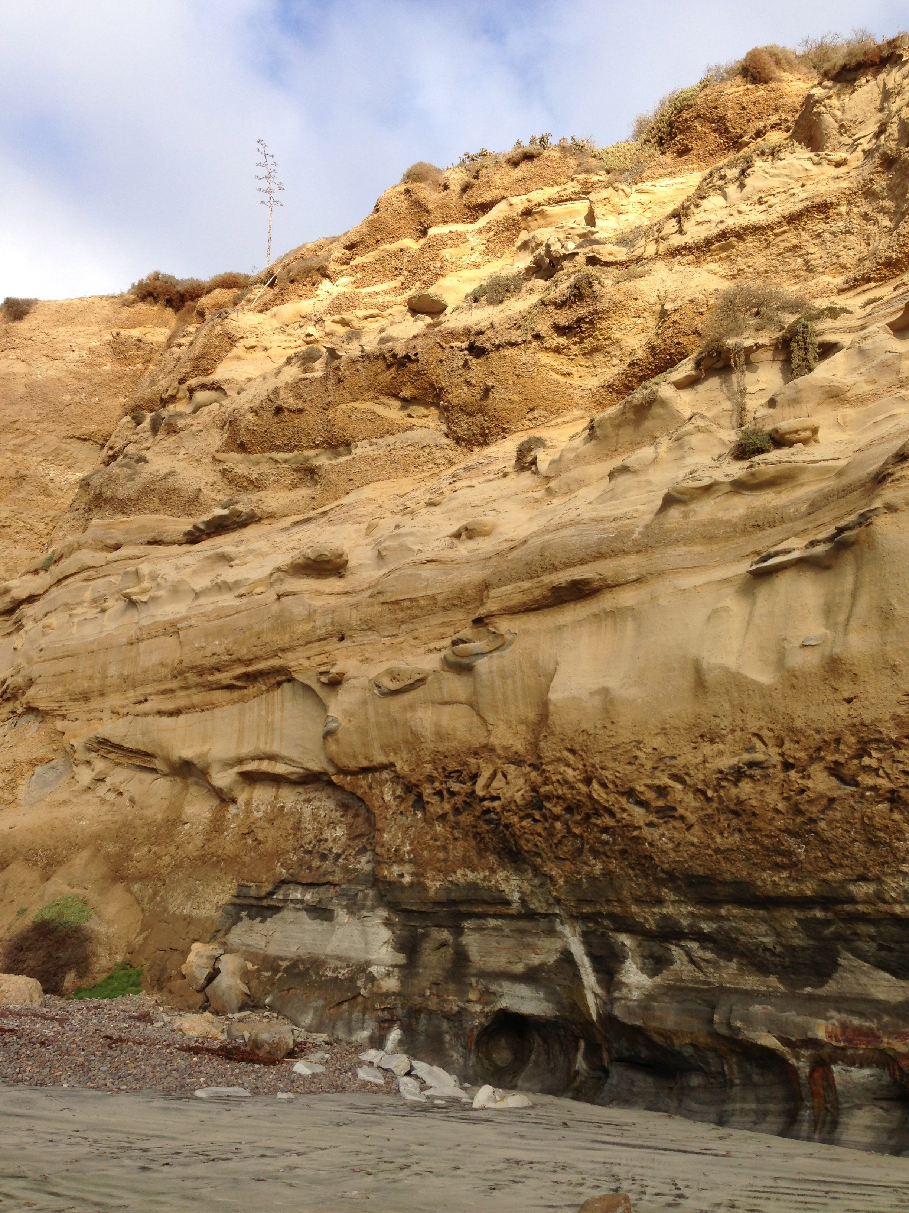
5
4
3
2
1
Present day beach
Notes:
Photo credit: J. Maloney

Slide 2
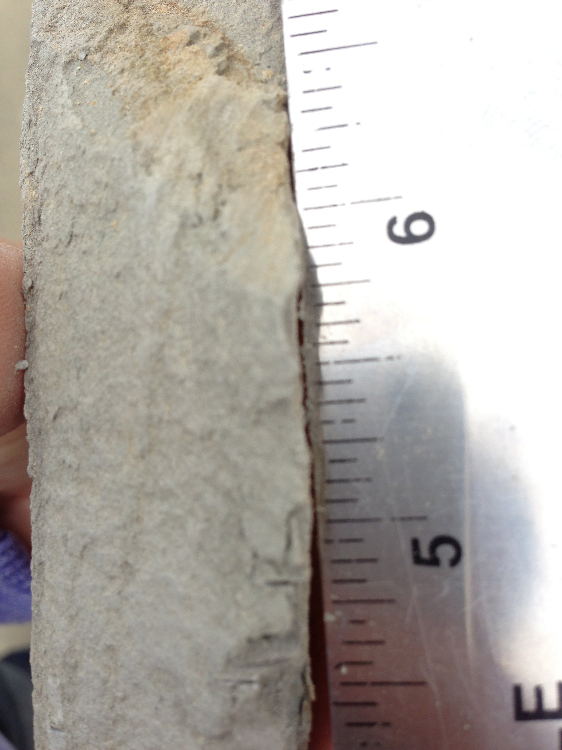
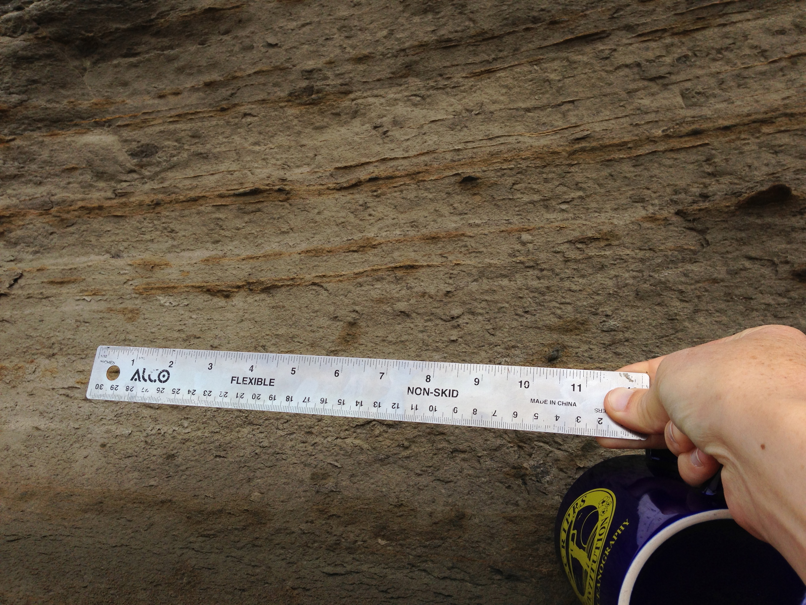
1. Sediment
-Grain size < 0.004 mm
-Thin layering
-Rock breaks into thin pieces along layers
-Does not dissolve with acid
Notes:
Photo credits: J. Maloney

Slide 3
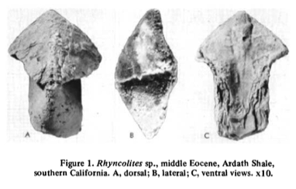
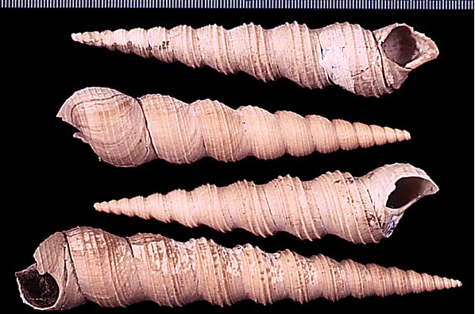
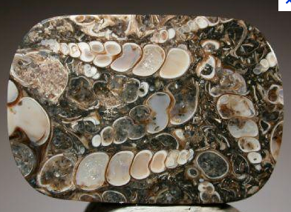
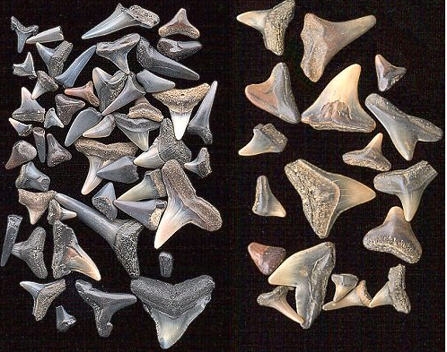
1. Fossils
Jaw bone from octopus/squid type animal
Shells from snails (Molluscs)
Shark and ray teeth
Notes:
Image credits:
Snails - http://www.google.com/imgres?hl=en&client=safari&sa=X&tbo=d&rls=en&biw=2021&bih=1425&tbm=isch&tbnid=zMR_LXzB2agXgM:&imgrefurl=http://www.ucmp.berkeley.edu/tertiary/pli/bodjong.html&docid=_oUHiAYY4DMeJM&imgurl=http://www.ucmp.berkeley.edu/tertiary/pli/bodjong/turritella.jpg&w=600&h=400&ei=BkucUJ-GAanYigKxy4Eo&zoom=1&iact=hc&vpx=620&vpy=347&dur=300&hovh=183&hovw=275&tx=178&ty=133&sig=107351531844110770054&page=1&tbnh=146&tbnw=209&start=0&ndsp=85&ved=1t:429,r:16,s:0,i:137
http://stoneplus.cst.cmich.edu/fossiliferous.htm
Jaw – Teichert & Stanley, 1975, Geology
Shark teeth - http://geology.about.com/od/fossilstimeevolution/ig/fossil-pictures/shark-teeth.htm

Slide 4
5
4
3
2
1
Present day beach
Notes:
Photo credit: J. Maloney

Slide 5
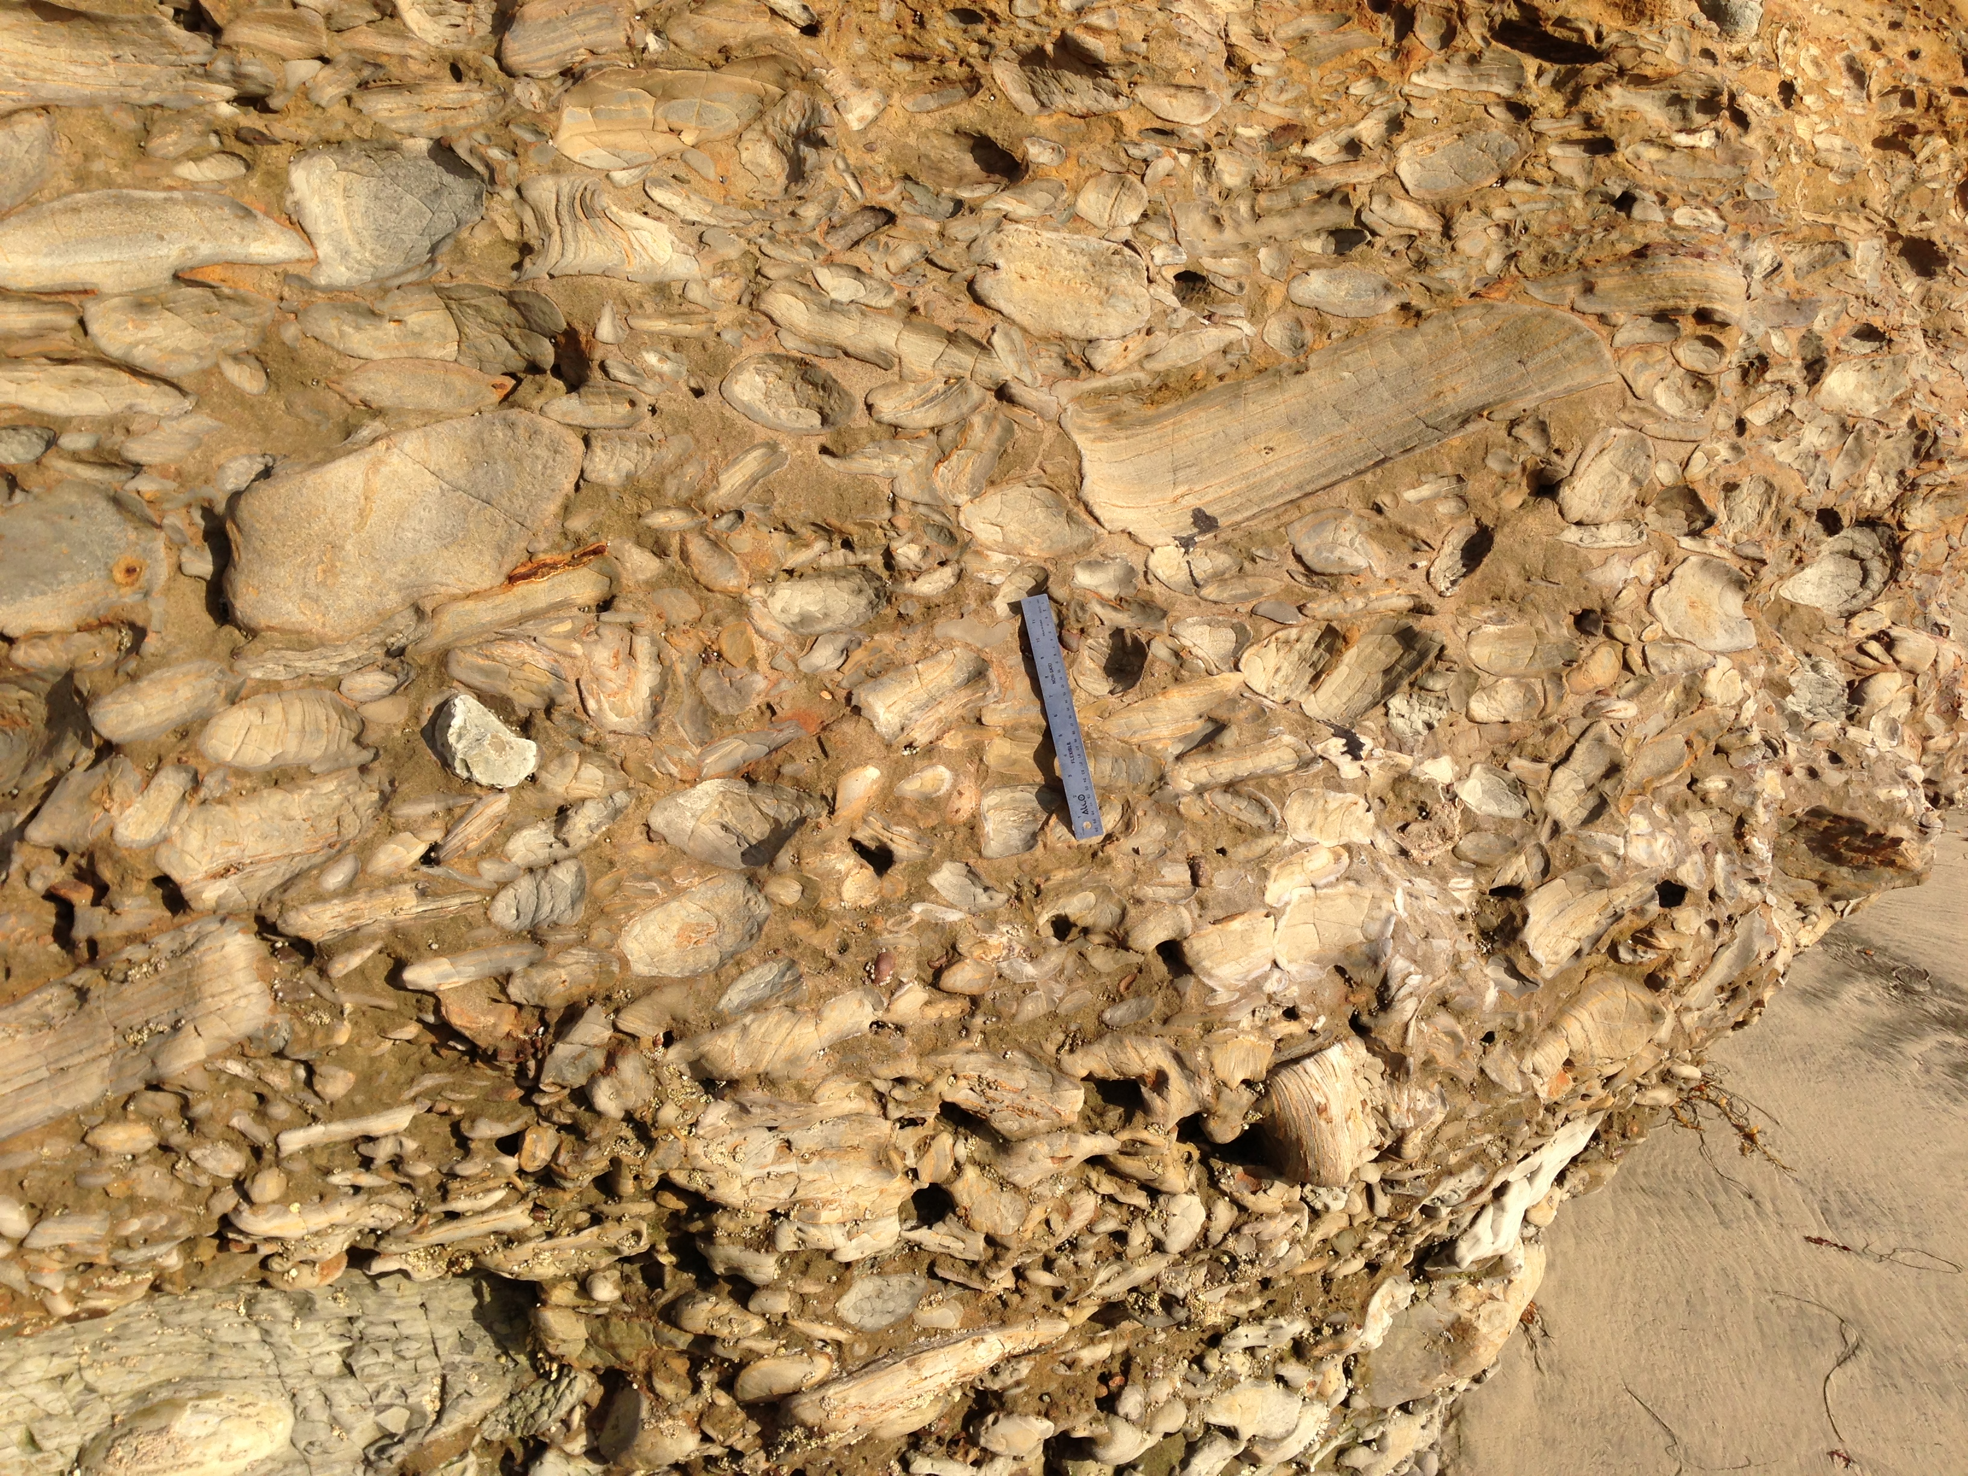
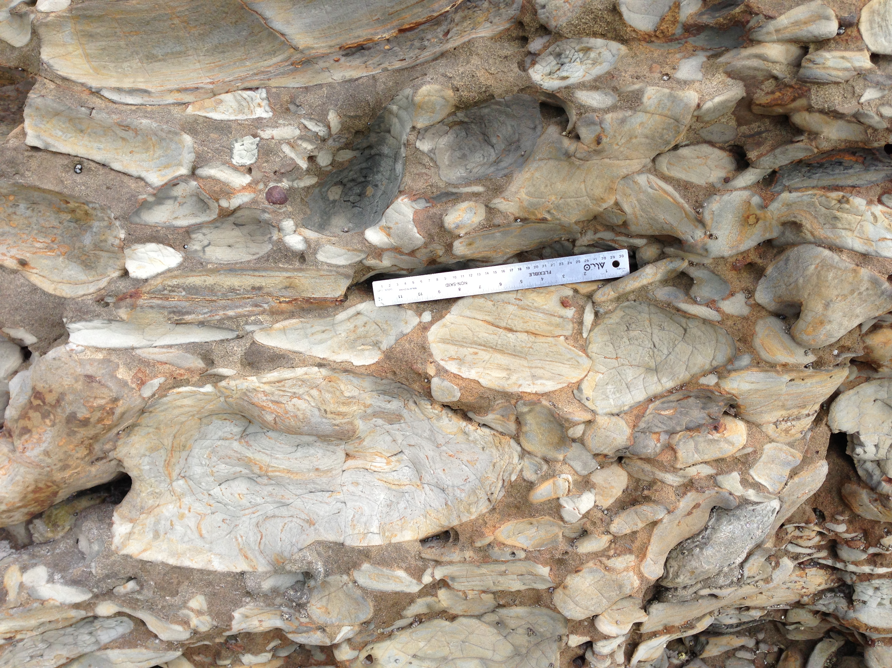
2. Sediment
-Grain size – 4.0 - > 256.0 mm
-Does not dissolve with acid

Slide 6
2. Fossils
Jaw bone from octopus/squid type animal
Shells from snails (Molluscs)
Shark and ray teeth
Notes:
Image credits:
Snails - http://www.google.com/imgres?hl=en&client=safari&sa=X&tbo=d&rls=en&biw=2021&bih=1425&tbm=isch&tbnid=zMR_LXzB2agXgM:&imgrefurl=http://www.ucmp.berkeley.edu/tertiary/pli/bodjong.html&docid=_oUHiAYY4DMeJM&imgurl=http://www.ucmp.berkeley.edu/tertiary/pli/bodjong/turritella.jpg&w=600&h=400&ei=BkucUJ-GAanYigKxy4Eo&zoom=1&iact=hc&vpx=620&vpy=347&dur=300&hovh=183&hovw=275&tx=178&ty=133&sig=107351531844110770054&page=1&tbnh=146&tbnw=209&start=0&ndsp=85&ved=1t:429,r:16,s:0,i:137
http://stoneplus.cst.cmich.edu/fossiliferous.htm
Jaw – Teichert & Stanley, 1975, Geology
Shark teeth - http://geology.about.com/od/fossilstimeevolution/ig/fossil-pictures/shark-teeth.htm

Slide 7
5
4
3
2
1
Present day beach
Notes:
Photo credit: J. Maloney

Slide 8
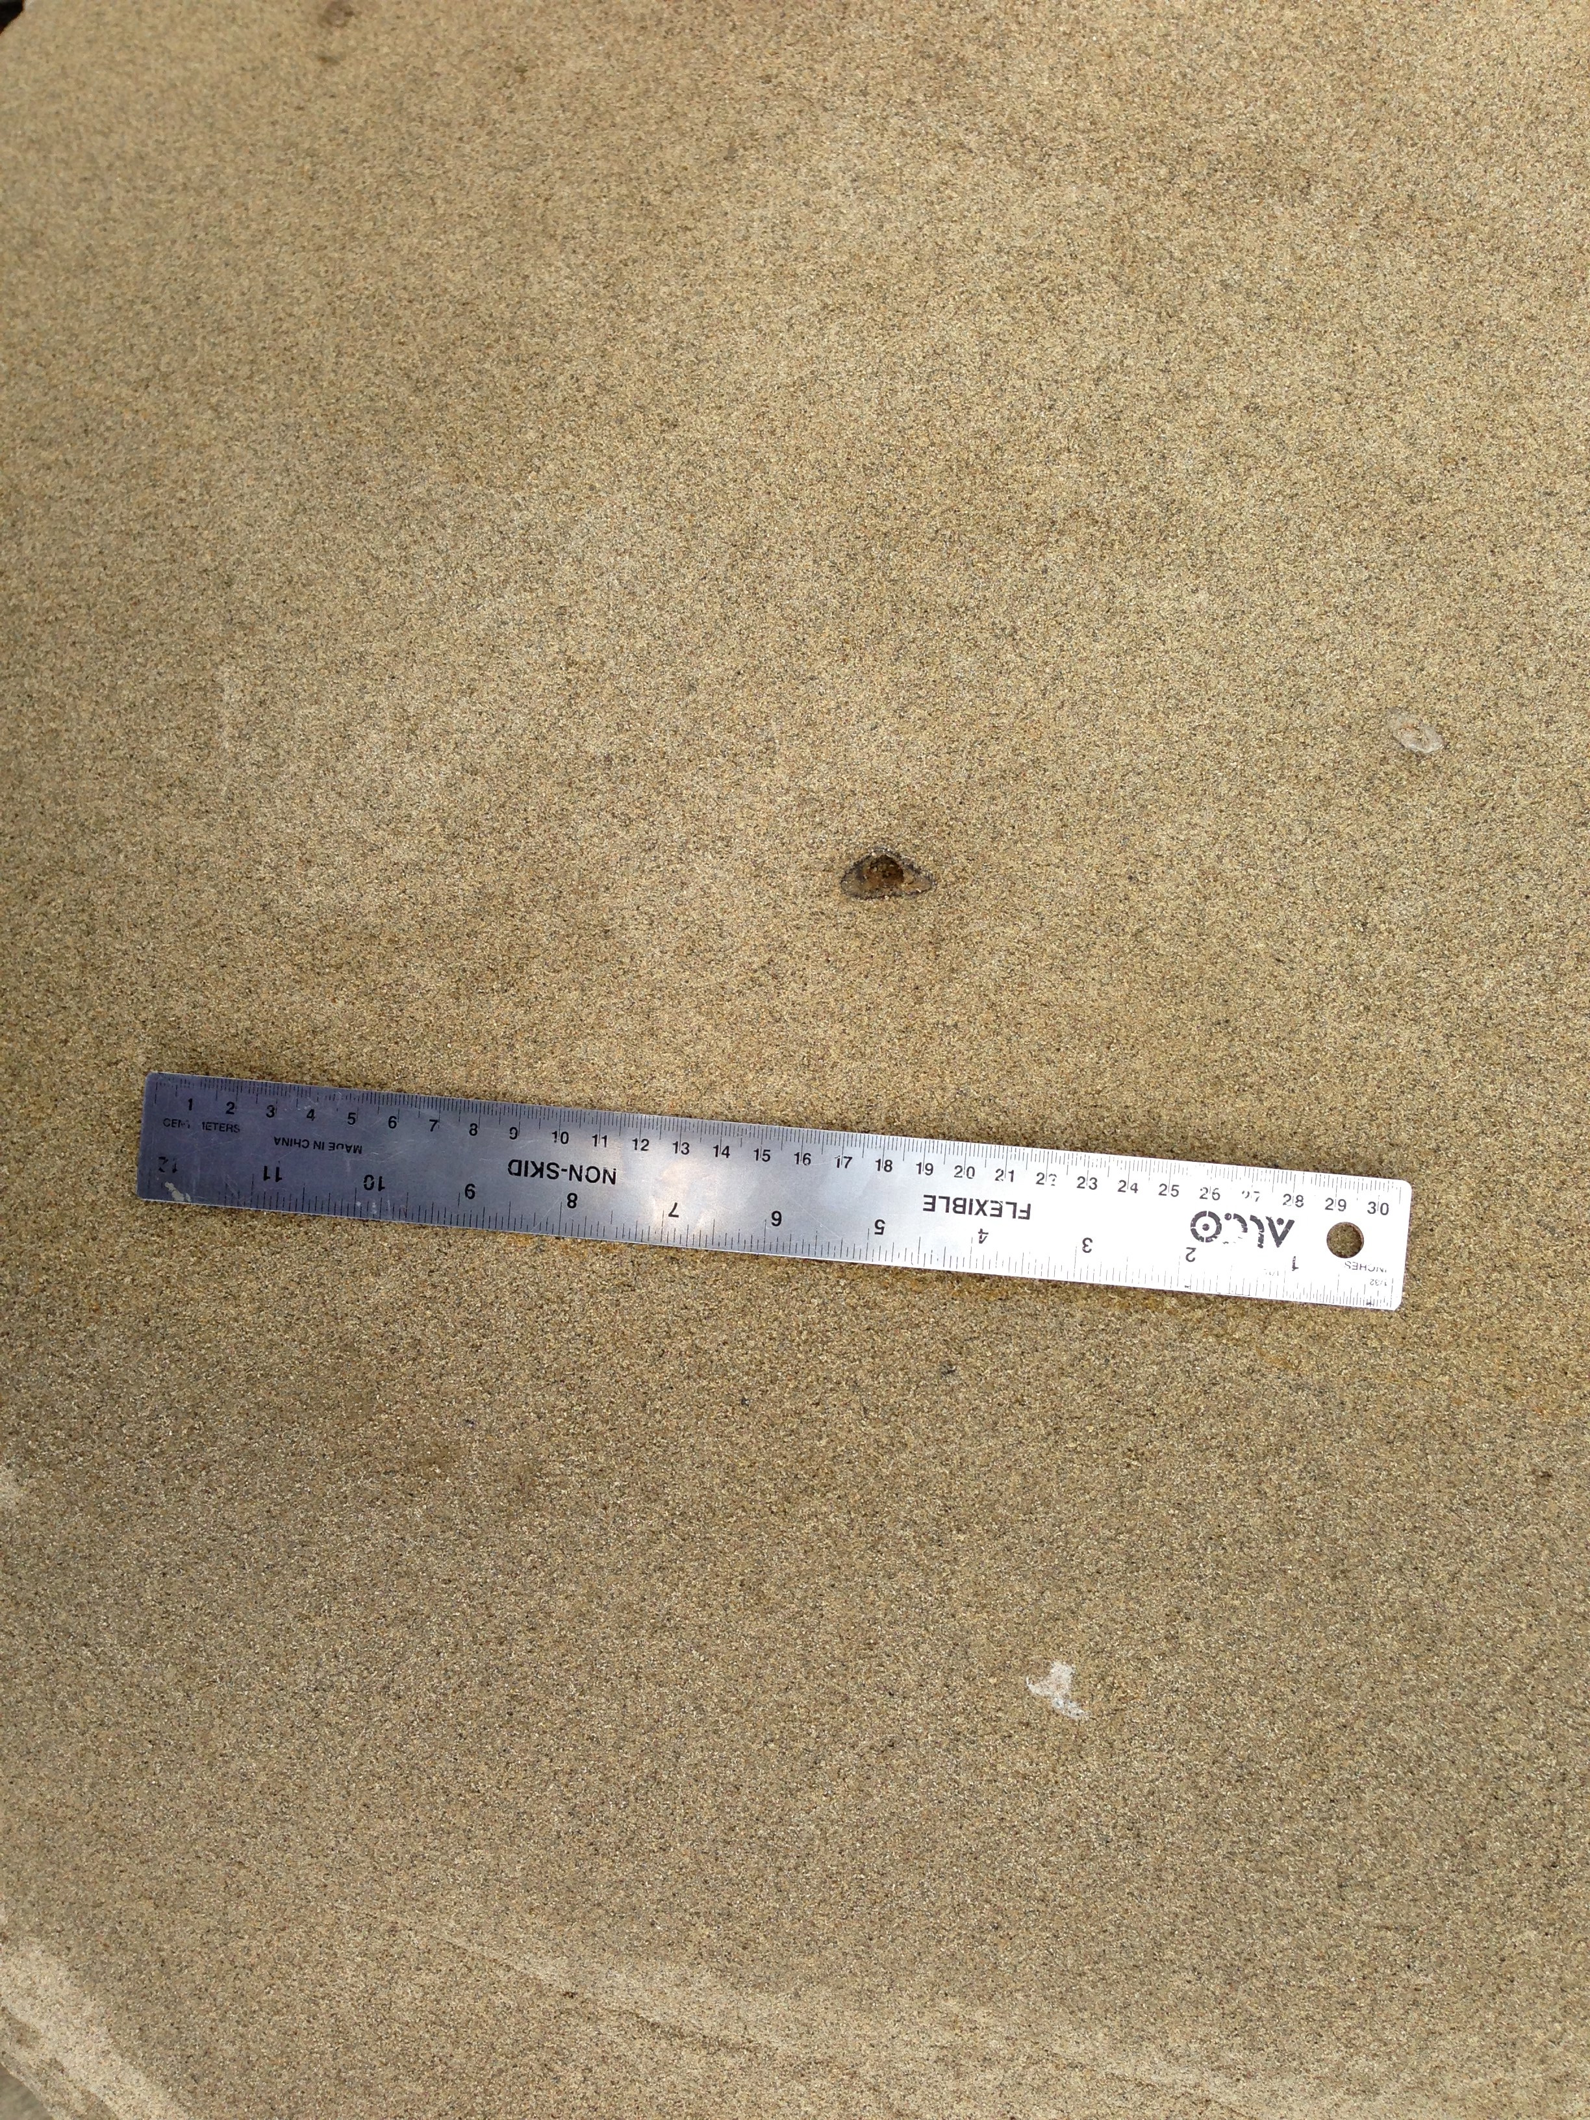
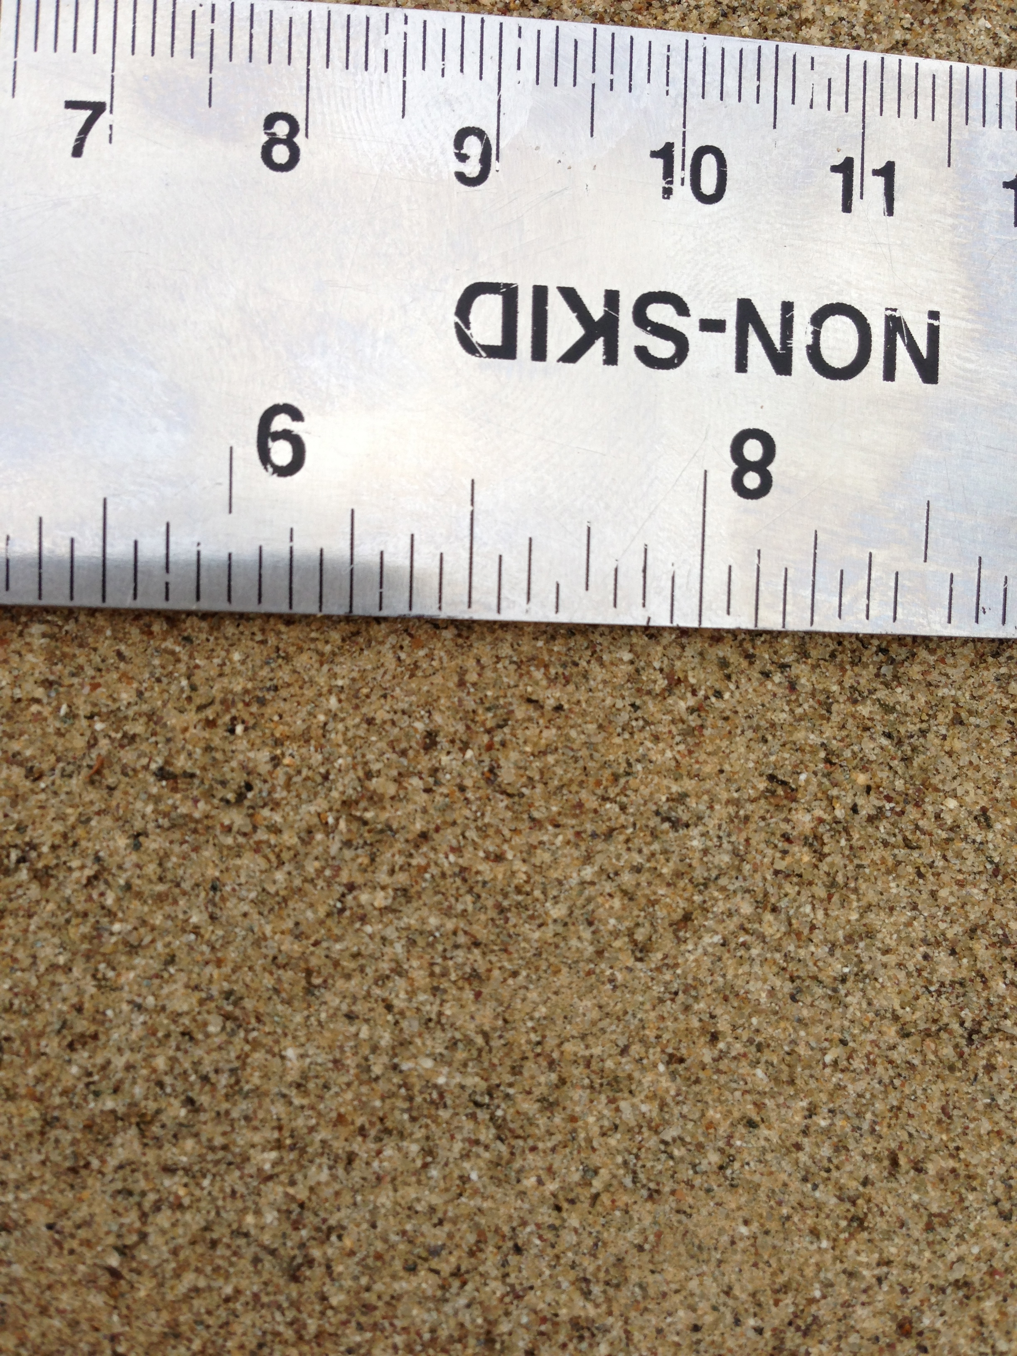
3. Sediment
-Grain size – 0.08 mm
-Does not dissolve with acid
-Rounded grains
Notes:
Photo credit: J. Maloney

Slide 9
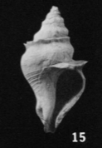
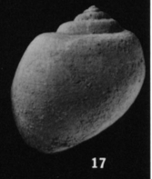
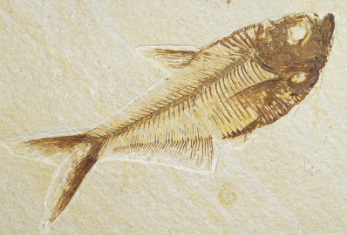
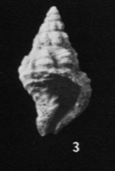
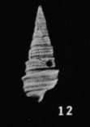

3. Fossils
Shells from clams and snails (Molluscs)
Bony fishes
Notes:
Image Credits:
Snails - Givens & Kennedy, 1975, http://www.cahighspeedrail.ca.gov/assets/0/152/256/261/7a644433-5e35-4d23-9466-c3b7976eeb3a.pdf
Fish picture - http://www.gulfislandsguide.com/national-geographic-posters/fossils/-/cat-52534/

Slide 10
5
4
3
2
1
Present day beach
Notes:
Photo credit: J. Maloney

Slide 11
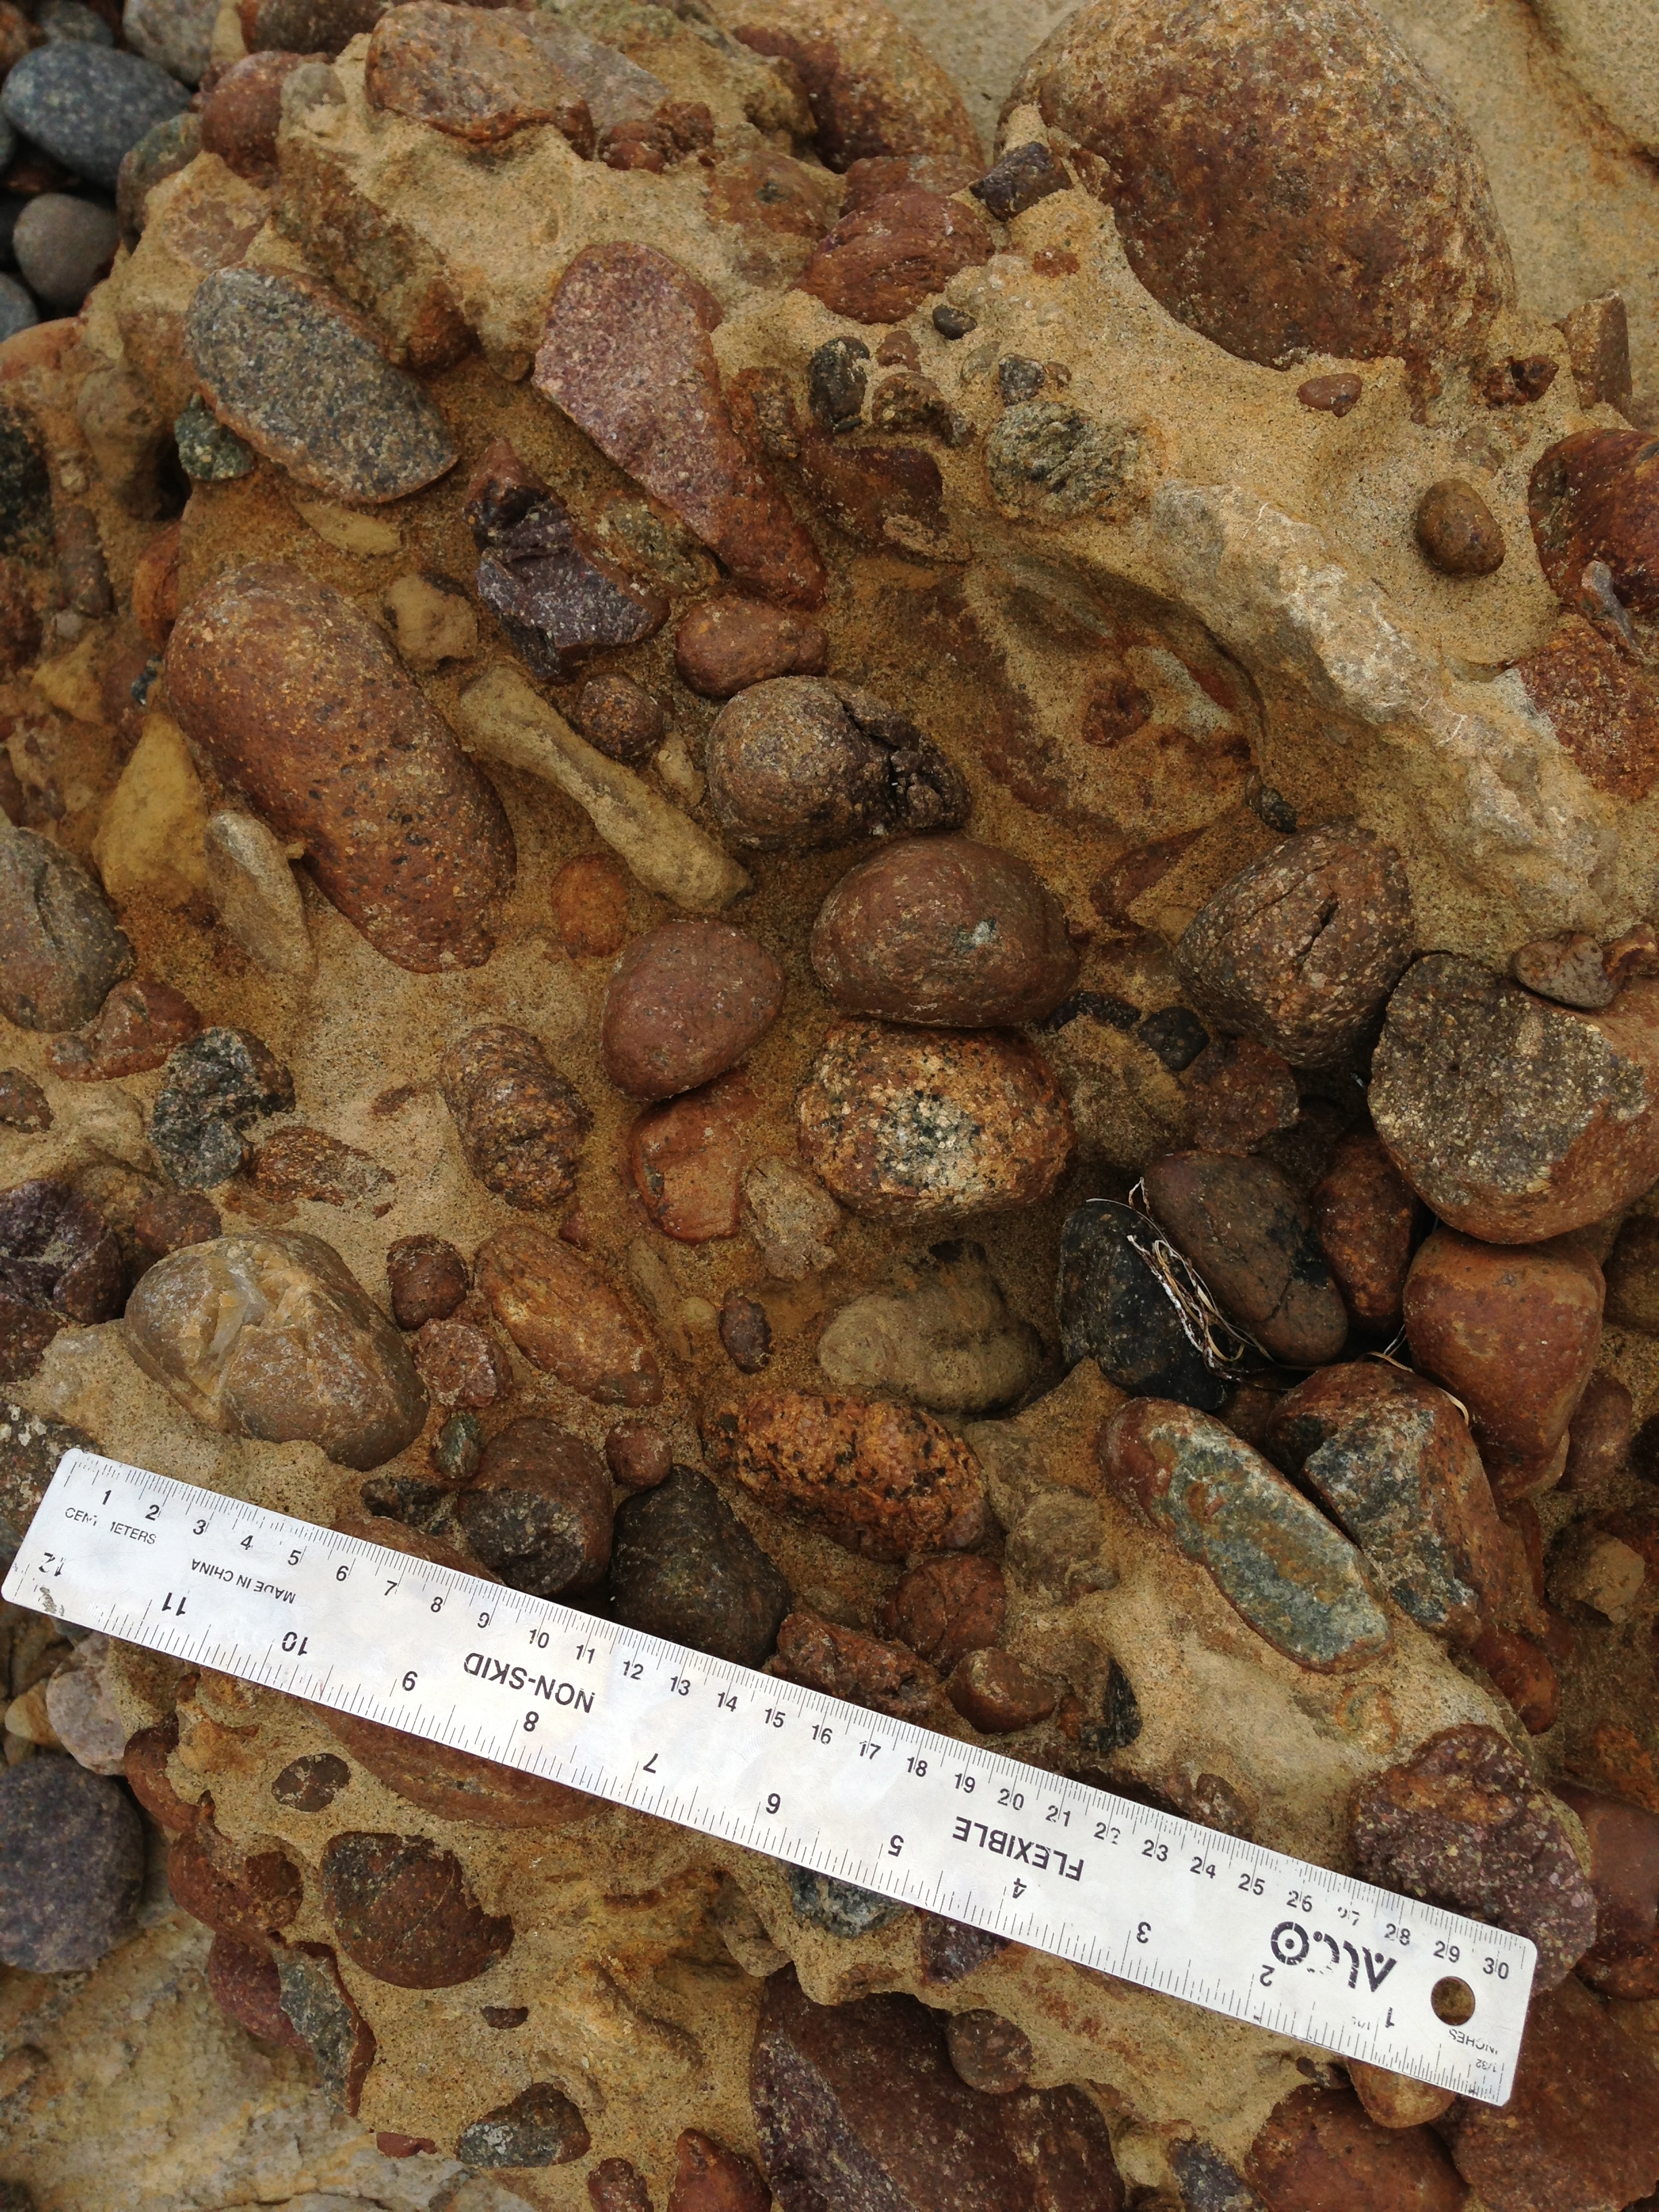
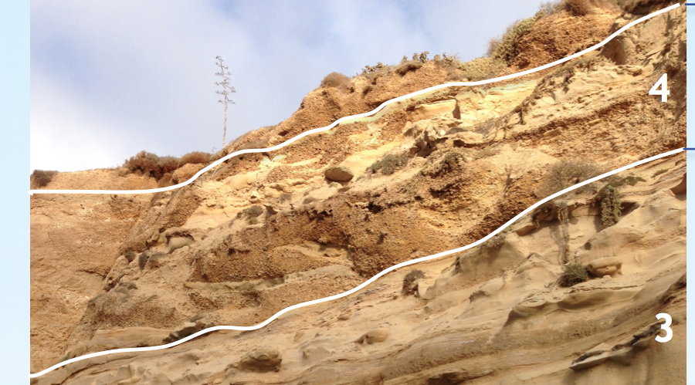
4. Sediment
This layer has 2 types of sediment (4a and 4b).
4a
-Grain size – 0.08 mm
-Does not dissolve with acid
-Rounded grains
4b
-Grain size – 4.0 – 256.0 mm
-Channel shaped
Notes:
Photo credit: J. Maloney

Slide 12
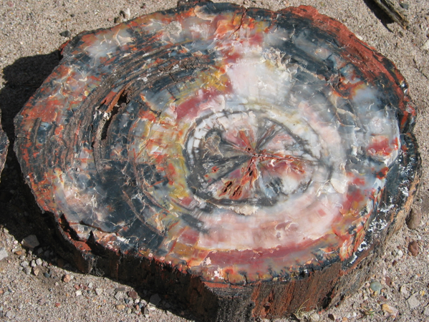
4. Fossils
Shells from clams and snails (Molluscs)
Bony fishes
Petrified Wood
Notes:
Image credits:
Snails - Givens & Kennedy, 1975, http://www.cahighspeedrail.ca.gov/assets/0/152/256/261/7a644433-5e35-4d23-9466-c3b7976eeb3a.pdf
Fish picture - http://www.gulfislandsguide.com/national-geographic-posters/fossils/-/cat-52534/
Wood - http://en.wikipedia.org/wiki/File:Petrified_wood_closeup_2.jpg

Slide 13
5
4
3
2
1
Present day beach
Notes:
Photo credit: J. Maloney

Slide 14
5. Sediment
-Grain size – 4.0 – 256.0 mm
-Does not dissolve with acid
Notes:
Photo credit: J. Maloney

Slide 15
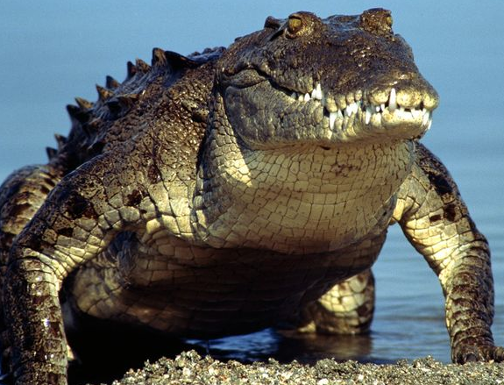
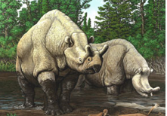
5. Fossils
Crocodile Teeth and Bones
Petrified Wood
Brontothere Bones
Notes:
Source - http://www.cahighspeedrail.ca.gov/assets/0/152/256/261/7a644433-5e35-4d23-9466-c3b7976eeb3a.pdf
Image credit:
Wood - http://en.wikipedia.org/wiki/File:Petrified_wood_closeup_2.jpg
Croc picture – http://animals.nationalgeographic.com/animals/reptiles/american-crocodile/
Brontothere - http://research.amnh.org/paleontology/perissodactyl/evolution/groups/brontotheriidae

