Slide 1
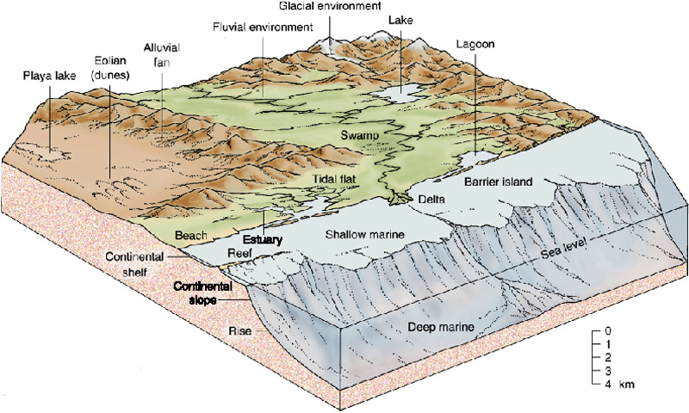
Cliff Interpretation
Notes:
This slide is for the instructor
AUTHORS: Jillian Maloney, Scripps Institution of Oceanography and Jerry Ruiz, Dana Middle School, San Diego, CA
WHY: Geologists study layers of rocks to learn how the environments of earth have changed through time. This branch of geology is known as stratigraphy. Based on the characteristics of sedimentary rocks, including grain size, rounding, fossils, and geochemistry, geologists can infer information about the environment where the rock was formed. In this way we can learn about ancient climates, prehistoric animals, and past tectonic movements of earth’s lithosphere (hard outer shell).
SUMMARY: Students will use evidence they collected previously from a sequence of sedimentary rock layers to interpret the types of environments where the rocks may have formed. Students will gain an understanding of how geologists use characteristics of rocks to learn about their history. They will also learn that earth’s environments change through time because of things like sea-level fluctuations and plate tectonics.
PICTURE/GRAPHICS CREDITS: Credits given on each individual slide.
WEBSITES USED IN THIS PRESENTATION: NA
ADDITIONAL READING: NA
CONTEXT FOR USE: This lesson was designed for a 6th grade science class and is lesson 6 of 7 in a unit on “Sedimentary Rocks: Recorders of earth’s past environments.” The unit is meant to be taught after students have learned the rock cycle, as it focuses on a specific part of the cycle. The lessons build on one another and are best taught in order. Details on the complete unit can be found at earthref.org/SCC/.
MISCONCEPTIONS: 1. Earth’s environments have always been the same.
EVALUATION TIPS: Students will be creating their own stratigraphic columns, which can be used for evaluation.
TEACHING NOTES. Slide notes are contained within each slide. Please view the 5E lesson plan for additional information (6_5E_CliffInterpretation.docx).
LESSON DOCUMENTS:
6_Cliff_Interpretation.pptx
6_5E_CliffInterpretation.docx
-----
Figures:
This diagram shows different environments where sediments can be deposited. We can use evidence from sedimentary rocks to understand the type of environment where they formed.
Image credit: http://higheredbcs.wiley.com/legacy/college/levin/0471697435/chap_tut/chaps/chapter05-02.html

Slide 2


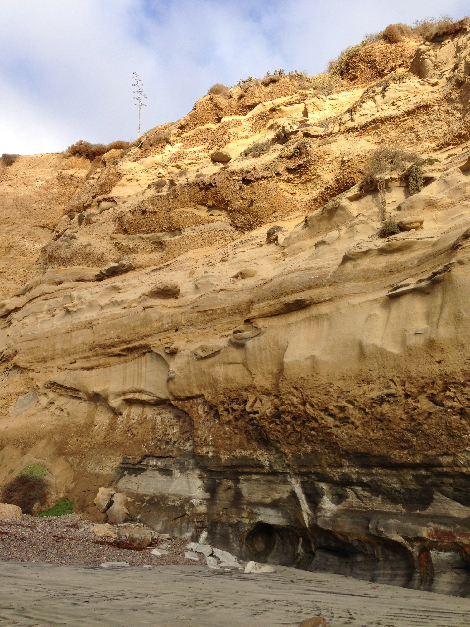




5
4
3
2
1
Present day beach
Notes:
ENGAGE
This slide is for the instructor
Directions for instructor:
Ask students to take out their strat columns and data tables from the previous lesson on Cliff Stratigraphy.
Q: Do you think all of these layers formed in the same environment?
A: NO.
Q: How can you tell?
A: They have different grain sizes and shapes, and have different fossils.
Q: Look at your evidence for layer 1 – do you have any ideas about the environment where it formed? You can put up the image from Slide 1 to give them an idea of different types of environments.
A: Hopefully students will notice that it has small sediment grains, so that means low energy environment. They may also notice that the fossils are from the ocean, so it had to have formed on the seafloor.
-----
Figures:
This is a photo of a cliff on the beach in La Jolla, California, north of Scripps Institution of Oceanography (left), and an example of a students stratigraphic column (right). These sedimentary layers were deposited during Eocene time (34-56 million years ago). The rocks include the Ardath Shale at the base of the cliff – grayish color and the Scripps Formation above – yellowish-brown. Photo credit: J. Maloney

Slide 3
Stratigraphic Column Interpretation
Layer ID | Energy | Transport Time | Environment
1
2
3
4
5
Energy – low, medium, high
Transport Time - very long, long, short, very short
Environment - River, Beach, Deep ocean, Shallow ocean
Notes:
EXPLORE
This slide is for students
Directions for instructor:
This is the data table students will make for this activity. Have students copy it down in their notebooks.
Explain that we’ll use the data table and strat column from the previous lesson to see what we can learn about where the rocks were formed. The lists at the bottom give them options for what they’ll write in each of the columns.
You can now model the activity using layer 1.

Slide 4
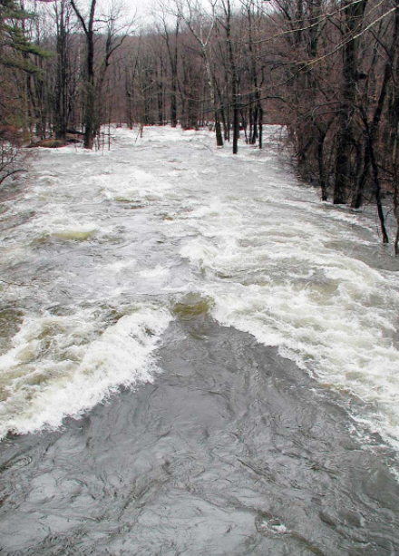
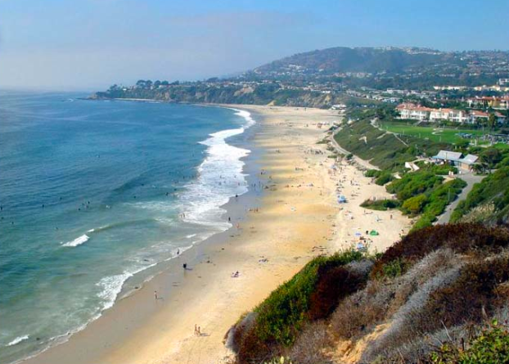


Grain Size & Energy – Water Tables
Large
(pebbles, cobbles)
Medium (sand)
Small (slit & clay)
High Energy
(River, Landslide)
Medium Energy
(Beaches, Shallow Ocean)
Low Energy
(Deep ocean, Lakes)
Rounding & Transport Time - Lollipops
Moved and eroded for a long time
(River, Beach)
Just broken
(Landslide)
Notes:
EXPLORE
This slide is for students
Directions for instructor:
These charts show the relationships between grain size and energy that the students learned about with the water table experiment, and the relationship between rounding and transport time that the students learned about with the lollipop experiment. Now they’ll need to put everything together to figure out where the rock layers formed.
Ask students to look at the grain size of layer 1. It’s clay. So, looking at the top chart, does that mean it’s from a high, medium, or low energy environment? Low.
For layer 1, we don’t know about the rounding, but for the next layers, students will use the bottom chart to determine how long the sediment was transported.
Now you can fill in the data table for energy and transport time – next slide.
-----
Figures:
Rounding - http://www.northstonematerials.com/about-us/education/basic-geological-classification/
Low energy - http://deepseanews.com/2009/06/once-upon-a-time-the-ocean-was-blue/
River - http://nj.usgs.gov/hazards/flood/flood0405/
Beach - http://california-beach-rental.com

Slide 5
Stratigraphic Column Interpretation
Layer ID | Energy | Transport Time | Environment
1 | Low | ?
2
3
4
5
Energy – low, medium, high
Transport Time - very long, long, short, very short
Environment - River, Beach, Deep ocean, Shallow ocean
Notes:
EXPLORE
This slide is for students
Directions for instructor:
Now, using the energy (not transport time in this case), can we tell what kind of environment the layer was formed in?
Let’s look at the charts again – next slide.

Slide 6
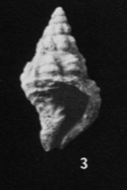
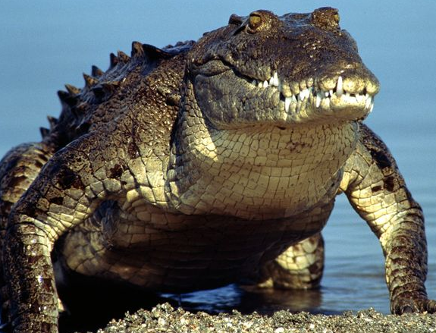
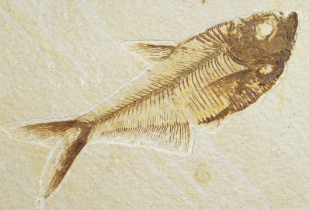
Grain Size – Water Tables
Large
(pebbles, cobbles)
Medium (sand)
Small (slit & clay)
High Energy
(River, Landslide)
Medium Energy
(Beaches, Shallow Ocean)
Low Energy
(Deep ocean, Lakes)
Rounding - Lollipops
Moved and eroded for a long time
(River, Beach)
Just broken
(Landslide)
Fossils
On Land, Close to Ocean, In Ocean?
Notes:
EXPLORE
This slide is for students.
Directions for instructor:
Looking at the top diagram, a low energy environment could be the deep ocean, or a lake. How can we decide which is right? Let’s look at the fossils.
All the fossils from layer 1 are from the ocean, so what is the best choice for the environment? Deep ocean. Let’s fill that in on the next slide.
-----
Figures:
Rounding - http://www.northstonematerials.com/about-us/education/basic-geological-classification/
Low energy - http://deepseanews.com/2009/06/once-upon-a-time-the-ocean-was-blue/
River - http://nj.usgs.gov/hazards/flood/flood0405/
Beach - http://california-beach-rental.com

Slide 7
Stratigraphic Column Interpretation
Layer ID | Energy | Transport Time | Environment
1 | Low | ? | Deep ocean
2
3
4
5
Energy – low, medium, high
Transport Time - very long, long, short, very short
Environment - River, Beach, Deep ocean, Shallow ocean
Notes:
EXPLORE
This slide is for students
Directions for instructor:
Fill in the last column for Layer 1.
Now students can go through the rest of the activity for the remaining layers. We did this as a group. We went back and forth between this slide and the previous slide with the charts. After students agreed on the answer, I had one of them come up and fill in the data table on the Smartboard.
Let them know they can put a range of energy or transport time. For example, layer 4 has two grain sizes – one is high energy, one activity for the remaining layers on their own. Go back to the previous slide and leave it is medium, so they can put medium-high.

Slide 8
Layer ID | Energy (High, Medium, Low) | Transport Time (very long, long, short, very short) | Environment (River, Beach, Deep ocean, Shallow ocean, Landslide)
1 | Low | -- | Deep Ocean
2 | High | Short | Landslide
3 | Medium | Long-Very long | Shallow Ocean
4 | Medium-High | Long-Very long | Shallow Ocean/Beach
5 | High | Long-Very long | River
Notes:
EXPLAIN
This is the answer key for the activity.

Slide 9
46 million years ago
River
Beach or shallow ocean
with channels
Shallow ocean
Submarine landslide
Deep ocean
48 million years ago
Notes:
EXPLAIN/EVALUATE
This slide is optional for students
Directions for instructor:
Ask students to write their environments next to the corresponding layers on their strat columns. They can also write the ages on the right (these are the approximate ages of the actual rocks in the cliff).
At the end of class, you could ask for students to turn in an exit slip listing 3 lines of evidence geologists use to learn about where rocks were formed. A: grain size, rounding, fossils

Slide 10
5
River
46 million years ago
Beach or shallow ocean with channels
4
3
Shallow ocean
2
Submarine landslide
1
Deep ocean
48 million years ago
Present day beach
Notes:
EXTEND
This slide is for students
Directions for instructor:
Here you can ask students to think about how the environments on earth have changed. This leads well into lessons on tectonics or climate change.
Q: How do earth’s environments change over time? For example, if layer 1 was made in the deep ocean, how come we see it now on land at the beach?
A: Environments can change because of changes in climate, changes in sea-level (especially during ice-ages), or because of tectonic movements of earth’s plates.
-----
Figures:
This is a photo of a cliff on the beach in La Jolla, California, north of Scripps Institution of Oceanography. These sedimentary layers were deposited during Eocene time (34-56 million years ago). The rocks include the Ardath Shale at the base of the cliff – grayish color and the Scripps Formation above – yellowish-brown. Photo credit: J. Maloney

