Slide 1
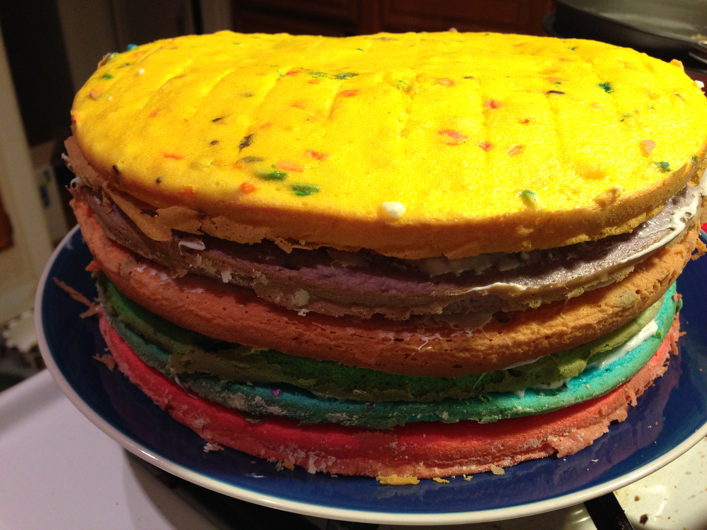
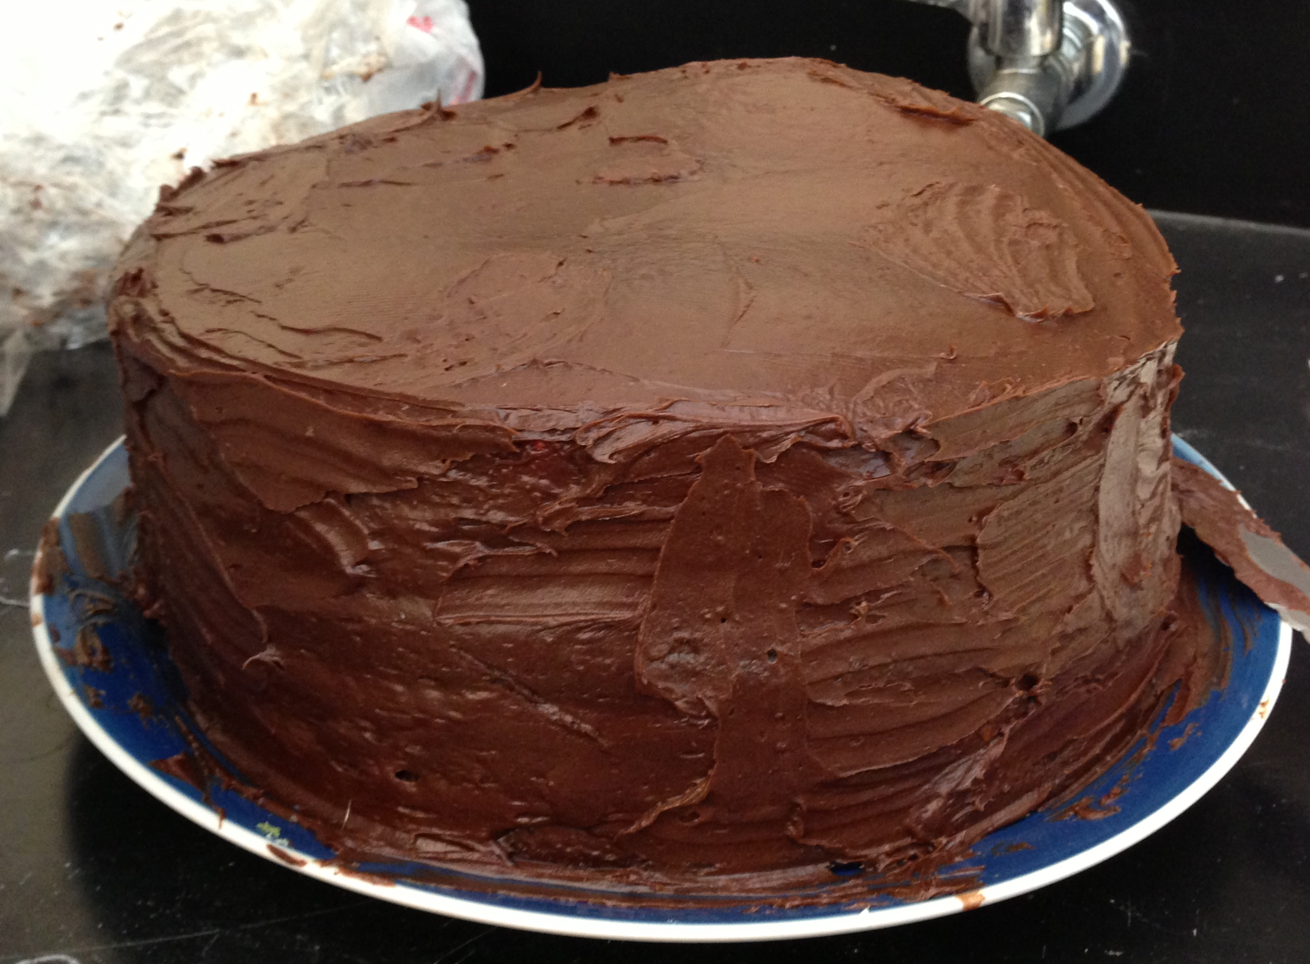
Layer Cake
Notes:
This slide is for the instructor
AUTHORS: Jillian Maloney, Scripps Institution of Oceanography and Jerry Ruiz, Dana Middle School, San Diego, CA
WHY: How do we learn about sedimentary layers that are covered up? For example, how do you know what the layers look like under your school? Or under the ocean? This lesson and associated activity show students how scientists study sediment layers when they aren’t exposed at the earth’s surface. Scientists can use tools, like echosounders, to image sedimentary layers. Scientists can also take sediment cores to collect a tube of sediment layers beneath the earth’s surface. In this activity students, will get to take a core of layer cake that represents sedimentary rock layers beneath the earth’s surface.
SUMMARY: Students will learn about some of the tools scientists use to study sedimentary layers that aren’t exposed on the earth’s surface, including echosounders and sediment cores. Students will be presented with a frosted layer cake and asked to write a procedure for how to find out what the layers look like without cutting into the cake. Students will then take a “core” of the cake using straws and will draw and label the layers based on what they’ve learned in previous lessons from this unit.
PICTURE/GRAPHICS CREDITS: Credits given on each individual slide.
WEBSITES USED IN THIS PRESENTATION: NA
ADDITIONAL READING: NA
CONTEXT FOR USE: Activity is good for middle or high school classes. This is lesson 7 of 7 in the unit “Principles of Geology” available at earthref.org/SCC
MISCONCEPTIONS: 1. The only way to see what is under the surface of the earth is to dig a big hole.
EVALUATION TIPS: The object of this lesson is to get students thinking about different ways scientists study sedimentary rocks. To evaluate learning from the previous lessons (4-6) you can ask students to draw their cores and label the oldest and youngest layers.
TEACHING NOTES. Slide notes are contained within each slide. Please view 7_5E_LayerCake.docx” for additional information on this activity.
LESSON DOCUMENTS:
7_LakerCake.pptx
7_5E_LayerCake.docx
-----------------------------------------------------------------------------------
This Slide:
Figure: This is an image of the layer cake I made for this lesson before (left) and after (right) it was frosted. Simple white cake with food coloring provided 6 layers of different colors. I used chocolate frosting to cover the layers (because chocolate is the color of dirt, and the cake is meant to represent part of the earth. (photo credit J. Maloney).

Slide 2
Materials
Layer cake
Enough straws (or something similar) for each group of 2. The wider the straw, the better.
Colored markers/crayons/pencils.
Notes:
This Slide is for instructor
Directions for Instructor:
For this lesson you will need to either make or buy a frosted cake with several layers. You will be asking students to figure out a way to see what the layers look like, without cutting the cake open, so it’s important that they can’t see the layers to begin with. We did the activity with 6 layers of white cake, colored differently with food coloring, and frosted with chocolate frosting. You could make your layers more elaborate by adding sprinkles or other edible “grains” for students to describe. Keep in mind they will be taking a small diameter core, so they might not capture some of the patterns. If you want to try the activity with ice cream cake, just make sure that you are able to push a straw all the way through it.
Go through the following 4 slides with the students as an ENGAGE activity to get them thinking about how scientists study sediment layers beneath the earth’s surface.
Tell students that we are going to use a model of the earth to think about how we can see sediment layers that aren’t visible at the surface of the earth. Show students the cake that represents part of the earth (it’s helpful not to show them the cake until this point, because they will start to lose focus and have lots of questions about what kind of cake it is, who made it, etc…) Also, you might want to specify that the cake doesn’t represent the whole earth, to avoid students thinking about the layers of the earth (core, mantle, crust). This cake is just a shallow part of the crust. You could give them a scale, or say that it represents the ground underneath the school, or underneath a nearby body of water. The layers we are talking about here are layers of sedimentary rock which are found all over the earth’s surface.
Ask students to write a procedure to be able to see the layers in the cake without cutting the cake open, or removing the frosting.
After students come up with ideas for how to see the layers in the cake, you will give each group of 2 a straw (some students will probably think of this, or of using something similar to a straw). Each group will push the straw into the cake, and pull it back out. They should be able to see all the layers if they push it down to the bottom, but the layers will be compressed. We used “Boba Tea” straws, which are a larger diameter than regular straws, and can be purchased from Amazon.com.
Ask students to draw their core. Make sure they remember to draw the core in the correct orientation. Students have a tendency to hold the core upside down so the cake doesn’t come out the bottom. They then draw the core upside down, and it becomes confusing to remember what side is supposed to be on top. You can remind them to draw it so that the layers are in the same order as they are in the cake. Use the frosting as a guide for them to remember which side is the top. Where is the frosting on the cake? – the top. So which side is the top of your core? The side with frosting. Depending on how elaborate your cake is, you might want to ask students to write a description of each layer next to it in their drawing.
Ask students to label the oldest and youngest layers on their drawings. The top is the youngest, and the bottom is the oldest. This should be an evaluation from lessons 4-6 of 7 in this unit.

Slide 3
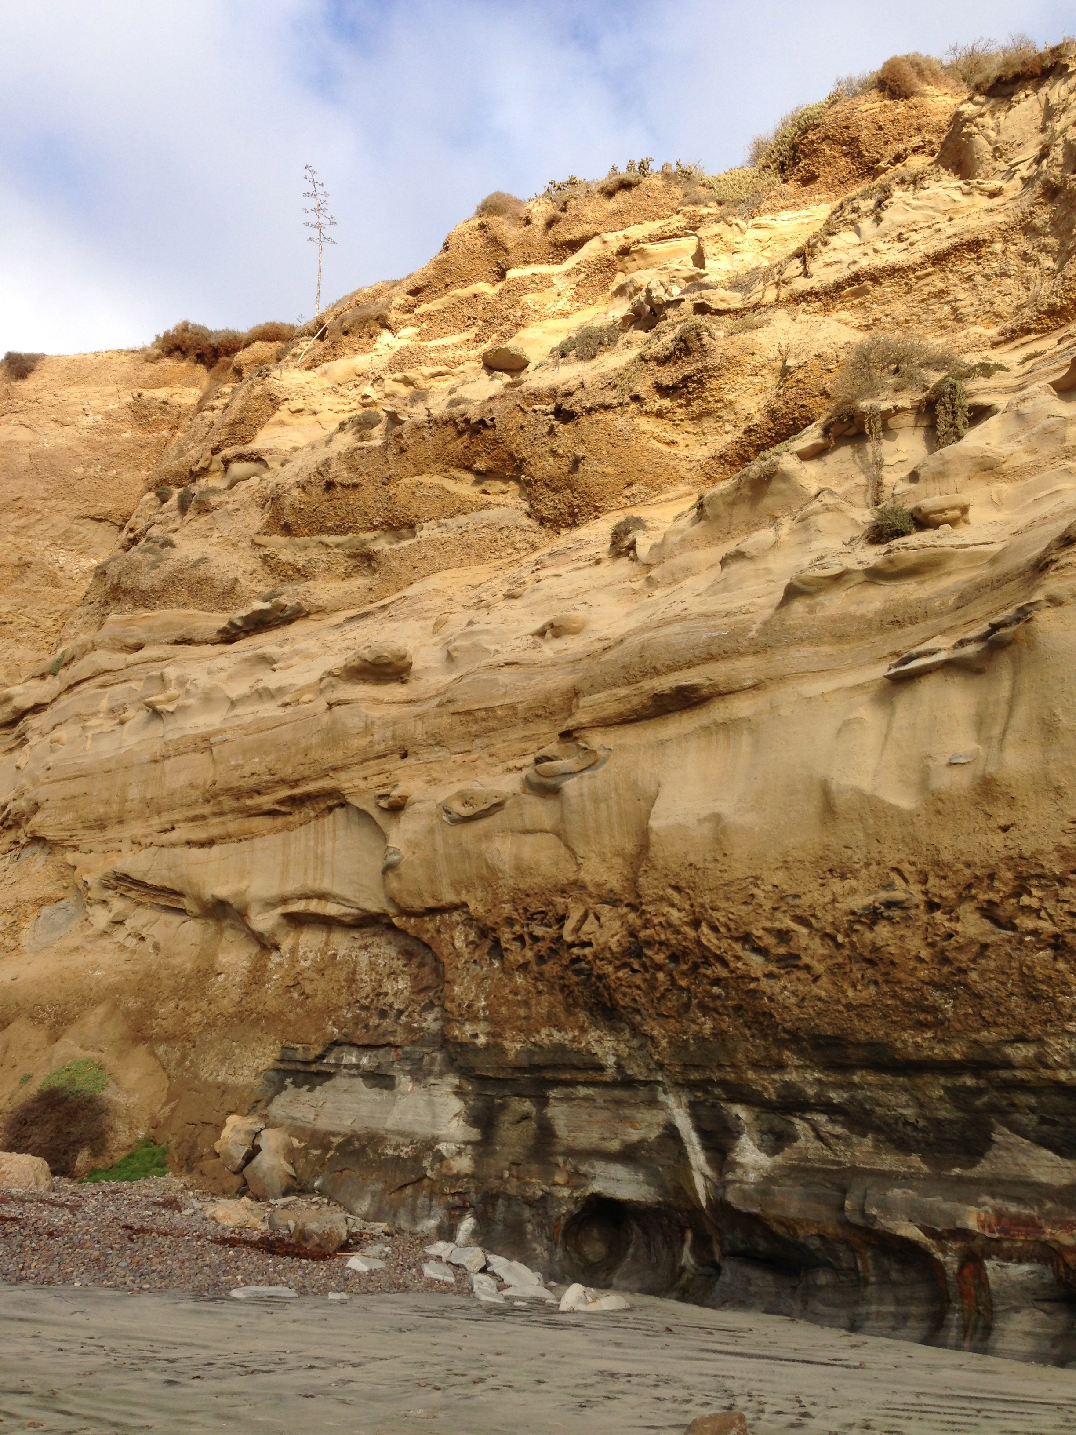
Echosounders - CHIRP
Notes:
ENGAGE
This slide is for students
Directions for instructor:
Show students this image of the cliff that they have been working with. Here where we can see sedimentary rock layers exposed at the surface of the earth. In this setting, geologists can walk up to the layers to describe them or take samples. Ask the students, “What if we want to learn about layers that are under the earth’s surface?” You could ask them how they would see layers under their school, or under water, for example. Students can brainstorm different ideas and share out with the group as a Think, Pair, Share or on posters or the board.
If they haven’t come up with imaging techniques already, you can give them a hint – what do doctors do if they want to see things inside of our bodies without cutting us open? Students will likely say X-Rays, and hopefully some may say ultrasound (or sonogram). If you don’t get ultrasound as an answer you could ask directed questions about what doctors use to see babies inside women’s bellies. You can explain that ultrasounds use sound waves that bounce off of structures (in this example, the baby) to tell them where the object is. Using this information, they can make images of the object. You can also ask students if they know which animals use sound to locate objects – bats and dolphins are good examples of animals that use echolocation.
Move on to the next slide to show how geologists use sound to make images of sedimentary layers beneath the earth’s surface.
----
Photo credit: J. Maloney

Slide 4
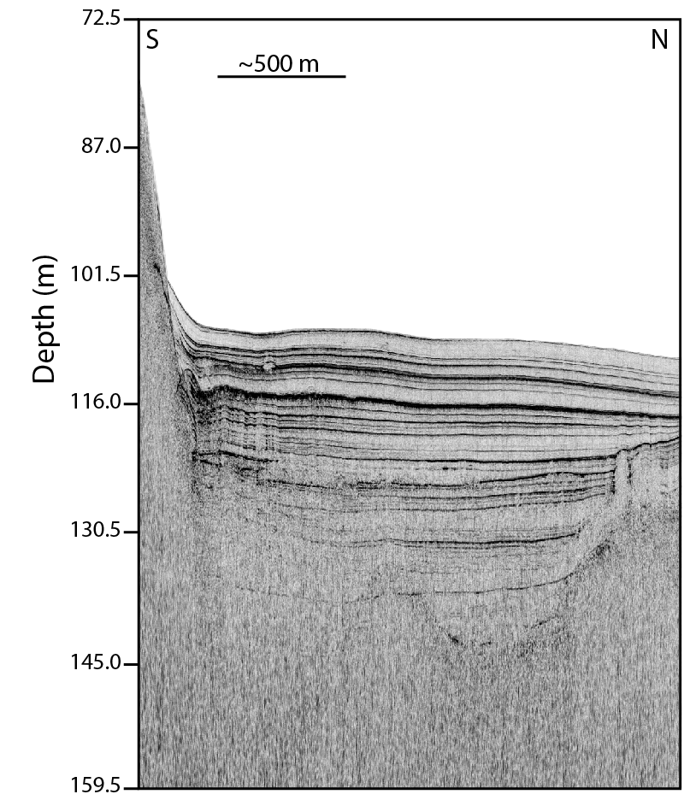
Echosounders - CHIRP
Seafloor
Sediment Layers beneath the seafloor
1
Notes:
ENGAGE
This slide is for students
Directions for instructor:
Explain that the figure on the right is an image of CHIRP data. CHIRP stands for Compressed High Intensity Radar Pulse. CHIRP data is collected by an echosounder that sends a sound pulse towards the seafloor and listens for the sound to bounce off sediment layers and return to the echosounder. This is similar to ultrasounds or echolocation used by bats and dolphins. In the figure, the black line marked by the arrow is the seafloor. The white above the seafloor is seawater, and the gray and black below the seafloor are sediment layers. The black lines represent boundaries between different sediment layers where sound has been reflected. The 2-D CHIRP image is similar to if we were looking at a cliff with different layers, as seen on the left. The next slide shows an animation of how CHIRP works.
----
Image credits: J. Maloney

Slide 5
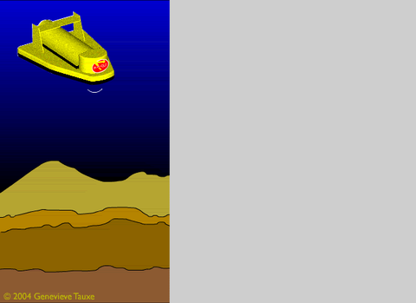
Echosounders - CHIRP
Notes:
ENGAGE
This slide is for students.
Directions for instructor:
1. Play and explain this animation to the class:
In this animation, the CHIRP echosounder is the yellow object with the red dot on the front. The CHIRP emits sound waves (white) that bounce off sediment layers (various shades of brown) beneath the earth’s surface. The CHIRP is towed behind or attached to a ship – the blue in the animation is water. The sound waves reflect off the different sediment layers and return to the CHIRP. Each time the CHIRP hears a reflection, it makes a little blip on the black and white chart on the far right. These peaks line up to mark the boundaries between sediment layers. Many of the peaks next to each other create an image similar to that seen on the previous slide. The black lines represent the blips seen in this animation.
----
Animation credit - Genevieve Tauxe, 2004

Slide 6
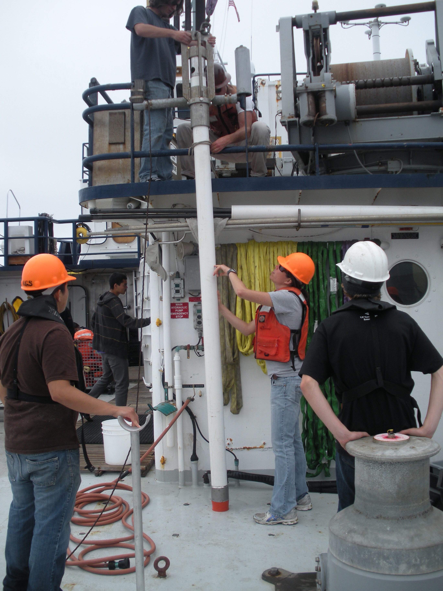
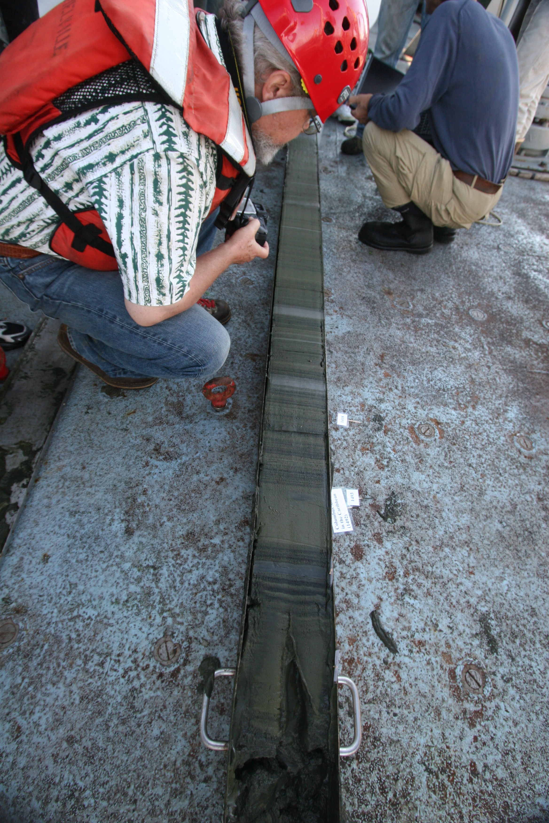
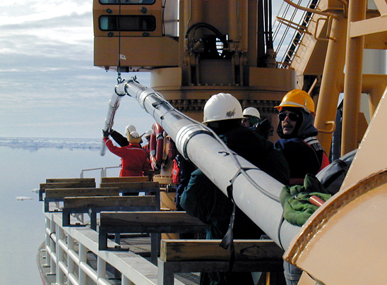
Sediment Cores
Notes:
ENGAGE
This slide is for students.
Directions for instructor:
1. Show images and explain sediment cores to students:
Another way scientists study sediment layers beneath the earth’s surface is to take sediment cores. Scientists drop different sized tubes from ships into the water and down to the seafloor. These tubes sink into the sediment at the bottom of the ocean or lake. Then scientists pull the tube out, filled with the sediment, and bring it back to the ship. The two images on the left show different ship operations for deploying and recovering cores. The photo on the right shows a sediment core cut in half so scientists can look at the sediment inside. Be sure to notice the different colored layers. These layers have different characteristics that may record changes in the environment, like those the students studied in lessons 5-6 of this unit.
----
Photo credits:
Upper left - Alex Hangsterfer, SIO, 2012
Lower left and right - http://www.whoi.edu/page.do?pid=80696&i=1210

