Slide 1
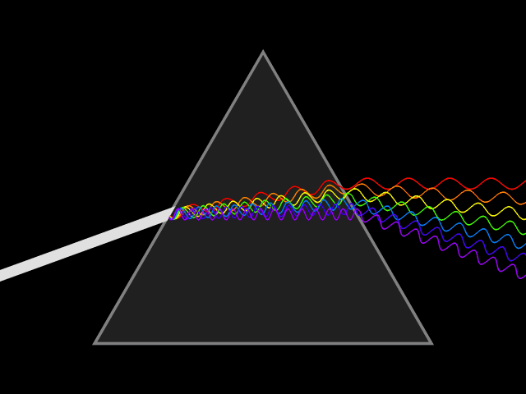
The Electromagnetic Spectrum
Notes:
Authors: Kristina Pistone, Scripps Institution of Oceanography; Dave Van Dusen, San Diego School of Creative and Performing Arts
WHY :
Electromagnetic radiation is everywhere in nature and has innumerable applications in science/technology, and is especially important in atmospheric science. The Earth receives mostly visible light/energy from the sun and emits it as infrared. Understanding the differences between different types of electromagnetic radiation is critical to our understanding of the Earth’s climate system.
SUMMARY:
This is the first lesson in a 3-part unit. Lesson 1 introduces the different parts of the electromagnetic spectrum, focusing on the portions most important to atmospheric/Earth science. It also introduces the concept of a black body, how temperature and wavelength are related, and puts this in the context of atmospheric science. The idealized spectra of both the sun and Earth are discussed, as well as the effects (absorption, reemission) of the atmosphere (which will be covered more in Lesson 2).
PICTURE/GRAPHICS CREDITS:
http://en.wikipedia.org/wiki/File:Light_dispersion_conceptual_waves.gif
WEBSITES USED IN THIS PRESENTATION/ADDITIONAL READING:
Additional information on the electromagnetic spectrum can be found in the NASA series starting at http://missionscience.nasa.gov/ems/01_intro.html.
Some additional information about blackbody radiation, including Wien’s law and the Stefan-Boltzmann equation: http://www.spaceflight.esa.int/impress/text/education/Heat%20Transfer/Radiation.html
Further reading on atmospheric spectroscopy: http://lasp.colorado.edu/~bagenal/3720/CLASS5/5Spectroscopy.html
Addressing misconceptions about light and energy: http://amazing-space.stsci.edu/resources/myths/light.php
CONTEXT FOR USE:
This is the first of a three-lesson series given to an AP Physics B class, but can be adapted down to other physics classrooms. The Earth science here is presented in a physics context.
POTENTIAL MISCONCEPTIONS:
Longer wavelengths are more energetic.
Light and heat are not related.
The Earth reflects sunlight and that’s why the planet is warm (we will instead learn that the more sunlight the Earth reflects, the cooler it is)
The image of a radio telescope on slide 3 is of a “satellite” (they’re thinking satellite dishes, but we found this to be a surprisingly common misconception).
Heat is a molecule.
EVALUATION TIPS:
TEACHING NOTES:

Slide 2
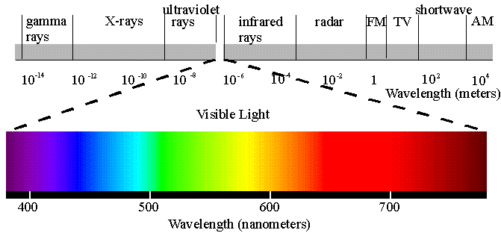
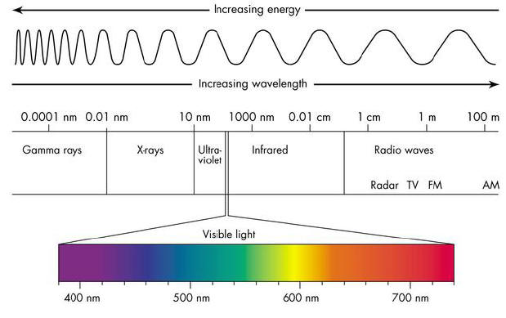

The Electromagnetic Spectrum
The electromagnetic spectrum is the range of all electromagnetic radiation arranged by frequency or wavelength
-- Visible wavelengths are a small portion of this range
Frequency and wavelength are related by :
$$c=fλ$$
Notes:
This slide introduces and defines the electromagnetic spectrum (EM spectrum). The electromagnetic spectrum is way for organizing light waves by their frequency or wavelength (in high-frequency ranges, this may be expressed as energy, as described below). It covers the range of all electromagnetic radiation. The EM spectrum is arranged by frequency/wavelength. The image illustrates the EM spectrum and some important regions within it. The x-axis is organized left to right according to short to long wavelength (high to low frequency). The following slides will go through each range of this spectrum in more detail.
The equation on the slide, $c=fλ$, relates frequency f, wavelength λ, and the speed of EM radiation (aka speed of light) c=3×10⁸m/s. This equation shows how the frequency and wavelength are inversely related; if one increases, the other has to decrease so that their product always equals c. Because of this relationship, different EM ranges can be referred to by different metrics, depending on what is most convenient or their typical usage. For example, you will see that radio waves are in terms of frequency (MHz, kHz); infrared, visible, and ultraviolet tend to be in terms of wavelength (nm, μm); very short wavelength ranges such as X-rays and gamma rays are converted into energy (electron-volts: http://en.wikipedia.org/wiki/Electronvolt) according to Planck’s relation E=hf (http://en.wikipedia.org/wiki/Planck_constant)– if X-rays alone were to be expressed in frequency instead, it would be on the order of petahertz to exahertz (10¹⁵ to 10¹⁸ Hz)!
Wavelength and frequency have an inverse relationship: longer wavelength corresponds to shorter frequency and vice versa.
Wavelength is measured in meters (or kilometers [1km = 1000m or 1×10³m], or millimeters [1mm = 0.001m or 1×10⁻³m], microns [1μm = 1×10⁻⁶m], nanometers [1nm = 1×10⁻⁹m], or sometimes Angstroms [1Å=1×10⁻¹⁰m]), e.g. green light has a wavelength around 520nm.
Frequency is measured in Hertz = 1/second, or kHz, MHz, GHz (1×10³, 1×10⁶, 1×10⁹ Hz, respectively), e.g. green light has a wavelength around .6MHz
The light that we can actually see is a very small portion of the entire spectrum (we will talk about this shortly)
Image from:
http://www.yorku.ca/eye/spectru.htm
For additional information on the SI prefixes used to express a wide range of frequencies and wavelengths, see: http://en.wikipedia.org/wiki/Metric_prefix

Slide 3
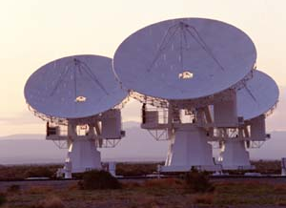
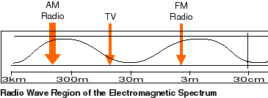

Radio waves
Radio waves
-- very low frequency (long wavelength) radiation; longer than visible or IR
-- used in astronomy (telescopes) and communication (radios)
Notes:
This slide introduces the radio portion of the EM spectrum, with the longest wavelengths.
Radio waves include the longest wavelength EM radiation.
The image shows radio telescopes, which are often arranged in large arrays (networks of telescopes) to act as one giant telescope and be able to get better pictures.
The lower image shows the range of frequencies in the radio range, from 30kHz (λ=10km) to 3 GHz (λ=0.1m). The Statue of Liberty, at 93m tall, is right in the middle of this range, meaning there are radio waves that, peak to peak, are longer than the Statue of Liberty is tall!
Radio waves have very low frequencies (very long wavelengths); longer than visible or infrared radiation
Common applications of radio waves are for astronomical observations (as shown in the figure) and in communication.
The radio range is allocated by the government to say who can transmit on which frequencies to avoid communication/broadcast interference (see: http://www.ntia.doc.gov/files/ntia/publications/spectrum_wall_chart_aug2011.pdf; other countries will have different allocations); these are the ranges AM/FM/UHF/VHF. The numbers of AM/FM radio stations that you tune to are the frequency they broadcast at in kHz and MHz, respectively.
Note on misconception: students will most likely respond “satellite” when asked what the image is a picture of. This is a good opportunity to discuss what is a satellite.
Images from/for more information see:
http://science.hq.nasa.gov/kids/imagers/ems/radio.html
http://missionscience.nasa.gov/ems/05_radiowaves.html

Slide 4
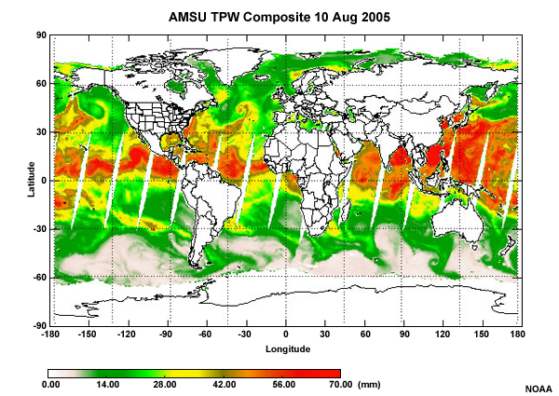

Microwaves
Microwaves:
-- Shorter in wavelength than radio waves.
-- Strong interaction with water molecules.
-- Useful in measuring water in the Earth’s climate system.
-- Can also use them to heat our food.
Notes:
This slide introduces microwaves. The microwave region of the spectrum is just longer than the radio portion (300MHz to 300 GHz = 1m to 1mm). We commonly use microwave radiation to cook our food; this wavelength interacts with the water molecules in the food to give them energy, heating them and cooking your food. The strong interaction of microwaves with water is also the basis for many ground- and satellite-based instruments which measure water vapor and liquid water in the atmosphere.
The image shows an exciting application of microwaves. It shows the total liquid water in the atmosphere (in the form of clouds) over the globe, as measured from satellites. The image is from the AMSU instrument (Advanced Microwave Sounding Unit); other instruments which measure water from satellites are the TMI (TRMM Microwave Imager) on the TRMM (Tropical Rainfall Measuring Mission) satellite, the SSM/I (Special Sensor Microwave/Imager) which is also used to derive the main sea ice dataset, and many local weather satellites. Ground-based instruments that use microwaves include microwave radiometers (MWR: http://en.wikipedia.org/wiki/Microwave_radiometer), which measure the liquid water and water vapor in the atmosphere above the instrument by looking at two or more different wavelengths and deriving the amount of liquid and vapor using the known absorption in each channel. The conventional units of this are mm, which corresponds to the height of the column of water if all the water were condensed out to the ground. Satellites are extremely useful platforms because they allow measurements on a near-global scale with high frequency. Note that this figure shows data only over the ocean, as varied terrain makes retrievals more difficult over land, so the retrievals over ocean and land are typically processed separately.
Image from/for more information:
http://www.meted.ucar.edu/npoess/microwave_topics/clouds_precip_water_vapor/print.htm#s2p10
http://missionscience.nasa.gov/ems/06_microwaves.html
For more information on microwave satellite imagery:
http://www.meted.ucar.edu/npoess/microwave_topics/clouds_precip_water_vapor/print.htm (requires registration (free))
http://trmm.gsfc.nasa.gov/overview_dir/tmi.html
http://disc.sci.gsfc.nasa.gov/precipitation/additional/applications/trmm_apps/trmm_diurnal_3g68_tmi.shtml

Slide 5
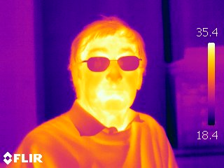

Infrared radiation
Infrared radiation is the wavelength range just longer than visible
-- near infrared is the shortest
-- far infrared is the longest (farthest from visible)
-- the Earth and human beings both give off radiation in the infrared
Notes:
This slide describes the infrared portion of the EM spectrum. Infrared radiation has wavelengths just longer than the visible range (~700nm-1mm)
The image shows the infrared radiation given off by a human body. Regions of bare skin have the highest temperature (shorter wavelengths), clothing is in the middle range, and the man’s glasses give off nearly none (glass is opaque to infrared radiation).
Note: in class, some students will likely express the impression that the man in the image is wearing sunglasses. The reference site below (http://herschel.cf.ac.uk/science/infrared) has a visible-wavelength image as well, showing that they are normal glasses, which is useful for placing infrared and visible into context. Start off by asking them which are the warmest parts of his face, and which are the coldest (pointing out the temperature scale on the right). Why is his mouth the warmest? (because he’s exhaling and his core body temperature will be higher than his skin temperature) Why are his glasses the coldest? (Because glass is opaque to infrared radiation– none of the heat coming from his face is able to pass through the glasses).
Infrared also has important applications in construction; looking at infrared images of houses is a common way to determine where a building is losing heat. The less heat that escapes from windows or drafts, the less energy needs to be spent on heating those buildings.
Near-infrared (NIR) is the shortest wavelengths (“near” to visible)
Thermal infrared (TIR) is mid-range
Far infrared (FIR) is the longest (“far” from visible)
Human beings emit in the thermal infrared. This is what night-vision goggles show.
The Earth’s emission spectrum is centered in the NIR. This makes it particularly important in Earth Science.
Images from/for more information see:
http://herschel.cf.ac.uk/science/infrared
http://science.hq.nasa.gov/kids/imagers/ems/infrared.html
http://missionscience.nasa.gov/ems/07_infraredwaves.html

Slide 6
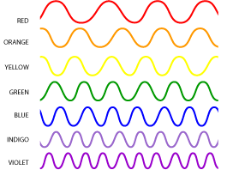
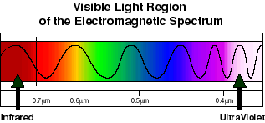

Visible light
Visible light refers to the wavelengths of the EM spectrum that are visible to human eyes (~700 to 400 nm)
-- red has the longest and violet has the shortest wavelength
-- energy from the sun is centered in this visible range; our eyes evolved to see the most sunlight!
Notes:
The image shows different wavelengths of the visible spectrum. Red has the longest wavelengths and violet has the shortest. Note that infrared (infra = below; red = red) is the next region (on the red edge of visible), and ultraviolet (ultra =above, extreme; violet = purple) is the next region adjacent to the violet edge of visible.
Visible light is the range from roughly 700 nm (or 0.7 microns) to 400 nm (0.4 microns), corresponding to red and violet, respectively.
This is the range of light that human eyes can see (some other animals can see either infrared (some snakes, fish, or insects) or UV (e.g. bees))
Green wavelengths are roughly 550 nm
Yellow wavelengths are roughly 600 nm
Energy reaching us from the sun is centered in the visible range. This makes it evolutionarily advantageous for human eyes to be able to “see” in the visible! It also makes it particularly important in Earth Science.
Images from/for more information see:
http://science.hq.nasa.gov/kids/imagers/ems/visible.html
http://missionscience.nasa.gov/ems/09_visiblelight.html

Slide 7
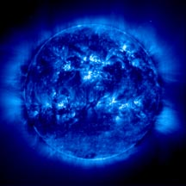
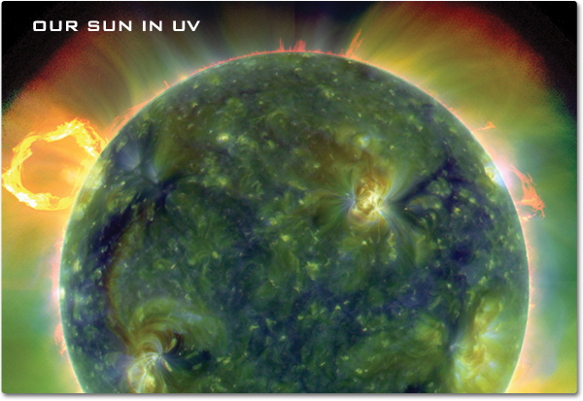

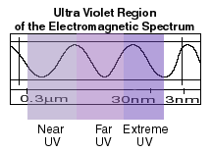
Ultraviolet
Ultraviolet
-- spectral region nearest to the visible but with higher frequency (shorter wavelength)
-- the sun also emits UV radiation; most is blocked by the ozone layer. The rest causes sunburns.
Notes:
This slide describes the ultraviolet region of the spectrum (~3×10⁻⁴ m to 1×10⁻⁸m, or 0.3 microns to 10 nm)
The image shows the sun as seen in ultraviolet wavelengths, in false-color, with red colors being relatively low temperatures (longer wavelengths) and blues and greens showing hotter temperatures (shorter wavelengths). It is evident from the photo that the sun emits a lot of ultraviolet radiation. In contrast to the visible, the bright (in the UV) sunspots are emitting more energy at these wavelengths (which appear dark at visible wavelengths), and the solar flares have a (relatively!) lower temperature than other parts of the sun.
Ultraviolet is the region of the spectrum closest to the visible but with shorter wavelengths (close to the violet end of the visible)
The sun emits in the UV as well, but most of this is blocked by photochemical reactions in the ozone layer. This is the same principle that will be used in Activity 2 in Lesson 3. For more information about the process by which the ozone layer blocks UV radiation, see http://en.wikipedia.org/wiki/Ozone-oxygen_cycle.
Images from/for more information see:
http://science.hq.nasa.gov/kids/imagers/ems/uv.html
http://missionscience.nasa.gov/ems/10_ultravioletwaves.html

Slide 8
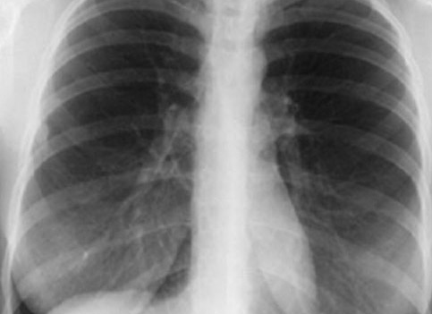

X-rays
X-rays
-- higher frequency than ultraviolet
-- short wavelengths
-- used in medicine and astronomy
Notes:
This slide introduces X-rays.
The top image shows an X-ray image of a human rib cage. The bottom image illustrates the range of X-rays. Note that by convention, at very short wavelengths energy is often used to describe the range rather than wavelength or frequency. Here, the 100eV to 200keV (electron-volts) range corresponds to wavelengths of ~12nm to 0.006nm (6pm), according to the Planck relationship E=hf, where E=energy, h=the Planck constant, and f=frequency.
X-rays are of higher frequency (shorter wavelength) than ultraviolet (100eV to 200keV ~10 to 0.01nm), but not as short as gamma rays
X-rays are used in medicine because they will travel through skin but not bone.
They are also used in astronomy as many astronomical objects give off x-rays.
Images from/for more information see:
http://missionscience.nasa.gov/ems/11_xrays.html
http://www.meddean.luc.edu/lumen/meded/medicine/pulmonar/cxr/atlas/cxratlas_f.htm

Slide 9
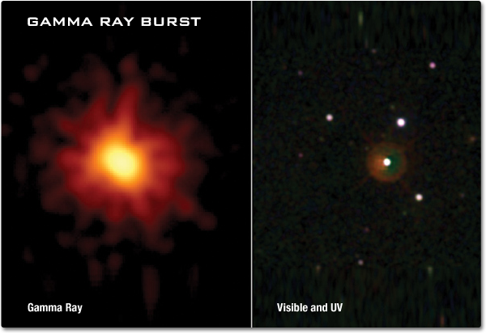

Gamma rays
Gamma rays
-- highest frequency waves on the EM spectrum
-- used in astronomy
-- some gamma features are not visible in other wavelengths
Notes:
This slide introduces gamma rays. As on the previous slide, these very short wavelength ranges are expressed in energy rather than wavelength according to the conversion in the Planck equation: E=hf.
Gamma rays have the shortest wavelength of the electromagnetic spectrum (200keV ~ 6pm (picometers), 200MeV ~ 6fm (femtometers); for more information see http://en.wikipedia.org/wiki/Planck_constant).
Primarily used in astronomy to observe features not apparent in other wavelengths. They are produced by very hot, very high-energy objects or events, such as neutron stars or supernova explosions. Sources on Earth include radioactive decay, nuclear explosions, or lightning.
Images from/for more information see:
http://missionscience.nasa.gov/ems/12_gammarays.html
http://science.hq.nasa.gov/kids/imagers/ems/gamma.html

Slide 10
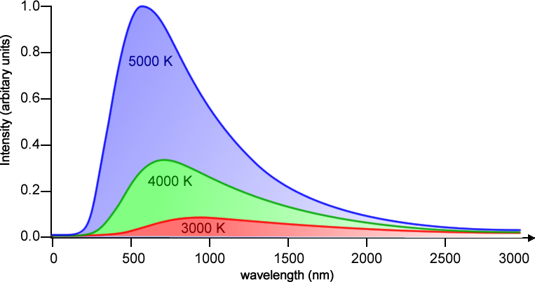
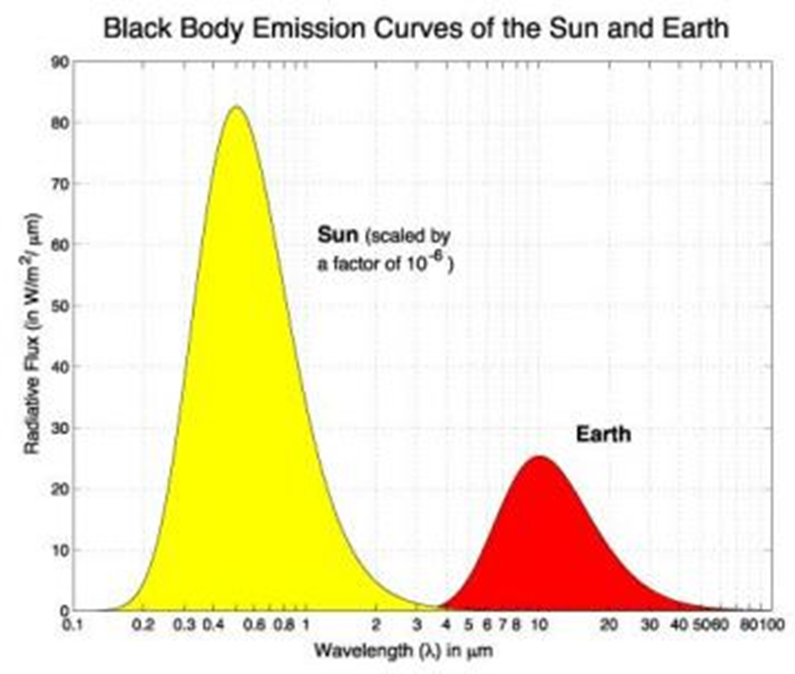
Blackbody radiation
A black body is an idealized object that absorbs all radiation hitting it, and emits all absorbed radiation.
--The wavelength of maximum radiation intensity is determined by the temperature of the body
--The characteristic pattern of emitted radiation is called the blackbody spectrum
Notes:
The different ranges of radiation come from a variety of different sources. As will be discussed in more detail in the next lesson, temperature of an object and the type (wavelength) of radiation it emits are linked. This slide introduces the concept of a black body. This is important because to a good approximation we can take both the sun and the Earth to be black bodies.
A black body is an idealized object that absorbs all radiation hitting it, and emits all absorbed radiation according to a particular spectrum.
Black body radiation is described by Planck’s Law (see: http://en.wikipedia.org/wiki/Planck%27s_law)
The wavelength of maximum radiation intensity is determined by the temperature of the body. This also determines the intensity of radiation emitted (more for shorter wavelengths/higher temperatures)
The figure shows black body curves for three different temperatures, normalized to the peak of the 5000 K curve. From this you can see that the peak for the 4000 K and 3000 K curves are at progressively longer wavelengths than the 5000 K curve. Also, there is a much higher intensity of energy coming from a black body at 5000 K. Although it is difficult to see from this figure, the curves all exhibit the same basic shape, just shifted to longer wavelengths and smaller magnitudes for lower temperatures. As we will see, the temperature of Earth is less than 300K– what might that curve look like on this plot? Would we be able to see it? (We will address this question on the next slide.)
Using a black body approximation, we are able to tell the temperature of many astronomical objects. Conversely, if we know the temperature, we can determine how much radiation it is emitting at each wavelength, even if we can only observe some of it (because some has been absorbed between emission and our viewing of it– this is important when we consider that radiation passing through the Earth’s atmosphere will be absorbed by it! This will be discussed in the following lesson.)
The range of emitted radiation for a black body is called the blackbody spectrum; the characteristic shape is often referred to as a blackbody curve. Note that these are idealized spectra, and in the real universe perfect black bodies don’t exist– however, like many things in physics, this is a good approximation.
Image from: http://www.spaceflight.esa.int/impress/text/education/Heat%20Transfer/Radiation.html
For further information:
http://en.wikipedia.org/wiki/Black-body_radiation

Slide 11
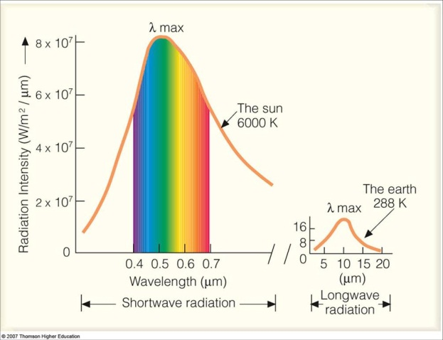
Spectra of the sun and the Earth
Scientists consider both the sun and the Earth as black bodies
-- the sun’s spectrum is centered in visible wavelengths
-- the spectrum of the Earth is centered in the infrared region
-- we call the sun’s range shortwave and the Earth’s radiation longwave
Notes:
Actual objects can be idealized as black bodies, based on their temperature and radiation emitted. This slide introduces the solar and Earth emission spectra, i.e. the radiation given off by each body. The sun and Earth can each be approximated as black bodies.
Note that the y-axis is conventionally shown in units of W/m²/μm, representing the fact that the radiation intensity varies based on wavelength (here, microns). If we integrate over all wavelengths, we get the total amount of energy per time per square meter (W/m²). Note that the amount of energy emitted from the sun is several orders of magnitude larger than the energy emitted by the Earth!
the sun’s spectrum is centered in visible wavelengths, i.e. most of the radiation from the sun is in the visible range, although the sun also gives off energy in the near-infrared and in the UV (UV is mostly blocked by the Earth’s ozone layer; otherwise we would all get sunburns). The solar spectrum is also known as shortwave radiation.
the spectrum of the Earth is centered in the infrared region, so most of the energy radiated from the surface of the Earth is in this wavelength range. Because infrared radiation has a longer wavelength than visible radiation, we also call this longwave radiation.
One point to note conceptually: the sun and Earth both emit as black bodies uniformly in all directions (this is the /m2 part; if you draw an imaginary circle around a black body, the W/m2 will be the amount of energy per each square meter on that sphere), but the solar energy that hits the Earth is only a circular projection of this where the spherical energy reaches the Earth’s orbit. Then the Earth emits in all directions as well; in Lesson 2 we see this equation as S₀/4; the difference between spherical radiation away from the Earth and circular solar incidence is why we divide the solar constant by a factor of 4. This is also why the tropics are warmer, because we have a circle of energy incident on a hemisphere, so there is more energy per square meter at the equator (at the poles the sunlight hits at an angle).
Image from:
http://apollo.lsc.vsc.edu/classes/met130/notes/chapter2/plank_e_sun.html

Slide 12
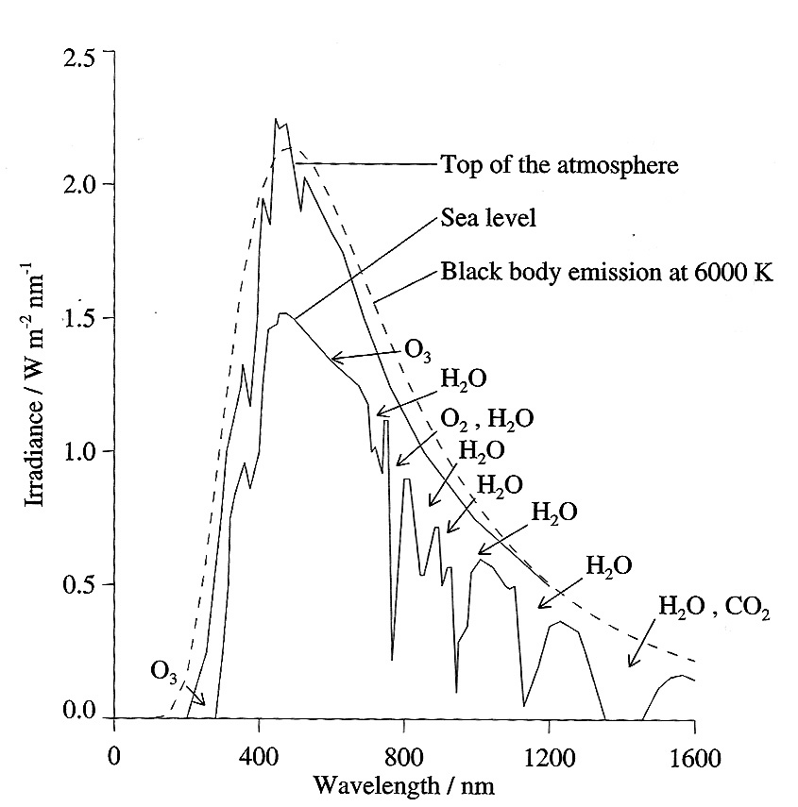
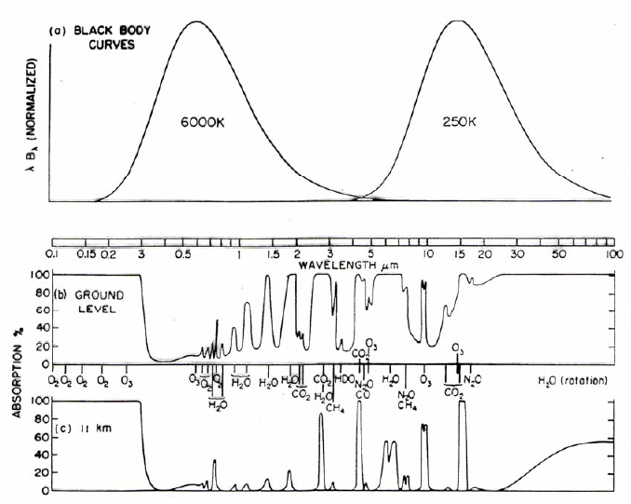
Atmospheric spectrum
Molecules within the atmosphere absorb at characteristic wavelengths
-- this depends on the molecule (e.g. CO₂, CH₄, H₂O, O₃)
-- seen from space, the Earth’s spectrum has many dips in intensity due to atmospheric absorption
Notes:
Building off the last slide, here we see what happens to the Earth’s black body spectrum when the atmosphere is considered. This will lead into Lesson 2, where the physics behind this absorption will be discussed more thoroughly.
Just like the sun emits radiation at many different wavelengths (mostly visible, but also infrared, which is warm, and UV, which gives us sunburns), the Earth is also emitting radiation (as described on the previous slide). Since the Earth is much cooler than the sun, it emits at longer wavelengths (centered in the infrared instead of in the visible), and emits much less radiation.
The figure shows the (normalized) blackbody curves for the sun (6000 K) and Earth (250 K) as a function of wavelength as in the previous slide, and then atmospheric absorption (as a %) at both ground level (i.e. the whole atmosphere) and at 11km (high level; roughly the tropopause, above most of the atmospheric mass). Absorption bands are labeled as to which molecule causes each. The black body curves are normalized because otherwise the Earth curve would be too small to see compared with the sun curve. This is in contrast to the previous slide, which better conveys the large difference between the magnitude of the Earth’s and the sun’s spectra. Also note that these are not Gaussian distributions, as here the x-axis is on a logarithmic scale.
Terminology: the lower part of the atmosphere, where most of the mass is, is called the troposphere, and typically extends up to 8-12 km, varying with season and latitude. Above the troposphere is the stratosphere, extending to ~50 km, where most of the UV-blocking ozone is located. The two are separated by the tropopause (the top of the stratosphere is called the stratopause). See also: http://en.wikipedia.org/wiki/Troposphere and http://en.wikipedia.org/wiki/Stratosphere
Molecules within the atmosphere absorb at certain wavelengths, producing predictable deviations from the Earth’s blackbody radiation profile
As seen from space, the Earth’s spectrum has many dips in intensity due to atmospheric absorption, even though the radiation emitted from the surface of Earth is as a blackbody curve. Most of these happen in the lower atmosphere, which has the most atmospheric mass. The absorption in the higher atmosphere is primarily due to ozone, which is significant in the stratosphere.
Different dips correspond to absorption by different molecules (e.g. CO2, CH4, H2O, O3). We will discuss this in Lesson 2.
Figure from:
R.M. Goody and Y.L. Yung, Atmospheric Radiation: Theoretical Basis, 1995. Figure 1.1, page 4. Available on Google Scholar: http://books.google.com/books?id=Ji0vfj4MMH0C&lpg=PA1&ots=7TlKZ240bi&dq=goody%201964%20atmospheric%20radiation&lr&pg=PA4#v=snippet&q=absorption%20spectrum%20earth&f=false
This text is an excellent resource as well for further information on radiation in the atmosphere.
Further reference:
http://lasp.colorado.edu/~bagenal/3720/CLASS5/5Spectroscopy.html

Slide 13
Conclusions
The electromagnetic spectrum is made up of many different types of radiation, organized by wavelength or frequency.
The most important ranges for Earth Science are infrared and visible.
All bodies emit radiation at wavelengths that are dependent on their temperature. This is often called blackbody radiation.
Notes:
This lesson introduced the different parts of the electromagnetic spectrum. The take-home points are:
The EM spectrum is defined as the wide range of electromagnetic waves which have vastly different properties. The ranges within the EM spectrum include radio, microwave, infrared, visible, ultraviolet, x-ray, and gamma rays. Even within specific ranges the radiation can have different distinguishing properties (think about the difference between red and blue, even though they’re both visible, or the difference between AM/FM radio stations).
In earth science we mostly focus on the visible and infrared ranges. In earth science these ranges are sometimes called “shortwave” and “longwave,” respectively, because visible is of a shorter wavelength and infrared is of a longer wavelength.
This is because these are the ranges that correspond to emission from the sun and Earth, respectively. The radiation emitted by these bodies follows a predictable curve, called a blackbody curve, that is determined by their temperature.
In the next lesson we will talk about what happens when this energy interacts with matter, and how this is the principle behind the greenhouse effect and climate change.

