Slide 1
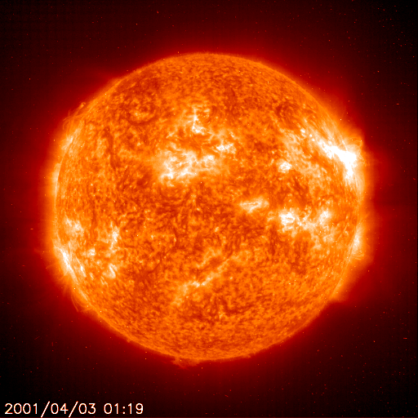
Energy, heat, and absorption
Notes:
Authors: Kristina Pistone, Scripps Institution of Oceanography; Dave Van Dusen, San Diego School of Creative and Performing Arts
WHY:
What causes a sunburn? What is the greenhouse effect? Why is it a bad idea to walk barefoot on asphalt in the summer? All these questions have to do with how energy interacts with matter in the Earth system.
SUMMARY:
The goals of this lesson are to:
Understand how materials interact with electromagnetic energy (light) and convert it into thermal energy
Understand the concept of absorption: molecules will absorb certain wavelengths of the spectrum while being transparent to others (The other ways in which energy interacts with matter will be discussed in Lesson 3)
Understand how this principle applies to the greenhouse effect and anthropogenic (human-caused) climate change.
PICTURE/GRAPHICS CREDITS:
http://sohowww.nascom.nasa.gov/hotshots/X17/
WEBSITES USED IN THIS PRESENTATION/ADDITIONAL READING:
http://hyperphysics.phy-astr.gsu.edu/hbase/mod3.html
http://hyperphysics.phy-astr.gsu.edu/hbase/mod4.html
http://lasp.colorado.edu/~bagenal/3720/CLASS5/5Spectroscopy.html
For some nice visualizations of of molecular absorption/vibrational energy: http://www2.chemistry.msu.edu/faculty/reusch/VirtTxtJml/Spectrpy/InfraRed/infrared.htm
CONTEXT FOR USE:
This is the second of a three-lesson series given to an AP Physics B class, but can be adapted to other physics or earth science classrooms. The Earth science here is presented in a physics context.
POTENTIAL MISCONCEPTIONS:
CO2 molecules in the atmosphere primarily absorb visible energy from the sun
The ozone hole allows more heating of the atmosphere, causing global warming
Heat is a molecule
Energy is a molecule
The Earth’s atmosphere is made up primarily of oxygen and carbon dioxide.

Slide 2
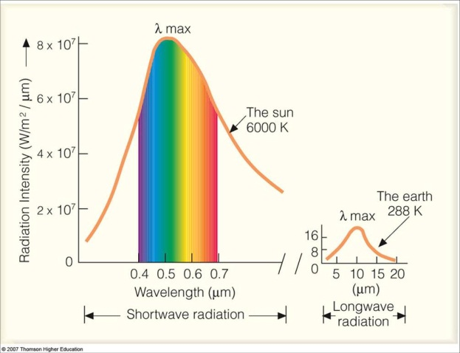
Spectra of the sun and the Earth
Scientists consider both the sun and the Earth as black bodies
-- the sun’s spectrum is centered in visible wavelengths
-- the spectrum of the Earth is centered in the infrared region
-- we call the sun’s range shortwave and the Earth’s radiation longwave
Notes:
This slide re-introduces the solar and Earth emission spectra, i.e. the radiation given off by each body, as was first introduced in Lesson 1. The sun and Earth can both be approximated as black bodies; the figure shows the idealized black body spectra of the sun and the Earth.
The x-axis shows wavelength; energy decreases with increasing wavelength. The y-axis shows the intensity of radiation in terms of energy per second (Joules/second = Watts) per square meter, per wavelength.
the sun’s spectrum is centered in visible wavelengths (the rainbow in the figure), i.e. most of the radiation from the sun is in the visible range, although the sun also gives off energy in the near-infrared and in the UV (UV is mostly blocked by the Earth’s ozone layer; otherwise we would all get sunburns). The solar spectrum is also known as shortwave radiation (as indicated on the x-axis).
the spectrum of the Earth is centered in the infrared region (no rainbow), so most of the energy radiated from the surface of the Earth is in this wavelength range. Because infrared radiation has a longer wavelength than visible radiation, we also call this longwave radiation (as indicated on the x-axis).
Note that the amount of energy emitted from the sun is many orders of magnitude larger than the energy emitted by the Earth! However, since this radiation is emitted in all directions out from the sun, only a very small portion of it reaches the surface area of the Earth.
Figure from:
http://apollo.lsc.vsc.edu/classes/met130/notes/chapter2/plank_e_sun.html

Slide 3
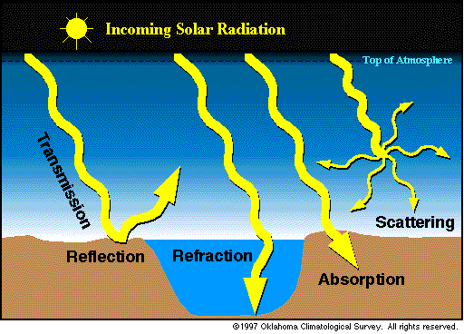
How energy interacts with matter
When energy encounters matter, it can either be
-- absorbed
-- reflected
-- refracted
-- transmitted
-- scattered
All of these happen in the Earth system
Notes:
While energy is emitted by both the sun and the Earth, there are a number of ways this energy can then interact with matter. This slide introduces an overview of the different ways that such energy (radiation, light) can interact with matter, in the context of the Earth system. The terms introduced here will be elaborated upon in the rest of this lesson and in the next one.
When energy (for example visible solar light, or terrestrial infrared heat, but also other forms of EM radiation) encounters matter, it can either be:
transmitted: Most solar radiation into the Earth system is transmitted directly through the atmosphere to the surface, unchanged in terms of direction or intensity/wavelength.
reflected: however, about 30% of the solar energy into the Earth system is reflected back to space, primarily by clouds, ice, and certain types of pollution. These are all things with high albedo. We will talk about it later.
refracted: refracted light is made to change direction in a regular way, governed by Snell’s law (http://en.wikipedia.org/wiki/Snell's_law). This is important in distinct transitions between two media, such as air -> water, or very stratified atmospheric layers (in terms of density). We will not focus on this, but it’s good to note.
absorbed: solar (shortwave) energy that hits the Earth’s surface tends to be absorbed, heating the surface. Similarly, longwave (infrared) radiation that is emitted from the Earth’s surface is absorbed by atmospheric molecules such as carbon dioxide (CO2) or methane (CH4). While a small amount of solar radiation can be absorbed within the atmosphere by gas molecules (and more may be absorbed by dark substances such as black soot aerosol (black carbon); Lesson 3), the majority of absorption by atmospheric gas molecules is of the infrared wavelengths. The rest of this lesson will focus on what happens when radiation is absorbed by a body; the remaining options will be addressed in Lesson 3.
scattered: the direction (but not the wavelength) of the radiation is changed. Scattering will be the focus of Lesson 3, and primarily occurs with atmospheric aerosol particles or cloud droplets.
All of these happen in the Earth system! We will talk about them in the following slides.
Figure from: http://okfirst.mesonet.org/train/meteorology/Radiation.html (Oklahoma Climatological Survey)
Further info:
http://www.physicsclassroom.com/Class/light/u12l2c.cfm

Slide 4
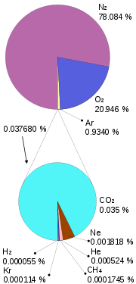
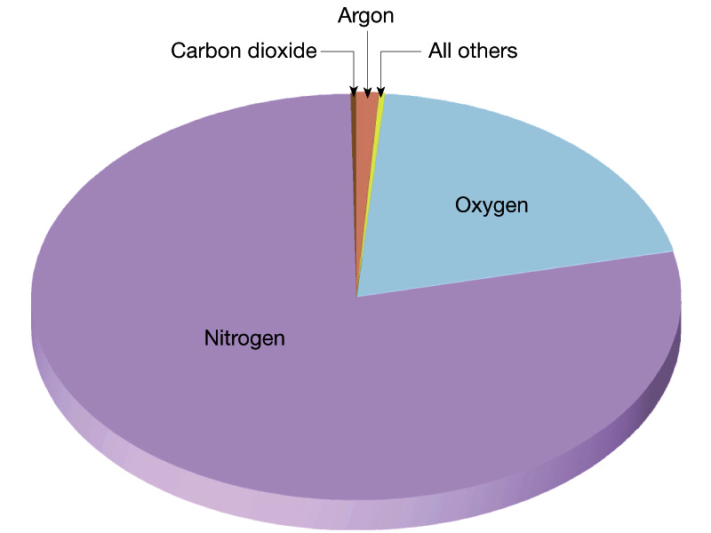
Atmospheric composition
The Earth’s atmosphere is approximately:
-- 78% nitrogen
-- 21% oxygen
-- 0.9% argon
-- 1-4% water vapor
The remainder of the atmosphere is in trace gases.
--Carbon dioxide currently makes up around 400ppm (0.04%) of the atmosphere
Notes:
In the following lessons we will talk about how the components of the atmosphere interact with energy as on the previous slide; thus it is beneficial to first know what these atmospheric components are.
This slide shows the composition of the Earth’s atmosphere. The atmosphere is approximately 78% nitrogen, 21% oxygen, 0.9% argon (a noble gas), with the remainder of the atmosphere consisting of trace gases such as carbon dioxide, neon, helium, and methane. Some of these gases are naturally-occurring, and some have been modified by human activities. The water vapor content of the atmosphere is highly variable depending on temperature and location, and typically varies between 1 and 4% of total atmosphere (one can imagine this range if one considers the atmosphere over the (wet) ocean versus over a (dry) desert).
Misconception: many students will probably believe the majority of the atmosphere is oxygen and/or carbon dioxide. However, note that the most important components of the atmosphere are not the largest one– nitrogen has almost no effects (either radiatively or in terms of what we breathe!)
Image from:
http://en.wikipedia.org/wiki/Atmosphere_of_Earth
http://www.ux1.eiu.edu/~cfjps/1400/FIG01_010.JPG
http://www.ux1.eiu.edu/~cfjps/1400/atmos_origin.html

Slide 5
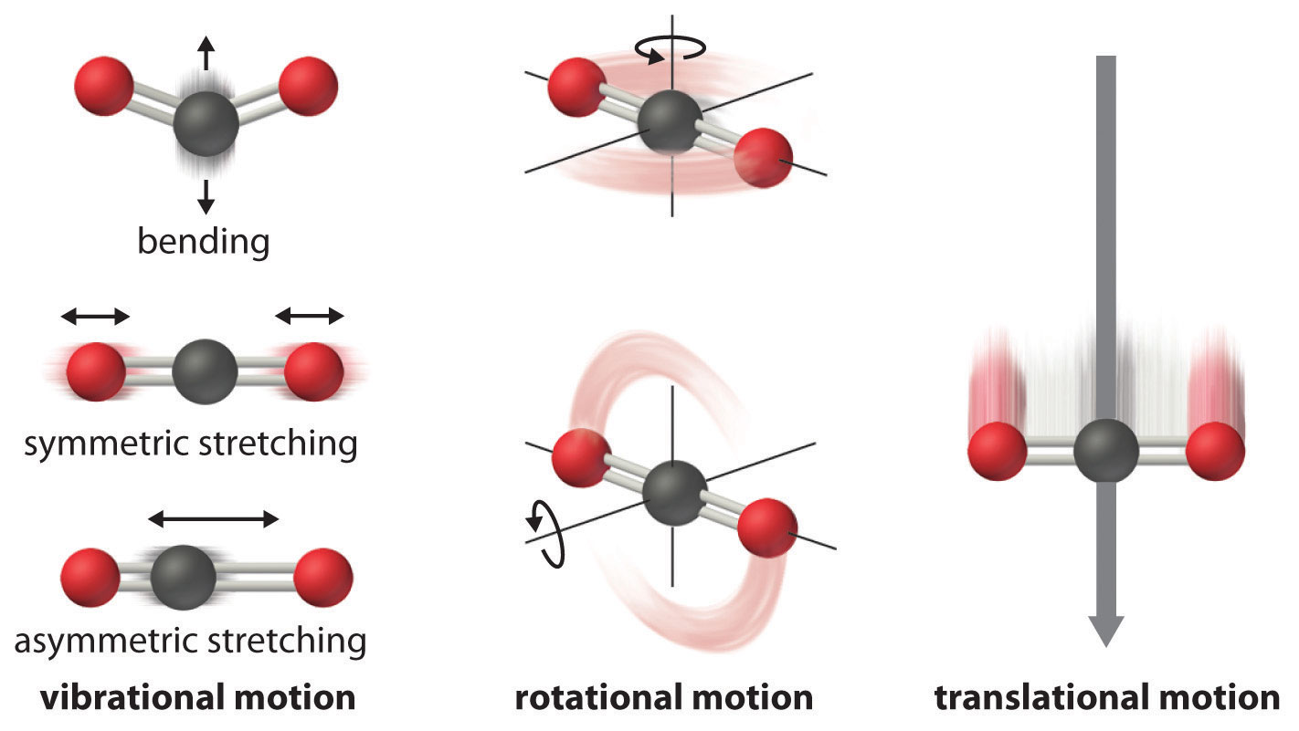
What physically happens when we have molecular absorption?
Modes of molecular motion for a 3-atom molecule such as carbon dioxide
-- vibration
-- rotation
-- translation
What types of motion for different sizes/ configurations of molecules?
Notes:
All molecules have some sort of motion, and this molecular motion is what determines temperature. Absolute zero (0K) is (theoretically) when there is no molecular motion at all, but the degree (no pun intended) and type of molecular motion corresponds to a certain temperature. This is why solids have less molecular motion (for example water ice, where the molecules are rigidly structured together), liquids have more freedom (liquid water molecules are able to flow against one another, and fit their container), and gases have still more motion (boiling water gives even more energy (and temperature) to the water molecules, and they are able to move much more than liquids or solids). This slide illustrates what physically happens to molecules when they absorb energy.
This slide uses the example of a 3-atom molecule (e.g. water vapor, carbon dioxide). More complex molecules have different modes of motion (vibration, rotation) that are not available to simpler (e.g. 2-atom) molecules. For this reason 3-atom molecules or larger (methane, which has five atoms) have more absorption potential (a stronger greenhouse effect) than do diatomic nitrogen or diatomic oxygen. Very complex molecules such as hydrofluorocarbons exhibit even stronger warming.
Water itself is a particular case, due to its polarized rather than linear molecular shape.
Each mode corresponds to absorption of a specific wavelength (see next slide). For each motion to occur, the molecule absorbs a particular wavelength of electromagnetic energy. Because there are a limited number of motions, there are a limited number of wavelengths that will be absorbed by a given molecule.
An activity in class would be to ask students to make a prediction as to which types of vibrations one would expect for each molecular configuration (2 vs 3 vs 5 atoms). Which types of motion shown on this slide would not be possible for a 2-atom molecule? What additional movements would a 4- or 5-atom molecule be capable?
Note that the absorption of energy by molecules will reduce the transmission of energy through a medium such as the atmosphere; that is, when a molecule absorbs energy, that energy is no longer passing through the atmosphere (either incoming or outgoing), which is a key concept in the greenhouse effect.
Figure from: “Entropy Changes and the Third Law of Thermodynamics”, section 18.4 from the book Principles of General Chemistry (v. 1.0). http://2012books.lardbucket.org/books/general-chemistry-principles-patterns-and-applications-v1.0/section_22_04.html
For more info on molecular motion: http://www.nyu.edu/pages/mathmol/textbook/motion.html
http://www2.chemistry.msu.edu/faculty/reusch/VirtTxtJml/Spectrpy/InfraRed/infrared.htm
http://en.wikipedia.org/wiki/Molecular_vibration

Slide 6
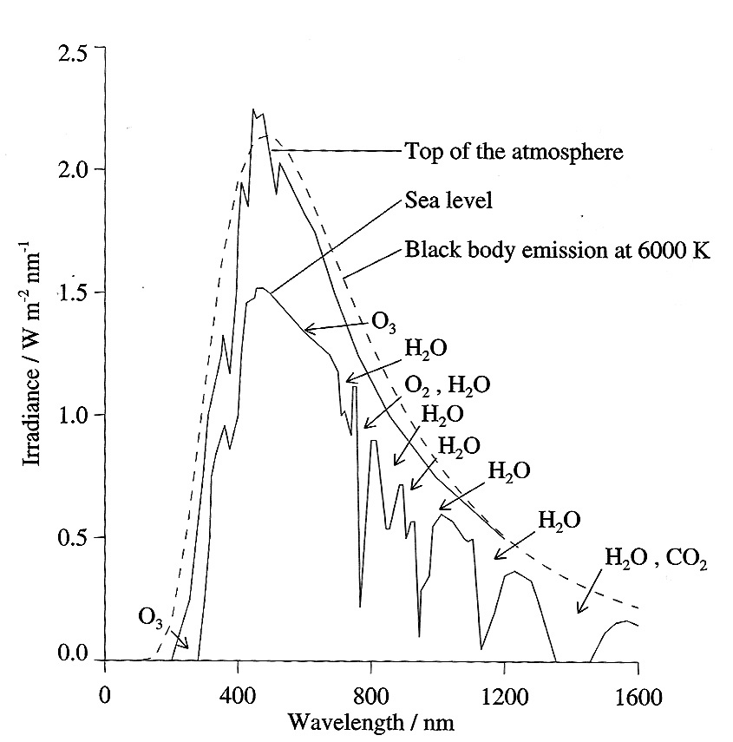
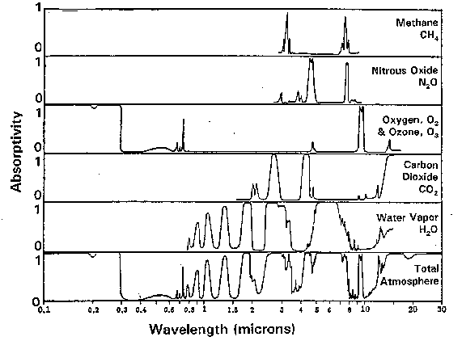
Absorption spectra
-- Molecules absorb energy at different wavelengths
-- This produces different bands of absorption at specific wavelengths when we observe the atmosphere
visible infrared
Notes:
This slide shows how the molecular motion on the previous slide translates to what actually happens in the atmosphere. If we combine all the different wavelengths which produce the different types of motion for the different molecules in the atmosphere, and we look at what happens when the solar spectrum (Slide 2) experiences this absorption, this is what we observe: absorption at certain wavelengths by certain molecules means we observe less energy at the surface from these wavelengths.
Molecules absorb energy at different wavelengths due to the different motions they can follow. This produces different bands of absorption at specific wavelengths when we observe the solar energy coming through the atmosphere. We can contrast this to what we observe at the top of the atmosphere, i.e. in space (or close to it).
Each absorption band for a particular molecule corresponds to a particular motion shown on the previous slide. The larger the dip compared to the top-of-atmosphere curve, the more radiation is absorbed.
Looking at the figure one can see that water vapor absorbs very strongly in several bands. However, water vapor is not uniform throughout the atmosphere so its overall effect in the atmosphere is varied.
Carbon dioxide absorbs very strongly in the infrared.
Note that most of the absorption bands are in the infrared, rather than the visible wavelengths.
Ozone absorbs at shorter wavelengths (the ultraviolet, primarily high in the stratospheric ozone layer). The ozone hole (due to human-emitted CFCs) is worrying for this reason; if there is less ozone to absorb the ultraviolet, we will see more of these harmful rays at the surface, where it can cause skin cancer in humans.
Image from: http://lasp.colorado.edu/~bagenal/3720/CLASS5/5Spectroscopy.html
For more information:
http://www.meteor.iastate.edu/gccourse/forcing/images.html

Slide 7
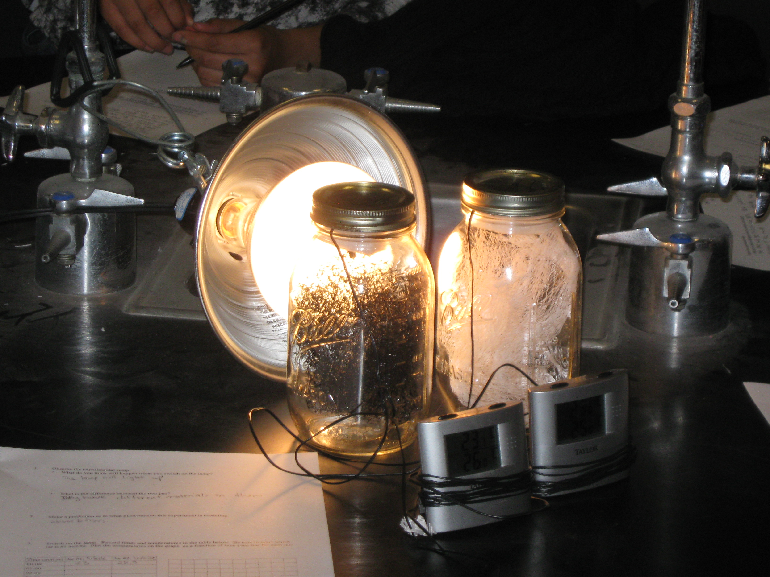
Jar Activity
Two jars, one light-colored and one dark-colored, are exposed to a heat source
Students graph temperature with time
Concepts illustrated: albedo: reflectivity, brightness of an object (white things have higher albedos, absorb less energy)
Notes:
This slide describes the in-class activity to demonstrate absorption, and is not intended to be shown in class. This activity (#1) is described in more detail in the accompanying Activities description document. An accompanying worksheet (Day 1) is also included.
The image shows the experimental setup.
Two jars are exposed to a heat source, one with black and one with white mesh.
Student pre-experiment predictions: How will temperature change with time? Which changes faster? Why might some jars heat faster and some less fast?
Graph temperature with time
What do the circles/meshes represent in the real Earth system? How is this a decent approximation? How is it a not-good approximation?
Concept: albedo: reflectivity, brightness of an object (white things have higher albedos, absorb less energy)
This activity also provides data collection and graphing experience.
The key concept here is that the visible light is being absorbed by the black mesh more than it is absorbed by the white mesh.
Potential misconceptions:
Heat is a molecule. The “heat molecules” (thermal molecules, energy molecules) are being absorbed by the mesh. Either this or the “heat molecules” are what is absorbing the heat.
Black “attracts” heat more than white does.
Image credit: Dave Van Dusen

Slide 8
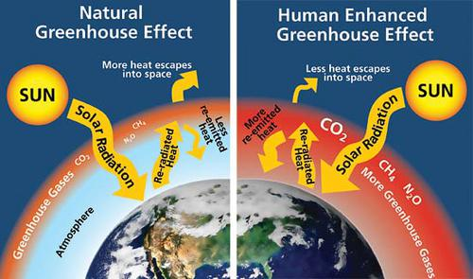
Introduction to climate change
Notes:
Now that we’ve gone over the types of energy and molecules we see in the Earth system, we now put these puzzle pieces together in the framework of the greenhouse effect, global warming, and climate change. This slide introduces the basics of climate change science.
The greenhouse effect is caused by atmospheric gases trapping heat near the surface of the planet. The main global contributor to the greenhouse effect is carbon dioxide (water vapor is a more potent warmer, but is not uniformly distributed throughout the atmosphere, so it has a less constant effect). The greenhouse effect is actually good, as it keeps the planet at a habitable level. Gases which cause a greenhouse effect are known as greenhouse gases; in addition to carbon dioxide and water vapor, methane and hydrofluorocarbons (HFCs) are GHGs
Global warming is when the atmospheric concentrations of these gases are increased by human activities, particularly fossil fuel burning which produces carbon dioxide and other gases through combustion, but also agriculture, land use changes, and other activities can contribute to global warming.
Climate change refers to the larger suite of climate effects that are associated with human activities. This includes, but is not limited to, long-term rising global temperatures; it also includes changes in precipitation (the hydrological cycle– how water moves through the Earth system), clouds, ocean acidification, and to a lesser degree the effects of aerosol particulate pollution, which will be discussed in Lesson 3 (although strictly speaking the effects of aerosol are too short-lived to be “climate” change; if humanity were to cut out these emissions these effects would go away, but since that’s not something likely to happen, the effects of aerosol do have to be included in climate models).
It bears defining the term climate refers to the long-term characteristics of the Earth system (temperature, precip, etc); this is distinct from weather. See also: https://en.wikipedia.org/wiki/Climate for a broader overview.
Figure from: http://www.nps.gov/goga/naturescience/climate-change-causes.htm ***Note***: This figure suggests that under the enhanced greenhouse effect, less heat will escape to space. While this is true short-term (when the system is not in equilibrium), in the long-term (when the temperature of the atmosphere has increased accordingly) the energy into the Earth/atmosphere/ocean system will necessarily balance the amount of energy out, because the atmosphere itself will begin radiating more heat to outer space - until the incoming and outgoing radiation are balanced. The earth cannot constantly take in more energy than it radiates back because this would result in a runaway heating of the atmosphere.
You will recall from previous slides that the hotter the blackbody temperature of an object is, the more energy it radiates (for example the sun versus the Earth). In order to radiate more energy back to space, the atmospheric temperature must increase, or conversely, when the temperature of the atmosphere increases (due to more molecular absorption), that means it radiates more energy away. This will be discussed in more detail on slide 11.

Slide 9
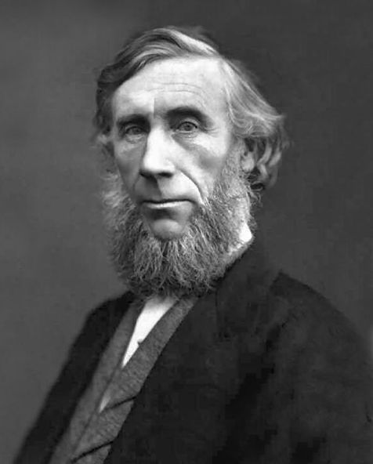
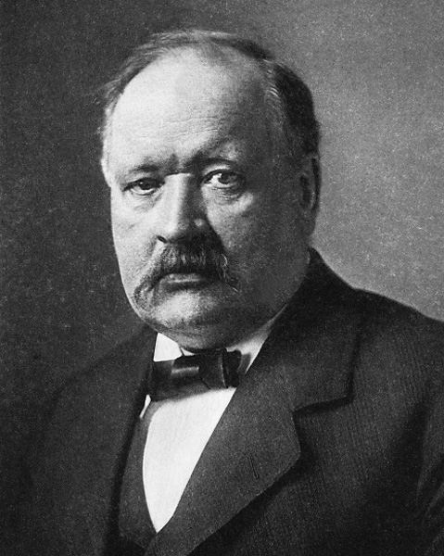
Svante Arrhenius (1859-1927)
On the Influence of Carbonic Acid in the Air upon the Temperature of the Ground (1896)
John Tyndall
(1820-1893)
1859: showed that CO₂ and H₂O can absorb infrared energy
Notes:
It is interesting to place the greenhouse effect into a historical context, as the political climate often tends to brush off these concepts as unproven (these misconceptions may be found in the classroom, as well). This slide introduces the history of greenhouse gas study.
Changes to the amount of CO2 in the atmosphere lead to changes in this greenhouse effect; we’ve known this for a very long time thanks in part to the work of John Tyndall and Svante Arrhenius.
Tyndall showed in 1859 that carbon dioxide and water vapor can absorb infrared energy.
Arrhenius is frequently credited with being the first to publish on the atmospheric warming potential of carbon dioxide (1896)
For more information (and image credit):
http://en.wikipedia.org/wiki/John_Tyndall
http://earthobservatory.nasa.gov/Features/Tyndall/
http://en.wikipedia.org/wiki/Svante_Arrhenius
http://earthobservatory.nasa.gov/Features/Arrhenius/

Slide 10
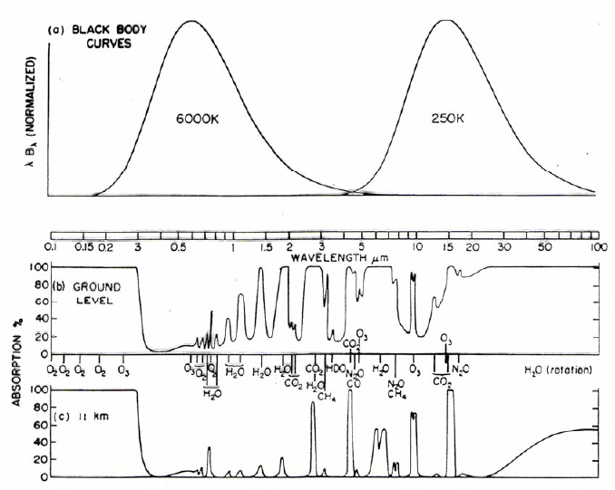
Atmospheric spectrum
Molecules within the atmosphere absorb at characteristic wavelengths
-- this depends on the molecule (e.g. CO2, CH4, H2O, O3)
-- seen from space, the Earth’s spectrum has many dips due to atmospheric absorption
Notes:
This slide, similar to slide 6, describes the Earth’s spectrum when the atmosphere is considered. As this is an important concept, it is useful to repeat here after having discussed the concept of the molecular absorption of heat (as was described by Tyndall/Arrhenius).
The figure shows the (normalized; otherwise the Earth’s spectrum would not be visible compared to the magnitude of the sun’s) blackbody curves for the sun and Earth as a function of wavelength, and atmospheric absorption (as a %) at both ground level (i.e. the whole atmosphere) and at 11km (roughly the tropopause). Absorption bands are labeled as to which molecule causes each. 100% indicates all radiation is absorbed by gases in the atmosphere, and 0% indicates the radiation is able to pass through. Note that the absorption at the Earth’s surface is greater than the absorption high in the atmosphere (11km) because most of the atmospheric mass is concentrated at lower altitudes (i.e. in the troposphere, as defined earlier). Because the energy here has to travel through more mass, there is more opportunity for it to be absorbed. However, the UV region is almost entirely absorbed at all levels, due to absorption by the stratospheric ozone layer.
Molecules within the atmosphere absorb at certain wavelengths, producing deviations from the Earth’s blackbody radiation profile
As seen from space, the Earth’s spectrum has many dips in intensity due to atmospheric absorption
Different dips correspond to different molecules (e.g. CO2 (carbon dioxide), CH4 (methane), H2O (water vapor), O3 (ozone))
Figure from:
R.M. Goody, 1964, Atmospheric Radiation, Part I. London, Oxford University Press.
For more info:
http://lasp.colorado.edu/~bagenal/3720/CLASS5/5Spectroscopy.html

Slide 11
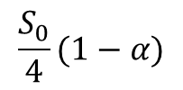



Radiative equilibrium
Sun
The most basic model to determine planetary temperature
-- energy comes from the sun, is absorbed by the planet
-- the Earth reemits radiation at the surface as a blackbody
-- the atmosphere absorbs the outgoing radiation and reemits upward and downward, also as a blackbody
-- energy in = energy out at each level allows us to solve for temperature
atmosphere
Earth
Notes:
This slide introduces the concept of radiative equilibrium (or energy balance), the most basic model to determine planetary temperature under conditions of an absorbing atmosphere. NB: this section may be skipped in lower-level or less math-intensive classes.
The basic concept of energy balance here is that the amount of energy into a layer has to equal the amount of energy out, because energy must be conserved. Here we idealize each component: the atmosphere is shown as one uniform layer, and the Earth’s surface is another. Solar energy is not absorbed by the atmosphere, but is absorbed by the planet. Terrestrial energy is entirely absorbed by the atmosphere (none is transmitted directly to space).
We are now talking about temperature, as the black body temperature determines the black body radiation; if we know the temperature of an object (the sun, the earth, or the atmosphere) as measured, and idealize things as black bodies, we then know how much energy is being emitted by this object. This slide shows a very simplified picture of the Earth’s radiative balance, where the atmosphere is idealized as one layer, and we deal with global averages. The next slide will show a more complex version of the same picture.
Energy comes from the sun, is absorbed by the planet. α is the albedo of the earth, or how much solar energy is reflected by parts of the earth being white. S₀ is the solar constant, or the amount of energy (flux density) emitted by the sun, and is approximately 1361 W/m² (varying through the solar cycle). To understand this, mathematically one can recall that spherical surface area is given by $4πr^{2}$, and circular surface area is $πr^{2}$; the Earth only receives solar energy on one side, which is basically a circular cross-section of the Earth’s radius (although it’s spread over a hemisphere), but will emit energy from its whole spherical surface area, which is where we get the factor of 4.
the Earth reemits radiation at the surface as a blackbody, given by σT⁴ according to the Stefan-Boltzmann equation (σ is the Stefan-Boltzmann constant). Temperature is that of the Earth’s surface.
The atmosphere (idealized as one layer) absorbs the outgoing radiation and reemits upward and downward (technically it is emitting in all directions; however since the atmosphere is a sphere covering the globe, the side-to-side emission is canceled out by more atmosphere), also as a blackbody given by σT⁴, here with temperature T corresponding to the atmospheric temperature T_{a}.
energy in (absorbed, left side of equation) = energy out (emitted, right side of equation) at each level
Within the atmosphere: σT_{s}⁴=2σT_{a}⁴
At the surface: S₀/4(1-α)=σT_{s}⁴ + σT_{a}⁴
These two equations can be solved for T_{s} and T_{a} if Earth’s albedo is known.
Radiative equilibrium without an atmosphere would give a surface temperature of 255 K versus the observed 288 K (you can test this by solving the equation: S₀/4(1-α)=σT_{s}⁴).
What happens in the other direction? You will recall from slide 8 that the long-term the energy into the Earth/atmosphere/ocean system will necessarily balance the amount of energy out. In reality changing CO2 changes this equation because the atmosphere is not perfectly opaque to the radiation from the surface (longwave), but instead emits (and consequently absorbs) some fraction of the surface radiation instead, εσT_{a}⁴ where 0<ε<1. As CO₂ increases, ε increases, which increases both T_{s} and T_{a}. This is called radiative equilibrium. The following slide explains in much greater detail what happens in the real-life climate system.
Figure from: Kristina Pistone

Slide 12
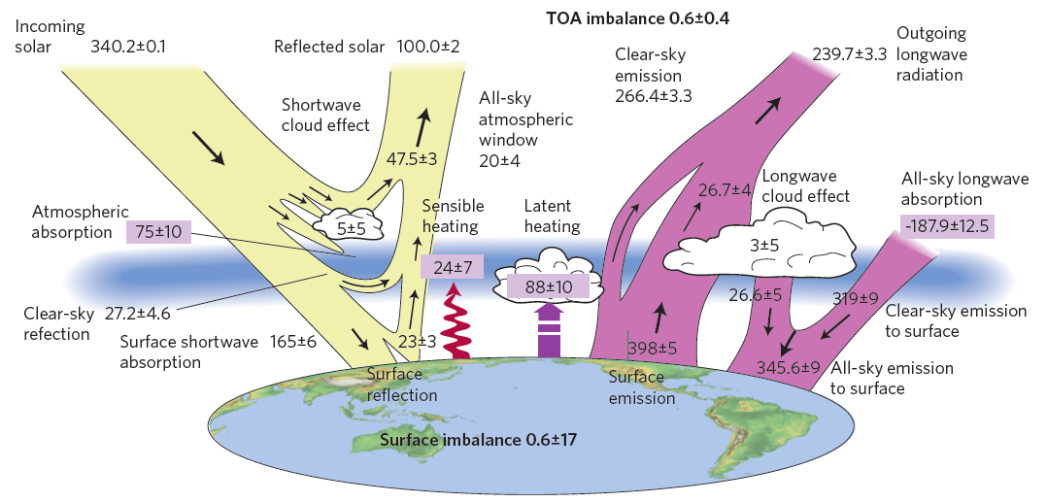
W/m²
W/m²
W/m²
W/m²
W/m²
W/m²
W/m²
W/m²
W/m²
The amount of radiation entering the top of the Earth’s atmosphere is equal to the amount leaving it, if the system is in equilibrium
The TOA imbalance is due to anthropogenic greenhouse forcing
Within the Earth system, the Earth’s surface and atmospheric constituents all play different roles
Notes:
Following from the simplified energy balance shown on the previous slide, this slide shows a more complex schematic of the radiation budget of the Earth. All units are in W/m². This gives an idea as to the real complexities (and real areas of active research!) of the Earth system, compared with the simplified diagram on Slide 11.
On the left (yellow) are the solar (shortwave) components of the atmospheric heat balance, and the right (purple) are the longwave (infrared). The large arrows to the top are the main flows in (from the sun), and out (solar reflected, and longwave emitted). Each of these outward flows are composed of several smaller components (e.g. shortwave cloud effect, surface absorption, clear-sky reflection; surface emission, atmospheric emission). Note that these values are global averages; on a long timescale, the system approaches equilibrium, but on shorter scales the system is not in exact balance due to energy being taken up by the biosphere (energy used to grow plants), heat stored in the ocean, and of course additional energy absorbed by human-emitted greenhouse gases (due to the burning of fossil fuels, these gases represent energy which was sequestered into the biosphere by prehistoric (fossilized) life). The topic of what happens to energy (such as other aspects of the climate system: biosphere, hydrosphere, lithosphere) and the imbalances in the system may be an interesting topic for classroom discussion.
The figure above also incorporates the instrumental uncertainties in our best estimates.
Figure is taken from Stephens et al (2012). It breaks down the contributions to the radiation budget given by the sun, the Earth’s surface, and various components of the atmosphere.
All-sky longwave absorption is what was discussed in the past slides: absorption by greenhouse gases, which is then emitted as outgoing longwave radiation or clear-sky emission (to surface). (all-sky emission to surface includes the effects of clouds trapping heat).
Atmospheric absorption of solar bears some elaboration. This can be on the longwave end of the solar spectrum, but also includes contributions from dark soot pollution. We will discuss this and other aerosol effects in Lesson 3.
Shortwave cloud effects (clouds reflect incoming solar radiation), clear-sky reflection (air molecules in the atmosphere reflect incoming solar radiation, especially at high latitudes/angles of solar incidence), and surface reflection (solar energy reflected back off of light surfaces (and to a lesser extent darker surfaces) without being absorbed, such as snow, ice, and desert) contribute to the α parameter on Slide 11 (here reflected solar). Longwave cloud effects are when clouds prevent outgoing longwave energy from escaping to space. High, thick clouds will have the greatest longwave effects.
Sensible heating is when the warmer surface directly increases the atmospheric temperature. This is in contrast to latent heating which is the energy transferred from the surface to the atmosphere by evaporation of water (which increases the energy content without increasing the temperature).
As on Slide 11, the terms absorbed and emitted (not directly reflected) by the surface of the Earth, atmosphere, and top-of-atmosphere sum to approximately zero.
The top of atmosphere imbalance represents human-caused (anthropogenic) forcing; the uncertainties given are due to instrument and calculation uncertainties. Some appear larger than their sum because the sum (i.e. top of atmosphere values) are directly measured, whereas other terms (such as atmospheric emission, absorption, and sensible and latent heating) are modeled using boundary conditions.
Note that these values are given in Watts per square meter (energy per time per area), and have been integrated over all wavelengths.
Reference: G. Stephens et al (2012) “An update on Earth’s energy balance in light of the latest global observations,” Nature Geoscience DOI:10.1038/NGEO1580
For further information:
Stephens et al 2012
http://science-edu.larc.nasa.gov/EDDOCS/radiation_facts.html
http://en.wikipedia.org/wiki/Radiative_equilibrium
http://en.wikipedia.org/wiki/Cloud_forcing
http://earthobservatory.nasa.gov/Features/Clouds/
http://en.wikipedia.org/wiki/Sensible_heat
http://en.wikipedia.org/wiki/Latent_heat

Slide 13
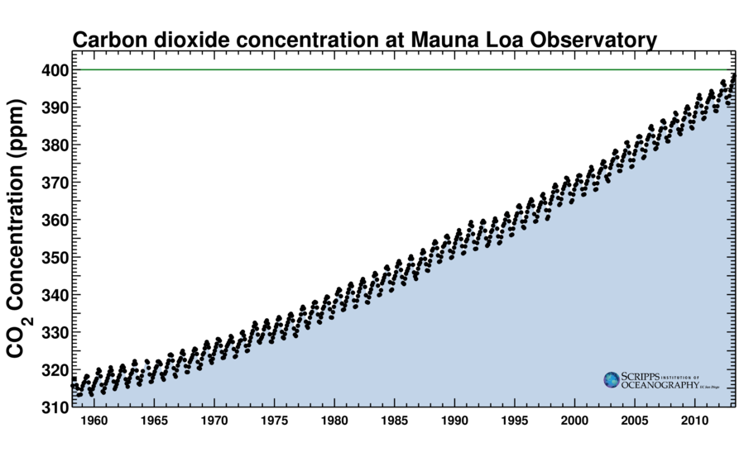
The Keeling Curve
Record started by Charles David Keeling in 1958 measuring carbon dioxide concentration. The record is continued through the present at SIO
-- carbon dioxide has increased from around 315ppm in 1958 to 400ppm in 2013
-- the small oscillations in the annual cycle are due to plants breathing
Notes:
This slide introduces the Keeling Curve, which shows the carbon dioxide concentration at Mauna Loa since 1958. This is important in the context of the previous slide, as these changes in CO2 affect the energy absorbed as shown on the previous slides, primarily in terms of longwave atmospheric absorption. As we have seen, CO2 absorbs certain wavelengths of energy, but thus far we’ve primarily dealt with a system in equilibrium (i.e. unchanging). As CO2 concentrations increase, more heat is absorbed, the energy balance is changed, and thus the temperature changes as well.
The Keeling Curve is the name for the long-term record of carbon dioxide concentration. The record was started by Charles David Keeling in 1958 and is continued through the present by his son Ralph Keeling at SIO.
carbon dioxide has increased from around 315ppm (parts per million, i.e. parts per million parts of air) in 1958 to 400ppm in 2013
the small oscillations in the annual cycle are due to plants: they take up more CO2 in the (northern) spring and less in the winter. There is more land in the northern hemisphere and thus more plants respiring according to this annual pattern.
Image from: keelingcurve.ucsd.edu

Slide 14
Conclusions
Bodies emit radiation based on their temperature, which can interact with matter in several different ways.
Absorption and reemission of energy plays a key role in the Earth’s climate system.
Atmospheric greenhouse gases have increased over time due to human activities, which has increased the amount of energy trapped by the atmosphere.
Notes:
To conclude:
The Earth and Sun both emit energy over a range of wavelengths. These idealized emission curves are known as black bodies. The energy emitted by the sun travels through space and warms the Earth.
Energy can interact with matter (gas, liquid, or solid) in several different ways, including absorption. Each molecule absorbs specific wavelengths which correspond to different modes of molecular motion.
Absorption of energy plays a key role in the climate system; solar energy is absorbed by the planet, infrared energy is absorbed by the atmosphere due to the greenhouse gas molecules in the atmosphere. This is because most solar energy is not of the wavelengths that are absorbed by greenhouse gases such as CO2, but the infrared energy emitted by the Earth is. Some level of this heat trapping is good, because it keeps the planet warm enough for life.
Atmospheric greenhouse gases have increased beyond natural levels due to human activities, which has increased the amount of energy trapped by the atmosphere.

