Slide 1

Scattering
Notes:
Authors: Kristina Pistone, Scripps Institution of Oceanography; Dave Van Dusen, San Diego School of Creative and Performing Arts
WHY: Why is the sky blue? Why are sunsets red? Why are clouds white? Energy interacts with matter in a variety of ways. Here we talk about what happens when light is scattered by molecules, particularly in the context of atmospheric science.
SUMMARY:
The goal of this lesson is to introduce the concept of scattering in general, and specifically light scattering by matter in an atmospheric context. Students should understand:
what scattering is and where and why it happens
that scattering varies based on wavelength, and that preferential scattering of shorter (blue) wavelengths by molecules in the atmosphere is what makes the sky blue. Scattering by larger particles (aerosols and cloud droplets) is less dependent on wavelength
how scattering of incoming radiation by aerosols and clouds affects the Earth’s climate
how aerosol particles are formed, and the role they play in cloud formation
PICTURE/GRAPHICS CREDITS: Kristina Pistone, sunset in Hanimaadhoo, Maldives, 2012.
WEBSITES USED IN THIS PRESENTATION/ADDITIONAL READING:
http://www.webexhibits.org/causesofcolor/14.html
http://hyperphysics.phy-astr.gsu.edu/hbase/atmos/blusky.html
http://mtweb.mtsu.edu/nchong/PM-Atm3.htm
Some useful animations: http://home.snc.edu/takamasatakahashi/login/AstroSp10/Animations/Active_Figures/20/
http://home.snc.edu/takamasatakahashi/login/AstroSp10/Animations/Astronomy_Exercises/astro_applets_html/7608_bluesky.html
CONTEXT FOR USE:
This is the third of a three-lesson series given to an AP Physics B class, but can be adapted down to other physics classrooms. The Earth science here is presented in a physics context.
POTENTIAL MISCONCEPTIONS:
“aerosol” comes from a hairspray can
The sky is blue because it reflects off the ocean (what’s the color of the sky in Kansas?)
Volcanoes cause global warming (false: while volcanoes do emit carbon dioxide, they also emit large amounts of sulfate aerosol into the stratosphere, for an overall cooling effect due to atmospheric scattering; also the relatively small amounts of CO2 emitted by volcanoes are balanced by natural sinks on geological timescales)
Laser beams get “thicker” with aerosol
“smoke” and “cloud” are the same thing
No scattering is occurring when one can see the path of a laser beam (the opposite is true)

Slide 2
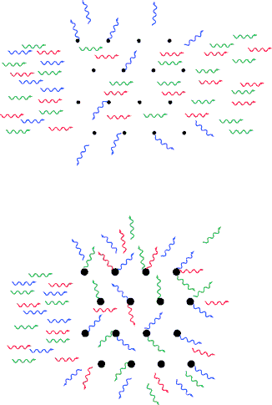
Scattering
Scattering is when the light interacts with particles in the atmosphere to change its direction, but not its properties (i.e. wavelength)
-- dependent on the size of the scattering particles and the wavelength of the scattered energy
--scattering from small particles is Rayleigh scattering; from larger particles it is known as Mie scattering
Notes:
This slide introduces the concept of scattering, which is the focus of this lesson. Later slides will go into more detail; here we introduce the principle. Scattering is when the light interacts with particles in the atmosphere to change its direction, but not its properties (i.e. wavelength)
The figure shows the difference between scattering by small particles (top), which will only scatter shorter wavelengths (Rayleigh scattering, which will be discussed later) and scattering by large particles (bottom), which scatter other wavelengths as well (Mie scattering). Light of all wavelengths (here represented by red, green, and blue waves) enters from the left side of the figure, and encounters the particles (black dots). In the case of smaller particles, only the blue (short wavelength) light is scattered; for larger particles, all wavelengths are scattered to some degree, although blue is still more scattered (as seen by some red wavelengths passing through to the right edge of the figure).
scattering is analogous to diffuse reflection from particles (as opposed to from a surface)
scattering is dependent on the size of the particles doing the scattering as well as the wavelength of the EM energy. Short wavelengths (such as blue versus red light) scatter more than long wavelengths (top figure). For larger particles, there is more scattering in all wavelengths.
scattering from small particles is Rayleigh scattering; from larger particles it is known as Mie scattering.
Image from: http://mtweb.mtsu.edu/nchong/PM-Atm3.htm
For more information: http://en.wikipedia.org/wiki/Diffuse_sky_radiation
http://en.wikipedia.org/wiki/Rayleigh_scattering
http://en.wikipedia.org/wiki/Mie_theory

Slide 3

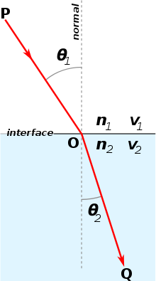
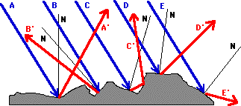
Reflection and Refraction
Reflection:
-- light/energy is bounced off a surface at the same angle as when it arrived (Law of Reflection)
-- reflection may be specular (smooth surfaces) or diffuse (rough surfaces)
Refraction:
-- light is bent as it travels between media
Notes:
This slide talks about reflection, and, for comparison, refraction, in a geometric optics context. Physics students may have already seen reflection detailed in this way. This is useful to contextualize the lecture within a standard high school physics curriculum, as scattering is analogous to diffuse reflection from particles (as opposed to a surface) and it is different from refraction, which is a change in direction due to a change in light speed due to a change in medium.
Reflection:
light/energy is bounced off a surface at the same angle as when it arrived (Law of Reflection)
For smooth (specular) surfaces, this produces a coherent reflection, as in mirrors
For rough surfaces, this produces diffuse reflection due to incident light beams hitting different angles of the surface.
Another topic of geometric optics is refraction. This may be useful to mention depending on students’ prior knowledge.
Refraction:
light is bent as it travels from one medium to another (Snell’s Law: for more info see http://en.wikipedia.org/wiki/Snell's_law)
Images from:
http://www.physicsclassroom.com/Class/refln/u13l1d.cfm
http://en.wikipedia.org/wiki/Snell's_law

Slide 4
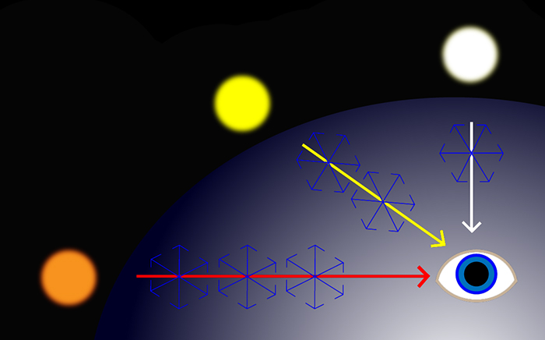
Rayleigh scattering
-- For small particles, incoming light from the sun is scattered more at shorter (blue) wavelengths
-- During a sunset, or times of more pollution, the light has to travel through more atmosphere, so longer (redder) wavelengths are also scattered
Notes:
This slide draws on a real-world example to explain why the sky is blue and why the sun overhead is white, while the setting sun is red (hint: it’s scattering!).
If there was no or very thin atmosphere, the sun would appear white, as no wavelengths would be scattered (top path).
For small atmospheric particles or a moderate atmosphere, incoming light from the sun is scattered preferentially for the shorter (i.e. bluer) wavelengths (middle ray path). This happens in our actual atmosphere most of the time, and the sun appears yellow
During a sunset, the light has to travel through more atmosphere, so more light is scattered (both blues and the longer wavelengths), making the sun appear orange (leftmost ray path). The sun will also appear orange under atmospheric conditions with high amounts of particles, such as smog, fires, or volcanic eruptions. This is the same basic principle in that the light that passes through more mass will scatter more and look orange (either by traveling through more air volume, or through more molecules of polluted air in the same volume)
Image from: http://mtweb.mtsu.edu/nchong/PM-Atm3.htm
http://www.studioninja.co.uk/photography-tutorials/understanding-colour-3-colour-correction/

Slide 5
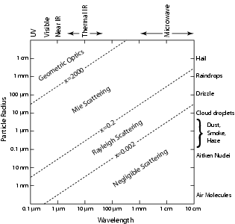
Notes:
This slide gives a basic idea of when Mie versus Rayleigh scattering happens in a more quantitative sense. On slide 2 we introduced Rayleigh scattering as what happens for small particles, and Mie scattering happens for larger particles; a more detailed description is that these scattering types happen for particles which are (small/large) with respect to the wavelength of light.
On this figure, the wavelength on the x-axis is the wavelength of electromagnetic radiation as we defined in Lesson 1. Visible light is between 0.4 and 0.7um and in infrared is around 10um. Radio waves are around 1cm. The y-axis shows the size of particles through which the light passes, in terms of the radius (large particles are at the top, and small particles are at the bottom). Note that both scales are logarithmic and that typical examples are given for particle sizes (right side) and the type of radiation on top of the diagram. Remember that our eyes can observe only in the visible range (but our instruments can observe the full range).
The intersection between the two tells how a given wavelength of light will be affected by particles of a given size. That is, the scattering is a function of both wavelength and particle size. For example, light of 1 micron in wavelength will experience Rayleigh scattering through particles of 1 nm radius, but Mie scattering through particles of 1 micron radius.
For very small particles or very long wavelengths, there is no scattering.
For small particles (like air molecules), visible light is scattered. Longer wavelengths (microwaves) may experience scattering for larger particles (drizzle).
Mie scattering happens for most aerosol/cloud/precipitation for visible light.
For much larger particles, the light behaves according to geometric optics, as taught in your typical physics classroom
Note: this slide is to give a general idea of the regimes of scattering; this should likely only be shown to advanced physics students (when appropriate).
Figures from: http://clouds.wikidot.com/session3

Slide 6
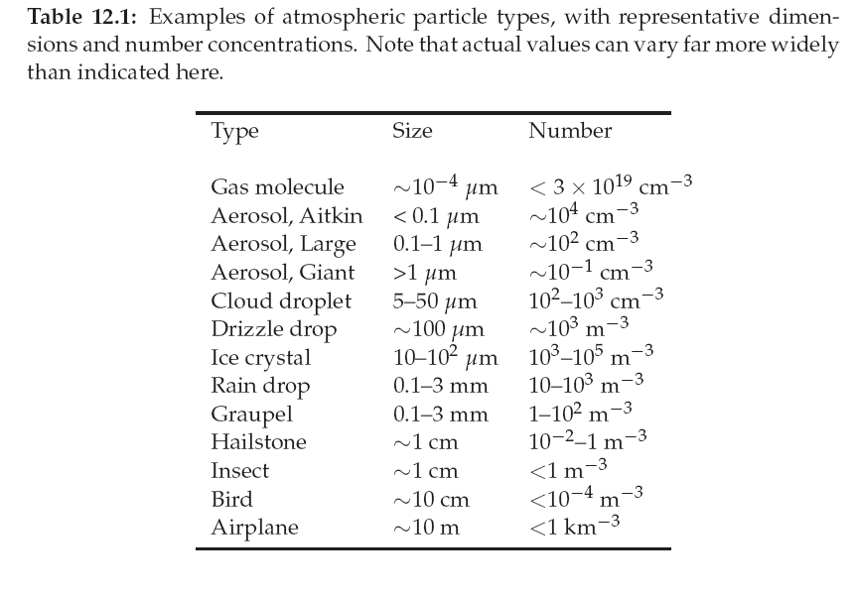
Notes:
This slide shows the abundances and sizes of typical particles found in the atmosphere. Each type of particle is defined by its size (submicron to tens of meters), and the typical number of these particles in a given volume (from many per cubic centimeter less than 1 per kilometer). Macrophysical objects (insects, birds, planes) are shown for context. Together with the previous slide, this gives a basic idea of under what conditions Mie or Rayleigh scattering may happen. As on the previous slide, different types of scattering happen for small/large particles as defined with respect to the wavelength of light.
For small particles (such as gas molecules), there is no scattering of long wavelengths.
For small particles (like air molecules), visible light is scattered.
Longer wavelengths (microwaves) may experience scattering only for larger particles (such as drizzle droplets).
Mie scattering happens for visible light for aerosol, cloud and drizzle droplets.
Note that cloud droplets are 5-100 times as large as aerosol particles
For much larger particles, the light behaves according to geometric optics, as taught in your typical physics classroom
Note: this slide is to give a general idea of the regimes of scattering; this should likely only be shown to advanced physics students (when appropriate).
Figure from: http://clouds.wikidot.com/session3

Slide 7
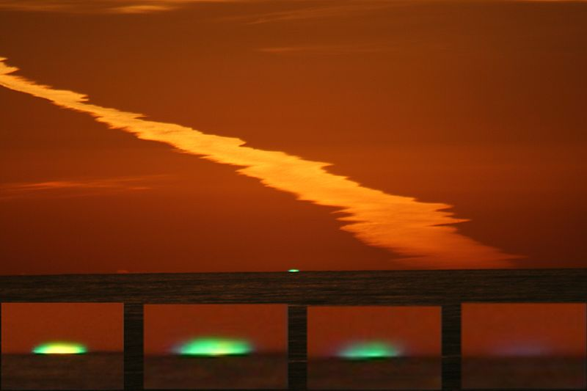
Green flash
A green flash occurs under specific atmospheric conditions; green light around the edge of the sun may be seen just as the sun sinks below the horizon.
Green flashes are due to atmospheric scattering and refraction of visible light.
Notes:
This slide illustrates another example of atmospheric scattering and refraction; the image shows an atmospheric phenomenon known as a green flash.
This may happen on clear days when the green wavelengths coming from the sun are most visible. Green flashes are typically seen right at sunset when the disc of the sun is no longer visible, and slightly scattered (refracted) green light may still be seen. Just after the much brighter disc of the sun falls below the horizon, slightly scattered and refracted green light becomes visible as it is no longer overwhelmed by the yellow disc.
Some types of green flash, occurring under a highly stratified atmosphere, are similar to a phenomenon called a mirage where an image of a distant object appears on the horizon (in this way a reflection of the sky off of land may be mistaken for water).
Days with calm atmospheric conditions are more conducive to green flashes: a very stratified atmosphere increases the refraction within a certain layer (towards the viewer) rather than scattering it in all directions.
Image from/for more information:
http://en.wikipedia.org/wiki/Green_flash
http://mintaka.sdsu.edu/GF/pictures.html

Slide 8
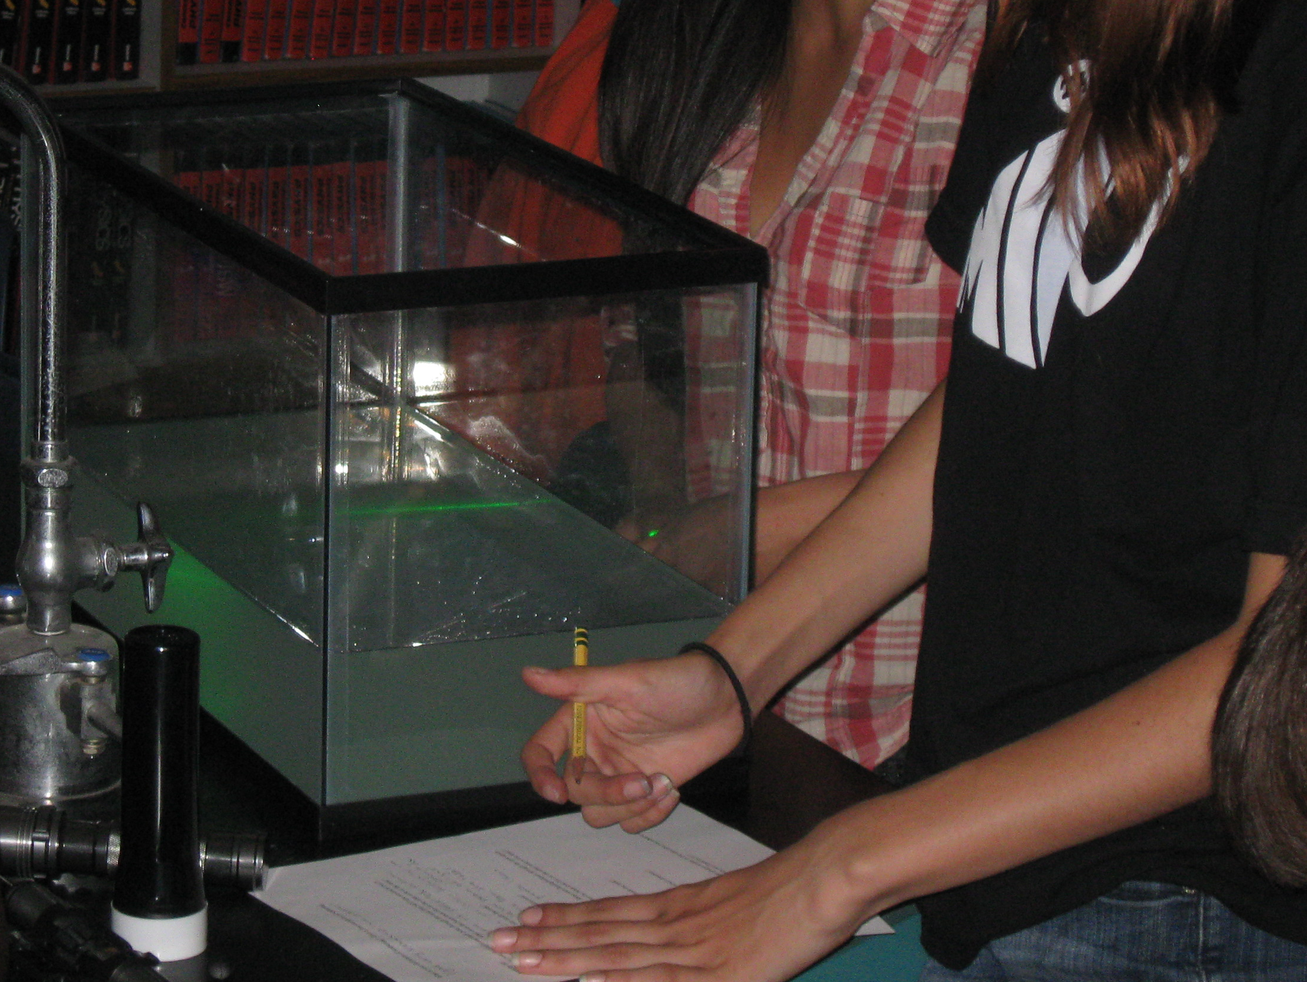
Activity: Rayleigh scattering
“Sunset in a jar”
-- a tank full of water will directly transmit the light of a white flashlight shone into it
-- when a few drops of milk are added, the beam appears yellow while the rest of the tank appears bluish
-- this demonstrates atmospheric Rayleigh scattering (why the sky is blue and the sun appears yellow)
Notes:
This slide introduces the “sunset in a jar” classroom activity used to demonstrate scattering, and is not intended to be shown in class. This activity (#2) is described in more detail in the accompanying Activities description document. An accompanying worksheet (Day 2) is also included.
a tank (“jar”) full of water will directly transmit the light of a white flashlight shone into it
The tank of clear water will also scatter blue laser (405nm) light versus red laser light, i.e. one will be able to see the path of the blue laser (due to scattering) but will not be able to see the red beam as the light is transmitted through the water without scattering. Green laser light will experience some scattering.
when a few drops of milk are added, the beam appears yellow while the rest of the tank appears bluish
With added milk, all laser colors will be visible through the tank; the blue will likely be completely scattered before passing completely through the tank.
this demonstrates atmospheric Rayleigh scattering (why the sky is blue and the sun appears yellow), due to scattering by particles
See accompanying handout for more information.
Teaching note: be prepared to discuss why the visible blue beam means it *is* scattered (the light emitted by the laser is made to change direction (scatter) by the water molecules, and some of these photons hit your eye which is why you can see it), and although the red beam is not visible in the tank, this does not mean the water is completely scattering the red light away (put your hand on the opposite side of the tank– do you see a red dot on it?). The concept of when scattering is happening (when the tank turns blue) and when it is not (when you cannot see the red line, but see a red dot on your hand because all of the light is passing through the tank) is a difficult one, and likely deserves special mention in class.
Photo credit: Dave Van Dusen

Slide 9
Aerosol
A solid particle or liquid droplet suspended in a gas.
Important in creating cloud droplets
May have adverse health impacts and create smog
Most aerosol has an overall cooling effect on climate, but some aerosol may instead warm the planet
Notes:
Now that we have defined scattering, we will talk about some atmospheric components which do a good deal of it. This slide defines the term “aerosol” as used in an atmospheric science context. Aerosol plays a complex role in atmospheric science. Potential misconceptions: “aerosol” is what comes out of a hairspray can.
Aerosol, as the term is used in atmospheric science, is defined as a solid particle or liquid droplet suspended in a gas.
Many types of atmospheric aerosol particles are important in creating cloud droplets (see next slide for sources)
However, certain types of aerosol (from human emissions/pollution) have adverse health impacts and may create smog. For example, tropospheric sulfate aerosol was found to cause acid rain in the 1970s-80s. Particulate soot aerosol from cookstoves contributes to morbidity and mortality particularly among rural, poor women and children.
Aerosols play a complex role in the climate as they have an overall cooling effect (scattering radiation back to space) for reasons explained in the beginning slides. This includes sulfate aerosol from power plants. However, some aerosol warm the planet by absorbing solar radiation.
Whether aerosols cool or warm (locally) depends on the composition and source of the aerosol.
Some suggestions of geoengineering ideas include injecting quantities of cooling aerosol high into the stratosphere where they will persist for a long time and scatter incoming radiation back to space.
Image from: http://earthobservatory.nasa.gov/NaturalHazards/view.php?id=19481 This image shows aerosol pollution from biomass (wood, crop residue, animal dung) or fossil fuel (diesel, coal) burning over India. This atmospheric brown cloud is visible from space.

Slide 10
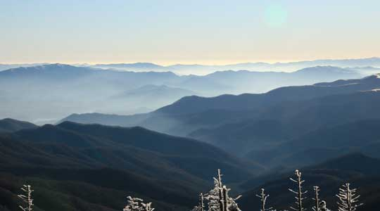
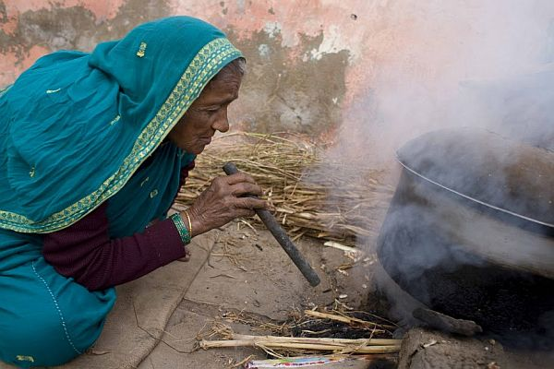
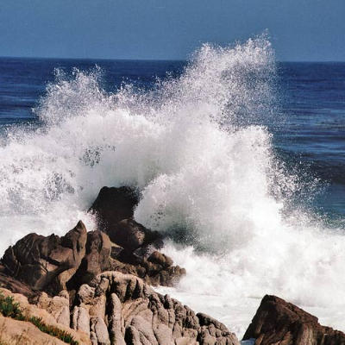
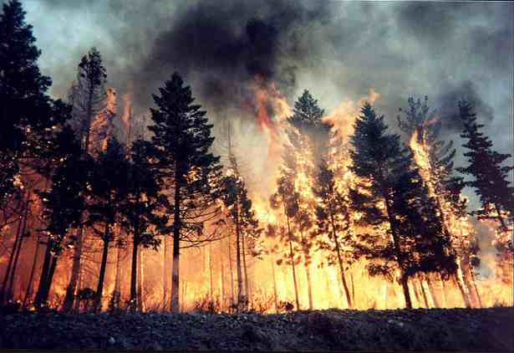
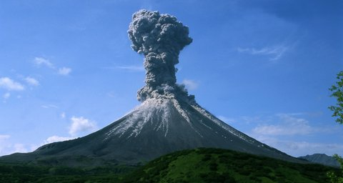
Sources of aerosol
a. b.
c. d.
e.
-- natural: sea spray, desert dust, volatiles from trees or other plants, volcanoes
-- anthropogenic: power plant emissions, diesel engines, open biomass burning (crop residue, deforestation/ clear-cut burning), residential coal or wood/ animal dung
Common aerosol types:
-- sulfate
-- dust
-- sea spray
-- smoke
-- soot (black carbon)
Notes:
This slide describes sources of aerosol as defined on the previous slide. Aerosol can be:
Of natural origin: sea spray (c), desert dust, volatiles from trees or other plants (a), volcanoes (e), forest fires (d)
Anthropogenic (from humans): power plant emissions, diesel engines, open biomass burning (crop residue, deforestation/ clear-cut burning), residential coal or wood/ animal dung (b)
Common aerosol types:
-- sulfate: from power plants and other sources of combustion (especially coal), sulfates were found to cause acid rain in the 1970s, and so the US and the rest of the industrialized world started working to clean up their power plants. Unfortunately sulfate are one of the emissions with an overall cooling effect on the atmosphere and so these aerosols actually have the opposite effect of global warming from CO2 and other greenhouse gases. Hence, when we remove sulfate (as we should), we end up accelerating the warming.
-- dust: typically from deserts; dust are very large aerosol particles
-- sea spray: as bubbles on the surface of the ocean burst, droplets of salt water can be transferred to the atmosphere, where sea salt can act as cloud condensation nuclei. For more information on sea spray, see the SCC lesson plan on the topic at: http://earthref.org/SCC/lessons/2012/airseainteractions/
-- smoke and soot: from fires, particularly smoldering fires of incomplete combustion, smoke contains so-called black carbon or organic carbon. The organic carbon tends to have a cooling effect, and black carbon absorbs solar heat for a warming effect. Black carbon is also hydrophobic, meaning it doesn’t like to take up water to become cloud droplets. More efficient stoves can cut down on the amount of soot from cooking sources, and open biomass burning
Images from: http://ciip.som.yale.edu/content/why-dont-poor-adopt-cookstoves-improve-their-health
http://biomasshub.com/epa-backtracks-biomass-carbon/
http://www.coastalliving.com/lifestyle/capture-the-coast-reader-photo-contest/2005-capture-coast-photo-contest-honorable-mentions-00400000000862/page7.html
http://earthdata.nasa.gov/featured-stories/featured-research/volatile-trees
http://www.egu.eu/medialibrary/image/14/karymsky-volcano-2004/
For more information: http://www.ucsusa.org/global_warming/science_and_impacts/science/aerosols-and-global-warming-faq.html

Slide 11
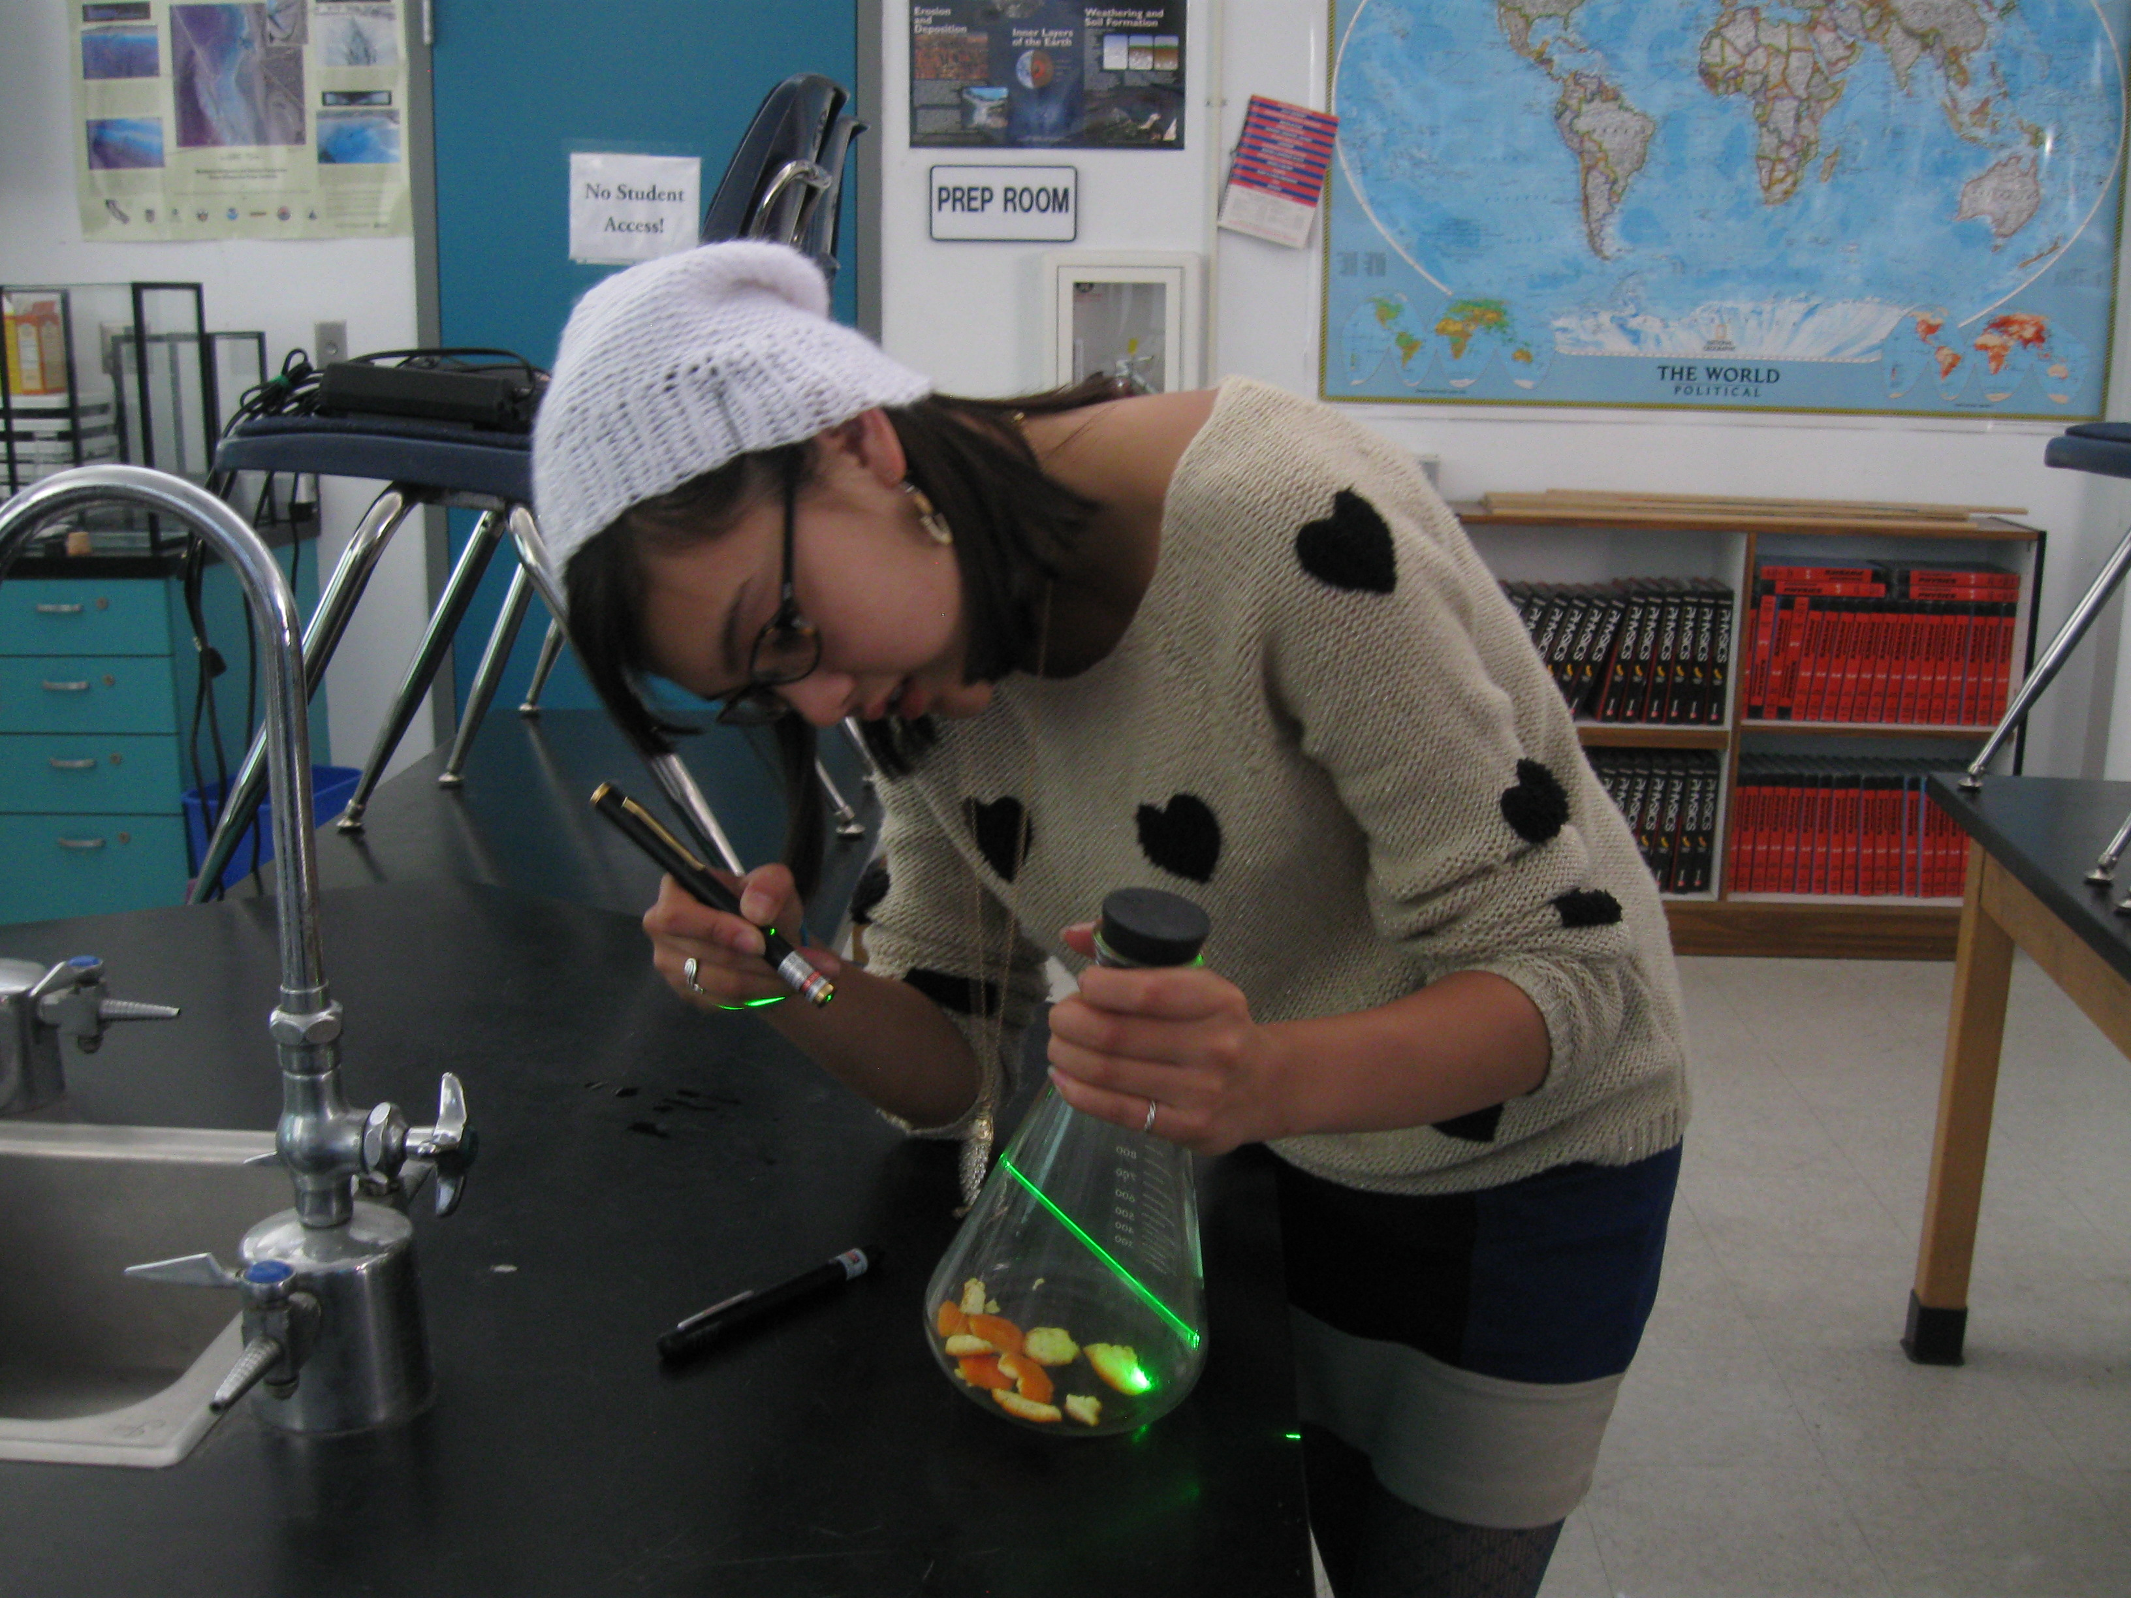
Activity: smog in a bottle
Demo to illustrate how UV radiation interacts with aerosol to produce smog
A UV pen in a jar will oxidize the air in the jar; when a source of aromatic aerosol (orange peel) is introduced to the jar, smog particles are produced.
Notes:
This slide introduces a demo on aerosol intended to illustrate how ultraviolet radiation interacts with aromatic particulates to form smog, and is not intended to be shown in class. This activity (#3) is described in more detail in the accompanying Activities description document. An accompanying worksheet (Day 2) is also included.
In the experiment, a jar is prepared with a ultraviolet pen lamp, which creates ozone molecules from the O2 oxygen molecules in ambient air. Before the orange peel is added, a laser pen shone through the jar shows nothing. After, the beam will be visible within the jar as the volatile organics from the orange peel interact with the ozone to form particulates. This demonstrates how photochemical smog is formed.
Note: this may be done as a demo rather than a student activity depending on limited numbers of UV pens and the amount of time the pen must sit in the jar, and the potential hazards of the pen to eyes. If these can be overcome, this activity can be done as a student exploratory activity. In our unit of study, this was done as a breakout student activity (with accompanying worksheet); UV pens/flasks were set up before class and allowed to run until used.
For further information: http://aerosols.ucsd.edu/classes/COSMOS12_Lab_Smog.pdf
http://en.wikipedia.org/wiki/Photochemical_smog
http://en.wikipedia.org/wiki/Ozone#Location_and_production
http://en.wikipedia.org/wiki/Volatile_organic_compound
Photo credit: Kristina Pistone

Slide 12
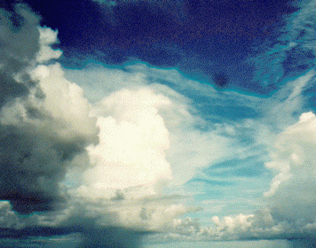
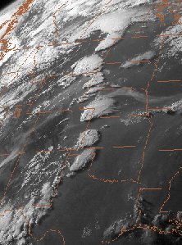
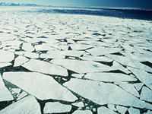
Albedo
-- Albedo is a “bulk property” = reflection from many particles
-- Regions of high albedo on Earth are mostly due to clouds, ice and snow, and atmospheric aerosol
-- Earth’s planetary albedo is around 30%
Notes:
While scattering happens on an individual molecular level, when taken together the amount of backscattering may be termed albedo. This slide introduces this concept. Albedo is the reflectivity of an object, or how much incident light is reflected back into space rather than being absorbed (This concept also appeared on Slide 12 in Lesson 2).
The leftmost figure is a GOES satellite image showing reflection off of clouds and aerosol over the midwest of the US. Along with sea ice, clouds and aerosol are the main contributors to planetary albedo.
Albedo is a “bulk property,” meaning that it is the overall reflectivity off of many particles, rather than just one solid surface as in traditional optical reflection. Particularly in clouds, light will be scattered from individual particles in many directions, mostly forward, but when scattered by many particles together, much energy ends up reflected back to space.
High albedo regions on Earth are mostly due to clouds, ice and snow, and atmospheric aerosol; as such these all appear white.
Earth’s planetary albedo (the fraction of light from the sun that is reflected back to space instead of absorbed by the Earth or its atmosphere) is around 30% (Lesson 2, Slide 12). This is mostly due to clouds; although ice is very reflective, it is mostly concentrated in polar regions, which get less incident sunlight than the tropics.
Images from:
http://www.esrl.noaa.gov/psd/psd3/air-sea/csp/
http://nsidc.org/cryosphere/allaboutcryosphere.html
http://www.meted.ucar.edu/satmet/goeschan/navmenu.php?tab=1&page=2.5.0&type=text

Slide 13
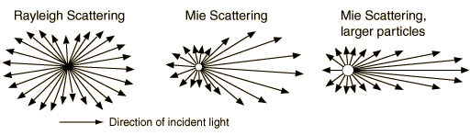
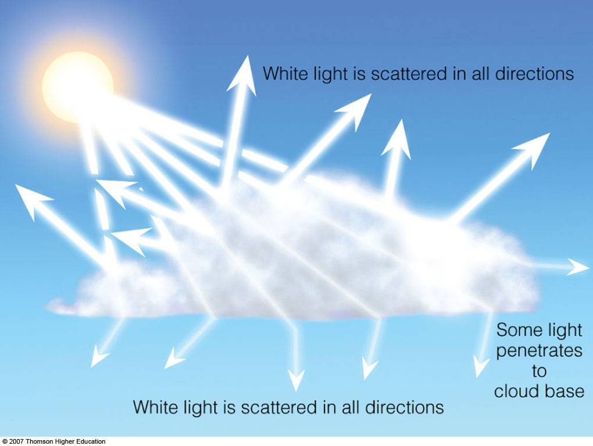
Mie scattering
When light encounters larger particles, light is scattered in all directions, but preferentially forward
When light is scattered from many particles, it is more likely to be scattered back out the top of the cloud
Notes:
This slide introduces Mie scattering as it differs from Rayleigh scattering. You will remember (Slides 4-6) that Mie scattering involves larger particles than Rayleigh scattering, and thus the scattered light behaves differently. Here we place this into the context of albedo, specifically cloud albedo and how predominantly forward- (Mie) scattering particles can still have albedo (i.e. backwards reflection).
The top image indicates what happens to light when it interacts with a particle of particular size. The size of the arrows correspond to the probability that light will proceed in a given direction.
When light encounters small particles, light is equally likely to be scattered forward or backwards (Rayleigh scattering; left).
When light encounters larger particles, light is scattered in all directions, but mostly forward (Mie scattering; right). This effect is stronger for larger particles (far right image).
The second image shows what happens when light encounters many particles. The black arrows indicate an example of some complex scattering paths that individual photons might take within the cloud.
When light is scattered from many particles, as in a thick cloud, although the majority of photons may be scattered forward, there is always some which is scattered backwards. When we deal with many many particles, there is an increased probability that these multiple scatterings will end up curving the path around to exit the top of the cloud (due e.g. to one incident of backscattering), rather than effectively passing through the entire thick cloud (and more scatterings) without significant deviations.
Thus in thick clouds there is a higher probability a lot of light will end up scattered back out the top of the cloud. In thinner clouds, more light may pass through. For this reason, thick clouds have higher albedo (as described earlier).
One can observe this: thicker (either in terms of physical thickness or more particles) clouds will appear grey (dark) from the ground, because little light is able to pass all the way out to the bottom of the cloud.
This is also one of the indirect effects of aerosol on climate: where we have more anthropogenic aerosol, we have smaller droplets which form, for more relative backscattering and higher-albedo clouds. This is an area of active research in climate science!
Image from: http://hyperphysics.phy-astr.gsu.edu/hbase/atmos/blusky.html
http://apollo.lsc.vsc.edu/classes/met130/notes/chapter19/mie_scatt.html (overlay by K. Pistone)

Slide 14
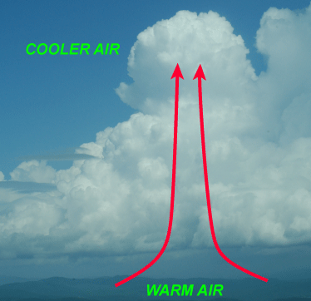
Cloud formation
Water typically evaporates from the surface, and as the warm, moist air rises, it cools and becomes saturated
Without any particulates in the atmosphere, air must become very supersaturated in order to form cloud droplets. Instead aerosol can act as cloud condensation nuclei (CCN) to form clouds at lower saturation.
The ability of a type of aerosol to act as CCN depends on its size and chemical composition
Notes:
This slide represents a very brief overview of how clouds are formed, in order to give an idea of how aerosol actually helps to form cloud droplets (a process called nucleation).
Water typically evaporates from the land or ocean surface, and as the air rises, it cools and becomes saturated. If at some altitude enough water vapor is present so that the rising plume becomes supersaturated with respect to its surroundings, the vapor may condense out to form cloud droplets.
Without any particulates in the atmosphere, air must become very supersaturated in order to form cloud droplets. Instead aerosol can act as cloud condensation nuclei (CCN) to form clouds at lower saturations (requiring less energy). It is very difficult for atmospheric water vapor to overcome surface tension to spontaneously become a cloud droplet; we need aerosol to act as a seed. This is the same basic idea behind putting a string in boiling sugar water to make rock candy. The string gives the sugar something to condense on and form the crystals, rather than having hundreds of tiny crystals forming in the pot.
The ability of a type of aerosol to act as CCN depends on its size and chemical composition. Certain particles are very good at taking up water (“hydrophillic”), such as sea salt or sulfates; others effectively repel water (“hydrophobic”) such as fresh soot. Regardless, aerosol of some type is needed to form clouds!
This is also the idea behind cloud seeding: putting more particles into the atmosphere will induce clouds to form, though such experiments have not been proven effective beyond the natural variability within cloud formation.
For more information, see Köhler theory, which describes how particle activation (becoming able to be a CCN) depends on the interaction between surface tension that needs to be overcome (depending on the size of the particles) and the saturation vapor pressure of the aerosol, or how readily that particular molecule will take up water.
Image from: http://apollo.lsc.vsc.edu/classes/met130/notes/chapter2/atm_conv3.html
For more information: http://en.wikipedia.org/wiki/Nucleation
http://www.ess.uci.edu/~cpasquer/classes/ess200b/pdfs/cloud_microphysics.pdf
http://en.wikipedia.org/wiki/Kohler_theory

Slide 15
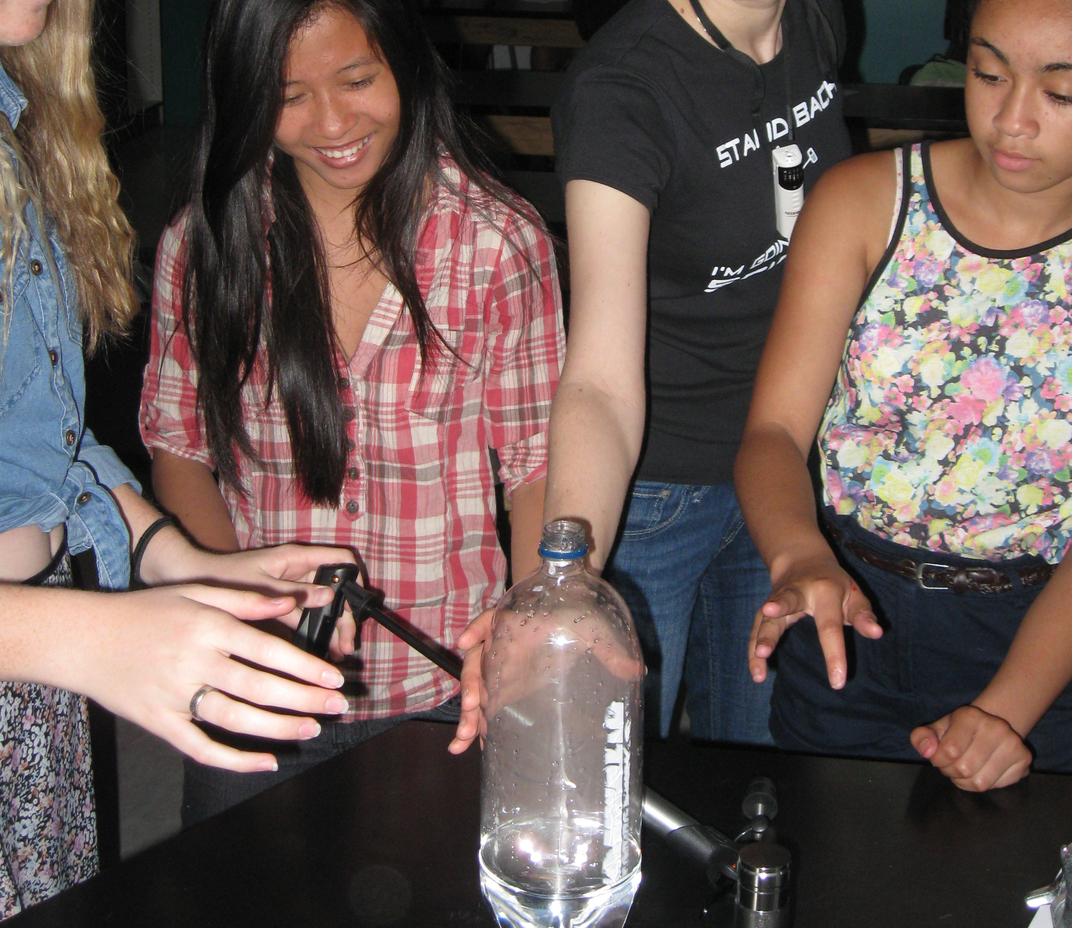
Activity: cloud in a bottle
This activity demonstrates cloud nucleation
-- a small amount of water is put into a plastic soda bottle
-- aerosol particles are introduced using a match
-- when the pressure in the bottle is increased, the water will nucleate around the aerosol particles and a cloud forms in the bottle
Notes:
This slide describes the activity to demonstrate cloud nucleation, and is not intended to be shown in class. This activity (#4) is described in more detail in the accompanying Activities description document. An accompanying worksheet (Day 2) is also included.
a small amount of water is put into a plastic soda bottle
aerosol particles are introduced using a match
when the pressure in the bottle is increased using a bicycle pump and then released, the water will nucleate around the aerosol particles and a cloud forms in the bottle
Photo credit: Dave Van Dusen
See also: http://www.youtube.com/watch?v=E8AvfXar9zs, or http://www.youtube.com/watch?v=msSVQ903T8k for another variation.

Slide 16
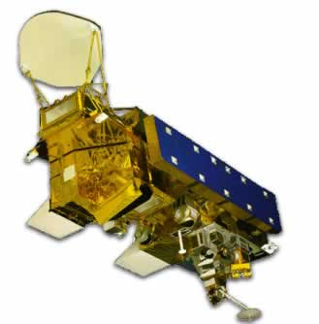
Why do we care about how things scatter?
Understanding of scattering is important to many areas of science
--proper interpretation of satellite observations depends on scattering
-- this is an area of active research!
Land Ocean Ice
Notes:
Why do we care about scattering? This slide introduces one important application of scattering theory. The image is an illustration of the CERES instrument (http://ceres.larc.nasa.gov/) on the Aqua spacecraft. CERES measures the radiation coming from the Earth in different wavelengths. (the image is not to scale!)
Satellites typically measure radiation in a number of different wavelengths (or wavelength ranges) at once. I hope by this point I have conveyed how important the wavelength dependence of these measurements are, and how much information is in them!
Any time you have light arriving at a satellite we can learn something about the earth system– sometimes as signal and sometimes as noise, because reflection and/or emission off of land, ocean, atmospheric constituents, vegetation, etc, may dominate any particular wavelength channel; one must have a good understanding of these components in order to interpret the measurements. For example, see the microwave satellite image in Lesson 1. As another example, if a satellite measures the incoming and reflected shortwave (solar) radiation, it can tell us how much of the incoming energy has been absorbed somewhere in the climate system.
However, in many cases of satellite observations of the Earth, we know the location of the sun and of the satellite, but what the satellite observes (i.e. in terms of reflected sunlight) may vary based on the geometry of clouds (or aerosol!)– which scatter. Thus it is important to understand scattering if we are to be able to accurately interpret the observations.
If we know how incident light scatters off of clouds and how that will relate to the satellite location, we can gain a better understanding of the climate system. Many satellites measure in different wavelength bands, meaning they can combine different images in different wavelengths, meaning our knowledge of how the radiation scatters, absorbs, or reflects in each different wavelength is very important.
For example, in order to determine what fraction of radiation is scattered back to space from the sun, we need to know:
Where the sun is in relation to the satellite
What sort of surface is below the satellite. Is it land, ocean, or ice? Are there clouds present? Did the clouds interact with the radiation from the surface or directly from the sun?
How the light is scattered (Mie or Rayleigh or geometric optics?)
Is what the satellite sees coming from directly below, or has it been scattered from a neighboring area?
The figure is meant to give a basic schematic idea of the different questions at play.
In order to address these questions and obtain meaningful results from satellite instruments, scientists must have a good working knowledge of how light scatters within the Earth system. Then they apply these equations to the raw observations to obtain the desired metrics. For CERES this involves measuring both incoming and outgoing shortwave energy (effectively measuring the planetary albedo), as well as measuring the amount of longwave radiation emitted from the Earth’s surface (This is an area of active research; algorithms are always being tested, validated, and improved).
Another satellite, CALIPSO (http://www.nasa.gov/mission_pages/calipso/main/), shoots a laser beam known as a lidar at the Earth, and measures the amount and timing of backscatter to determine where clouds and aerosol are in the vertical column.
Image from: http://ceres.larc.nasa.gov/aqua_ceres.php
For (a great deal of) further information: http://ceres.larc.nasa.gov/atbd.php

Slide 17
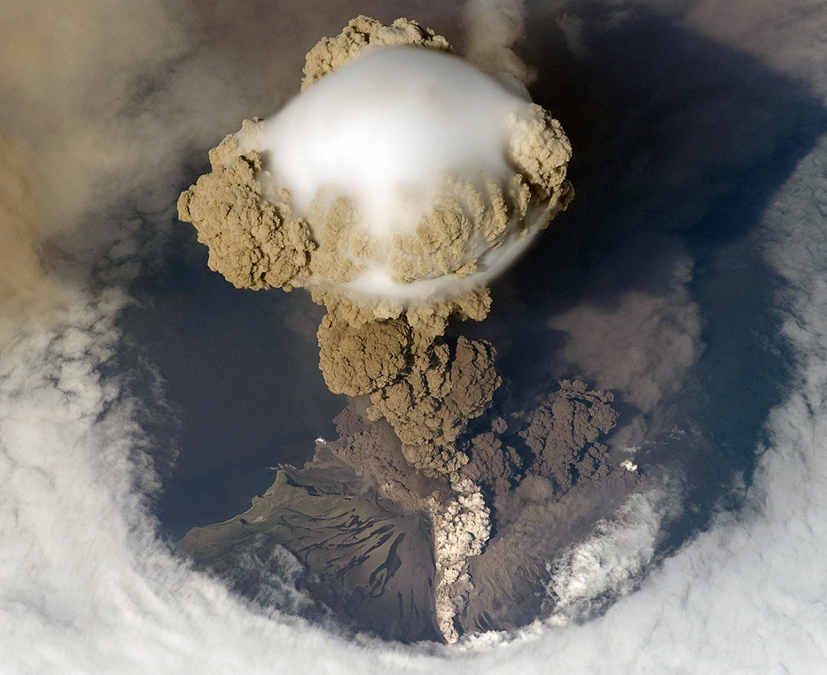
Conclusions
Scattering is when the direction but not the wavelength of light is changed upon encountering matter
Scattering can be predicted probabilistically based on the wavelength of the radiation and the size of the particles
Atmospheric aerosol particles have a number of sources and play an important role in cloud formation
Notes:
To conclude:
Scattering is when the direction but not the wavelength of light is changed upon encountering matter
Scattering can be predicted probabilistically based on the wavelength of the radiation and the size of the particles
Atmospheric aerosol particles have a number of sources and play an important role in cloud formation. Our knowledge of scattering is used in such applications as satellites and is important to our knowledge of the Earth system as a whole.
Image from NASA, via http://contrailscience.com/a-very-unusual-contrail/, showing the Sarychev Volcano erupting on Matua Island emitting ash and sulfate aerosol (the brown-gray color), as well as lifting water vapor from lower altitudes (which condenses into the white cloud at altitude). The photo was taken by an astronaut on the International Space Station. You will remember that sulfate aerosol is primarily scattering (for a cooling effect); overall, the cooling effect of the sulfate emitted is greater than the warming effect from the carbon dioxide emitted by the same eruption
For further information see also: http://hyperphysics.phy-astr.gsu.edu/hbase/atmos/blusky.html

