Slide 1
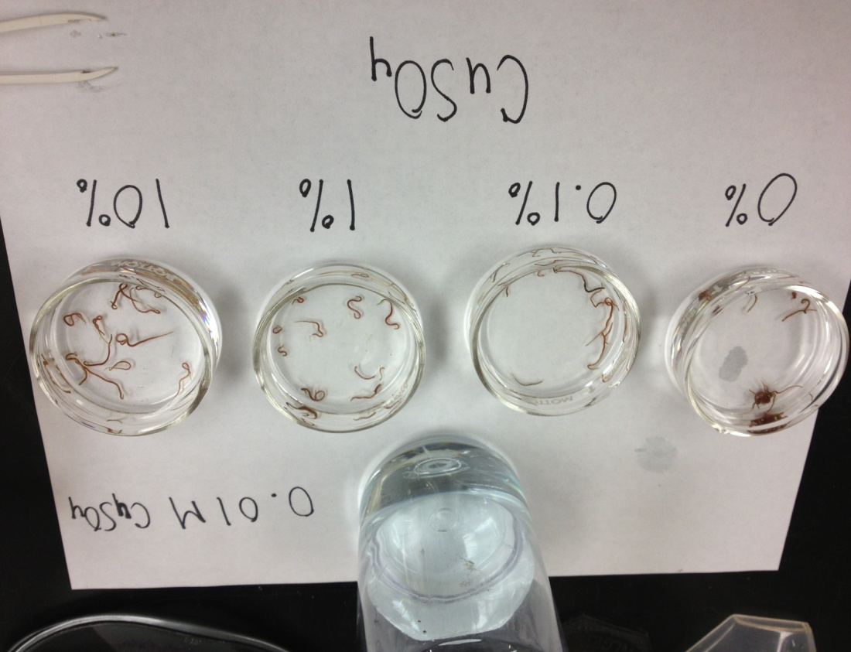
LD-50 Lab Introduction
earthref.org
Scripps Classroom Connection
Notes:
1. AUTHORS AND CONTEXT:
Randelle Bundy, Scripps Institution of Oceanography, Ph.D. Candidate
Jennifer Ogo, Kearny High School, Science Teacher
In this lesson, students are introduced to dose response curves, specifically LD-50 (lethal dose 50%) and threshold effects. Students will understand that the dose of toxin will determine its effects, and these effects can vary between organisms. Students will draw their own LD-50 curves on mini-whiteboards in order to be formatively assessed by the teacher.
This lesson is the second part of a multi-part lesson on heavy metal pollution and phytoremediation.
This introductory lesson is designed to be implemented before completing the LD-50 Lab for Blackworms, see Lesson Overview for an overview of the lesson.
2. WHY:
How do we determine what level of toxins can be tolerated in the environment? When we determine the LD-50 value of different toxins in the environment, we can use these values to make informed decisions in risk assessments about safe concentrations of pollutants in our soil and water. This introductory lesson allows students to discover why we calculate LD-50 values, and how we use them to make safe environmental laws.
3. SUMMARY:
This presentation introduces the students to dose response curves, and how to calculate LD-50 and threshold values.
4. PICTURE/GRAPHICS CREDITS:
This picture shows the set-up for a traditional LD-50 lab. Photograph by Randelle Bundy.
5. WEBSITES USED IN THIS PRESENTATION:
none
6. ADDITIONAL READING:
Students can read background information in their AP Environmental Science text book on toxicity and dose response curves.
7. CONTEXT FOR USE:
This presentation was designed for an AP Environmental Science class within their toxicology unit. It is an introduction to dose response curves, with specific focus on LD-50 values and threshold effects.
8. MISCONCEPTIONS:
Certain things are bad for you or good for you; the amount you consume doesn’t matter- This misconception is addressed in this lesson with an introductory statement from Paracelsus and by using examples of dose response curves with activities such as watching TV or taking Advil, which the students associate as “good for them.”
9. EVALUATION TIPS:
The teacher can use mini-whiteboards throughout this lesson to ask students to draw their own LD-50 curves, and answer questions throughout the lesson to formatively assess the students.
10. TEACHING NOTES:
See the Lesson Outline for more information about how this lesson fits into the heavy metal and phytoremediation unit. Also refer to the LD-50 Lab with Blackworms for the students and teacher for additional background information on LD-50 values and the activity that follows this introductory lesson.

Slide 2
“Everything is poisonous yet nothing is poisonous.”
Paracelsus
earthref.org
Scripps Classroom Connection
Notes:
POINT OF SLIDE:
This slide introduces the concepts to be covered in this lesson.
BULLETED POINTS:
Have the students share aloud what they think this quote means. This will get the students thinking about how the dose of something might determine its effects on humans or other organisms. Make sure the students understand that anything can be poisonous (bad for you) if you have too much of it. It is the dose that matters
PICTURE/GRAPHICS CREDITS:
none

Slide 3
Max Benefit
Beneficial
Increasing Amount
Harmful
Everything can be beneficial up
to a certain point, and then might
be harmful.
earthref.org
Scripps Classroom Connection
Notes:
POINT OF SLIDE:
This slide introduces dose response curves.
BULLETED POINTS:
Certain things can be beneficial up to a certain amount or “dose,” but then may become harmful once that dose is exceeded. Even medicines or activities you think might be good for you such as Advil can be harmful if you take too much, or if you exceed the desired dose. Advil will not help you if you take too little, but can then kill you if you exceed a certain dose. Therefore the dose is essential for maximum benefit and minimal harm.
PICTURES/GRAPHICS CREDITS:
Randelle Bundy

Slide 4
Example: Watching TV
Max Benefit
Beneficial
0.5 1 2 3 4 5 6 7
Increasing Hours
Harmful
earthref.org
Scripps Classroom Connection
Notes:
POINT OF SLIDE:
This slide shows a dose response curve with an example of a “beneficial” activity, such as watching TV.
BULLETED POINTS:
Watching TV is assumed to be a generally beneficial activity, but once you pass a certain number of hours it may become bad for you. This effect might also vary between people, where one person gets tired of watching TV after only 30 minutes, and another can watch it for 3 hours before it is harmful to their eyes and their health.
PICTURE/GRAPHICS CREDITS:
Randelle Bundy

Slide 5
Dose Response Curves
How can you decide what is the optimal dose? A harmful dose?
Important dose “indicator”
  LD50- lethal dose, where 50% of the population dies
earthref.org
Scripps Classroom Connection
Notes:
POINT OF SLIDE:
This slide introduces dose indicators, specifically LD-50 values, by having the students first think about what indicators can be used to determine if a dose is harmful or beneficial.
BULLETED POINTS:
Every living thing has a different response to different doses of chemicals. Therefore, we have to use indicators in order to determine toxicity. One of the most important dose indicators is the LD-50, which stands for the lethal dose of 50% of the population. This is the dose where 50% of the population dies at a certain dose of the toxin or chemical.
PICTURE/GRAPHICS CREDITS:
none

Slide 6
A Closer Look: LD 50 Examples
Toxic Substance A
100
100
Toxic Substance B
50
50
% Showing A Response
0
0
Dose of toxicant
earthref.org
Scripps Classroom Connection
Notes:
POINT OF SLIDE:
This slide shows examples of LD-50 curves.
BULLETED POINTS:
The plot on the left shows a generalized LD-50 curve, where the 50% lethal dose is shown by the dashed blue line. The response is a negative response (death, etc…). In the plot on the right, two different curves are shown, for a toxin A and B. Discuss the differences between the curves: At low concentration substance B shows a stronger response than A, but that response levels off and substance A becomes more toxic at lower concentration. Here you can have the students write on their mini-whiteboards which substance they think is more toxic between the two shown. Toxic substance A is more toxic because a lower dose of that toxin will kill half of the population.
PICTURE/GRAPHICS CREDITS:
Randelle Bundy

Slide 7
Threshold Effects
Threshold: no effects are seen to occur in response to the dose
100
A
Which substance,
A or B
has a higher threshold for toxicity?
B
Response %
50
0
earthref.org
Scripps Classroom Connection
Notes:
POINT OF SLIDE:
This slide shows examples of another type of dose indicator, called the threshold value.
BULLETED POINTS:
Threshold effects refer to the dose at which an effect in seen in the population you are examining. An “effect” can be defined as a change in behavior, or any adverse symptoms of toxicity. The plot shown shows two response curves for a substance A and B. You can ask the students again to write on their mini-whiteboards which substance they think is less toxic, or has a higher toxicity threshold. Substance B has the higher threshold value (less toxic) because a higher dose is needed before a response is seen in the population. The arrows indicate the value of the threshold dose for each substance shown.
PICTURE/GRAPHICS CREDITS:
Randelle Bundy

Slide 8
Risk Assessments
Determining potential adverse environmental health effects on people exposed to pollutants
  LD50 and threshold effects
  Includes many steps and processing
  Eventually incorporated into regulations
earthref.org
Scripps Classroom Connection
Notes:
POINT OF SLIDE:
This slide introduces risk assessments and why LD-50 values are beneficial for these assessments.
BULLETED POINTS:
Risk assessments are used to compile the potential adverse effects that a toxin can have on humans and other organisms in the environment. Since toxins cannot be directly tested on people, LD-50 values and threshold effects are often used in risk assessments as indicators of toxicity. Risk assessments involve many steps and levels of processing, but are often the first step in transforming toxicity indicators into environmental regulations. Humans are never used for risk assessments, and often LD-50 tests are performed on mice or another relevant species (marine species if dealing with water pollution). LD-50 tests are then eventually a component of the overall risk assessment.
PICTURE/GRAPHICS CREDITS:
none

