Slide 1
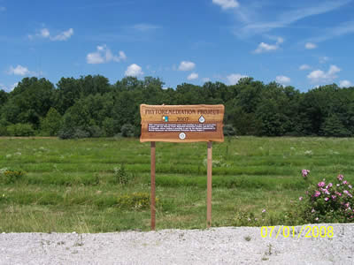
Bioremediation and Phytoremediation:
Natural Methods for Toxic Clean-Up
earthref.org
Scripps Classroom Connection
Notes:
1. AUTHORS AND CONTEXT:
Randelle Bundy, Scripps Institution of Oceanography, Ph.D. Candidate
Jennifer Ogo, Kearny High School, Science Teacher
This lesson is part of a multi-part lesson on heavy metal toxicity and phytoremediation. This lesson provides background for a phytoremediation lab activity in an AP Environmental Science class as part of the water pollution and toxicity unit. In this lesson, students will be introduced to bioremediation and phytoremediation in the environment and how they compare to traditional clean-up methods. Students will learn about different types of phytoremediation and some examples where this type of remediation method has been used. They will also understand how phytoremediation compares to traditional clean-up methods, and the advantages and disadvantages associated with each.
To see where this lesson fits within the broader heavy metal and phytoremediation unit, see the Lesson Overview and the Phytoremediation Lab for the students and the teacher for more information.
2. WHY:
Bioremediation and phytoremediation are two methods for toxic clean-up that are increasingly being applied in the natural environment. These methods are often less expensive and less invasive than other clean-up methods and the technology for phytoremediation is being constantly improved. Several examples of phytoremediation will be explored in this lesson, and will be implemented in the lab activity that follows this introductory lesson.
3. SUMMARY:
Phytoremediation is an effective method for cleaning up some types of toxic waste, including heavy metals and oil. Hyperaccumulating plants are used for phytoremediation because they can accumulate pollutants in their tissues at higher concentrations than their surrounding environment. Some case studies are explored which are using this technology and why it works for that particular site and pollutant.
4. PICTURE/GRAPHICS CREDITS:
This picture shows a landfill in Columbia, Missouri where phytoremediation is being used.
5. WEBSITES USED IN THIS PRESENTATION:
This photo is from: https://www.gocolumbiamo.com/PublicWorks/Solidwaste/Phytoremediation.php
6. ADDITIONAL READING:
See Phytoremediation Lab for an activity related to this lesson on phytoremediation.
7. CONTEXT FOR USE:
This lesson was designed to be used in a water pollution and toxicity unit in an AP Environmental Science class before the students complete a phytoremediation lab.
8. MISCONCEPTIONS:
A general misconception about phytoremediation is that it is “natural” and therefore has no disadvantages. This misconception will be addressed by comparing and contrasting the advantages and disadvantages of phytoremediation compared to traditional clean-up methods.
9. EVALUATION TIPS:
Students can make their own T-chart in pairs of what they think the advantages and disadvantages of phytoremediation are in order to get them to think about phytoremediation on their own.
10. TEACHING NOTES:
This lesson should be preceded by other lessons on water and soil quality and Superfund sites.

Slide 2
What is Bioremediation and Phytoremediation?
Remedium- restore balance
  Phyto- plant
  Bio- any living organism
Getting rid of pollutants
  Metals
  Pesticides
  Solvents
  Explosives
  Oil
Clean, cost-effective environmental clean-up methods
earthref.org
Scripps Classroom Connection
Notes:
POINT OF SLIDE:
This slide introduces the definition of bioremediation and phytoremediation.
BULLETED POINTS:
Bio (any living organism) and phyto-remediation (specifically plants) are terms that refer to remediation or restoring balance to an ecosystem. These methods can be used to get rid of pollutants in air, water or soil. Phytoremediation and bioremediation can be used with a variety of pollutants, including metals, pesticides, solvents, explosives, and oil. They are generally thought to be very cost-effective and environmentally friendly clean-up methods.
PICTURE/GRAPHICS CREDITS:
none

Slide 3
Phytoremediation:
Advantages vs. Disadvantages
Advantages
  Costs less
  Recovery and re-use
  Natural state
Disadvantages
  Limited to the surface area of plants
  Long-term
  Leaching
  Potential for bioaccumulation
earthref.org
Scripps Classroom Connection
Notes:
POINT OF SLIDE:
This slide shows the advantages and disadvantages of using phytoremediation in the environment compared to traditional clean-up methods.
BULLETED POINTS:
An advantage of phytoremediation is that it costs less than physically removing pollutants from the environment. Often, it is also possible to fully recover and reuse the pollutant, and the environment is able to be preserved in its natural state. The disadvantages of phytoremediation are that it is only limited to the root depth of the plants you are using, so if pollutants are concentrated in the surface layer of soil or water then this method can be effective. Phytoremediation also requires a long-term commitment during the lifetime of the plant, and can even cause leaching of the pollutant into the water source for the plant. One of the main disadvantages is the potential for bioaccumulation in higher trophic levels if the plants used for phytoremediation are consumed by higher level consumers.
PICTURE/GRAPHICS CREDITS:
none

Slide 4
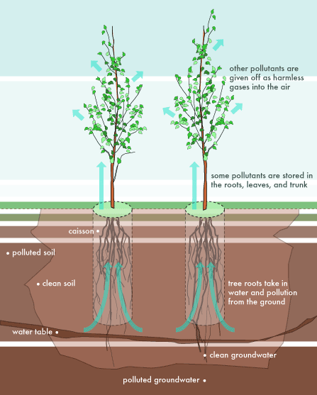
What Plants Can Be Used?
Hyperaccumulators: concentrate pollutants
  Examples: mustard plants, hemp, pigweed, duckweed, water lettuce
earthref.org
Scripps Classroom Connection
Notes:
POINT OF SLIDE:
This slide explains the type of plants that can be used in phytoremediation.
BULLETED POINTS:
Hyperaccumulators are the type of plants that have to be used in phytoremediation because they can accumulate pollutants in their tissues in much higher concentrations than in the medium in which they are growing. Examples of these types of plants are mustard plants, hemp, pigweed, duckweed and water lettuce. This picture depicts how hyperaccumulators take up pollutants from their environment.
PICTURE/GRAPHICS CREDITS:
http://access.ncsa.illinois.edu/Stories/phytoremediation/diagram.html

Slide 5
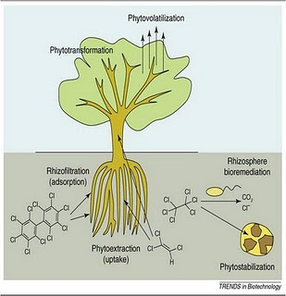
Types of Phytoremediation
Phytoextraction
Phytostabilization
Phytotransformation
Rhizosphere degradation
Phytovolatilization
Rhizofiltration
earthref.org
Scripps Classroom Connection
Notes:
POINT OF SLIDE:
This slide shows different types of phytoremediation used in the environment.
BULLETED POINTS:
There are several types of phytoremediation, and they differ based on the fate of pollutant. Phytoextraction involves the uptake of the pollutant into the plant’s biomass, and is the most common type of phytoremediation. Phytostabilization is the process by which the plant simply limits the leaching of the pollutant in the environment. Phytotransformation is when the plant transforms the pollutant into a less harmful chemical by metabolizing it and degrading it. Rhizosphere degradation refers to the processes in the roots that degrade the pollutant. Phytovolatilization refers to the removal of the pollutant and transformation into a harmless gas that is released to the atmosphere. And finally, rhizofiltration is the physical process of a pollutant being filtered through the roots of the plant to get rid of the contaminant. This picture shows the different types of phytoremediation.
PICTURE/GRAPHICS CREDITS:
http://www.oilspillsolutions.org/inlandspills.htm

Slide 6
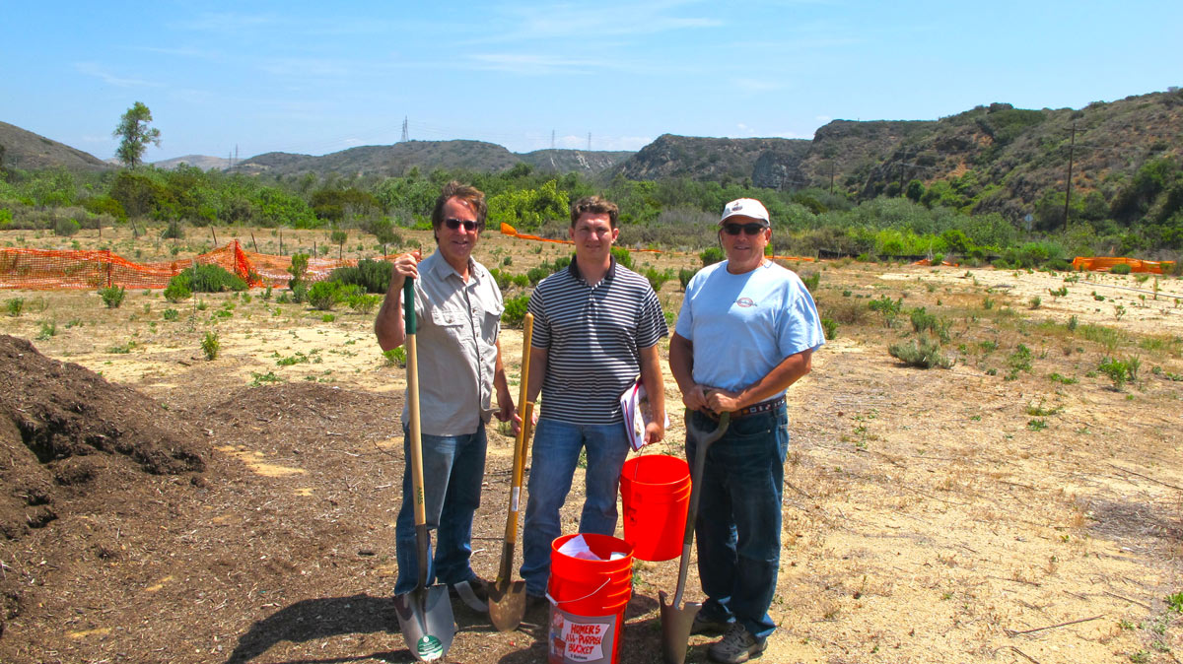
Superfund Sites
Superfund:
  EPA to clean up polluted sites through a trust fund or by finding the guilty party
earthref.org
Scripps Classroom Connection
Notes:
POINT OF SLIDE:
The point of this slide is to give an example of a Superfund site that uses phytoremediation.
BULLETED POINTS:
A Superfund site is a site that has been deemed highly contaminated by the Comprehensive Environmental Response, Compensation and Liability Act of 1980 (CERCLA). This act enabled the EPA to interfere and clean-up highly contaminated sites. Camp Pendleton in San Diego is one such site, and they are using phytoremediation as one of the many ways to clean-up the contaminated soil. This picture shows researchers at UCSD taking soil samples at the Superfund site in Camp Pendleton.
PICTURE/GRAPHICS CREDITS:
http://superfund.ucsd.edu/index.php/news/detail/research_translation_core_collects_soil_sample_from_camp_pendleton_superfun

Slide 7
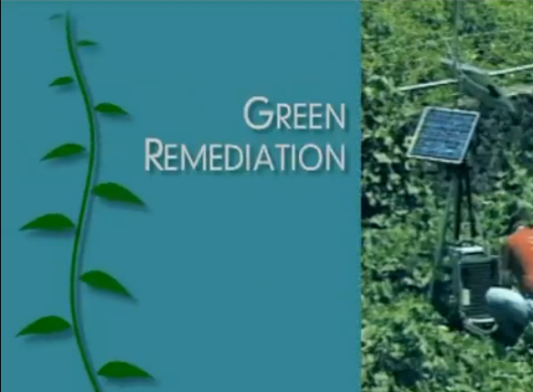
Case Study: Arsenic Remediation in Crozet, Virginia
http://www.youtube.com/watch?v=IabslL-SgqY
earthref.org
Scripps Classroom Connection
Notes:
POINT OF SLIDE:
This slide introduces a video about a case study of phytoremediation being used in Crozet, Virginia.
BULLETED POINTS:
This is a screen shot of a YouTube video about a phytoremediation project in Crozet, Virginia. The video discusses why phytoremediation was chosen, and how the process works at this site.
PICTURE/GRAPHICS CREDITS:
http://www.youtube.com/watch?v=IabslL-SgqY

Slide 8
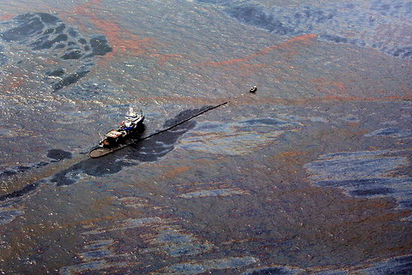
Bioremediation in Oil spills
Naturally occurring bacteria can “eat” oil
  Break down hydrocarbons
  Natural oil seeps
Clean up oil spills
  Deepwater Horizon
  Oil Spill
earthref.org
Scripps Classroom Connection
Notes:
POINT OF SLIDE:
This slide shows how bioremediation can be used in oil spills.
BULLETED POINTS:
Naturally occurring bacteria can degrade oil, and these microbes are found near natural oil seeps on land and in the ocean. Using these bacteria to clean up oil spills has been implemented recently in the Deepwater Horizon oil spill in the Gulf of Mexico, and can be a useful alternative to use in conjunction with dispersants and other physical methods of oil clean-up. This type of remediation only works when the bacteria are able to grow; namely in conditions of lots of nutrients and warm temperatures. There are many unknown consequences of this type of bioremediation however, and there is active research exploring these possibilities. This picture shows the Deepwater Horizon oil spill.
PICTURE/GRAPHICS CREDITS:
http://green.blogs.nytimes.com/2012/01/09/revisiting-the-deepwater-horizon-plumes/?_r=0

Slide 9
Conclusions
Phytoremediation- using plants to clean up pollutants
  Advantages/disadvantages
  Common uses
Bioremediation- using bacteria to clean up pollutants
  Oil spills
earthref.org
Scripps Classroom Connection
Notes:
POINT OF SLIDE:
This slide summarizes what was covered in the lesson.
BULLETED POINTS:
Phytoremediation is a type of bioremediation, where plants are specifically used to clean up harmful pollutants. There are many advantages to this type of remediation, including keeping the environment in its natural state, and it is usually cost-effective. Disadvantages are the possibility of introducing invasive species, and the potential for bioaccumulation. Bioremediation is the general term for using living things to clean up pollutants. Most bioremediation uses bacteria, and the most common form of bioremediation is in oil spills such as the Deepwater Horizon oil spill.
PICTURE/GRAPHICS CREDITS:
none

