Slide 1

The Earth is Alive
Notes:
Title Slide Notes
AUTHORS:
Geoffrey Cromwell (Scripps Institution of Oceanography, La Jolla, CA) and Danny Blas (Lincoln High School, San Diego, CA)
WHY:
The Earth is not just a chunk of rock orbiting the Sun, it is an active, life-giving world full of wondrous features.
SUMMARY:
This lesson asks students to think about the Earth as a living world, not a dead rock. Students define what makes the Earth alive and compare that to indicators that define humans as alive (for instance both humans and the Earth give off heat). Volcanoes are integral to the Earth’s “life cycle”. Students learn several key roles volcanoes play in Earth history and develop a creative advertisement highlighting key facts about volcanoes.
PICTURE/GRAPHICS CREDITS:
Image from http://upload.wikimedia.org/wikipedia/commons/9/97/The_Earth_seen_from_Apollo_17.jpg
CONTEXT FOR USE:
This lesson is the first lesson in a larger Volcano Unit intended for 11th and 12th grade Marine Science students. The lesson following this one is titled “Melting the Earth”. No prior knowledge is necessary for this lesson. It is likely that 11th and 12th grade students will have been exposed to volcanoes at an earlier age, so they should have some prior understanding about volcanoes and Earth processes.
MISCONCEPTIONS:
The Earth is unchanging
Volcanoes are unrelated to plate tectonics and major Earth processes
TEACHING NOTES:
This powerpoint is a description of this lesson plan designed for teachers and is not intended to be a presentation directed towards students.

Slide 2
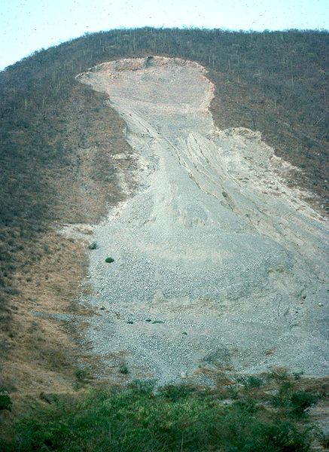
Think/Pair/Share
How do we know the Earth is alive?
Name two indicators that tell you the Earth is active and not just a chunk of rock.
After you list your two indicators, share your answers with a partner
Notes:
Notes:
This slide is the first part of the lesson, a Think/Pair/Share activity. Students will answer the above question on their own and then share their responses with a partner. Following the partner sharing, discuss various responses as a class and build a consensus based on the students’ understanding. Record student responses on a chalk board or poster paper for reference during the remainder of the lesson.
Some answers students might give in response to the question, “How do we know the Earth is alive?”:
Plate tectonics
Creates new crust (spreading centers)
Recycles old crust (subduction)
Volcanoes
Earthquakes
Hurricanes
Storms
Waves
Gives off heat (volcanoes)
Rotation (night and day)
Magnetic field
Answers about weather are OK, but these are minor effects compared to major events like earthquakes and volcanoes. Lead the discussion towards solid earth events.
Image of a landslide in Mexico: http://en.wikipedia.org/wiki/File:Slide-guerrero1.JPG

Slide 3
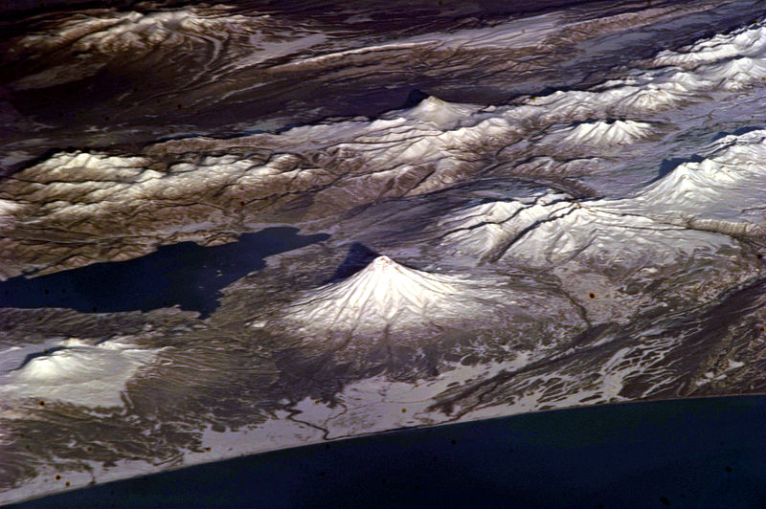
The Importance of Volcanoes
Volcanoes are the primary ways we can see that the Earth is alive
So what do volcanoes do?
1. Cool the earth
2. Allow gas to escape
Notes:
Notes:
This slide details key information about volcanoes that student’s should record in their notebooks. These notes answer the main questions of this lesson: What do volcanoes actually do? What role does volcanism play in Earth’s history?
As part of this presentation, teachers should illustrate that Volcanoes are one of the primary ways we can physically see that the Earth is alive. We can visually record eruptions, both on the Earth’s surface and below the oceans. Volcanoes have a direct impact on thousands of people; they destroy property, take lives and require constant vigilance.
There are two main facts about volcanoes that play a major role in Earth’s history.
1. Primary way the Earth keeps cool- Heat in the earth is released through melting rock in the mantle and rising to the Earth’s surface. Energy is released at volcanoes, maintaining equilibrium between sources of heat (radioactive, initial heat) in Earth’s interior.
2. Degassing-transfer gaseous elements from the Earth’s interior into the atmosphere. Volcanoes are responsible for the formation of the early Earth atmosphere.
In addition to the two main roles of volcanoes, there are several features that also shape the structure of the Earth.
Make new oceanic crust at spreading centers underneath the ocean
Make new mountain ranges. This occurs at subductions zones and the formation of island arcs
Make new fertile soils. Volcanoes release a lot of minerals and nutrients that benefic local soils
Maintain and affect the current atmosphere and climate . For example the 1783 Laki eruption in Iceland caused global cooling.
Above image of volcano field in Kamchatka: http://commons.wikimedia.org/wiki/File:Kamchatka_Volcanoes.JPG

Slide 4
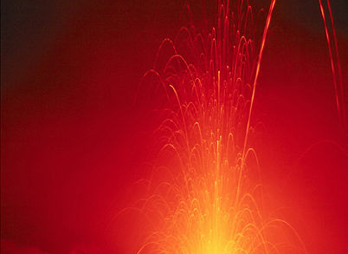
Humans and Planet Earth
Humans and Earth are both “alive”.
Create a T-chart of different indicators showing how humans and Earth are both active systems.
Compare your lists for humans and Earth. Are there any similarities?
Notes:
Notes:
This slide describes a follow-up activity to Think/Pair/Share. Students will create a T-chart (see “Lesson1_T Chart”) listing indicators of how we know humans and Earth are alive. This is obviously not a direct comparison but it will allow students to think creatively and they should find similarities between themselves and Earth processes. Below are some possible responses students might come up with. Students should list as many facts as they can think of. The instructor should guide students as they make their lists, classroom discussion is not necessary but it may be beneficial to record answers from some students to check for understanding.
How we know humans are alive:
Sweat
Breath
Give off heat
Thinking
Move limbs
Sleeping
Running/walking
Eating
Giving off gas (burping, farting)
Shiver
How we know the Earth is alive:
Plate tectonics
Creates new crust
Volcanoes
Earthquakes
Gives off heat
Magnetic field
Mountains
Canyons
Gasses from volcanic eruptions
Image of an eruption of the Stromboli volcano: http://commons.wikimedia.org/wiki/File:Stromboli_Eruption.jpg

Slide 5
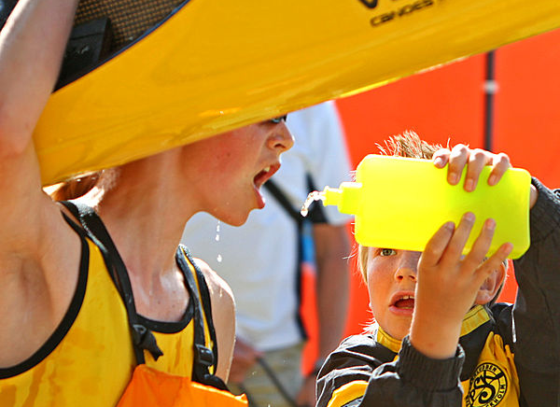
Volcano Advertisement
Design an advertisement for a refreshing, volcano-themed drink
Make up a name for the drink like “Volcano Cooler” or “Lava Splash”.
Tell your customers about all the benefits of volcanoes and how they keep the Earth alive.
Notes:
Notes:
This slide describes the output activity where students demonstrate what they learned about volcanoes in today’s lesson. In this activity, student’s design an advertisement for a volcano-themed sports drink. Students must make up a creative, volcano-themed name for their beverage (like “Volcano Blast”), and include at least four facts about volcanoes and how they relate to Earth’s history (students should use their notes from the previous slide). Students must draw and design a bottle and label for their drink. If there is time, have the students share their advertisements with their classmates and vote on the best ones.
See the accompanying document, “Lesson1_Output-Volcano Drink”, for an example of what students should create in this activity.
Image of a sports drink on a hot day: http://commons.wikimedia.org/wiki/File:Drinking.jpg

Slide 6
Conclusions
Volcanoes are a primary way we can observe that the Earth is alive
Volcanoes:
-Cool the Earth (so it doesn’t explode)
-Release gasses from the Earth’s interior (make the atmosphere)
Other things volcanoes do:
-Make new land
-Build mountain ranges
-Affect the atmosphere and climate
Notes:
Notes:
At the conclusion of the lesson, make sure that students have recorded and understand the main points highlighted in the above slide. Remind students that the Earth is an active system and that volcanoes pay an important role in that activity. Volcanoes play two main roles in the Earth, they allow the Earth to cool and allow gasses to escape from the interior, in effect creating the early Earth’s atmosphere.
Volcanoes also create new land at mid-ocean ridges, build mountains at subduction zones and affect the atmosphere and climate by releasing gasses and ash.
While there are other signs the Earth is alive (like earthquakes), volcanoes are the most visible.
The volcano-themed drink advertisement will allow students to demonstrate their knowledge about the key points about volcanoes and Earth’s history.

