Slide 1
Melting the Earth
Notes:
AUTHORS:
Geoffrey Cromwell (Scripps Institution of Oceanography, La Jolla, CA) and Danny Blas (Lincoln High School, San Diego, CA)
WHY:
Volcanoes erupt lava that was once solid rock. Melt forms deep in the Earth through two processes; 1) decompression melting and 2) flux-melting. Rocks DO NOT melt not simply by high temperatures, even though this is the most apparent idea.
SUMMARY:
In this lesson student’s will learn that melt forms deep in the Earth through depressurization and the addition of volatile compounds (flux melting). Students will understand that rocks don’t melt in the Earth because of high temperatures. Students will think about the question in a Think/Pair/Share activity to start the class, followed by a brief powerpoint presentation explaining the key facts about rocks and how they melt. At the end of class, student’s will demonstrate what they learned in a synthesis activity based on their notes.
CONTEXT FOR USE:
This lesson is the second lesson in a larger Volcano Unit intended for 11th and 12th grade Marine Science students. The previous lesson is titled “The Earth is Alive”, the following lesson in this Unit is titled “Volcanic Eruptions”. Student’s require some knowledge about plate tectonics prior to the Volcano Unit. This lesson builds on information presented in “The Earth is Alive”.
MISCONCEPTIONS:
Rocks melt because they are hot
The Earth’s mantle is made of molten rock
Volcanoes are randomly distributed on the Earth
All rocks melt the same way

Slide 2

Definitions
Melt
The earth’s interior is so hot that it can happen that solid rock melts into a liquid forming pockets within the rock.
Volatiles
Under high pressure, gasses can be included in rocks, melts or minerals
e.g., water, carbon dioxide
Notes:
Notes:
Introduce the student’s to two key words, Melt and Volatiles. These terms are likely new to the students and they should be familiar with the geologic meaning of these terms. Students should record these definitions and refer to them throughout the unit.
Melt: Pockets of molten rock in the Earth’s interior. Melt forms from solid rock deep in the Earth’s mantle. Melt rises to the surface of the Earth and eventually is erupted as lava or cools near the surface as the core of mountain ranges.
Volatiles: Gasses (e.g., water vapor, carbon dioxide). Volatiles are gasses that lower the melting temperature of solids they come in contact with through chemical reactions.

Slide 3
How do rocks melt?
Three possibilities:
Direct heating
Depressurization
Flux melting
1
Notes:
Notes:
There are three likely ways that rocks can melt: Direct Heating (very high temperatures causing melt), Depressurization (decreasing overlying pressure, allowing molecular bonds to change phase from solid to liquid), and Flux Melting (adding volatiles to a system, causing melting temperatures to decrease).
Explain to students that that Direct Heating is NOT the primary way that rocks melt in the Earth. While high temperatures play a role, other factors must be present for melt to form. Depressurization and Flux melting are the primary ways that melt forms in the Earth.

Slide 4
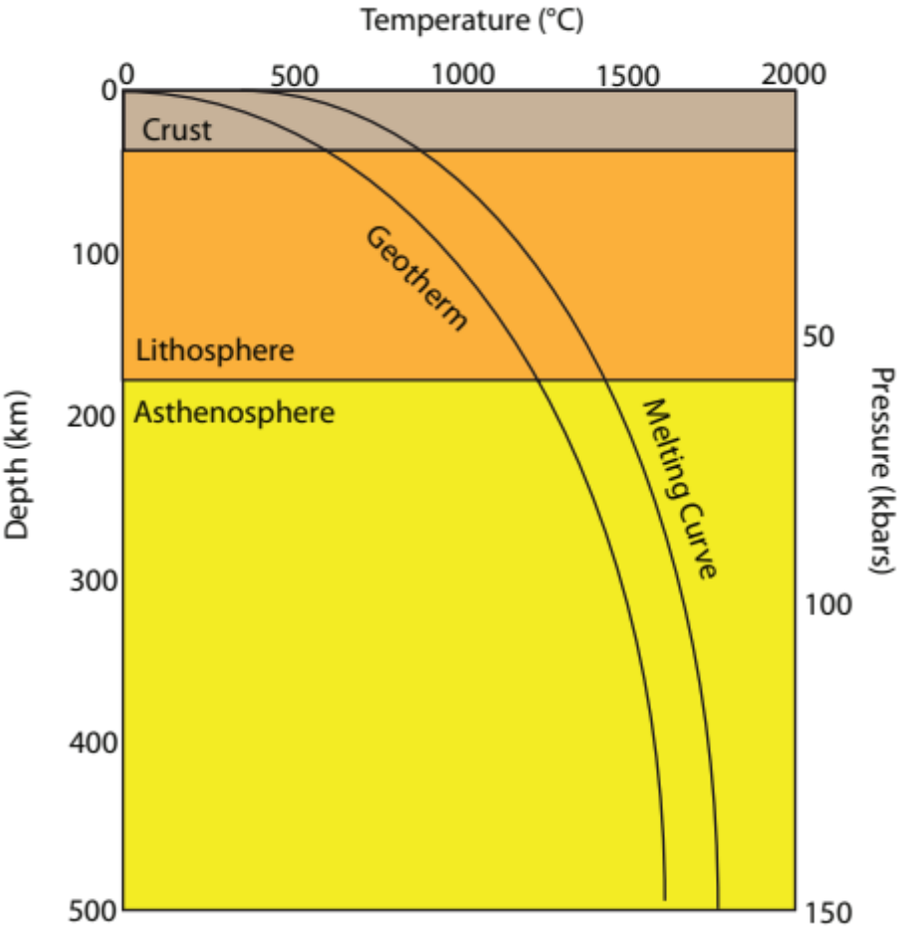
Direct Heating - Doesn’t Work!
Rocks melt at temperatures described by the Melting Curve
The interior of the Earth only reaches temperatures of the Geotherm
Earth’s Geotherm is not hot enough to melt rocks!
Notes:
Notes:
Direct heating is the equivalent of heating a rock with a blow torch or putting a rock in an oven. Lavas erupt from volcanoes at temperatures exceeding 1000° C, but this is at the earth’s surface where pressure equals 1 atm. The deep Earth easily reaches these temperatures, so one might expect melt to form once you go deep enough. However, the farther away you get from the Earth’s surface, pressure increases from all the overlying rock. As we know from physics and chemistry, higher pressures prevent materials from changing phase (i.e. from solid to liquid) without also increasing temperature.
At any given depth, the geotherm of the earth is cooler than the melting curve. So although, the Earth’s interior can reach very high temperatures, the interaction between temperature, pressure and depth prevents melting strictly by temperature. There must be other effects going on that essentially allow the geotherm to equal the melting curve.
Cartoon:
The cartoon on this slide shows a typical geothermal gradient of the Earth (change in temperature with depth) and a typical melting curve of mantle rock (in this case peridotite). It is important that students copy the cartoon in their notes. Note that all depths and curves are approximate and are designed to show general characteristics.
The left axis is depth in kilometers, with 0 being at the Earth’s surface. The top axis is temperature in degrees Celcius, 0 on this axis is also at the Earth’s surface. The third axis, on the right side, is pressure in kilobars, 0 kbar is at the Earth’s surface.
First explain the geotherm to the students in terms of depth and temperature. As you move from the Earth’s surface (0 km, 0 C) down the curve, you are going deeper into the Earth and the temperature gets hotter. Point out that pressure and depth are directly related, the deeper you go the higher the pressure gets. The geotherm traces the temperature and pressure conditions of the Earth with depth.
Now trace the melting curve with the students. The melting curve marks the conditions within the Earth that are necessary for mantle rock to turn from solid to liquid. Notice that at every depth, the melting curve is at higher temperatures than the geotherm, meaning that the Earth is never hot enough at any one depth to cause peridotite to melt. We know that rocks DO melt in the Earth, but clearly temperature alone can’t be the reason.
Cartoon is by Geoff Cromwell.

Slide 5
Depressurization Melting
Decrease pressure
Melting conditions change at a given location
Rocks can now melt where they used to be solid
2
Notes:
Notes:
This slide outlines the process of depressurization melting and how it allows melt to form in the Earth.
Students should record these steps and refer to them in the following slides.

Slide 6

1. Lower Pressure
Changes in density can cause a material to rise or sink within a system
Hot rock is less dense than cold rock
The hotter rock will rise in the mantle, even though it is still solid.
This is an example video of this effect
Notes:
Notes:
The video on this slide shows the effect of heat and density on a material. Hot water and cold water are placed in a tank with ambient temperature. The hot water, dyed red, rises to the surface, while the cold water (dyed blue) stays on the bottom of the tank. This is a similar relationship to changes in temperature in the Earth’s interior. Pockets of hot mantle rock will rise as they become less dense, which in turn lowers the overlying pressure and allows that pocket of rock to expand and rise even more.
It is important to distinguish the liquid water in the video with the solid rock in the Earth’s mantle. The rock in the mantle is not a liquid.
The video is from youtube: https://www.youtube.com/watch?v=_Ww6BIy3nc0

Slide 7

1. Depressurization Melting
Reduced Pressure
Geotherm essentially moves up
Crosses the melting curve
Rocks can melt where they couldn’t before
Notes:
Notes:
This shows the end result of depressurization melting in terms of the geotherm and melting curve of the Earth. Decreasing pressure in a specific area means that at a given depth, the pressure is lower, essentially raising the geotherm curve at that location and allowing it to cross the melting curve. Under the new conditions, lower pressure, rocks will melt at that location where they originally would not.

Slide 8
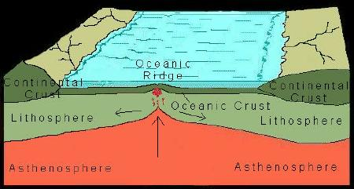
1. Depressurization – Spreading Centers
Spreading Centers
Plates move away from each other
Space opens up between the plates
Underlying mantle rises up to surface
Notes:
Notes:
This slide highlights one example of depressurization melting that occurs at spreading centers.
At spreading centers the overlying crust thins as two plates move away from each other and eventually separate. The separation between the two plates creates a gap, reducing pressure on the underlying mantle, which allows the mantle rock to melt rise up to the surface. The now melted rock erupts along the spreading center, replacing the material that was once there.
Image from : http://www.utexas.edu/tmm/npl/mineralogy/blowups/oceanicridge.jpg

Slide 9
Flux Melting
Occurs at subduction zones
Gasses and fluids mix with mantle
Lower melting temperature
Rocks melt at lower temperatures
3
Notes:
Notes:
This slide outlines the process of flux melting and how it allows melt to form in the Earth.
Students should record these steps and refer to them in the following slides.

Slide 10
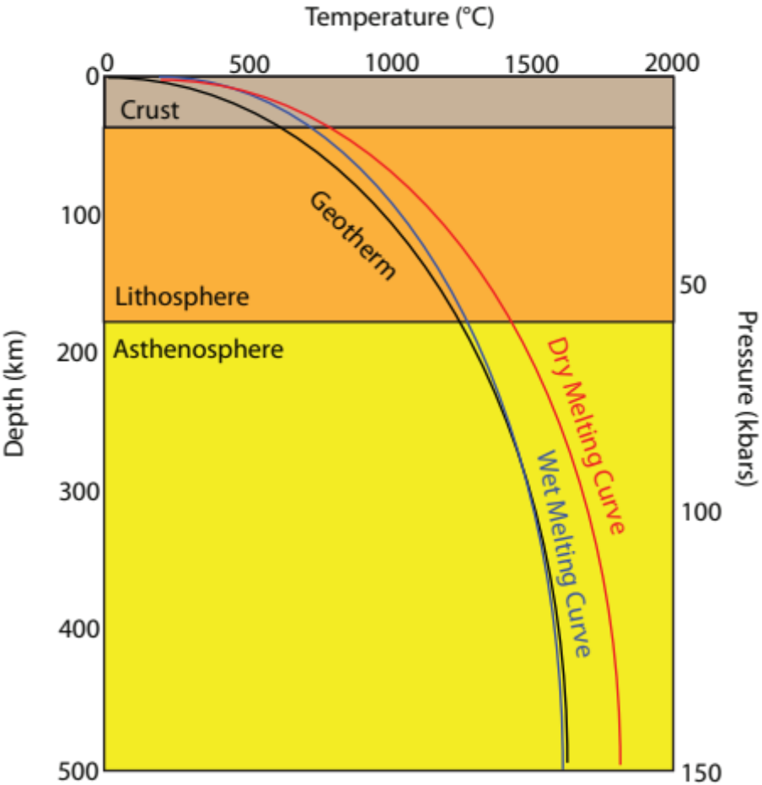
2. Flux Melting
Volatiles lower the melting temperature of the mantle rock
Solid rock able to melt at current temperatures
Does not require additional heat
Notes:
Notes:
Volatiles cause the melting temperature of the solid mantle rock to decrease, meaning that the rocks will melt at their current temperatures where before they would have remained in a solid state. The “Dry” melting curve reflects the melting curve of mantle rock without volatiles. The “Wet” curve is for those mantle rocks that have been combined with gasses and liquids. The Wet Melting Curve has shifted to cooler temperatures and crosses the geotherm for that specific location, while the Dry Curve continues to require higher temperatures. No additional heat has been added to the this system, the only change has been the addition of volatiles to the mantle rock.
One example of flux melting with an everyday object is adding salt to ice cubes. The salt acts as a volatile and slightly lowers the melting temperature of the ice, allowing the ice cube to melt at a lower temperature.
Cartoon by: Geoff Cromwell

Slide 11
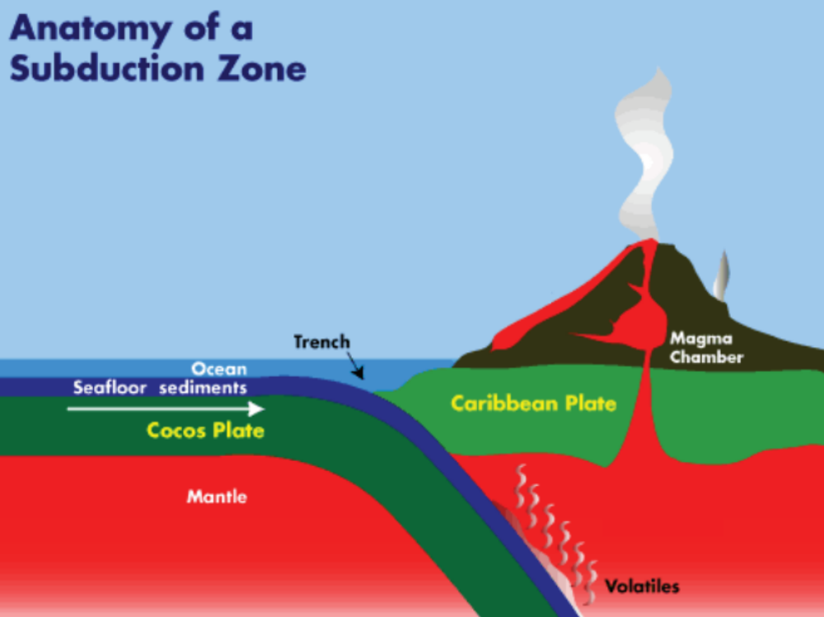
1. Subduction
Oceanic plate subducts into the mantle
Subducting plate heats up, volatiles are expelled and rise up
Volatiles (water vapor, carbon dioxide) interact with overlying mantle
Notes:
Notes:
The image on this slide illustrates subduction between the Cocos plate and the Caribbean Plate and will explain the process where volatiles get added to a mantle system.
The Cocos plate, on the left, subducts beneath the Caribbean plate and carries with it seafloor sediments and oceanic crust. The subducting Cocos plate contains cold sediments and oceanic crust saturated with water from millions of years under the sea. The saturated Cocos plate is heated from the top down by the overlying mantle wedge. During this heating process, volatiles (e.g., water vapor, carbon dioxide) are released from the sediments and mix into the surrounding hot mantle, lowering the melting temperature of those mantle rocks. The resulting pockets of melt rise to the surface where they are erupted as lava from volcanoes. Subduction zones generate many of the world’s volcanoes through this process. Also in this image is the magma chamber, where the molten rock is stored before erupting. The trench forms where the subducting and overriding plates collide.
Subduction zones, and flux-melting, are responsible for creating many of the world’s stratovolcanoes. The addition of volatiles to the mantle, and then the erupting magma, creates chemical conditions conducive to large scale, violent eruptions. We will talk more about stratovolcanoes and the role volatiles play in the following lessons.
Above image modified from: http://sio.ucsd.edu/volcano/about/subduction.html

Slide 12
Conclusions
Two ways rocks melt in the Earth
1. Depressurization Melting
- Lower pressure at a given depth
-Geotherm changes, allows melt to form
2. Flux Melting
-Volatiles (e.g., gas) added to mantle
-Lowers melting temperature, Melting curve shifts
3. …NOT by direct heating!!
-High temperatures don’t mean rocks melt
Notes:
Notes:
This conclusion slide illustrates the main points of this brief powerpoint presentation. Melt (molten rock) in the Earth is generated by Depressurization melting and Flux melting. Direct heating is not the primary cause of melt because of the unique conditions in the Earth’s interior. The geotherm and melting curves for a normal system do not cross, and melt will not be able to form. By lowering pressure (depressurization) or decreasing the melting temperature (adding volatiles), the conditions inside the Earth change and essentially shift the geotherm and melting curves until they cross, and allow melt to form.
Following this presentation there is a summary activity based on student notes from this powerpoint. The activity is titled “Lesson2_activity_strips”.

