Slide 1
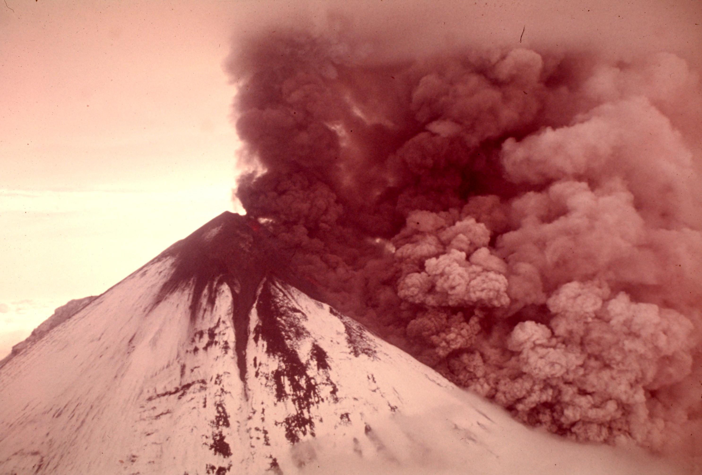
Volcanic Eruptions and Lava Flows
Notes:
AUTHORS: Geoffrey Cromwell (Scripps Institution of Oceanography, La Jolla, CA) and Danny Blas (Lincoln High School, San Diego, CA)
WHY: Different volcano types can be defined by their magma composition. Here we explore how magma viscosity influences volcano shape and the type of lava that is erupted.
SUMMARY:
An introduction to two different types of volcanoes, stratovolcano and shield volcano, and some of the differences between them. This lesson explores how different types of magmas influence volcano shape and the types of lava that is extruded. Students will watch two short videos explaining the difference between pahoehoe and aa lavas.
PICTURE/GRAPHICS CREDITS: Image from http://upload.wikimedia.org/wikipedia/commons/e/ee/1975_Pavlof_volcano_eruption,_Alaska_(1182883978).jpg
There are four videos used in this lesson, from youtube.com and personal videos created by Danny Blas and Geoff Cromwell
Aa_Lava.mv4 and Pahoehoe_Lava.mv4 are from D.B and G.C.
Flowing_aa.mp4 is from http://www.youtube.com/watch?v=iyIV5fd1Aww
Flowing_pahoehoe.mp4 is from http://www.youtube.com/watch?v=6J6X9PsAR5w
CONTEXT FOR USE: This lesson is the third lesson in a larger Volcano Unit intended for 11th and 12th grade Marine Science students. This lesson builds on information presented in the preceding lesson, “Melting the Earth”.
MISCONCEPTIONS:
All volcanoes have the same type of lava

Slide 2
Introduction
Shield and stratovolcanoes
Explosive and non-explosive eruptions
Magma Viscosity
Volcano shape and explosivity

Slide 3
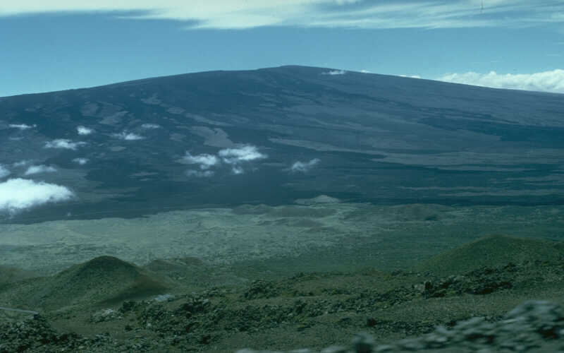
Mauna Loa
Shield volcano
Hotspots
Low viscosity magma
Less explosive
Notes:
Notes:
Shield volcanoes, like Mauna Loa in Hawaii, are often found at hotspots and have large magma supplies. Hotspot volcanoes can form anywhere on Earth and aren’t constrained by plate tectonics. Shield volcanoes generally have low viscosity magmas, and as a result generally have less explosive eruptions. The lavas that erupts at shield volcanoes are usually dark in color and called basalt.
It is important to note that the lavas erupted from shield volcanoes can be low viscosity, called pahoehoe, or high viscosity, called aa. Viscosity is dependent on temperature and a hot, low-viscosity pahoehoe flow may cool down away from the vent and turn into a slow moving, viscous aa flow.
The upper image is of Mauna Loa and is from http://volcanoes.usgs.gov/Imgs/Jpg/Photoglossary/shieldvolcano1_large.jpg

Slide 4
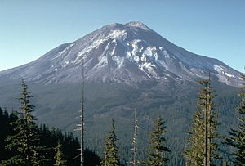
Mt. St. Helens
Stratovolcano
Subduction zones
High viscosity magma
More explosive
Volcaniclastics
Notes:
Notes:
Stratovolcanoes, like Mt. St Helens above, are generally found at subduction zones, where an oceanic plate dives under another oceanic or continental plate. Volcanoes at subduction zones are found in volcanic arcs or island arcs. Stratovolcanoes are generally very explosive due to their highly viscous magmas, which usually have different chemical composition than shield volcano magmas. The lavas that erupt from stratovolcanoes are often lighter in color and called rhyolite or andesite.
Stratovolcanoes generally erupt viscous lavas of rhyolite and andesite in smaller quantities than the lavas from shield volcanoes.
One of the key differences between stratovolcano eruptions and shield volcano eruptions is that stratovolcanoes generally eject large quantities of volcaniclastic material. Volcaniclastics range in size from small bits of ash, to large boulders and house-sized rocks called “bombs”. Volcaniclastics can be thrown miles away from the volcano, and for small particles like ash, all the way up to the stratosphere and around the globe.
The image of Mt. St. Helens is from: http://en.wikipedia.org/wiki/File:Sthelens1.jpg

Slide 5
Viscosity
Resistance to flow
High viscosity-flows slowly
-honey, syrup
Low viscosity-flows easily
-water, milk
http://www.youtube.com/watch?v=vNzTYzjLgKE
Notes:
This slide is a brief introduction about the viscosity of liquids. The purpose is to remind students (who have likely learned about viscosity at some point) that viscosity of a liquid represents its resistance to flow. A high viscosity liquid, like honey or syrup, will flow slower and appear thicker. A low viscosity liquid, like water, flows faster with less resistance.
The short youtube video demonstrates the differences between a high and low viscosity liquids, and should give students a general idea of how magmas in shield and stratovolcanoes differ. Viscosity can be affected by temperature as well as chemical composition. In the next lesson, we will go into greater detail about viscosity and explosivity.

Slide 6
Volcano Shape
Sketch the general shape of each volcano
Describe each volcano in terms of shape and explosivity
Shield Volcano
Stratovolcano
Notes:
Notes:
This slide asks students to synthesize what they learned in the last two slides. Students should sketch each type of volcano in their notes and describe the general shape in a sentence or two. In the last two slides the students learned that shield volcanoes are generally less explosive, while stratovolcanoes are more explosive due to differences in their magma viscosity and chemistry. It is important to note that they shouldn’t be comparing apparent elevation differences between the two pictured volcanoes. Some shield volcanoes are actually the largest volcanoes on Earth. What’s important is the shape of the volcano, not how tall it appears to be.
The connection students should make in their volcano descriptions should be something like the following:
Shield volcanoes have very gentle slopes, and look like a soldier’s shield lying on the ground. A volcano of this shape is likely to be less explosive
Stratovolcanoes have gentle sides at the base, but steep sides towards the crater. Stratovolcanoes have a “classic volcano shape”. Volcanoes that look like this are likely to be explosive.

Slide 7
Conclusions
Shield volcanoes
- Gentle sides
-Less explosive
Stratovolcanoes
-Steep sides (classic volcano look)
-Explosive
Notes:
Notes:
Conclude with this slide that sums up the key points in this brief presentation and activity. Stratovolcanoe are steep sided and explosive, with high viscosity magmas. Shield volcanoes have shallow sloping sides and are generally effusive (non explosive). Shield volcanoes generally have low viscosity magmas. Stratovolcanoes and shield volcanoes come from different tectonic regimes. Stratovolcanoes are found in subduction zones at plate boundaries, while stratovolcanoes often occur at hotspots.

Slide 8
Lava Flow Activity
Divide students into small groups
Watch short videos about aa and pahoehoe lava flows (4 videos total)
Answer questions about each video as a group
Notes:
This slide is for teacher reference only. The first part of the lesson focused on explosive eruptions and the connection between explosivity and magma viscosity and volcano shape. This next part is a group activity looking at lava flows and how they are affected by viscosity.
There are four videos about lava flows on Hawaii, two each for aa and pahoehoe lavas.
Aa: the two videos are titled “Aa Lava” and “Flowing aa”. Aa is a high viscosity lava and flows very slowly and has a jagged, mound-like structure. Aa cools in spires and built-up walls of rock. Listen to the distinctive sound the aa makes as it flows, the cooled lava breaks off and sounds like glass as it falls and moves around.
Pahoehoe: The two videos are titled “Pahoehoe Lava” and “Flowing pahoehoe”. Pahoehoe has a much lower viscosity than aa, and flows like a river. When it cools, pahoehoe forms a glassy, ropey skin and you can see flow structures.
“Aa Lava” and “Pahoehoe Lava” were taken on the Big Island of Hawaii during a field trip in September 2012. The videos describe cooled pahoehoe and aa lava flows and some of the differences between them. The other two “Flowing” videos are from youtube.com and show active lava flows.
This activity is designed as an independent or group learning activity where students watch the videos (using classroom computers) and answer the questions at their own pace. The videos could also be shown to the entire class at the same time. Student activity directions and questions about the videos are in the document, “Lesson3_Video Questions”.

