Slide 1
Volcano Demonstration
A Garbage Can Volcano
Notes:
AUTHORS: Geoffrey Cromwell (Scripps Institution of Oceanography, La Jolla, CA) and Danny Blas (Lincoln High School, San Diego, CA)
WHY: Most people will never witness an actual volcanic eruption in their lifetime. In this lesson you can watch a volcano explode, a garbage can volcano! Using liquid nitrogen, a soda bottle and a trash can, this lesson will simulate a stratovolcano eruption.
SUMMARY:
Students will learn about the demonstration and will make predictions about various components of the eruption. Following initial predictions in the classroom, students will go outside to witness two garbage can eruptions and evaluate the outcomes of their predictions. Back in the classroom, students will write-up a synthesis of the garbage can eruption and compare the demonstration to an actual stratovolcano eruption.
WEBSITES USED IN THIS PRESENTATION:
http://classes.colgate.edu/kharpp/Depth_Charge/default.htm
ADDITIONAL READING:
http://classes.colgate.edu/kharpp/Depth_Charge/default.htm
CONTEXT FOR USE:
This lesson is designed for a 11th and 12th grade Marine Science class with 55-minute class periods. This lesson is the sixth lesson in a larger volcano unit. The preceeding lesson is titled “Explosive Kilauea”. The lesson following this one is titled “Volcano Map”
MISCONCEPTIONS:
Liquid nitrogen only keeps things cold
Fire or heat is necessary for an explosion

Slide 2
Demonstration Outline
This lesson is split into three parts, and can take place during a single 55 minute class period
Inside the classroom, describe the experiment and make predictions
Outside, erupt the volcano!
Wrap-up and discuss back in the classroom

Slide 3
1. Inside the Classroom
Go over the purpose of the demonstration (“Lesson6_Volcano Instructions”)
Review each step and explain the function of each component
Watch the sample video (“VolcanoDemo.MOV”)
Notes:
Notes:
Use the instructions document, “Lesson6_Volcano Instructions”, as a reference for this section
Explain the demonstration, detailing each step, all the components used (i.e. bricks) and what the purpose of each step is (i.e. bricks, to hold the bottle down, otherwise it will float). Refer to the instructions on the Colgate University website for a thorough review of the demonstration.
Watch the accompanying video showing an example demonstration “VolcanoDemo.MOV”, as well as some of the youtube.com videos listed on the instruction sheet. The VolcanoDemo.MOV is actual footage from our classroom demonstration. While showing the video, ask students to make notes on what they see, and how the eruptions in each video are similar or different from each other.

Slide 4
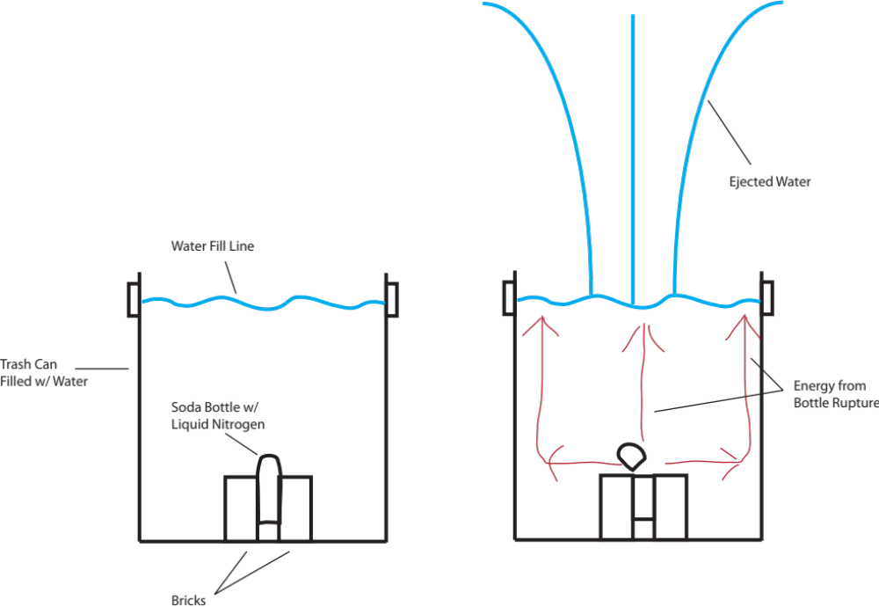
Demonstration Diagram
Notes:
This is a diagram showing the general set-up of the garbage can volcano. Show this diagram to the students so that they can get a better idea of the set-up and some of the dynamics of what will happen during the demonstration. Note, this is not drawn to scale, but is a close approximation.
The drawing on the left shows the garbage can filled about 70-80% with water (again, not to scale). The soda bottle, having been filled half-way with liquid nitrogen and the cap securely tightened, is duct-taped to two bricks and placed at the bottom of the trash can. After tightening the bottle cap, the instructor will place the brick/bottle combination at the center of the trash can as quickly as possible. It will take about 5-10 seconds for the bottle to erupt.
Once the cap is tightened, the liquid nitrogen will begin evaporating into gas and fill the bottle. The liquid will keep evaporating, and building up pressure inside the bottle, until the bottle eventually erupts. The bottle will usually erupt at its weakest point, often at the cap and sometimes along the side.
The drawing on the right shows the effects of liquid nitrogen eruption immediately after the bottle ruptures. The bottle ruptures somewhere near the top of the bottle (not always), and the energy from the explosion radiates outwards in all directions. The red arrows show the direction the energy travels. Some of the energy goes straight upwards, but most of it radiates outwards, interacting with the garbage can wall where it is deflected upward to the opening. If a garbage can has a weakness or corrosion on the sides, the can may break from the energy.
All the energy eventually gets deflected upwards, ejecting the water out of the garbage can and into the air.

Slide 5
1. Inside the Classroom
Students make predictions about the demonstration and answer questions about what the garbage can volcano (see below)
Students will address their predictions following the demonstration
Notes:
Have students answer the following questions about the processes of the garbage can volcano and what the students might see during their own demonstration (answers in parentheses).
Review student answers as a class and record the responses. Following the demonstration, students will look over their predictions and adjust their responses based on what they observe.
How does the garbage can volcano get energy for the eruption? (From the pressure of expanding nitrogen gas that builds up in the soda bottle)
Will the eruption occur in a quick, single event? Or will the garbage can volcano produce several eruptions? (Single event)
Based on the above answers, what type of volcano does the garbage can volcano represent? (Stratovolcano)
Before volcanic eruptions occur, scientists often detect earthquakes and degassing from the volcano. Scientists use this information to predict when
a volcano might erupt. What evidence should you look for to predict when the garbage can volcano will erupt? (Reasonable responses might be: bubbles prior to eruption, some noise or sound)
Will you be able to predict exactly when it will erupt? Why or why not? (Answers will vary, but, like scientists, students will not be able to accurately predict when the eruption will occur. Scientists only recognize signs that an eruptions is likely to happen)
Do you expect the eruption to go straight up or to the side? Why? (straight up. Based on the diagram of the demonstration, the garbage can walls will direct the energy upwards).
If the eruption did go to the side, what might have happened to the garbage can to allow this? (there might be a weakness in the garbage can walls, allowing the energy from the gas to blow out the side instead of the top)
What effect might wind have on the eruption of the garbage can volcano? (none, the eruption will occur regardless of what the wind is doing)
What about the projectiles (e.g., ping pong balls), will they be affected by the wind? (Prevalent winds play a significant role in volcanic eruptions. Winds can affect the direction of volcanic as and other small volcaniclastic debris)

Slide 6
2. Outside
Gather the students around the garbage can and review safety procedures
Set up the demonstration, talking students through each step
Following the initial eruption, discuss observations
Do more than one eruption if time allows
Notes:
Direct students to an open area of the school and set up demonstration. You will want an open space (at least 50 ft) with easy access to a water hose. Have the students circle around the garbage can, keeping a distance of 15-20 ft from the volcano.
As you prepare the eruption, walk the students through each step, especially safety instructions and cautions because of the liquid nitrogen and the potential for flying debris. It would be beneficial to have one or two students record the eruption for the class.
Perform the eruption at least two times if time allows. After each eruption, allow the students the students to help you set up the next eruption and discuss the predictions the students made. Before the next eruption, ask students if they expect the second demonstration to differ from the first and have them predict how long the second demonstration will take before it erupts. This is important so student’s can see that even with the same methodology, each eruption is likely to be different (highlighting the unpredictable nature of volcanoes!)
Following the demonstrations, have the students help clean up and direct them back to the classroom.

Slide 7
3. Back in the Classroom
Record class observations about each eruption performed outside
-e.g., sound, height reached, wind effects
Differences and similarities with natural volcanic eruptions
Address student predictions
Notes:
Back in the classroom, students will discuss their observations and address the predictions they made prior to the garbage can volcano demonstrations.
To begin, ask the students as a class to recall details about each eruption they witnessed. Ask students about the height of each eruption, the sound, how long it took each eruption to blow (from initial placement of the bottle in the garbage can), wind direction, distance of water spray, direction of ping pong balls, and anything else students can think of. The purpose of this is to compare two different demonstrations, that presumably had the same initial parameters, and to show that in variables are a natural occurrence. Even though you as the instructor did everything exactly the same (within human error), there are enough variables involved in the controlled garbage can eruption that affected the outcome. Ask students to imagine how eruptions will differ out in nature!
After discussing observations as a class, have the students review their predictions and make any adjustments they see necessary. It would be good at this point to give the the students the correct answers after they make changes on their own.

Slide 8
Garbage Can Volcano Conclusion
The garbage can volcano is a gas-driven eruption
-Like a stratovolcano
Volcano erupts in a single, destructive event
No eruption is 100% predictable, even under controlled conditions
Notes:
The garbage can volcano demonstration illustrates the effects of a gas-driven eruption. This type of volcanic eruption is very similar to that of a stratovolcano where pressure is the major source of energy for the eruption. The garbage can acts as the rock structure of the volcano and the soda-bottle with liquid nitrogen is the magma chamber. Like most stratovolcano eruptions, the garbage can volcano erupts in a single, explosive event. This is different from some shield volcanoes, and other effusive eruptions (like at Kilauea on the Big Island of Hawaii), where there can be near-continuous eruptions for days, years, and even decades.
The main takeaway from the post-demonstration wrap-up is that volcanic eruptions are inherently unpredictable. The descriptions about each eruption should be at least somewhat different, even though the recipe for each demonstration was the same. Scientists can often predict that an eruption is likely to happen, but the exact type, timing and scale of a volcanic eruption are unknown. The unpredictability of the garbage can
This unpredictability highlights the danger of living near volcanoes.

