Slide 1
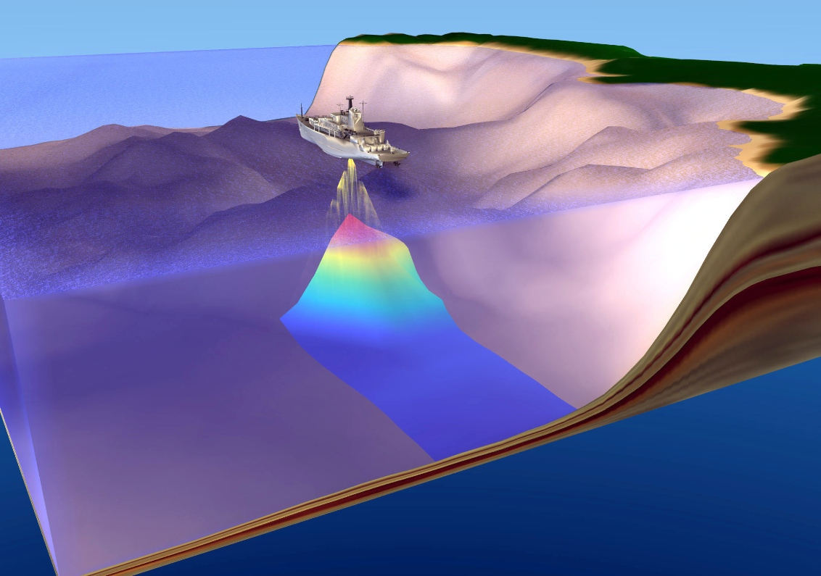
Using Sound in the Ocean
Notes:
AUTHORS: Eric Orenstein – Scripps Institution of Oceanography, University of California – San Diego
Susan Hooker – University City High School, San Diego Unified School District
WHY: Sound travels faster and more efficiently in water than in air. This allows animals like whales and dolphins to communicate and eat. Likewise, humans have been able to use these same properties to study those organisms. Scientists and engineers have further leveraged these properties to find fish, track submarines, locate the epicenter of earthquakes, and more. These technologies and the data they produce are used widely outside of the oceanographic community.
SUMMARY: This presentation will cover the physics of the SOFAR channel by modeling it as a waveguide. Students will understand:
that sound speed is a function of the material through which it is propagating.
in the ocean, the sound speed is a function of salinity, temperature, and pressure.
sound refracts as it propagates within the SOFAR channel.
simple physics equations like v = d/t can be used to make reasonable estimates of distance in the ocean.
PICTURE/GRAPHICS CREDITS: http://www.siosearch.org/?p=81
WEBSITES USED IN THIS PRESENTATION: See slides
ADDITIONAL READING: See slides
CONTEXT FOR USE: This lesson was designed for use in an Advanced Physics class for 10th and 11th graders who have already been introduced to the basic anatomy and properties of waves. Lesson 3 of Brianne Moskovitz’s waves unit (http://earthref.org/ERDA/1503/) provides a good introduction. A strong understanding of algebra is necessary to complete the associated group activity.
MISCONCEPTIONS:
A higher sound speed means the acoustic signal propagates more efficiently.
Sound travels more efficiently in air than in water because molecules have more room to oscillate (or “wiggle” as one student put it).
Waves carry matter not energy (this is something that is reiterated in all following lessons).
EVALUATION TIPS: The companion activity to this presentation has students research an underwater acoustic technology of their choice and write a word problem. The finished products can be assembled and assigned as homework or a group project. Students can be evaluated based on the quality of their problems and their ability to complete the set. These points are expanded upon in the teacher version of the activity handout.
TEACHING NOTES: Students in my class were generally comfortable with the simple algebra needed to write the problems. They had a little difficulty with choosing numbers to make the units physically reasonable.

Slide 2
Warm up:
Please answer the following questions:
What kind of wave is sound?
How does it propagate?
What governs the speed of sound?
Does sound travel faster in air or water?
Notes:
TEACHER NOTES: This activity was framed as think-pair-share. The students should know the answers to these questions, but may need to have their memory jogged. I found that the students were able to answer these questions pretty well with a little encouragement and explanation.
ANSWERS:
Sound is a longitudinal pressure wave. Students in my class had done a classroom activity where different kinds of waves were illustrated with a slinky. Many of the groups explained the motion of a longitudinal wave with a slinky coil analogy.
Sound propagates by vibrating particles in the medium through which it is traveling. A specific example or demonstration helps here. For example, when a bell is rung is vibrates. As it moves back and forth, it pushes air particles. The result is an area of air near the bell with a changing amount of air particles. As the particles collide and more away from the bell, they set other air particles in motion. The result is an oscillating pressure field moving way from the bell.
Again, the slinky analogy worked well here. Describing a bunched up group of coils as an area of high pressure helped the students visualize what is going on. One of the animations in the websites below may help, too.
Sound speed is a property of the material through which the signal is traveling. In the ocean, sound speed is a function of salinity, temperature, and pressure. This point will be expanded upon in the discussion of sound speed profiles.
Sound propagates 5 times faster in water. Sound speed in air is about 340 m/s while in seawater it is 1500 m/s.
WEBSITES: For additional information and animation:
- For sound propagation check out: http://auditoryneuroscience.com/acoustics/sound_propagation
- More on sound: http://www.physicsclassroom.com/Class/sound/u11l1a.cfm
- More on sound (with a good animation): http://dev.physicslab.org/Document.aspx?doctype=3&filename=WavesSound_IntroSound.xml
- HTML based frequency generator: https://github.com/geodynamics-liberation-front/frequency-generator

Slide 3
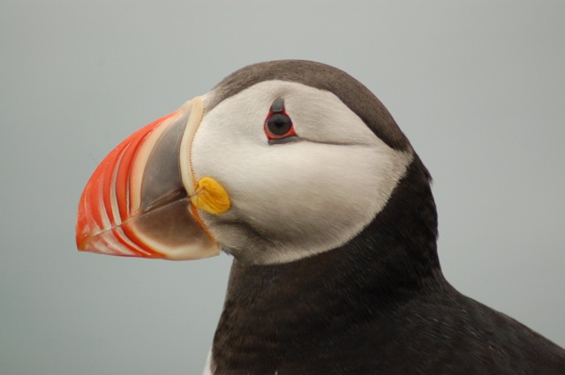
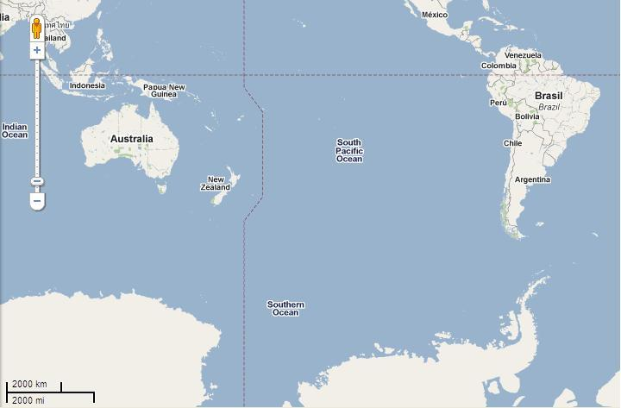
Sound travels faster in water. . . so what?
How long would it take a signal to travel from the coast of Chile to the east coast of Australia? Assume:
The sound speed in the water is 1500 m/s
The distance to be traveled is 12000 km
Notes:
SOLUTION:
c = d/t
1500 m/s = 12000 km / t
1500 m/s = 12000000 m /t
(1500 m/s)*t = 12000000 m
t = (12000000 m)/(15000 m/s)
t = 8000 sec = 134 min = 2.25 hours
For comparison, a commercial flight from Santiago, Chile to Sydney, Australia takes about 14 hours non-stop. Sound is fast in water!
TEACHER NOTE: This was done with the entire class. Rather then using this image in Powerpoint, I actually pointed at the large world map in the room. I made a show of estimating the distance between Chile and Australia using the legend. I did the math on the board, emphasizing the conversion of kilometers to meters.
PICTURE CREDIT: maps.google.com

Slide 4
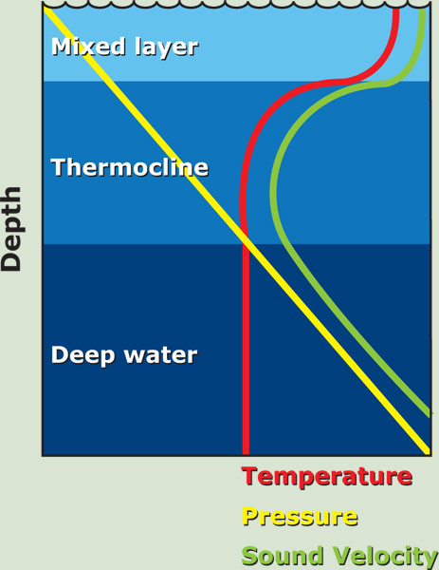
SOund Fixing and Ranging (SOFAR) Channel
Notes:
TEACHER NOTES:
Sound speed in seawater is a function of the temperature, pressure, and salinity of the water. The sound speed gets higher in warmer water because the water particles can bounce off each other more quickly (they have more kinetic energy). Likewise, the sound speed gets higher when the pressure goes up because the particles get closer together and do not have to move as far to propagate a signal. This means there is an area of minimum sound speed.
In the diagram, the red line is temperature, the yellow line is pressure, and the green line is sound speed. In the mixed layer, the sun heats surface waters causing the temperature maximum. Temperature declines sharply below the mixed layer in the thermocline. Below the thermocline, the temperature is constant. The pressure increases linearly with depth. The effects of temperature are prevalent at first, with pressure becoming more important with depth. The resultant velocity profile has a minimum where the temperature is low, but the pressure is not so great as to drastically increase the sound speed.
At this stage, I asked my students why the sound might get trapped in between the areas of high sound speed and let them voice some ideas. A few guessed reflection without being able to offer an explanation. The answer is reflection and the “why” is explained in the next slide.
Important points:
Sound speed is a function of temperature and pressure
At the surface, the water is warm.
Pressure increases with depth
The sound speed is high in the surface and at the bottom
Sound gets trapped in between.
PICTURE CREDIT: http://www.divediscover.whoi.edu/expedition12/hottopics/images/sound4-en.jpg
WEBSITES:
- http://www.divediscover.whoi.edu/expedition12/hottopics/
- http://www.dosits.org/science/soundmovement/sofar/sofartravel/

Slide 5
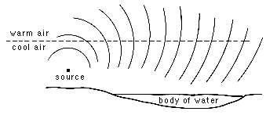
Reflection in the SOFAR channel
HIGH sound speed
LOW sound speed
Notes:
TEACHER NOTES:
This diagram follows a single wave front after it is created at the source. Imagine it as a time lapse; each dark line is the same wave at a different point in time. The dotted line the middle represents the divide between a area of high sound speed above and low sound speed below (where the source is). The sound leaves the source in an area of low sound speed (such as the SOFAR channel) propagating toward an area of high sound speed. When part of the wave crosses into the area of high sound speed, the wave front changes shape and direction. This is because the portion of the wave in the high speed area is traveling faster then the part in the lower region. The whole wave is eventually turned so that is traveling back downward.
Ask the students to think about the previous slide. If the wave is now pointing downward, will it travel all the way to the bottom of the ocean? The answer is no, it will encounter another high-speed zone. At that interface, the process will reverse so that the wave is now point upward. This process repeats itself as the wave propagates down the waveguide.
This is tough for some students to understand. I like the analogy of a toy car rolling along a wood floor. If the toy crosses onto a carpet at an angle, the first tire to cross will rotate more slowly due to the increased friction. As a result, the car pivots.
PICTURE CREDIT: http://www.sfu.ca/sonic-studio/handbook/Graphics/Refraction.gif
WEBSITES:
http://www.dosits.org/science/soundmovement/sofar/sofartravel/
http://www.pmel.noaa.gov/vents/acoustics/tutorial/11-sofar.html
http://oceanexplorer.noaa.gov/explorations/sound01/background/acoustics/media/sofar.html
http://en.wikipedia.org/wiki/SOFAR_channel – this Wikipedia page provides a lot vocabulary to could be used for a more advanced or marine science class
http://www.mrwaynesclass.com/teacher/sound/refraction.htm – this is a fun animation for sound in air
http://www.ndt-ed.org/EducationResources/HighSchool/Sound/refraction.htm – more animations and an applet

Slide 6
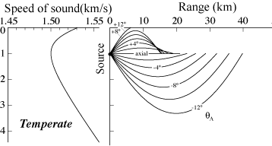
Putting it together
Notes:
TEACHER NOTES: This slide unifies the previous two. On the left is a graph of the sound speed profile. Speed is on the x-axis and depth is on the y-axis (zero is the surface). On the right are ray paths of sound waves. Stress that the lines in the graph on the right are RAYS. That is, they represent the directions of propagation of the sound wave, not the oscillations themselves. Lines can be drawn perpendicular to the -12º ray to illustrate this point. Note how the rays bend at both the top and the bottom of the channel. None of the rays are actually bouncing off of the bottom or the surface. Complicated things like bottom loss and surface scattering occur at those “hard” boundaries.
PHOTO CREDIT: http://www.dosits.org/science/soundmovement/sofar/sofartravel/

Slide 7
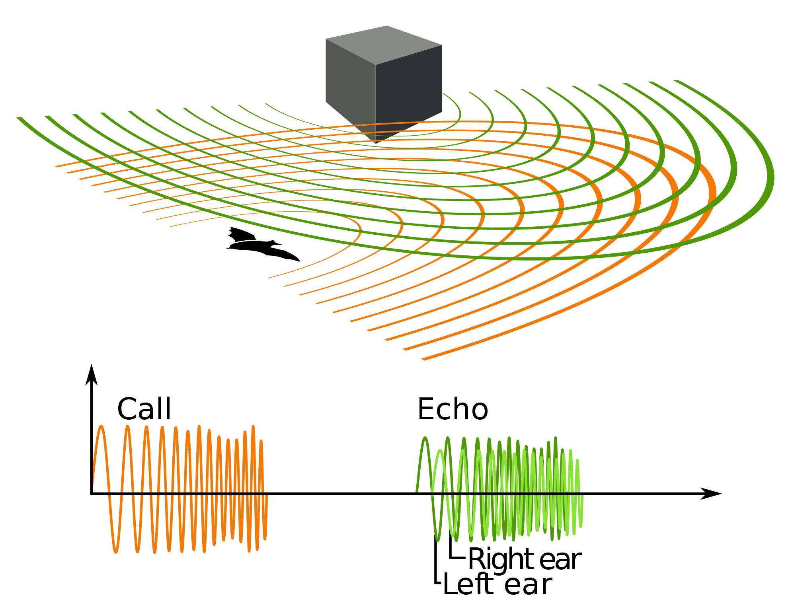
Echolocation
Notes:
TEACHER NOTES: The next several slides have diagrams and illustrations of sound being used in the ocean. These slides are not meant to be covered in any great depth. In the classroom activity, the students will select one of the following applications to write a word problem about. In the course of doing so, they will do research and become a “classroom expert” in that area.
This slide contains an illustration of echolocation. The animal is a bat, but the process is the same for a cetaceans (whales). The animal emits a sound and listens for reflections. The animal can use the time it takes for the echo to come back to figure out how far away the object is. They further use the difference in travel time between their ears to further localize the object. Animals use echolocation to navigate, find prey, and communicate.
PHOTO CREDIT: http://en.wikipedia.org/wiki/Animal_echolocation

Slide 8
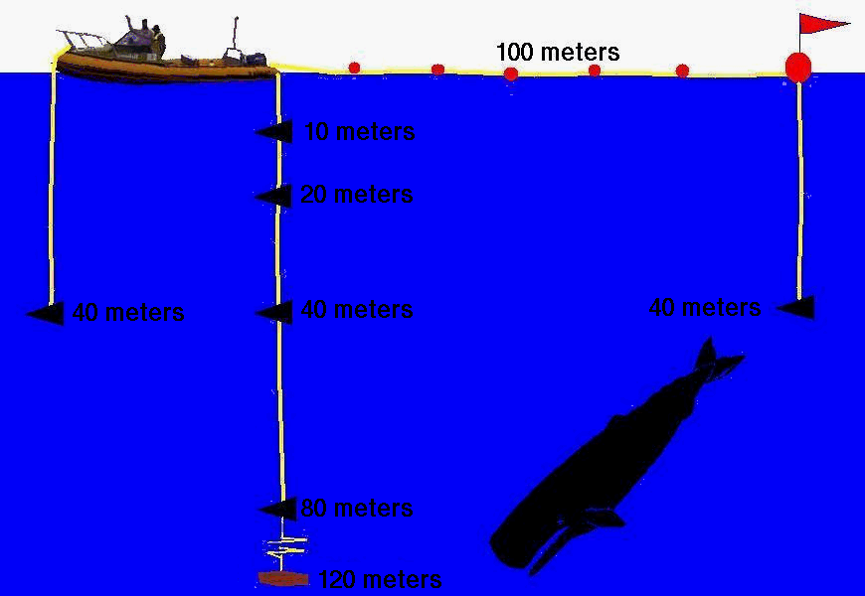
Tracking and wildlife surveys
Notes:
TEACHER NOTES: Scientists can listen for sounds in the ocean to try to learn about wildlife. In this diagram, the triangles represent hydrophones, devices used to listen for sound underwater. The whale is hanging out somewhere near the array (not necessarily right next to the array) and makes a sound. The sound is picked up by all the different hydrophones. Scientists can then look at the differences in the arrival times (when the sound shows up) between the hydrophones to determine where the whale was. The works in much the same way as ears do to localize a sound source (imagine hearing a sound to your left. Your right ear hears it two, but you register it on the left first).
PHOTO CREDIT: http://seawifs.gsfc.nasa.gov/OCEAN_PLANET/SQUID/journal.5Mar1999.part2.html

Slide 9
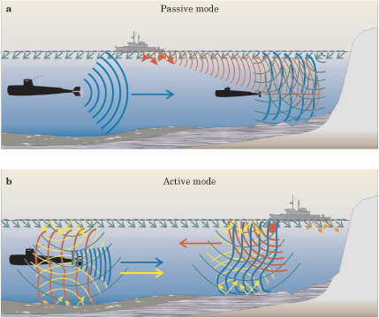
SOund Navigation and Ranging (SONAR)
Notes:
TEACHER NOTES: SONAR stands for Sound Navigation and Ranging. There are two types of SONAR: active and passive. Active SONAR requires a signal to be sound out and reflections listened for (similar to echolocation). Passive SONAR is when a receiver is placed underwater and sounds are simply listened for (like with the whale tracking).
The diagram illustrates the two modes. The top illustrates passive SONAR. The vessel on the surface is simply listening for things under the surface. The green lines illustrate noise from surface conditions. The orange lines are noise from the vessel itself. The blue lines from the large submarine on the left are sounds coming from the propellers. The surface ship tries to detect the sound of the large submarine amid all the other noise in the ocean. Differences in arrival times can again be used to compute the distance to the target. The smaller sub on the right is not moving, but nonetheless causes disturbances in the sonic field since it causes reflections.
The lower panel illustrates active SONAR. The vessel on the surface is now putting out sound (the ping noise so common in navel movies) as illustrated by the dark orange lines. The sound reflects off the surface and the bottom as shown by the yellow lines. The probe sound also bounces off the submarine. Again, travel times can be used to figure out how far away the submarine is. This system is analogous to animal echolocation.
PHOTO CREDIT: http://www.mpl.ucsd.edu/people/hcsong/papers/pt_Kuperman10_2004.pdf
REFERENCE:
Kuperman, William A., and James F. Lynch. "Shallow-water acoustics." Physics Today 57.10 (2004): 55-61.

Slide 10
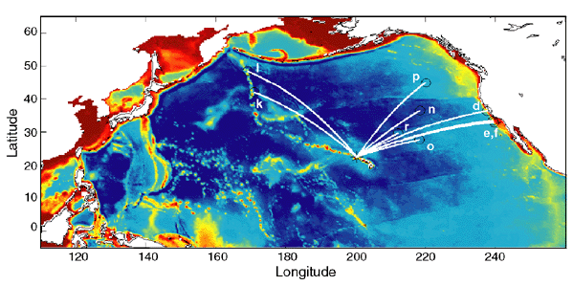
Climate Studies
Notes:
TEACHER NOTES: Temperature can be measured with sound because sound speed in the ocean is a function of temperature, pressure, and salinity. Have students think back to the diagram in slide 4. In the Acoustic Thermometry of the Ocean Climate (ATOC) experiment, a sound source was placed off the shore of Hawaii. The source was moored in the SOFAR channel to ensure the signal propagated an appropriate distance. Stations all over the Pacific Ocean listened for arrivals. Using minute changes in the travel time between Hawaii and the listening stations, scientists have been able to monitor changes in ocean temperature on a large scale. The differences in arrival times were used to deduce details of the thermal structure of the ocean well below the surface. The study ran from 1996 to 2006 and provided accurate measurements of ocean temperature fluctuations in response to global climate change.
PHOTO CREDIT: http://en.wikipedia.org/wiki/Acoustic_Thermometry_of_Ocean_Climate
WEBSITES:
http://atoc.ucsd.edu/

Slide 11
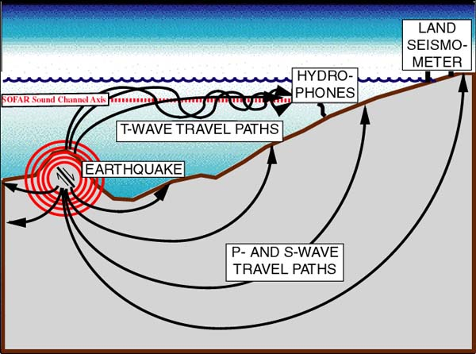
Earthquake localization
Notes:
TEACHER NOTES: When an earthquake occurs, hydrophones can pick up acoustic signals from the event. Earthquakes produce a number of different kinds of waves. Primary-waves and secondary-waves are two major ones. P-waves are longitudinal compressional waves and S-waves are transverse. These two types of waves propagate in the earth itself, but also create acoustic signals in the ocean. If the event is nearby and the detector is an array of hydrophones, the epicenter can be located in the same way as the whale tracking. That is, the difference in arrival times of the P- and S-waves can be used to localize the epicenter. This situation is illustrated in the diagram by the waves propagating in the ocean and arriving that the shallow hydrophone. The travel paths in the earth are the direction of seismic propagation.
PHOTO CREDIT: http://www.pmel.noaa.gov/eoi/nemo/education/
WEBSITES:
- http://www.pmel.noaa.gov/vents/geology/tphase.html

Slide 12
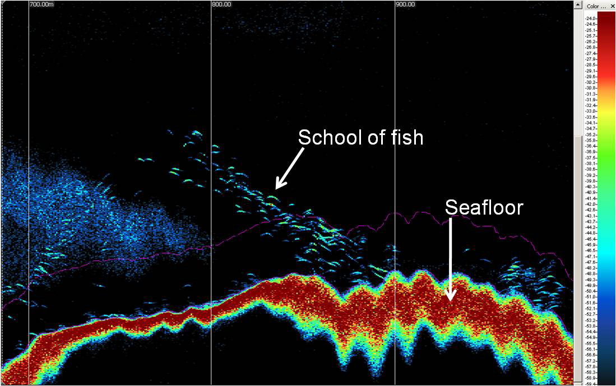
Fish Finding
Notes:
TEACHER NOTES: This image is from the screen of a fish finder. Commercial fish finders use SONAR in much the same way whales do. A transducer/receiver (a fancy name for a device that makes sound and listens for reflections) transmits a pulse of sound from the bottom of a fishing boat or research vessel. Reflections are recorded at the source and the travel time is used to compute the distance. In this image, the seafloor is visible a along the bottom. A school of fish is resolved above that.
PHOTO CREDIT: http://flowergarden.noaa.gov/science/fostersanctuaryscience2011.html

Slide 13
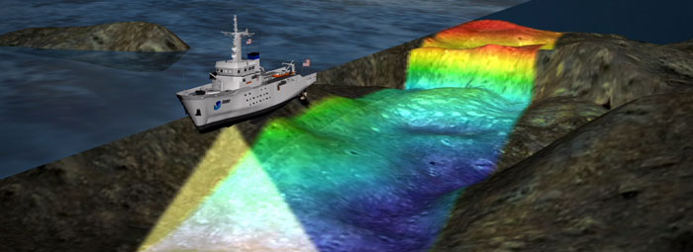
Ocean Bottom Mapping
Notes:
TEACHER NOTES: These arrays are more complex versions of fish finders. The arrays consist of multiple transducer/receivers to increase the field of view. Each transducer/receiver transmits a pulse of sound. The pulse bounces off the bottom and is recorded. The travel time is then used to compute the distance to the ocean bottom. In this image, the beam is coming from the bottom of the boat on the surface. The path behind it illustrates where it has already mapped. The color scale illustrates the depth the array records.
PHOTO CREDIT: http://ccma.nos.noaa.gov/products/biogeography/usvi_nps/details.aspx
WEBSITES:
http://oceanexplorer.noaa.gov/edu/curriculum/section2.pdf – This has some really cool activities for Earth Science classes
http://video.nationalgeographic.com/video/news/environment-news/us-ocean-floor-mapping-vin/ - 5 minute video describing an ocean bottom survey from 2004
http://www.divediscover.whoi.edu/tools/sonar-singlebeam.html – Describes a single beam echo sounder.
http://oceanservice.noaa.gov/education/seafloor-mapping/how_multibeamsonar.html

Slide 14
Activity: Write a word problem!
In your groups, choose one of the following sound applications:
Echolocation
Whale tracking
Sonar
Measuring ocean temperature (ATOC)
Locating earthquakes
Fish finding
Ocean bottom mapping
Notes:
TEACHER NOTES: Each group should select a topic that was touched on briefly earlier in class. They will do some preliminary research using the handout as a guide. The goal is for the students to learn some vocabulary and understand how sound is applied in a wide range of applications. The most complex equations the students will need to use is v = d/t. If some students choose to look at any passive processes, they will need to write a system of equations using the difference in arrivals of a spread out pulse. The math is not that much harder, but requires explaining the concept of geometric dispersion (see the next slide).
This activity was done in the classroom having students use their smart phones for research. At least one smart phone was available in each group in my class. For the most part, the students stayed focused and seemed to enjoy being able to freely use their mobile device in class. Emphasize the use of reliable resources. Wikipedia has good information for most of these topics. Also point them to:
http://www.dosits.org – Has good information for almost all the topics
http://www.divediscover.whoi.edu/tools/sonar-singlebeam.html - Resource for echo-sounding
http://atoc.ucsd.edu/ - for measuring ocean temperature
http://www.wikipedia.org – is a good jumping off point for any topic
http://misclab.umeoce.maine.edu/boss/classes/SMS_598_2005/PDFs/Physics%20Today%20October%202004-%20Shallow-Water%20Acoustics.htm

Slide 15
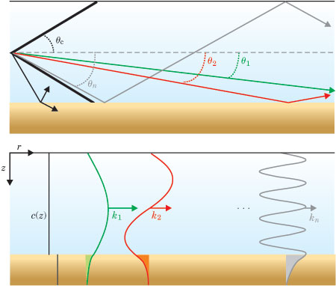
Acoustic Dispersion – extension slide
Notes:
TEACHER NOTE: The topic of dispersion is complex and may confuse some students. Include this slide only for advanced classes or students that want to do whale tracking or passive sonar.
Due to the geometry of the ocean waveguide, only certain modes of acoustics waves propagate. The physics is quite similar to those of a pipe organ; the size and shape of a particular pipe only allow certain sounds to be made. The acoustic waves that are allowed to travel in an underwater waveguide are called modes. Each mode propagates at a slightly different speed near the source. All sounds approach the ambient sound speed further away from the source. That initial difference is enough to observe a spread in the signal at a receiver. The difference in arrival times can be used to localize the source.
This diagram shows two simple, idealized waveguides. These are not SOFAR channels since the sound speed profile is constant (as indicated by the c(z) line on the right hand side of the lower panel). The top diagram illustrates the trajectory of each mode with a ray. Each trajectory is associated with a specific mode shape as illustrated in the bottom diagram. So the shape of k₁, the green curve in the bottom, propagates down the waveguide at θ₁. Every shape up to some k_{n} travels slightly differently down the guide. Above a critical angle, θ_{c}, no sound travels. Each of these wave shapes is associated with a different frequency. Each different frequency travels at a slightly different speed. This means that a receiver will pick up a “pulse spread” that can be used to figure out how far way something is.
PHOTO CREDIT: http://www.mpl.ucsd.edu/people/hcsong/papers/pt_Kuperman10_2004.pdf
WEBSITES:
http://physicsbuzz.physicscentral.com/2009/09/surprising-physics-of-pipe-organs.html
http://www.youtube.com/watch?v=rhakZPMjPKE – video about pipe organs
http://www.mpl.ucsd.edu/people/hcsong/papers/pt_Kuperman10_2004.pdf – great overview of underwater acoustics

Slide 16
Conclusions
Sound propagates efficiently in the ocean.
Sound can travel long distances in the SOFAR channel.
Sound has many applications in the ocean
Notes:
TEACHER NOTES:
Sound speed changes based on what material it is propagating through. In the ocean, sound is a function of salinity, temperature, and depth. These three factors change the density of the water and thus the sound speed. In many places in the ocean, these factors create a sound speed profile that lends itself to long distance propagation of sound.
The SOFAR channel is a sound speed minimum zone located between warm surface waters and cold, pressurized deep water. As sound travels within in the channel, it reflects off the surface and bottom the channel to keep it focused around the middle. The signal can then propagate long distance without losing much energy.
As seen in the slides and activity, sound is used in many ways in the study of the ocean. While the details of many of these technologies are different, the basic physics is the same: v = d/t.

