Slide 1
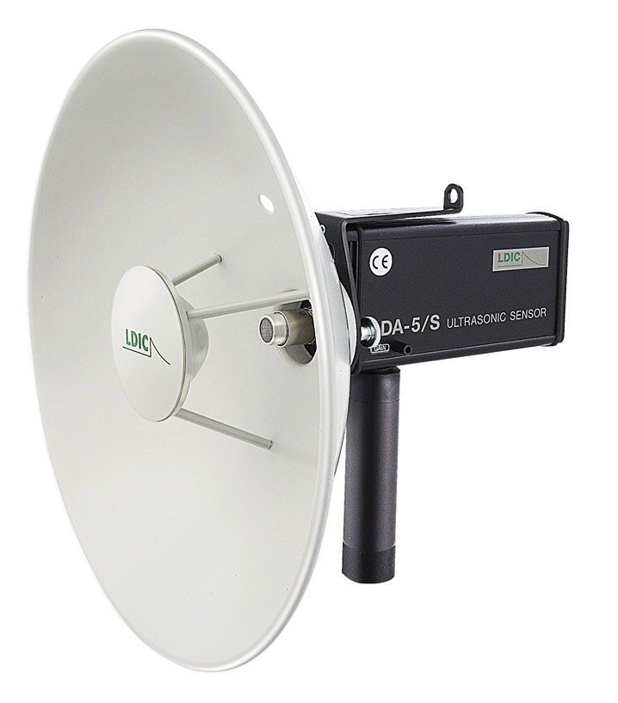
Acoustic Superposition and Spectral Analysis
Notes:
AUTHORS:
WHY: Scientists and engineers use reflective surfaces to guide information to a single point in applications as wide ranging as ocean- color observation and radio astronomy. Reflective dishes are found in more everyday applications such as satellite television and point–to-point wireless data communication. An understanding of the geometry of wave propagation and the laws of reflection and refraction is fundamental to these technologies.
SUMMARY: Students will build a directional microphone and use it with a spectrum analyzer. The first two points will be explained in lecture and the second two will be explored in lab. Students will understand:
the basics of superposition.
what a Fourier transform is and how to use a spectrum analyzer.
how reflection off a dish can improve range of a device.
how sound (and other waves’) intensity decreases as a function of distance (1/r² law).
PICTURE/GRAPHIC CREDIT:
http://www.directindustry.com/prod/doble-lemke/ultrasonic-directional-microphones-for-the-location-of-partial-discharges-55765-365635.html
WEBSITES USED IN THIS PRESENTATION:
http://www.phys.unsw.edu.au/~jw/I&Iexperiments.pdf – pages 11 - 13 provided the basis for this project. The other lab activities are very cool, too.
ADDITIONAL READING: See individual slides
CONTEXT FOR USE: This lesson was designed for use in an Advanced Physics class for 10th and 11th graders who have already been introduced to the basic anatomy and properties of waves. Students should also be familiar with the concept of reflection and parabolic reflectors. Good graphing skills and some background in geometry is helpful for completing the lab activity.
MISCONCEPTIONS:
Waves carry matter not energy (this is something that is reiterated in all following lessons).
Once waves are added together, you cannot separate them
EVALUATION TIPS: Students can be evaluated based on their participation in the lab. Their results can be also be evaluated. Please see the teacher version of the lab handout for more instructions.
TEACHING NOTES: See individual slides

Slide 2
Warm Up:
Please answer the following questions:
How does sound travel in air?
Can you describe what frequency is?
How do you think noise-canceling headphones work?
Notes:
TEACHER NOTES: Present this as a think-pair-share type activity.
Sound propagates by vibrating particles in the medium through which it is traveling. A specific example or demonstration helps here. For example, when a bell is rung it vibrates. As it moves back and forth, it pushes air particles. The result is an area of air near the bell with a changing amount of air particles. As the particles collide and more away from the bell, they set other air particles in motion. The result is an oscillating pressure field moving way from the bell.
Frequency is a measure of the number of cycles per unit time of a periodic wave. It is typically measured in Hertz with units of 1/seconds.
This question is meant to ground the following discussion in terms of something they may have already seen. Active noise-canceling headphones sense the sonic environment around them and create a waveform that that reduces the noise. People use them on airplanes to reduce engine noise. This technology relies on the concept of superposition; the physical principle describing how waves can be layered on top of each other linearly. Superposition is a way to describe how complex sounds can be made up of many simpler sounds. Scientists and engineers can quantify how much of a particular simple wave is in a more complex one using a spectrum analyzer. The concepts of superposition and spectral analysis are explored in more detail in the rest of the lecture.

Slide 3
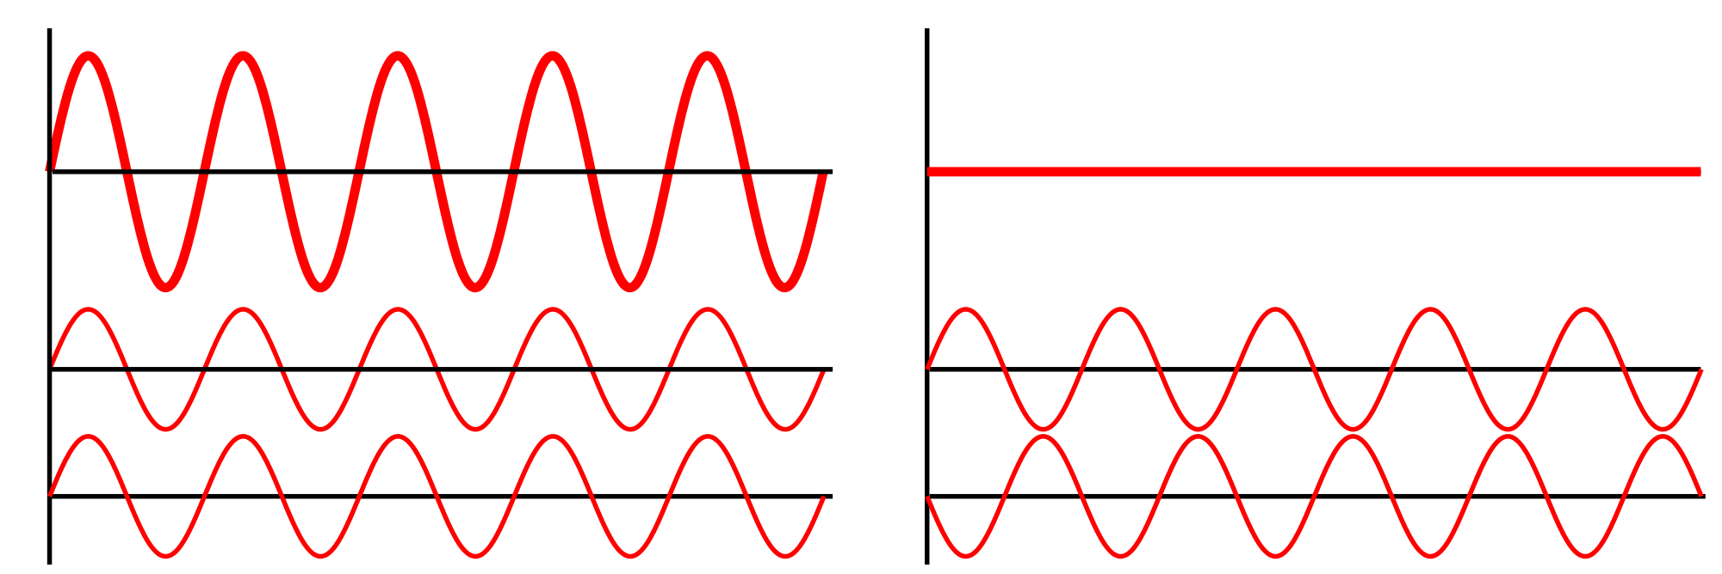
Superposition
Waves add together to create new waves!
Perfect Constructive interference
Perfect Destructive interference
Combinations!
Notes:
TEACHER NOTES:
Superposition is the word used to describe how waves add together linearly to create new waves. In the diagram, three different situations are shown:
On the left, two waves of the same frequency are added together in phase (the sounds are played at the same time) to create a wave with a larger amplitude. This is called perfect constructive interference.
The right panel shows two waves of the same frequency being added together 180º out of phase (sounds played at different times). The peaks and troughs eliminate each other. This is called perfect destructive interference.
Emphasize that the situation illustrated in the diagram are “perfect.” That is, waves can add together in any number of ways in between these two extremes. In fact, the sounds produced by musical instruments are a result of imperfect superposition. Human speech also comes from adding together sounds produced in the vocal tract. Likewise, whales and dolphins create the complex sounds they use to echolocate and communicate by adding different noises.
The school where I taught had access to Pasco Xplorer GLX computers. These are handheld, scientific multi-meters with tons of functionality. It has sound production capabilities that allow for observation of interference and beats. In the lab activity, my students used these as the sound source to be measured. After I showed this slide, II let each group play with them to explore sound interference. If such sound generators are unavailable, there are a number of applets available online for demonstration purposes. There are also cellphone apps the students can download to explore further (some apps do not support overlaying different frequencies. Students can play sounds through two phones to observe similar effects).
PHOTO CREDIT: http://en.wikipedia.org/wiki/File:Interference_of_two_waves.svg
WEBSITES:
- http://www.math.umn.edu/~rogness/math1155/soundwaves/ - has a nice explanation of adding sound waves and some examples
- http://library.thinkquest.org/19537/java/Wave.html – sound production applet (must have java installed)
- http://www.androidblip.com/android-apps/audio-tone-generator-270939.html – free tone generator for Android phones
- https://itunes.apple.com/us/app/tone-generator/id457003837?mt=8 – free tone generator for iPhones
VIDEOS: The following links go to pages that have music and the corresponding waveform:
http://www.freesound.org/people/StrangerEight/sounds/148695/ - This is the waveform in time of an acoustic guitar track. Be sure to point out how complicated the structure of the wave is. It would be impossible to pick out individual frequencies from this graph. The website, http://www.freesound.org, has lots of visualizations like this.
http://www.theatlantic.com/video/archive/2012/04/i-will-never-change-benga/255637/ - This is a link to a video of an artist’s visualization of the waveform of a dubstep song. While the graph is not scientific, the waveform is qualitatively accurate and visually interesting. Point out again that the structure of the superposition is really complicated.
http://www.youtube.com/watch?v=gpCquUWqaYw - This is a video of a Ruben’s tube being driven with a few different songs. A Ruben’s tube is a sound visualizer that plays sound through a pipe filled with and pressurized by propane. The pipe has holes drilled at constant intervals and are lit on fire much like a gas grill. When sound is driven through the tube, the elevated sound pressure drives more propane through some of the holes creating the waveform. It makes for an interesting discussion to ask what the students think is going on before explaining it. This video serves to underscore the point that sound waves are fluctuations of pressure.

Slide 4
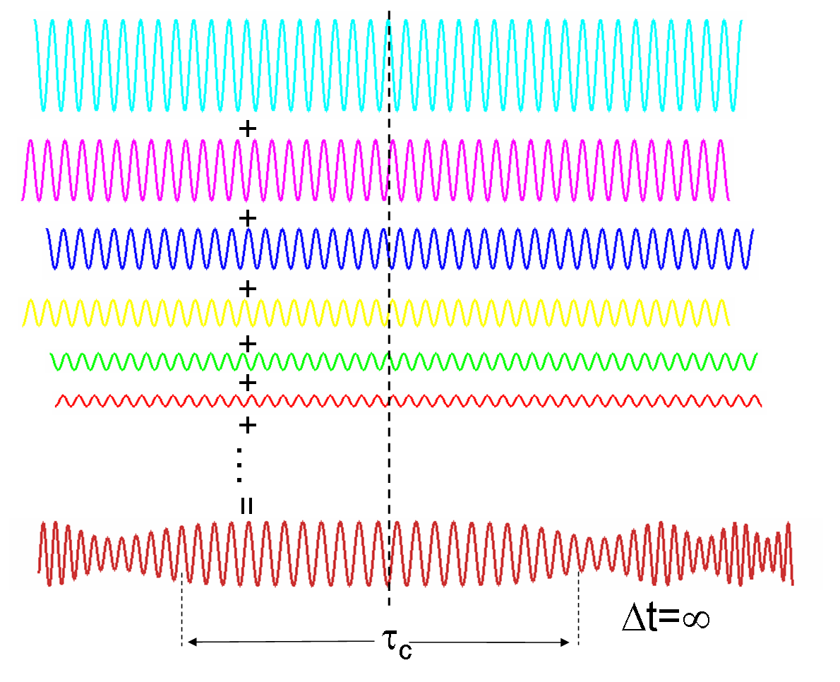
Superposition of many waves
Notes:
TEACHER NOTES: The value of the each of the component waves at any given point is added to the corresponding points in each of the waves. The sum of all these waves gives the more complicated red wave at the bottom. You can emphasize this by following the value of the waves down the vertical dotted line in the middle.
PHOTO CREDIT: http://en.wikipedia.org/wiki/Coherence_(physics)

Slide 5
How could we observe a single frequency from a sound?
What if we wanted to pick up a single frequency from a complicated super position?
Think about how a scientist might tease out a whale call from all the noise in the ocean.
Notes:
TEACHER NOTES: Give the students a few minutes to think about this on their own and then solicit ideas from the whole class. You’ll get some interesting answers.
Fourier decomposition breaks a signal into the waves that form it. This is essentially the reverse of superposing multiple signals on top of each other like the diagram shows in slide 4. Remind students that each of the constituent parts of the complicated wave are individual, different frequencies. Fourier decomposition picks out how much of an individual frequency is in your signal.
WEBSITES:
- https://en.wikipedia.org/wiki/Fourier_transform – history and math resource
- http://mathworld.wolfram.com/FourierSeries.html – general math resource
- http://clas.mq.edu.au/acoustics/frequency/spectral.html – a description of Fourier transforms in the context of speech analysis
- http://hyperphysics.phy-astr.gsu.edu/hbase/audio/fourier.html - good illustration and description of Fourier transforms

Slide 6
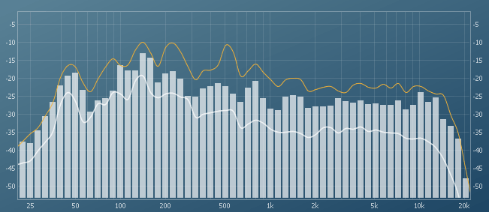
Spectrum Analyzer
Computers will do all that for us!
Something like a spectrum analyzer is available on most audio players
Notes:
TEACHER NOTES:
A spectrum analyzer takes a sound and breaks it down into frequency components using Fourier transforms. In this graph the x – axis is frequency, and the y – axis is decibels (dB). Decibels are the unit of measuring sound level. It defined as the ratio of the measured level to a reference level in whatever medium the sound is traveling through. In air the reference is 2 x 10⁻⁴ pascals, which is a level of 0 dB. For reference, a barely audible noise has a level of 10 dB and a very loud concert has a level of 110 dB. Point out that the units are constructed this way because humans can hear such a wide range of sounds.
In the histogram, the level of each bar describes how much of the total signal is due to each of the frequencies along the x-axis. All these tones added together give the sound you hear, Some computer music visualizers use this. Sound engineers use graphs like this all the time when mixing records.
It is important that students understand that what this graph is showing is how much of a particular frequency is in the entire sound. Each bar shows how much of a particular, single frequency sine wave is present in the whole sound.
PHOTO CREDIT: http://img441.imageshack.us/img441/8390/id725x1342sitesevenphas.png
WEBSITES:
- http://en.wikipedia.org/wiki/Spectrum_analyzer#Audio-frequency_uses

Slide 7
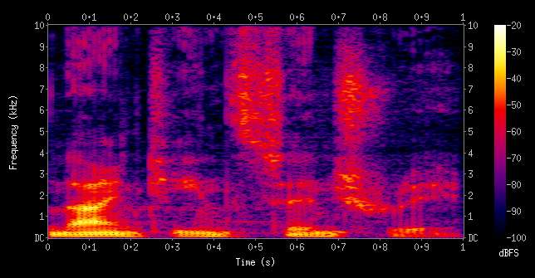
Spectrum Analyzer
Notes:
TEACHER NOTES:
This is another, slightly more complex spectrogram. The x-axis is time and the y-axis is frequency. The color scale is in decibels as described by the bar on the right. The graph shows the frequency content of the signal at each instant in time. So as the signal is changing over time, the graph is recording the decibel contribution of each frequency. Graphs like these are used extensively by scientists studying animal calls and linguistics. Electrical engineers also use spectrograms as a diagnostic tool to assess the performance of a system.
PHOTO CREDIT: http://en.wikipedia.org/wiki/Spectrogram

Slide 8
Download a spectrum analyzer
FOR iPHONE: FOURIER LITE
FOR ANDROID: FREQUENSEE
ONCE THE APP HAS DOWNLOADED, PLAY WITH IT A LITTLE BIT TO GET A SENSE FOR WHAT YOU ARE LOOKING AT. WE WILL USE THESE IN TODAY’S LAB.
Notes:
TEACHER NOTES: Have students download a spectrum analyzer. In my classroom, at least one student per group had a smartphone. In groups, have them play with the analyzer. Other group members can whistle, or a sound can be played from another phone or other type of sound generator. Be sure that the students are making both high and low pitched noises at different volumes. Have them pay particular attention to where the peak frequencies are on the graph. That is where is a high pitch found relative to a low pitch.
There are other free analyzer apps available. I like these because you can pause them and scroll around the graph. Some students may find a bar graph visualizer easier to understand.
WEBSITES:
https://play.google.com/store/apps/details?id=jp.gr.java_conf.nand.audio_analyzer_free&feature=also_installed#?t=W251bGwsMSwxLDEwNCwianAuZ3IuamF2YV9jb25mLm5hbmQuYXVkaW9fYW5hbHl6ZXJfZnJlZSJd – Real time audio analyzer for Android
https://itunes.apple.com/us/app/fourier-lite/id386084443?mt=8 – Fourier lite for the iPhone
https://play.google.com/store/apps/details?id=com.DanielBach.FrequenSee&hl=en- a free spectrum analyzer that can be downloaded for a desktop computer

Slide 9
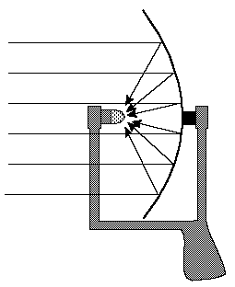
Directional microphone
A dish is used to reflect sound to a single point using . This extends the range of a microphone.
Each group will build a directional microphone following the directions in the lab handout.
Notes:
TEACHER NOTES: This is a schematic of the microphone the students will build. Emphasize that this diagram shows how rays will be directed to the focus. These rays are just a ways to visualize the direction of sound propagation. Also point out that this same schematic can be used to guide electromagnetic waves. Dishes are commonly used to pick-up everything from television signals (like DirectTV) to transmissions from outer-space (with radio telescopes).
Pass out the lab handout and explain the procedure. Make sure the students understand that the spectrum analyzer allows them to do this by picking out the probe sound from the rest of the acoustic environment.
PHOTO CREDIT: http://www.scienceprog.com/wp-content/uploads/2013/01/parab.gif
WEBSITES:
- http://en.wikipedia.org/wiki/Radio_telescope
- http://en.wikipedia.org/wiki/Radar
- http://en.wikipedia.org/wiki/Communications_satellite
- http://modis.gsfc.nasa.gov/about/design.php - NASA satellites use mirror assemblies to guide light into sensing arrays for observing the Earth
- http://www.physicsclassroom.com/class/refln/u13l3c.cfm - this website discusses concave mirrors in the context of light, but is equally applicable for sound

Slide 10
Conclusions
Superposition describes how waves are added together.
Most sounds we hear are superpositions
Complex waveforms can be broken down into their component simple waves
Spectral analysis is useful in many scientific areas
Notes:
TEACHER NOTES:
Superposition describes how waves are added together – students should understand what the concept of superposition is. It is a physical and mathematical framework that describes how simple waves can be added linearly to make more complex ones. Superposition underlies phenomena like constructive and destructive interference of sound (and any other kind of wave).
Most sounds we hear are superpositions – students should understand that the sounds we hear all around us are themselves superpositions of simple, single frequency waves. Music and speech can both be understood as many waves layered on top of each other.
Complex waveforms can be broken down into their component simple waves – the concept of superposition can be used in reverse to study complicated signals. This is down with a sophisticated mathematical procedure called the Fourier transform. Efficient computer routines can execute the Fourier transform in real time, allowing scientists and engineers to gain insight into the signal they are studying.
Spectral analysis is useful in many scientific areas – Fourier decomposition allows scientists to study the frequency content of many different signals. Linguists use them to study human speech. Oceanographers use spectral analysis to study everything from marine mammals to shipping noise. Spectral analysis is important in areas outside of the study of sound, too. Anything that can be though of as a wave can be studied with Fourier transforms.

