Slide 1
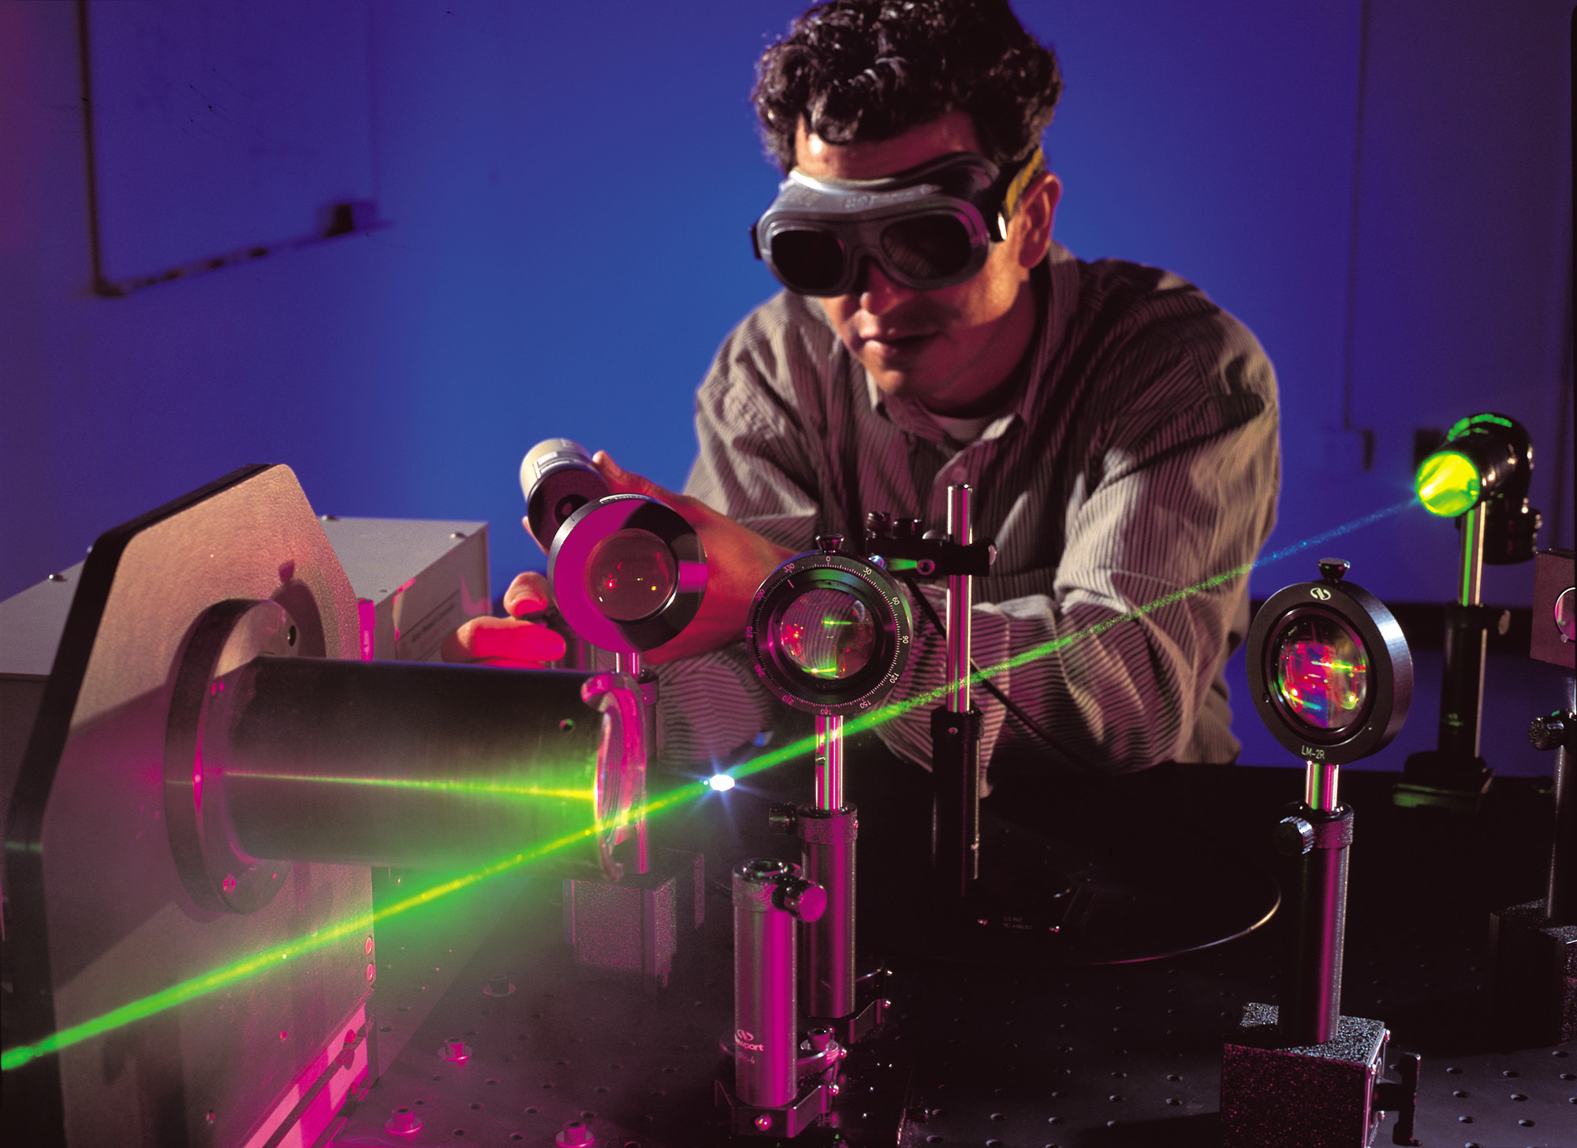
Laser Range-Finder
Notes:
AUTHORS: Eric Orenstein – Scripps Institution of Oceanography, University of California – San Diego
Susan Hooker – University City High School, San Diego Unified School District
WHY: Lasers can be used to accurately measure distances without having to use a ruler or even touch the object in question. Such measurements can be made using only geometry and basic properties of light propagation. The physics is simple but fundamental to many applications like LIDAR and 3-D object recognition.
SUMMARY: Students will build a basic laser range-finder. Students will understand:
what a beam splitter does.
that trigonometry can be used to solve scientific problems.
how the laws of reflections and refraction can be applied in the real world.
the difference between incoherent and coherent light
PICTURE/GRAPHIC CREDIT: http://plaza.ufl.edu/dwhahn/LaserPhoto5.jpg
WEBSITES USED IN THIS PRESENTATION: See slides
ADDITIONAL READING: See individual slides. For those teachers comfortable with some calculus, Eugene Hecht’s Optics textbook does a really nice job of covering the subject in a very comprehensible way. Another good book with more of an engineering bend is Saleh and Teich’s Fundamentals of Photonics.
CONTEXT FOR USE: This lesson was designed for use in an Advanced Physics class for 10th and 11th graders who have already been introduced to the basic anatomy and properties of waves. Lesson 3 of Brianne Moskovtiz’s waves unit (http://earthref.org/ERDA/1503/) provides a good introduction. Students should already know a little bit about basic wave phenomena like reflection and refraction. Some understanding of atoms and energy states may be helpful for discussions of the inner workings of lasers. For the lab activity, students need to be familiar with trigonometry.
MISCONCEPTIONS:
Waves carry matter not energy (this is something that is reiterated in all following lessons).
Lasers are either small handheld pointers or giant laser-guns.
The law of refraction is only useful for finding the deviation angle of a ray in lab activities.
EVALUATION TIPS: Students can be evaluated based on their participation in the lab. Their results can be also be evaluated. Please see the teacher version of the lab handout for more instructions.
TEACHING NOTES: See individual slides

Slide 2
Warm-up
Please answer the following questions:
What is reflection? Refraction?
Does light travel faster in air or water?
What is a laser? How do you think one works?
Notes:
TEACHER NOTES:
Use these questions as a “think-pair-share” activity.
Reflection is the change in directions of a wave at the interface between two different media such that the wave returns to the direction it came from. The law of reflection states that θ_{i} = θ_{r} where the index “i” refers to the incident angle and “r” to the reflected angle. This states that the angle of the incoming ray is equal to the outgoing ray. Refraction is the change of direction of a wave as it passes from one medium to another. Refraction is governed by Snell’s law, which for light is: n₁*sin(θ_{i}) = n₂*sin(θ_{r}) where n is the dimensionless index of refraction and θ is measured with respect to the vertical. Snell’s law dictates the angular deflection of a ray as it travels from one media to another. Use the example of trying to grab a diving ring out of the pool. You have to account for the bending of light at the air-water interface in order to get your hand on the ring.
To get into the “why” of reflection and refraction, refer to a textbook such as Optics (4th Edition) (12 August 2001) by Eugene Hecht.
The speed of light is a function of the material through which it travels, much like acoustic waves. The speed is described by the refractive index of the material. n = c/v where c is the speed of light in a vacuum and v is the speed of light in the material. n_{air} = 1.0003 and n_{water} = 1.3 so the speed of light is faster in air. c = 3 x 10⁸ m²/s which is so fast that light can be considered to travel instantly for more applications.
I posed this question to see what the students already knew. It provides a lead-in to the discussion about the innards of a LASER.
WEBSITES:
-http://en.wikipedia.org/wiki/List_of_applications_for_lasers – list of laser applications

Slide 3
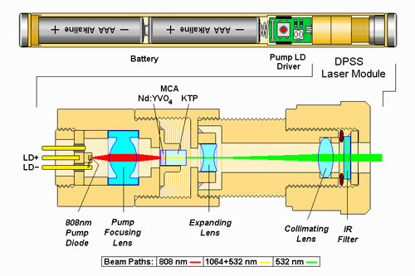
LASERs
Notes:
TEACHER NOTES:
LASER is an acronym:
Light
Amplification by
Stimulated
Emission of
Radiation
This is a diagram of a green hand-held laser pointer. The important part is the blown up DPSS (diode pumped solid state) laser module. In the module, a small diode emits red light on the far left side of the blown up region. The red light is focused in the “focusing lens” down to a smaller spot size (much like how a camera focuses an image). The light is then used to pump a neodymium-doped yttrium orthovanadate (Nd:YVO₄) crystal. “Pumping” refers to the energy that is imparted to the atoms in the crystal by the red beam. The atoms in the crystal reach an excited energy state and release photons when they return to ground. This creates a cascade where the photons from the first few atoms excite more atoms and so on. The result is a highly coherent (in phase) green beam leaving the crystal. That beam is then expanded and sent toward the opening of the pointer. To prevent the beam from expanding too much, it first goes through a collimating lens to reduce the beam divergence. The IR filter removes certain wavelengths of light that may be particularly harmful to human eyes.
To relate it to the acronym, light is initially created by the diode. The amplification takes place in the crystal. Atoms in the crystal are stimulated to a higher, unstable energy state by the light from the diode. The excited atoms quickly drop back down to their ground state, emitting radiation as a result. This process repeats itself through the crystal, resulting in more light coming out than was put-in.
The DPSS is just one kind of laser. The ideas underlying the function of other lasers are similar. For other kinds of lasers see the links below.
PHOTO CREDIT: https://en.wikipedia.org/wiki/Laser - Solid-state_lasers
WEBSITES:
- http://science.howstuffworks.com/laser.htm
- http://www.youtube.com/watch?v=y3SBSbsdiYg - Minute Physics video

Slide 4
Question:
What is the difference between a light bulb and a laser??
Notes:
TEACHER NOTES: Pose this as a quick “think about it” question. After a few minutes, solicit answers from your students. The primary purpose here is to get the students thinking about what they already know about lights and lasers. Of primary concern is that the students understand that a light bulb produces diffuse, spread out light. A LASER, on the other hand, creates a tight beam. With these differences in mind, the concepts of incoherent and coherent light may be easier to grasp. The answer is discussed in detail in the following slide.

Slide 5
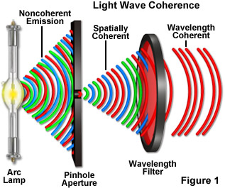
Coherent and Incoherent Light
Notes:
TEACHER NOTES:
Incoherent:
Many frequencies and wavelengths (colors)
Waves do not line up
Coherent:
One frequency and wavelength (color)
Waves line up
This picture illustrates how incoherent light from an incandescent light bulb can be made into coherent light. The incoherent, white light is spatially filtered through a pinhole aperture which lines the waves up. The light is then filtered down to just one color by the wavelength filter, producing coherent light like that of a laser.
The important part of the diagram is to show that incoherent light is randomly fluctuating and made up of many different colors. Coherent light is of one color where all the waves are in phase. Another helpful diagram is in the next slide.
PHOTO CREDIT: http://zeiss-campus.magnet.fsu.edu/tutorials/coherence/
WEBSITES:
- http://en.wikipedia.org/wiki/Coherence_(physics)#Spatial_coherence
- http://zeiss-campus.magnet.fsu.edu/tutorials/coherence/ - This website has a cool applet to play with pinhole size and filter color

Slide 6
Coherent and Incoherent
Notes:
TEACHER NOTE: This figure illustrates the same concepts as the previous figure. Point out that the incoherent light has lots of colors and the waves do not line up (OUT of phase). The LASER is one color and all the waves line up nicely (IN phase). Also note that both of these graphs are made up purely of sine waves.
PHOTO CREDIT: Eric Orenstein

Slide 7
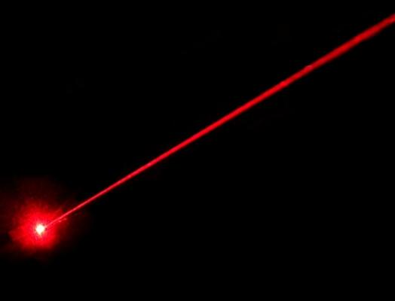
Coherent light does amazing things!
Lots of energy in a small spot
Propagate long distances
Notes:
TEACHER NOTES: Coherent light beams concentrate a lot of energy in a small spot and propagate a long ways. Both of these properties are consequences of coherent light having a small divergence (the light does not spread out very much). That means the beam can travel a long way without losing a lot of energy to spreading out. Mention the flashlight beam again; how quickly does that beam spread out? Have a student draw a picture of light from a flashlight and light from a LASER on the board to illustrate this. The picture in the slide should give them a clue (a light bulb will not create a tight spot like the LASER).
PHOTO CREDIT: http://www.discovercircuits.com/dc-mag/Issue_1111/Photos/Red Laser Beam.jpg
WEBSITES:
The first two links below are videos that demonstrate that LASERs do in fact focuses energy and propagates it over long distances. Both videos use a Wicked brand LASER. Point out that these LASERs are much more powerful than a typical laser pointer and care needs to be taken to protect the eyes.
http://www.youtube.com/watch?v=Y7ACAI8szdE&feature=player_embedded - !– video of bottle rockets being lit with a laser
http://www.youtube.com/watch?v=WlnzcZj_rqU&feature=player_embedded - balloons being popped with a laser
http://www.rp-photonics.com/encyclopedia.html
http://spie.org/x35947.xml– this website lists some very cool laser applications
https://en.wikipedia.org/wiki/Gaussian_beam- this Wikipedia article explains beam divergence in more depth

Slide 8
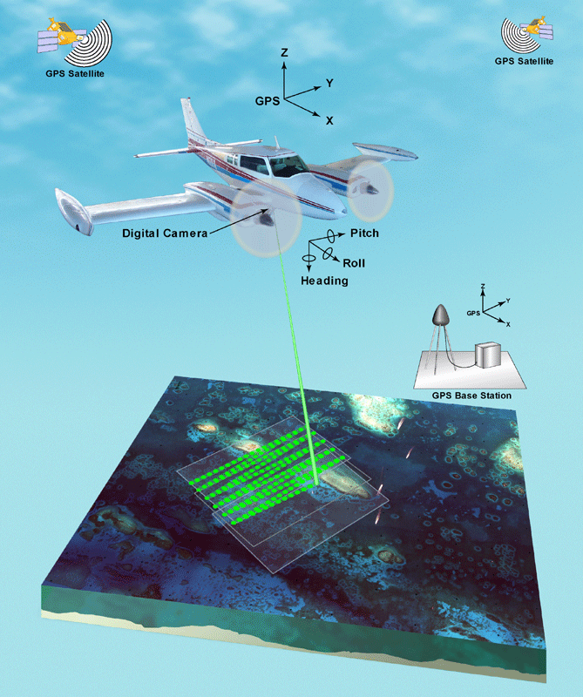
One application: LIDAR
Another acronym!
LIght
Detection
And
Ranging
Notes:
TEACHER NOTES: LIDAR is very similar to active SONAR. A beam of light is sent out from a device, bounced off of something, and the reflection is recorded. The distance to the object from the detector is computed from the travel time with d = c*t. This is only possible because LASER beams propagate so efficiently. There are other types of LIDAR that measure the phase change of the beam reflected back to the plane (how much the original test beam has been distorted). These measurements can be used to directly measure the distance to the target.
The illustration above shows a LIDAR housed in an airplane. The airplane is surveying sea surface height around some islands. LIDAR allows scientists to make very accurate measurements of sea surface height over large areas. The other parameters shown (pitch, roll, etc.) allow scientists to account for the orientation of the plane when extracting the sea surface height from the full data set.
PHOTO CREDIT: http://ngom.usgs.gov/dsp/tech/eaarl/images/Eaarl1.gif
WEBSITES:
http://oceanservice.noaa.gov/facts/lidar.html
http://lidar.cr.usgs.gov/- lists some very cool uses of LIDAR for Earth observation
http://www2.engr.arizona.edu/~arsl/lidar.html- a concise explanation of LIDAR
USGS LIDAR presentation

Slide 9
Lab Activity
Follow the directions in the handout to build a geometric laser range-finder
Notes:
TEACHER NOTES: The lab handout includes a detailed description of how to set up the range finder. Have the students play with the set-up a little bit before showing them the following schematic.

Slide 10
Schematic
Notes:
TEACHER NOTES:
This slide should not be shown to the class immediately! Give the students some time to brain storm about how to put the experiment together based on the directions in the hand out.
The laser is on the left and the protractor-mirror assembly is on the left. The beam-splitter is represented by the blue box. The beam-splitter and the mirror are separated by one meter. The object being measured is the green hexagon.
The beam-splitter both transmits and reflects light. The laser enters the slide, half of the light continues straight toward the mirror. The other half is sent toward the object via internal reflection. When the beam splitter is oriented properly, these two branches of the beam will make a 90º angle.
Students will adjust the mirror so that the two spots will coincide on the object. They now have a right triangle with an angle they can measure from the protractor. Using trigonometry, the students can compute all the relevant distances. The relationship can be found in the teacher version of the lab handout. I let my students try to come up with the relation on their own.
PHOTO CREDIT: Eric Orenstein

Slide 11
Conclusion
Coherent vs. Incoherent light
LASERs produce coherent light
LASERs in the real world
Notes:
TEACHER NOTES: Important points:
Coherent vs. Incoherent light – students should understand the difference between these two types of light. Coherent light is of one color with all the constituent parts of the beam in phase. Incoherent light is made up of many wavelengths that are interacting out of phase.
LASERs produce coherent light – students should know that LASERs produce coherent light. LASERs are so useful because they are able to concentrate energy into small, coherent, low divergence beams.
LASERs in the real world – one application of LASERs is measurement via LIDAR. Have the students think about other application of LASERs they have heard of. Ask them to think about how a LASER is uniquely able to preform that function. Students might mention things like LASIK or other surgical instruments. These use LASERs to make highly precise manipulations of living tissue. The focused nature of the LASER beams allows such procedures to be effective. Similarly precise LASERs are used for micro-machining, an industrial technique for producing small components such as air bag triggers.
WEBSITES:
- http://en.wikipedia.org/wiki/Laser - Uses - lists many applications of LASERs.

