Slide 1
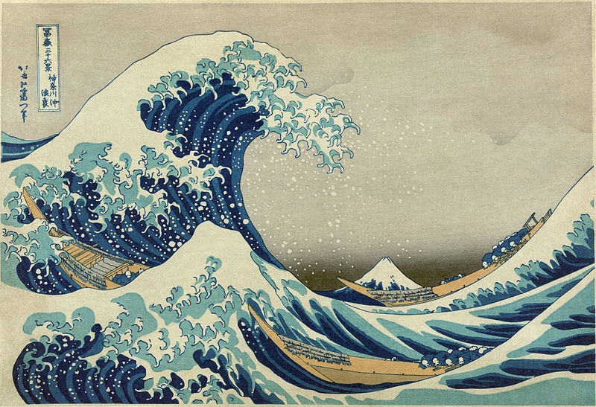
Mechanical Waves - Form & Function
Parts of a Wave
http://earthref.org/SCC
Scripps Classroom Connection
Notes:
AUTHORS:
Robert Petersen, UCSD
Dan Grendziak, Wangenheim Middle School
WHY:
Waves exist everywhere, in the ocean, the atmosphere, the solid earth and the deepest reaches of space. Waves enable our technology and communication, the Internet runs on waves. Waves are useful, some waves are dangerous, think earthquakes and tsunami, even cosmic rays. Science in grade eight is taught with an emphasis on physical interactions and transfer of energy. Waves are a primary vector of energy transfer.
SUMMARY:
The lessons presented here are part of a unit on waves geared toward eighth and ninth graders. In grade six students will have studied earthquakes and their wave properties in a phenomenological way. The unit presented here continues to use a phenomenological approach. The unit focuses on mechanical waves, identifying them as the most tractable.
This slide presentation is not meant to be shown in the classroom, but rather give the instructor the background material necessary to teach the unit within the context and logistical framework of the existing school year plan.
IMAGES:
“The Great Wave off Kanagawa” by Hokusai.
(http://en.wikipedia.org/wiki/The_Great_Wave_off_Kanagawa)
WEBSITES USED IN THIS PRESENTATION:
N/A
ADDITIONAL READING:
The following references will provide the instructor with additional information not presented in this unit.
http://en.wikipedia.org/wiki/Mechanical_wave
http://www.physicsclassroom.com/class/sound/u11l1a.cfm
http://www.acs.psu.edu/drussell/demos/waves/wavemotion.html
CONTEXT FOR USE:
This lecture is suitable to grade 8 and grade 9 students studying general science. While this unit is independent from other units available students should be familiar with the concepts of energy storage and transfer.
MISCONCEPTIONS:
A common misconception regarding waves, and one that is addresses in this unit; is that waves carry the medium through which they travel. Waves carry energy from a source to a sync. This is the primary concept that should be communicated in this unit. It should be noted that in the ocean wave motion does produce some transport of water. This transport is much smaller than the transport caused by currents. The main motion caused by waves in the ocean is in the vertical direction.
EVALUATION TIPS:
Students will have mastered the vocabulary necessary to discuss waves and wave phenomena, be able to identify parts of a wave form and phases of an earthquake wave (P,S, and Surface Waves) in a seismograph. Students will understand that waves transport energy and will be able to diagram an energetic interaction involving a wave.
TEACHING NOTES.
<number>

Slide 2


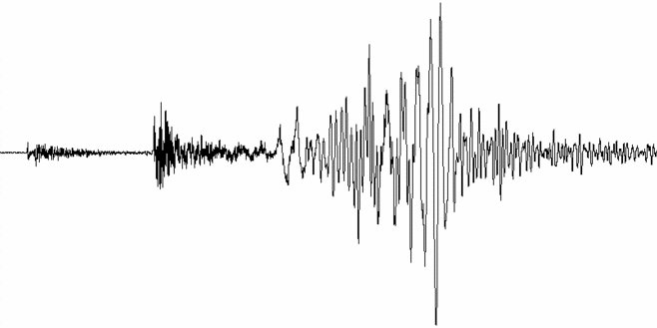
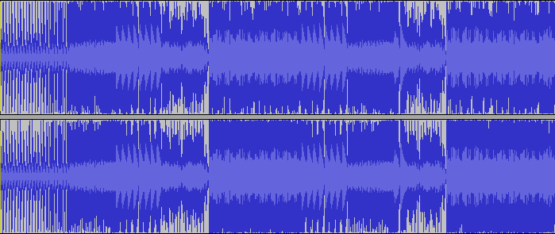
Chapter Question:
How are ocean, earthquake and sound waves alike and different?
http://earthref.org/SCC
Scripps Classroom Connection
Notes:
This slide shows from top to bottom images of a water wave, a seismograph representation of an earthquake wave and a graph of a stereo sound wave.
Theses waves, though transmitted through different media, share several important properties which will be identified and defined in the remainder of this presentation.
These images are meant to prompt an examination of existing knowledge about waves and how they can be compared.
IMAGES:
“water, wave, splashes sea, wallpapers for desktop”, hwalls.com
(http://hwalls.com/download/1612)
“Tacoma Olympia Earthquake 2/28/2001”, The IRIS Consortium
(http://www.iris.edu/hq/gallery/photo/1667)
“Electric Pow Wow Drum Waveform”, R. I. Petersen
<number>

Slide 3

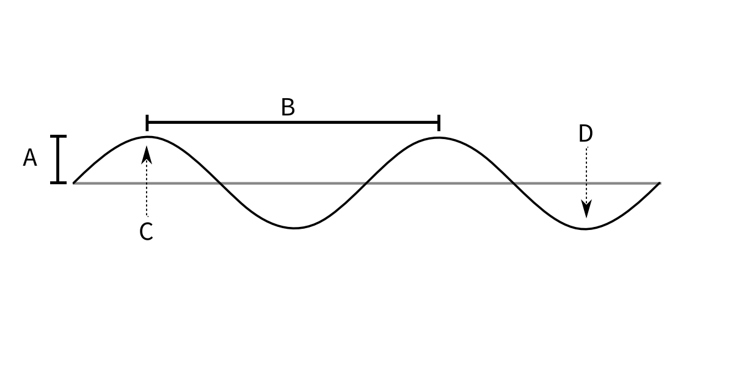
Lab Notebook:
Amplitude
Crest
Trough
Wavelength
http://earthref.org/SCC
Scripps Classroom Connection
Notes:
This schematic of a wave shows the important elements of a wave. These properties are present in all waves. Students should understand these terms, be able to apply them and use these terms in discussing waves.
A - Amplitude – The distance from the axis to the wave.
C - Crest – The point at which the wave has it's maximum amplitude.
D - Trough – The point at which the wave has it's minimum amplitude.
B - Wavelength – The distance from crest to crest or trough to trough.
<number>

Slide 4


Compare the waves.
http://earthref.org/SCC
Scripps Classroom Connection
Notes:
This slide shows two waves for comparison. Each wave has a different number of crests and troughs. Each wave has a different wavelength. Both waves have the same amplitude. Students should be able to describe each wave using the appropriate terms and compare the waves using the same. As the number of crests increases the wavelength decreases, this is an important reciprocal relationship.
<number>

Slide 5

Frequency & Period of a waves.
http://earthref.org/SCC
Scripps Classroom Connection
Notes:
When we speak of “frequency” of something , we mean how often does it happen. For example, the minute hand on a watch goes around the face once every hour, while the hour hand goes around every twelve hours. The frequency of a wave is the time it takes 1 wavelength to pass. It is measured in Hertz (Hz). 1Hz means 1 wave per second.
The “period” of a wave is related to it's frequency. In the previous example of the watch. The minute hand went around the clock face once per hour. The period is how long a repeating event takes to repeat. Back to the watch, the minute hand repeatedly passes the “12” and it takes one hour to pass the “12” again, so the period is one hour.
The frequency and period of a wave are related by the wave speed.
c=λf
Where c is the wave speed (m/s)
λ is the wavelength (m)
f is the frequency (Hz) or equivalently (1/s)
IMAGES:
“Mondaine Official Swiss Railways Watch Evolution”
(http://www.hour-hand.com/022009/mondaine-official-swiss-railways-watch-e)
<number>

Slide 6
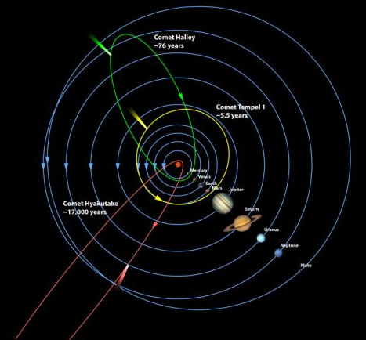
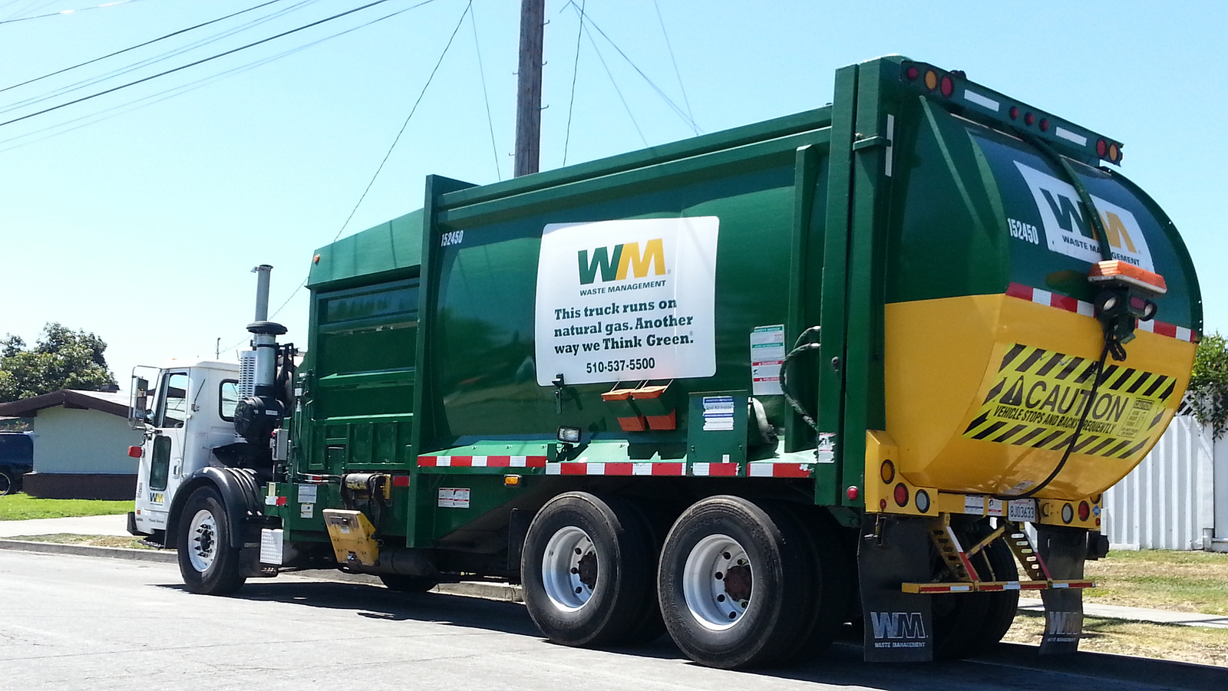
What other things have frequency and period?
http://earthref.org/SCC
Scripps Classroom Connection
Notes:
The orbits of space objects and the weekly collection of waste are two processed that have a period and orbit and not typically considered waves.
Lets us consider how all the properties of a wave compare to these events. The distance of a planet from it's start plotted over the course of several years would appear as a wave. The amplitude is the distance from the start. At the perihelion (the time when the planet is closest to the star) would be the trough in the graph. At aphelion (the time the planet is furthest from the start) would be the crest or peak in the graph. The period, the distance from peak to peak or trough to trough would measure a ``year'' on that planet.
The images in this slide are meant to suggest that many events in the world have a period and frequency. The concept of thinking of periodic events as having a wave function is a useful one applied the math and the physical sciences. A full understanding of this concept is not expected of the student in grade 8, but beginning to think in terms of wave functions in general will behoove the student.
IMAGES:
“Comparative Comet Orbits”, Kay Gibson, Ball Aerospace & Technologies Corp.
(http://deepimpact.umd.edu/gallery/jpg/D1381_001d.jpg)
“Waste Management Autocar MSL Garbage Truck (2)”, Dominick Keys
(http://www.flickr.com/photos/81472530@N03/7792236420/)
<number>

Slide 7
Conclusions
Waves have common properties that allow us to describe and compare different waves.
Amplitude
Frequency
Period
Wavelength
http://earthref.org/SCC
Scripps Classroom Connection
Notes:
Waves exist everywhere, in the ocean, the atmosphere, the solid earth and the deepest reaches of space. Waves enable our technology and communication; the Internet runs on waves. Waves are useful, some waves are dangerous, think earthquakes and tsunami, even cosmic rays. The very fact that waves are useful and found everywhere means that a full and complete understanding of all the aspect of waves would take you well into graduate school. Do not be dissuaded by this! It also means that there are many properties of waves, such as those discussed here, that are tractable to students in a very real and tactile way. In the following lessons we will generate our own waves. Of course we always have, since our very first moment at birth we when let out our first cry. We will get to understand what is is that we are creating, the energy we put into it and energy we sense from waves. From a very intuitive sensation of waves we will build a more complex understanding of them.
<number>

