Slide 1
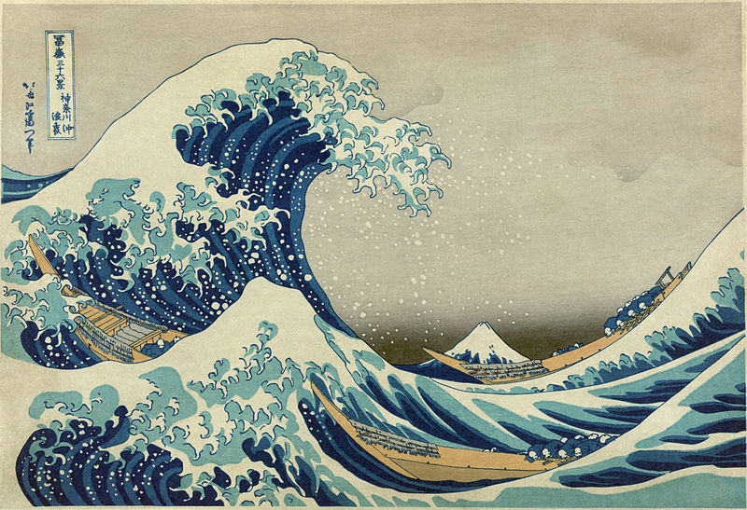
Mechanical Waves - Form & Function
Wave Activities
http://earthref.org/SCC
Scripps Classroom Connection
Notes:
AUTHORS:
Robert Petersen, UCSD
Dan Grendziak, Wangenheim Middle School
WHY:
Waves exist everywhere, in the ocean, the atmosphere, the solid earth and the deepest reaches of space. Waves enable our technology and communication, the Internet runs on waves. Waves are useful, some waves are dangerous, think earthquakes and tsunami, even cosmic rays. Science in grade eight is taught with an emphasis on physical interactions and transfer of energy. Waves are a primary vector of energy transfer.
SUMMARY:
In lesson 2 we present two activities wherein students explore waves and their properties. We also introduce the notion of “transverse” and “longitudinal” waves.
The transverse wave (also known as the 's' wave in seismology) is a wave which oscillates perpendicular to the direction the wave is traveling in.
The longitudinal wave, also called a compression wave and 'p' wave in seismology is a wave which the oscillation is in the same direction as the direction the wave is traveling.
IMAGES:
“The Great Wave off Kanagawa” by Hokusai.
(http://en.wikipedia.org/wiki/The_Great_Wave_off_Kanagawa)
WEBSITES USED IN THIS PRESENTATION:
Rubins' Tube Video:
http://www.youtube.com/watch?v=7s21VqEajVw
Frequency Generator Site:
http://igppweb.ucsd.edu/~rpetersen/frequency_generator/
Frequency Generator Repository:
https://github.com/geodynamics-liberation-front/frequency-generator
How to Break a Glass With Your Speakers:
http://www.youtube.com/watch?v=9KuwJXMQUdc
ADDITIONAL READING:
The following references will provide the instructor with additional information not presented in this unit.
http://en.wikipedia.org/wiki/Mechanical_wave
http://www.physicsclassroom.com/class/sound/u11l1a.cfm
http://www.acs.psu.edu/drussell/demos/waves/wavemotion.html
CONTEXT FOR USE:
This lecture is suitable to grade 8 and grade 9 students studying general science. While this unit is independent from other units available students should be familiar with the concepts of energy storage and transfer.
MISCONCEPTIONS:
A common misconception regarding waves, and one that is addresses in this unit; is that waves carry the medium through which they travel. Waves carry energy from a source to a sync. This is the primary concept that should be communicated in this unit. It should be noted that in the ocean wave motion does produce some transport of water. This transport is much smaller than the transport caused by currents. The main motion caused by waves in the ocean is in the vertical direction.
EVALUATION TIPS:
Students will have mastered the vocabulary necessary to discuss waves and wave phenomena, be able to identify parts of a wave form and phases of an earthquake wave (P,S, and Surface Waves) in a seismograph. Students will understand that waves transport energy and will be able to diagram an energetic interaction involving a wave.
TEACHING NOTES.
<number>

Slide 2

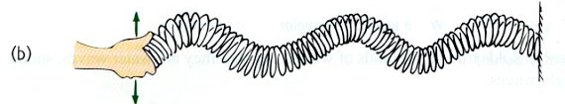

How can you control the amplitude, frequency and wavelength of the slinky wave?
http://earthref.org/SCC
Scripps Classroom Connection
Notes:
This slide shows the two types of waves discussed previously. At the top a transverse wave is generated by moving the slinky from side to side. The bottom image shows the longitudinal wave. From this image it becomes clear why this type of wave is also called a compression wave. The coils of the spring are compressed at the peak of the wave. The longitudinal wave is generated by moving your hand forward and back in the same direction as the slinky is stretched out.
In this activity we pair students together and ask them to generate both types of waves. Students are asked to figure out how they can change the amplitude, frequency and wavelength of the waves.
In this setting the notion of transferring energy comes alive with the students. The student who drives the oscillations can feel the work they put into moving the slinky. This is especially true as we have found students, who are natural engineers and love to test limits, naturally create the highest amplitude and highest frequency waves they can. These require the most energy to drive and the most energy to hold still. The student holding the other end may (and more likely than not will) at some point loose their grasp on the slinky, that end being ripped out of there had and the imparted energy from the wave exceeds there grasp. Certainly chaotic, these moments are excellent points to reinforce the concept of waves transmitting energy.
Taking the time to create both large and small waves the students will realize that a change in effort on their part in driving the wave corresponds to a change in amplitude. This is a crystal clear example of the fact that higher amplitude waves require more energy.
The speed at which they drive the slinky corresponds to the frequency. From a slow gentle back and forth, i.e. a low frequency wave, the students will see one or two waves traveling down the slinky with a wavelength on the same order as the distance between them. As the frequency increases, students vigorously moving their slinkies will notice a marked decrease in the wavelength and corresponding increase in the number of waves that span the distance between the classmates.
This is a concrete example that the frequency increases the wavelength decreases, when wave speed is constant..
For either type of wave, the transverse and the longitudinal, students feel the input and transfer on energy. Furthermore the students will see that though the coils of the slinky move locally when a wave passes. The coils do not travel with the wave. Energy is is traveling from one student to another via the wave, but the medium, that is the slinky is not.
<number>

Slide 3
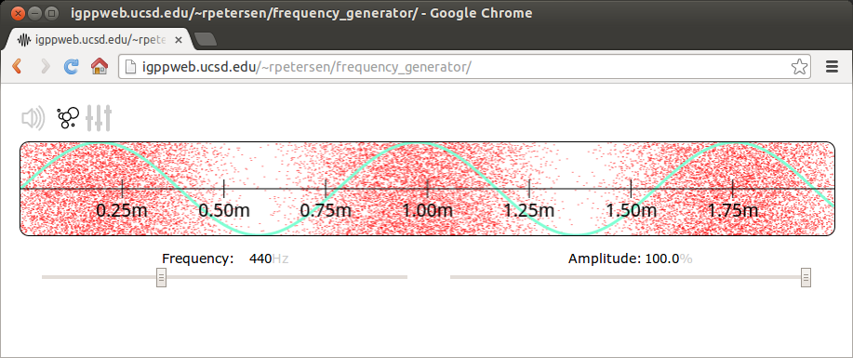
What does the change in frequency and amplitude sound like?
What does it do to the “air molecules”?
http://earthref.org/SCC
Scripps Classroom Connection
Notes:
This slide shows a web-based frequency generator. The frequency generator is capable of producing a wide spectrum of frequencies (100Hz – 10000Hz). The amplitude of the generated wave can also be controlled
The interface displays the wave in two ways. The first, a cyan colored, sine wave shows the relative pressure generated by sound wave. Sound waves are pressure waves, the oscillations travel in the same direction as the wave. The cyan wave is really a graph of the pressure. The second representation of the wave is the cloud of “air molecules”. At high pressures (the peek of the wave) the dots are compressed together and rarefied at the low pressure points (the troughs).
As the frequency increases and the wavelength decreases the sound becomes high pitched.
At the highest amplitude the compression of the air is at its highest magnitude. As the amplitude approaches 0 the difference in density between the high and low pressure zones is greatly diminished.
Students will note the correspondence between amplitude and volume and that the frequency of a sound wave is also called pitch.
The frequency generator requires a browser that supports “Web Audio API”. Currently the recent versions (>14) of the Chrome Browser are the only browsers to support this API.
Frequency Generator Site:
http://igppweb.ucsd.edu/~rpetersen/frequency_generator/
Frequency Generator Repository:
https://github.com/geodynamics-liberation-front/frequency-generator
<number>

Slide 4
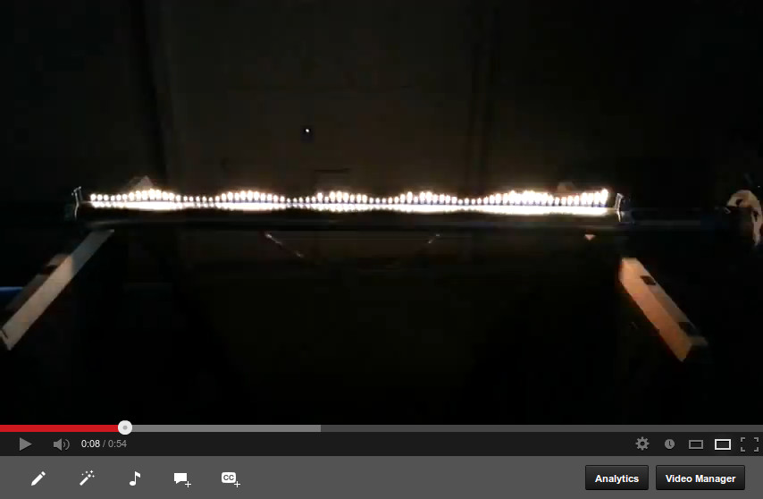
A visual representation of a pressure wave – the Rubens' Tube
http://www.youtube.com/watch?v=7s21VqEajVw
http://earthref.org/SCC
Scripps Classroom Connection
Notes:
This slide shows a Rubens' Tube. This device demonstrates the wave properties of a sound wave. A metal tube with regularly spaced holes is connected to a propane supply and set alight. At one end of the tube a speaker is attached and the other end is closed off. The sound wave causes the propane in the tube to have a different pressure at different points. At points where the pressure is high the resultant flame is tall, and conversely at points where the pressure is low the flame is short.
The URL links to a video showing the response of the Rubens' Tube to Beethoven's Für Elise.
http://www.youtube.com/watch?v=7s21VqEajVw
<number>

Slide 5
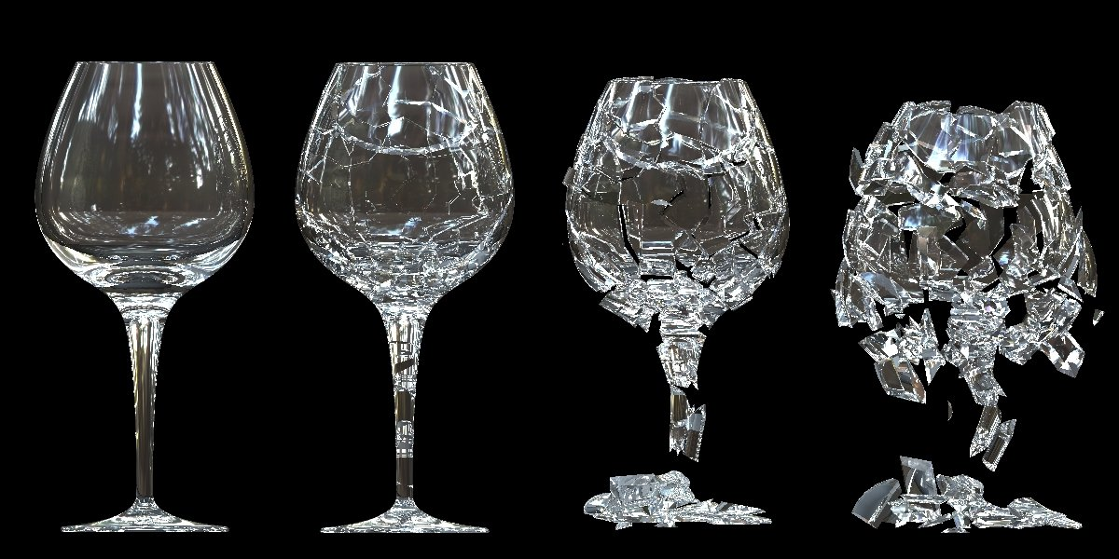
How does sound transmit energy?
http://earthref.org/SCC
Scripps Classroom Connection
Notes:
This image shows a glass being shattered by sound waves. From the previous activities the students should have an understanding that sound waves transmit energy.
Sound is a wave carried through the air, as that wave energy is transmitted to the glass the glass deforms in response. Because sound is a wave, at regular points energy is deforms the glass, the peak of the wave. At points when the pressure is low (the trough) the glass relaxes to it's regular shape. This happens repeatedly and if the frequency matches the ``natural frequency'' of the glass the deformation of the glass will exceed it's strength and shatter.
A useful way of thinking about natural frequency is to imagine pushing a child on a swing. The experienced playmate will know that the best time to push the child is just after the swing has swung back and is just beginning to move forward again. With such timing the swing will go higher and higher and the person pushing does not need to push harder.
There are many videos on-line that demonstrate the phenomena of breaking glass with sounds. Likewise there are videos that provide instructions for doing the experiment yourself, for example (http://www.youtube.com/watch?v=9KuwJXMQUdc).
Throughout all of the grade 8 general science our students have been drawing energy diagrams (see the appendix slide after the conclusions for an example). An energy diagram is a block diagram that shows the source and form of energy, the medium and form the energy is transmitted as and the final form that the energy takes. We find these diagrams useful in underscoring the year-long theme of energy transfer.
That said the ultimate goal is to have the student understand that sound is generated (by voice or more likely a speaker), transmitted through the air as pressure waves and vibrates the glass. Furthermore the students should note that the sound carries energy which is imparted to the glass, the waves do not carry air, which is what the sound travels through.
<number>

Slide 6
Conclusions
Waves carry energy, the higher the amplitude the higher the energy.
The material the wave travels through is not transported by the wave.
Energy travels from a source to a sink.
http://earthref.org/SCC
Scripps Classroom Connection
Notes:
As the slinky carried waves it took energy for the student to create those waves while the student holding the slinky in place had to fight to hold the end of the slinky still as the energy traveled down the slinky. The springs of the slinky moved back and forth across the table when making transverse waves or the coils of the springs got closer and further while the students made compression waves. This movement is not the same as transport. The coils didn't move from one student to the other, only the energy moved down the spring, as the slinky coils stayed more or less in place.
The same is true for the sound waves in generated by the frequency generator. The higher amplitude sound waves compressed the gas molecules more than the low amplitude sound wave. The web application provided a visual representation of this compression, as did the Rubins' Tube. As sound traveled from the speakers to the student's ears, the energy moved between them and the speaker, the air did not. The students will attest that there was not great gust of wind that came at them at the same speed as the sound!
The Rubins' Tube at a frequency which generates standing waves demonstrates again that energy travels and the medium does not. The standing wave will have peaks and troughs that are stable. This is despite the fact that the sound in constantly traveling as the speaker produces it.
The final demonstration of the breaking glass dramatically shows how energy is transmitted by sound waves. It further extends the concept that waves are everywhere. The glass vibrating is a kind of wave, and when the sound is at the natural frequency of the glass the energy transmission is so efficient as to setup waves in the glass will amplitudes so great that the exceed the strength of the glass.
<number>

Slide 7
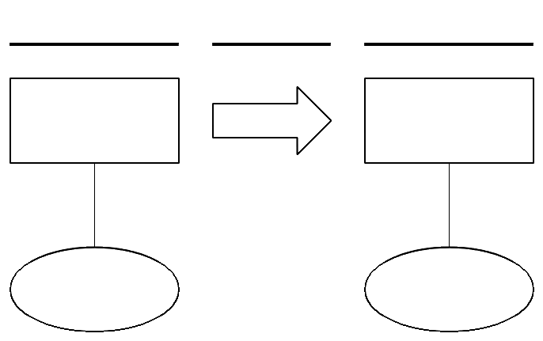
An Energy Transfer diagram..
http://earthref.org/SCC
Scripps Classroom Connection
Notes:
Students model energy transfer using this diagram. The two boxes are labeled with the physical objects which are the source of energy on the left and the sink on the right. The arrow is labeled with the medium for the transmitted energy. The lines above the boxes and arrows are labeled with the form of energy. The ovals below the boxes are labeled with with “increase” or “decrease” indicating and increase or decrease in the energy.
For example in an interaction between a speaker and a vibrating glass the labels may be thus:
BOXES/Arrow: Source: Speaker, Transport: Air, Sink: Glass
LINES: Source: Electrical Energy, Transport: Mechanical Wave Energy, Sink: Motion Energy
OVALS: Source: decrease, Sink: Increase
<number>

