Slide 1
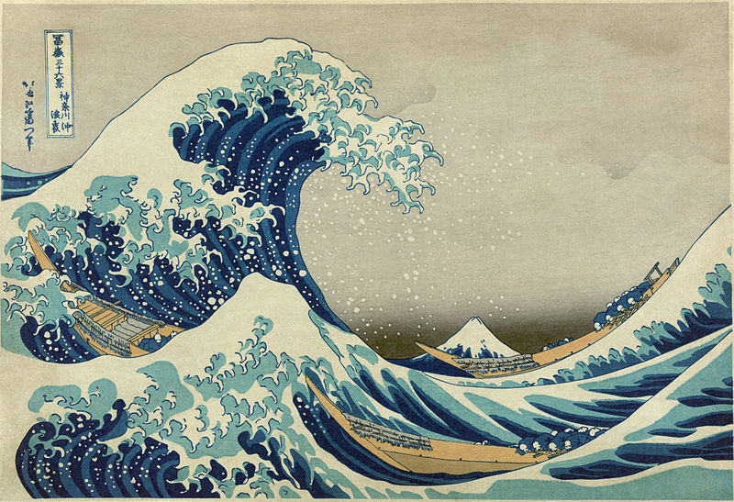
Mechanical Waves - Form & Function
Earthquake & Ocean Waves
http://earthref.org/SCC
Scripps Classroom Connection
Notes:
AUTHORS:
Robert Petersen, UCSD
Dan Grendziak, Wangenheim Middle School
WHY:
Waves exist everywhere, in the ocean, the atmosphere, the solid earth and the deepest reaches of space. Waves enable our technology and communication, the Internet runs on waves. Waves are useful, some waves are dangerous, think earthquakes and tsunami, even cosmic rays. Science in grade eight is taught with an emphasis on physical interactions and transfer of energy. Waves are a primary vector of energy transfer.
SUMMARY:
In this lesson we present earthquake waves. Looking at a seismograph we can see the arrival of the primary wave (P-wave), the secondary wave (S-wave) and the surface wave. Using what the students learned about the relationship between amplitude and energy, the relative energy of these waves is determined. Earthquake waves form as longitudinal waves (P-waves), transverse waves (S-waves) and a combination of longitudinal and transverse waves (surface waves).
Will will also address the misconception that breaking waves on the beach are similar to the waves we are talking about in this lesson. Using the concept of ocean swell we will then revisit the idea that waves carry energy and not water.
IMAGES:
“The Great Wave off Kanagawa” by Hokusai.
(http://en.wikipedia.org/wiki/The_Great_Wave_off_Kanagawa)
WEBSITES USED IN THIS PRESENTATION:
“Waves Across the Pacific”
Ocean Swell Clip:
http://www.youtube.com/watch?v=_WZSQO-deu8
Full Documentary:
http://www.youtube.com/watch?feature=player_detailpage&v=MX5cKoOm6Pk
ADDITIONAL READING:
The following references will provide the instructor with additional information not presented in this unit.
http://en.wikipedia.org/wiki/Mechanical_wave
http://www.physicsclassroom.com/class/sound/u11l1a.cfm
http://www.acs.psu.edu/drussell/demos/waves/wavemotion.html
CONTEXT FOR USE:
This lecture is suitable to grade 8 and grade 9 students studying general science. While this unit is independent from other units available students should be familiar with the concepts of energy storage and transfer.
MISCONCEPTIONS:
A common misconception regarding waves, and one that is addresses in this unit; is that waves carry the medium through which they travel. Waves carry energy from a source to a sync. This is the primary concept that should be communicated in this unit. It should be noted that in the ocean wave motion does produce some transport of water. This transport is much smaller than the transport caused by currents. The main motion caused by waves in the ocean is in the vertical direction.
EVALUATION TIPS:
Students will have mastered the vocabulary necessary to discuss waves and wave phenomena, be able to identify parts of a wave form and phases of an earthquake wave (P,S, and Surface Waves) in a seismograph. Students will understand that waves transport energy and will be able to diagram an energetic interaction involving a wave.
TEACHING NOTES.
<number>

Slide 2
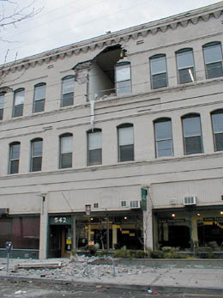

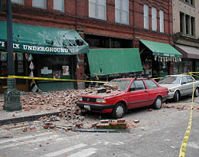
Earthquake wave transmit extreme amounts of energy from the breaking of faults between tectonic plates to buildings.
http://earthref.org/SCC
Scripps Classroom Connection
Notes:
These images are from the Feb 28, 2001 earthquake near Tacoma Washington. The temblor registered a magnitude 6.9, caused more that $1 billion in damage and injured 200 people.
The deadly power of earthquakes comes from the ability of the waves to transmit the energy released from tectonic plates as the forces driving them exceed the ability of the plates to remain bound together. This breaking releases vast amounts of energy which may travel to to buildings and other structures. Like the wine glass this energy can setup waves in the structures so large that the strength of the build is exceeded and it too breaks. As the wave travels through the earth little of the energy is lost. Like ripples on a pond, the energy from an earthquake spreads out from the epicenter in all directions. The energy from earthquakes that are far away or deeply sourced is spread out over a vast area so the local effect is reduced.
IMAGES:
Upper Left: “Collapsed wall on 1st Ave below S Jackson Street Seattle”
Lower Right: “Falling debris crushed parked cars at the Fenix Club, 2nd Avenue S at S Jackson Street, February 28, 2001”
http://www.historylink.org/index.cfm?DisplayPage=output.cfm&file_id=3039
<number>

Slide 3
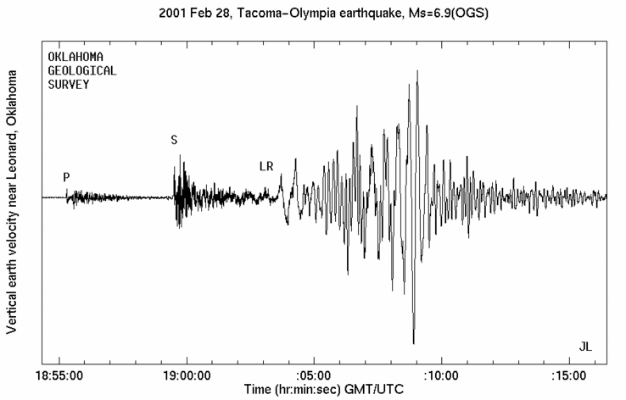
Earthquakes generate several types of waves.
http://earthref.org/SCC
Scripps Classroom Connection
Notes:
This slide shows the seismograph of a magnitude 6.9 earthquake near Tacoma Washington that occurred on 28 Feb, 2001. In the seismograph one can see three distinct wave arrivals.
A seismograph is a recoding of the movement of the earth during an earthquake. The vertical axis measures the movement of the earth and the horizontal axis measures the time, increasing from left to right. In the absence of an earth motion, the plot has zero amplitude. When an earthquake arrives the movement of the earth shown in the plot as deflections from the stead-state either above or below the line.
The first arrival, called the primary or P wave, is a compressional wave. P waves are the fastest waves which is why they arrive first.
The second arrival is the secondary or S wave. This is a transverse waves also called a shear wave. The S wave has a higher amplitude and carries more energy.
The very large amplitude waves shown at the end of the earthquake in the seismograph are surface waves. Unlike P and S waves which travel through the earth's interior, surface waves travel along the surface of the earth. The surface waves are the largest magnitude and carry the most energy and are responsible for the bulk of earthquake damage.
Image:
“Tacoma Olympia Earthquake 2/28/2001”, The IRIS Consortium
(http://www.iris.edu/hq/gallery/photo/1667)
<number>

Slide 4
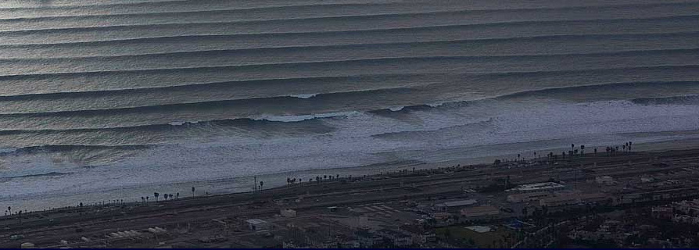
What wave properties can you identify in ocean waves?
How do ocean waves transfer energy?
http://earthref.org/SCC
Scripps Classroom Connection
Notes:
The image shows ocean swell approaching and breaking on a beach. Students frequently identify breaking waves as an example of waves. For this unit however they are a poor example as they include turbulence and other nonlinear properties not associated with the simple waves presented here.
A better example of ocean waves are the waves far from shore or swell. These waves have all the properties that have been presented in this unit and are easily identifiable.
Waves that occur in the ocean or on large lakes are driven by wind. The fetch (length of water over which the wind is blowing) and the wind speed are primarily responsible for wave size. When the wave reaches the shore the energy is transferred to the beach and to the atmosphere. The sound of breaking waves is evidence of such energy transfer as is movement of sand on the beach.
IMAGE:
http://alinecasey.blogspot.com/2011_06_01_archive.html
<number>

Slide 5
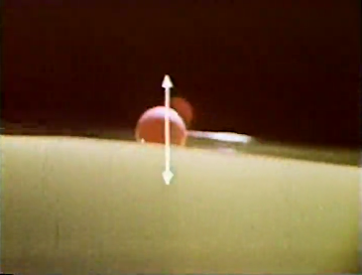
Ocean waves primarily transport energy not water.
http://earthref.org/SCC
Scripps Classroom Connection
Notes:
This is a clip from the film “Waves Across the Pacific”. This documentary showcases Walter Munk's research on waves generated by Antarctic storms. The film documents Munk's collaboration as they track storm-driven waves from Antarctica across the Pacific Ocean to Alaska. The film features scenes of early digital equipment in use in field experiments with Munk's commentary on how unsure they were about using such new technology in remote locations.
In the clip selected (see URL below) Munk describes the motion of ocean swell over a video of a wave tank. In the wave tank a ball is floating on the surface. As the wave passes the ball the viewer sees the primary motion ball (and by proxy the water) is up and down.
Energy moves horizontally, not the water.
VIDEO:
Ocean Swell Clip:
http://www.youtube.com/watch?v=_WZSQO-deu8
Full Documentary:
http://www.youtube.com/watch?feature=player_detailpage&v=MX5cKoOm6Pk
<number>

Slide 6
Conclusions
Sound waves, earthquake and ocean waves share several properties common to all waves and are very efficient transmitters of energy.
Amplitude
Frequency
Period
Wavelength
Speed
http://earthref.org/SCC
Scripps Classroom Connection
Notes:
We have now see waves in several different media, the air, water and land. All of these waves carry energy. In the case of sound waves that energy can be interpreted as information. Waves that travel through the earth, seismic waves carry the extreme energy released during the rupture on an earthquake fault. The seismograph shows that after the initial shaking of the first arriving P-wave the coming S and surface waves will have still more shaking with greater amplitude and energy.
As the ocean waves crash on the shore, the energy that they carried from far off in the ocean is transformed into sound, and used to move sand on the beach and causes the water to run up on the shore. When a large swell is coming in beach goers know that it will crash with a louder sound and will run up on the beach further because it carries more energy.
The demonstration of the ball in the water tank shows how the ball (and the water) primarily moves up and down, while the waves move left to right. The waves carry energy, not water.
In all these places and in all these different media these waves have properties that allow us to compare and contrast them. All waves have an amplitude. The amplitude is how high the transverse wave is or how compressed the medium of the longitudinal wave is. For example how compressed are the coils of the slinky or the pressure in the gas carrying a sound wave.
The peak and trough are the points of maximum and minimum amplitude. These points provide use with a clear point on which to measure other parts of the wave. The frequency for example is how ofter a peak passes a fixed point. The distance from peak to peak or trough to trough is the wavelength.
As the waves travel, from speaker to ear, or from epicenter to seismometer, or from ocean storm to shore, it takes time to travel. The speed of the wave (like all speed) is the distance traveled divided by time it takes to travel.
Amplitude – The height of the wave above or below zero.
Wavelength – The distance from peak to peak or trough to trough, measured in meters (m)
Frequency – The number of times a peak or trough passes a point per second, measured in Hertz (Hz)
Period – The time it takes for a wave to travel 1 wavelength, measured in seconds (s)
Speed – The time it takes a wave to go a certain distance, measured in meters per second (m/s). The speed is the wavelength divided by the period or the wavelength times the frequency.
<number>

