Slide 1
Tsunamis
Today we’ll focus on the tsunamis you researched a few days ago.
Key Question: What creates a tsunami? Where do tsunamis tend to occur?
Notes:
Tsunamis
Valerie Sahakian (Graduate Student, Scripps Institution of Oceanography) and Joe Krupens (Teacher, University City High School, San Diego, CA)
**Note: This power point is meant to help teachers guide classroom discussion and learning, not to show. Slide 2 however is meant to be shown to students.
WHY : Tsunamis can be caused by several things (landslides, volcanic eruptions, earthquakes), but most are associated with large megathrust earthquakes. Understanding where they happen and why is key in forming early warning systems, preventing damage, and saving lives.
SUMMARY: This lesson begins with a review of students’ Damage Caused list for tsunamis, students write a paragraph summarizing the type of damage tsunamis tend to cause. Next, perform a demo using a wave tank to allow students to observe the difference between wind-driven waves and tsunamis. This is followed by a discussion of the similarities and differences, and can be followed by a video (URL below) if more explanation is necessary. Once students understand the characteristics of these two waves, they look at the tsunamis they researched in Lesson 1 and map the cause of their tsunamis. They add to their Observations list with any new patterns they notice after mapping the cause, and once this is complete, they form hypotheses of an earth process that would explain all of their observations.
This lesson uses the document WaveTankDemo.docx. This has instructions for making the wave tank and running the demo.
WEBSITES/RESOURCES USED IN THIS PRESENTATION:
Ocean Waves
National Oceanic and Atmospheric Administration’s Ocean Explorer Multimedia Discovery Missions
http://oceanexplorer.noaa.gov/edu/learning/player/lesson09.html
CONTEXT FOR USE: This is part of the Plate tectonics through Natural Disasters unit, intended for a 9th grade earth science classroom. Prerequisites for this lesson are Lessons 1 and 2, and a basic knowledge of mechanical waves (characteristics such as amplitude, frequency and period, as well as understanding that water doesn’t move, energy moves).
MISCONCEPTIONS: Students may think that tsunamis are a very large, breaking ocean wave when in fact it’s more like a flood or short-period tide. Some students may think that tsunamis are caused by storms or wind.
EVALUATION TIPS: Reading students’ paragraphs and descriptions of the wave demo can be used to evaluate their understanding of ocean wave/tsunami characteristics. The group/class lists they make on the board can be used. Additionally, their additions to their Observations list can be used to evaluate their understanding of tsunamis and where they tend to occur, as well as the hypotheses the write to explain all of the observations on their list.
TEACHING NOTES. On this slide, have students read the key question and write thoughts in their notebook.

Slide 2
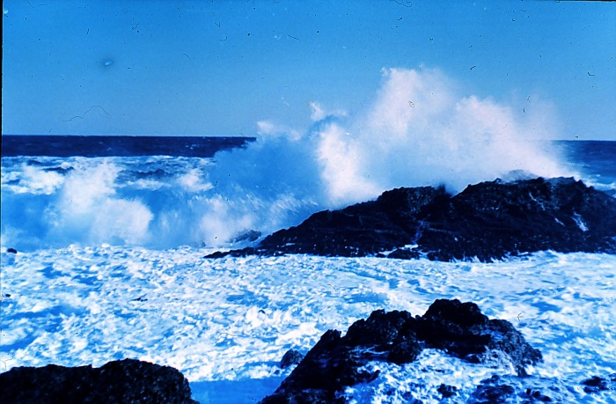
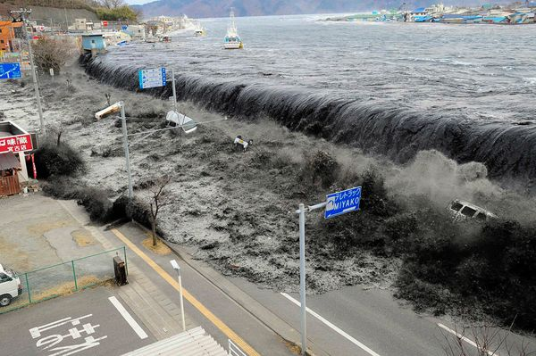
What kind of damage occurred due to the tsunamis you researched?
Is there anything in common?
Which picture above is a tsunami, and which is an ocean wave?
Notes:
TeachingNotes: The purpose of this section is to guide the presenter through what should be said when discussing this particular slide.
What kind of damage occurred due to the tsunamis you researched? -- Have students look through their Damage Caused list to pick out what occurred due to tsunamis.
Is there anything in common? -- Have students discuss what damage is common to tsunamis. Have them then write a paragraph summarizing their findings – what kind of damage is common for tsunamis, and what could be done about it in the future.
Which picture above is a tsunami, and which is an ocean wave? -- The top picture is an ocean wave breaking. The bottom picture is from the 2011 Tohoku tsunami. Ask students why they pick their response – what do they know about tsunamis? This is important for determining misconceptions.
Top photo:
Captain Albert E. Theberge, NOAA corps (retired)
Wave breaking in Point Lobos, CA
NOAA photo library
http://www.photolib.noaa.gov/htmls/theb0011.htm
Bottom photo:
Mainichi Shimbun/Reuters
National Geographic News – Japan Tsunami, 20 unforgettable pictures
Tsunami in Miyako City, Iwate Prefecture, March 11th 2011
http://news.nationalgeographic.com/news/2011/03/pictures/110315-nuclear-reactor-japan-tsunami-earthquake-world-photos-meltdown/#/japan-earthquake-tsunami-nuclear-unforgettable-pictures-wave_33291_600x450.jpg

Slide 3
Wave Tank Demo
Watch the wave tank demos. For each demo, record:
  The approximate length between cycles or wavelength
  Do particles at the bottom of the tank move?
Notes:
Use this slide to guide the wave tank demo. Use WaveTankDemo.docx to create the wave tank, and run the demo.
Have students use a page in their notebook to record the values listed in the slide (amplitude, and if the particles at the bottom of the tank move). Have them perform 5 trials for ocean waves and tsunamis each, and compute the average amplitude for ocean waves and for tsunamis.
Once the demo is complete, have students make a class list with the characteristics of ocean waves vs. tsunamis. These values they recorded will be used here, and also used to determine how they affect us.
Ask students if their preconceptions about tsunamis has changed. What did they learn from this exercise?

Slide 4
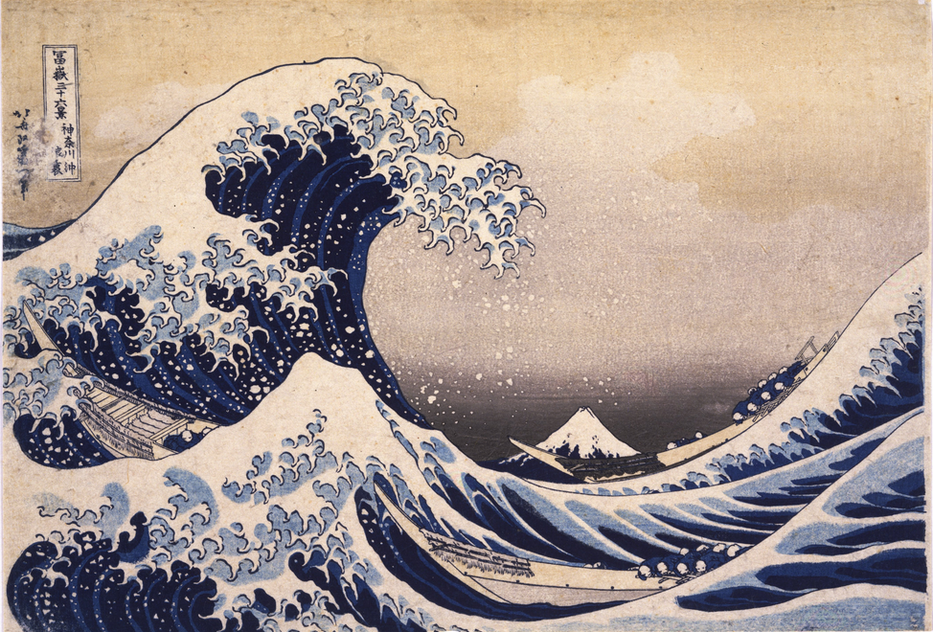
NOAA Ocean Explorer - Waves
The Great Wave Off Kanagawa, Katsuhika Hokusai c. 1829-32
Notes:
Play this lesson from NOAA Ocean Explorer. The remaining slides are important to cover however – this is an added explanation if students seem to be having difficulty understanding the difference/characteristics between tsunamis and ocean waves.
Note that at some point in the video, tsunamis are represented as breaking waves –this almost never happens. It is important to mention this to students.
Ocean Waves
National Oceanic and Atmospheric Administration’s Ocean Explorer Multimedia Discovery Missions
http://oceanexplorer.noaa.gov/edu/learning/player/lesson09.html
The Lesson here discusses the characteristics of ocean waves and tsunamis. The first part of the global impact video is more directed towards energy harnessed from waves, which is a little beyond the scope of the presentation, though interesting if you wish. The second half discusses tsunamis.
Photo:
Artist: Katsuhika Hokusai
Year: c. 1829 - 1832
Print: The Great Wave Off Kanagawa

Slide 5
What about your tsunamis?
What caused your tsunamis?
Map the cause of your tsunamis
What do you notice about where these tend to occur? Does this add anything to your previous observations?
Notes:
-What caused your tsunamis? -- Have students look back at their tsunamis and find what caused them. Reinforce that movement of the seafloor is what creates tsunamis.
-Map the cause of your tsunamis -- Have students add stickers/labels to their globe for the cause of their tsunamis.
-What do you notice about where these tend to occur? Does this add anything to your previous observations? -- Have students add to their Observations list with anything new they notice. This is important for evaluation, in seeing what the students pick out about the connection between certain plate boundaries and the hazards that exist there, as well as how it affects places across the ocean.

Slide 6
What do you think?
Add one last thing to your observations list – what do you notice about the seafloor features and bathymetry? Is there any connection to everything else you’ve mapped?
Look back at your Observations List – what kind of earth processes would explain all your observations?
Form a hypothesis.
Notes:
-Add one last thing to your observations list – what do you notice about the seafloor features and bathymetry? Is there any connection to everything else you’ve mapped? -- Have students look at the bathymetry and seafloor features on their globes/maps, and write down anything they notice about these features and their events.
-Look back at your Observations List – what kind of earth processes would explain all your observations? -- Have students re-read all their observations, and start to think of an explanation for them. What kind of earth process could explain all these?
-Form a hypothesis. -- Have students write down a hypothesis. This should explain all their observations. If you have not covered plate tectonics at all, try to lead them to a system that would create this. If you have covered some plate tectonics, this can be a more detailed hypothesis, ie how do the plate boundaries affect the stress regime in different areas, how does this affect us, etc.
-Once students have complete this, have them share their hypotheses with each other, and write them on the board. Start a discussion about how the might test their hypotheses, and which of all those posed do they think is the most viable?
-These hypotheses will be important for the next few lessons, where students focus more on the engineering aspect of things – now that they’re aware of the hazards that exist at certain plate boundaries and the type of damage these potential disasters cause, what can they do to prevent future damage? Why is plate tectonics important in their daily lives?

