Slide 1
Earthquakes
Why do we care about plate tectonics? For one, they make earthquakes!
Key Question: Why are earthquakes damaging? How can we better engineer our buildings to prevent damage and collapse?
Notes:
Earthquakes and Engineering
Valerie Sahakian, Graduate Student, Scripps Institution of Oceanography and Joe Krupens, Teacher, University City High School, San Diego CA
**Note: This powerpoint is meant mostly as a guide to teachers, for notes and as a discussion guide. Slides 4 – 7 however should be shown to students.
WHY : Most damage during earthquakes is not due to the movement of the earth itself, but due to structures around us. This lesson will introduce students to seismology basics, and how to apply those to engineering solutions to reduce damage and prevent collapse of structures during an earthquake.
SUMMARY: This lesson may take 2 days or more. It starts off with seismology basics, such as how body waves and surface waves move. It shows students how to interpret a seismogram. Then it transitions to engineering, first trying to explain the impact of seismic waves on structures with real shake table videos, and then leads students through an exercise of engineering their own buildings to seismic code, and writing a building code for southern california.
This lesson uses Earthquakes.docx, ShakeTableActivity.docx, ShakeTableAct_forTeachers.docx, Lesson4TestingAndWritingRubric.docx.
WEBSITES/RESOURCES USED IN THIS PRESENTATION:
Pictures of seismic waves: Exploratorium, Faultline Seismic Science http://www.exploratorium.edu/faultline/basics/waves.html
L. Braile, Purdue University, Personal Website: http://web.ics.purdue.edu/~braile/edumod/waves/WaveDemo.htm#P_S_R_L_Animations
USGS Interactive Fault Map - http://earthquake.usgs.gov/hazards/qfaults/map/
USGS California Fault Map - http://geohazards.usgs.gov/qfaults/ca/California.php
Earthquakes, FEMA ready.gov - http://www.ready.gov/earthquakes
QuakeQuizSF, San Francisco Department of Emergency Management - http://quakequizsf.org/
Beat The Quake Quiz, Earthquake Country Alliance and Home Depot - www.dropcoverholdon.org/beatthequake/game/
The Great ShakeOut - Earthquakes, FEMA ready.gov - http://www.ready.gov/earthquakes
ADDITIONAL READING: The IRIS Seismic Wave Behavior animation could be helpful for demonstrating how seismic waves affect buildings. http://www.iris.edu/hq/programs/education_and_outreach/animations/6
CONTEXT FOR USE: This lesson is intended for a 9th grade science classroom. Prerequisites: Basic understanding of waves (characteristics, that they transfer energy), and basic understanding of plate tectonics. This lesson is intended to complement the first few lessons in the unit Natural Disasters through plate tectonics.
MISCONCEPTIONS: Students may think that the earth opens during earthquakes and that is the hazard; they may think that the majority of damage in an earthquake is from severe ground shaking; they may think that all seismic waves move in the same way. Students may think that Surface waves are “aftershocks” and p and s waves are the main shock – every earthquake has all of these seismic waves (including aftershocks) – aftershocks are just smaller earthquakes that continue to release stress in the earth’s crust.
EVALUATION TIPS: Use students seismic wave matching exercise to evaluate their understanding of the reading and lesson information; Evaluate students based on how they label the seismogram (this will determine how well they understood the concept of seismic waves traveling at different speeds); Watch students’ building models for the shaketable, and listen and read their “reports” on the building’s performance and on future building codes.
TEACHING NOTES. Have students write down their first thoughts regarding the key question. This will get them thinking about what they already know regarding earthquakes.

Slide 2
What causes earthquakes?
They happen at plate boundaries
As plates move, they stick, like holding two pieces of sandpaper.
This builds up energy.
After a while, the plates will slip, releasing energy. A lot of this energy is in the form of seismic waves.
Notes:
TEACHING NOTES: Use this slide to guide students discussion; you may wish to not show the slides at all, as this can be distracting. If you do show the slide, then ask them a question regarding the bullet before showing the bullet, and wait for their response. For example:
What have we learned now about earthquakes and plate tectonics, where do we tend to find earthquakes? (Wait for responses, gauge students’ understanding by their responses and try to fix holes if you notice misconceptions). Show bullet after class comes to a consensus.
Do you think plates smoothly slide against each other like butter, or do they stick? (Wait for responses, show bullet)
What happens when the plates stick? (Wait for responses, show bullet)
So then how do earthquakes start? What happens to all that energy that was built up? (See what students say – if they seem to understand that plates break once the stress builds up to a certain amount, then continue on to ask what happens to the energy. Make sure students understand that waves transfer energy, and do not move the material. Then show bullet).

Slide 3
Slinky Activity
Make seismic waves with your slinkies!
Now read the article on Earthquakes.
Which of your waves is a P-wave? An S-wave? A Love or Rayleigh wave?
Notes:
Make seismic waves with your slinkies! -- Have students partner up. One partner holds one end of the slinky still, and the other partner moves the other end of the slinky. Have them think of any possible way to make a “wave” with the slinky. This includes: back and forth, side to side, up and down, and a combination of all of these.
You can use the URL below to visualize the types of waves they can make:
http://www.exploratorium.edu/faultline/activezone/slinky.html
And here you can visualize waves other than P (to try with the slinky):
http://web.ics.purdue.edu/~braile/edumod/waves/WaveDemo.htm#P_S_R_L_Animations
Walk around to direct students, and make sure they understand all the different ways to make a wave. Then ask them to share how they made a wave. Maybe demonstrate at the front of the classroom if not everyone can see what they’re doing.
2. Have them read the article Earthquakes.docx. Print out a couple of these per group, or one per student.
3. After they’ve read the article, ask them to think back to the waves they made with their slinky. Ask them to match the waves they made with what they read about.
Alternative method:
Instead of having students play with the slinkies individually or in groups, you can do a demonstration in the hallway or front of the classroom in the same fashion – ask students how you might be able to move the slinky. With each demonstration, discuss what type of wave it is (compressional, transverse, or both) and then describe which ones P, S, Love and Rayleigh waves are. Be sure to ask them where the peak and crest are in the wave you are making, and ask them if the slinky is traveling between people holding it or if energy is traveling between the two people. Then have them read the article after the demonstration. Students may have a difficult time identifying the peak and crest of the compressional wave with the slinky.
**IMPORTANT: Students should have some previous knowledge on mechanical waves. Be sure to remind them (and ask them) what’s happening with the energy in the slinky, and the physical slinky. Is the whole slinky moving, or just parts of it? What about the energy? Be sure to note that the energy is transmitted from one person to another, and eventually returns to the original person. It is transmitted by temporarily moving parts of the slinky, but not the whole slinky. This disturbance is how mechanical waves transmit energy – the same thing is happening in the earth, or in water with seismic waves and waves in the ocean (ocean waves, tsunamis).

Slide 4
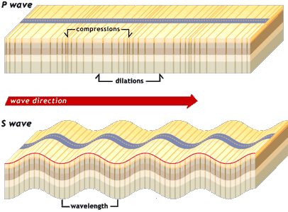
P-waves and S-waves
Body Waves
They travel straight through the earth
P-waves are compressional – back and forth.
S-waves are transverse or shear – side to side, or up and down
Notes:
TeachingNotes: This slide is to reinforce what they learned about Body waves. Use the image (same as on their reading) to reinforce the wave they made with their slinky to the seismic wave.
This photo shows P-waves being compressional. It shows the areas of compression, and dilatation. It also demonstrates that S-waves move up and down or side to side, and shows how one would measure the wavelength. It shows the direction in which the wave is moving.
Bullets: Body waves travel straight through the earth (through the “body” of the earth as opposed to on the surface)
P-waves have a compressional motion, made by moving particles back and forth (aka pushing the slinky back and forth).
S-waves have transverse or shear motion, particles move up and down or side to side.
Additional Resources – this video is very good to explain transverse/longitudinal waves, and the different types of transverse motion. Starting in section 2.
Monterey Institute for Technology and Education
Wave Motion/Wave Basics
http://www.montereyinstitute.org/courses/Introductory%20Physics%20II/course%20files/multimedia/lesson42/lessonp.html?showTopic=1
Photo: From the Exploratorium Faultine Seismic Science site
http://www.exploratorium.edu/faultline/basics/waves.html

Slide 5
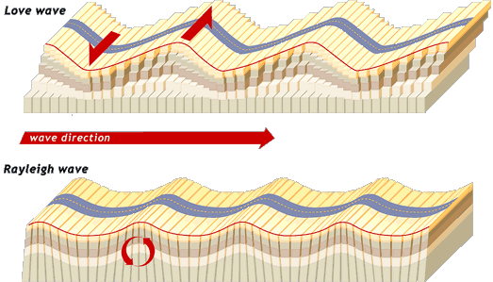
Love and Rayleigh waves
Surface Waves
They travel on the surface
Love waves move side to side
Rayleigh waves move up and down, and back and forth.
Notes:
TeachingNotes: This slide is to reinforce what they learned about Body waves. Use the image (same as on their reading) to reinforce the wave they made with their slinky to the seismic wave.
This photo shows P-waves being compressional. It shows the areas of compression, and dilatation. It also demonstrates that S-waves move up and down or side to side, and shows how one would measure the wavelength. It shows the direction in which the wave is moving.
Bullets: Surface waves travel only on the surface of the earth
Love waves move side to side, like some S waves
Rayleigh waves move up and down AND back and forth
Photo: From the Exploratorium Faultine Seismic Science site
http://www.exploratorium.edu/faultline/basics/waves.html

Slide 6
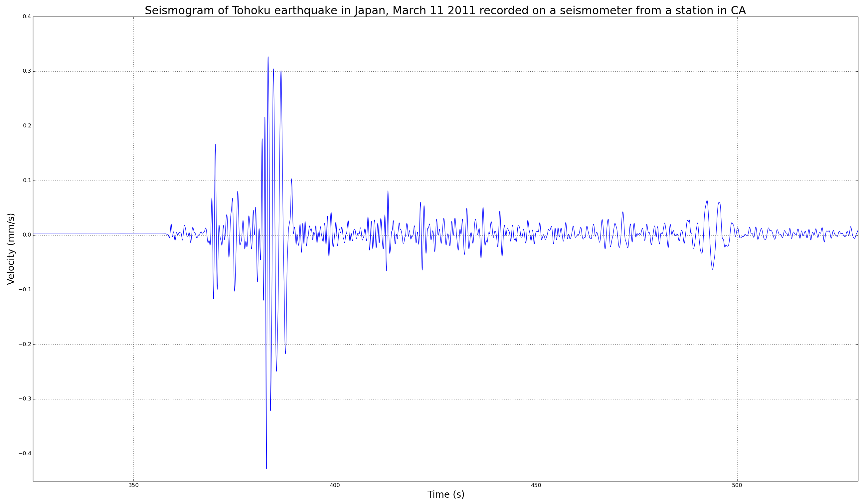
Identify waves in a seismogram
Notes:
Teaching notes:
A seismogram is the recording from a seismometer, the instrument we use to measure how fast the ground is moving during an earthquake. Make sure students understand the axes – the x axis is time in seconds, and the y axis is velocity in mm/s – so how fast the ground is moving.
- Ask students to identify the P wave (the first, small wave you see), the S wave (the second wave), and the surface waves (these start with the highest amplitude waves after the S wave, and continue). There’s a slide at the end with these labeled. Students should understand that P waves travel the fastest so this will be the first wave they see in the seismogram (the “first arrival”). They should understand that S waves travel the second fastest, so that will be the second wave, and surface waves travel on the surface and are even slower so it will take them longer to reach the instrument – and hence are the last wave to be recorded.
Ask students which wave they think would be the most damaging. They should notice that the surface waves have the largest amplitude, and these will likely cause the most damage since the shake the ground the most.
Plot:
Recording from the station PFO at Pinon Flats in California. The recording is from March 11 2011, and the event seen here is the Tohoku earthquake in Japan (magnitude 9.0).

Slide 7

Earthquake on the San Andreas Fault!!
Notes:
Teaching Notes:
This is a model of a potential earthquake on the San Andreas Fault, magnitude 7.7. The model on the left assumes the fault ruptures from north to south, and the model on the right assumes the fault ruptures from south to north, starting at it’s tip by the Salton Sea. The thick white lines are faults. The color represents velocity, the cross-hair is where the peak velocity magnitude is during the simulation.
First make sure students can orient themselves – make sure they know where they are on the map, and what direction is North (there is a N arrow – in each simulation, the left-hand side of the map is NW, and right-hand side is SE). Be sure students understand that this is a model – meaning scientists make some assumptions, and make a model based on information they know. These are two of the most likely scenarios of an earthquake on the San Andreas given the information we have. Note how most of the shaking is in LA for both models. In the left simulation, the fault starts rupturing in the NW and goes to the SE. Here, most of the ground shaking is directed South, towards the Salton Sea and Palm Springs and Mexico. In the simulation on the right, the fault ruptures in the opposite direction, so from the Salton Sea to the NW. In this model, LA sustains ground shaking for a long time, and large values as well. Seismic waves get trapped in the sedimentary basin around LA. Use this to ask students what areas they think would experience the most shaking if the San Andreas Fault ruptured in this way, and where they think the greatest hazard is. Ask them in which areas they would make building codes stricter.
It may be good to play this a few times – the first time just to allow students to watch, and the second, third etc. for narration.
Movie:
TeraShake_vmag-sidebyside_1280
Movies made as part of the Southern California Earthquake Center’s (SCEC’s) TeraShake program.
http://www.scec.org/resources/movies.html

Slide 8
UCSD Shake table
Shake table Denali Earthquake – Outside
Shake table - Interior
Notes:
About the shaketable and videos:
These two videos are from the shake table, operating at the University of California, San Diego (UCSD) in conjunction with the Network for Earthquake Engineering Simulation (NEES). The shake table is used for many projects, to test building response and engineering during earthquakes. The videos shown here are from a 5 story building. Simulations were designed to test various engineering techniques (ie base isolators), and also had home, office, and hospital rooms set up inside. Another main test was to see how well various hospital settings (ie surgery room) would perform during an earthquake, and what can be done in the future to insure that they continue to function after a large earthquake. Lastly, they set the building on fire to see how a seismically damaged building would respond to fire (which is not unlikely in the event of an earthquake). For more information, watch the video below under Additional Resources. The video explains the intentions of these simulations, among other things. 13 minutes long.
Teaching Notes:
Before showing these links, ask students what they think can be done to prevent damage or building collapse during an earthquake. Ask them what they think the greatest danger is (ie the building shaking, or things inside the building?), ask them if they think certain buildings are more important than others and which (hint: hospitals are very important to infrastructure especially after an earthquake, and should be designed to continue functioning after an event. See the additional resources video on the shake table – you can show this to students if there’s time.
Then, show students the two videos linked in this slide. The first is a video showing the outside of the building during a Magnitude 7.9 earthquake from a strike-slip fault - it mimics the M7.9 earthquake that occurred in Denali, Alaska in 2002. The first video also shows the main columns in the building on the first and third floors. Mention to students that you can see an outlet in one of the columns, for scale.
The second video shows the inside of the building, on a floor with a home environment and laboratory environment. It shows three simulations: the first two simulate an earthquake that occurred in 2007 in Pisco, Peru from a subduction zone (M8.0). The first simulation shows the response of the building with base isolators (rubber bearings that allow the building’s foundation to move back and forth). The second simulation shows the building without base isolators – so a fixed foundation.
Ask students to compare the first two simulations of this second video – how much do things move? Is it different between simulations? (Base isolators will allow less shaking in the building since it allows the building to move back and forth).
The third simulation shows the building during the 2002 M7.9 Denali Earthquake on a building with a fixed base. Ask students how different this is. In this one, some items fall down inside the building – ask them if they think that is a problem. Ask them what would happen if it were a glass cabinet, or if there were heavy items on shelves that were not secured, etc. Get them thinking about things that should be secured inside a building.
Lastly, have students add to the list they made earlier about things to consider when designing buildings for earthquakes. Have their thoughts changed?
Additional resources:
13 minute video on shake table
http://uctv.tv/shows/Protecting-Californias-Hospitals-The-Preview-UCTV-Prime-Cuts-23597
Videos:
Outside of building, UCSD/NEES’s large high-performance outdoor shake table in San Diego.
http://www.youtube.com/watch?v=gpFGpO0P9e4
Inside of building, UCSD/NEES’s large high-performance outdoor shake table in San Diego.
http://www.youtube.com/watch?v=fczaBmW4yK4&feature=youtu.be
More can be found here:
http://bncs.ucsd.edu/index.html

Slide 9
Your own shake table and building code
Build your own buildings to test on a shake table! Follow the instructions given to you by your teacher.
Which buildings performed the best? Why do you think they performed the best?
Make your own building code!
Notes:
Build your own buildings to test on a shake table! Follow the instructions given to you by your teacher
Give students the activity in ShakeTableActivity.docx. Teacher’s guide in ShakeTableAct_forTeachers.docx. The instructions for making a simple shake table are in the ShakeTableAct_forTeachers document, and the activity to give to the students is in ShakeTableActivity.
Before performing this activity, give students an overview of how it will be run. Discuss how moving the table back and forth represents one direction of shaking in the ground (the ground actually shakes in 3 directions). This is like reproducing the ground motions during an actual earthquake, or close to it.
Which buildings performed the best? Why do you think they performed the best?
Ask students which building lasted the longest, sustained the strongest shaking. Ask them what about the engineering/structure of the building made it perform the best. If the base isolators or cross braces performed the best, ask them what they think about those techniques makes a difference. Why did these engineering techniques perform the best? What about these structures allows them to withstand the shaking?
Make your own building code!
Have students write a “building code” for southern California. They should include things like which cities should have stricter building code (have them think back to the San Andreas fault rupture model, maybe LA should have a stricter building code!), what types of structures are most important in an earthquake (ie hospitals and schools are very important, water facilities, power facilities, etc), and what type of building techniques would they require. What about things inside the buildings? (How should they be secured? Tied down, or have shelves with lips…)
If there is no time in class, have them complete this as a homework assignment.
For this part of the activity, use Lesson4TeachingAndWritingRubric.docx. This describes the chart students should use to record their observations during the activity, as well as the expectations for the writing assignment which will be used to assess them.
This will help them understand what type of structures are important in an earthquake, and different ways that we can reduce damage during an earthquake.
Links to put up while students are writing – use these fault maps so they can determine which areas of California are near active faults (the quaternary faults):
USGS Interactive Fault Map
http://earthquake.usgs.gov/hazards/qfaults/map/
USGS California Fault Map
http://geohazards.usgs.gov/qfaults/ca/California.php

Slide 10

What can YOU do to be safe in the next earthquake?
Make a list of things you can do to stay safe:
  Before an earthquake
  During an earthquake
  After an earthquake
Compare these with a list that your teacher shows yo
Participate in the ShakeOut!
Notes:
Teaching Notes:
This unit was taught in Southern California – part of “Earthquake Country!” Students should not only understand what earthquakes are and how they’re started, and how we prepare for them as a society – but they should also understand what they can do individually.
-Have students group up. Have them first make a list of the hazards that they think could exist in their own homes, schools, during their commutes, etc if an earthquake were to happen.
-Have students then make a list of things they could do to stay safe: before the earthquake, during the earthquake, and after the earthquake.
-Have them discuss these with the class. Next, put up this website:
Earthquakes, FEMA ready.gov - http://www.ready.gov/earthquakes
-Go through the Before, During, and After tabs (especially the “Build a Kit” link in the before tab), and have them compare to their list. Have them modify their list to include some of these tips.
-For fun, have the groups participate in these two interactive quizzes to reinforce what they just learned – one about what to do during an earthquake, and the other about making a living room safe.
QuakeQuizSF, San Francisco Department of Emergency Management - http://quakequizsf.org/
Beat The Quake Quiz, Earthquake Country Alliance and Home Depot - www.dropcoverholdon.org/beatthequake/game/
-Lastly, talk with your students about the Great Shake Out Earthquake Drills. There are drills all over the world – to participate, just sign up and follow some of the custom instructions for K-12 schools. These drills are intended for earthquakes that could happen in your region. Before the drill, students may do things like study and/or create evacuation plans, check earthquake supplies, etc. At a certain time, the simulated earthquake will “occur”, and students can “drop, cover, and hold on” For more information and to register to participate, go to: http://www.shakeout.org/
Additional Resources:
Federal Emergency Management Agency (FEMA), Earthquake Safety at School - http://www.fema.gov/earthquake/earthquake-safety-school
United States Geological Survey, Preparedness - http://earthquake.usgs.gov/learn/preparedness.php
Photo credit:
The Great California ShakeOut
Shake Out. Don’t Freak Out.
http://www.shakeout.org/california/resources/index.html#multimedia

Slide 11
Identify waves in a seismogram
S-wave
P-wave
Surface waves
Notes:
Labeled seismogram, with P, S, and surface waves.
Plot:
Recording from the station PFO at Pinon Flats in California. The recording is from March 11 2011, and the event seen here is the Tohoku earthquake in Japan (magnitude 9.0).

