Slide 1
Tsunami Warning and Engineering
Tsunamis cannot be prevented, but some of the damage caused by them can be.
Key Question: In what way do you think damage from tsunamis can be reduced?
Notes:
Valerie Sahakian (Graduate Student, Scripps Institution of Oceanography) and Joe Krupens (Teacher, University City High School, San Diego, CA)
**Note: This powerpoint is meant for teachers, to help guide the lesson and questioning. However, slides 3 and 5 should be shown to students.
WHY : Tsunamis can devastate regions. Although they cannot be prevented, some of the damage can be reduced. By investigating early warning systems and engineering solution, students will become aware of hazards in various places of the world, what solutions exist to reduce damage, and how to apply what they’ve learned about waves and plate tectonics.
SUMMARY: Students first watch some tsunami footage to understand how these waves affect land. They discuss how they think early warning could be implemented, and ideas for engineering buildings to be tsunami proof. Next, they are walked through the components of an early warning system and what one can do with that warning. Last, they build structures to test in the wave tank to learn about what is used in real life.
This lesson uses TsunamiEngActivity.docx and TsunamiEngAct_Teachers.docx.
WEBSITES/RESOURCES USED IN THIS PRESENTATION:
-The wave tank used in Lesson 3 will be necessary for this lesson.
-HD Footage of Japan Tsunami
http://www.youtube.com/watch?v=J2hUwFo6Vpc
-NOAA Ocean Explorer Tsunami Early Warning Animation
http://oceanexplorer.noaa.gov/edu/learning/player/lesson09/l9la2_b.html
-Model of the 2004 Indian Ocean Tsunami from Dr. Steven Ward at UC Santa Cruz.
https://www.youtube.com/watch?v=IC4xWwZ60BE
-Model from NOAA of the Japan 2011 tsunami.
http://green.blogs.nytimes.com/2011/03/15/wave-power-of-tsunami/?_php=true&_type=blogs&_php=true&_type=blogs&_r=1
ADDITIONAL READING:
-NOAA: How a tsunami early warning system works: This is helpful for some information about the process of a tsunami early warning system
http://www.tsunami.noaa.gov/warning_system_works.html
CONTEXT FOR USE: This lesson is part of the Plate Tectonics and Natural Disasters unit. It is intended for a 9th grade earth science classroom. Prerequisites: Lessons 1-4. A basic understanding of mechanical waves and the anatomy of a wave, as well as a basic understanding of plate tectonics.
MISCONCEPTIONS: Students may think that tsunamis cause damage as a large breaking wave would (instead of like a powerful flood or surge).
EVALUATION TIPS: Listen to students’ discussions about how early warning systems would work, about what is so damaging to structures and how to construct better buildings to solve this, watch their building construction, and read their paragraphs on what “at-risk” areas should do for their buildings and seawalls, etc.
TEACHING NOTES. Use the Key Question to get students to write down their initial ideas. No idea is right or wrong, this is just to see from their standpoint as well as a teacher’s standpoint what they already know about the subject and what they can learn. Ask them in what ways do they think damage from tsunamis could be reduced – what if you had warning? Do you think you could devise a system to give a warning – say if you knew an earthquake happened? Could you build your structures differently?

Slide 2
Tohoku Tsunami Footage
Watch this video.
What kind of damage did you see?
Could anything be done to reduce some of this damage?
Notes:
-Show students the video of footage from the Japan tsunami. Pause every so often for discussion if helpful. Talk about how this is the initial arrival of the tsunami – after this it goes out, and comes back in, etc.
-What kind of damage did you see? - Ask them to describe what type of damage they see, and what they think it’s from.
-Could anything be done to reduce some of this damage? - There were trucks and cars on the road – what do you think you could do with a certain amount of warning – 10 minutes, 30 minutes? Or for example, when houses are carried away, could anything be done (perhaps inland, not by the coast where the tsunami is very powerful) to prevent that from happening?
Have students discuss in their groups and write some ideas about what could be done. How could they instate a tsunami early warning system? What kind of instruments would they use, how would you calculate a warning time? How about engineering buildings?
Video:
HD Footage of the Tohoku Tsunami in Japan.
http://www.youtube.com/watch?v=J2hUwFo6Vpc

Slide 3
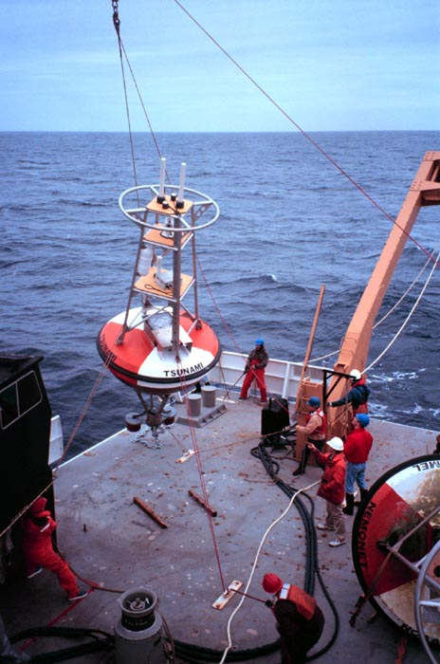
Tsunami Early Warning System
Early Warning starts when seismometers record an earthquake
Earthquake magnitude is important
What about tracking the wave?
Early Warning Animation
Notes:
-Early warning starts when seismometers record an earthquake - The first step in recognizing that a tsunami may have been generated is recording an earthquake on a thrust fault. We can tell from seismometers where an earthquake happened, how large it is, and what type of fault it occurred on, so if the first (and quick) estimate indicates it happened on a large thrust fault, other types of monitoring should begin and the first warning should be issued.
Ask students what they think the next steps are when seismometers have recorded an earthquake. Ask them if they think it matters where the earthquake happens, and on what type of fault.
-Earthquake magnitude is important. - The larger the earthquake, the larger the displacement, the larger the potential tsunami. The displacement at the seafloor is what matters, and not all large earthquakes produce the same amount of displacement on the seafloor (More displacement = larger tsunami).
Ask students why they think the magnitude is important. Ask them how that would affect the warning.
-What about tracking the wave? - Now you have a clue that there is likely a tsunami, but you want to know how large it is and where it is, how fast it’s traveling. How would you track it? Ask them for their ideas.
-Early Warning Animation - Have students watch the short animation from NOAA about pressure sensors and DART buoys. These pressure sensors are placed under the ocean floor, and can sense a tsunami because there is more pressure on top of it as the crest of the wave passes. They send the data to a buoy on the surface, which sends the data to a satellite and then to data centers around the world which use it to model the tsunami. Once this happens, we have a much better idea of how much time before the tsunami reaches land.
Ask students what they think is going on in the animation, and then describe it. If time, ask them the questions below the animation, especially the one regarding ocean waves.
Then ask students what they would do with that much time of warning – where would they put sirens, how would the communicate to the public the warning?
Early Warning Animation:
NOAA Ocean Explorer Tsunami Early Warning Animation
http://oceanexplorer.noaa.gov/edu/learning/player/lesson09/l9la2_b.html
Some things to keep in mind:
- Models are an important part of the warning process. For areas close to the earthquake, the best solution is just to go to higher ground for a few hours, until risk has passed. For areas that are further away, early warning helps in models. This is where the buoys come in – the wave height they record goes into models that will predict wave height and arrival time at different areas across the ocean.
- To illustrate this, show these two videos:
1. Model of the 2004 Indian Ocean Tsunami from Dr. Steven Ward at UC Santa Cruz. Notice that around 1 hour and 30 minutes the tsunami hits madagascar. This is where the model would be useful, if an early warning system were in place. There are wave run-up heights at the end of the movie. https://www.youtube.com/watch?v=IC4xWwZ60BE
2. Model from NOAA of the Japan 2011 tsunami. Notice how this takes about 6 or 7 hours to hit the Hawaiian islands. Also notice how this encounter diffuses the wave a bit.
http://green.blogs.nytimes.com/2011/03/15/wave-power-of-tsunami/?_php=true&_type=blogs&_php=true&_type=blogs&_r=1
3. Having information from buoys helps immensely for an accurate prediction from these models.
Early Warning Animation:
NOAA Ocean Explorer Tsunami Early Warning Animation
http://oceanexplorer.noaa.gov/edu/learning/player/lesson09/l9la2_b.html
Photo:
Tsunami buoy being deployed
NOAA news
http://www.noaanews.noaa.gov/stories2004/s2358.htm

Slide 4
Tsunami Engineering
Why do you think tsunamis are so destructive to buildings?
What can be done to reduce some of this destruction?
Notes:
-Why do you think tsunamis are so destructive to buildings? - One of the reasons tsunamis are so destructive to buildings is because of scour on the foundations – the water scours the sides of the buildings, weakening them.
Ask students why they think the tsunami is so destructive to buildings (other than it’s force). Lead them to the conclusion that it’s partly because of scour – the more surface area, the more scour.
-What can be done to reduce some of this destruction? - Buildings can be raised on pilings, buried deep into the ground. This way it reduces the amount of surface area for scour, and most of the wave can pass through the building. The pilings do need to be deep however, otherwise the wave will wash away the sediment around the pilings. Additionally, seawalls can reduce some of the damage.
Ask students what they think can be done to reduce some of this destruction. Lead them to seawalls, or how they think buildings can be better designed to reduce scour? Have students write a list of things to try.
Now, use TsunamiEngActivity.docx. Have students make their structures to test in the wave tank (WaveTankDemo.docx, from the first tsunami lesson in this unit – Lesson 3). Use TsunamiEngActivity_Teachers.docx for guidance on how to construct the seawall and pilings (and to direct students in this activity).

Slide 5
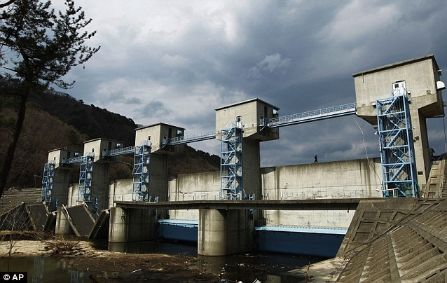
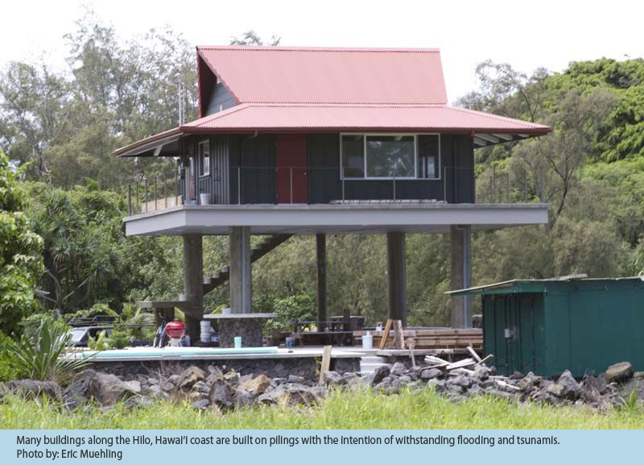
Engineering
Conclusions
Engineering solutions can reduce damage from tsunamis.
What engineering solutions did you come up with?
Notes:
Wrap-up the activity by asking students which buildings/engineering solutions performed the best. Ask them why they think that.
Have them write a report describing the building/solution’s performance, and why they performed that way. Have them also write which areas are at greatest risk of tsunamis, and what type of structures they would recommend for those regions.
This will integrate their knowledge of plate tectonics, tsunami wave basics, damage that caused by tsunamis, and what solutions exist to reduce some of this damage.
**Interesting Note: The buildings in Hawaii began to use these pilings after the 1960 tsunami from Chile (which was include in the event search).
Photo on left:
Sea wall at Fudai (was tall and strong enough to protect the city)
Daily Mail
http://www.dailymail.co.uk/news/article-1386978/The-Japanese-mayor-laughed-building-huge-sea-wall--village-left-untouched-tsunami.html
Photo on right:
Building in Hilo, Hawaii on pilings to protect from tsunami
Hawaii Tsunami Education System: Unit 7.3 Tsunami Aftermath and Response
http://www.discovertsunamis.org/tsunami_science_u7.html

