Slide 1


Density
Notes:
AUTHORS AND CONTEXT
Greg Sinnett, Scripps Institution of Oceanography, Ph.D. Student
Jennifer Ogo, Kearny High School, Science Teacher
This slide is intended for teachers to introduce the unit and this lesson. The remaining slides can be shown to students.
This lesson is designed to introduce students to the concept of density and how density can play a significant role in the ocean.
In this lesson, students will be introduced to the concept and the mathematical definition of density. They will understand how density is different from weight (a common misconception) and how weight is different from mass. They will be introduced to what happens when fluids of different densities interact through a “density float” demonstration. Using the definition of density, they will calculate the densities of each fluid and predict how the layers will stack up in the density float. Students will then be introduced to how density differences happen in the ocean through a lab experience. They will use temperature and salt to adjust the density of two different water masses. They will then combine these water masses to observe how the layers interact. The activity is designed to introduce students to what a “stratified” water column profile might look like in the ocean, how it behaves and why it is important to understand in the context of oceanography.
After this lesson, students will be prepared to learn how density differences cause currents in the ocean.
WHY:
It is easy to think that the ocean is just one big, blue pool of water (after all – it looks that way!) However, small changes in the temperature and salinity cause density differences which cause global scale currents to form and affect how marine organisms behave, how water moves around the planet, and the local climate in many regions of the world. This introductory lesson establishes the concept of density, and prepares the students to explore the ocean as a dynamic and constantly changing place.
3. SUMMARY:
This presentation introduces the concept of density. A demonstration will show students how to calculate the density of various fluids and how fluids of different density interact with one another. A lab experience will introduce students to how density in the ocean changes and what ocean density differences look like.
4. PICTURE/GRAPHICS CREDITS:
http://commons.wikimedia.org/wiki/File:Blue_water,_Lake_Tahoe.jpg
5. WEBSITES USED IN THIS PRESENTATION:
None
ADDITIONAL READING:
Chapter 6 from: Stewart, Robert H. “Introduction to Physical Oceanography” Department of Oceanography, Texas A&M University. 1997-2005.
Section 6.5 linked here: http://oceanworld.tamu.edu/resources/ocng_textbook/chapter06/chapter06_05.htm
7. CONTEXT FOR USE: This lesson was designed for a 9th grade marine science class as part of a unit on ocean circulation and physical oceanography.
MISCONCEPTIONS:
“The heavier something is, the denser it is” – This misconception is addressed through the introduction to density calculations and the power point lecture
“Mass is the same thing as weight” – This misconception is addressed through the power point lecture
“The ocean is just a big pool of water” – This misconception is addressed by the lab experience and demonstration introducing stratification
9. EVALUATION TIPS: In-class discussions on calculating density during the presentation, group activity (calculating the various fluid densities) during the demonstration, and the lab activity are all opportunities for evaluation. The lab write up is intended to gauge the students understanding of density and ability to apply that understanding to the ocean.
TEACHING NOTES: See the Lesson Overview for more information on the various activities and labs associated with this unit of study (approximately 5-6 class periods, 90 minutes each)
SCIENCE STANDARDS ADDRESSED: This lesson addresses HS-ESS2-5, HS-PS3-4.

Slide 2
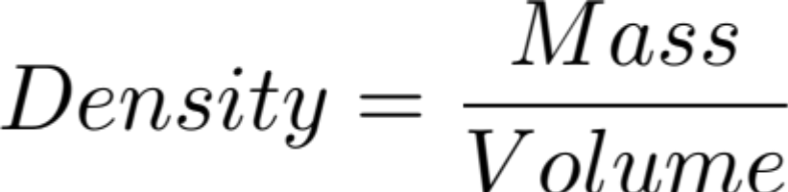

What is Density?
Mass: Measure of how much matter is in an object
Weight: The force on the mass of an object due to gravity
Volume is the space an object takes up
Density is “how much mass is in a given volume”
Notes:
POINT OF SLIDE:
This slide introduces the concept of density and is intended to show students.
CONTENT:
Density is a simple proportion of mass to volume but it has a large roll in physical oceanography. We will use this proportion to explore density in this lesson. It is important to note that mass is not the same as weight (weight = mass * gravity). Underwater is a “weightless” environment (you can’t use a bathroom scale to weigh a fish underwater, for instance) but objects underwater still have mass.
For further information on mass vs. weight, please see for instance: http://en.wikipedia.org/wiki/Mass_versus_weight

Slide 3
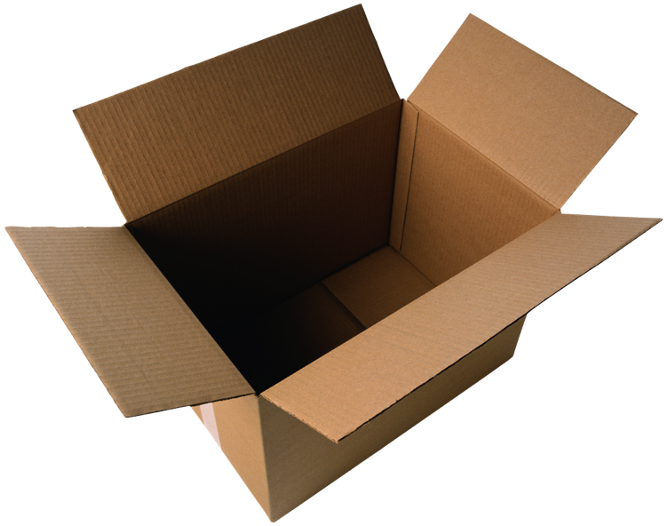
Answer: 200 marbles in a box
If marbles weigh 10 g each…
Which has a higher density?
A) 100 marbles in a box
B) 200 marbles in a box
Notes:
POINT OF SLIDE:
This slide is meant to introduce the concept of density in a tangible way.
CONTENT:
Here we ask students to apply what they know about density (Density = Mass/Volume). Ask the students the question on the left, then advance the slide to reveal the answer. This example should be somewhat physically intuitive (more marbles means more density), but the point is that it is more MASS in the same VOLUME that means higher density.

Slide 4
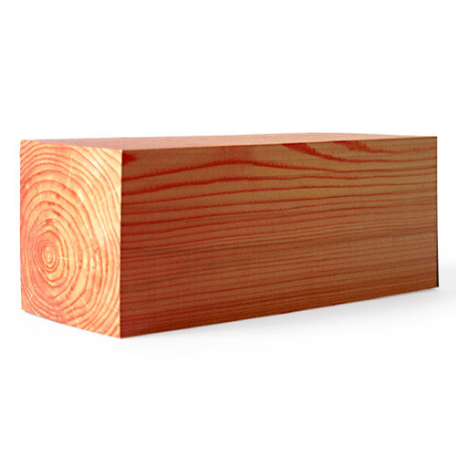
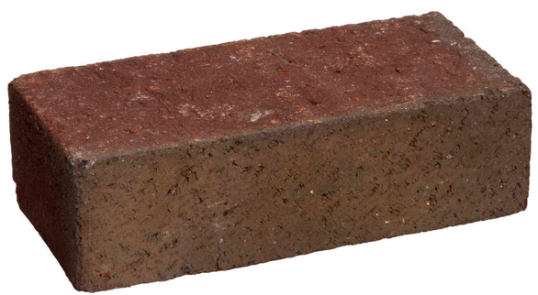
Answer: Brick
Remember:
Which is denser?
A) This brick
B) This block of wood
Mass: 1 kg
Volume: 0.001 m³
Mass: 0.5 kg
Volume: 0.001 m³
Notes:
POINT OF SLIDE:
This is a less intuitive example that requires students to actually use the formula for density to answer.
CONTENT:
Again, ask the students the question on the left, allowing time for the students to do the calculation. Advance the slide to reveal the answer. Students should be able to see that the volume of these two objects is the same, but the mass of the brick is greater. Therefore the brick has higher density than the wood. Remind students that density is how much mass is contained in a given volume.
For advanced classes, the instructor may ask students other questions. For example: What if the brick was cut in half so that the mass of the new brick was the same as the wood, and the volume of the new brick was 0.0005 m^3? (Answer: The half of a brick is still more dense because there is the same amount of mass as the wood, but in half the volume.) Or, what if a large press compacted the wood (squeezed it) so that it now took up half of it’s original volume – which is more dense then? (Answer: The brick and the compressed wood have the same density since the proportion of mass/volume is the same.)

Slide 5
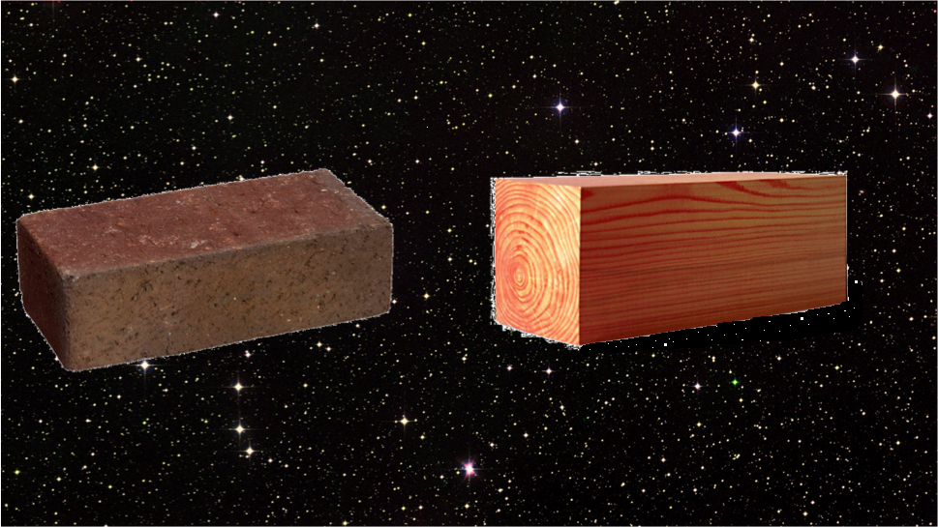
Answer: Brick
(Although each are weightless, the mass of the objects still has not changed)
Which is denser?
A) This brick
(In weightlessness of space)
B) This block of wood
(In weightlessness of space)
Mass: 1 kg
Volume: 0.001 m³
Mass: 0.5 kg
Volume: 0.001 m³
Mass: 1 kg
Volume: 0.001 m³
Mass: 0.5 kg
Volume: 0.001 m³
Notes:
POINT OF SLIDE:
This slide addresses common misconceptions around weight vs. mass. This is an important concept to master if students are to have an intuition about density in the ocean.
CONTENT:
Ask the students the question on the left. This is the same question as in the previous slide – but now in space. Advance the slide to reveal the answer. Weight = Mass * gravity, so on earth where gravity is roughly constant, weight and mass are related simply by a constant. But where there is no acceleration due to gravity (as in space) the object is “weightless” but not “massless.” The answers to this slide are the same as in the previous slide. Thus, density is a property of the substance and does not change due to the environment (in space, under water, in air etc…)

Slide 6
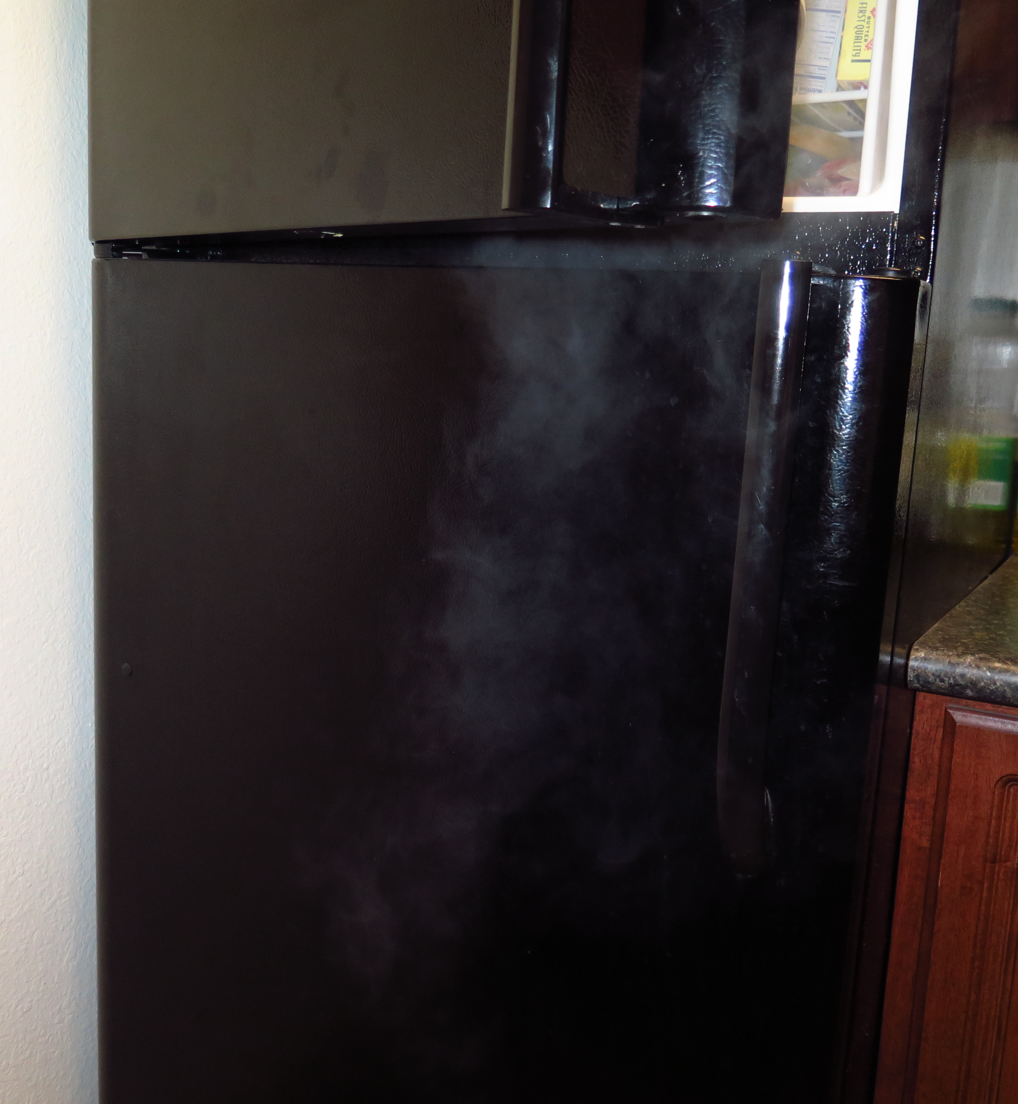

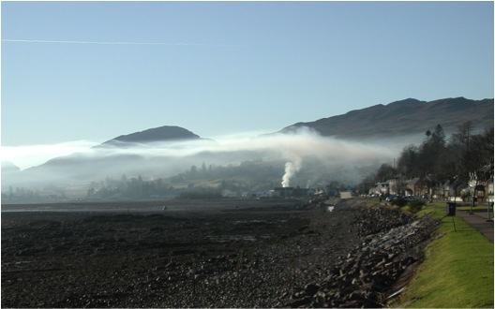
Answer: Cold Air
Which is denser?
Warm Air
Cold Air
Temperature
Inversion
Notes:
POINT OF SLIDE:
This slide introduces the fact that the density of objects (like air or water) can change due to differences in temperature. We introduce this concept in air first because students are more likely to have observed this phenomenon before.
CONTENT:
Ask the students the question on the left - they will need to draw from personal experience. Advance the slide to reveal the answer, then explain that when air warms up, it expands (takes up less volume) and is less dense then before. This is why hot-air balloons are able to rise (the warm air inside the balloon is less dense than the surrounding air, and the balloon “floats”.) Similarly, when air (and water) cool down, they take up less volume and are more dense than before. This is why air from an open freezer door (the photo on the left) is seen to tumble to the floor. Students should understand that the act of warming or cooling the air (or water) changes the volume of the air (or water) which changes its density. Usually the lower atmosphere is warm, caused by the warm earth and the pressure of the upper atmosphere. Air is typically cooler higher up, mostly due to the reduction in atmospheric pressure.
Advance the slide to reveal the last image, which shows one way density differences can be seen in the atmosphere.
Typically, the temperature profile in the atmosphere is dictated by the atmospheric pressure, and the fact that the earth acts to heat up the air – making the lower troposphere warmer than the upper troposphere (see, for instance, http://commons.wikimedia.org/wiki/File:Atmprofile.jpg). This results in air near the earth being heated and rising to high altitudes where it eventually cools and finds an altitude with air of similar density. The situation depicted here (which is not typical) is called an “inversion” which takes place when there is cold (dense) air near the ground and warmer air aloft. This may happen in valleys where solar heating is shadowed, or coastal valleys where the ocean cools the lower atmosphere. The smoke from the chimney trapped by the low density warm layer of air sitting above the cold layer. When the rising smoke meets this layer, the density of the smoke is less then the warm layer, so the smoke does not continue to rise. This effect is commonly seen as “smog” in places that have cool low lying areas with warm upper air (like Los Angeles or San Francisco, which are cooled by the ocean) that can trap car or factory exhaust similar to the chimney in this photo.
The main takeaway for students is that the difference in densities between the warm upper air and cold lower air forms a “stratification.” Thus, the density differences cause the air to be “stratified.”
IMAGE/GRAPHICS CREDITS:
http://upload.wikimedia.org/wikipedia/commons/b/b9/SmokeCeilingInLochcarron.jpg
http://upload.wikimedia.org/wikipedia/commons/b/ba/Hot_air_balloon_in_flight_quebec_2005.jpeg

Slide 7
Density of Liquids
Time for a demonstration
Remember:
Notes:
POINT OF SLIDE:
This slide introduces the concept of density in the ocean. This is a demonstration intended to prepare the students for the lab experience.
CONTENT:
This is a demonstration to illustrate how different density fluids interact. The demo procedure is outlined in “DensityDemo.docx”.
We have talked about how temperature affects density, but different fluids have different densities as well. The difference in density is due to the chemical nature of the fluid – some fluids have heavy molecules close together, while others have lighter molecules that are spaced farther apart. This demo is divided into two parts:
“Magic floating objects” Show the students the glass beaker filled with corn syrup and vegetable oil (half and half). Ask the students what they think will happen when you drop the bolt in the liquid, then do it. Ask them what will happen when you drop the ping-pong ball in the liquid. Now ask what will happen when you drop the die in the liquid. Hopefully some students will say it will float, and some will say it will sink. This is a good time to ask why they think something will float or sink – remind them that objects that are less dense float on objects that are more dense. Drop the die in; it should sink to the bottom of the vegetable oil but float on the corn syrup. Ask the students if the die is more or less dense then the corn syrup and vegetable oil. (Answer: Die is more dense then the vegetable oil, but less dense then the corn syrup.)
“Density Calculation” Now you will do a density float to help prepare them for the lab (follow the procedure outlined in ****. A brief outline is provided here for reference.) First, show the students the liquids (corn syrup, milk, water, vegetable oil and rubbing alcohol). Second, measure out the same quantity of liquid into the small graduated cylindars; it is very important that the same volume is measured into each. Third, weigh each cup and have the class record the value. Fourth, give the class time to calculate the density of each liquid (this is best done in groups of 4 or 5). Fifth, discuss which are the densest liquids and which are less dense. Have the students rank them from most to least dense. Sixth, being careful not to get any on the sides, pour the liquids into a wide graduated cylinder in the following order: corn syrup, milk, water, vegetable oil and rubbing alcohol. Ask the students if they were right about the density.
PICTURE/GRAPHICS CREDITS:
None

Slide 8
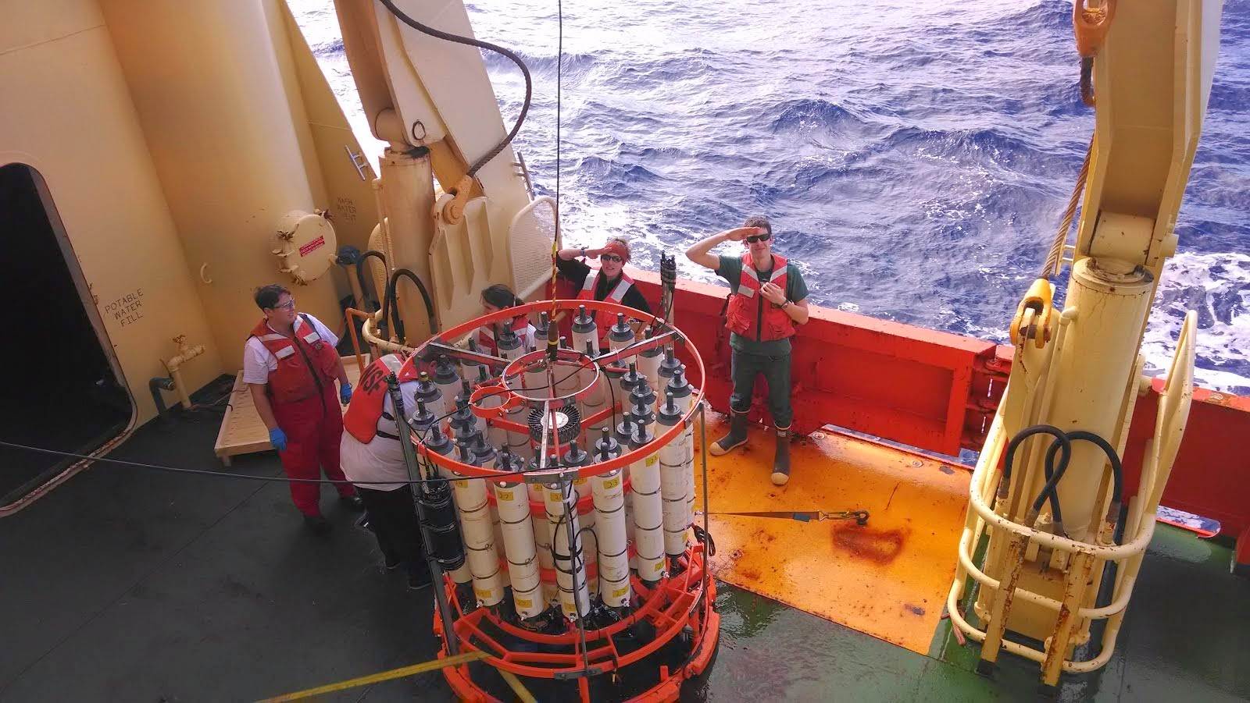
Density in the Ocean Lab
Notes:
POINT OF SLIDE:
This is a background slide intended to be displayed while the students are working on the lab.
CONTENT:
The lab is described in “DensityLab.docx”. Students will create low and high density water by adjusting the temperature and the salt content. They will then observe what happens when the two layers are combined. This is intended to mimic what happens in the ocean when two water masses of different densities come together.
PICTURE/GRAPHICS CREDITS:
Veronica Tamsitt: Aboard the R/V Palmer April 18, 2014 in the Southern Ocean
These scientists are doing casts using a “rosette” (the big round orange thing) with several Niskin bottles (the white cylinders) and a “CTD” (Conductivity, Temperature and Depth) device (the black instrument strapped to the left side of the rosette. The whole instrument is lowered overboard to the bottom of the ocean, while water samples are collected in the Niskin bottles, and a profile of salinity, temperature and depth is recorded – from which density can be calculated. This is one way oceanographers study density profiles in the ocean.

Slide 9
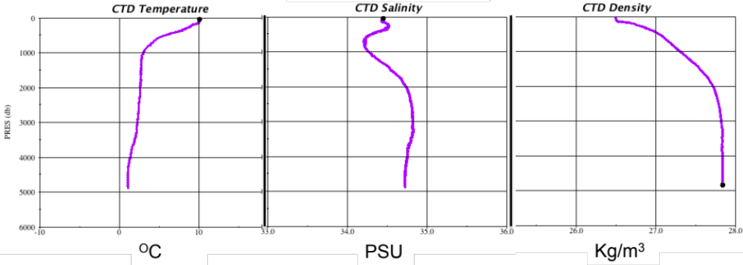
CTD and the Ocean
Notes:
POINT OF SLIDE:
This slide is intended to illustrate how the “CTD” (photo in the previous slide) measures properties of seawater.
CONTENT:
This plot shows the temperature, the salinity (measured in PSU or “practical salinity units”), and the density of a water column in the middle of the southern Atlantic ocean. The CTD instrument measures the temperature, the conductivity of the water (which is a function of salinity) and the pressure (which is a function of density and depth). From this information, oceanographers can calculate the density profile of the water column.
Note the relatively warm layer on the surface (left plot) and the essentially mirror image of temperature in the density profile (right plot). Temperature (at least in this location) is the dominant feature that sets the density.
In the lab, we used warm fresh water and cold salty water to mimic two different water masses. This illustrates stratification and what happens when water masses of two different densities come together, but not what salt and temperature do to density independently of each other. Use this slide to have students observe what happens to the density as temperature and salt change independently.
1)
PICTURE/GRAPHICS CREDITS:
Generated using the Java Ocean Atlas and data from the 1992 “A12” section.
http://joa.ucsd.edu/data/best.html

Slide 10
Summary and Extension
Density can change:
  Cold and salty water (like the North Atlantic) is dense
  Warm and fresh water is less dense.
Fluids of different densities can form layers or be “stratified”
Think further…
What might happen in some parts of the ocean to cause density to change?
How could changes in density cause currents in the ocean?
Notes:
POINT OF SLIDE:
This slide summarizes the main points in this lesson introducing density.
BULLETED POINTS:
Density is a ratio of an objects mass to the volume it occupies. Remember, mass is not the same as weight. Heating objects usually causes their molecules to spread out, increasing the volume the object occupies, thus decreasing the density. Cooling objects generally decreases the space between the molecules, thus increasing the density. Adding salt incorporates extra mass (that is dissolved) to the water, thus increasing the density. Fluids can float on one another if they have different densities. In the lab, we saw that warm fresh water floated on top of cold salty water. Both increasing the temperature and keeping the water fresh make the water less dense (similarly, cooling the water and adding salt make the water more dense). Thus, you may want to ask an advanced class what would happen if we tried warm salty water and cold fresh water. The answer is undetermined – these two effects would then be competing, and it may be possible to have these two water masses have equal densities.
The next lesson in this unit focuses on how density differences in the ocean form and how these differences can drive global currents. Ask students to consider what parts of the earth might add heat (near the equator) and what parts might cool the water (near the poles). What parts of the earth might add freshwater (where it rains a lot) or what parts of the world might have a saltier ocean (where there’s a lot of evaporation). Cooling or adding salt to water increases its density and causes it to sink. This drives some of the large-scale currents in the ocean addressed in the next lesson.
PICTURE/GRAPHICS CREDITS:
none

