Slide 1


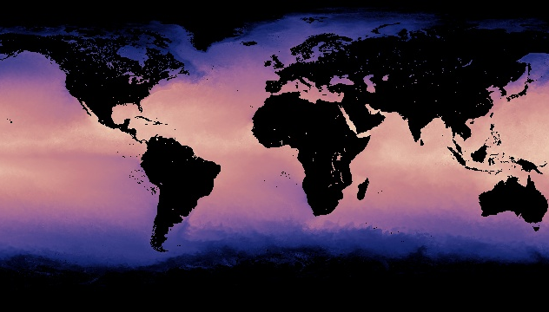

Density Driven Current
Notes:
AUTHORS AND CONTEXT
Greg Sinnett, Scripps Institution of Oceanography, Ph.D. Student
Jennifer Ogo, Kearny High School, Science Teacher
This is the second (of 5) lessons on ocean currents and physical oceanography. This lesson uses what the students learned about density in the ocean to introduce how density causes water to flow in large (ocean scale) currents.
WHY:
Ocean currents are primarily forced by two mechanisms: winds and density differences (gradients). This lesson will explore how density differences cause large currents to develop, and how those currents affect life on earth by transporting heat.
3. SUMMARY:
In this lesson, students will learn that different parts of the world can change the ocean’s surface temperature or the salinity. Making surface water colder or saltier increases the density, and students will learn that this can create a vertical current of sinking water. They will observe how these density driven currents look in a lab experience, and measure the rate of sinking (and rising) of the dense (and lighter) water. Students will then learn why these density driven currents (or “thermohaline circulation”) are important to people on earth by observing how heat is transported. They will compare the climate of two locations, one warmed by thermohaline circulation, and one not.
This introductory slide is a good opportunity to review the “Thinking Further” questions from Lesson 1 as a class or group discussion. Specifically: 1) What might happen in some parts of the ocean to change its density. 2) How could changes in density cause currents in the ocean? This lesson will address both of these questions. See the description of the pictures below for background on this slide’s images.
4. PICTURE/GRAPHICS CREDITS:
Aqua Launch: http://earthobservatory.nasa.gov/Features/Aqua/Aqua3.php
Aqua Sea Surface Temperature data: http://neo.sci.gsfc.nasa.gov/view.php?datasetId=MYD28M&year=2013
In 1999, NASA launched “AQUA” the second (of many) earth observing satellites as part of the “Earth Observing System.” The satellite launch is shown on the left. AQUA was equipped with many instruments to study the earth, atmosphere and oceans; one of which is a microwave scanning radiometer which measures sea-surface temperature. On the right is a plot of monthly mean sea-surface temperature (January 2013 is shown) taken from AQUA data. Temperature is a major contributor to density differences in the ocean, and it is important to understand that ocean temperature changes in different parts of the world. We will use more AQUA data later in the presentation.
5. WEBSITES USED IN THIS PRESENTATION:
None
ADDITIONAL READING:
Chapter 6 from: Stewart, Robert H. “Introduction to Physical Oceanography” Department of Oceanography, Texas A&M University. 1997-2005.
Section 6.5 linked here: http://oceanworld.tamu.edu/resources/ocng_textbook/chapter06/chapter06_05.htm
7. CONTEXT FOR USE: This lesson was designed for a 9th grade marine science class as part of a unit on ocean circulation and physical oceanography.
MISCONCEPTIONS:
“The ocean is just a big pool of water” – This misconception is addressed by plots of ocean surface temperature and salinity - which change in different parts of the world.
“Water in the ocean only moves from side to side” – Most people observe currents that move from one place to another (on the surface) but currents can travel up and down too (by sinking or floating). This misconception is addressed by the lab exercise.
“Currents flow from one place to another” – Although this is technically true, it is important to understand that currents are part of a connected system. Students will understand this by talking about “circulation” and the connected loop of thermohaline circulation.
9. EVALUATION TIPS: Student discussions during the first few slides about why thermohaline circulation happens and what drives it are good opportunities to gauge understanding. The lab experience and write up are also good chances to see how well the students can make the connection between what they see happen and how this applies to the ocean. The discussion about the significance of thermohaline circulation (slides 7-9) will demonstrate students’ understanding of the non-intuitive effects on a region’s climate.
TEACHING NOTES: See the Lesson Overview for more information on the various activities and labs associated with this unit of study (approximately 5-6 class periods, 90 minutes each)
SCIENCE STANDARDS ADDRESSED: This lesson can be used to illustrate HS-PS3-4, HS-ESS2-2, HS-ESS2-4, HS-ESS2-5

Slide 2
How to Increase Density in the Ocean?
Increase Salinity (3 psu)
Increases Mass
Denser by 3 kg/m³
Decrease Temperature (15 ºC)
Decrease Volume
Denser by 3 kg/m³
Temperature change of 15 ºC is more likely than a salinity change of 3 psu.
Temperature is the major driver of density differences in the ocean.
Notes:
POINT OF SLIDE:
This slide introduces the concept that density of ocean water can change due to changes in temperature or salinity.
CONTENT:
This slide is read left to right. Here we explore what happens under two hypothetical situations. The “Change in Ocean” is to either increase the salinity (usually by evaporation) or decrease temperature (usually at the polar latitudes). The “Effect on Water” is to either increase the mass as the salt dissolves in the water (there are now salt ions trapped in the polar water molecules), or decrease the volume (as the space between the molecules shrinks as thermal energy is removed). The “Result” in each case is that the density is increased by 3 kg/m^3.
Note that it is much more likely that ocean water will undergo a temperature change of 15 degrees C (usually at the poles) than a salinity change of 3 psu (“practical salinity units”). Thus, temperature changes (and not salinity changes) are what usually act to change the density in the ocean.
Practical Salinity Units are used by physical oceanographers as a way to relate conductivity (how electricity flows through seawater) to the amount of salt ions in the water. A typical sample of seawater may have 35 ppt (perts per trillion salt) and a PSU of 35, with about 35.5 g/kg (grams salt per kilogram seawater).

Slide 3
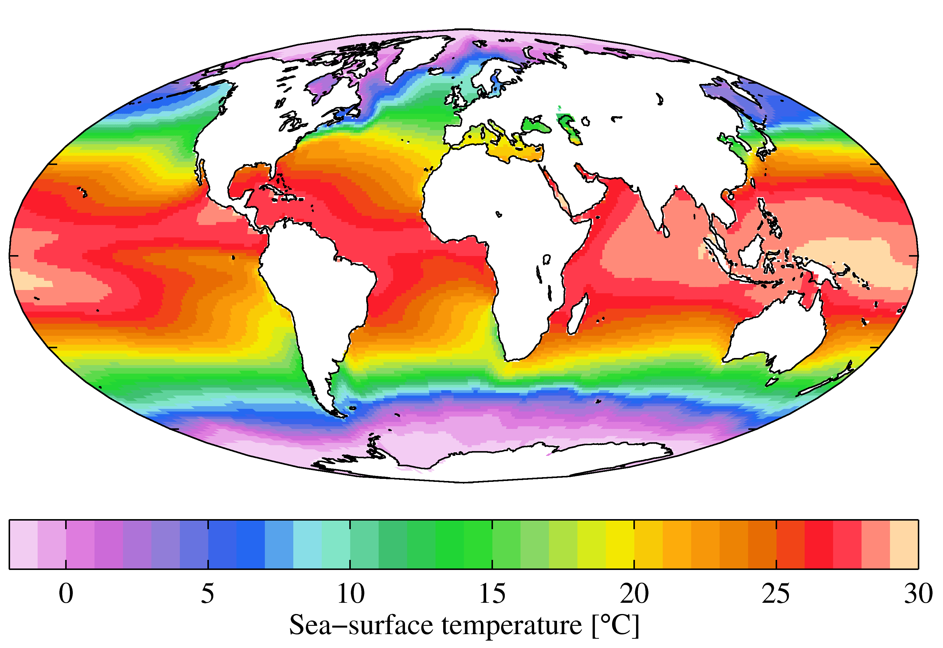
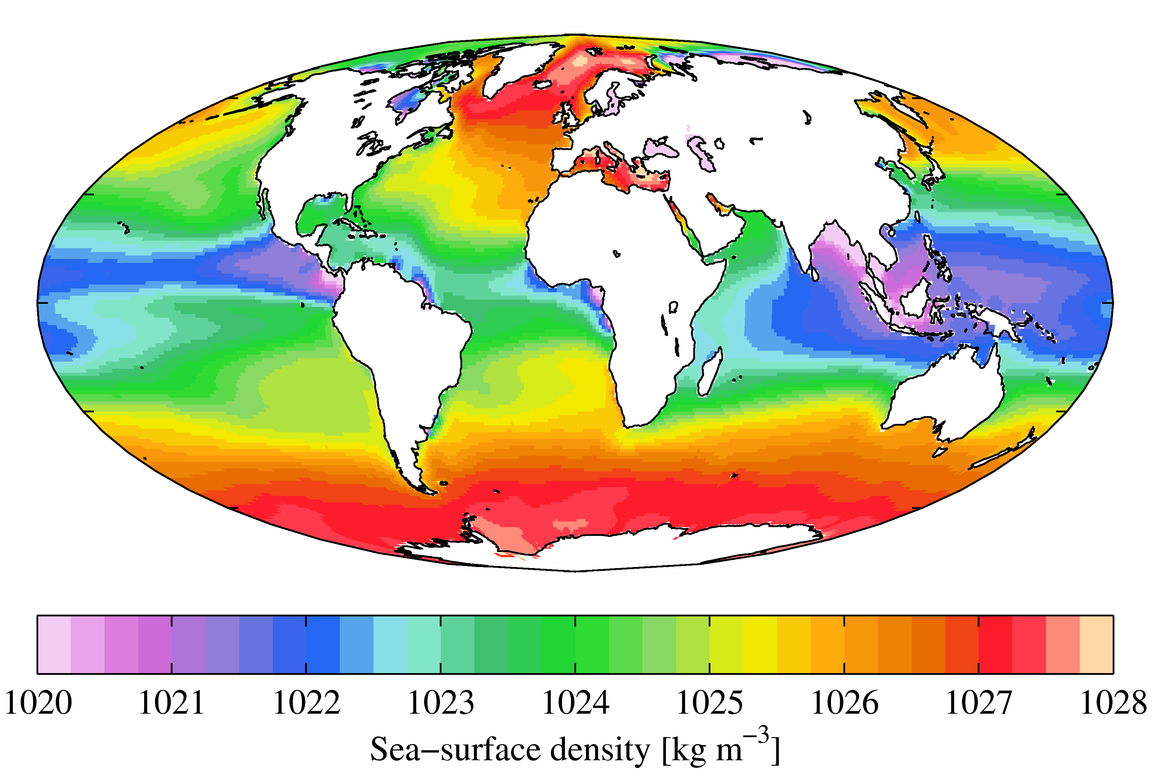
Ocean Surface Density
Temperature (ºC)
Sea-Surface Density (kg/m³)
Cold Temperature = High Density
Notes:
POINT OF SLIDE:
This slide illustrates where dense water is created.
CONTENT:
In order for water to sink from the surface to the bottom, the density of the surface water needs to increase. This is primarily done in two general regions.
Surface temperature is shown in the left plot. Point out that places with cooler temperatures have denser surface water (these areas are circled near the poles). Warm water that enters these regions is cooled and becomes more dense.
The resulting sea surface density is shown in the right-hand plot. Red areas have the highest surface density; these are polar regions (where cold air and strong wind cools the surface water). These areas are where light surface water becomes more dense and sinks.
PICTURE CREDITS:
Photos from the World Ocean Atlas 2009: http://en.wikipedia.org/wiki/World_Ocean_Atlas and http://en.wikipedia.org/wiki/File:WOA09_sea-surf_DEN_AYool.png

Slide 4
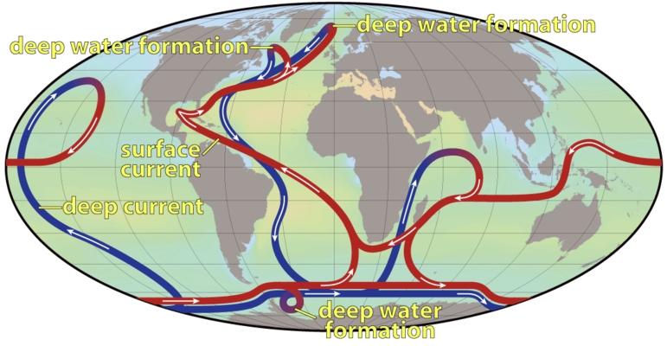
Thermohaline Circulation
Thermo = Temperature Haline = Salt
Notes:
POINT OF SLIDE:
This slide introduces the “Thermohaline Circulation” which results from the sinking water formed from increasing surface density.
CONTENT:
This is a simplified cartoon image of the “Global Overturning Circulation” or “Thermohaline Circulation”. The root words for “Thermohaline” come from “temperature” and “salt” – this circulation is current that is driven by temperature and salt (and thus density!) The red currents are intended to be warm surface water, and the blue currents represent colder deep currents. The regions of the world where surface density is increased (circled on the previous slide) are highlighted here as locations for “deep water formation”. At these locations, warm surface water is cooled and becomes more dense. This newly formed dense water sinks and spreads out along the bottom of the ocean.
The typical “conveyor belt” moves water in steps: 1) Warm surface water enters the northern or southern latitudes (labeled deep water formation), 2) The surface water is cooled, gains density and sinks, 3) The newly formed bottom water spreads out, moving south from the Norwegian Sea, or north from the Antarctic Circumpolar Current into the Pacific and Indian oceans, 4) Here, the water SLOWLY rises again to the surface over thousands of years, 5) The now warmer surface water returns to the site of deepwater formation.
Many students are confused by the fact that currents appear to cross over each other. Make sure they understand that these currents are at different depths (red on top and blue on the bottom). In the lab exercise, we will explore what happens in the spots where the surface current (red) turns more dense and becomes a bottom current (blue) and also where bottom current becomes surface current (in the Pacific Ocean and Indian Ocean – east of Africa).
IMAGE CREDIT:
Photo from http://en.wikipedia.org/wiki/File:Thermohaline_Circulation_2.png

Slide 5
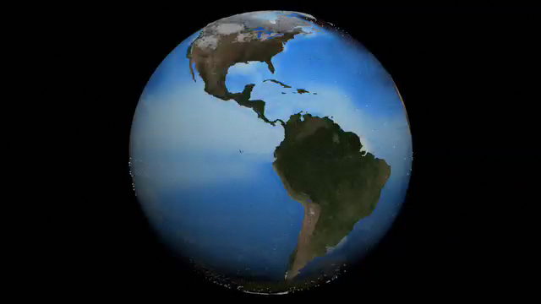
Deep Water Formation Lab
Notes:
POINT OF SLIDE:
This slide better illustrates the dynamics of the thermohaline circulation in preparation for the lab.
CONTENT:
This video has no sound. Arrows indicate the direction of flow with white arrows representing surface current, and darker arrows representing bottom current.
The movie will zoom in near the Nordic and Labrador Seas, where we will see surface water sink to the bottom. Point out that this is because the warm water moving north (the Gulf Stream) is cooled by strong winds and cold air. The video will then zoom out so we can see how this newly formed bottom water spreads south, eventually joining deep water formed near Antarctica. As the earth rotates, we see some of this deep water becoming shallow water in the Indian Ocean again.
A lab exercise (*****) will explore the processes related to the sinking water (seen near the beginning of the video) and the slowly rising water seen near the end.
VIDEO CREDIT:
Movie Credit: http://svs.gsfc.nasa.gov/vis/a000000/a003600/a003658/

Slide 6
Observations
What Happened?
Notes:
POINT OF SLIDE:
This slide is intended to build consensus on the lab exercise and prepare the students for an extension. It is intended to help instructors (not to show students)
CONTENT:
This slide is intended to wrap up the lab and build consensus on what happened in the lab.
Guide the students through a discussion on their results – specifically:
In the freshwater beaker:
The freshwater glass should have had colored cold water sink in a relatively concentrated plume. (This is directly analogous to the sinking water in the deep water formation sites)
The sinking rate was rapid and water stayed on the bottom. (Dense water that is formed sinks quickly)
The rising rate of the rest of the water column was relatively slow. (The students observed a rate that is probably at least one order of magnitude smaller. In the ocean, this rate is hundreds of thousands of times smaller – about 10^-7 m/s.)
The two layers didn’t mix much – although if stirred, they would.
Saltwater:
Depending on the amount of salt, the colored cold water may have floated on the top or sank much slower.
Optional follow up questions for advanced students:
What would happen if we let the experiment sit for a very long time? (Diffusion would eventually mix the layers – this is an extremely slow process and may take years)
What if we stirred it, would the water settle back out? (No, unlike oil and water which do not mix, the temperature and salt properties of the water will mix. After stirring, the water would be homogeneous.)
What part of the world did we just simulate? (We simulated the polar regions where surface water is cooled and sinks to the bottom

Slide 7
Why do we care?
Thermohaline circulation brings cold water to warm places, and warm water to cold places (heat transport).
This circulation affects local weather, and changes to the circulation can affect climate.
Notes:
POINT OF SLIDE:
This slide introduces why thermohaline circulation is important to everyday people.
CONTENT:
Bulleted points: Because of thermohaline circulation, cold water moves to warmer places (cooling them down) and warm water moves to colder places (warming them up). This process has been called a “heat conveyor belt” that supplies heat to different parts of the world affecting both the local weather (day to day) and the climate (long term average). In general, places that lie near warm surface currents (such as the Gulf Stream) are on average warmer than they would be otherwise.
As in Slide 4, the typical “conveyor belt” moves water in steps: 1) Warm surface water enters the northern or southern latitudes (labeled deep water formation) near Bergen, 2) The surface water is cooled, gains density and sinks, 3) The newly formed bottom water spreads out, moving south from the Norwegian Sea, or north from the Antarctic Circumpolar Current into the Pacific and Indian oceans, 4) Here, the water SLOWLY rises again to the surface over thousands of years, 5) The now warmer surface water returns to the site of deepwater formation (near Bergen)

Slide 8
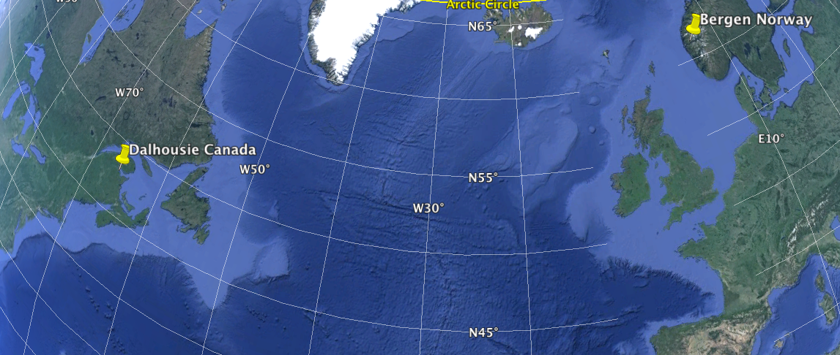
Why do we care?
Who do you think has a colder winter?
Dalhousie Canada (48 ºN) Bergen Norway (60 ºN)
Notes:
POINT OF SLIDE:
As an example of how thermohaline circulation directly affects people, we will compare the winters of Dalhousie Canada and Bergen Norway. This is a map showing the two cities.
CONTENT:
Bergen Norway is about 1000 miles farther north than Dalhousie is (this is similar to the distance between Portland OR and San Diego CA, or Boston MA and Charleston SC.) However, the Norwegians experience a more mild winter due to the heat transported to the Nordic Sea via thermohaline circulation. This non-intuitive result is a good example of how important the thermohaline circulation is to everyday people (in this case the Norwegians!)
Ask the students to predict which city has a colder winter. Most will choose Bergen Norway because it is farther north.
IMAGE CREDIT:
Google Earth

Slide 9
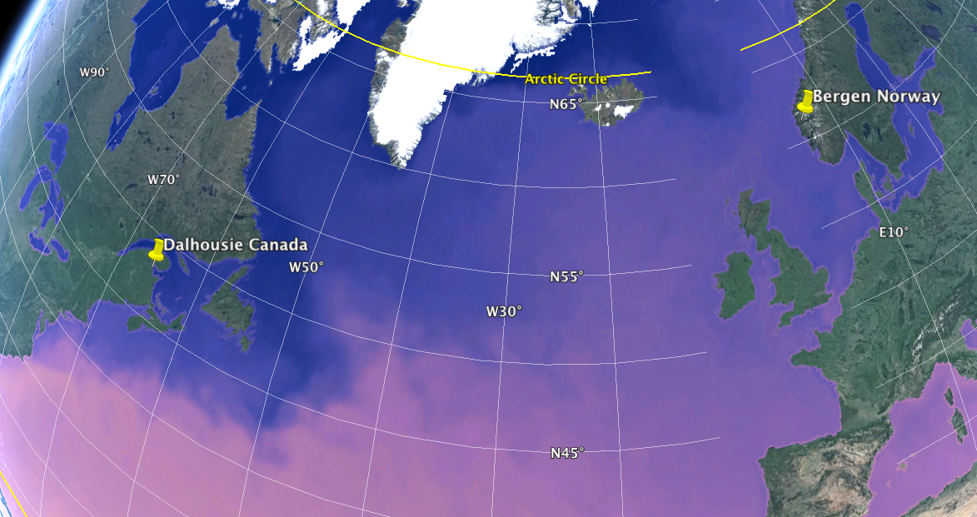

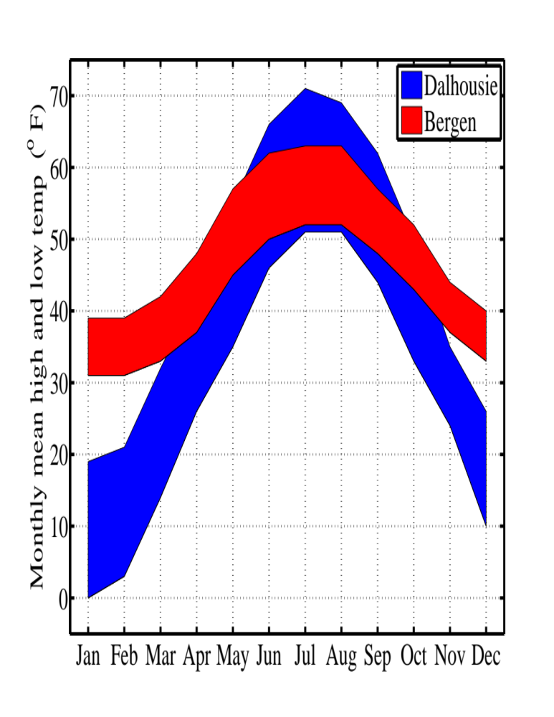
Dalhousie has a colder winter!
Notes:
POINT OF SLIDE:
This slide shows the effect of the thermohaline circulation on the climate of Dalhousie Canada and Bergen Norway.
CONTENT:
This is the same map as the previous slide – only with the sea surface temperature overlaid on the ocean surface. Pink colors are warmer (colorbar in the upper left) and show the Gulf Stream moving off to the middle of the Atlantic ocean near North Carolina (bottom left of the map). The warm water makes its way across the Atlantic, all the way north to Bergen Norway, where it eventually gives up its heat to the atmosphere and cools. This water sinks, but the heat it gives up warms the climate of Bergen Norway. Notice that the Gulf Stream is too far south to significantly affect Dalhousie’s climate.
Advance the slide to reveal the average climate in each city. The graph shows the monthly high and low temperature (Dalhousie is the blue area, and Bergen is the red area). For example, the average February high temperature in Bergen is 39 degrees Fahrenheit and the average February low temperature is 31 degrees Fahrenheit. The summer temperatures are roughly the same, but the warm water near Bergen (due to thermohaline circulation) keeps the winters warmer. Point out that the difference in the winter months (with Dalhousie much colder than Bergen) is due to the fact that the thermohaline circulation brings warm water near Bergen, but not Dalhousie.
Some students may wonder why the thermohaline circulation does not increase the summer temperature in Bergen as well. This is because the water temperature is actually cooler than the air in summer – thus Dalhousie’s summer (farther south) is cooled more than Bergen’s summer (in the north), making the summer temperatures roughly equal on average.
Thermohaline circulation is not the only contributor to climate in these regions. Upper air wind patterns (among many other things) also play a part – but thermohaline circulation is a large factor in Bergen’s mild climate.
IMAGE CREDIT:
Google Earth

Slide 10
Summary and Extension
Some places cool surface water, increasing the density
When water becomes denser, it sinks
This dense water spreads out over the bottom of the ocean and drives “Thermohaline Circulation”
Thermohaline Circulation transports heat and affects climate
Think Further…
Scientists have shown that on average, the earth’s climate is heating up – especially in polar regions. What do you think would happen to the thermohaline circulation if the polar regions became warmer?
Notes:
POINT OF SLIDE:
This slide summarizes the main points in this lesson introducing thermohaline circulation.
BULLETED POINTS:
Thermohaline circulation is driven by density changes to the surface of the ocean that occur at specific places (the polar regions especially). These locations make the water denser (by cooling it). When dense water is created on the surface, it sinks (like the colored water in the lab exercise) and then spreads out on the bottom of the ocean. Since water is constantly being cooled at the surface, and sinking, this is the driver for the “Thermohaline Circulation”. Essentially, this is a heat pump that carries cold water away from the surface in specific parts of the world, and lets warm water replace it (bringing warm water to an otherwise very cold place).
The extension point asks students to think about the impact of global climate change on thermohaline circulation. Scientists believe that warming in the surface ocean will weaken the thermohaline circulation (sometimes called the Atlantic Meridional Overturning Circulation) in the 21st century by between 11% and 34%. Unlike some previous estimates students may have seen (i.e., the film “An Inconvenient Truth” and others), it is “unlikely” the thermohaline circulation will collapse in the 21st century.
ADDITIONAL READING AND INFORMATION:
Additional information can be found in the Intergovernmental Panel on Climate Change Working Group I report on the Physical Science Basis. The summary is linked below:
http://www.climatechange2013.org/images/report/WG1AR5_SPM_FINAL.pdf
PICTURE/GRAPHICS CREDITS:
none

