Slide 1

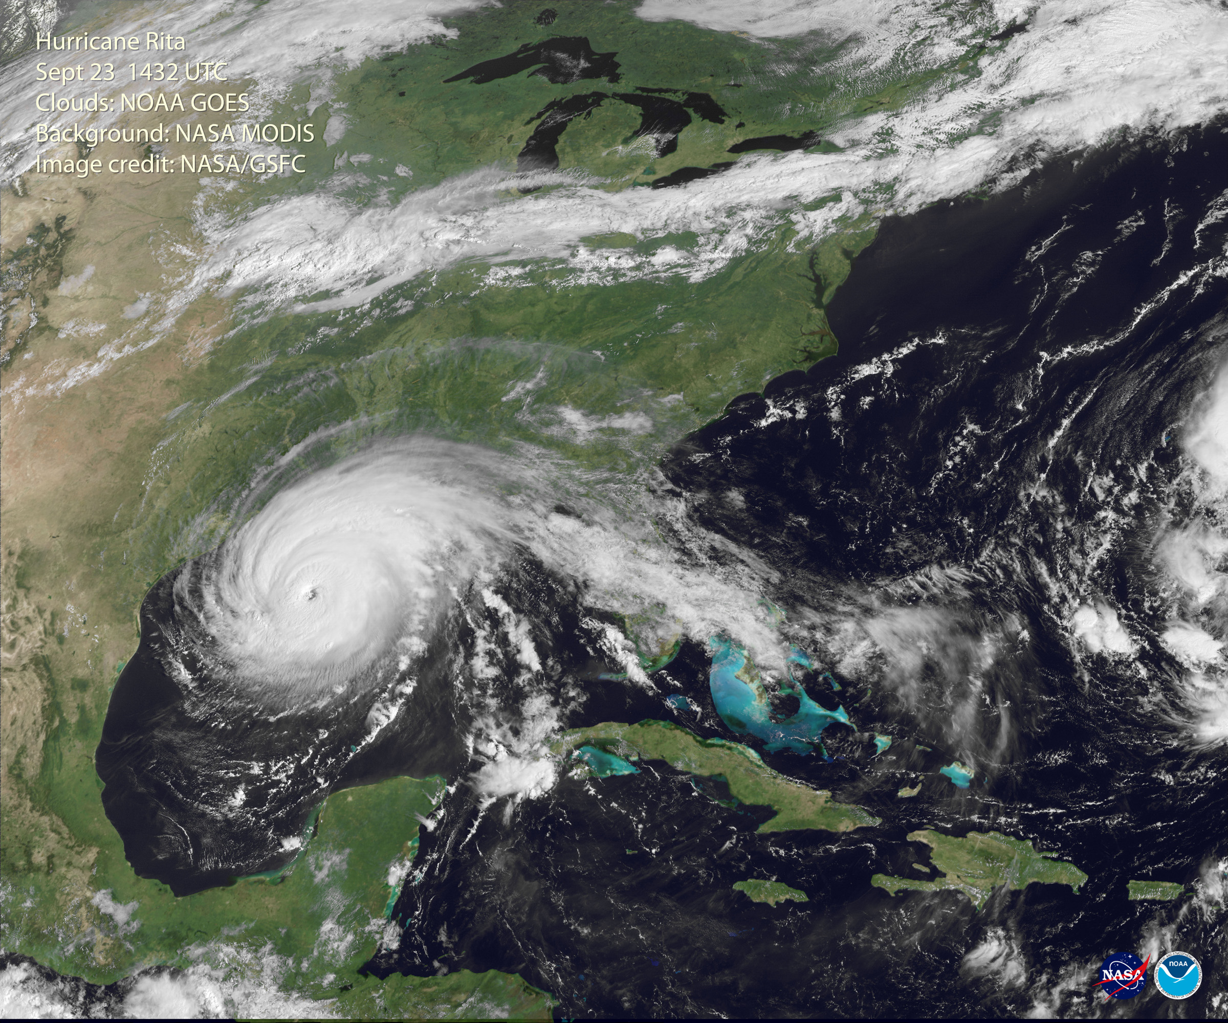
Coriolis
Notes:
AUTHORS AND CONTEXT
Greg Sinnett, Scripps Institution of Oceanography, Ph.D. Student
Jennifer Ogo, Kearny High School, Science Teacher
This is the third (of 5) lessons on ocean currents and physical oceanography. This lesson introduces the “coriolis effect” – a critical component for physical oceanography, particularly wind driven ocean circulation. This lecture is in preparation for the next lesson on wind-driven currents.
WHY:
Ocean currents are primarily forced by two mechanisms: winds and density differences (gradients). This lesson will prepare students to learn how winds drive currents on the earth (in the next lesson) by introducing the “coriolis effect”.
3. SUMMARY:
The coriolis effect is an apparent force that arises from the fact that we are observers on a rotating reference frame. Students may be familiar with Newton’s first law of motion (… an object in motion will remain in motion unless acted on by an outside force), but this is true only for a stationary reference frame. This lesson explores this law in a game of “golf” where students can experience how objects travel in a straight line unless they are moved by an external force. In a rotating reference frame, however, objects that are traveling straight (and unaffected by an external force) appear to curve because the observer is moving in the rotating reference frame. This is true for us on earth, and students will explore what this looks like through a video and then a lab experience. At the end of the lesson, students should understand how rotating reference frames affect the apparent motion paths of objects, and how this affects the motion wind and ocean currents on earth.
4. PICTURE/GRAPHICS CREDITS:
Hurricane Rita: http://rsd.gsfc.nasa.gov/goes/pub/goes/050923.rita.goes_modis.jpg
Hurricanes are an example of how the coriolis effect works in the atmosphere. The center of the hurricane has low air pressure compared to the surrounding air. Thus, just like how air is drawn into a vacuum cleaner, air is drawn in toward the center of the hurricane. This is evident if you trace the clouds from the right side of the image (north of Haiti) in toward the hurricane. The clouds curve to the right (due to the coriolis effect in the northern hemisphere), arcing over the Bahamas, central Florida and the Florida panhandle, before joining the circulation around the hurricane.
5. WEBSITES USED IN THIS PRESENTATION:
None
ADDITIONAL READING:
An excellent scientific article on understanding the Coriolis force: Persson, Anders. (1998) “How Do We Understand the Coriolis Force?” Bulletin of the American Meteorological Society. Vol. 79, n. 7. 1373-1385.
http://www.aos.princeton.edu/WWWPUBLIC/gkv/history/Persson98.pdf
7. CONTEXT FOR USE: This lesson was designed for a 9th grade marine science class as part of a unit on ocean circulation and physical oceanography.
MISCONCEPTIONS:
“Objects on the earth always travel in a straight line if no force is applied” – Although this is Newton’s first law, it only applies to stationary reference frames. Students will observe what happens in rotating reference frames in the lecture and lab.
“Something pushes the object to deflect it” – Although it looks like an object is “pushed” to the right or left due to coriolis, it is simply that the the rotating reference frame makes it look like the object is following a curved path. Students will observe this in the video.
“Coriolis always deflects objects to the right (or left)” – The direction of apparent deflection is dependent on the rotation. This will be observed in the lab.
“The direction water drains is due to the coriolis effect” – A common misconception is that water in a sink or toilet swirls one way in the northern hemisphere and the opposite way in the southern hemisphere because of coriolis. In reality, the length scale and velocity of this motion is much too small and fast to allow coriolis to be important (i.e., the Rossby number is very large).
TEACHING NOTES: See the Lesson Overview for more information on the various activities and labs associated with this unit of study (approximately 5-6 class periods, 90 minutes each)
SCIENCE STANDARDS ADDRESSED: HS-PS2-2

Slide 2
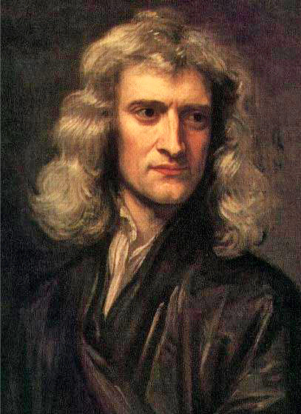
Motion
Lex I: Corpus omne perseverare in statu suo quiescendi vel movendi uniformiter in directum, nisi quatenus a viribus impressis cogitur statum illum matare.
First Law:
An object at rest will remain at rest, and an object in motion will remain in motion unless acted on by an external and unbalanced force.
Notes:
POINT OF SLIDE:
This slide introduces Newton’s first law of motion - the foundation for understanding the coriolis effect.
CONTENT:
Newton (pictured) outlined several basic laws of nature in his masterpiece “Mathematical Principles of Natural Philosophy” written in Latin in 1687. In it, are his famous three laws of motion – the first of which is stated on this slide. Basically, the law says that a stationary object will remain stationary, and a moving object will move in a straight line unless an external force is applied to it.
Ask the students to read the first law and then explain it in their own words. Students may want to draw on personal experiences (the motion of a hockey puck, air hockey table etc).
We will apply this law first in a stationary reference frame (where both the observer and object have the same fixed coordinate system) and then to a moving reference frame (where the observer is rotating relative to the object - which gives rise to the coriolis “force” in the observers frame of reference).
PICTURE/IMAGE CREDITS:
Newton’s picture: http://upload.wikimedia.org/wikipedia/commons/3/39/GodfreyKneller-IsaacNewton-1689.jpg

Slide 3
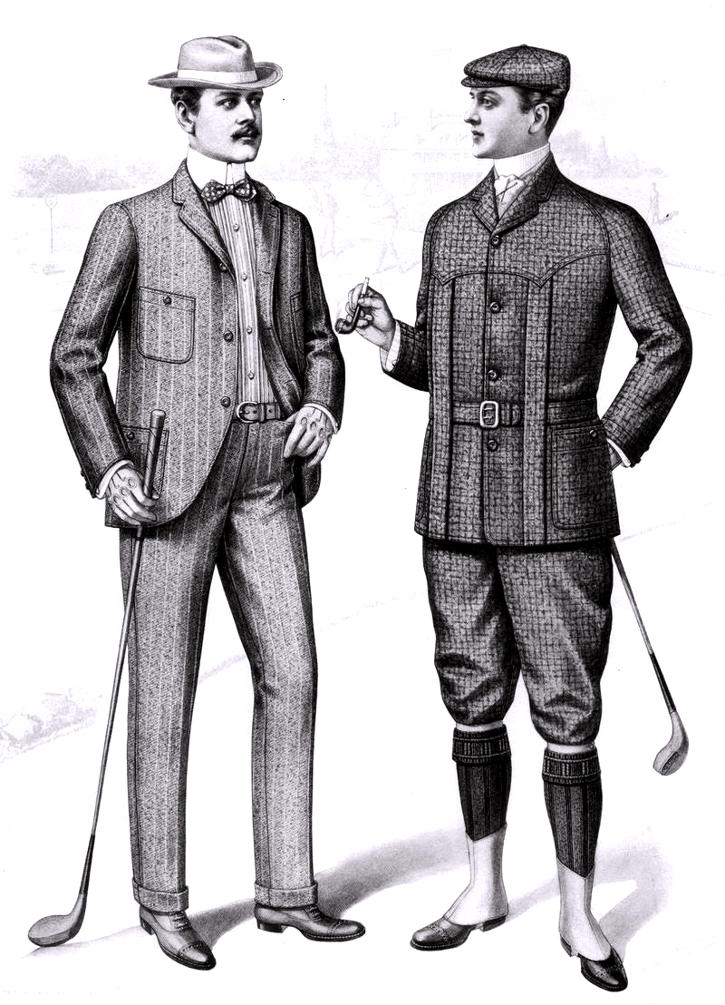
Newton’s Golf
Object: Get the marble to touch the dot.
Set-up:
Place the marble on the “tee.”
Four players then go to each side of the “course”
Using only a puff of air through the straw, move the marble from the tee to the hole.
Rules:
You can only blow through the straw.
You can only blow in quick puffs.
You can only blow in the North, South, East or West directions.
You cannot touch the marble or move the paper in any way.
Notes:
POINT OF SLIDE:
This slide introduces an activity to demonstrate Newton’s first law. It is intended for the instructor, but may be shown to students for a reference.
CONTENT:
This activity (~10 min) is designed to help students develop an intuition for what Newton’s first law “looks like” in a stationary reference frame. Using the “playing board” found in NewtonGolfBoard.pptx” and the instructions on this slide and in “NewtonGolfActivity.docx”, observe the students blowing on a marble to explore Newton’s first law.
Tips: You may want to start out asking the students to blow only one at a time, taking turns at forcing the marble to travel different ways. If the students are having trouble controlling the marble, encourage them to gently blow from one direction (say the east) to start the motion of the marble, then have another student gently blow from the opposite direction to stop the motion of the marble.
PHOTO/IMAGE CREDIT:
http://upload.wikimedia.org/wikipedia/commons/d/db/1901_Sartorial_Arts_Journal_Fashion_Plate_Men%27s_Golfing_Clothes.png

Slide 4
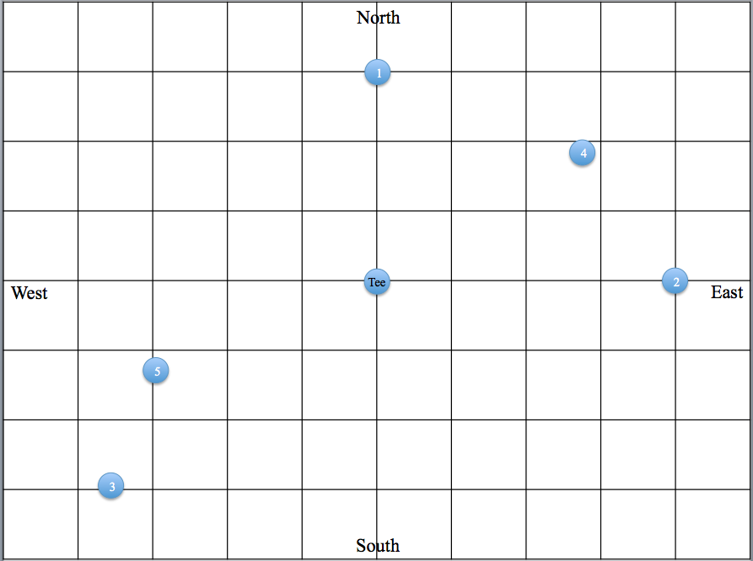
Newton’s Golf
What did you observe about the marble when you blew on it?
How about when you stopped blowing on it?
What were the most effective strategies?
Would the game be easier or harder if the paper were spinning?
Why?
Notes:
POINT OF SLIDE:
This slide is designed to guide a discussion on what Newton’s first law looked like in a fixed reference frame. It can be shown to students to aid discussion, but is intended for teachers.
CONTENT:
After the “Newton’s Golf” activity, the students should have observed the following:
When blowing on the marble, the marble changed direction.
When not blowing on the marble, the marble would continue in the same direction of travel.
You can use the image of the game board to talk about some of the students’ strategies. Some effective strategies may include blowing one at a time, first from one direction to get the marble moving, then from a second direction to change the trajectory. Another may be to blow only from the East/West direction to start (then stop) the marble at the right East/West location, then blow from the North/South direction to move the marble along this axis. In either case, students must take advantage of the fact that when they are not blowing, the marble continues in a straight line.
The last question asks the students to think about what would happen if the paper were spinning (and the reference frame was no longer stationary.) Help the students realize that their intuition that the game would be harder is correct (even though the marble would still obey Newton’s laws and travel in a straight line). The straight path the marble takes would no longer be straight relative to the rotating playing field, however.

Slide 5
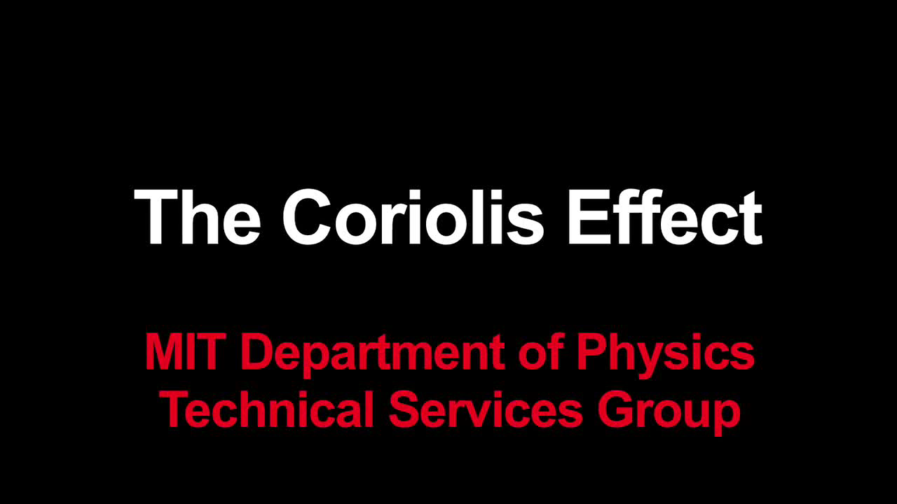
Coriolis Effect
Notes:
POINT OF SLIDE:
This slide introduces the coriolis effect in the context of the Newton’s golf activity and objects traveling in a straight line through a moving reference frame.
CONTENT:
The video (no sound) highlights the effects of an object traveling in a straight line through a rotating reference frame.
Before starting the video, introduce the students the the concept of a “reference frame” (the perspective from which we observe the motion of the ball). Newton’s Golf worked because we were in an “inertial reference frame.” But what would happen if we rotated the paper? What if the paper was stationary, but I rotated the room? These are examples of moving reference frames (relative to the motion of the ball) and are what cause the apparent force that we observe as the Coriolis effect.
The video has three useful sections. You may want to pause it to discuss what is happening after each section.
1) 0:00 to 0:20 The start of the video is similar to the Newton’s golf activity. Explain that passing the ball back and forth is like blowing on the marble – it travels in a predictable straight line after it has been pushed. When the platform starts spinning, the reference frame is no longer stationary. The two people are not in a rotating reference frame relative to the classroom and the ball. When the ball is pushed, it travels in a straight line relative to the non-rotating room (since there are no external forces acting on the ball) but the people in the rotating frame see the path of the ball differently.
2) 0:20 to 1:00 From an overhead view in the “Rest Frame” the camera is fixed to the classroom floor, and we see the travel of the ball as obeying Newton’s first law. The path is straight when it is released from the person’s hand.
3) 1:00 to 2:14 From an overhead view in the “Rotating Frame” the camera is mounted to the rotating platform. This “rotating frame” is what the people observe as the path of the ball. In the replay, we can see that the path of the ball appears curved in the rotating frame, even though we know it to be straight in the non-rotating frame. Changing the direction of rotation also changes the direction the ball appears to curve.
Note: There’s a funny blooper’s real at the end (with sound).
Make sure the students understand three very important things:
The ball travels in a straight line in the non-rotating frame, obeying Newton’s first law.
Observers in a rotating frame see the ball follow a curved path because they are moving around the straight path of the ball.
The direction of rotation determines the direction the object appears to curve.
On earth, the coriolis effect is an apparent force felt 90 degrees to the right or left (depending on the hemisphere) of the path of motion. The magnitude of the coriolis “force” depends on the coriolis parameter, f, which in turn depends on the rotation rate of the earth (in radians/second) and the latitude. f = 2Ωsin(φ) where Ω is the rotation rate of the earth and φ is the latitude. A “typical” value of f is about 1x10^-4 rad/sec, but can range between 0 (at the equator) and 1.46x10^-4 at the poles. Coriolis is a difficult concept even without this extra detail, so it is not mentioned in this lesson – however advanced classes may want to discuss how the coriolis (apparent) force changes with latitude, and what this would mean for a parcel of air or water that crossed the equator.
For more information, see: http://en.wikipedia.org/wiki/Coriolis_effect#Rotating_sphere
Video: https://www.youtube.com/watch?v=dt_XJp77-mk

Slide 6
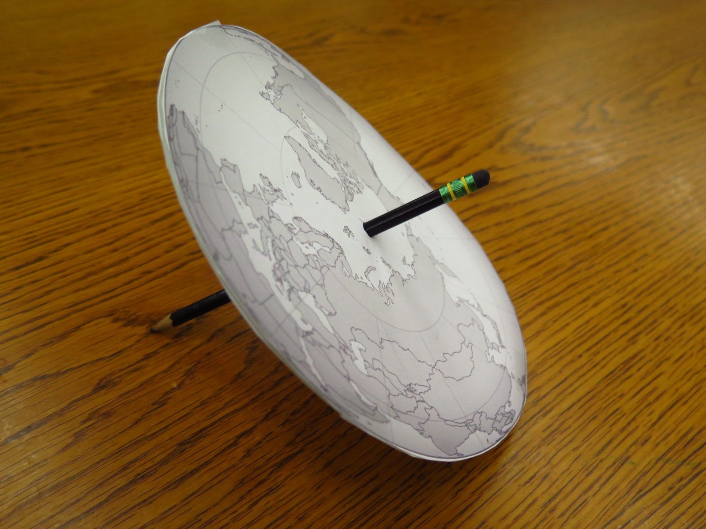
Coriolis Effect Lab
Notes:
POINT OF SLIDE:
This slide introduces the coriolis lab activity.
CONTENT:
The lab activity, outlined in CoriolisLab.docx, allows to students to see how the coriolis effect changes the apparent path of a moving object in a rotating frame. The students will be able to link what they observe in the lab with what happens on the rotating earth, and will be able to experiment with how the direction of rotation affects the direction of apparent curvature.
The photo is of the model earth they will build to see the path of a freely moving droplet placed on the spinning surface.
NOTE: Three things about this demonstration are approximations to the actual coriolis effect. Instructors may wish to discuss these with students (advanced classes) or they may choose to ignore them in favor of a simplified demonstration.
This demonstration uses the fact that the friction between two things not moving relative to each other is greater than the friction between two things sliding past each other (static friction is larger than kinetic friction). Thus, when the droplet finally “releases” from its initial position, it will feel some frictional effects of the rotating paper, but the friction will be much less than it initially felt before it broke loose. Thus, this is an approximation of the coriolis effect since the droplet still feels the effect of rotation as it moves through space, causing the path in the stationary frame to be slightly curved as well. The kinetic friction is small enough, however, that a straight line is still a fairly good approximation for the droplet’s path in the fixed frame.
The droplet begins as a stationary object in the rotating frame (as objects on earth do). However, rather than give the droplet a “push” to start it moving, we rely on the centrifugal force to overcome the static friction of the droplet with the paper. Thus the rotation itself causes the initial movement – which does not happen on earth.
The “earth” here is flat. The simulated coriolis effect here will not depend on latitude as it does on the real earth.

Slide 7
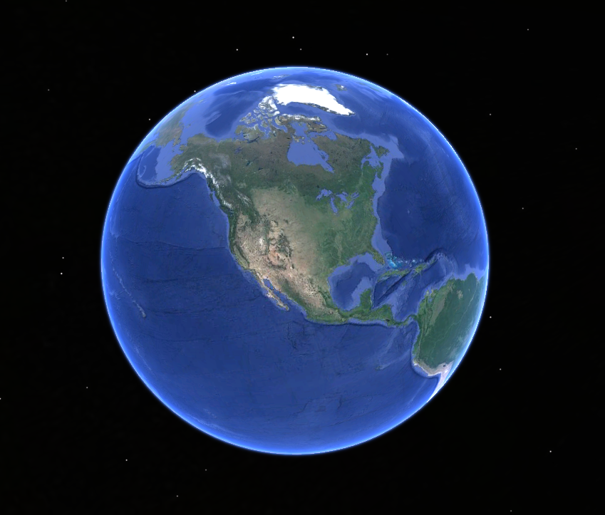
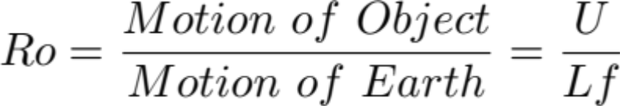
Coriolis Effect On Earth
Does Coriolis matter?
Why don’t we see the Coriolis effect deflecting everyday objects?
Compare the motion of the object with the motion of the earth.
Object motion: U (m/s) = Object velocity
Earth’s rotational motion: Lf (m/s)
L = Path length (m)
f = Earth’s rotational frequency (1/s)
Rossby Number (no units):
Small Ro means the Coriolis effect is important.
Initial Path
Actual Path
Notes:
POINT OF SLIDE:
This slide is intended to show how we know if coriolis is important using the Rossby number. This is a more advanced concept that shows when the Coriolis force is important (for large, slow flows) and when it is not (for fast, small flows – like water going down a drain).
CONTENT:
The concept of when coriolis is important is a common misconception, but is a more advanced topic. Some classes may wish to stop here and skip the next two slides and activity, and some may wish to address this topic. For those who skip these slides, it is important to note that the coriolis effect on earth is only important for large motion (more than a kilometer or so) and plays no effect in the rotation of motion in a toilet or drain (for instance).
Coriolis affects all moving objects on earth. However, its impact is extremely small for very small motion on small scales (which is why you don’t run into the doorframe, or why basketball players don’t need to adjust for the curvature of the basketball due to the Coriolis effect when they take a shot.)
However, at larger planitary scales (or slow velocities), the coriolis effect does matter. To see if the coriolis effect is important, we compare the angular frequency of the rotation of the earth to the speed and length scale of the object motion. This is called the Rossby number. Small Rossby numbers (less than about 1) mean that coriolis is important.
The motion of an object (in the diagram this is indicated by the curved yellow dotted line) has a velocity, U, and a distance, L. Their ratio is shown as U/L. The rotational motion of the earth (indicated by a red arrow around the axis) is given in radians/second. This is a measure of the rate of the earth’s rotation. (Radians are similar to angular degrees. A degree is measured out of 360, whereas a radian is measured out of 2*pi.)
It is important that the students realize that the Rossby number compares the Coriolis force (due to the earth’s rotation) to the inertial motion of the object itself. This means that the size of the Rossby number tells whether Coriolis is important or not. A large Rossby number indicates that the object is traveling very fast or on small scales relative to the rotation of the earth. In this case, Coriolis is not important. When the Rossby number is small, the rotation of the earth is significant compared to the motion of the object and the Coriolis effect must be considered.
This is why for most planetary-scale motion (ocean or wind currents) the coriolis effect is important, but for most motions that we observe on smaller scales (passing a ball, or water going down a drain) the coriolis effect is extremely small compared to other forces.
IMAGE CREDIT:
Google Earth

Slide 8
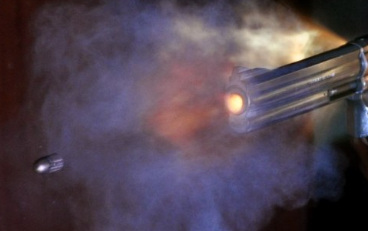
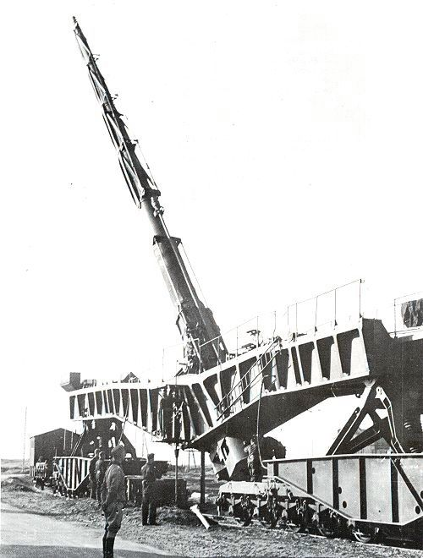
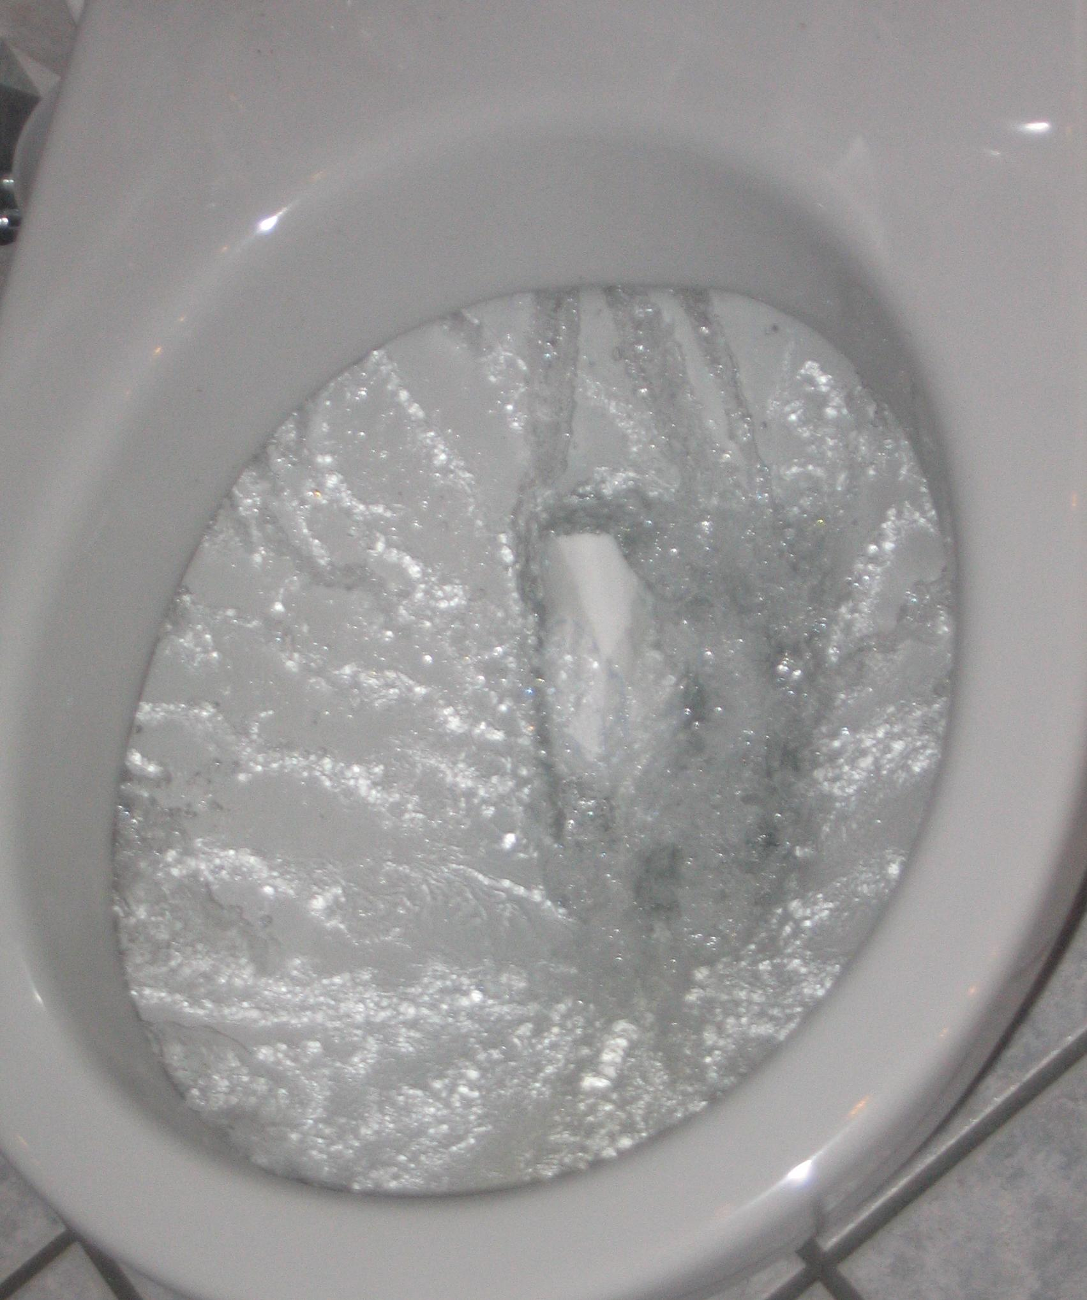
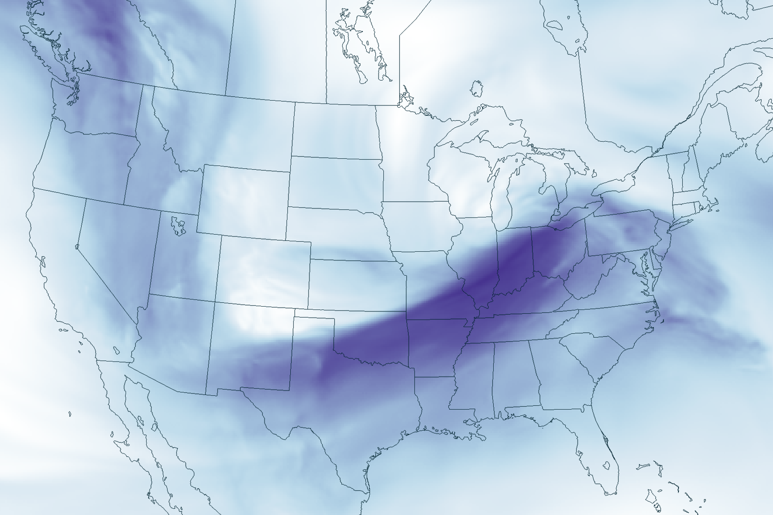
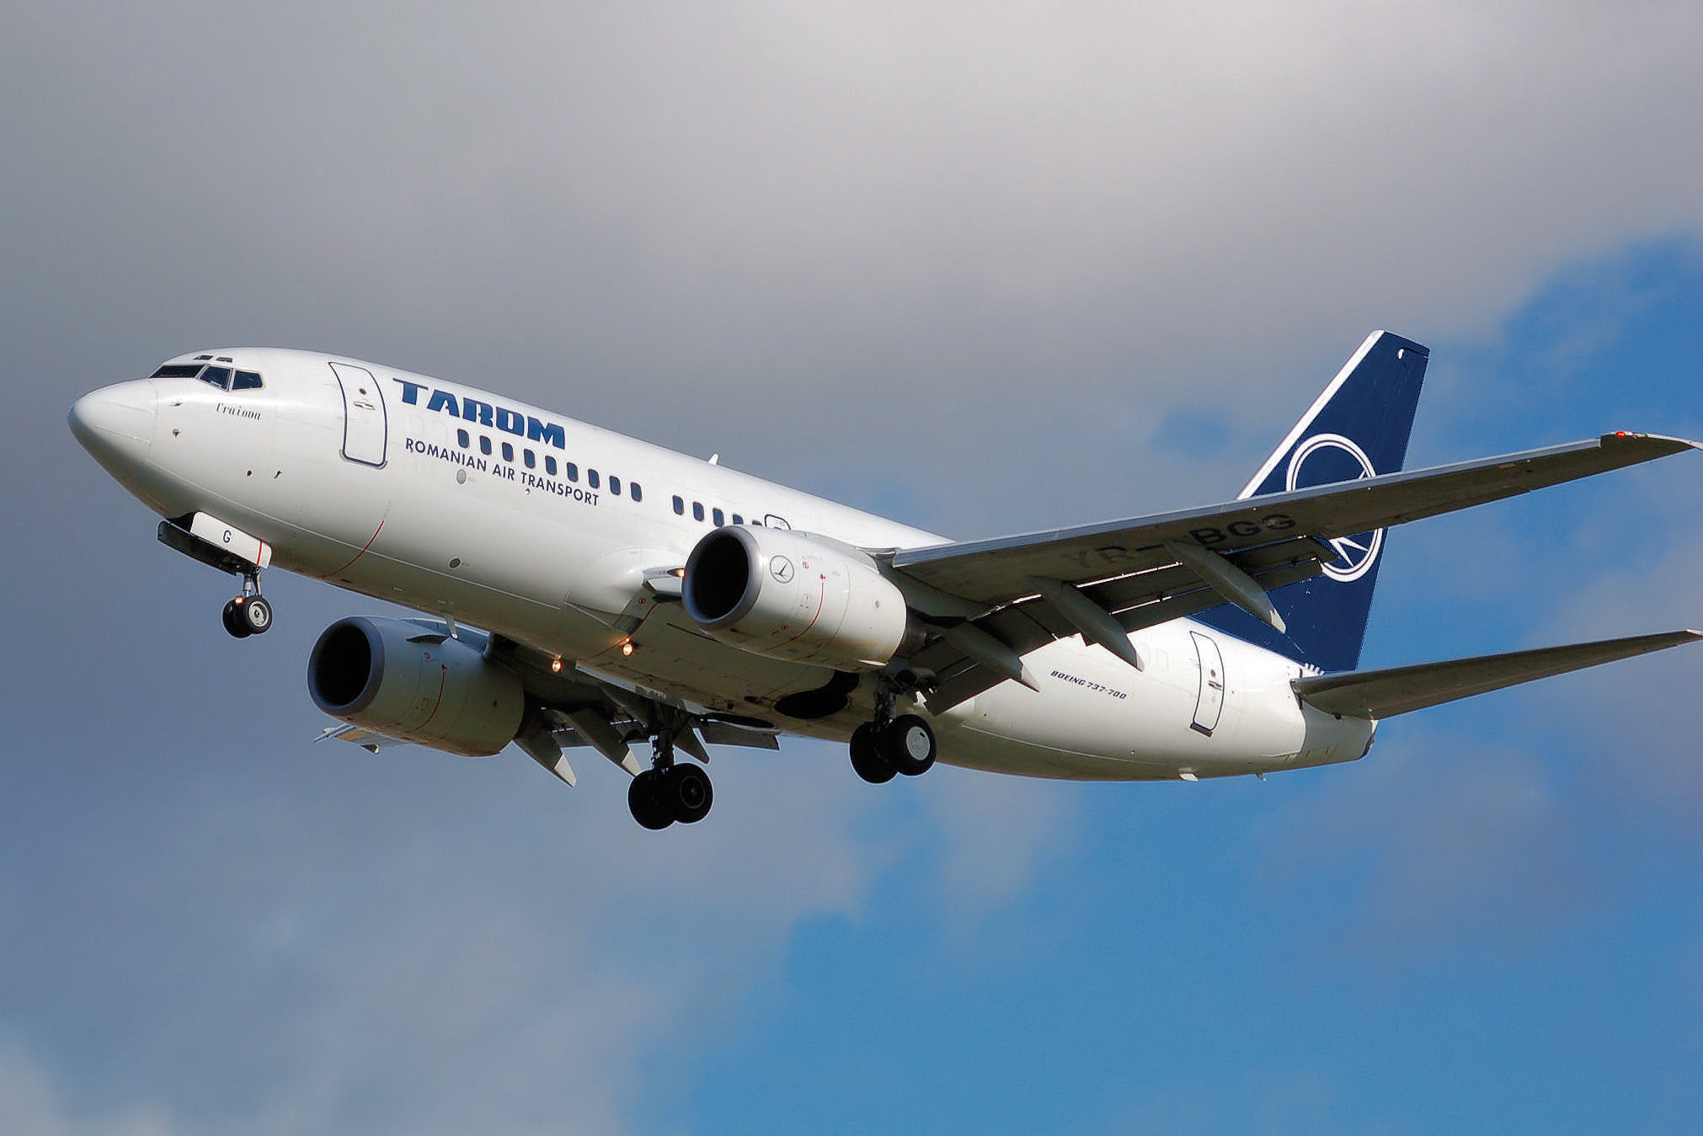
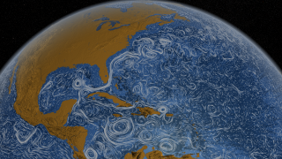
Coriolis Effect On Earth
Use f = 10⁻⁴ | U (m/s) | L (m) | Ro = U/(Lf)
Hurricane | 32 | 400,000
Bullet | 1000 | 100
Railway Gun | 1640 | 120,000
Toilet | 1 | 0.5
Jet Stream | 20 | 400,000
Airplane | 220 | 1,000,000
Ocean Currents | 0.1 | 400,000
Notes:
POINT OF SLIDE:
This slide is intended to address some misconceptions and illustrate how we know if coriolis is important.
CONTENT:
The Rossby number tells whether or not Coriolis is important in determining the path of an objects motion. This activity (to be done as a class or in groups) uses the Rossby number to see if Coriolis is important for different kinds of motion on earth. Many students have misconceptions about whether Coriolis is important (for example, they may think that the toilet will spin the other way in the southern hemisphere.) For each case listed in the table, help the students calculate the Rossby number using an approximate value for the earth’s rotation (f = 10^-4 rad/sec). Then, help the students decide if coriolis is likely to affect the object’s motion.
Hurricane: Ro = 0.8 (Coriolis is important for hurricanes – deflected incoming air is what causes them to start spinning.)
Bullet: Ro = 100000 (This can vary depending on muzzle velocity and firing distance – but for most guns, coriolis is not important.)
Railway Gun: Ro = 137 (This enormous gun was built during WWII. Similar to the famous Paris Gun of WWI, it could fire so far coriolis started to become weakly important and minor adjustments to aim the gun were required.)
Toilet: Ro = 20,000 (Despite popular misconceptions, toilets and sink drains are unaffected by coriolis. A toilet would have to be about 10km across for coriolis to start being important.)
Jet Stream: Ro = 0.5 (The upper air wind is affected by Coriolis. This is often what causes the dips and curves in the wind patterns.)
Airplane: Ro = 2.2 (Typically, airplanes are weekly affected by Coriolis. The slower or farther it travels, the more deflection due to coriolis the airplane experiences.)
Ocean Currents: Ro = 0.0025 (Large-scale ocean currents are affected by Coriolis, which is why we are studying this! Most ocean processes at latitudes higher than 20 degrees and larger than a few kilometers are affected by Coriolis.)
IMAGE CREDITS:
Hurricane Rita: http://rsd.gsfc.nasa.gov/goes/pub/goes/050923.rita.goes_modis.jpg
Bullet: http://upload.wikimedia.org/wikipedia/commons/2/23/Bullet_coming_from_S%26W.jpg
Railway Gun: http://upload.wikimedia.org/wikipedia/commons/d/d1/210_mm_Railway_Gun.jpg
Toilet: http://upload.wikimedia.org/wikipedia/commons/3/3c/Flushing_toilet.jpg
Jet Stream: http://www.nnvl.noaa.gov/MediaDetail2.php?MediaID=1002&MediaTypeID=1 (The color scale represents upper air velocity – darker is faster)
Airplane: http://upload.wikimedia.org/wikipedia/commons/f/fc/Tarom.b737-700.yr-bgg.arp.jpg
Ocean Currents: http://svs.gsfc.nasa.gov/vis/a000000/a003800/a003827/siggraph_currents_STILL2.15402_web.png

Slide 9
Summary and Extension
Newton’s law: Objects travel in a straight line unless another force deflects them.
On a rotating earth, straight line motion appears curved.
This is the “Coriolis effect”
The Coriolis effect is only important on large spatial scales
Coriolis is needed to understand wind and water currents.
Notes:
POINT OF SLIDE:
This slide summarizes the main points in this lesson introducing the Coriolis force.
BULLETED POINTS:
In a fixed reference frame, objects in motion obey Newton’s first law and travel in a straight line unless some other external force deflects them. The students explored this in the “Newton’s Golf” activity.
However, if the person observing the straight line motion of an object is in a rotating frame (rotating around the moving object), the path of the object appears curved. Students observed this from the path of the ball in the video.
This “apparent motion” is termed the coriolis effect or coriolis force (even though there is not actually a “force” deflecting the motion of the object.
On large scales (greater than about a kilometer) most motion we observe on earth starts to be affected by coriolis. This is why oceanographers who study ocean or wind currents must take coriolis into account.
ADDITIONAL READING:
An excellent scientific article on understanding the Coriolis force: Persson, Anders. (1998) “How Do We Understand the Coriolis Force?” Bulletin of the American Meteorological Society. Vol. 79, n. 7. 1373-1385.
PICTURE/GRAPHICS CREDITS:
none

