Slide 1

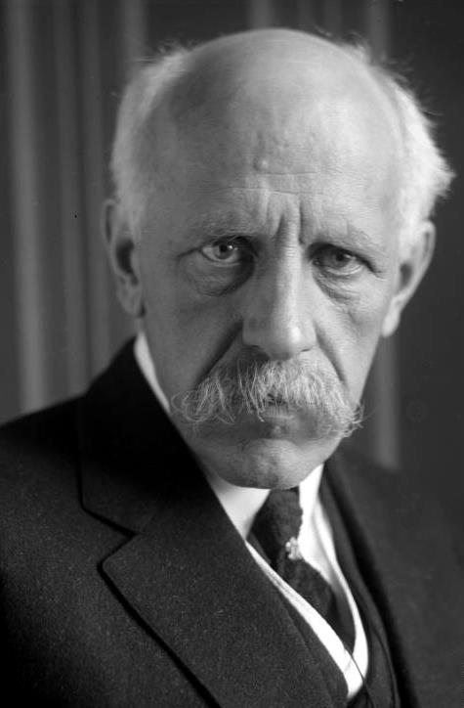
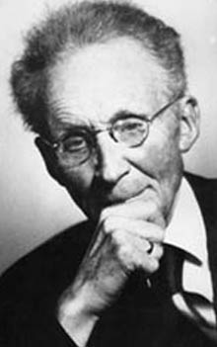
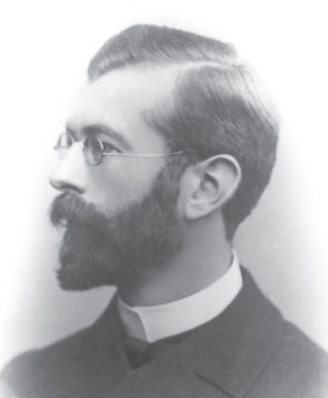
Winds and Surface Current
Explorer
Scientist
Student
Notes:
AUTHORS AND CONTEXT
Greg Sinnett, Scripps Institution of Oceanography, Ph.D. Student
Jennifer Ogo, Kearny High School, Science Teacher
This is the 4th (of 5) lessons on ocean currents and physical oceanography. This lesson builds on the previous lesson regarding the Coriolis effect to explore how winds drive ocean currents.
WHY:
Ocean currents are primarily forced by two mechanisms: winds and density differences (gradients). This lesson will explore how winds and the (coriolis effect) produce surface currents in the ocean.
3. SUMMARY:
The first few slides tell the story of the “Voyage of the Fram” between 1893 and 1896. It was on this voyage that the true nature of wind driven ocean currents were first observed and later explained. Students will learn how careful observations lead to questions, which eventually were explained by physics and tested repeatedly. The scientific method at work!
Students will then build an “Ekman Spiral” in a ~30 min activity, and explore how wind driven current works on earth.
This slide introduces the story of how wind driven ocean currents were first understood. The “Explorer” Fridjof Nansen provided puzzling data to the “Scientist” Vilhelm Bjerknes who asked his student Vagn Walfrid Ekman to look into it. Ekman solved the problem – which we will study in this lesson.
4. PICTURE/GRAPHICS CREDITS:
Nansen Photo: http://upload.wikimedia.org/wikipedia/en/c/c6/Bundesarchiv_Bild_102-09772%2C_Fridjof_Nansen_%28cropped%29.jpg
Bjerknes Photo: http://upload.wikimedia.org/wikipedia/commons/4/42/Bjerknes.jpg
Ekman Photo: http://upload.wikimedia.org/wikipedia/commons/a/ac/Ekman_Vagn.jpg
5. WEBSITES USED IN THIS PRESENTATION:
None
ADDITIONAL READING:
On how Fridtjof Nansen, Vilhelm Bjerknes and Walfrid Ekman observed ship and iceberg drift to apply the coriolis force to develop a theory on how winds force current in the ocean:
Persson, Anders. (2001) “The Coriolis force and drifting icebergs (Coriolis part 6).” Weather. Vol. 56, pp. 439-444.
http://onlinelibrary.wiley.com/store/10.1002/j.1477-8696.2001.tb06527.x/asset/j.1477-8696.2001.tb06527.x.pdf?v=1&t=hulgnpye&s=a449874d70bd83f019d0977e5603eb119568d285
Ekman’s landmark paper: Ekman, V. Walfrid. (1905) “On the Influence of the Earth’s Rotation on Ocean-Currents.” Arkiv for Matematik, Astronomi Och Fysik, Vol 2. No. 11.
http://www.aos.princeton.edu/WWWPUBLIC/gkv/history/Ekman05.pdf
Reference on wind driven surface currents: See Chapter 9 of http://oceanworld.tamu.edu/resources/ocng_textbook/contents.html (Especially 9.2, 9.3 and 9.4)
7. CONTEXT FOR USE: This lesson was designed for a 9th grade marine science class as part of a unit on ocean circulation and physical oceanography.
MISCONCEPTIONS:
“Water travels the same way the wind blows” – The coriolis force actually causes the water to move differently. Students will explore how rotation affects the motion of wind forces water in the Ekman spiral activity.
“Currents travel in the same direction at all depths” – Students often think that water moves as “chunks.” In reality, water is sheared (moves in different directions at different depths) when the wind blows.
EVALUATION TIPS:
Students often have a hard time with the concept that wind blowing in one direction can cause water to move in many directions. As students build the models of current flow, observe their conversations as they work out which way current must flow. Answers to the questions of how the “Ekman Spiral” is formed and what it means for the direction of water transport will show the student’s level of understanding of this complicated topic.
10. TEACHING NOTES: See the Lesson Overview for more information on the various activities and labs associated with this unit of study (approximately 5-6 class periods, 90 minutes each)
11. SCIENCE STANDARDS ADDRESSED: HS-ESS2-5, HS-PS3-2 (partially), HS-PS3-3 (modeled),

Slide 2
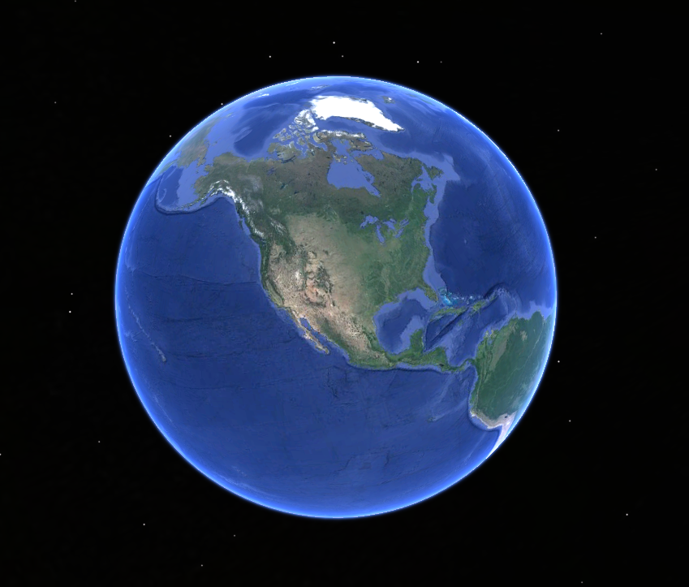
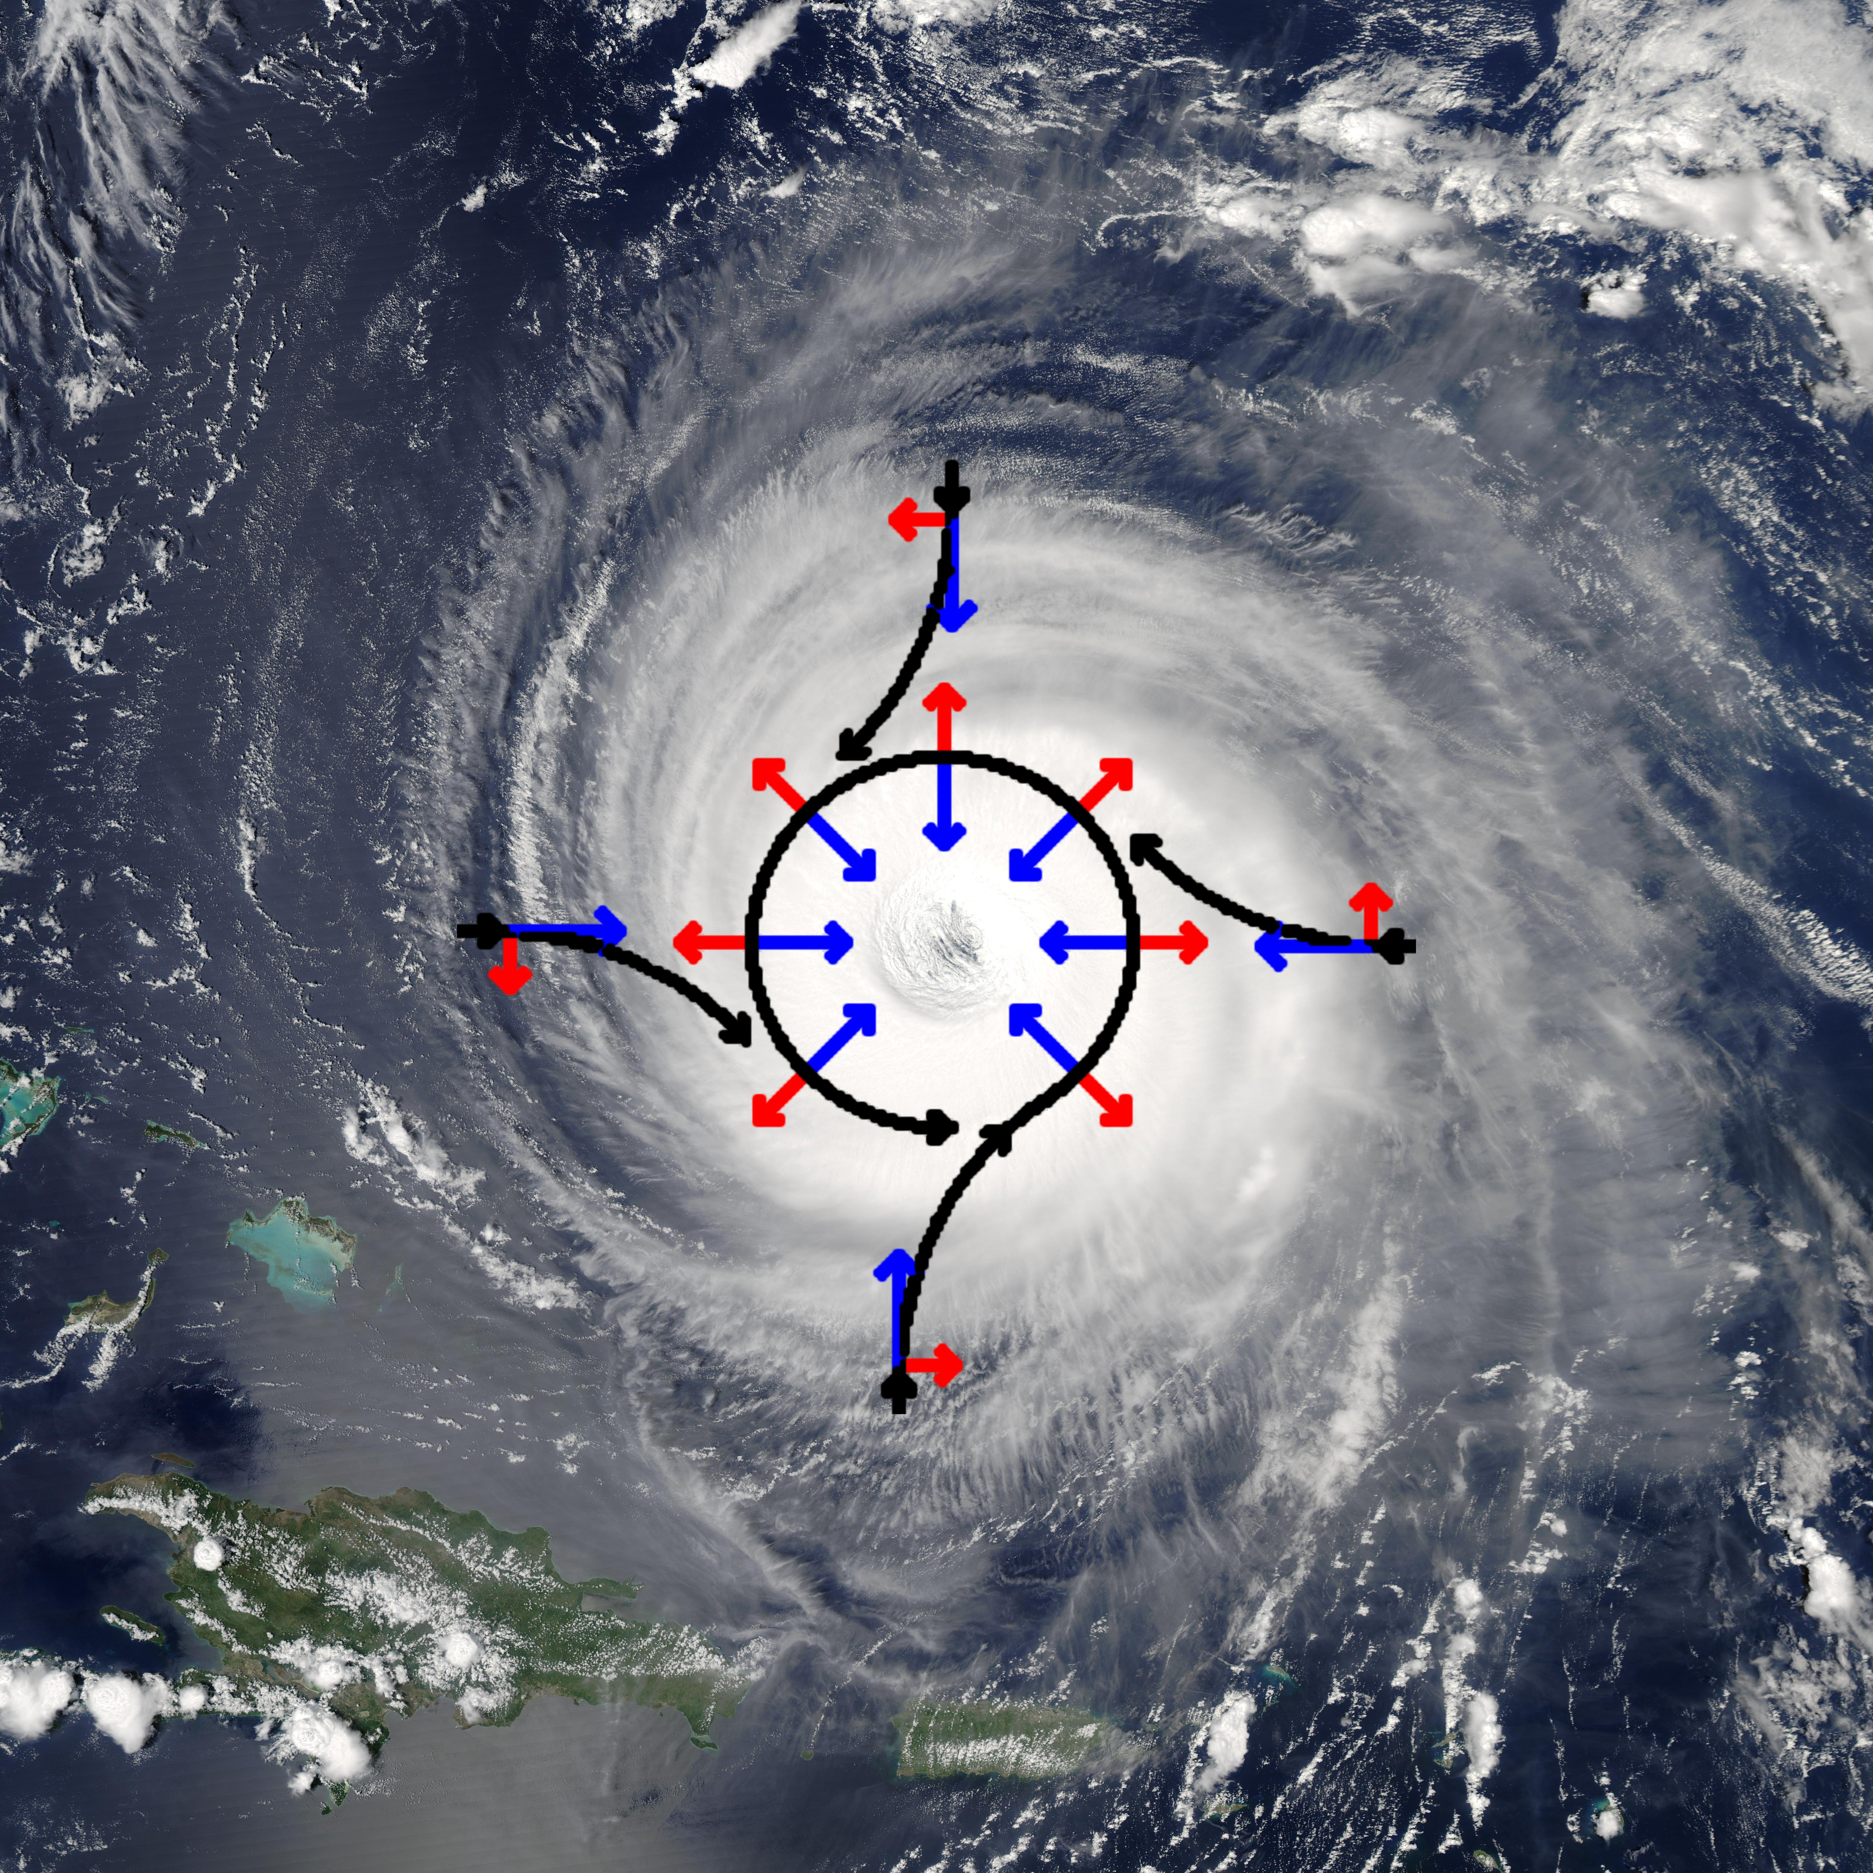
Coriolis Review
Initial Path
Actual Path
Pressure Force
Coriolis “Force”
Notes:
POINT OF SLIDE:
The Coriolis effect (due to observing straight line motion from a rotating frame of reference) is very important to wind driven current. This slide reviews some basic concepts from the third lesson.
CONTENT:
Ask the students to recall what the Coriolis effect is and what it does by using these two images. They may do this in groups, or in front of the class. Remind them that it is the result of viewing straight line motion from a rotating reference frame (similar to throwing a ball across a merry-go-round). Refer to lesson 3 for more information and demonstrations on the Coriolis effect.
The picture on the left is Hurricane Isabel with overlaid wind paths (in black), pressure force (blue) and coriolis effect (red). Walk the students through what is happening, asking for input along the way: 1) Warm, moist air rises in the center of the hurricane, creating low pressure in the center. 2) The low pressure creates a “pressure gradient force” directed toward the center (blue). 3) This force causes air to begin moving toward the center of the hurricane. 4) The moving air is deflected by coriolis (red) until the air moves quickly enough that the apparent coriolis force balances the pressure gradient force. 5) The important take-away is that even though the coriolis force is to the right of the direction of air motion, the storm begins to rotate counter-clockwise (in the northern hemisphere)
The picture on the right is a schematic of what the coriolis deflection might look like on the rotating planet. Ask the students to describe what is happening, and use this to differentiate between the initial path of an object set in motion, and the actual path it takes on the rotating planet.
PICTURE/IMAGE CREDITS:
Hurricane Isabel with diagram of air motion: http://upload.wikimedia.org/wikipedia/commons/0/03/Hurricane_isabel_and_coriolis_force.jpg

Slide 3
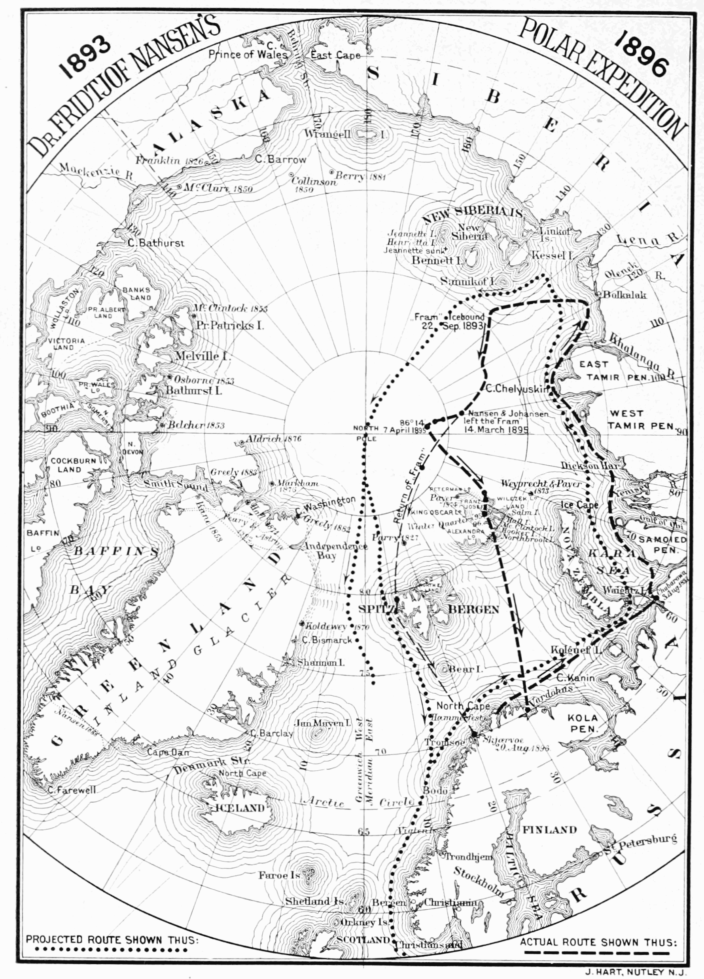
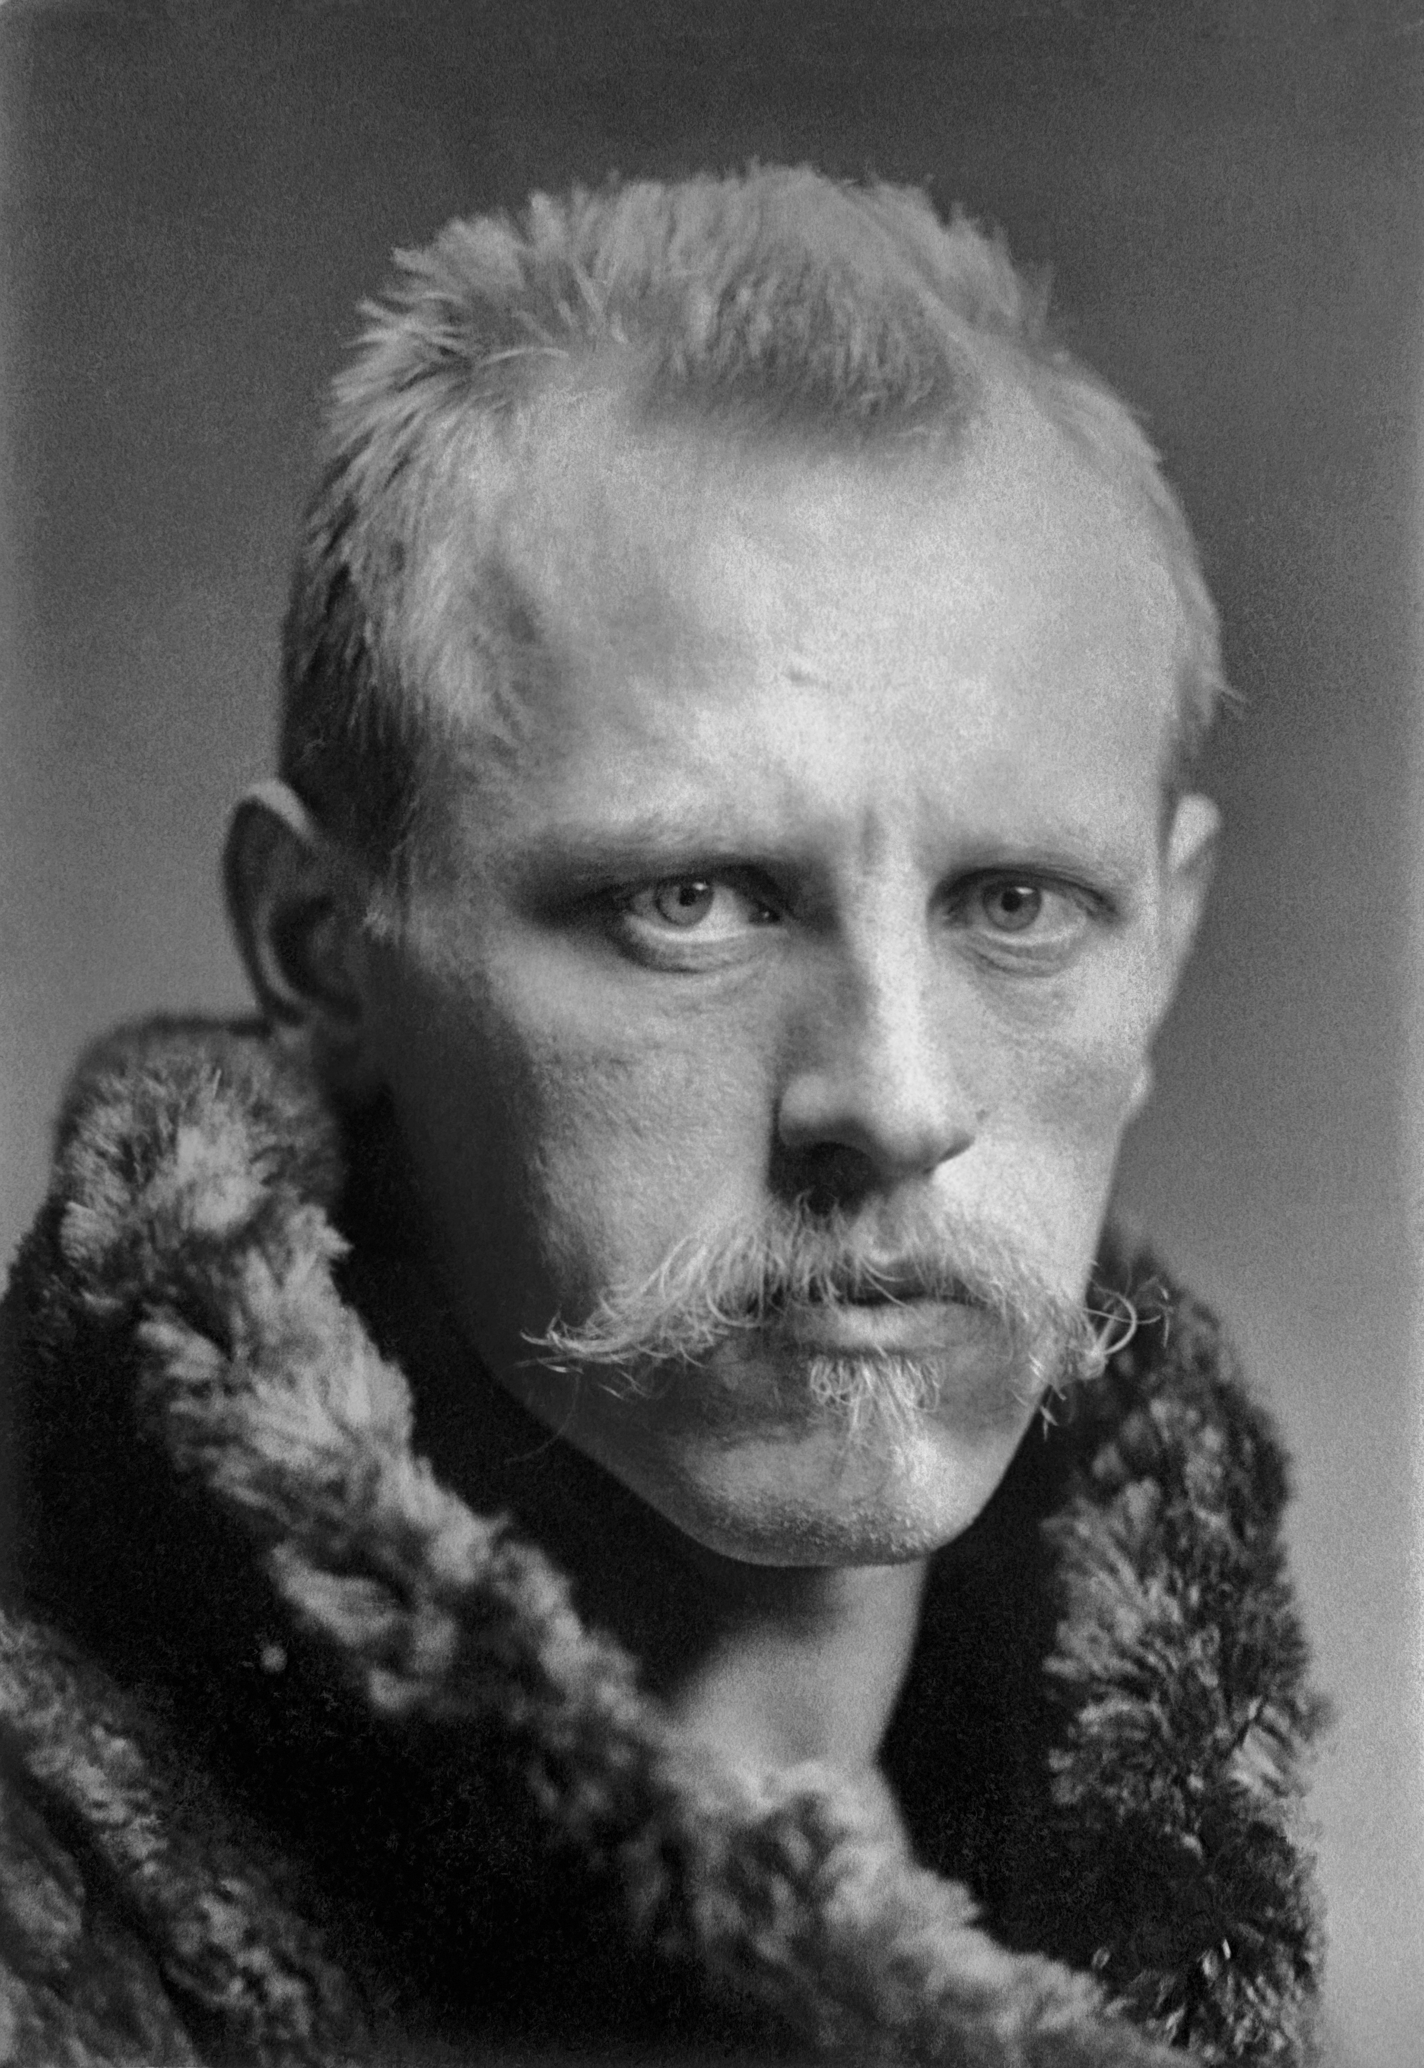
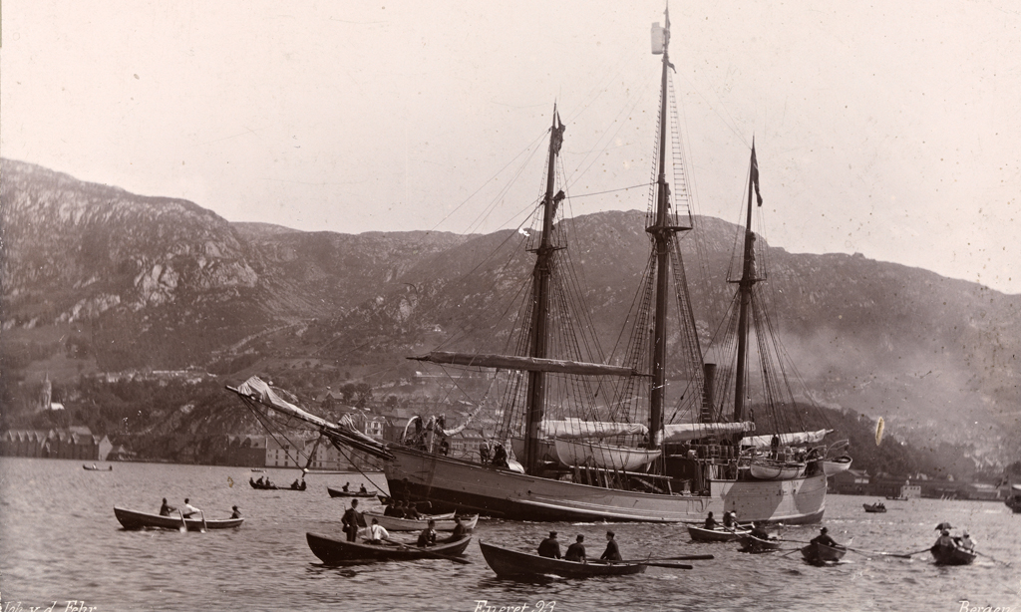
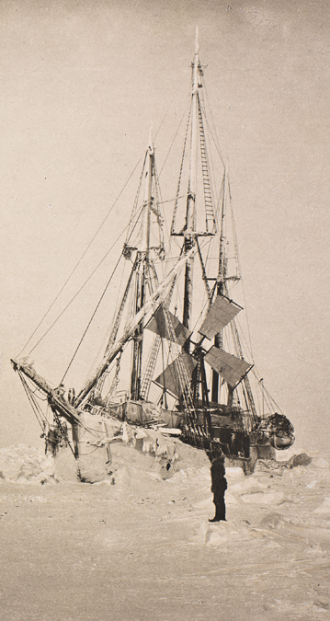
Nansen’s Voyage to the Arctic
Notes:
POINT OF SLIDE:
This slide is intended to be shown during the story of the Fram. It shows pictures of Nansen and his voyage. Advancing the slide will show a larger image of the voyage map.
CONTENT:
This slide illustrates some of the events in the story of the Fram (Fram Story.doc) Use this slide to illustrate the narrative, while having the students take turns reading each paragraph. Clicking forward will bring up a large map of the expedition.
First describe the photos:
Left Photo: Photo of Fridtjof Nansen – Norwegian polar explorer (1861-1930)
Top Photo: Photo of the Fram as it leaves Bergen Norway in July of 1893. (Bergen Norway was the city used as an example of thermohaline circulation affecting local climate in lesson 2)
Right Photo: Photo of the Fram stuck in ice and adrift in the Arctic ocean in March 1884. Note the windmill used to provide electricity.
Bottom Photo: Map showing the Fram’s projected rout (dotted) and actual voyage (dashed) from the upper right corner (New Siberia Islands) to the bottom (Norway). To date, this was the closest anyone had ever gotten to the North Pole.
Next, read the story of the Fram (Fram Story.doc). Advance this slide to show a larger map of the expedition. The map shows Nansen’s intended route over the north pole as a dotted line. His actual route is the dark dashed line (including a brief expedition on foot to try to reach the pole). It may be important to emphasize that the overall path the ship took while encased in ice was largely due to the “Transpolar Current” that runs from northern Russia to the eastern coast of Greenland. While in the arctic, Nansen observed icebergs traveling in a direction to the right of the wind.
After reading the narrative, ask the students to hypothesize why the ice drifted at an angle of about 20-40 degrees from the direction of the wind.
PICTURE/IMAGE CREDITS:
Photo of Nansen: http://upload.wikimedia.org/wikipedia/commons/9/9b/Fridtjof_Nansen_LOC_03377u-3.jpg
Photo of Fram: http://upload.wikimedia.org/wikipedia/commons/9/91/Fram_Bergen_1893.jpg
Photo of Fram in Ice: http://upload.wikimedia.org/wikipedia/commons/d/d9/Fram_March_1894.jpg
Photo of Expedition map: http://upload.wikimedia.org/wikipedia/commons/d/d5/PSM_V57_D434_Map_showing_the_regions_traversed_by_nansen.png

Slide 4
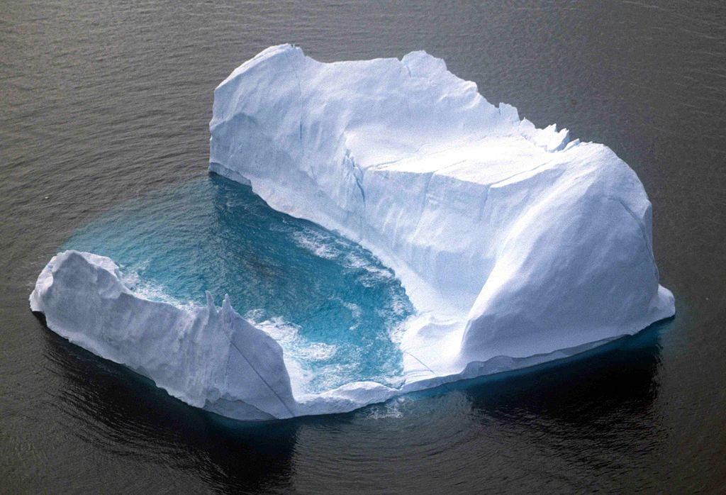
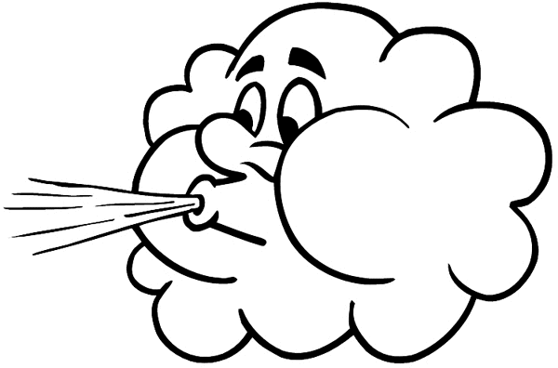
Ekman’s Explanation of Drifting Ice
Coriolis deflects moving objects to the right or left…
Ice motion
Wind direction
1) Wind starts to blow
2) Ice starts to move
3) Coriolis is important. The apparent ship track is curved.
4) The ice has moved at an angle to the wind.
Notes:
POINT OF SLIDE:
This slide illustrates Ekman’s explanation of Nansen’s observations of wind and drifting ice.
CONTENT:
This slide picks up where the story of Nansen and the Fram leaves off. Continue the story by explaining the photo on the left is Vagn Walfrid Ekman who solved the mystery of Nansen’s drifting icebergs when he was still a student.
Nansen gave the oceanographer Vilhelm Bjerknes his data, who then passed it along to his student Vagn Walfried Ekman. Ekman looked at the data, then came up with a brilliant solution.
This slide is animated, advancing the slide in presenter view will play the animation. Walk the students through Ekman’s explanation of wind-driven motion on the surface. Animation steps are described below:
Ekman and a top view (looking down) of an iceberg is shown. (Advance the slide)
Wind starts to blow on the iceberg. In this case the wind is from the “rear”, but in reality, the wind direction doesn’t matter (we could be facing in any direction). (Advance the slide)
The wind pushes the iceberg forward in the direction of the wind. However, the motion is slow (about 1.6 km per day) and the scale is large, so that the Rossby number is low (about 0.15) indicating Coriolis is important. (Advance the slide)
The Coriolis effect (the apparent force caused by observing straight line motion from a rotating reference frame) deflects the iceberg to the right (in the northern hemisphere) relative to the earth’s reference frame. The ice continues to deflect to the right until the coriolis “force” (“pulling” the ice to the right in the earth’s reference frame) balances the wind force (pushing the ice to the left). (Advance the slide)
Thus, the ice eventually moves at an angle relative to the direction of the wind motion just like Nansen observed!
PICTURE/IMAGE CREDITS:
Photo of Ekman: http://upload.wikimedia.org/wikipedia/commons/a/ac/Ekman_Vagn.jpg
Iceberg: http://commons.wikimedia.org/wiki/Iceberg#mediaviewer/File:Iceberg_1_1997_08_07.jpg
Wind icon: https://mauritiusattractions.com/content/images/guide/mauritius-wind.gif (clip art)

Slide 5
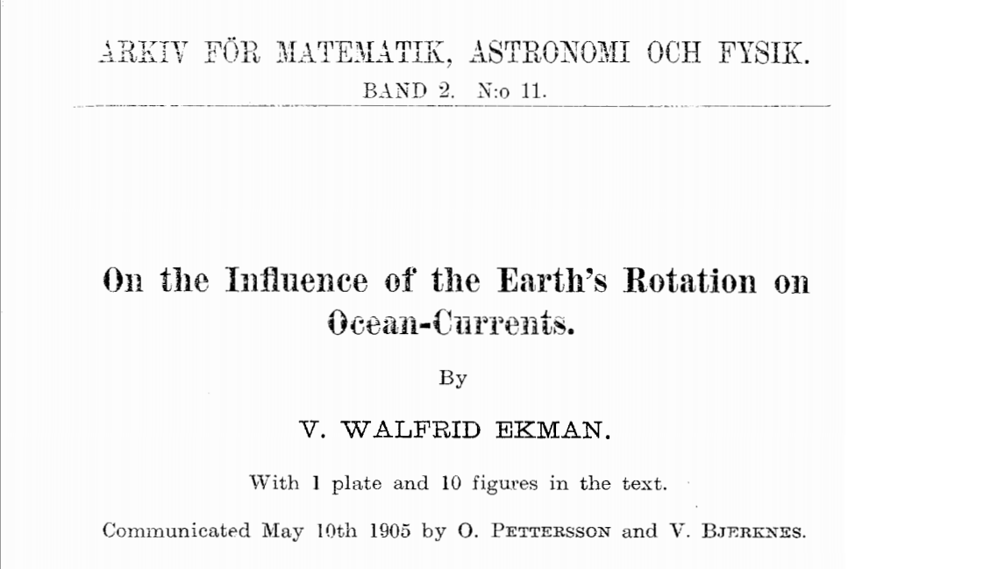
Ekman’s Lab Report
Notes:
POINT OF SLIDE:
This slide introduces the lab activity which will apply Ekman’s principal at the surface to wind-driven ocean current beneath the surface.
CONTENT:
Ekman applied what he knew about fluid dynamics and Coriolis to explain not only the SURFACE motion due to wind, but also motion below the surface of the ocean. This slide is the title page of Ekman’s landmark paper (essentially his “lab report”) on wind-driven ocean currents.
In this lab activity, we will perform the same thought experiment Ekman did to arrive at what is known as the “Ekman spiral” (a spiral of current decreasing in magnitude with depth) in response to wind blowing on the surface. Further, we will deduce what direction the average current (or transport) is flowing with respect to the wind – called “Ekman Transport.”
Tell the students that Ekman thought deeply about what would happen below the surface of the ocean by applying what he knew to be happening on the surface. The students will do the same in this lab.
The lab materials can be found in Ekman Lab.docx and LabArrows.docx
PICTURE/IMAGE CREDITS:
This is the title page to Ekman’s landmark paper in which he describes how the Coriolis force affects wind driven currents in the ocean

Slide 6
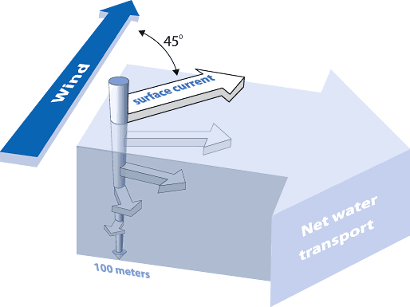
Lab Recap
Notes:
POINT OF SLIDE:
This slide summarizes the results of the lab.
CONTENT:
After the lab, use this slide to build consensus. There are three points to emphasize.
The surface current is deflected roughly 45 degrees to the right (left) of the wind stress in the northern (southern) hemisphere.
Water below the surface does not “feel” the wind stress, but instead is affected by friction from the water just above it. This friction causes the water below the surface to spiral downwards in the “Ekman Spiral”
On average, the transport of water in the “surface layer” (that affected by the wind) is 90 degrees to the right (left) of the wind stress in the northern (southern) hemisphere.
It may be helpful to have the students reason through the “Ekman’s Breakthrough” section of the lab. The discussion might go something like: Q: What two forces act on the water at the surface? A: Stress from the wind and apparent deflection by coriolis. Q: Which direction are these forces in? A: Wind stress is in the direction of the wind, and coriolis is 90 degrees to the right or left of the motion of the water. Q: When these two forces add together, what direction do they point (recall the vector adding part of the lab). A: roughly 45 degrees to the right of the wind direction. Q: Now we move down a “layer” to 20m below the surface. What two forces act on water at this depth? A: The stress of the water above it, and coriolis. (It is tempting for students to say that wind is a force acting on water at 20 m – however, water below the surface is not in direct contact with the atmosphere.) Q: What direction do these forces point? A: The stress due to the water above 20 m points in the direction of that water’s motion (we figured this out in the previous step), and coriolis points 90 degrees to the right or left of the motion of the water at 20m. Q: What is the resulting direction of motion for water at 20 m? A: It is rotated to the right of the wind stress (in the northern hemisphere) in this example. The teacher can continue for deeper water layers, using the figure as a guide and stopping at their discretion.
These results are not intuitive! Students may have a hard time understanding why a wind stress on the surface in one direction could cause a current in another direction. Remind them that ocean currents are not attached to the earth (they are free to move as Newton’s laws require) and we are just moving around them in our rotating reference frame. Next, we will explore two ways the wind-driven “Ekman Transport” causes important ocean currents to form, so building consensus at this step is critical.
PICTURE/IMAGE CREDITS:
http://oceanservice.noaa.gov/education/tutorial_currents/media/supp_cur04e.html

Slide 7
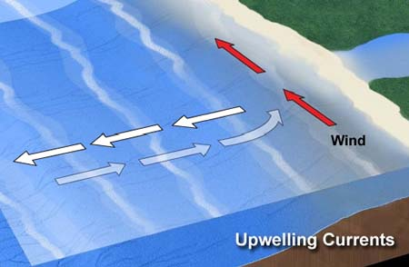
Upwelling
This photo is in the SOUTHERN hemisphere
Notes:
POINT OF SLIDE:
This slide introduces Ekman upwelling near coasts. Upwelling is an important feature of wind driven currents that bring nutrients to the coasts.
CONTENT:
This picture shows an upwelling current near a coast in the southern hemisphere (Southern Peru for instance.) A wind starts to blow from the south to the north. Ask the students how coriolis and the wind forcing might cause water to be brought up near the coast from below.
Here’s what’s happening:
The wind starts to blow from south to north
The wind starts to move the surface water toward the north, but it is deflected due to the coriolis effect. (Make sure the students understand that coriolis deflects objects to the left in the southern hemisphere.)
The deflected surface water moves offshore (due to coriolis).
When surface water is moved away from the shore, it is replaced by water from underneath (as the white arrows in the figure show). Fish love this because this water is typically nutrient rich.
Now ask the students what happens when the wind blows the other way. In this case, upwelling doesn’t happen, since buoyant surface water is deflected toward the coast by coriolis, and is simply trapped against the coast.
The fact that the water near the coast comes from the deep ocean (we say it is “upwelled”) means it is likely rich in nutrients and can support coastal marine life better than the old nutrient-depleted surface water that was transported offshore.
PICTURE/IMAGE CREDITS:
Upwelling photo: http://oceanservice.noaa.gov/education/tutorial_currents/media/supp_cur03b.html and http://oceanservice.noaa.gov/education/tutorial_currents/03coastal4.html

Slide 8
Summary
Wind pushes the surface water – but Coriolis deflects it.
Wind and Coriolis can cause upwelling – important for fish and the coastal habitat.
    Beneath the surface, Coriolis causes an “Ekman Spiral”
Notes:
POINT OF SLIDE:
This slide summarizes the main points in this lesson introducing wind driven currents.
BULLETED POINTS:
Nansen’s expedition to the north pole provided the data for Ekman’s theory on wind driven surface currents. As the wind stress on the surface of the ocean causes the ocean to move, but on this large scale and slow motion, the coriolis effect is important and deflects the water to the right (northern hemisphere) or to the left (southern hemisphere). Beneath the surface of the ocean, the water does not feel the wind stress, but instead feels the water directly above it – thus the coriolis force continues to rotate the flow in what is known as the “Ekman Spiral.” The “net” transport is roughly 90º to the right (or left in the southern hemisphere) of the wind stress. So a wind blowing along the shore will push water offshore or onshore. If water is pushed offshore, nutrient rich bottom water “upwells” to take its place. If water is pushed onshore, upwelling doesn’t happen and nutrient rich bottom water is pushed deeper and farther from the coast.
PICTURE/GRAPHICS CREDITS:
Photo of the Fram: http://upload.wikimedia.org/wikipedia/commons/d/d9/Fram_March_1894.jpg
Ekman Spiral Photo: http://oceanservice.noaa.gov/education/tutorial_currents/media/supp_cur04e.html
Upwelling photo: http://oceanservice.noaa.gov/education/tutorial_currents/media/supp_cur03b.html and http://oceanservice.noaa.gov/education/tutorial_currents/03coastal4.html

