Slide 1

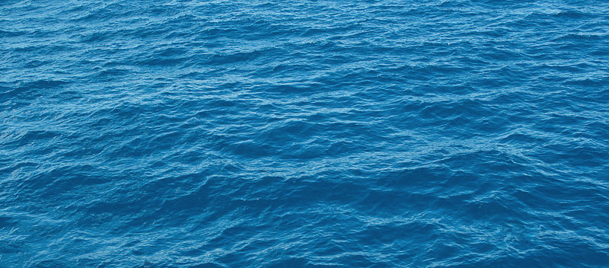
Ocean Currents
Putting it all together
Notes:
AUTHORS AND CONTEXT
Greg Sinnett, Scripps Institution of Oceanography, Ph.D. Student
Jennifer Ogo, Kearny High School, Science Teacher
This is the last lesson in a 5 lesson unit on physical oceanography and ocean currents. This lesson is intended to wrap up the unit and summarize key points. Students are then able to see how understanding ocean currents and physical oceanography is important by participating in a simulation experience as a National Oceanic and Atmospheric Administration (NOAA) oceanographer.
This first slide is a visualization that shows ocean surface currents from June 2005 to December 2007. Satellite data, as well as data from ships, buoys and drifters deployed around the world were combined and then processed at high enough resolution so that eddies (the swirls of water) and strong narrow currents (such as the gulf stream near Florida) could be resolved. You may want to point out times when wind appears to blow on the surface of the water (when regions appear to “flash” quickly – this is not a gust, but rather a strong sustained wind that pushed water and is then sped up in the simulation so that it appears as a gust). Also, advanced classes may be aware that the water moves in a straight line near the equator, but there are lots of rings and eddies near the poles. This is the result of the coriolis force which is strong near the poles and zero on the equator.
WHY:
The unit has presented four key concepts: 1) Density as it relates to the ocean, 2) Density driven currents (“Thermohaline Circulation”), 3) The Coriolis effect, and 4) Wind driven surface currents. This lesson reviews key concepts from each lesson, and then combines them in a fun and engaging experience.
SUMMARY:
The first part of the lesson is a quiz/gameshow that reviews concepts from each of the previous lessons. The second part lets students use an actual simulation tool oceanographers at NOAA use to track and remediate oil spills. Students will use their knowledge of winds and currents to predict and model ocean currents and an actual historical oil spill in Santa Barbara channel.
PICTURE/GRAPHICS CREDITS:
Surface ocean currents video: http://svs.gsfc.nasa.gov/vis/a000000/a003800/a003827/
WEBSITES USED IN THIS PRESENTATION:
ADDITIONAL READING:
CONTEXT FOR USE:
This lesson was designed for a 9th grade marine science class as part of a unit on ocean circulation and physical oceanography.
MISCONCEPTIONS:
“Ocean currents do not apply to me” – The ocean is easy to dismiss as far away or not part of everyday life. This misconception is addressed by students applying their knowledge of ocean currents to protect the coast from an oil spill in the lab experience.
“Oceanographers just study fish and animals” – Oceanographers do lots of things. The lab experience will show them an aspect of oceanography that many people are unfamiliar with.
EVALUATION TIPS:
The quiz/gameshow is a great opportunity to gauge students comfort level with basic concepts presented in this unit. The teacher may want to have students do this as a group (5 or less seems to work well) or individually as a “quiz.” The lab experience is an extension of their understanding of concepts presented in this unit to application. The lab write-up is a great opportunity to gauge how well students synthesized the material and can apply it to a real situation.
TEACHING NOTES:
See the lesson overview for more information regarding this unit and lab activities associated with this series of lessons (approximately 6 class periods, 90 minutes each).
11. SCIENCE STANDARDS ADDRESSED: This lesson addresses HS-ETS1-4, HS-ETS1-3, and HS-ESS3-4 HS-LS2-7

Slide 2

Ocean Currents
Notes:
POINT OF SLIDE:
This slide is a video which shows a broad overview of surface currents around the world. This slide is intended to show students.
CONTENT:
This first slide is a visualization that shows ocean surface currents from June 2005 to December 2007. Satellite data, as well as data from ships, buoys and drifters deployed around the world were combined and then processed at high enough resolution so that eddies (the swirls of water) and strong narrow currents (such as the gulf stream near Florida) could be resolved. You may want to point out times when wind appears to blow on the surface of the water (when regions appear to “flash” quickly – this is not a gust, but rather a strong sustained wind that pushed water and is then sped up in the simulation so that it appears as a gust). Also, advanced classes may be aware that the water moves in a straight line near the equator, but there are lots of rings and eddies near the poles. This is the result of the coriolis force which is strong near the poles and zero on the equator.
Video CREDIT:
Surface ocean currents video: http://svs.gsfc.nasa.gov/vis/a000000/a003800/a003827/

Slide 3
Density
Ryan and Seth are going camping, but Ryan forgot a pillow. He plans to use his puffy down jacket, but it’s too soft and doesn’t support his head. What can he do to increase his makeshift pillow’s density?
Spread the jacket out as much as possible to increase it’s volume.
Lay his jacket on top of Seth’s down jacket, making twice the mass and twice the volume.
Stuff his jacket in a small bag, decreasing it’s volume.
Turn the jacket inside out, exposing the soft lining.
Notes:
POINT OF SLIDE:
This slide is one of a series of slides to quiz students on concepts presented in this unit.
CONTENT:
Answer: C Density is Mass/Volume and is increased by either decreasing the volume (keeping the mass of the object the same) or increasing the mass (keeping the volume of the object the same).
PHOTO CREDIT:

Slide 4
Density
It’s May 1st, and the weather is finally starting to get warm. Sarah decides to invite her friends over for a pool party. She takes the pool cover off in the morning so it will heat up in the midday sun. By 4pm, the thermometer bobbing on the surface reads 64ºC. Sarah’s friend Mark dives in and manages to swim around for a minute before he jumps out of the pool frozen. The thermometer now reads 57ºC. What happened?
The pool cover was keeping the water warm. When Sarah took the pool cover off, the surface temperature fell.
After 4pm, the sun stopped heating the pool. The temperature of the pool dropped very quickly (11ºC in one minute).
The sun warmed the pool, but the warm water floated on the surface. After Mark jumped in and swam around, the cooler bottom water was mixed up to where the thermometer was.
Mark is an extremely cold person and when he jumped in the pool, he cooled the water.
Notes:
POINT OF SLIDE:
This slide is one of a series of slides to quiz students on concepts presented in this unit.
CONTENT:
Answer: C Because warm water is less dense than cold water, a quite pool heated by the sun will become stratified with warmer water on the surface (where the thermometer was) and colder water at depth.
PHOTO CREDIT:

Slide 5
Thermohaline Circulation
Ocean water sinks or floats depending on its density. Two things are primarily responsible for changing the density of the ocean. What are they?
Ocean color and temperature (but primarily temperature)
Ocean salinity and currents
Ocean salinity and temperature (but primarily salinity)
Ocean salinity and temperature (but primarily temperature)
Ocean temperature and location
Notes:
POINT OF SLIDE:
This slide is one of a series of slides to quiz students on concepts presented in this unit.
CONTENT:
Answer: D Salinity and temperature are the two factors that change the density of ocean water. However, it is much more likely for there to be significant temperature changes than significant salinity changes in the ocean environment – so temperature is the primary factor responsible for density changes in the ocean. Note that we are not talking about freezing water – only cooling it down. When water freezes, it makes ice which is fresh (salt is excluded when the water crystals form) and is actually less dense than the surrounding water (hence the floating icebergs).
PHOTO CREDIT:

Slide 6
Thermohaline Circulation
Thermohaline circulation happens when surface water becomes more dense and falls to the bottom of the ocean. What processes might make surface water more dense?
A) Evaporation removes freshwater from the surface and puts it in the atmosphere, making the ocean water saltier.
B) Extremely cold air cools the warmer surface water.
C) Water cooled from melting ice sinks to the bottom.
D) All of the above
Notes:
POINT OF SLIDE:
This slide is one of a series of slides to quiz students on concepts presented in this unit.
CONTENT:
Answer: D All of these processes take place on the ocean surface making dense water that falls to the bottom. Evaporation happens frequently in the Mediterranean Sea, and cold are and ice cool the water near the polar regions.
PHOTO CREDIT:

Slide 7
Coriolis
Coriolis is an “apparent force.” That is, nothing is actually deflecting objects moving around the planet. Why then, do we observe this “apparent force”?
Just like gravity, the coriolis force is invisible but affects all moving objects.
The coriolis force is always present, you just have to be really far away to see it.
The coriolis force is not a “force” at all. We are just observing a moving object from a rotating reference frame (standing on earth). That’s why objects that travel in a straight line through space appear to curve to those standing on earth.
Just like a curveball in baseball, the spin (or rotation) of the object in motion causes the object to curve through the air or water.
Notes:
POINT OF SLIDE:
This slide is one of a series of slides to quiz students on concepts presented in this unit.
CONTENT:
Answer: C The Coriolis effect is simply the result of us (on a rotating planet) observing an object from a rotating reference frame. The object itself still obeys Newton’s laws (and travels in a straight line as long as no other forces act on it) but we see it from our spot on earth which is traveling at different velocities relative to the earth’s axis depending on whether you are on the equator (rotating at a high velocity around the earth’s axis) or on the pole (rotating at a low velocity around the earth’s axis.)
PHOTO CREDIT:

Slide 8
Coriolis
The coriolis force affects many processes on earth. Find the process that is NOT affected by the coriolis force.
Winds blow on the surface of the ocean, creating a spiral of current in upper 50 m or so of the ocean. The average current in this layer is at right angles to the wind.
Global wind patterns cause large circular currents in ocean basins called “gyres.”
Wind rushing in to a low pressure system is deflected (from the earth’s reference point), causing the system to start spinning and creating a hurricane.
Water going down a drain always starts to swirl.
Notes:
POINT OF SLIDE:
This slide is one of a series of slides to quiz students on concepts presented in this unit.
CONTENT:
Answer: D The Rossby number determines if the Coriolis effect is important (small Ro means Coriolis is important). Ro = Velocity/(Earth’s rotation * Length scale) and the only answer with an extremely small length scale is D (making Ro large and Coriolis unimportant).
Note: This is a common misconception that is important to address. Be sure that students understand that even though the Coriolis force is always present on earth, its effect is only significant over large length scales.
PHOTO CREDIT:

Slide 9
Wind Driven Circulation
Wind-driven upwelling is most likely to happen when:
A gust of wind pushes surface water offshore.
Ocean currents slam up against a coast.
Sustained winds blowing perpendicular to the shore cause surface water to be pushed offshore, which is replaced by water from below.
Sustained winds blowing parallel to the shore cause surface water to be pushed onshore.
Sustained winds blowing parallel to the shore cause surface water to be pushed offshore, which is replaced by water from below.
Notes:
POINT OF SLIDE:
This slide is one of a series of slides to quiz students on concepts presented in this unit.
CONTENT:
Answer: E Wind-driven currents require sustained winds. Upwelling requires Ekman transport offshore (meaning winds must be blowing parallel to the shore) which is replaced by water from below.
PHOTO CREDIT:

Slide 10
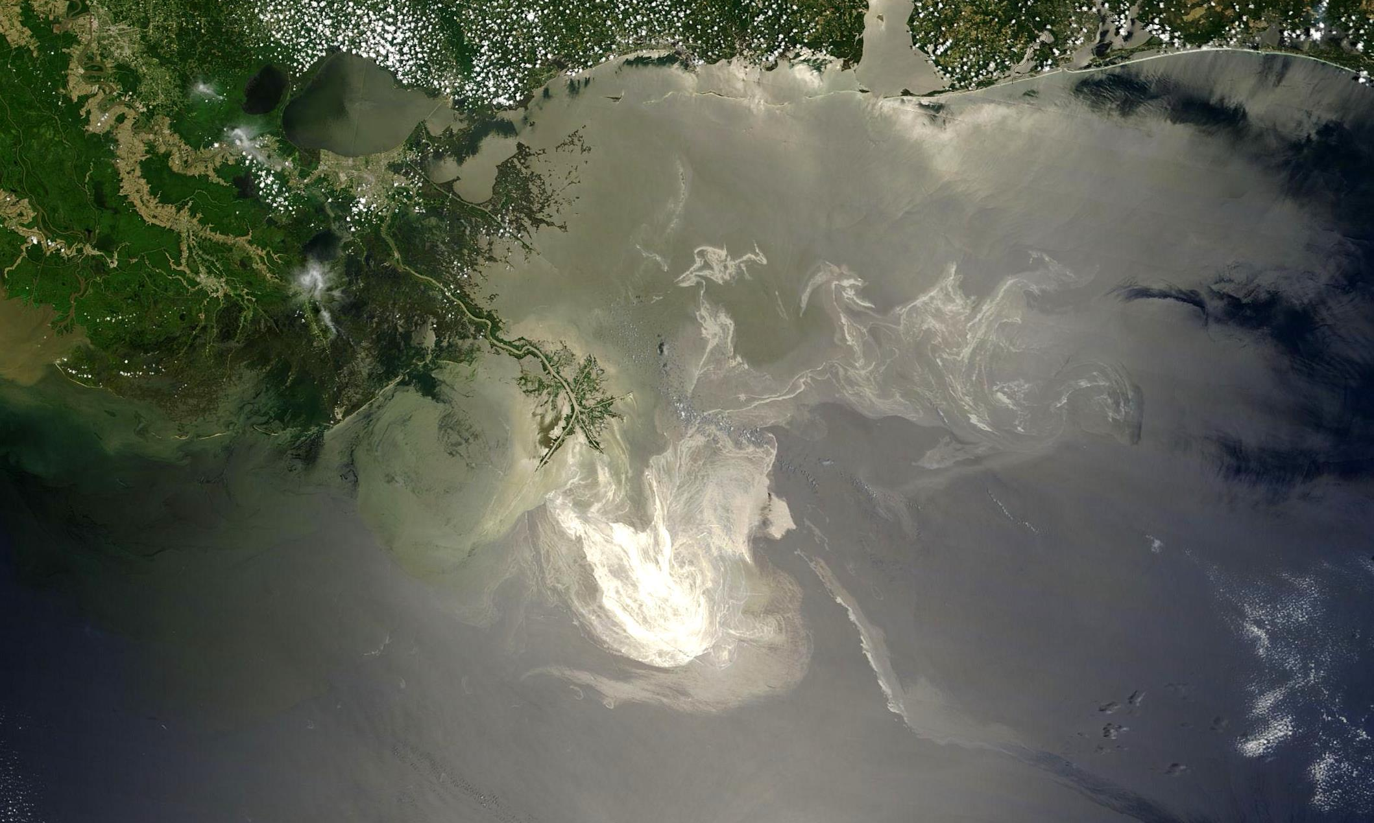
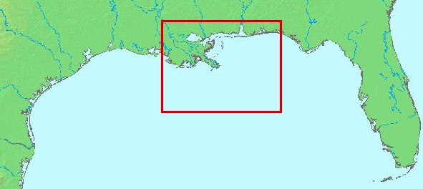
Ocean Currents in Action
Notes:
POINT OF SLIDE:
This slide introduces the lab experience of being a NOAA oceanographer.
CONTENT:
This photo from space is of the Deepwater Horizon oil spill in the Gulf of Mexico which spilled roughly 210 million gallons of oil. The red dot is the approximate location of the deepwater horizon rig, and the shiny film on the surface is the floating oil (which breaks down the surface tension of the water and reflects light differently). Ocean currents and surface winds are transporting the oil, potentially affecting thousands of miles of coastline and delicate habitat. Explain that oceanographers are responsible for predicting where that oil will go, and how best to prevent the oil from coming onshore. This is the students’ task today in the lab.
PHOTO CREDIT:
http://upload.wikimedia.org/wikipedia/commons/7/7b/Deepwater_Horizon_oil_spill_-_May_24%2C_2010_-_with_locator.jpg
This is a NASA photo taken from the “Terra” satellite on May 24th, 2010.

Slide 11
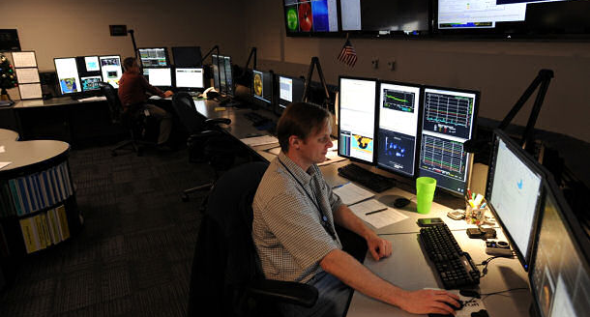
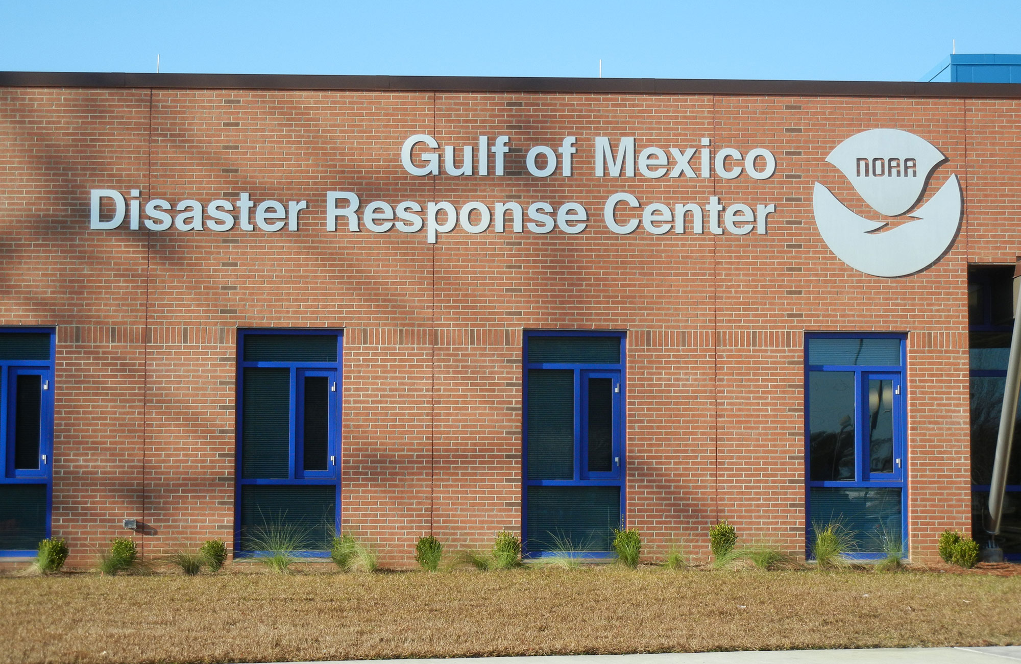
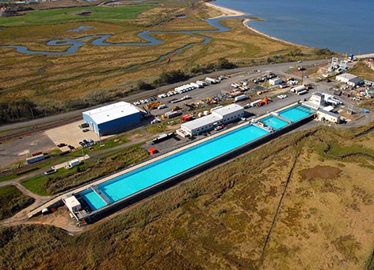
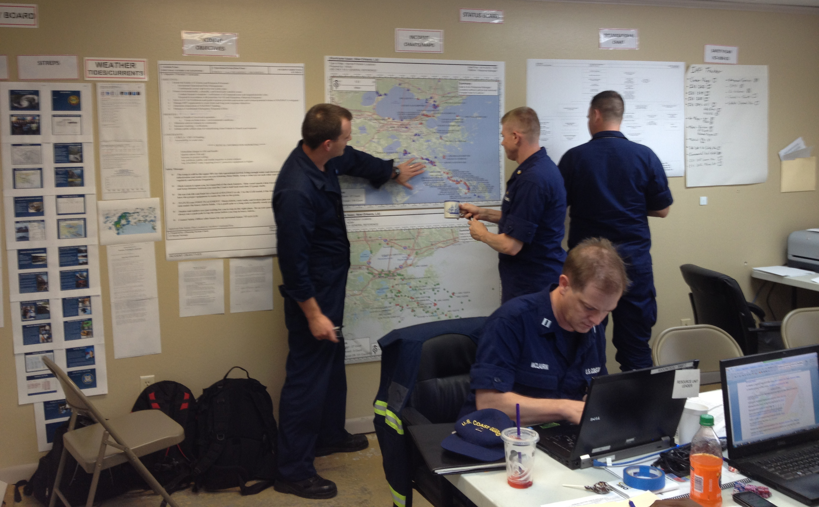
NOAA Simulation and Modeling and Response
Notes:
POINT OF SLIDE:
This slide shows what the NOAA Dissaster Response Center is like.
CONTENT:
NOAA has many more high tech instruments and command centers at their disposal. Some of these include (clockwise from top left) atmospheric weather prediction centers, disaster response centers, OHMSETT (Oil and Hazardous Material Simulated Environmental Test Tank), mobile response headquarters (this one in New Orleans LA, for Hurricane Isaac).
These centers use satellites and sophisticated computer models to inform time-sensitive decisions on how best to allocate resources and mitigate disasters.
PHOTO CREDIT:
http://www.ncep.noaa.gov/newsletter/january2012/
http://oceanservice.noaa.gov/hazards/drc/
http://response.restoration.noaa.gov/about/media/watching-chemical-dispersants-work-oil-spill-research-facility.html
http://usresponserestoration.wordpress.com/2012/09/18/weeks-later-responders-still-dealing-with-pollution-left-in-hurricane-isaacs-wake/ (linked from the NOAA page)

Slide 12
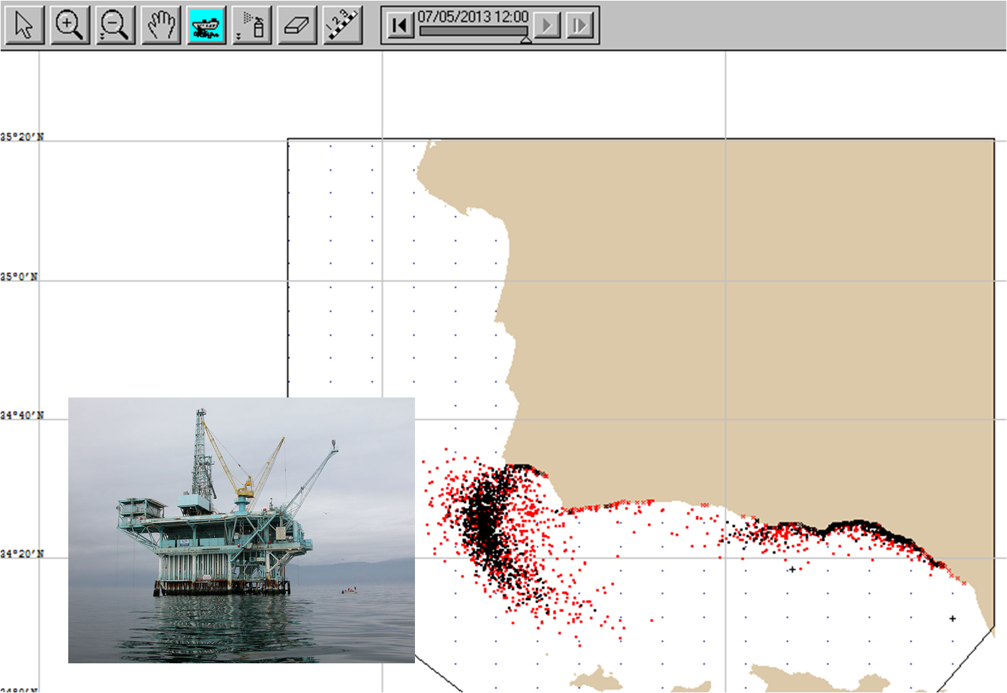
GNOME: General NOAA Operational Modeling Environment
Notes:
POINT OF SLIDE:
Introduce NOAA’s “General NOAA Operational Modeling Environment” (GNOME) modeling environment in the context of the Santa Barbara oil spill of 1969.
CONTENT:
GNOME is used by NOAA to predict the possible trajectories of pollutants in water. The model takes input from the scientist to forecast a path expected to be taken by the pollutants. Input to the model, such as wind speed, wind direction, ocean currents, tides, and other parameters are variables that can be set by the user. In this lab, we will use the conditions that were actually present during the Santa Barbara oil spill to practice an actual oil spill response. Students will then have the opportunity to experiment with the model to see how different conditions affect the oil spill trajectory.
This slide shows a simulation of the Santa Barbara channel (near LA in Southern California) with the black dots indicating where oil is in the water and red dots indicating where tracers or dispersants (used to help clean up the oil) are located. The inset photo is of the oil rig that failed in 1969 (Union Oil’s Platform A) spilling over 4 million gallons of oil (the third largest spill in US history as of 2014). This lab will use the NOAA GNOME modeling environment to model this spill.
GNOME homepage: http://response.restoration.noaa.gov/oil-and-chemical-spills/oil-spills/response-tools/gnome.html
Additional Ref: http://response.restoration.noaa.gov/oil-and-chemical-spills/oil-spills/response-tools/gnome-references.html
And: http://response.restoration.noaa.gov/oil-and-chemical-spills/oil-spills/response-tools/frequently-asked-questions-about-gnome.html
PHOTO CREDIT:
Platform A in Santa Barbara Channel (the one that blew out in 1969): http://en.wikipedia.org/wiki/File:Platform_A,_Dos_Cuadras_(1).jpg

Slide 13
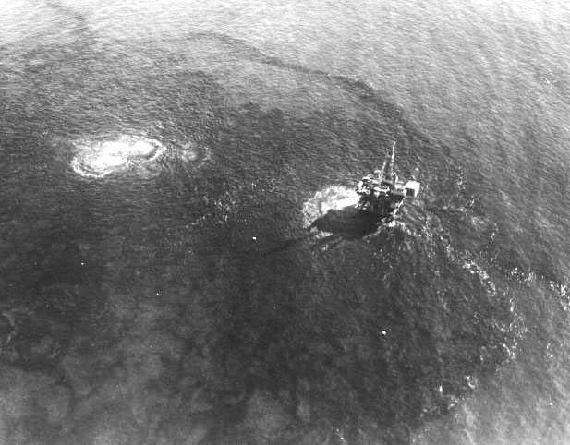
Lab Time!
Lab Objectives:
Test the model
“Hindcast” the Santa Barbara 1969 oil spill
Use the model
Form a plan for a spill that happens today.
Explore the model
Change parameters to see what happens in various conditions.
Notes:
POINT OF SLIDE:
This slide is intended to introduce the lab.
CONTENT:
Oceanographers use models to predict what will happen in the ocean. But before models are trusted, they must be verified. The bullet points on the left highlight the steps we will do in the lab to use the model. First, we will “hindcast” or use the model to simulate something we already know. We will simulate the 1969 oil spill to see if what the model predicts agrees with what actually happened. Next, we will use the model to plan for a spill that hasn’t happened yet. What if oil was spilled today from one of the hundreds of rigs in the Santa Barbara channel today!? Lastly, the students will explore the model to see what happens under different wind and ocean current conditions.
Lab material is found in “GNOME_Lab.docx”
For documentation on the lab for this lesson, please refer to the teacher’s materials:
See “GNOME_help_file.pptx” for step-by-step instructions to set up a simulation.
PHOTO CREDIT:
Platform A in Santa Barbara Channel (the one that blew out in 1969): http://en.wikipedia.org/wiki/File:Platform_A,_Dos_Cuadras_(1).jpg
http://en.wikipedia.org/wiki/File:1969_Santa_Barbara_Oil_Spill_CA.jpg

Slide 14
Ocean Currents
Ocean currents can be caused by:
  Density differences
  Wind
Oceanographers study many things about currents:
    - How currents form
  - Where currents will flow
  - How currents will change
  - How currents impact the environment
We have used our knowledge of ocean currents to clean up an oil spill. Can you think of other applications?
Notes:
POINT OF SLIDE:
This slide summarizes the main points in this concluding lesson.
BULLETED POINTS:
This lesson has addressed how two major factors (density and wind) cause currents to flow in the ocean. Instructors may wish to ask students to reflect on how density and wind cause water to move. (Less dense surface water is made more dense by cooling or increasing salinity and sinks then spreads out on the ocean floor. Winds blow surface water while the coriolis effect causes it to rotate in an Ekman spiral with net wind-driven transport being perpendicular to the wind stress.) The lab experience showed the students how understanding wind and ocean currents can help reduce the effect disasters (such as oil spills) can have on the population and environment. Critical to the success of the simulation was knowledge of how currents form, where they flow, how they change and what the impact of the current will be to the environment (for example, upwelling brings nutrients, while other currents may bring pollutants from river sources etc.)
PICTURE/GRAPHICS CREDITS:
none

