Slide 1
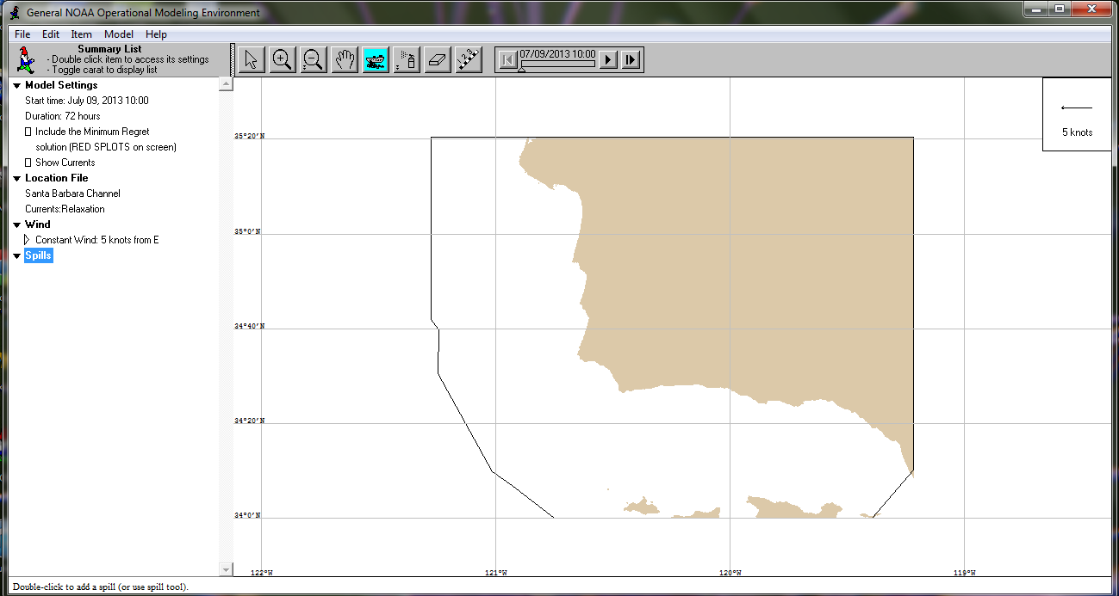
Home Screen
Simulation Set-up
Simulation Playback
Wind indicator

Slide 2
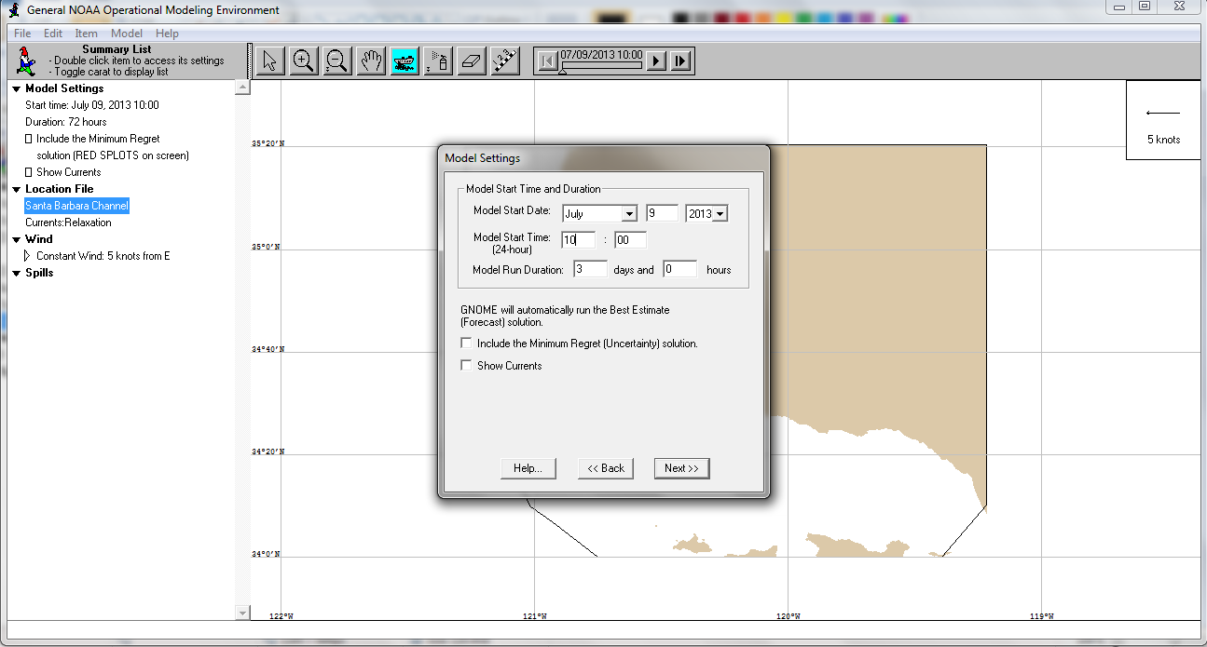
Model Set-up: Model duration
Adjust Model Settings:
Choose run duration = 3 days
Double-click here
Click “Next

Slide 3
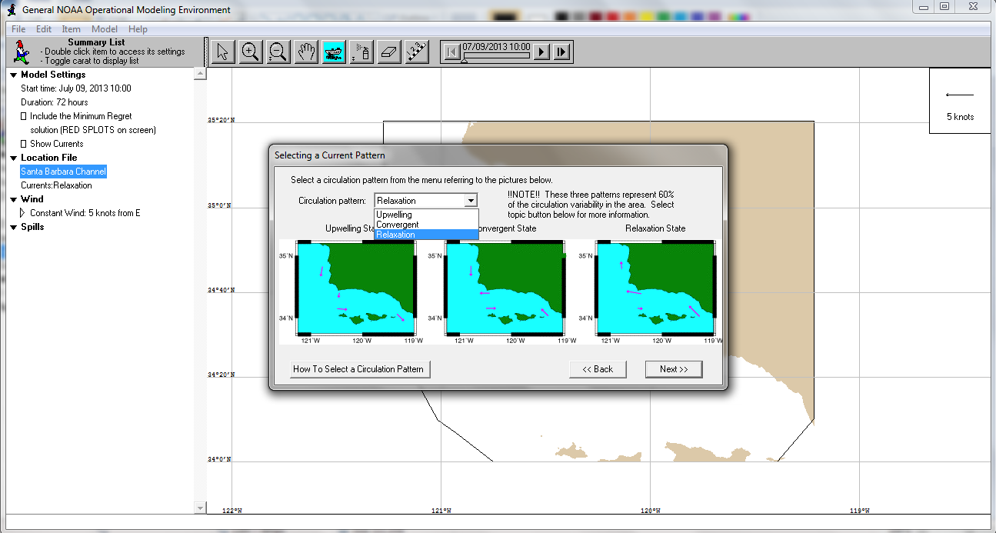
Model Set-up: Ocean Current State
Select Current pattern:
Choose “relaxation state”
Click “Next

Slide 4
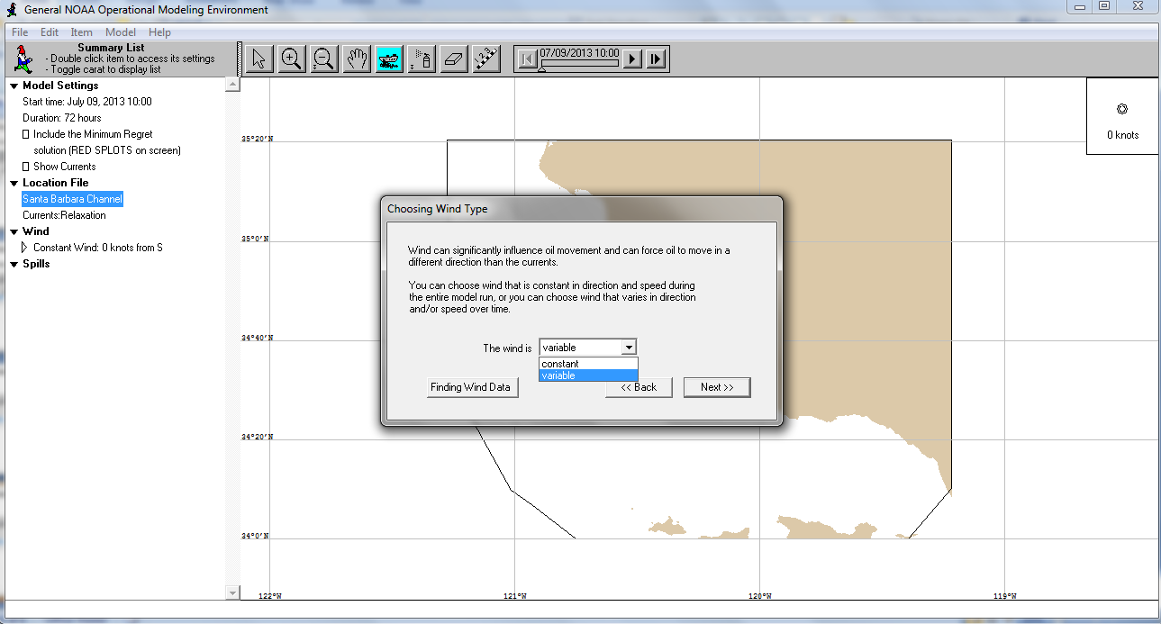
Model Set-up: Wind type
Select wind pattern:
Choose “variable”
Click “Next

Slide 5
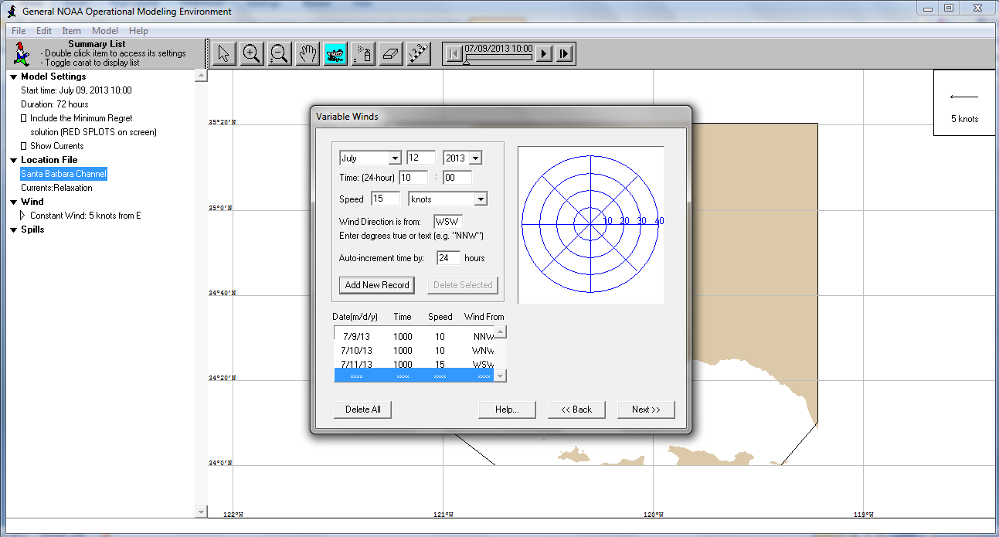
Model Set-up: Wind Variation
Repeat for each day
Then, click “Next
Change direction
Change auto-increment:
Choose 24 hours
Change speed
Click “Add New Record

Slide 6
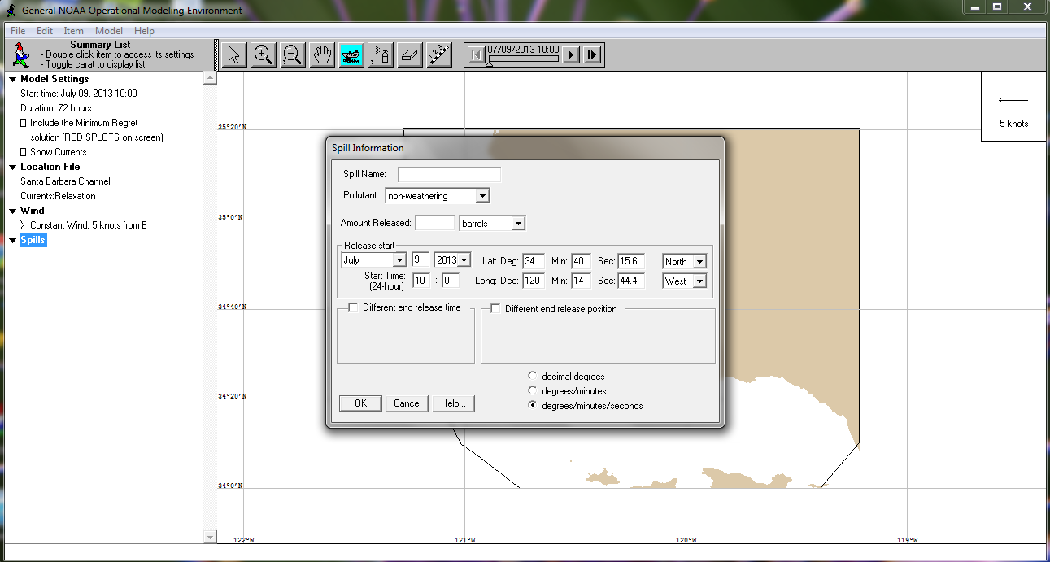
Create Oil Spill Information
Enter the amount spilled
Double-Click here
Enter the spill location
Click “OK”

