Slide 1
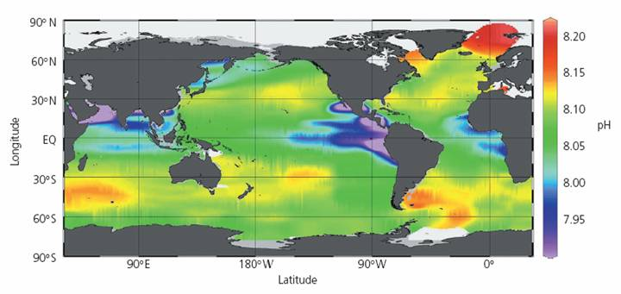
pH
http://earthref/SCC
Scripps Classroom Connection
Notes:
This slide is for the instructor
AUTHORS: Heather Page, Scripps Institution of Oceanography; Alison Dickens, Lincoln High School
WHY: Many organisms, including humans, rely on a narrow range of pH to control physiological processes. The humans maintain blood pH to regulate the carbon dioxide levels. When the pH of the blood changes, then the body accumulates too much carbon dioxide. Some marine animals, like crustaceans and fish, also regulate their internal pH to maintain daily life processes, including calcification. However, many invertebrates are not able to regulate their pH very well and therefore seawater pH plays a major role in their survival. The oceans are acidifying due to increased carbon dioxide. Before understanding the impact of pH on marine life, students need to have a thorough understanding of what pH means.
SUMMARY: The instructor will go through a demonstration that measures pH changes in a solution through an indicator dye. Student will then create their own pH scale by testing pH of ten common solutions, including seawater. Afterwards, students will do an online simulation of acids and bases to learn how to relate pH to hydrogen ion concentration and the difference between acids and bases. By the end of the class, they should be able to add numbers to their pH scale, represent hydrogen and hydroxide concentrations on their scales, and classify the solutions they measured as acidic, neutral, or basic. This lesson will take 2-3 days for a 50 min long class.
PICTURE/GRAPHICS CREDITS: Credits given on each individual slide.
WEBSITES USED IN THIS PRESENTATION: http://phet.colorado.edu/en/simulation/acid-base-solutions (slide 6)
ADDITIONAL RESOURCES: Exploring Acids and Bases Worksheet
CONTEXT FOR USE: This unit was designed for a high school chemistry class or middle school science class and is lesson 1 of 5 in a unit on “Ocean Acidification.” This unit should be taught after students have learned the carbon cycle, chemical reactions and equilibrium, and properties of gasses. The lessons should be taught in order as the concepts build upon one another. The activities within the lessons were designed to be performed in groups of 4 students.
MISCONCEPTIONS:
Ocean is a neutral solution since it’s water.
High pH means a solution is more acidic.
More hydrogen ions leads to bigger pH number.
EVALUATION TIPS: Instructor will collect the worksheet and pH poster completed by the students.
Next Generation Science Standards
MS-PS1-1: Develop models to describe atomic composition of simple molecules and extended structures
Substances are made from different types of atoms
Models can be used to observe systems that are too small to see by our naked eye
MS-PS1-2: Analyze and interpret data on the properties of substances before and after the substances interact to determine if a chemical reaction has occurred
Each pure substance has characteristic chemical properties
Substances react chemically in characteristic ways to form new properties
Macroscopic patterns are related to nature of atomic-level structure
MS-PS1-4: Develop a model that predicts and describes changes in state of a pure substance
In a liquid, molecules constantly in contact with others
Cause and effect relationships can be used to predict phenomena
HS-PS1-3: Plan and conduct an investigation to gather evidence to compare the structure of substances at the bulk scale to infer the strength of electrical forces between particles
Structure and interactions of matter at the bulk scale are determined by electrical forces within and between atoms
Different patterns may be observed at each of the scales at which a system is studied and can provide evidence for causality in explanations of phenomena
HS-PS1-6: Refine the design of a chemical system by specifying a change in conditions that would produce increased amounts of products at equilibrium
Much of science deals with constructing explanations of how things change
HS-PS2-6: Communicate scientific and technical information about why the molecular-level structure is important in the functioning of designed materials
Investigating structures requires a detailed examination of the properties of different materials, the structures of different components, and connections of components to reveal its function and/or solve a problem
-----------------------------------------------------------------------------------
This Slide: The figure uses colors to represent average pH of the world’s oceans. The overall average of seawater pH is 8.1. Older water that has been away from the surface has had more respiration occurring in it, causing a lower pH. This is why the Pacific Ocean has a lower pH than the Atlantic Ocean. (New water is formed at the Atlantic Ocean.) Older, deep water is upwelled (flows from deep water to the surface) on the eastern boundary of each ocean, causing low pH near the western coasts.
PICTURE/GRAPHICS CREDIT: http://www.appinsys.com/globalwarming/OceanAcidification.htm

Slide 2
Alka-Seltzer Rainbow Demo
Materials Needed
1 tablet Alka-Seltzer
350 mL Distilled Water (DIW)
100 mL 0.1M NaOH
10 mL pH Indicator Dye (See Below for Options)
10 mL Vinegar
600 mL Beaker
100 mL Graduated Cylinder
10 mL Graduated Cylinder
500 mL Graduated Cylinder
Stirring Rod
http://earthref/SCC
Scripps Classroom Connection
Notes:
This slide is for the instructor
WHY: The first few minutes of class will be spent on this demonstration, which will engage students in thinking about what is causing the color change. Students should fill out worksheets as the instructor goes through the demonstration (see slide 3).
DEMO CREDIT: Flinn Scientific
The materials needed for the demonstration are listed in the slide. The instructor can use one of three procedures depending on availability of pH indicator. The Universal Indicator will produce the most changes in colors.
Procedure Using Universal Indicator:
1. Measure out approximately 350 mL of distilled water in a 600 mL beaker.
2. Add 100 mL of 0.1 M NaOH.
3. Add 10 mL of universal indicator and stir. The solution should be dark purple.
4. Pour the solution into the 500 mL graduated cylinder.
5. Drop an Alka-Seltzer tablet into the 500 mL graduated cylinder. Observe the color changes as the carbon dioxide bubbles are formed. The color should change from purple to green.
6. When the tablet rises to the top of the graduated cylinder or when yellow starts appearing, add about 10 mL of vinegar to the solution. This will turn the solution in the top of the graduated cylinder red.
Alternative Procedure Using Bromothymol Blue
1. Measure out approximately 350 mL of distilled water in a 600 mL beaker.
2. Add 100 mL of 0.1 M NaOH.
3. Add 10 mL of universal indicator and stir. The solution should be blue.
4. Pour the solution into the 500 mL graduated cylinder.
5. Drop an Alka-Seltzer tablet into the 500 mL graduated cylinder. Carbon dioxide bubbles will form but color will not change.
6. When the tablet rises to the top of the graduated cylinder, add about 10 mL of vinegar to the solution. This will turn the solution green.
Alternative Procedure Using Litmus Solution
1. Measure out approximately 350 mL of distilled water in a 600 mL beaker.
2. Add 100 mL of 0.1 M NaOH.
3. Add 10 mL of universal indicator and stir. The solution should be blue.
4. Pour the solution into the 500 mL graduated cylinder.
5. Drop an Alka-Seltzer tablet into the 500 mL graduated cylinder. Carbon dioxide bubbles will form and observe color change to red.

Slide 3
Alka-Seltzer Rainbow Demo: Student Worksheet
Solution | I Observed… | I Wonder…
Distilled Water (DIW)
DIW with NaOH
DIW with Alka-Seltzer
DIW with Vinegar
Why did the solution change colors when the different liquids were added to the water?
http://earthref/SCC
Scripps Classroom Connection
Notes:
This slide is for the students
Directions for the Instructor:
This is an example of a notebook entry for the students to complete while you do the demonstration.
As you go through the demonstration, be sure to mention what is being added to the DIW and prompt students for their observed changes. Afterwards, ask them about their “I wonder…” comments.
Demonstration Explanation, modified from Flinn Scientific (can be used to answer students’ questions):
The Alka-Seltzer tablets contain sodium bicarbonate and citric acid. As the Alka-Seltzer tablet dissolves in water, the citric acid reacts with the sodium bicarbonate to produce carbonic acid and carbon dioxide.
HCO₃⁻ + H⁺ → H₂CO₃
H₂CO₃ → H₂O + CO₂
The carbonic acid then reacts with the basic sodium hydroxide to change the pH of the solution.
H₂CO₃ + OH⁻ → HCO₃⁻ + H₂O
HCO₃⁻ + OH⁻ → CO₃²⁻ + H₂O
As the base is consumed, the solution will slowly become more acidic, resulting in the color changes.
The Alka-Seltzer tablet initially sinks to the bottom of the cylinder. As the carbon dioxide bubbles adhere to the tablet, the tablet begins to rise and eventually floats. The buoyancy of the tablet and the final addition of vinegar lead to a pH gradient. Universal indicator makes the pH gradient visible and produces the characteristic rainbow of colors.

Slide 4
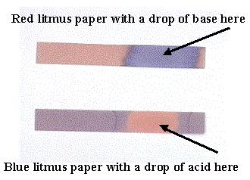
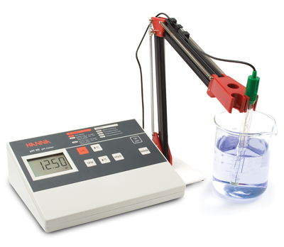
How we Measure pH
Indicator Dyes
Litmus Paper
Conductivity
http://earthref/SCC
Scripps Classroom Connection
Notes:
This slide is for the students
Narrative for the Instructor
The color changes observed in the demo were due to changes in the distilled water’s pH , which is a measure of its acidity. We used an indicator dye called universal indicator to track the changes in pH. Another example of an indicator dye is red cabbage extract. This indicator is made by extracting a pigment called flavin, which is sensitive to pH. Scientists also use litmus papers which change to blue or red, depending on the acidity of the solution. pH meters use conductivity to measure pH.
**********
PICTURE/GRAPHICS CREDITS:
Top: http://science7acidbase.wikispaces.com/Litmus+Paper
Bottom: http://www.hannainst.com/usa/prods2.cfm?id=040002&ProdCode=pH%2020

Slide 5
pH Lab
Materials Needed
(per group)
1 beaker (100 mL or smaller)
Universal Indicator Dye
Poster paper & Markers
Index Cards (1 per student)
Solutions to Measure
Lemon Juice (pH 2)
Soda (pH 3)
Vinegar (pH 3)
Orange Juice (pH 4)
Tomato Juice (pH 5)
DIW (pH 7)
Seawater (pH 8)
Dish Soap (pH 9)
Antacid (pH 10)
Bleach (pH 13)
http://earthref/SCC
Scripps Classroom Connection
Notes:
This slide is for the instructor
WHY: This lab activity in the classroom will build up students’ intuition about pH by testing the pH of common solutions, including seawater.
Laboratory Preparation (for the teacher):
Gather solutions listed on the slide. As many solutions should be used as possible to cover the whole range of the pH scale.
Solutions should be set around the room to prevent students from being on top of one another. For antacid, the tablet should be dissolved in water before students begin the lab activity. For seawater, you can collect some from the ocean, purchase Instant Ocean, or follow the recipe included with the unit (“Recipe for Artificial Seawater”)
Procedure for the lab activity:
1. Groups need to gather materials.
2. Add at least 25 mL of a solution to the beaker
3. Add a few drops of Universal pH indicator.
4. Note the color of the pH indicator.
5. Repeat steps 2-4 for each solution, cleaning out the beaker first.
6. Draw pH scale (based on color) with the solutions in the appropriate locations. The colors should form a gradient across the scale.
7. Students should set aside their poster and index cards. These will be completed later during the lesson (slide 9).

Slide 6
pH Inversely Relates to [H⁺]
pH = -log[H⁺]
ACID | Excess H⁺ | H-donor
BASE | Excess OH⁻ | H-acceptor
http://goo.gl/V0YcK
http://earthref/SCC
Scripps Classroom Connection
Notes:
This slide is for the students
WHY: The brief narrative and discussion led by the instructor will teach students some reactive properties of acids and bases. This introduction will be followed with a computer simulation that allows students to further explore acids and bases on the molecular level. Acids and bases are also related to pH which is the property they measured during the laboratory activity.
Narrative for the Instructor
pH is used to measure the acidity of a solution which is determined by the concentration of H⁺ ions as shown in the equation. Because of the negative sign in front of the log [H⁺], the relationship between pH and H⁺ is negative; lower pH values have higher concentrations of H⁺ while high pH values have lower concentrations of H⁺. Most solutions are recognized as acids or bases. Acids have low pH which means they have excess H⁺ ions and donate H⁺ ions to a solutions. Bases on the other hand have excess OH⁻ ions and therefore accept H⁺ ions from a solution.
Question for discussion: What do you think will happen if I add an acid (with excess H⁺ ions) to a base (with excess OH⁻ ions)? What compound will they form?
Explanation: When a strong acid and base react with one another, it will form water (H₂O) until there are no more excess ions to react.
Exploring Acids and Bases Worksheet
1. Instruct students to log into the shortcut link shown in the slide.
2. Have students complete the worksheet (“Exploring Acids and Bases Worksheet”) using the online simulation of acids and bases.
The shortcut link in the PowerPoint should take you to the following site: http://phet.colorado.edu/en/simulation/acid-base-solutions

Slide 7
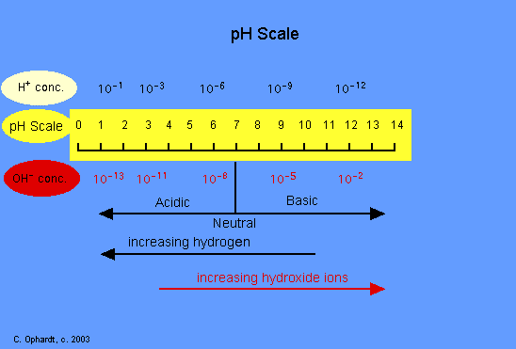
pH Scale
http://earthref/SCC
Scripps Classroom Connection
Notes:
This slide is for the students
WHY: The next two slides review what the students learned through the laboratory activity and computer simulation.
Procedure for the Instructor
If using a Promethan board, cover up the bottom half of the slide (everything below “acidic, neutral, basic”) so you can slowly reveal each component.
Walk students through each component using the narrative below.
Narrative for the Instructor
Shown in the yellow is the pH scale from 0 to 14. These are the numbers you saw in the gray box during the computer simulation activity. Remember that the low pH numbers have more hydrogen ions and that high pH numbers have more hydroxide ions. See how the concentrations change as you move from the left to the right side of the scale. During the computer simulation, you measured the pH and concentrations of these ions for water. What was the pH? (answer = 7) Was the concentration of hydrogen less than, equal to, or more than hydroxide? (answer = equal to) When the number of hydrogen and hydroxide ions are equal, the solution is considered to be neutral. (Reveal the next portion of the slide where it says “acidic, neutral, basic”) These are the three classifications of solutions. Do acids have more hydrogen or hydroxide ions? (answer = hydrogen; reveal the next portion of the slide where it says “increasing hydrogen”). Finally we have basic solutions with numbers 8-14. Which ion is more dominant for the basic solutions? (answer = hydroxide ions; reveal the last portion of the slide where it says “increasing hydroxide ions”)
**********
PICTURE/GRAPHICS CREDITS: http://www.elmhurst.edu/~chm/vchembook/184ph.html

Slide 8
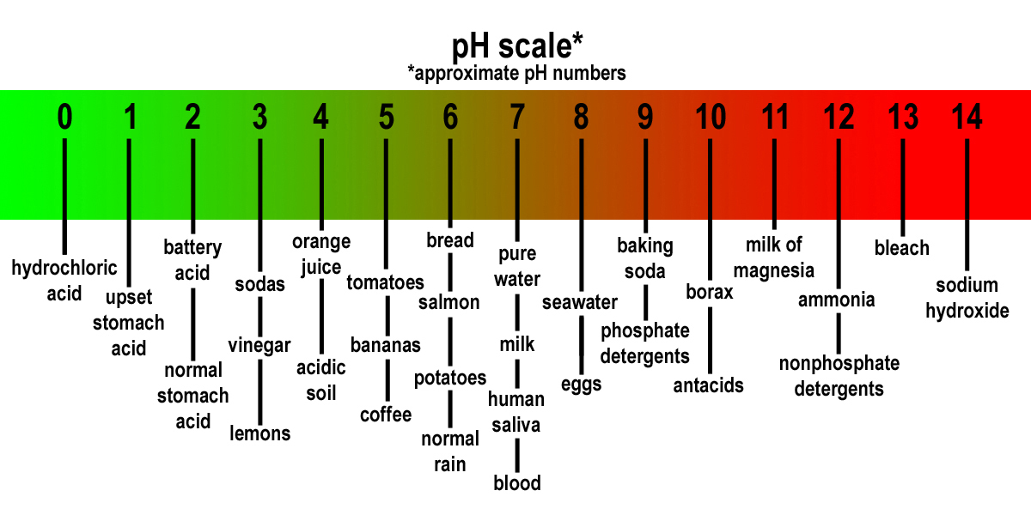
Classifying Solutions
Lots of H⁺ = Low pH (0-6) = Acidic
Few H⁺ = High pH (8-14) = Basic
http://earthref/SCC
Scripps Classroom Connection
Notes:
This slide is for the students
WHY: This slide just recaps the relationship between hydrogen ion concentration, pH number, and classification of solutions. Some common solutions, including ones measured during the laboratory activity, are listed as examples of acids and bases.
Narrative for the Instructor
Now we are going to pull everything together. During the laboratory activity, you measure the acidity of several solutions, which is a way to classify the solutions. If a solution has a lot of hydrogen ions, the pH number will be low – between 0 and 6. These solutions are considered acids. Some examples of acids are stomach acid, sodas, vinegar, and fruit. If a solution has few hydrogen ions, the pH number will be high – between 8 and 14. These solutions are basic and include seawater, baking soda, antacids, and bleach. Remember than a pH of 7 – right in the middle – is considered neutral and has an equal concentration of H⁺/OH⁻ ions.
Question to Students: Where do most foods fall on this pH scale?
Explanation: Most foods are acidic to varying degrees. This is why we might get an upset stomach sometimes when we eat too much foods. We are essentially adding acids to our stomach fluid, which is already acidic.
Question to Students: What do we do to combat an upset stomach and why?
Explanation: Typically we will take an antacid which is a base. When we add a base to our acidic stomach fluid, we help raise the pH slightly, restoring it to its natural pH.
Question to Students: Do you recognize any solutions on here that are bad for you?
Explanation: Solutions with very low (0-2) and very high (12-14) pH levels can be toxic. Our bodies depend on a narrow range of pH values in order to function properly. When we are exposed to strong acids or bases, it can change our pH and consequently affect our physiology such as gas exchange.
**********
PICTURE/GRAPHICS CREDITS: http://dnfitness.files.wordpress.com/2014/01/phscale.jpg

Slide 9
Final Assessment
Add numbers to your pH scale
Represent H⁺ and OH⁻ ions on your pH scale
Classify each solution as acidic, neutral, or basic
http://earthref/SCC
Scripps Classroom Connection
Notes:
This slide is for the students
WHY: Students will expand on the pH scale they started during the laboratory activity (slide 5) to reinforce all the concepts they learned during the lesson.
Directions for the Instructor:
Instruct students to add components listed on the slide to their group posters that were started during the laboratory activity
Instruct students to copy the pH scale with ions and solution classifications onto the index card they collected during the laboratory activity
The index cards can be handed in as an exit slip to the instructor. The students should receive these cards back before the 3rd lesson (Ocean Acidification) in this unit to help them remember acids and bases.

Slide 10
Conclusions
pH scale = 0-14
Low pH = acid
High pH = base
Seawater is basic
http://earthref/SCC
Scripps Classroom Connection
Notes:
This slide is for the students.
WHY: By the end of this lesson, students should be able to classify solutions as acids and bases based on the pH scale. They should also have learned that seawater is slightly basic (pH ~ 8).
Conclusions
The pH scale, which describes the acidity of a solution, ranges from 0 to 14. Universal Indicator will react with solutions to display different colors for each pH which is why the colors changed during the Alka_Seltzer Rainbow Demo (slide 2). Acids have a pH value of 0-6 which means they have a greater concentration of hydrogen ions (versus hydroxide ions). Solutions on the other end of the pH scale (8-14) are classified as bases and contain more hydroxide ions than hydrogen ions. A pH of 7 indicates a neutral solution that is neither an acid nor a base. During the laboratory activity, the students measured the acidity of seawater. The pH of seawater should be around 8 which is slightly basic. The following lessons in this unit will discuss the acidity of the oceans, so it is important that students notice the slightly basic pH of seawater.
MISCONCEPTIONS ADDRESSED:
Ocean is a neutral solution since it’s water.
High pH means a solution is more acidic.

