Slide 1
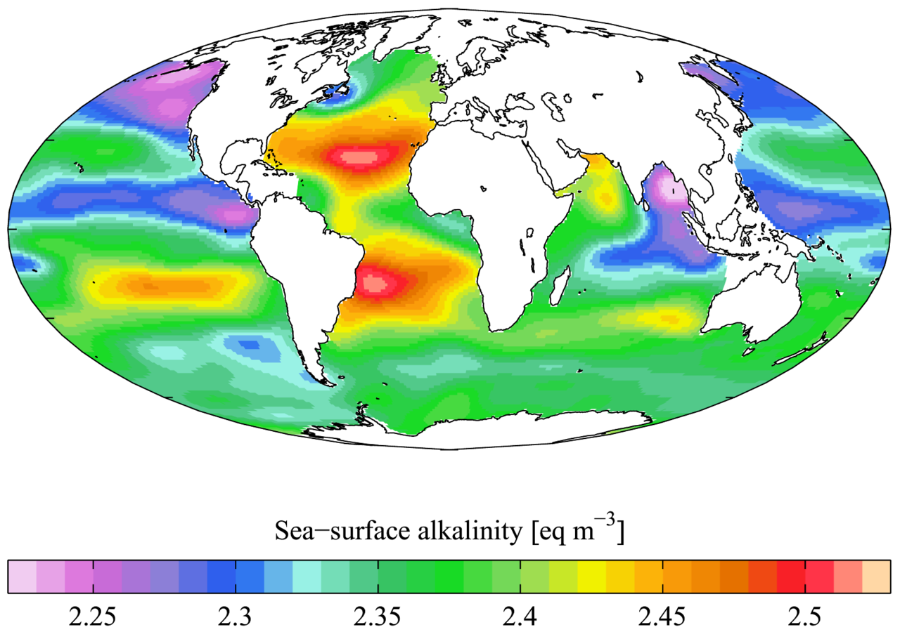
Buffering Capacity:
Seawater CO₂ Chemistry
http://earthref/SCC
Scripps Classroom Connection
Notes:
This slide is for the instructor
AUTHORS: Heather Page, Scripps Institution of Oceanography; Alison Dickens, Lincoln High School
WHY: This lesson is intended to teach students the significance of seawater pH and introduce the carbonate chemistry reaction which will re-appear in later lessons. Seawater acts as a buffer against changes in pH through carbonate chemistry reactions. In general, this buffering minimizes fluctuations in pH which allow marine organisms to carry out physiological processes critical for survival such as calcification and gas exchange across gills and blood vessels.
SUMMARY: This lesson will begin by having the teacher measure pH of seawater and distilled water while dissolving sand. Following the demonstration, students will complete a laboratory activity where acids and bases will be added to distilled water and seawater to measure the effects on the solution’s pH. A short lecture and modeling exercise teaches students the chemistry behind seawater buffering. To extend this lesson, they will talk about a personal experience with buffering in the blood by holding their breath and talking about the chemistry changes associated with stopping air flow through the body. Finally students will complete a worksheet that goes along with the movie Finding Nemo to further their understanding of buffers in the marine realm.
PICTURE/GRAPHICS CREDITS: Credits given on each individual slide.
WEBSITES USED IN THIS PRESENTATION: NA
ADDITIONAL RESOURCES: Finding Nemo (movie) and accompanying worksheet “Experiencing Buffers_A Fish’s View”
CONTEXT FOR USE: This unit was designed for a middle school life science or high school chemistry class and is lesson 2 of 5 in a unit on “Ocean Acidification.” This unit should be taught after students have learned about seawater pH. This lesson builds a foundation of knowledge on which future lessons are based. The lessons should be taught in order as the concepts build upon one another. The activities within the lessons were designed to be performed in groups of 4 students.
MISCONCEPTIONS:
Sand only comes from weathered rocks that have been broken down over time.
Solutions will change pH when a strong acid or base is added to it.
Buffering of seawater is controlled by salts.
We feel the need to take another breath because we need more oxygen.
EVALUATION TIPS: Instructors will collect student lab notebooks. Questions to pose to students are given throughout the teacher notes.
NGSS
MS-PS1-1: Develop models to describe atomic composition of simple molecules and extended structures
Substances are made from different types of atoms, which combine with one another in various ways
Models can be used to observe systems that are too small to see by our naked eye
MS-PS1-2: Analyze and interpret data on the properties of substances before and after the substances interact to determine if a chemical reaction has occurred
Substances react chemically in characteristic ways. In a chemical process, the atoms that make up the original substances are regrouped into different molecules, and these new substances have different properties from those of the reactants
Macroscopic patterns are related to nature of atomic-level structure
MS-PS1-4: Develop a model that predicts and describes changes in state of a pure substance
Cause and effect relationships can be used to predict phenomena
MS-PS1-5: Develop and use a model to describe how the total number of atoms does not change in a chemical reaction and thus mass is conserved
The total number of each type of atom is conserved, and thus the mass does not change
Matter is conserved because atoms are conserved in chemical processes
MS-LS1-8: Gather and synthesize information that sensory receptors respond to stimuli by sending messages to the brain for immediate behavior
Each sense receptor responds to different inputs (e.g. chemical), transmitting them as signals that travel along nerve cells to the brain
HS-PS1-2: Construct and revise an explanation for the outcome of a simple chemical reaction
Construct and revise an explanation based on valid and reliable evidence obtained from a variety of sources
HS-PS1-6: Refine the design of a chemical system by specifying a change in conditions that would produce increased amounts of products at equilibrium
In many situations, a dynamic and condition-dependent balance between a reaction and the reverse reaction determines the numbers of all types of molecules present
Much of sciences deals with constructing explanations of how things change and how they remain stable
HS-ESS2-5: Plan and conduct an investigation of the properties of water and its effects on Earth materials and surface processes.
The abundance of liquid water on Earth’s surface and its unique combination of physical and chemical properties are central to the planet’s dynamics
-----------------------------------------------------------------------------------
This Slide: The ability of seawater to buffer against pH changes is primarily controlled by its total alkalinity. Total alkalinity can be defined as the excess bases over acids. In this graphic, we see the sea-surface alkalinity for the world’s oceans. Lower values (purple areas) have low alkalinity and therefore cannot buffer against changes in pH as well as areas with higher alkalinity (red areas).
Graphics Credit: http://en.wikipedia.org/wiki/Alkalinity#mediaviewer/File:WOA05_GLODAP_pd_ALK_AYool.png

Slide 2
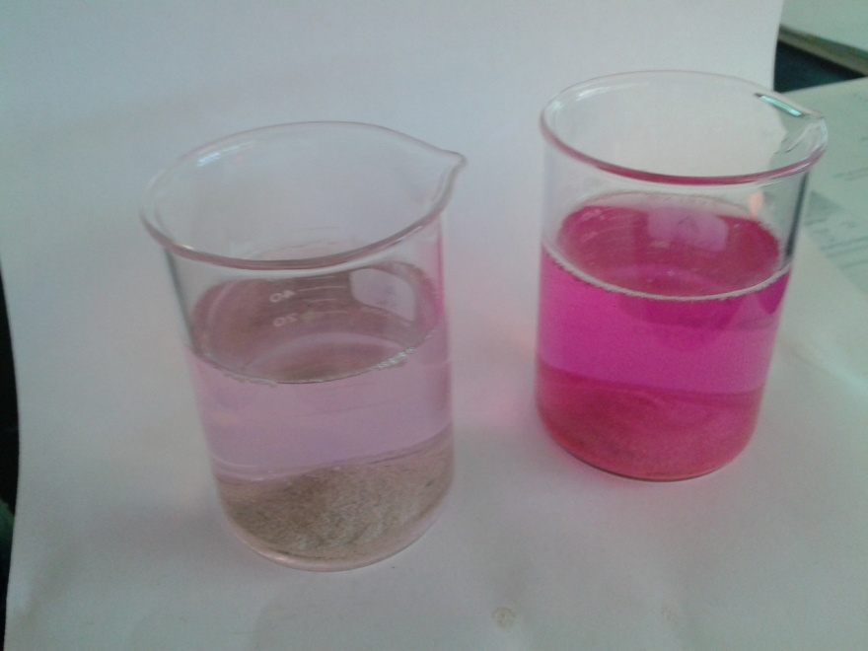
Sand Dissolution Demo
Materials Needed
Calcium Carbonate Sand
Two 100 mL beakers
Distilled water
Seawater
pH Indicator (probe or dye)
Stir plate & bars OR Spoon
http://earthref/SCC
Scripps Classroom Connection
Notes:
This slide is for the instructor
WHY: This demo engages students by having them observe the pH change differences between distilled water and seawater. Seawater pH should not change because it buffers against pH changes.
Sand Dissolution Demo
Set the two beakers side by side so the class can see both beakers.
Place a stir bar in each beaker.
Pour distilled water in one beaker and seawater in the other.
Set the beakers on the stir plates.
Add pH indicator to the solution. If using a probe, it would be easiest to have a stand holding the probe in the solution. Universal Indicator or Phenolphthalein can be used alternatively or in addition to the probe. Note the initial pH. Seawater pH will be slightly higher than distilled water.
Add ~15 mg of sand to each beaker and begin stirring. The pH of distilled water should start to rise as the sand dissolves.
Expected Result
The pH of the seawater shouldn’t change while the pH of the distilled water will increase as sand dissolves. The graphic shows the contrasting pH after some sand has dissolved in beakers dyed with phenolphthalein (darker pink = higher pH). The beaker on the left contains seawater while the beaker on the right contains distilled water. The color of the distilled water was initially clear.
**********
Graphic Credit: Heather Page (2014)

Slide 3
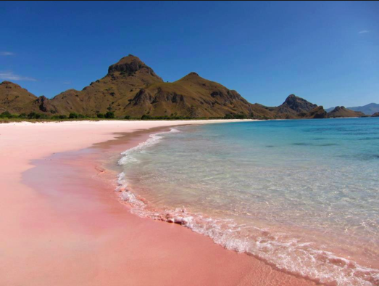
Where does sand come from?
Riverine Runoff
Weathering of Rocks
Calcified parts of marine species
  Corals
  Foraminifera
http://earthref/SCC
Scripps Classroom Connection
Notes:
This slide is for the students
WHY: Many students do not know where sand comes from. The next two slides (3-4) will give a brief (<5 minutes) overview of the origin and chemistry of sands.
Narrative for the Instructor
Have you ever noticed that sand can be a variety of colors? Beaches can be many colors based on the origin of the sand. Local sands are terrigenous, meaning they came from riverine runoff. Breakdown of lava leads to black and red sand beaches. The picture on the right is the famous Pink Sand Beach in Indonesia. The sand is pink because its made up of shells from microscopic marine organisms called foraminifera. Most of the world’s tropical sands actually come from coral! Some fish eat the algae growing on the coral and scrapes the coral skeleton during the process. The fish cannot digest the calcium carbonate of the skeleton so it passes through the gut and get deposited as sand elsewhere.
**********
Graphic Credit: http://www.theluxuryspot.com/what-could-be-more-fabulous-than-a-pink-beach/screen-shot-2013-07-21-at-5.02.38-pm/

Slide 4
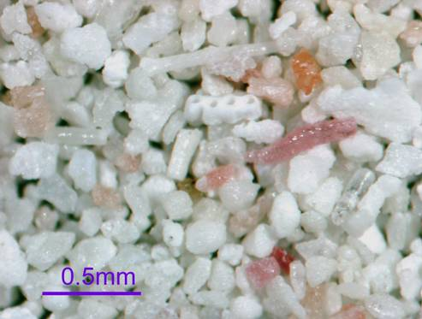
Chemistry of Sand
CaCO₃
http://earthref/SCC
Scripps Classroom Connection
Notes:
This slide is for the students
WHY: This slide continues from slide 3 to describe what makes up sand and its chemical composition.
Narrative for the Instructor (continued from slide 3)
In face, when you examine sand under a microscope, you can see the calcified structures from foraminifera, bivalves, and sea urchins. Sand is made of seashell fragments and other skeleton parts of marine organisms made of calcium carbonate, abbreviated as CaCO₃.
**********
Graphic Credit: http://www.newark.osu.edu/facultystaff/personal/jstjohn/Documents/Sediments/Carbonate-platform-beach-sediments.htm

Slide 5
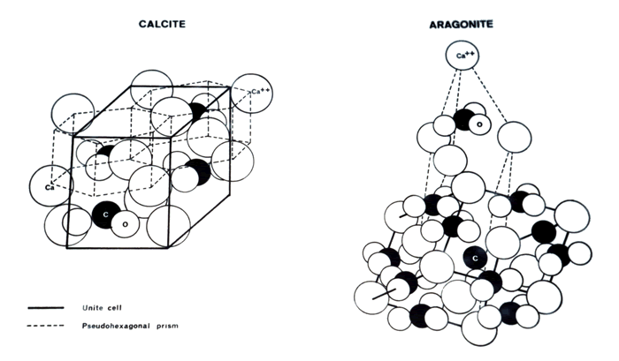
CaCO₃ Minerals
Calcite - rhombohedral
Aragonite - orthorhombic
Mg-Calcite – Mg²⁺ replaces >4% of Ca²⁺ in calcite
http://earthref/SCC
Scripps Classroom Connection
Notes:
This slide is for the instructor
WHY: This slide provides more background information for the instructor. This slide can be used to answer any questions by students or shown to more advanced chemistry classes.
Background Information
Sand made of calcium carbonate is not only important because of its abundance but also due to its high reactivity (dissolves easily). Calcium carbonate can take on several forms including calcite (least soluble), aragonite, and magnesium-calcite (most soluble). The primary difference between the forms of CaCO3 are the shapes of the crystal lattice; calcite is rhombohedral while aragonite is orthorhombic. So calcite forms a rectangular prism while aragonite forms a cube stretched along two of its orthogonal pairs. Magnesium-calcite occurs when magnesium becomes accidently substituted for calcium; this occurs often in seawater because magnesium is much more abundant. However, since magnesium and calcium are different sizes, this substitution alters the crystalline structure to a more readily dissolved state. Shells and skeletons of marine calcifiers – and therefore the calcium carbonate in sand – are made of either calcite or aragonite, with some magnesium-calcite mixed in due to the substitutions.
**********
Graphics Credit: http://www.pengellytrust.org/museum/aragonite/images/aragonite_crystalline_structure.gif

Slide 6
Seawater Buffering Lab
Materials Needed (per group)
Two 50 mL beakers
1 beaker will have distilled water (DIW)
1 beaker will have seawater (SW)
Universal Indicator
HCl (strong acid)
NaOH (strong base)
Droppers
Goggles (1 pair per student)
http://earthref/SCC
Scripps Classroom Connection
Notes:
This slide is for the instructor.
WHY: This laboratory activity gives students a chance to see how adding strong acids and bases may or may not change the pH of another solution (distilled water or seawater).
Instructor Preparation
Set out the materials needed for the laboratory activity, including safety goggles since the students will be working with strong acids and bases
Go over the procedure with the students before beginning the laboratory acitivity.
Procedure for the Seawater Buffering Lab Activity
1. Fill each beaker with ~40 mL of solution (distilled water and seawater).
2. Add ~5 drops of Universal Indicator to each beaker.
3. Record the initial pH of each beaker.
4. Add 2 drops of HCl to each beaker. Record the new pH, even if it did not change, of each beaker.
5. Add 3 more drops of HCl (so drops total 5) to each beaker. Record the new pH of each beaker.
6. Add drops of HCl in increments of 5 until a total of 20 drops is reached. Be sure to record the pH after each increment of 5 is added.
7. Rinse out the beakers and repeat steps 1-6 using NaOH instead of HCl.
Expected Results
The pH of DIW will change instantly to the lowest (highest) pH indicated by the dye.
The pH of SW will slowly decrease or increase when acid or base is added, respectively.
Follow-Up Questions
Which of the two solutions changed the quickest and/or the most? Why do you think this happened? What allows seawater to buffer against the rapid change in pH?
Expected Student Response: Salt in the seawater makes it change less or more slowly.

Slide 7
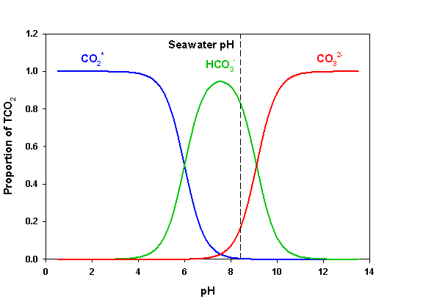
Relation of carbonate chemistry and pH
http://earthref/SCC
Scripps Classroom Connection
Notes:
This slide is for the instructor.
WHY: This slide shows that the pH of seawater actually depends on the relative concentrations of three inorganic carbon species
Background Information for the Instructor
Seawater was able to buffer against the pH changes expected from adding strong acids or bases to it. This is due to the relative amounts of three chemical species of carbon: carbon dioxide (in blue), bicarbonate (in green), and carbonate (in red). The pH scale is shown along the x-axis. When you add up the y-value of the three lines at any pH, they add up to 1. As you can see in the graph, the distribution of each carbonate species is closely related to the seawater pH. Low pH seawater contains mostly carbon dioxide while high pH seawater contains mostly carbonate. Seawater pH falls near the middle of the pH scale at ~8.2. At this pH, bicarbonate is the most abundant of the three carbon species. The actual concentrations of each species as well as hydrogen ions is given below:
HCO₃⁻: 1800 uM
CO₃²⁻: 200 uM
CO₂: 10 uM
H⁺: 0.01 uM (at pH ~8)
Looking at this graph, you might think that pH is controlling the distribution of these species but the abundance of each species also exerts control over the pH. In the laboratory activity, the concentration of hydrogen ions (pH) was altered by adding a strong acid. This would normally cause a decrease in pH but the carbonate ions in seawater can take up some of those hydrogen ions, forming bicarbonate and therefore buffering again changes in seawater pH. When a strong base is added, the bicarbonate can lose the hydrogen to lower the pH of the seawater.
The following two slides will allow students to examine how the carbon chemistry of seawater allows it to buffer against pH changes through a modeling exercise.
**********
Graphics Credit: www.advancedaquarist.com/2008/12/chemistry

Slide 8
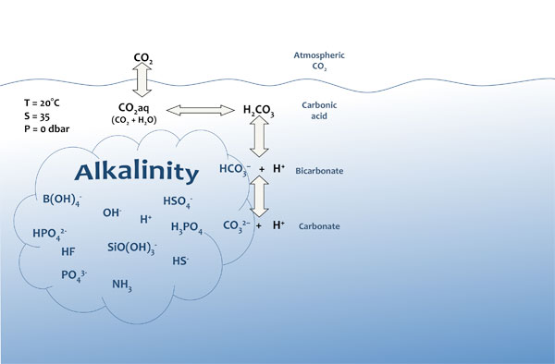
Seawater Buffering Capacity
Alkalinity (TA or A_{T}) = excess bases over acids
http://earthref/SCC
Scripps Classroom Connection
Notes:
This slide is for the students.
WHY: This slide addresses the misconception that salts in seawater allow the buffering to occur.
Narrative for the Instructor
Most of the students know seawater is salty and think this allows the buffering against pH changes. However, it is actually the alkalinity that allows buffering. Alkalinity can be defined as the amount of excess bases over acids. Two of the main components of alkalinity are bicarbonate and carbonate. Both of these chemical species come from carbon dioxide reacting with seawater. Next we are going to model what happens when carbon dioxide reacts with water and see how these reactions influence the pH of seawater.
**********
Graphics Credit: http://www.whoi.edu/OCB-OA/page.do?pid=40276&tid=441&cid=103589&ct=61&article=69327

Slide 9
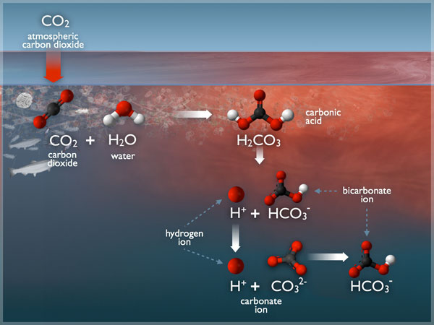
Modeling Seawater CO₂ Chemistry
CO₂ + H₂O ↔ H₂CO₃
→ HCO₃⁻ + H⁺
→
CO₃²⁻ + 2H⁺
http://earthref/SCC
Scripps Classroom Connection
Notes:
This slide is for the students.
WHY: This modeling exercise will allow students to tangibly see how the carbon chemistry relates to seawater pH and buffering.
Preparation for the Instructor
Materials need to be gathered for the modeling exercise. As you progress through the narrative (see below), you should model each of the chemical reactions. Molecular Model Kits are ideal to use but a cheap substitute can be colored marshmallows (atoms) and pretzel sticks (bonds). Each group will need materials to represent the following:
1 C atom
3 O atoms
2 H atoms
5 bonds
Procedure/ Narrative for the Instructor (Note: see the slide for the structure of the molecules)
First, we need to make our two molecules that are initially reacting with one another: carbon dioxide and water. Carbon dioxide needs to form 4 bonds to fill all of it’s vacant spots, while oxygen needs two. So what kind of bond does carbon make with each oxygen atom? (Answer: double bond)
The carbon dioxide gas that dissolves in seawater combines with water molecules to form carbonic acid.
Carbonic acid is very unstable in seawater and only last a few milliseconds. It almost immediately loses a hydrogen ion to form hydrogen and bicarbonate. Now you’ve just added a hydrogen ion to seawater. What does that do to the pH of seawater? (Answer: decreases it)
Bicarbonate still has one hydrogen attached to it. The bicarbonate can lose that hydrogen ion to become carbonate. Now how many hydrogen ions do you have in the seawater? (Answer: two) What does this do to the seawater pH? (Answer: decreases it)
Most of the free hydrogen ions in the seawater want to combine with another molecule. So they combine with carbonate to form more bicarbonate. We used up a hydrogen that was in the seawater to make our bicarbonate, so how does the pH of seawater change? (Answer: it increases)
Now this new bicarbonate can also lose its hydrogen ion to make carbonate again. This would decrease the seawater pH but carbonate likes to combine with hydrogen to keep pH from changing. This transition really forms the basis of seawater buffering. When there are too many hydrogen ions, carbonate can take them up to keep pH from decreasing. When seawater starts to become more basic, bicarbonate donates hydrogen to the solution, preventing the pH from increasing.
Now we are going to answer some questions to better understand alkalinity and buffering of seawater pH. Using your models and the diagram, let’s discuss some questions.
Questions for Student Discussion to Understand Figure
What is the main atom involved in this reaction?
Answer: Carbon is the central atom.
2. What molecules does this atom form in seawater?
Answer: Carbon dioxide, carbonic acid, bicarbonate, and carbonate
3. Which molecule appears to be the most abundant? What chemical
reactions form this molecule?
Answer: Bicarbonate. It can be formed from the breakdown of carbonic acid or the combination of hydrogen and carbonate.
4. Which molecule(s) acts as an acid? Which one acts as a base?
Answer: Carbonic acid and bicarbonate act as acids. Carbonate and sometime bicarbonate can act as bases by accepting hydrogen ions.
5. How does seawater buffer against pH changes?
Answer: The carbonate chemistry (or alkalinity) allows seawater to buffer against pH changes. Bicarbonate will donate hydrogen ions to a solution to form carbonate. Carbonate will take up excess hydrogens.
6. What might the blue and red colors of the figure represent? How did you arrive at this conclusion?
Answer: The colors represent the acidity of seawater. The red surface waters show more acidic regions while the deeper waters are more basic (blue). Buffering appears to be happening in the blue areas,
preventing the pH from decreasing too much.
**********
Graphics Credit: http://www.whoi.edu/OCB-OA/page.do?pid=112076

Slide 10
Modeling Seawater CO₂ Chemistry
O
C
O
CO₂
1. Dissolves in the ocean
O
HCO₃⁻
H
O
1. Reacts with water to form bicarbonate ion
and hydrogen ion
C
H
H₂O
O
O
H
H⁺
HCO₃⁻
O
O
CO₃²⁻
H⁺
3. Most of that hydrogen ion reacts with carbonate ion to form more bicarbonate
C
C
H
O
O
O
O
http://earthref/SCC
Scripps Classroom Connection
Notes:
This slide is for the students
WHY: This slide recaps the carbonate chemistry after the student discussion and displays the reaction a different way. This slide serves as a transition into the next activity which shows blood buffering (by the same chemical reactions).
Narrative for the Instructor
Once again, we see that carbon dioxide reacts with water to form bicarbonate and hydrogen ions (step 2 in the slide). Bicarbonate loses its hydrogen to become carbonate ions. Then most of the carbonate reacts with hydrogen ions to form more bicarbonate (step 3 in the slide). When reactions occur to form bicarbonate or carbonate, the pH of the seawater changes as the amount of hydrogen ions change.

Slide 11
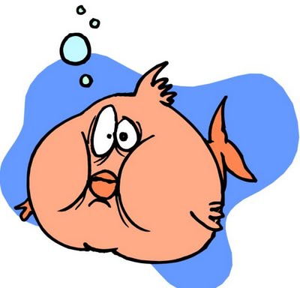
The Need to Breathe
Students hold breath as long as they can
They should have felt the urge to take another breath
This urge is due to increase of CO₂ beyond buffering capacity.
http://earthref/SCC
Scripps Classroom Connection
Notes:
This slide is for the instructor.
WHY: This personal experience will allow students to realize the importance of buffers in their everyday lives.
The Need to Breathe Activity
Students should hold their breaths for as long as they can. As they are holding their breaths, they should have felt the need to breathe again and possibly taken a big breath once they stopped holding it. Alternatively, you can just ask students about an experience with holding their breath.
Questions to Students (Narrative for Instructor)
Why they need to breathe again?
Expected Student Response: I need more oxygen.
Well, let’s think about what happens to your body when you hold your breath.
Expected Student Response: We run out of oxygen and don’t breathe out carbon
dioxide.
We stop breathing out carbon dioxide. What do we think will happen to blood pH if carbon dioxide keeps building up?
Answer: The pH of our blood decreases to become more acidic. Normally the
blood can buffer against the change in pH through the chemical
reactions we saw in seawater but too much carbon dioxide can
exceed the buffering capacity of the blood, resulting in acidosis.
**********
Graphics Credit: http://ubctriathlon.blogspot.com/2009/10/how-to-hold-your-breath.html

Slide 12
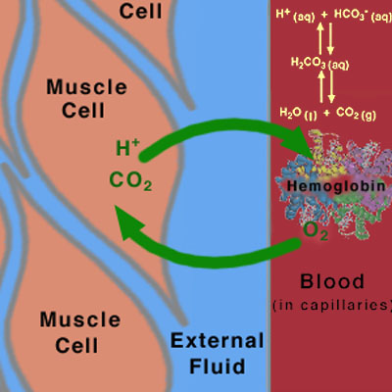
Another Buffer: Blood
Notes:
This slide is for the students.
Narrative for the Instructor
This picture shows how gas exchange between muscles and the blood works. The left side of the picture shows cells of muscle tissue. On the right side in red, we have the blood. The blood contains a protein called hemoglobin. Hemoglobin carries gasses (oxygen and carbon dioxide) through the blood stream. Normally oxygen goes into the muscle cells and carbon dioxide goes from the muscle to the blood where its carried to our lungs to be expelled from the body. However, this gas exchange between the muscles and blood can only occur if the blood pH is maintain around 7.35-7.45. The blood regulates pH through the same buffering reactions we saw in seawater shown by the yellow reactions in the blood on the figure. When we hold our breaths, carbon dioxide builds up in the blood, eventually overriding the ability of the reactions to buffer and causing the pH to decrease. This drop in blood pH is what signals our brain to take another breath, so the buffering system can regulate pH once again.

Slide 13
Conclusions
Buffers combat pH change
CO₂ chemistry buffers pH
Seawater is a buffer
Blood is a buffer
http://earthref/SCC
Scripps Classroom Connection
Notes:
This slide is for the students.
Conclusions
Buffers prevent pH of solutions from changing quickly when strong acids or bases are added to them by accepting protons when they are in excess and donating them when they are few hydrogen ions.
Carbon dioxide undergoes a series of reactions in water. Some of these reactions donate hydrogen ions to solution while other steps accept hydrogen ions.
The first example of a buffer seen in the demonstration (slide 2) and buffering laboratory activity (slide 6). Seawater regulates pH to maintain it around 8.
This second example of a buffer was seen in during the Need to Breathe activity (slide 11). Blood buffers pH to be maintained around 7.35-7.45 so gas exchange can occur between the muscles and blood.
Final Assessment
Students will now use their newfound knowledge to answer some questions about the role of buffers to marine organisms. They will complete a worksheet that corresponds to movie clips from Finding Nemo. The movie clips to show in class are listed in the worksheet.
Worksheet: Buffers and Control of Seawater pH Worksheet_Experiencing Buffers_A Fish’s View

