Slide 1
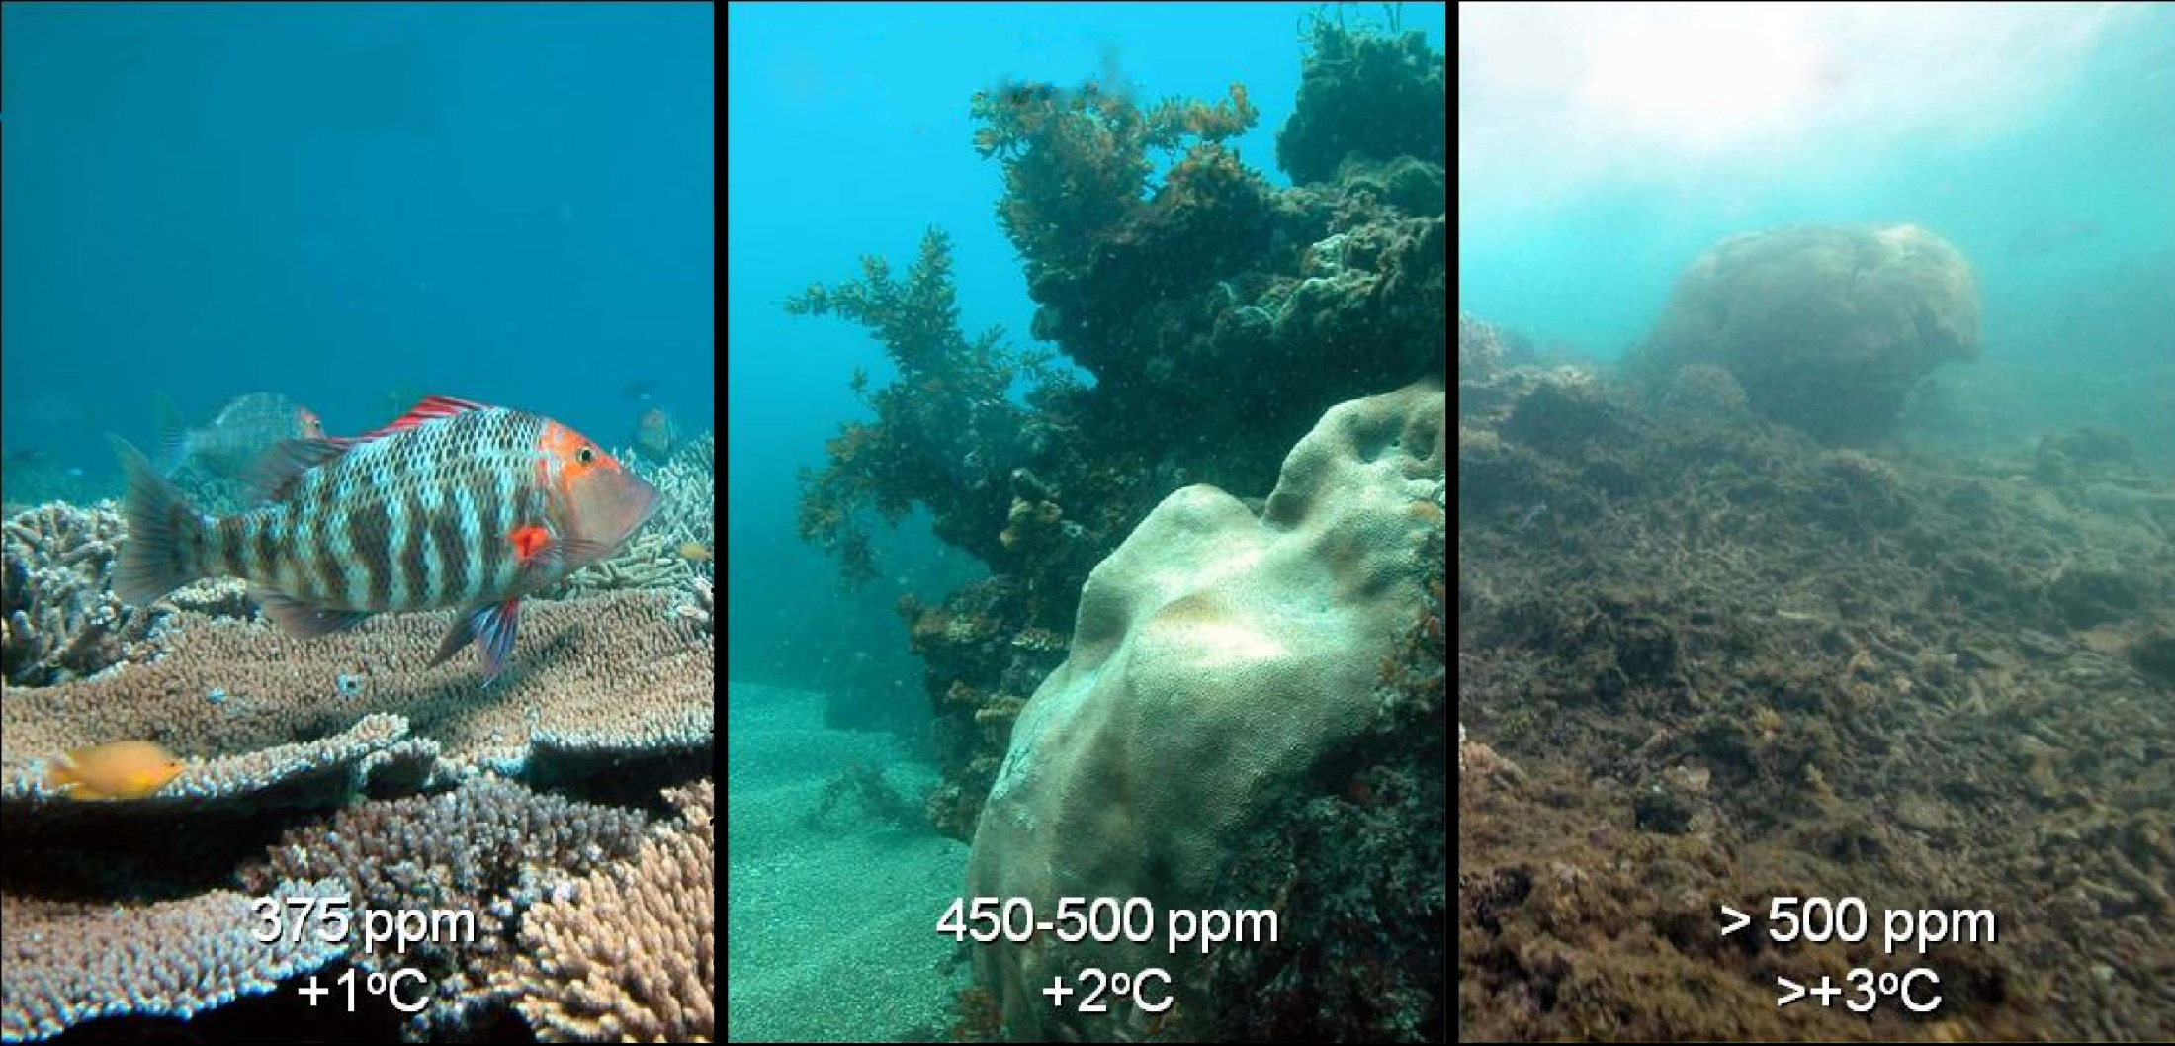
Ocean Acidification
http://earthref/SCC
Scripps Classroom Connection
Notes:
This slide is for the instructor
AUTHORS: Heather Page, Scripps Institution of Oceanography; Alison Dickens, Lincoln High School
WHY: As anthropogenic carbon dioxide (CO₂) emissions increase, marine ecosystems face the imminent threat of ocean acidification (OA) as the oceans absorb 26% of this CO₂. When CO₂ reacts with seawater, it reduces seawater pH and lowers carbonate (CO₃²⁻) saturation states with respect to CaCO₃ minerals, potentially making it more difficult for organisms such as shellfish (mussels, oysters, scallops), corals, and crustaceans (crabs, lobsters) to form shell and exoskeleton structures.
SUMMARY: This lesson begins with a 5-10 minute review of the sources and sinks of carbon dioxide. Students will interpret the Keeling Curve to see how carbon dioxide in the atmosphere has changed over time and then do an activity where sources and sinks are identified. Then the students will be taken outside for a demo that bubbles emissions from a car exhaust into a beaker of water with pH indicator to show the pH changed caused by carbon dioxide. Students will further explore the relationship between atmospheric carbon dioxide and seawater pH through a laboratory activity. During this laboratory activity, students will apply the Ideal Gas Law and create a graph of their data. A short lecture on ocean acidification follows the laboratory activity. Then the instructor will have students explain an ocean acidification demonstration and finally interpret a graph of carbon dioxide and seawater pH measurements taken in Hawaii.
PICTURE/GRAPHICS CREDITS: Credits given on each individual slide.
WEBSITES USED IN THIS PRESENTATION: NA
ADDITIONAL RESOURCES: NA
CONTEXT FOR USE: This unit was designed for a high school chemistry class and is lesson 3 of 5 in a unit on “Ocean Acidification. This unit should be taught after students have learned chemical reactions and properties of gases. The lessons should be taught in order as the concepts build upon one another. The activities within the lessons were designed to be performed in groups of 4 students.
MISCONCEPTIONS:
1. CO₂ stays in the atmosphere
2. Atmosphere and seawater are disconnected
3. Seawater is becoming an acid, rather than becoming more acidic
EVALUATION TIPS: Instructor should collect student lab notebooks. For the candle demo (slide 13) and the field data (slide 14), instructor may prompt students to explain what they are seeing and interpret the trends in the graph.
Next Generation Science Standards
MS-PS1-1. Develop models to describe the atomic composition of simple molecules and extended structures.
Time, space, and energy phenomena can be observed at various scales using models to study systems that are too large or too small
MS-PS1-2. Analyze and interpret data on the properties of substances before and after the substances interact to determine if a chemical reaction has occurred.
Analyze and interpret data to determine similarities and differences in findings
Science knowledge is based upon logical and conceptual connections between evidence and explanations
Substances react chemically in characteristic ways
Macroscopic patterns are related to the nature of microscopic and atomic-level structure
MS-PS1-4. Develop a model that predicts and describes changes in particle motion, temperature, and state of a pure substance when thermal energy is added or removed.
Gases and liquids are made of molecules or inert atoms that are moving about relative to each other
Cause and effect relationships may be used to predict phenomena in natural or designed systems
MS-LS1-6. Construct a scientific explanation based on evidence for the role of photosynthesis in the cycling of matter and flow of energy into and out of organisms
Plants, algae (including phytoplankton) and many microorganisms use the energy from light to make sugars (food) from carbon dioxide from the atmosphere and water through the process of photosynthesis, which also releases oxygen.
MS-LS2-3. Develop a model to describe the cycling of matter and flow of energy among living and nonliving parts of an ecosystem.
Transfers of matter into and out of the physical environment occur at every level.
Decomposers recycle nutrients from dead plant or animal matter back into the soil in terrestrial environments or to the water in aquatic environments. The atoms that make up the organisms in an ecosystem are cycled repeatedly between the living and nonliving parts of the ecosystem
MS-ESS2-1. Develop a model to describe the cycling of Earth’s materials and the flow of energy that drives this process.
All Earth’s processes are the result of energy flowing and matter cycling within and among the planet’s ecosystems. The energy that flows and matter that cycles produce chemical and physical changes in Earth’s materials and living organisms.
Explanations of stability and change in natural or designed systems can be constructed by examining the changes over time and processes at different scales, including the atomic scales.
Models can be used to represent systems and their interactions – such as inputs, processes, and outputs – and energy, matter, and information flows within systems.
HS-LS2-5. Develop a model to illustrate the role of photosynthesis and cellular respiration in the cycling of carbon among the biosphere, atmosphere, hydrosphere, and geosphere.
Photosynthesis and cellular respiration are important components of the carbon cycle, in which carbon is exchanged among the biosphere, atmosphere, oceans, and geosphere through chemical, physical, geological, and biological processes
Models can be used to simulate systems and interactions – including energy, matter, and information flows – within and between systems at different scales
HS-ESS2-6. Develop a quantitative model to describe the cycling of carbon among the hydrosphere, atmosphere, geosphere, and biosphere.
Changes in the atmosphere due to human activity have increased carbon dioxide concentrations and thus affect climate
-----------------------------------------------------------------------------------
This Slide: The figure represents the shift from a healthy coral reef to an unhealthy one in the future as seawater becomes more acidic and warms up. The numbers on each picture represent the concentration of carbon dioxide and average increase in seawater temperature relative to today. The healthy reef on the left is dominated by corals and large fish. As carbon dioxide concentrations increase, algae begins to take over the reef until it causes a phase shift from a coral-dominated state to an algal dominated state.
PICTURE/GRAPHICS CREDIT: Hoegh-Guldberg, O. et al. 2007. Coral Reefs Under Rapid Climate Change and Ocean Acidification. Science, 318: 1737-1742.

Slide 2
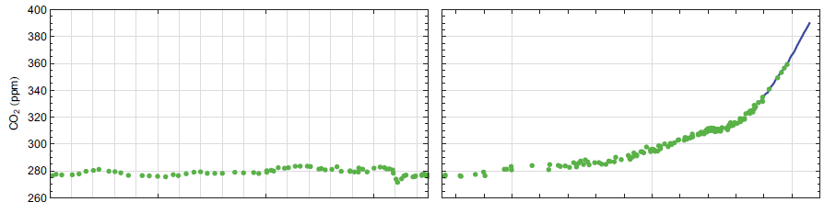
Atmospheric CO₂
0
500
1000
1500
1750
1800
1900
2000
2020
http://earthref/SCC
Scripps Classroom Connection
Notes:
This slide is for the students
WHY: This graph shows students how carbon dioxide levels in the atmosphere changes over time. They will begin thinking about carbon dioxide which causes environmental issues like ocean acidification.
Background Information for the Instructor
This graph shows the concentration of carbon dioxide in the atmosphere over the past 2000 years. As you can see, we have reached carbon dioxide concentrations that are unprecedented going back 2000 years. The rate of increase is also much faster than any time in history. If you go to the website listed on the slide (co2now.org), you can see the most recent measurements taken by Scripps Institution of Oceanography. The rapid increase in carbon dioxide since the 1950s is known as the Keeling Curve. David Keeling started measuring atmospheric CO₂ all over the world and noticed that the average concentration and trends in the data were similar. Beginning in 1957, Scripps Institution of Oceanography supported continuous monitoring of atmospheric CO₂ in Mauna Loa, Hawaii.
Narrative for the Instructor/Questions to ask Students
What does the x-axis of this graph show?
Answer: Time from year 0 to 2020
What does the y-axis of this graph show?
Answer: CO₂
What trend(s) do you notice about the left side of the graph? Is carbon dioxide increasing, decreasing, or staying stable? What is the concentration?
Answer: It’s fairly stable at ~280 ppm.
What trend(s) do you notice on the right side of the graph from 1800 to 2020?
Answer: There is a rapid increase in carbon dioxide
Why do you think there is a sudden increase in carbon dioxide?
Answer: The Industrial Revolution began during the 1850s. With the Industrial Revolution came a change in land use practices and production of more
factories.
**********
Graphics Credit: Ciais, P., C. Sabine, G. Bala, L. Bopp, V. Brovkin, J. Canadell, A. Chhabra, R. DeFries, J. Galloway, M. Heimann, C. Jones, C. Le Quéré, R.B. Myneni, S. Piao and P. Thornton, 2013: Carbon and Other Biogeochemical Cycles. In: Climate Change 2013: The Physical Science Basis. Contribution of Working Group I to the Fifth Assessment Report of the Intergovernmental Panel on Climate Change [Stocker, T.F., D. Qin, G.-K. Plattner, M. Tignor, S.K. Allen, J. Boschung, A. Nauels, Y. Xia, V. Bex and P.M. Midgley (eds.)]. Cambridge University Press, Cambridge, United Kingdom and New York, NY, USA.

Slide 3
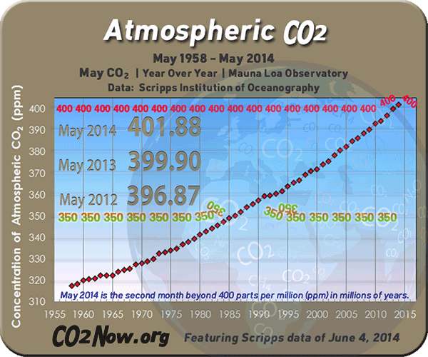
co2now.org
Notes:
This slide is for the instructor.
WHY: This slide shows an example of the graph displayed on co2now.org. The home page will also have the most recent measurement of CO₂ displayed.
Graphics Credit: co2now.org

Slide 4
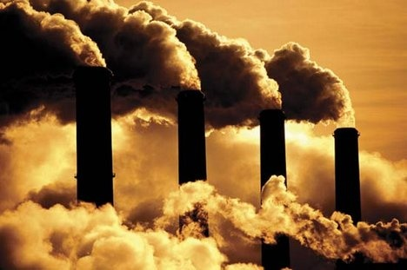
Sources of CO₂
Natural
vs.
Anthropogenic
http://earthref/SCC
Scripps Classroom Connection
Notes:
This slide is for the students
WHY: Students begin thinking about the sources of carbon dioxide and realize we are altering the amount of carbon dioxide in the atmosphere. This sets up the first activity of this lesson (slide 4).
Narrative for the Instructor
In addition to the Industrial Revolution beginning, you can probably think of many sources of carbon dioxide in the atmosphere. What are some of these sources?
Expected Student Responses: cars, airplanes, boats, factories, breathing
Those are few of many sources of carbon dioxide. Two other important sources are cement production and decomposition of plant or animal matter. Some of these sources can be classified as natural sources. However, some of the sources you named are considered to be anthropogenic, which can be defined as “caused by humans.”
**********
Graphics Credit: http://frack-off.org.uk/carbon-capture-and-storage-having-your-cake-and-burning-it/

Slide 5
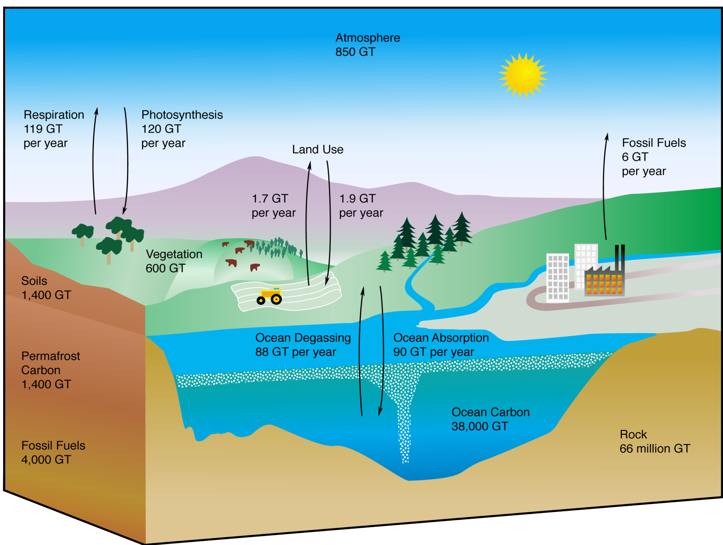
http://earthref/SCC
Scripps Classroom Connection
Notes:
This slide is for the students
WHY: This slides reviews the carbon cycle that students should have learned previously in an earth science or biology class. This activity will allow the instructor to assess prior student knowledge about the carbon cycle. This review should be brief (~5 min). You may have students list the sources and sinks in their notebooks.
Narrative for the Instructor
This figure shows the various sources, sinks, and storages of carbon through the carbon cycle. The numbers state how much carbon is transferred through that process each year or how much carbon is stored in that reservoir. For instance, the atmosphere holds 850 GT of carbon. The arrows show which way the carbon is flowing between reservoirs. Some of the reservoirs listed include the atmosphere, vegetation, fossil fuels, ocean, and rock. However, we are going to focus on the processes (arrows) in this figure. Let’s go through each of the processes on this figure and identify the sources and sinks of carbon dioxide.
(Note: Ask students whether each one of the following is a source or sink when guiding them through the processes.)
Respiration of plants and animals produce carbon dioxide, so it is considered a source.
Photosynthesis by plants use carbon dioxide, water, and light to make energy. This process would be a sink of carbon dioxide.
Land Use can be considered to be a source or sink. The changes to land use since the Industrial Revolution is a major contributor of the Keeling Curve seen
previously.
Burning of Fossil Fuels adds carbon dioxide (and other pollutants) to the atmosphere and therefore would be an anthropogenic source.
The Oceans can be a source or sink depending the process you are examining (degassing versus absorption) and where you are located. Overall, the
oceans are a sink of carbon dioxide which has helped prevent our climate from changing even more dramatically.
**********
GRAPHIC CREDIT: http://tothepoles.files.wordpress.com/2013/08/carboncycle.png

Slide 6

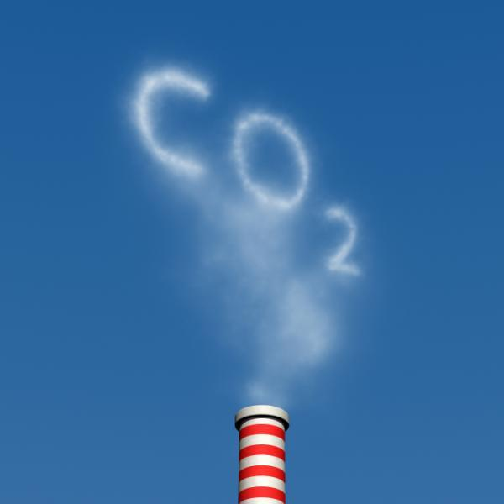
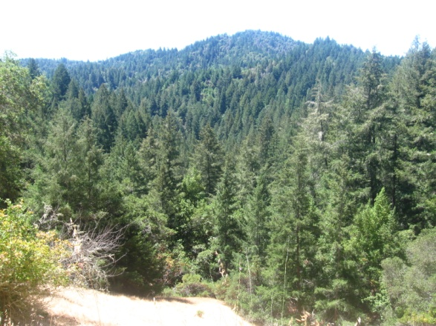

Sinks of CO₂
46%
Air
28%
Forests
28%
Oceans
http://earthref/SCC
Scripps Classroom Connection
Notes:
This slide is for the students
WHY: This slide shows the three sinks of carbon dioxide that is produced and the importance of the oceans as a sink.
Narrative for the Instructor
As you just saw, carbon is constantly cycling through living and nonliving parts of the ecosystem. Anthropogenic carbon dioxide produced from factories and deforestation does not stay in the atmosphere, only 46% of it remains in that sink. The other half is taken by plants for photosynthesis and dissolves into the oceans. These are all considered sinks because they remove the carbon dioxide that is produced.
Citation for Numbers: Le Quéré, C. et al. 2013. The global carbon budget 1959-2011. Earth Syst. Sci. Data, 5: 165-185.
**********
Graphic Credit (left): http://www.energyjustice.net/biomass
Graphics Credit (right): Heather Page

Slide 7
Car Exhaust Demo
Materials
Access to a Car Exhaust
Funnel (cheaper substitute: Index Folder)
Large Tubing to fit Funnel (cheaper substitute: Hose)
Large Beaker (cheaper substitute: Bucket)
Distilled Water or Seawater
pH Indicator Dye (BTB or Phenol Red)
http://earthref/SCC
Scripps Classroom Connection
Notes:
This slide is for the instructors
NOTE: Students will be taken outside for this demo. Teacher can substitute the candle demo (See slide 11) instead if this is not possible with their class.
WHY: Show students that CO₂ from car exhaust affects seawater pH.
Procedure:
1. Attach tubing to narrow end of the funnel.
2. Fill beaker with distilled water or seawater. If using distilled water, add the BTB pH indicator; for seawater, use phenol red.
3. Place the other end of the tubing into the beaker.
4. While wearing the oven mitt, hold the funnel to the car exhaust pipe.
5. Turn on car and observe color change in the seawater. The BTB in distilled water will turn from blue to light green/yellow. The phenol red in seawater will turn from red to yellow. Revving the engine will produce a faster, larger change in pH.
6. Have students take a picture so they can recall the color of the solution after CO₂ was added.
NOTE: Doing this demonstration with distilled water and seawater in two beakers can be done to reinforce the concept of buffering in seawater. The pH of seawater will not change as soon as distilled water and the change in pH will be less than that of distilled water.

Slide 8
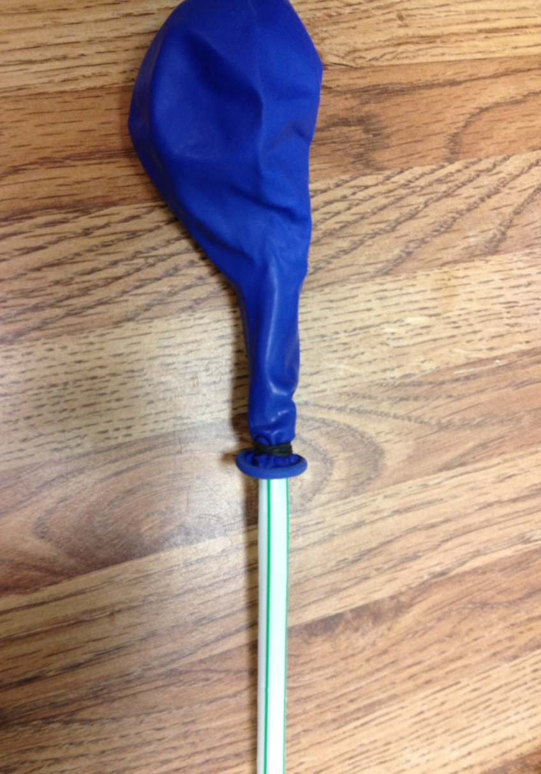
Ocean Acidification Balloon Lab
Materials
Balloons
Straws (cut in half)
Small Rubber Bands
250 mL Beakers
Seawater
pH Indicator Dye
Tape Measures
Calculators
http://earthref/SCC
Scripps Classroom Connection
Notes:
This slide is for the instructor
This lab may take up to 2-3 days to complete.
WHY: Students will learn about the relationship between [CO₂] and seawater pH change. They will also be able to apply the Ideal Gas Law.
Narrative for the Instructor
Atmospheric carbon dioxide have been dramatically increasing over the past 50 years, due to human actions. Roughly one-third of the carbon dioxide produced enters the world’s oceans. This contributes to a process known as ocean acidification. This is what we just observed during the demonstrate. Now we are going to a lab that looks at how atmospheric CO₂ affects the pH of seawater.
Instructor Preparation for the Lab
Gather materials for the activity
Cut each of the straws in half so you have one per student
Using the rubber bands, attach a balloon to the straw to replicate the picture in the slide. Small hair ties work well as a substitute for rubber bands. You want the rubber band tight enough to prevent loss of air once the balloon is blown up but not so tight that it cuts the air flow through the straw.
Laboratory Procedure:
Measure initial pH of seawater by placing 5 drops of pH Indicator Dye (BTB works very well for this lab) into 100 mL of seawater and record data.
Blow up a balloon through the straw. Temporarily close the open end of the straw by pinching the straw closed.
Measure the circumference of the balloon and record the data.
Submerge the open end of the straw into the seawater and slowly release the gas. The seawater should not be bubbling outside the beaker.
Measure the final pH of seawater and record the data.
Rinse out the beaker.
Repeat steps 1-6 two more times. There should be 3 sets of data by the time the laboratory acitivty is finished.
Calculate the volume of gas in the balloon for each trial by assuming the balloon is a sphere. Use C=2 π r and V=4/3 π r³
Calculate the [CO₂] by using the Ideal Gas Law (1 mole = 22.4 L) for each trial.
Conclusion Questions
Describe how this lab activity models what happens when car exhaust enters the oceans.
According to the graph, how does atmospheric CO2 affect the pH of seawater?
Were your hypotheses correct or incorrect? Explain why.
What are possible sources of error with this lab? How might you improve your methods?

Slide 9
Ocean CO₂ Chemistry
CO₂
CO₂
+
H₂O
+
+
HCO₃⁻
H⁺
CO₃²⁻
2H⁺
http://earthref/SCC
Scripps Classroom Connection
Notes:
This slide is for the instructor
WHY: Ties this lesson to the carbonate chemistry which the students saw previously in the “Buffering pH” lesson. This slide can be used the day after the laboratory activity is finished to review what the students just observed and begin the short lecture.
Narrative for the Instructor
We saw this reaction previously when we talked about seawater buffering. When carbon dioxide dissolves into the oceans, it reacts with seawater to produce bicarbonate, carbonate, and hydrogen ions. During this lesson, we are focusing on the relationship between carbon dioxide and hydrogen ions.

Slide 10
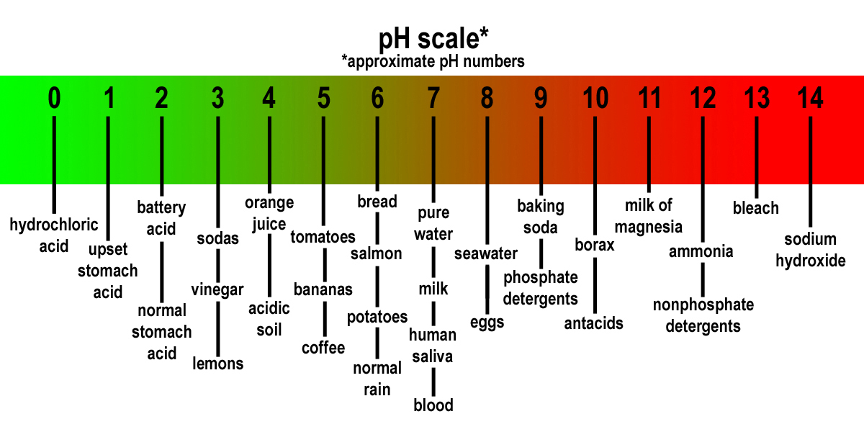
Seawater pH
Measure of a solution’s acidity
Few H⁺ = High pH = Basic
Lots of H⁺ = Low pH = Acidic
SW
http://earthref/SCC
Scripps Classroom Connection
Notes:
This slide is for the students
WHY: This slide helps students recall the first lesson of this unit covering pH to see how the pH changes observed in the laboratory activity relate to changes in the hydrogen ion concentration of the solution.
Narrative for the Instructor
During our pH lesson, you each copied down the pH scale onto individual index cards. Using your cards, please describe the relationship between pH and concentration of hydrogen ions. (Answer: Low pH numbers correspond to a lot of hydrogen ions while high pH numbers mean there are few hydrogen ions.) Which end of the pH scale is classified as basic? (Answer: right side; pH 8-14)
Now let’s focus on seawater since that is the solution we just worked with during the laboratory activity. When you measured the pH of seawater during the pH lab, where did it fall on the scale? (Answer: pH 8) By releasing the carbon dioxide gas from the balloon into the seawater, you changed the pH. What happened to the pH of the seawater? (Answer: It decreased, becoming more acidic) Although we refer to this process as ocean acidification, the oceans are not becoming acidic from the additional carbon dioxide. Instead, they are losing base, sliding towards a neutral pH. (Instruction for the Instructor: play the animation on the slide)

Slide 11
Ocean Acidification
CO₂
CO₂
+
H₂O
HCO₃⁻
+
H⁺
CO₃²⁻
+
2H⁺
Seawater pH
http://earthref/SCC
Scripps Classroom Connection
Notes:
This slide is for the students
WHY: This slides reviews the carbon chemistry of the oceans, which students have seen in the previous lesson on buffering pH, and how adding carbon dioxide changes the pH.
Narrative for the Instructor (play animations are you are talking)
This is the same reaction that was covered earlier in the lecture but now includes seawater pH. As we increase carbon dioxide emissions (animation), we are causing carbon dioxide concentration in seawater to increase (animation). This results in more hydrogen ions in seawater (animation) as the reaction goes forward, resulting in a decreased seawater pH (animation). This process of decreasing seawater pH due to increased carbon dioxide is known as ocean acidification.

Slide 12
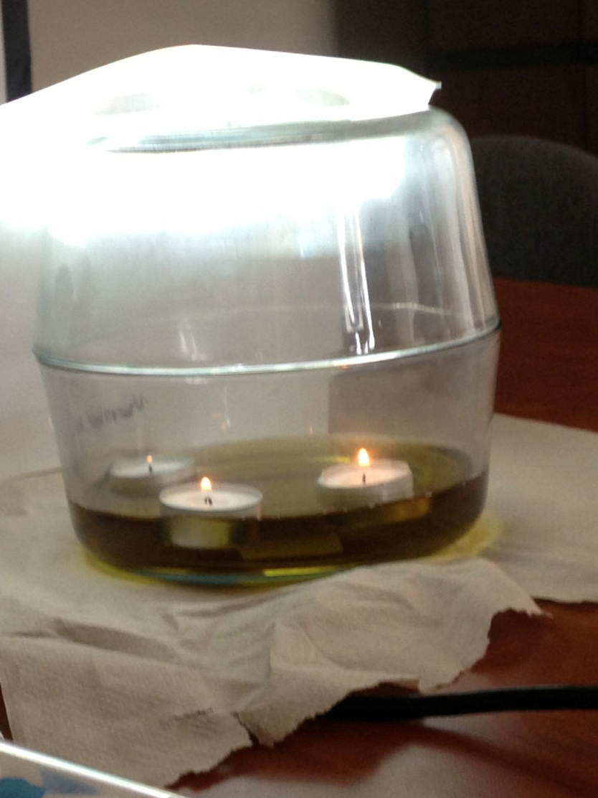
Candle Ocean Acidification Demo
Materials
Two wide, shallow glass dishes
Tea Candles (3)
Match/Lighter
pH Indicator Dye
Distilled Water or Tap Water
Scripps Classroom Connection
Notes:
This slide is for the instructor
This demonstration can also be done as an engagement activity near the beginning of class (in addition to or instead of the car demo).
WHY: This demonstration models the process of ocean acidification on the global scale.
Procedure:
1. Tell students that the water represents the ocean. Why DI Water? (Answer: you will see a pH change because it's not a buffer).
2. Add a 10-15 drops of pH indicator dye
3. Float candles in the water. The candles represent countries burning fossil fuels. (You can make them USA, China, and everyone else.)
4. Light the candles and quickly put the other dish on top of the dish with water. You've essentially created an entire atmosphere by doing so.
5. Ask questions to have students explain the observed changes over time.
a. Candles should burn out once the oxygen is used up
b. Color of water should change but only in the upper layer because that's where gas
exchange takes place.

Slide 13
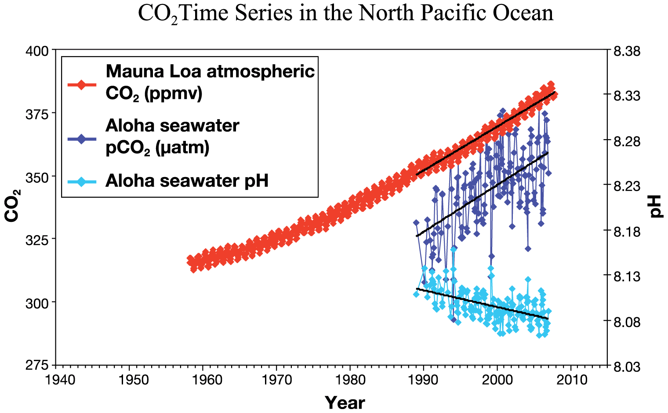
http://earthref/SCC
Scripps Classroom Connection
Notes:
This slide is for the students
WHY: Gives students an example of published data showing ocean acidification
Questions to Students/Narrative for the Instructor
Ocean acidification has been measured in the field and here is an example showing data collected in Hawaii.
What does the x-axis of this graph represent?
Answer: year from 1956-2010
This graph has two y-axes since the range of numbers are so different for CO2 and pH. The y-axis on the left side (CO2) shows the values for the red and blue lines. The green line on the graph goes with the other y-axis that shows pH from 8.03 to 8.38. Now let’s focus on the data shown in the graph.
What does the red line represent?
Answer: Atmospheric CO2 in units of ppmv
What trends do you see in the red line?
Answer: Overall increasing trend over time as seen in slide 2 and the Keeling Curve. The red line also is not smooth but has a zig-zag pattern. These
show seasonal differences in atmospheric carbon dioxide. The top peaks correspond with winter while the bottom peak matches summer.
Why would summer carbon dioxide values be lower than winter?
Answer: Photosynthesis occurs during the summer. (Note: You may need to help students get to this answer so students understand why there is more
photosynthesis in the summer. During the summer, plants receive more light and days are longer.)
Let’s move onto the blue now. According to the legend, what does this data does the blue line show?
Answer: Seawater pCO₂ in µatm (Note for the Instructor: ppmv and µatm have very similar values which is why they share one y-axis)
What trends do you see in the blue line?
Answer: It also increases over time like the blue line. (This makes sense because one-third of the carbon dioxide in the atmosphere dissolves into the
oceans.) The peaks and valleys of the data (noise) is much greater than the red line. These measurements were taken over a coral reef where
pCO₂ is not influenced by adsorption of atmospheric carbon dioxide but also biological activities such as photosynthesis, respiration, and
calcification. The next lesson (Lesson 4: Biology Influences Seawater Chemistry) will further explore the relationships between these biological
processes and seawater pCO₂ and pH.
Finally, we have one more set of data shown in this graph as the aqua line. What does this aqua line represent?
Answer: Seawater pH
What overall trend do you notice about seawater pH?
Answer: Its decreasing
Why is the seawater pH decreasing? How does it relate to the other data shown on this graph?
Answer: Seawater pH has been decreasing as seawater pCO2 and atmospheric CO2 concentration have been increasing. Carbon dioxide dissolves into
the oceans where it reacts with water, ultimately decreasing pH.
How much has CO2 decreased seawater pH from 1990-2010?
Answer: Seawater pH decreased approximately 0.04 units. This corresponds to an approximately 30% increase in acidity.
**********
Graphic Credit: http://www.igbp.net/news/features/features/changesinthecarbonatesystemoftheglobaloceans.5.1b8ae20512db692f2a680005564.html

Slide 14
CONCLUSIONS
Increased Emissions = More CO₂
CO₂ Dissolves into Oceans
Oceans Losing Base
http://earthref/SCC
Scripps Classroom Connection
Notes:
This slide is for the students
After completing the activities in this lesson, students should be able to summarize the main concepts of this lesson, which address the common misconceptions (also listed on slide 1).
Conclusions
Burning of more fossil fuels and land use changes have caused the amount of carbon dioxide in the atmosphere to increase to much higher concentration more quickly than in the past thousands of years.
Approximately one-third of the carbon dioxide produced dissolves into the oceans. The other sinks of carbon dioxide are the atmosphere and plants.
Once carbon dioxide enters the oceans, it reacts with water molecules to increase hydrogen ion concentration, consequently lowering the seawater pH. However, the oceans are still considered to be basic since the pH is above 7.
MISCONCEPTIONS:
1. CO₂ stays in the atmosphere
2. Atmosphere and seawater are disconnected
3. Seawater is becoming an acid, rather than becoming more acidic

