Slide 1
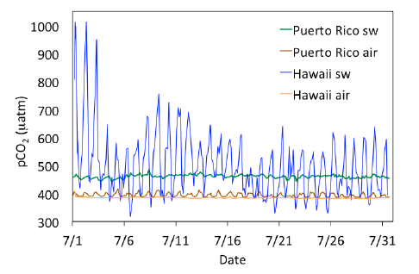
How Biology Influences Seawater CO₂ Chemistry
http://earthref/SCC
Scripps Classroom Connection
Notes:
This slide is for the instructor
AUTHORS: Heather Page, Scripps Institution of Oceanography; Alison Dickens, Lincoln High School
WHY: Ocean acidification isn’t the only process altering the amount of carbon dioxide, and therefore acidity, of seawater. Respiration and calcification increase carbon dioxide in seawater while photosynthesis and dissolution decrease it. In near-shore environments, such as coral reefs or estuaries, these biological processes could lead to much greater daily changes in seawater pCO₂. When considering the fate of marine environments, we need to consider both anthropogenic acidification and naturally occurring processes that alter seawater acidity.
SUMMARY: This lesson will start with the students acidifying cups of water by breathing into a straw immersed in the water. A short (10-15 min) lecture outlining how respiration, photosynthesis, calcification, and dissolution affect seawater chemistry will follow the engagement activity. Once the students have seen the overall influence of physiological processes on seawater CO₂ and pH, they will design their own experiment and conduct it in the classroom. For this laboratory, students practice each step of the scientific processes from creating a hypothesis to testing that hypothesis to sharing the results through a poster presentation. The laboratory activity can range from 2 to 5 days.
PICTURE/GRAPHICS CREDITS: Credits given on each individual slide.
WEBSITES USED IN THIS PRESENTATION: NA
ADDITIONAL RESOURCES: NA
CONTEXT FOR USE: This unit was designed for a high school chemistry class and is lesson 4 of 5 in a unit on “Ocean Acidification. This unit should be taught after students have learned about the carbon cycle and ocean acidification from human activities. The lessons should be taught in order as the concepts build upon one another. The activities within the lessons were designed to be performed in groups of 2-4 students.
MISCONCEPTIONS:
Marine organisms breathe seawater.
Photosynthesis doesn’t occur in the oceans.
Biology does not affect seawater chemistry
EVALUATION TIPS: The teacher may pose some questions (listed on slide 2) for the students after the engagement activity. They should assess the final poster students create (see “Suggested Grading Rubric for Posters”).
Next Generation Science Standards
MS-PS1-2. Analyze and interpret data on the properties of substances before and after the substances interact to determine if a chemical reaction has occurred.
Analyze and interpret data to determine similarities and differences in findings
Science knowledge is based upon logical and conceptual connections between evidence and explanations
Substances react chemically in characteristic ways
Macroscopic patterns are related to the nature of microscopic and atomic-level structure
MS-LS1-6. Construct a scientific explanation based on evidence for the role of photosynthesis in the cycling of matter and flow of energy into and out of organisms
Plants, algae (including phytoplankton) and many microorganisms use the energy from light to make sugars (food) from carbon dioxide from the atmosphere and water through the process of photosynthesis, which also releases oxygen.
MS-ESS2-1. Develop a model to describe the cycling of Earth’s materials and the flow of energy that drives this process.
All Earth’s processes are the result of energy flowing and matter cycling within and among the planet’s ecosystems. The energy that flows and matter that cycles produce chemical and physical changes in Earth’s materials and living organisms.
Explanations of stability and change in natural or designed systems can be constructed by examining the changes over time and processes at different scales, including the atomic scales.
Models can be used to represent systems and their interactions – such as inputs, processes, and outputs – and energy, matter, and information flows within systems.
HS-LS2-5. Develop a model to illustrate the role of photosynthesis and cellular respiration in the cycling of carbon among the biosphere, atmosphere, hydrosphere, and geosphere.
Photosynthesis and cellular respiration are important components of the carbon cycle, in which carbon is exchanged among the biosphere, atmosphere, oceans, and geosphere through chemical, physical, geological, and biological processes
Models can be used to simulate systems and interactions – including energy, matter, and information flows – within and between systems at different scales
-----------------------------------------------------------------------------------
This Slide: This graph shows the pCO₂ in the air and seawater of two coral reefs. The diurnal fluctuations are much greater than the atmosphere at both Puerto Rico and Hawaii. These changes are due to the balance of physiological processes on coral reefs that also manipulate pCO₂. During the day, calcification, respiration and photosynthesis occur. Although calcification and respiration increases pCO₂, photosynthesis decreases it, leading to the low peaks. At nighttime, calcification rates are typically lower and photosynthesis stops because there is no longer light. Because respiration continues, the pCO₂ level peaks to maximum values at night. In the graph, we can see that the fluctuations are much greater for Hawaii compared to Puerto Rico. These differences are probably due to proximity to the coral reef and the relative amounts of calcifying species and plants on each reef. (Coral reefs in the Pacific Ocean typically have more coral and algal cover than reefs in the Caribbean which can be dominated by sponges.)
PICTURE/GRAPHICS CREDIT: Andersson, AJ & Mackenzie, FT. 2012. Revisiting four scientific debates in ocean acidification research. Biogeosciences, 9: 893-905.

Slide 2
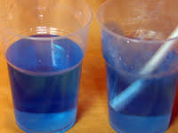
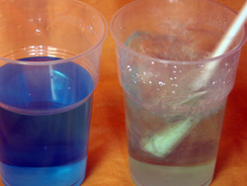
How Low Can You Go?
Materials List
Clear plastic cups or 25 mL beakers (1 per student)
Straws (1 per student)
Distilled or Tap Water
pH Indicator Dye
http://earthref/SCC
Scripps Classroom Connection
Notes:
This slide is for the teacher.
WHY: This activity is intended to engage students and have them realize biological activities such as breathing can change the pH of solutions.
Procedure
Each student needs to fill their cup or beaker with water.
Add a few drops of indicator dye (Bromothymol Blue or Universal Indicator) to the water.
Blow through the straw and watch the color of the dye change as pH changes.
Follow-Up Questions
What happened to the pH of the water? Why did the pH change?
A: The pH decreased due to the addition of carbon dioxide.
Can you think of other similar processes that can cause a change in pH? Are there anything in the oceans that can do these things?
A: Breathing, photosynthesis, calcification. Many animals breathe gasses that are dissolved in water. Plants do photosynthesis.
**********
Graphics Credit: http://www.csiro.au/helix/sciencemail/activities/AcidOcean.html

Slide 3
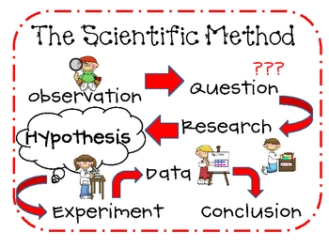
http://earthref/SCC
Scripps Classroom Connection
Notes:
This slide is for the students.
WHY: Reviews the scientific method and helps students understand the flow of the lesson
Narrative for the Instructor
During the activity, you made an observation about the water’s pH change. Now we want to move on to the next step of the scientific method. We might be wondering how biological processes alter seawater pH. That would be our research question. Next we’ll go over some research so you can eventually form your own hypothesis to test with an experiment.
**********
Graphic Credit: http://www.teacherspayteachers.com/Product/Scientific-Method-Mini-Posters-173881

Slide 4
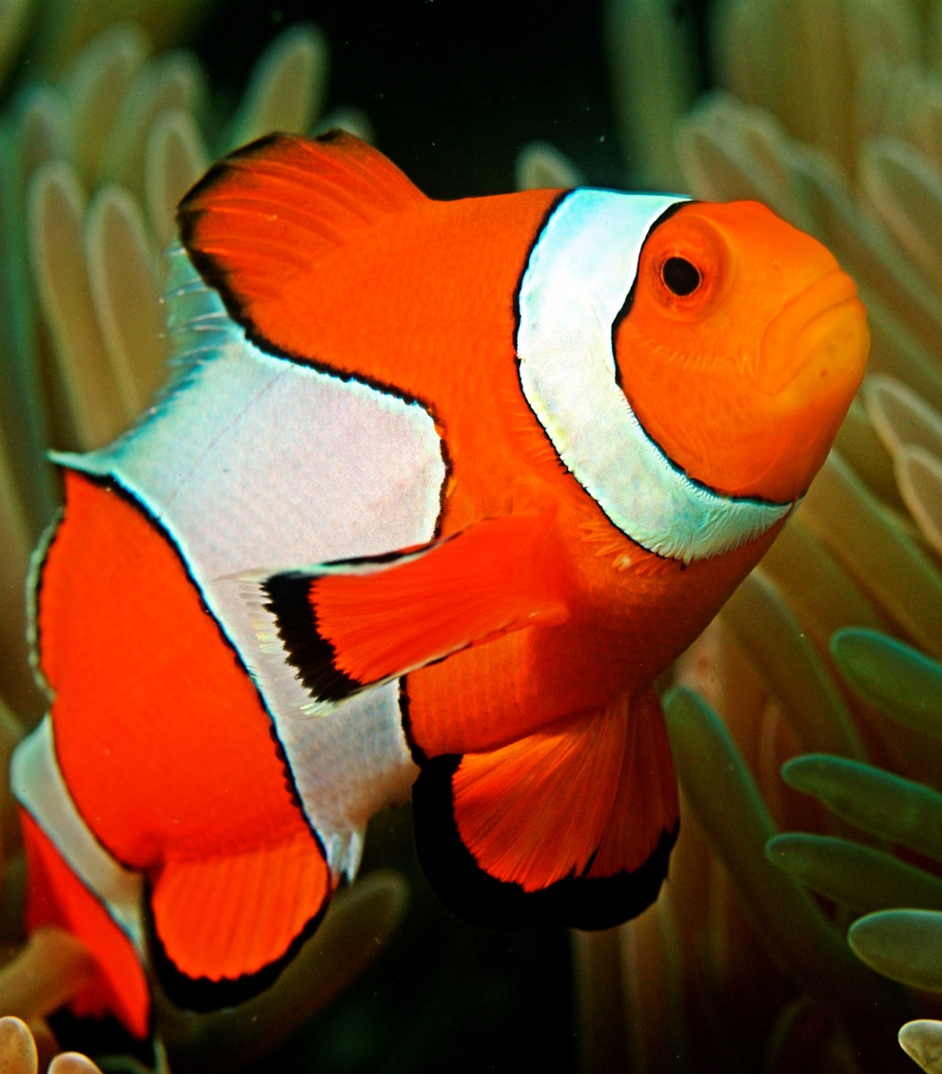
Animals Breathe!
CH₂O + O₂→CO₂ + H₂O
CO₂ increases
pH decreases
http://earthref/SCC
Scripps Classroom Connection
Notes:
This slide is for the students.
WHY: The next 3 slides go over how different biological processes influence seawater CO₂ and pH. This provides the “research” of the scientific method.
Note: The instructor may choose to remove the words “increases” and “decreases” on the next few slides to have students guess the answer by looking at the chemical reaction.
Narrative for the Instructor
Animals in the water breathe just like humans on land. Fish do not breathe the seawater itself but rather the gas in the seawater. They use oxygen gas and sugar to gain energy and this reaction produces carbon dioxide and water. So the amount of carbon dioxide gas in the water increases. As we’ve seen previously, an increase in carbon dioxide leads to a decrease in seawater pH. This process occurs throughout the day and night.
**********
Graphics Credit: http://en.wikipedia.org/wiki/Amphiprioninae

Slide 5
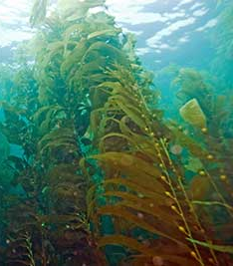
Plants Photosynthesize!
CO₂ + H₂O→CH₂O + O₂
CO₂ decreases
pH increases
http://earthref/SCC
Scripps Classroom Connection
Notes:
This slide is for the students.
Narrative for the Instructor
Plants perform photosynthesis to convert light into a usable form of energy. Sunlight can penetrate seawater, so photosynthesis happens in the water as well as on land. The reaction for photosynthesis is the opposite of respiration; carbon dioxide is used to produce sugars and oxygen. Sometimes you can see the oxygen gas as bubbles on the leaves of kelp and seaweeds. The process of photosynthesis uses carbon dioxide, so the amount in seawater decreases. This causes seawater pH to increase.
**********
Graphics Credit: http://www.californiasciencecenter.org/Exhibits/WorldOfEcology/ForestZone/KelpForest/KelpForest.php

Slide 6
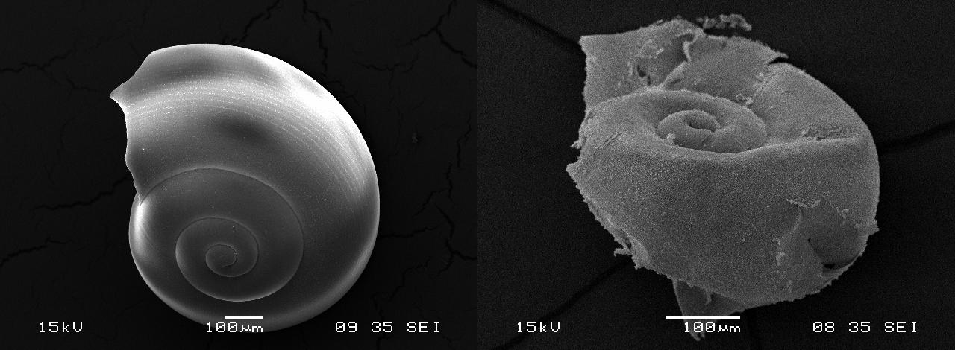
Calcification & Dissolution
Ca²⁺ + 2HCO₃⁻ ↔ CaCO₃ + CO₂ + H₂O
_{Calcification}
CO₂ increases
pH decreases
_{Dissolution}
CO₂ decreases
pH increases
http://earthref/SCC
Scripps Classroom Connection
Notes:
This slide is for the students.
Narrative for the Instructor
There are two other physiological processes that can alter seawater carbon chemistry and pH. They are calcification and dissolution. Calcification is the process of building shell or other hardened body structures like skeletons. Dissolution is the opposite of calcification. Dissolution is when the shells break down and dissolve into the water. When looking at the pictures, you can see that the shell has started to dissolve which is why the shell no longer looks smooth. Calcification produces carbon dioxide and lowers seawater pH while dissolution (which is the backwards reaction of calcification) has the opposite effect.
**********
Graphics Credit: http://timkovach.com/wp/2013/08/26/ocean-acidification-can-amplify-global-warming/

Slide 7
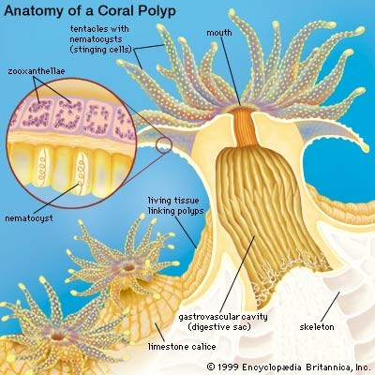
Some Animals & Plants do All Four Processes!
Coral
Animal living on CaCO₃ skeleton.
Symbiotic plants live inside them.
Calcification
Dissolution
Respiration
Photosynthesis
http://earthref/SCC
Scripps Classroom Connection
Notes:
This slide is for the students.
WHY: Corals are given as an example of an organism that can do all four processes. Marine organisms do more than one of the processes discussed, so their effect on seawater can be more difficult to predict.
Narrative for the Instructor
While the previous slides show very basic, predictable relationships, it is often more complicated in reality. Some plants (calcifying algae) and animals (coral) can do all four biological processes. Coral would be a classic example. A coral is an animal that forms tissue a few mm thick around a massive skeleton. Corals have a symbiotic algae called zooxanthellae living inside their tissues. So a living coral calcifies its skeleton which could dissolve depending on the seawater conditions. The zooxanthellae perform photosynthesis while both zooxanthellae and coral are doing respiration. We are still researching how these organisms change seawater carbonate chemistry and pH over short time periods.

Slide 8
http://earthref/SCC
Scripps Classroom Connection
Notes:
This slide is for the students.
WHY: Reviews the scientific method and helps students understand the flow of the lesson
Narrative for the Instructor
Now we have made an observation and done research related to our question of how biology affects seawater pH. Next you will be forming your own hypotheses, designing an experiment to test them, and then collecting data and forming conclusions. After you do the experiment and come up with your conclusions, you will be sharing your results through a scientific poster.
**********
Graphic Credit: http://www.teacherspayteachers.com/Product/Scientific-Method-Mini-Posters-173881

Slide 9
Lab: How Does Biology Influence Seawater pH?
Materials List
Small tanks (2 per group) (beta fish tanks work well)
Organisms for Tanks (fish, plants, snails, etc.)
Fish Food
Office Supplies (scissors, tape, glue, pencils, papers, etc.)
Black Construction Paper or Black Garbage Bag
Thermometer
Hydrometer
pH Indicator (Dye or Meters)
Lamp
http://earthref/SCC
Scripps Classroom Connection
Notes:
This slide is for the instructor.
WHY: This multi-day laboratory experiment will allow students to apply the Scientific Method. They will be developing their own research questions (suggestions given below), hypotheses, and experimental design. They will then set up the experiment in the classroom and collect data. Finally, the results will be graphed and shared as a scientific poster
Notes for the Instructor
In groups of 3-4, students will conduct a multi-day experiment to see how biological processes such as respiration, photosynthesis, and calcification may influence seawater pH. Given a list of available supplies, student groups will design their own research questions, hypotheses, and experimental design/procedure. The instructor should help students develop research questions and design an experiment that will test that research question. The instructor may determine how long the experiment will last and how often students are allowed to sample their water chemistry throughout the day. Students should measure seawater chemistry at the same time each day. A suggested timeline is given below.
The small tanks and organisms available to the students will depend on the store’s availability. Most pet stores carry beta fish tanks or tanks of similar size. You can find fish and live plants in any pet store but other organisms (snails, crabs, etc.) may not be available.
Preparation for the Instructor
Examples of research questions can be given to the students
See what plants and animals are available from the local pet store. This will determine the list of materials available to the students.
Materials need to be gathered. Each group should turn in a list of materials they need after the first day of planning.
Space should be cleared in the classroom for multiple tanks.
Examples of Research Questions
How does a fish change water pH?
How does a plant change water pH?
How do snails change the water pH?
How does sand change the water pH?
Does a plant with a fish keep water pH the same as water with no organisms?
Does light influence the effect of the organism on water pH?
How does the change caused by the organism differ when the seawater is acidified?
Examples of Experimental Setup for each Question
One tank contains water and the other tank contains water with a fish.
One tank contains water and the other tank contains water with a plant.
One tank contains water and the other tank contains water with snails.
One tank contains water and the other tank contains water with sand.
One tank contains water and the other tank contains water with a fish and plant.
One tank exposed to light and the other tank covered with black construction paper or garbage bag.
One tank contains regular water with an organism and the other tank contains acidified water with an organism.
Suggested Timeline (for 50 min. class periods)
Day 1: Develop research questions, hypotheses, and experimental setup. A list of available materials should be given to the students to help guide the planning process. At the end of the day, each group should turn in a list
of materials, including organisms, that they will need for their experiment.
Day 2: Students set up their tanks and collect initial data.
Day 3-5: Students continue collecting data by sampling water chemistry.
Day 6: Students create graphs or tables of their data. They should come up with conclusions; was their hypotheses proven or disproven?
Day 7-8: Instructor goes over the “How to Make a Poster Guide” with the students (see slide 10) and students create their posters using Powerpoint.

Slide 10
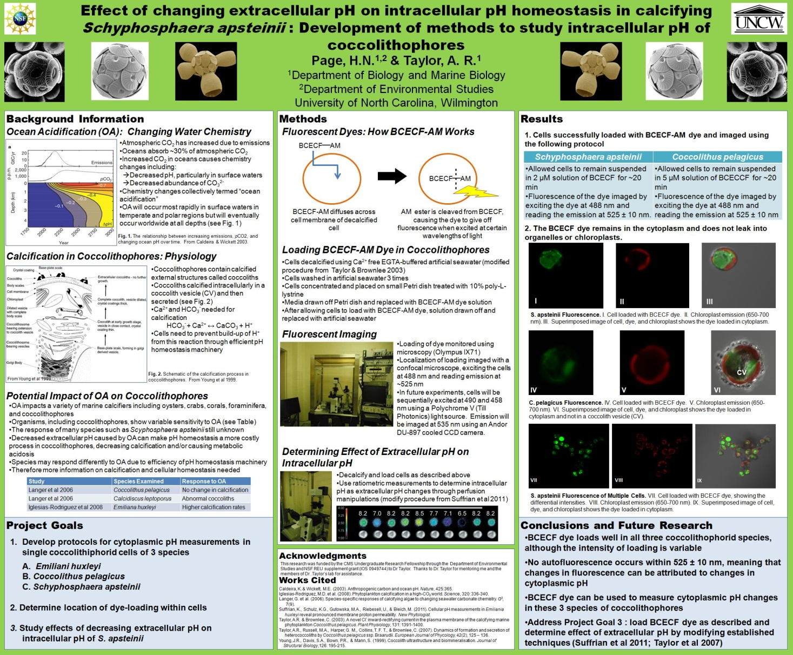
Lab: Creating a Scientific Poster
http://earthref/SCC
Scripps Classroom Connection
Notes:
This slide is for the students.
WHY: This serves as a final assessment to the laboratory experiment and allow students to develop computer skills that will be used in college.
Narrative for the Instructor
Now that you have completed your research project, you need to share your results with the scientific community. One way to communicate your research is by attending a scientific conference where you can present a poster like the one pictured on the slide. Using a guide, we will go over how to create the poster step by step and then you will start filling in your own information (research questions, methods, results, conclusions) on the poster.
Additional Worksheet: How to Make a Poster Guide

