Slide 1
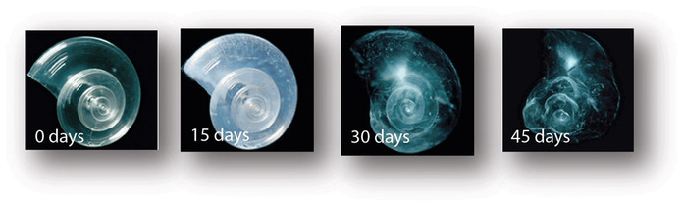
How Ocean Acidification Affects Biology
http://earthref/SCC
Scripps Classroom Connection
Notes:
This slide is for the instructor
AUTHORS: Heather Page, Scripps Institution of Oceanography; Alison Dickens, Lincoln High School
WHY: Ocean acidification affects marine life in a variety of ways. In general, calcifying species have more trouble forming hardened body structures and may even start to dissolves if waters become undersaturated with respect to calcium carbonate. Even non-calcifying species such as fish are influenced by ocean acidification. The different responses of plants and animals to ocean acidification may cause drastic changes in ecosystem goods (fishery species, medicines from sponges) and services (habitat for other species, shoreline protection by coral and oyster reefs).
SUMMARY: Ocean CO₂ chemistry will be reviewed by having students arrange paper slips with the carbonate reaction components listed. Class will then discuss calcium carbonate substances, including sand, on display, one of which will be acidified by the instructor. During the laboratory activity, students will monitor dissolution of different calcium carbonate minerals in regular and acidified seawater overnight. After this lab, students should be able to define ocean acidification and identify changes that occur in the field. Examples of dissolution in ocean acidification experiments will be given. The final assessment allows students to further explore the effects of ocean acidification on their favorite marine animal or plant.
PICTURE/GRAPHICS CREDITS: Credits given on each individual slide.
WEBSITES USED IN THIS PRESENTATION: NA
ADDITIONAL RESOURCES: NA
CONTEXT FOR USE: This unit was designed for a high school chemistry class and is lesson 5 of 5 in a unit on “Ocean Acidification.” This unit should be taught after students have learned seawater buffering and carbonate chemistry. The lessons should be taught in order as the concepts build upon one another. The activities within the lessons were designed to be performed in groups of 4 students.
MISCONCEPTIONS:
1. Ocean acidification will not affect marine organisms
2. All organisms have the same response to ocean acidification
EVALUATION TIPS: Discussion questions are given within the notes on each slide. A suggested grading rubric for the final project (brochure) has been posted online.
Next Generation Science Standards
MS-PS1-2. Analyze and interpret data on the properties of substances before and after the substances interact to determine if a chemical reaction has occurred.
Analyze and interpret data to determine similarities and differences in findings
Science knowledge is based upon logical and conceptual connections between evidence and explanations
Substances react chemically in characteristic ways
Macroscopic patterns are related to the nature of microscopic and atomic-level structure
MS-ESS3-3. Apply scientific principles to design a method for monitoring and minimizing a human impact on the environment.
Human activities have significantly altered the biosphere, sometimes damaging or destroying natural habitats and causing the extinction of other species.
HS-ESS2-5: Plan and conduct an investigation of the properties of water and its effects on Earth materials and surface processes.
The abundance of liquid water on Earth’s surface and its unique combination of physical and chemical properties are central to the planet’s dynamics.
-----------------------------------------------------------------------------------
This Slide: This series of pictures shows dissolution of the calcium carbonate skeleton of a pteropod, a very small mollusc (snail) that swims in the water, exposed to ocean acidification. The first picture on the left labeled “0 days” shows the original condition of the pteropod shell. After 15 days of being exposed to ocean acidification, the shell starts to change quality. By Days 30 and 45, the shell have become malformed due to dissolution from being exposed to the acidified waters for so long. Pteropods have been identified as one of the species more vulnerable to ocean acidification and their loss will be felt throughout the food web as they form the base of the food chain in coldwater environments (e.g. North Pacific Ocean).
PICTURE/GRAPHICS CREDIT: http://www.pmel.noaa.gov/co2/story/What+is+Ocean+Acidification%3F

Slide 2
Review: Ocean Acidification
Materials Needed
Small pieces of paper with the following (per group):
CO₂
H₂O
HCO₃⁻
H⁺
CO₃²⁻
H⁺
2H⁺
Arrow (5 per group)
Plus Sign (3 per group)
Envelope
http://earthref/SCC
Scripps Classroom Connection
Notes:
This slide is for the instructor
WHY: Engages students by having them recall the chemical equation shown previously. This equation pertains to the current lesson. In the previous lessons, we focused on the relationship between carbon dioxide and hydrogen ions (pH). During this lesson we are going to see why other components of this reaction (bicarbonate and carbonate) are important to biogeochemistry and marine organisms.
Instructor Preparation
Write individual pieces of paper each with a chemical symbol and/or sign as listed on the slide. Be sure to have multiple arrows and plus signs in each group’s envelope.
PROCEDURE:
Each group will be given an envelope containing slips of paper with chemical symbol or sign on it
Each group needs to form the carbonate chemistry reaction by using the given components
The final reaction should be (as previously taught): CO₂ + H₂O → HCO₃⁻ + H⁺ → CO₃²⁻ + 2H⁺

Slide 3
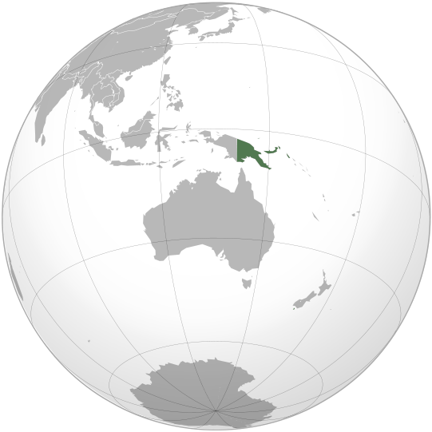
Naturally Acidified Reefs Video
Papua New Guinea
North of Australia
Seeps Add CO2
Creates Natural pH Gradient
Compare Coral Reefs Along Gradient
Notes:
This slide is for the instructor.
WHY: The reefs in Papua New Guinea (pictured in green on the world map) serve as a natural ocean acidification experiment. Natural outgassing of carbon dioxide (from the Earth’s interior) leads to localized areas of acidification, so the reefs located at the seeps and away from them can be compared. This short video will engage students by showing them how communities may respond to ocean acidification.
Objective: Compare and contrast the “healthy” coral reef (1st half of the video) and the reefs near the seep. This comparison may be done through discussion questions or having students record differences in their notebooks.
Suggested Discussion Questions for Students
What organism(s) were abundant in the reefs away from the seeps (first half of the video)?
Expected Student Response: corals, fish
What gas was bubbling up from the seeps? How does this gas affect seawater pH?
Expected Student Response: carbon dioxide lowers the pH
What organism(s) were abundant near the seeps?
Expected Student Response: grasses, plants, bleached coral, fish
Video: https://www.youtube.com/watch?v=15isE36esMM
In this video, divers (scientists) are collecting data on the coral reef communities near and removed from the seeps. During the first half of the video, they show a coral reef growing away from the seeps. The ecosystem contains many types of corals and other animals such as fish. Then, they show the community growing near the seeps. The bubbles are carbon dioxide released from the seabed. Where there is gas bubbling from the Earth’s seafloor, seagrasses and algae are abundant. Corals also look bleached (white) from exposure to acidified waters.
More Images from this reef: http://ocean.si.edu/blog/sneak-peek-future-coral-reefs-acidifying-ocean
Additional Notes for the Teacher
These carbon dioxide seeps are not permanent fixtures though the area in general always has carbon dioxide bubbling from the seabed.
The seeps are natural features and the gas bubbles up from the seafloor.
The divers are using waterproof paper and number 2 pencils to write underwater.
The white parts on the coral colonies indicate bleaching or death of the coral tissue.
**********
Graphic Credit: http://en.wikipedia.org/wiki/Papua_New_Guinea

Slide 4
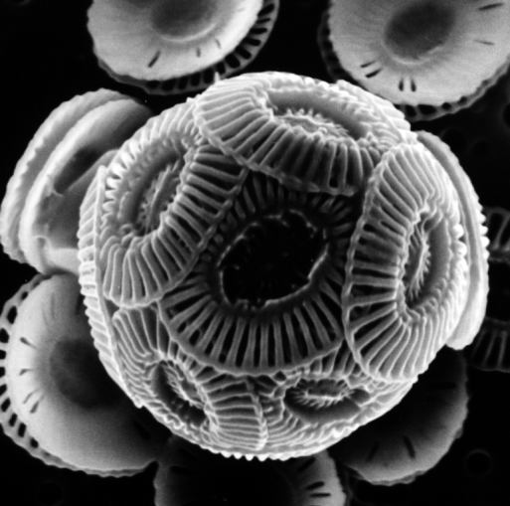
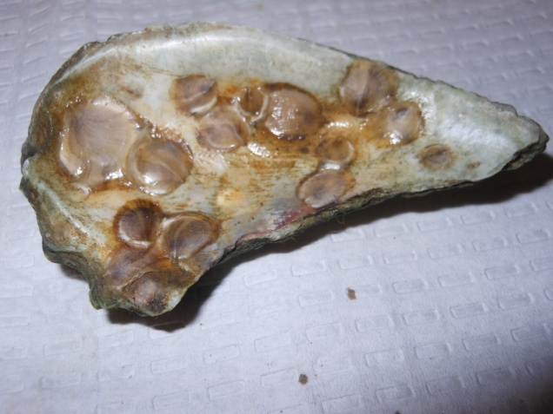
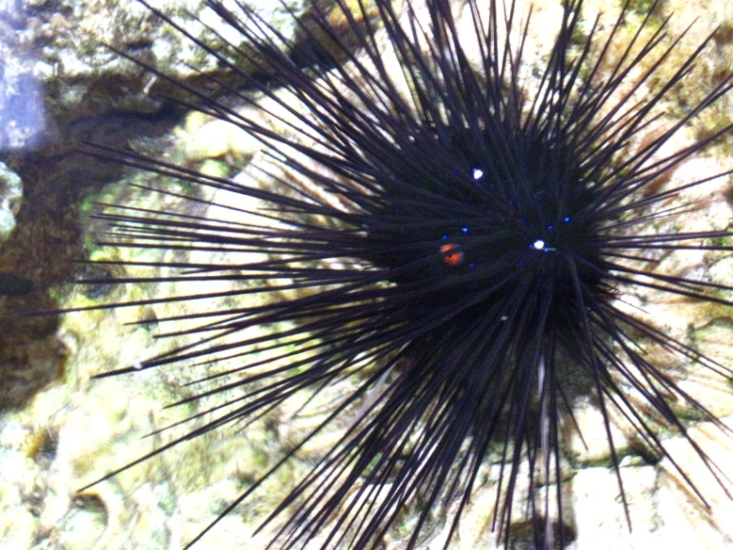
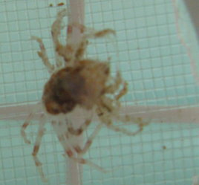
What do they have in common?
Coccolithophore
Oysters
Crab
Sea Urchin
http://earthref/SCC
Scripps Classroom Connection
Notes:
This slide is for the students
WHY: Ocean acidification poses a huge threat to marine organisms that produce calcium carbonate skeletons. The oceans are home to a wide variety of animals that calcify. This exercise allows students to realize how many organisms will be affected by changing seawater chemistry.
Objective: Investigate the shells and skeletons made of CaCO₃ pictured on the slide and/or on display for the students for commonality. Some materials to include are: coral skeletons, shells, crab molts, sea urchin spines, and sand. Instructor should lead investigative inquiry with the students.
Question for Students: What do all of these things (pictures and minerals on display) have in common?
Expected Responses: marine, live in the ocean, dead, hard, shells
Answer: All of the organisms showed have hardened structures made of the same chemical compound CaCO₃ (calcium carbonate).
**********
PICTURE/GRAPHIC CREDITS (starting at top left and going clockwise):
Coccolithophore – http://www.biolago.org/aktuelles-presse/news-artikel/alge-des-jahres-2009-emiliania-huxleyi-ein-algenzwerg-der-auf-das-weltweite-klima-wirkt/148/
Oyster with spat (newly settled oysters) – Heather Page
Tanner crab molting its exoskeleton – Heather Page
Sea Urchin – Heather Page

Slide 5
Day 1: Dissolution Lab
Materials
Microscopes
Scale & weighing containers
CaCO₃ Materials (e.g. sand, shells) (1 per group)
pH indicator (BTB or Universal Indicator)
Beakers (2 per group)
Seawater
Acidified Seawater
Parafilm
Filter papers & Funnels (Day 2)
Large beakers (~500 mL) (Day 2)
http://earthref/SCC
Scripps Classroom Connection
Notes:
This slide is for the instructor
WHY: This laboratory activity will allow students to see how dissolution may be affected by ocean acidification.
Laboratory Preparation
Gather materials listed on the slide
Acidify seawater by adding car exhaust fumes, CO₂ gas, or sodium bicarbonate to a container of seawater. Try to get the pH at least 0.4 units below the regular seawater pH since this represents the change expected by 2100 if we continue our current emission rates.
Procedure: Day 1
Label one beaker as “Regular Seawater” and fill with ~100 mL of seawater
Label the other beaker as “Acidified Seawater” and fill with ~100 mL of acidified seawater
Add 10 drops of pH indicator dye to the seawater in each beaker and record the initial pH.
Collect your CaCO3 material and make observations, including the initial weight and observations under the microscope.
Add the same amount of CaCO3 material to each beaker. Record any observations such as color change to the pH indicator, bubbles, etc.
Cover the beakers with Parafilm and label with the group name.
Expected Results
Students may observe bubbles coming off of the calcium carbonate minerals (particularly the sand). The bubbles are due to dissolution of calcium carbonate which produces carbon dioxide. The pH of seawater solutions should not change since seawater buffers against changes in pH.

Slide 6
Day 2: Dissolution Lab
  Expected Results
  CaCO3 minerals should weigh less.
  Some dissolution may be observed under the
  microscope.
  Order from least to most dissolved:
  Seawater
  Acidified Seawater
http://earthref/SCC
Scripps Classroom Connection
Notes:
This slide is for the instructor
Procedure: Day 2
1. Students make predictions about what happened to their CaCO₃ mineral.
2. Students collect their beakers and remove the Parafilm to make initial observations such as seawater pH of each beaker.
3. Students need to get one large beaker (1 per group), filter papers (2 per group), and funnels (1 per group)
4. Weigh the filter paper
4. Fold the filter paper to fit inside the funnel.
5. Pour contents of a beaker into the funnel to collect the CaCO₃ minerals. (You may need to wait an additional day before weighing the CaCO3 mineral so it can dry.)
6. Place the filter paper with CaCO₃ mineral into a weighing dish. Calculate the weight of the mineral. Was there a change?
7. Examine mineral under the microscope and observe changes from initial condition.
8. Repeat steps 4-7 for each beaker.
After all the groups are done, the class should do a share-out of results to compare seawater and acidified water.
Possible Conclusion Questions
1. How much did the weight of the sand change? (Final Sand Weight – Initial Sand Weight)
2. Did the weight of the sand change more in regular or acidified seawater?
Expected Response: Acidified
3. What process(es) led to the change in the weight of sand?
Expected Response: Dissolution
4. Using your answer from above, how might ocean acidification affect marine organisms?
Expected Response: Shells of marine animals may dissolve. These animals could die.

Slide 7
CaCO₃ Saturation State
Ca²⁺ + CO₃²⁻ ↔ CaCO₃
[Ca²⁺][CO₃²⁻]
Ω =
K’_{sp}
Ω > 1 Supersaturated
Ω = 1 Saturated
Ω < 1 Undersaturated → Dissolution!
http://earthref/SCC
Scripps Classroom Connection
Notes:
This slide is for the instructor
Background Information
Calcification is described by the reaction given at the top of the slide. Again, calcium carbonate can be one of three forms: calcite, aragonite, or Mg-calcite (see Lesson 3_Ocean Acidification). The ability of calcium carbonate to be precipitated in seawater depends on the saturation state (Ω) with respect to the calcium carbonate mineral. The saturation state is calculated from the concentrations of calcium and carbonate over a solubility constant (K’_{sp}). The solubility product basically describes how much calcium carbonate would dissolve under a certain pressure and temperature. Because [Ca²⁺] is relatively constant in the oceans, the saturation state is largely controlled by carbonate.
As a consequence of ocean acidification, the concentration of carbonate ions decreases. Therefore, the overall saturation state with respect to calcium carbonate also decreases. This means that is could be harder to precipitate calcium carbonate and that calcium carbonate will more readily dissolve.
When the saturation state is above one, there is more carbonate than expected at equilibrium and the solution is considered to be supersaturated. When the saturation state falls below one, calcium carbonate will start to dissolve into the seawater. Dissolution is the reverse of the calcification reaction. Some marine organisms (e.g. corals) may require a higher saturation state in order to calcify while other organisms in the deep sea are able to calcify even though the seawater is under-saturated.

Slide 8
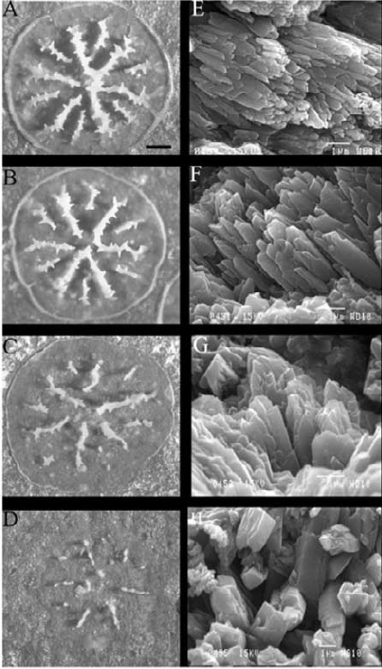
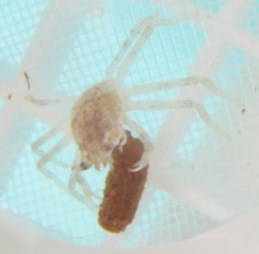
Low Ω Causes Changes in CaCO₃ Minerals
Increasing
CO₂
High pH
Low pH
http://earthref/SCC
Scripps Classroom Connection
Notes:
This slide is for the students
WHY: Shows students the different responses of marine organisms to ocean acidification.
Narrative for the Instructor
This slide shows the results of two different studies. The study on the left examined the growth of young Tanner crabs local to Alaska. We have three different bars shown on the graph; each one of these bars represents a different concentration of carbon dioxide, or saturation state. The blue bar corresponds to regular seawater while the red and green bars show seawater acidified with carbon dioxide gas. The crabs growing in the regular seawater had more growth than the crab growing in seawater that was acidified. (Note: The carapace refers to the main part of the exoskeleton which covers most of its body.) Therefore, the crabs growing in the acidified seawater were smaller than the ones growing in regular seawater. So not only can we have dissolution as you observed in your lab, but ocean acidification may also slow down growth (calcification).
The second study examined the changes in coral skeletons of young Bermudian corals that have just started growing their skeleton. The top skeleton grew in regular seawater and you can see the progressive changes as the seawater acidity (or amount of carbon dioxide) increases. In the most acidified seawater, the coral skeleton was almost completely dissolved.
**********
Graphics Credit (Left): Heather Page (2010)
Graphic Credit (Right): Cohen, AL, McCorkle, DC, de Putron, S, Gaetani, GA & Rose, KA. 2009. Morphological and compositional changes in the skeletons of new coral recruits reared in acidified seawater: Insights into the biomineralization response to ocean acidification. G³, 10(7): ISSN 1525-2027.

Slide 9
Ocean Acidification: Tying it All Together
CO₂
CO₂
+
H₂O
HCO₃⁻
+
H⁺
HCO₃⁻
CO₃²⁻
+
H⁺
Seawater pH
Dissolution
Calcification
http://earthref/SCC
Scripps Classroom Connection
Notes:
This slide is for the students
WHY: This slide summarizes student knowledge about ocean acidification.
Note for the Instructor: This slide contains animations to go along with the narrative. The animations serve to emphasize the changes in seawater chemistry and processes due to increased carbon dioxide emission and ocean acidification. When an animation should be played, there will be a note within the text.
Narrative for the Instructor
Before introducing the final project for this unit, let’s summarize what we’ve learned so far. This slide shows the carbon dioxide in the atmosphere dissolving into the ocean where it goes through a series of reactions. These are the same reactions we’ve seen throughout the unit but now they are written out as two reactions. Remember that the second reaction can go forwards and backwards, allowing seawater to buffer pH changes. However, we have seen that seawater doesn’t completely buffer against changes in pH as the oceans continue to take up the carbon dioxide from the atmosphere. So how is the concentration of carbon dioxide in the atmosphere changing? (Answer: Increasing; play animation) Then as some of this carbon dioxide dissolves into the oceans, it causes the amount in seawater to increase as well (play animation). When carbon dioxide levels in seawater increase, how does the concentration of hydrogen ions change? (Answer: Increases; play animation) More hydrogen ions means the pH is smaller or bigger? (Answer: Smaller; play animation) We saw in the laboratory activity that ocean acidification caused more dissolution of sand (play animation). How did the calcification of crabs change when exposed to seawater with smaller pH? (Answer: Decreased; play animation)
Extend Activity
Think-Pair-Share: Students should come up with their own definition of ocean acidification now that they have learned about these different components.

Slide 10
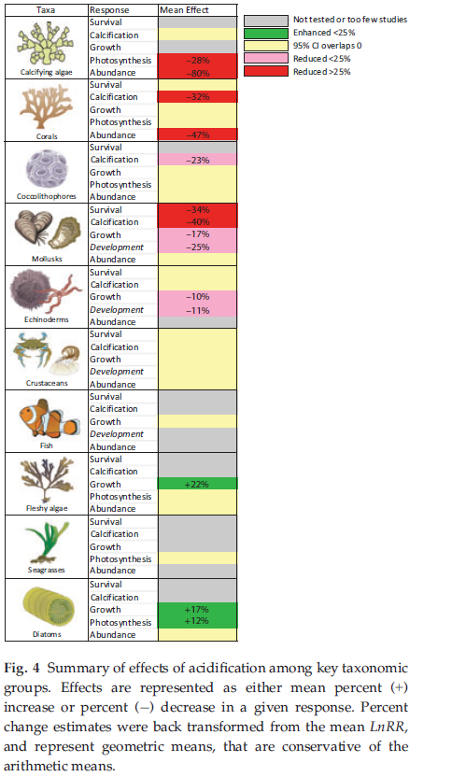
Other Effects on Biology: Final Project
Hired by grassroots organization
Want to increase public awareness
Create informational brochure
  Ocean acidification
  Response by marine life
  How we can help
http://earthref/SCC
Scripps Classroom Connection
Notes:
This slide is for the students.
WHY: Final project for the students to complete in order to learn about different responses of marine organisms and show what they have learned throughout this unit.
Narrative for the Instructor
While decreased calcification and increased dissolution are common responses to ocean acidification, few marine organisms can respond differently. We can see the variety of responses in this graph on the right. Along the left side of the graph, we see several groups of marine organisms, including corals, bivalves, crustaceans, and plants. The second column lists different physiological processes like survival, calcification, growth, and photosynthesis. Next to each of these, is a box shaded red, yellow, grey or green. Red means there is a reduction in that process while green means there is an increase. Yellow means there is no change and grey areas are still unknown. Do you see one of these colors or multiple? (Answer: multiple colors) So what does that mean in terms of the response of marine organisms? (Answer: They respond differently)
For your final project, you have been hired by a grassroots organization that was started to protect the oceans, with a focus of increasing the public’s awareness about ocean acidification and how it affects marine organisms. To do this, they would like you to create an informational brochure about ocean acidification and its effects on your marine organism, as well as how we can help your organism deal with these effects.
Process/Steps for the Students
Choose your marine organism (suggested organisms on slide 11 of this DLP)
Collect information about ocean acidification and your marine organism (see “Ocean Acidification Brochure Data Collection Worksheet”)
Make a draft of your brochure layout
Create the final product using Microsoft Word
Suggested Grading Rubric included. These brochures should be shared so students can see the variety of responses by marine organisms.
**********
Graphic Credit: http://www.ncbi.nlm.nih.gov/pmc/articles/PMC3664023/

Slide 11
Suggested Marine Organisms
Oyster
Mussel
Clam
Coccolithophore
Diatom
Pteropod
Cold Water Coral
Tropical Coral
Seagrass/Algae
Cuttlefish
Fish (Clownfish)
Shrimp
Lobster
Crab
Barnacle
Sea Urchin
Sea Star
http://earthref/SCC
Scripps Classroom Connection
Notes:
This slide is for the instructor
Examples of Marine Organisms for Final Project
Marine organisms can be assigned to students or they may pick from the list. There are many resources online as well as publications describing the response of these marine organisms to ocean acidification.

Slide 12
Conclusions
Acidification changes ecosystems
Acidification causes CaCO₃ dissolution
Different marine responses
http://earthref/SCC
Scripps Classroom Connection
Notes:
This slide is for the students.
By the end of this lesson, students should understand the significance of ocean acidification through the combination of activities, short lecture, and final project that addressed two misconceptions listed on slide 1 and below.
Conclusions
During the video (slide 3 engagement activity), the differences in ecosystems growing near and away from vents were seen. Coral reefs grew in seawater away from the vents but seagrasses dominated the ecosystem where carbon dioxide was bubbling through the seafloor.
More dissolution was observed for calcium carbonate materials (sand, shells, etc.) that were exposed to acidified seawater.
By the end of their final projects, students should understand that some marine organisms may do worse under ocean acidification (e.g. most calcifying species) while others grow more (e.g. crustaceans, seagrasses).
MISCONCEPTIONS:
1. Ocean acidification will not affect marine organisms
2. All organisms have the same response to ocean acidification

