Slide 1
Mutation Unit:
The Cellular Construction Zone
Using a construction site as an analogy for how proteins effect phenotype
Notes:
Teacher Slide:
Authors: Sarah Lerch and Felicia Ryder
WHY :
Genetic mutation is naturally intriguing to students because it brings to mind thoughts of superman and monsters, but it is also an important concept for them to understand. Natural selection is dependent on genetic mutation, a concept which they will focus on more as they continue in science. This unit can also be used as a platform to introduce students to genetics and parts of the central dogma of biology (DNA→ RNA→ Protein).
This lesson is the first in a series of four looking at genetic mutation using single celled organisms called diatoms. The lesson will begin by discussing mutation in multicellular organisms which students are more familiar with. This and the following units will then transition into discussing mutation in single cells, the basic components of multicellular life. Because diatoms are a single celled organism with a distinct phenotype they are a good model for students to learn about mutation within. Diatoms will be described in greater detail in the following lessons.
This first lesson will introduce students to the idea that proteins are the cellular genetic elements that actually create phenotypes. It will be helpful if students have already done their inheritance unit (Mendel, punnett squares, the concept of genes etc.) before this lesson.
SUMMARY:
Students will use a construction site analogy paired with a matching activity in order to understand the roles proteins play in the cell and how these roles impact phenotype. Students will begin by thinking about what mutants are and how genetics control phenotype, this will lead into a matching activity where they will match construction workers/ materials to their analogous protein functions. The activity will end with students thinking about how the constructed building (cell) would change if workers did things differently/ different materials were used (protein functions changed) and linking this back to what causes mutants to look different.
Lesson learning goal: Students understand that genes determine phenotype through a variety proteins with different functions.
Key Questions:
What are proteins?
What jobs do proteins have in the cell?
How do protein’s different jobs effect a cell’s phenotype?
Overview of the lesson:
Engage
Goal: To get students intrigued with the idea of mutants, mutation and their relationship with genetics. During this Engage they will establish what they already know (or think they know) about mutants.
Begin by allowing students to hypothesize about answers to the 3 key questions (see above).
Following this up with the video on DNA will help them to focus on the genetic answers to these questions.
Capture students attention with an image of a mouse with red eyes, blue lobster and an altered DNA double helix.
Use questioning to start students thinking about mutants and the causes of mutant phenotypes.
What do you think of when I say mutant?
What causes mutants to look different?
What makes organisms look the way they do?
DNA brain pop video on genetics.
Explore
Goals: (1) Solidify previously learned concepts about different elements of genetics and their relationships with one another. (2) Students understand that proteins have a variety of functions within the cell and that these different functions affect the cell’s phenotype.
Genetic elements and their relationships: Matching activity where students have a chance to review the elements involved in genetics and their relationships.
Necessary documents: 1. DNA relationship worksheet.pdf, 1. DNA relationship worksheet-key.pdf
Optional documents: 1. Genetic elements-flipchart.flipchart
Supplemental slides provided for additional review/ information
Give students a visual connection to phenotype using images of “critters” from the Science & Life Issues textbook. This is a reminder to students that although they know that genes determine phenotype, they are actually missing the link between genes and phenotype, proteins.
Introduce and define proteins.
Introduce students to the idea that single celled organisms have phenotypes too. This will be their first introduction to diatoms.
Cellular construction zone analogy matching: This will be a matching activity using a construction site as an analogy for a cell, where the cell is the house and the construction workers are the proteins. The jobs of the construction workers and the way they do them will change the way the house looks, changing its phenotype, similarly to how proteins determine a cell’s phenotype.
Necessary documents: 1. Cellular construction zone-matching. docx
Optional documents: 1. Cellular construction zone matching-flipchart.flipchart
Vocabulary, give students time to write down their new vocabulary in their notebooks.
Explain
Goal: Allow students to cement the new ideas they have learned through writing and discussion.
Students answer analysis questions in their notebooks after table/ class discussion.
What would happen to the building if the workers did their jobs differently?
What is an example of a way a worker would change what they were doing?
How would this change the way the building looked?
How does a construction site represent a cell with proteins?
What causes a mutant to look different?
Assign homework
Students re-visit initial hypotheses and answer questions using evidence from notebooks if they were incorrect. These answers are recorded in notebooks.
PICTURE/ GRAPHICS CREDITS:
- Cited on each slide.
WEBSITES/ RESOURCES USED IN THIS PRESENTATION:
Science Education for Public Understanding Program, UC Berkeley. Science & Life Issues. Ronkonkoma: Lab Aids, 2001.
ADDITIONAL READING:
Websites/ media for genetics and DNA review:
http://www.dnaftb.org/
Video: https://www.youtube.com/watch?v=9kQpYdCnU14
Websites for background on diatoms:
http://earthguide.ucsd.edu/diatom/d1.html (Great website, discusses topics in ways that could be explained to students as well)
http://www.ucl.ac.uk/GeolSci/micropal/diatom.html (More detailed than necessary but has good information and images)
Websites/ media for additional information on proteins:
http://www.nature.com/scitable/topicpage/protein-function-14123348
http://ghr.nlm.nih.gov/handbook/howgeneswork/protein
Video: https://www.youtube.com/watch?v=g9G0zzdQx-M
CONTEXT FOR USE:
7TH grade life science
First lesson in four lesson unit on genetic mutation
The Cellular Construction Zone
From Gene to Protein
Causes of Mutation
Modeling Mutants
Should follow inheritance unit.
Works well when it follows Primary Production unit authored by Sarah Lerch and Felicia Ryder on SCC website; can be modified so this is not necessary though.
EVALUATION TIPS:
Evaluation techniques used in this activity: Gauging class discussions, notebooks
Refer to 5E lesson plan, 1. Cellular construction zone-5E.doc
TEACHING NOTES:
ESR will be used as an acronym for Expected Student Response.
Each slide will have “Teacher slide:” or “Student slide:” at the top of the presentation notes. This indicates whether or not the slide should be used by the teacher (teacher slide) or shown to the students (student slide). Teacher slides can be hidden when presenting using the “Hide Slide” option.
Students will be required to record ideas and analysis in notebooks throughout the unit, a template for the student notebooks is provided in 1. Cellular construction zone-notebook.docx
Underlined text indicates a place where students should record something in their notebooks
Notebooks will always be divided into 4 sections: Questions, hypotheses, evidence and analysis.
This set up allows students to hypothesize about the questions looked at in the unit, gather evidence, analyze that evidence and compare their final answers to the problems to their original hypotheses.
VOCABULARY:
Protein: Compounds made by organisms that are involved in almost every aspect of what happens in living organisms.
Function: What something does, or its job.
MATERIALS PROVIDED:
1. Cellular construction zone.ppt
1. Cellular construction zone-5E.docx
1. Cellular construction zone-notebook.docx
1. Cellular construction zone-notebook-key.docx
1. Cellular construction zone-matching. docx
1. Construction site matching-flipchart.flipchart
1. Genetic elements-flipchart.flipchart
1. DNA relationship worksheet.pdf
1. DNA relationship worksheet-key.pdf
OPTIONAL MATERIALS:
Small, single person white boards.
Whiteboard pens.
Promethean interactive whiteboard and associated software.

Slide 2
Engage Overview
Hypothesizing:
  What are proteins?
  What jobs do proteins have in the cell?
  How do protein’s different jobs affect a cell’s phenotype?
Questioning:
  What do you think of when I say mutant?
  What causes mutants to look different?
  What are three main concepts you learned from the video?
Multimedia:
  Brain pop video on DNA/ genes
Notes:
Teacher slide: ENGAGE
INSTRUCTIONS:
- This slide can be used as a quick reference for the Engage section. More details will be provided in the comments for each slide.
ENGAGE GOAL:
- To get students intrigued with the idea of mutants, mutation and their relationship with genetics. During this Engage they will establish what they already know (or think they know) about mutants.
OVERVIEW:
Hypothesizing
Goal: To allow students to establish their current ideas about proteins, revealing their misconceptions and prior knowledge.
Students hypothesize about the 3 main questions they are trying to answer through the unit’s activities.
Questions
What are proteins?
ESR: Stuff found in meat, things in muscle.
What jobs do proteins have in the cell?
ESR: Make them stronger, make them bigger.
How do protein’s different jobs effect a cell’s phenotype?
ESR: Change how big they are.
Hypotheses are recorded in notebooks.
Questioning
Goal: Intrigue students with three seemingly disconnected images and get them thinking about the concept of mutants.
Students are introduced to images of three things and are asked to find what they have in common (they are all mutants or mutated).
Questions:
What do you think of when I say mutant?
ESR: Blue lobsters, mice with red eyes , monsters, super heroes, ninja turtles, deformed people and animals
What causes mutants to look different?
ESR: The yellow DNA, genes, poisons, pollution, nuclear waste, radiation, born with it, genetic disease
Multimedia
Goal: Give students basic information on DNA, chromosomes and genes; what they are and what they do.
Students watch an animated video on genetics and record three main points of their choice from the video.
http://www.brainpop.com/science/cellularlifeandgenetics/dna/ (show only through 1:50)

Slide 3
Hypothesize
What are proteins?
What jobs do proteins have in the cell?
How do protein’s different jobs effect a cell’s phenotype?
Notes:
Student slide: ENGAGE
INSTRUCTIONS:
Bring up each different hypothesis question separately.
Students discuss hypotheses at tables and then write them down in notebooks.
Sentence starters may be needed by some classes.
Ex: Proteins are------.
Ex: Proteins do ------------ and ------------ in the cell.
Ex: Protein’s different jobs affect a cells phenotype by ---------------------.
ESRs:
Stuff found in meat, things in muscle.
Make them stronger, make them bigger.
Change how big they are.
SLIDE GOAL:
Goal: To allow students to establish their current ideas about proteins, revealing their misconceptions and prior knowledge.
NOTES:
-It is ok that these questions will take many students off guard, this is an opportunity for them to establish what they know/ think now before they go through the lesson, their answers to these questions will likely change. It’s not expected that any students will know what cellular proteins are at this point.

Slide 4
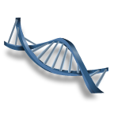
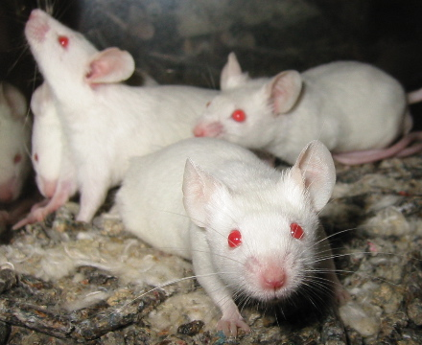
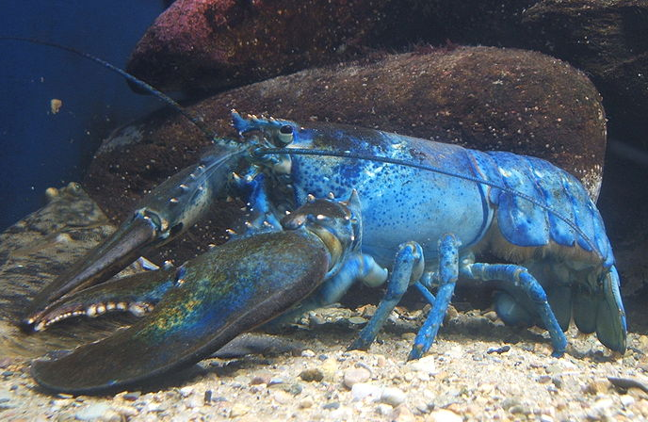
Notes:
Student Slide: ENGAGE
INSTRUCTIONS:
Let students know that the lesson is shifting gears now but that it is all leading up to answering the questions they hypothesized about.
Ask: What do these three images have common?
Students discuss ideas at tables and share out.
As they are considering this question it might be helpful to prompt them with some of the following questions to get them thinking.
So we have white mice with red eyes, and a blue lobster…. Those are both animals but what about this other piece?
Does anyone have any ideas about what this spiral shape might represent?
How might whatever this spiral shape represent relate to these animals?
Why do you think one of these bars is yellow?
ESR: They all have DNA, they all look weird, they are all deformed, they all have weird coloration
We will come back to these later in the unit!
SLIDE GOAL:
- This is a simple Engage in order to get the students focused and interested in the lesson. Hopefully the mystery of how all these things are related will intrigue them.
NOTES:
- These images all have something to do with mutation. The red eyes of the mice and the blue color of the lobster are created by genetic mutations. The blue spiral represents a DNA double helix, the orange rod in the spiral represents a mutation in the DNA. The lesson will come back to this slide at the end, with hopes that students might be able to see the common link.
PICTURE/ GRAPHICS CREDITS:
- Blue Lobster: Blue American Lobster by Steven G. Johnson- GFDL and CC-by-SA, http://en.wikipedia.org/wiki/File:Blue-lobster.jpg
- Albino Mouse Image: Laboratory Mice by Aaron Logan- CC, http://en.wikipedia.org/wiki/File:Lightmatter-lab-mice.jpg
- DNA: Microsoft clipart 2014, modified

Slide 5
What do you think of
when I say mutant?
Write a sentence and/or draw a picture on your white board. Share it with your table.
Notes:
Student Slide: ENGAGE
INSTRUCTIONS:
Ask: What do you think of when I say mutant?
Have students to think about this question as you hand out small white boards to each student.
Students then draw or write what they think of when you say mutant.
Students then share out drawn images or words to their tables and verbalize ideas of a mutant to the class.
ESR: Blue lobsters, mice with red eyes , monsters, super heroes, ninja turtles, deformed people and animals
SLIDE GOAL:
Get students engaged and expose their current conceptions of what a mutant is.
Expose common theme that mutants look different than normal things.
NOTES:
- To do this activity as written you will need small hand held whiteboards and pens for each student. If not available modify as necessary.
PICTURE/ GRAPHICS CREDITS:
- Lobster Image: Blue American Lobster by Steven G. Johnson- GFDL and CC-by-SA, http://en.wikipedia.org/wiki/File:Blue-lobster.jpg
- Albino Mouse Image: Laboratory Mice by Aaron Logan- CC, http://en.wikipedia.org/wiki/File:Lightmatter-lab-mice.jpg
- Modified DNA: Microsoft clipart

Slide 6
What causes mutants to look different?
Discuss as a table,
then share out your ideas to the class.
Notes:
Student Slide: ENGAGE
INSTRUCTIONS:
Ask: What causes mutants to look different?
Students discuss as tables and then share out to the class.
Write student responses on the board as students share them, do not acknowledge right or wrong answers.
ESR: The yellow DNA, the spiral shape, DNA, genes, poisons, pollution, nuclear waste, radiation, born with it, genetic disease
SLIDE GOAL:
Get students thinking about what makes organisms look different, link these ideas to mutation.
PICTURE/ GRAPHICS CREDITS:
- Lobster Image: Blue American Lobster by Steven G. Johnson- GFDL and CC-by-SA, http://en.wikipedia.org/wiki/File:Blue-lobster.jpg
- Albino Mouse Image: Laboratory Mice by Aaron Logan- CC, http://en.wikipedia.org/wiki/File:Lightmatter-lab-mice.jpg
- Modified DNA: Microsoft clipart

Slide 7
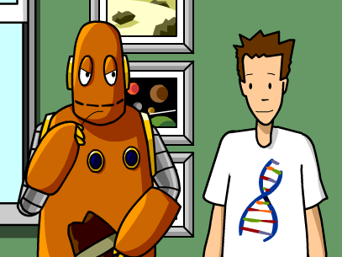
What makes organisms look the way they do?
Notes:
Student Slide: ENGAGE
INSTRUCTIONS:
Ask: What make organisms look the way they do?
Have students keep this question in mind while watching the following video.
Play video until just before the cloning section, 1:50, http://www.brainpop.com/science/cellularlifeandgenetics/dna/
After watching the video…
Ask: What are 3 main concepts you learned from the video?
Students share a single concept with class using Activeengage if available, then each student writes down 3 main concepts in notebooks.
ESR: All cells have a complete set of DNA, DNA is made up of bases, DNA determines traits, pattern of bases in DNA determines traits, sections of DNA in a chromosome are genes.
These are the important student responses you want to emphasize.
Ask: What word would go in the blank for this sentence “ All these functions come together to make a cell that-------------------- a certain way.”
Students record responses in notebooks.
ESR: Looks, works, functions
The goal here is for students to answer looks but other answers would be correct as well.
Ask: What makes organisms look the way they do? Students answer in online forum if available.
ESR: Their parents, their DNA, their genes
SLIDE GOAL:
Give students basic information on DNA, chromosomes and genes, what they are and what they do.
NOTES:
Video link is embedded into screen shot from video.
PICTURE/ GRAPHICS CREDITS:
- Brain Pop video/ screenshot, DNA: http://www.brainpop.com/science/cellularlifeandgenetics/dna/

Slide 8
Explore overview
Genetic elements and their relationships
  Matching activity
    Students match images of genetic elements with names
  Necessary materials
    1.DNA relationships worksheet.pdf
Cellular Construction Zone: Matching activity
  Matching activity
    Uses a construction site analogy
    Students match “protein” functions with images
  Necessary materials
    1. Construction site matching. docx
Notes:
Teacher Slide: EXPLORE
INSTRUCTIONS:
- This slide can be used as a quick reference for the explore section. More details will be provided in the comments for each slide.
EXPLORE GOAL:
Solidify previously learned concepts about different elements of genetics and their relationships with one another.
Students understand that proteins have a variety of functions within the cell and that these different functions affect the cell’s phenotype.
OVERVIEW:
Genetic elements and their relationships
- Students match images of the different elements involved in genetics with their names and descriptions.
- Students then use a worksheet to visualize and write down the relationships between these elements.
- Learning goals: Students understand the following points:
DNA is located in the nucleus.
DNA is condensed into chromosomes/ chromosomes are made of DNA.
Sections of DNA on the chromosome are genes.
DNA contains base pairs.
The patterns of base pairs in DNA create codes which determine traits.
This will hopefully be a refresher on concepts students have previously learned.*
Bridge: Introduce and define proteins. Emphasize proteins’ links to phenotype. Introduce phenotype in single celled organisms.
Cellular Construction Site
A construction site and its workers will be used as an analogy for a cell and its proteins. Students will match workers/ proteins with their jobs/ functions.
Learning goal: Students understand that genes determine phenotype through a variety proteins with different functions.
NOTES:
* If these concepts are new or continuing to be difficult the supplementary slides may be helpful.

Slide 9
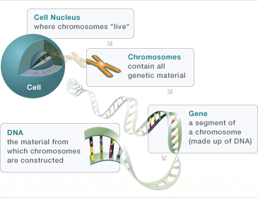
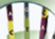
Genetic elements and their relationships matching activity
Base Pairs
Parts of DNA that can be arranged in a code that determines a trait
Notes:
Teacher slide: EXPLORE
INSTRUCTIONS:
This image will be used in a matching activity, refer back to this slide as the key if necessary.
There are two options for how this activity can be done, 1. with the flipchart and 2. with a PowerPoint slide. Refer to next slide for instructions for both.
SLIDE GOAL:
This slide provides the teacher with a key for the matching activity that will follow.
PICTURE/ GRAPHICS CREDITS:
- Modified cell and DNA relationship image: Genzyme Corporation, a Sanofi company. “Understanding Genetics." Pompe Community . 28 August 2013. <http://www.pompe.com/patients/inheriting-pompe/genetics.aspx>

Slide 10
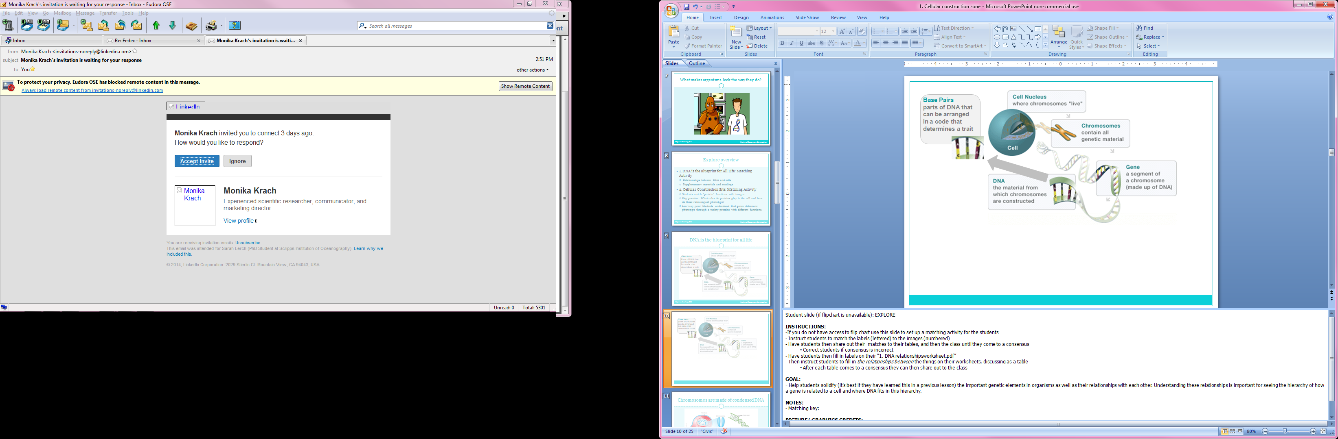
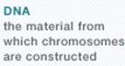
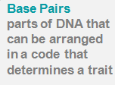
1
Base Pairs
parts of DNA that can be arranged in a code that determines a trait
5
2
3
4
C.
E.
A.
B.
D.
Notes:
Student slide (if flipchart is unavailable): EXPLORE
Teacher slide (if flipchart is available)
INSTRUCTIONS:
Option 1: With flipchart
Open “1. Genetic elements-flipchart.flipchart”
Link activity back to the brainpop: The students just heard a video reviewing concepts they should already know about genetics and DNA. This matching activity is drawing on that same knowledge.
Explain the diagram to students: This is a diagram showing different elements that are involved with genetics, starting with a cell and going all the way down to the smallest elements involved. Next to an image of each element on this diagram there is a numbered blue box, one of the lettered names and descriptions below matches to that box and describes the element its next to.
Give students a few minutes to discuss matches at their tables. Facilitate students coming up to the board and matching by dragging the definitions to the spaces next to their images.
Allow for class to come to a consensus together, correct any incorrect matches left at this point.
Hand out “1. DNA relationship worksheet.pdf” and have students fill in their matches to the numbered spaces
Ex: 1 Cell Nucleus
Take a moment to emphasize the importance of genes: We just established that genes are made of DNA. And DNA is made of base pairs that have specific patterns that determine traits. So on each gene there is a pattern of base pairs that determines what trait it affects, like tail color or eye color. We are going to come back to this idea so keep it in the back of your mind.
Then instruct students to fill in the relationships in the spaces between the different genetic elements their worksheets, discussing as a table
After each table comes to a consensus they can then share out to the class.
Students may need to use the descriptions provided with the names of each element as a base to fill these relationships in, encourage them to use their own words if they can though.
See key to the worksheet in the “1. DNA relationship worksheet-key.pdf” document for possible answers.
Option 2: With PowerPoint slide
If you do not have access to flip chart use this slide to set up a matching activity for the students
Link activity back to the brainpop: The students just heard a video reviewing concepts they should already know about genetics and DNA. This matching activity is drawing on that same knowledge.
Hand out “1. DNA relationship worksheet.pdf”s to each student
See key to the worksheet in the “1. DNA relationship worksheet-key.pdf” document
Explain the diagram to students: This is a diagram showing different elements that are involved with genetics, starting with a cell and going all the way down to the smallest elements involved. Next to an image of each element on this diagram there is a numbered blue box, one of the lettered names and descriptions below matches to that box and describes the element its next to.
Give students a few minutes to discuss matches at their tables. Then instruct students to write down their matches on their worksheets.
Ex: 1 Cell Nucleus
Take a moment to emphasize the importance of genes: We just established that genes are made of DNA. And DNA is made of base pairs that have specific patterns that determine traits. So on each gene there is a pattern of base pairs that determines what trait it affects., like tail color or eye color. We are going to come back to this idea so keep it in the back of your mind.
Have each table share out, writing matches on the board. Be sure the class has come to a correct consensus before moving on. Allow for students to make corrections on their worksheets if necessary.
Then instruct students to fill in the relationships in the spaces between the different genetic elements their worksheets, discussing as a table
After each table comes to a consensus they can then share out to the class
Students may need to use the descriptions provided with the names of each element as a base to fill these relationships in, encourage them to use their own words if they can though
See key to the worksheet in the “1. DNA relationship worksheet-key.pdf” document for possible answers
CONTENT:
- A full set of an organism’s DNA is located in the cell nucleus
DNA is condensed into chromosomes/ chromosomes are made of DNA
Sections of DNA on the chromosome are genes
DNA contains base pairs
The patterns of base pairs in the DNA of a gene create codes which determine traits
SLIDE GOAL:
- Help students solidify (it’s best if they have learned this in a previous lesson) the important genetic elements in organisms as well as their relationships with each other. Understanding these relationships is important for seeing the hierarchy of how a gene is related to a cell and where DNA fits in this hierarchy. The specific take aways for students are listed under the CONTENT section.
NOTES:
Matching key: 1. C 2. D 3. B 4. E 5. A
If students are having a hard time with/ unprepared for this activity review supplementary slide 11 with the class
If students are curious about base pairs and the structure of DNA use supplementary slide 12 to better describe it
PICTURE/ GRAPHICS CREDITS:
- Modified Cell and DNA relationship image: Genzyme Corporation, a Sanofi company. “Understanding Genetics." Pompe Community . 28 August 2013. <http://www.pompe.com/patients/inheriting-pompe/genetics.aspx>

Slide 11
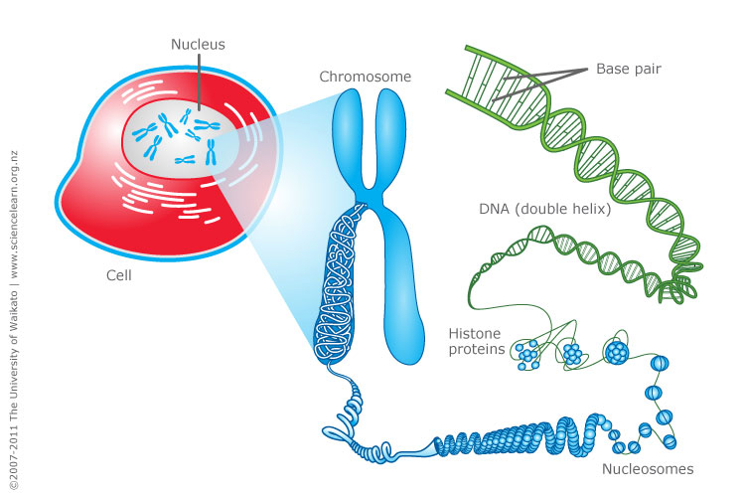
Chromosomes are made of condensed DNA
Gene
Notes:
Teacher Slide: EXPLORE Supplemental Slide
INSTRUCTIONS:
Continue to slide 13 if not necessary
Review this slide in detail: Here is a cell which contains the a nucleus, nearly every cell in an organism contains all its DNA. Chromosomes are made up of condensed DNA. You can see in this image that the cell contains multiple chromosomes, each of these contains different sections of the organisms condensed DNA.
For students who are interested the way DNA is condensed into the chromosome can be talked about as well, histone proteins form groups wrapped in DNA called nucleosomes. The nucleosomes are then structured into a spiral which is spiraled again and packed into DNA (for more information see the link below). The thing to emphasize here are the many ways DNA is organized in order to get it so compact, there is a lot of DNA in those chromosomes!
Here is a cool YouTube video on it: https://www.youtube.com/watch?v=9kQpYdCnU14
After reviewing this slide go back and re-try the “Genetics elements and their relationships” activity.
SLIDE GOAL:
To give the students another way to visualize the relationships between all the important genetic elements if the matching activity is too much without additional review.
NOTES:
This slide is a supplemental image meant to support the following bolded concepts for the genetic elements and their relationships activity:
A full set of an organism’s DNA is located in the cell nucleus
DNA is condensed into chromosomes/ chromosomes are made of DNA
Sections of DNA on the chromosome are genes
DNA contains base pairs
The patterns of base pairs in the DNA of a gene create codes which determine traits.
- Video on DNA packing in chromosomes: https://www.youtube.com/watch?v=9kQpYdCnU14
PICTURE/ GRAPHICS CREDITS:
- Modified Cell to DNA image: Science Learning Hub, The University of Wakato (2011,June 8th). Cell, chromosomes and DNA. Science Learning; sparking Fresh Thinking. Retrieved August 30, 2013, from http://www.sciencelearn.org.nz/Contexts/Uniquely-Me/Sci-Media/Images/Cell-chromosomes-and-DNA.

Slide 12
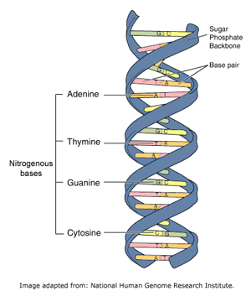
DNA contains pairs of bases
Notes:
Teacher Slide: EXPLORE Supplemental Slide
INSTRUCTIONS:
Continue to slide 13 if not necessary.
Review the slide, emphasizing the double helix shape and the way that the base pairs create the “rungs” of the DNA ladder and have specific pairs (Adenine - Thymine, Guanine-Cytosine).
Possible Activity: Have students come up with their own illustrated mnemonics in order to remember the pairings Ex: Alligators eat Toes and Cars need Gas.
SLIDE GOAL:
- To give more information on base pairs and DNA structure for classes who are interested.
NOTES:
This would be an appropriate slide to use for a higher functioning class or if some students are particularly interested in the structure of DNA itself.
Base pairings and DNA structure will not be essential knowledge for the rest of the unit.
Refer to the links under additional readings to expand on this concept, specifically #19 under Molecules of Genetics on http://www.dnaftb.org/
PICTURE/ GRAPHICS CREDITS:
DNA Double Helix Image: National Human Genome Research Institute, DNA, genes and chromosomes. Virtual Genetics Education Centre. Retrieved August 30, 2013, from http://www2.le.ac.uk/departments/genetics/vgec/highereducation/topics/dnageneschromosomes.

Slide 13
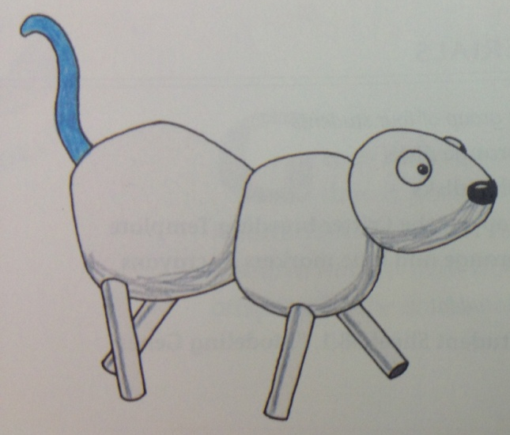

Genes determine phenotype
Tail Color Genes
? ? ?
Proteins
Notes:
Student Slide: EXPLORE
INSTRUCTIONS:
This is an animated slide, each frame will be paired with its description.
Focus the discussion on DNA and genes, a few of the genetic elements seen in the matching activity.
Frame 1: First, its important to remember that all of an organisms combined traits are its phenotype.
Poppy and Skye have different phenotypes. Their tails are different colors.
Remember what Tim and Moby said? DNA determines different traits.
Frame 2: Genes determine phenotype, we (the class) don’t not know how genes determine phenotype yet.
Frame 3: Ask: How do the tail color genes make the different tail colors?
Students discuss at tables and share out.
Frame 4: Genes determine phenotype through proteins.
We will discuss more about how they do this later, hold on!
First we will focus on proteins.
SLIDE GOAL:
To highlight what students understand about the links between genes and phenotypes as well as what they don’t.
NOTES:
This slide relates to an activity, taken from the UC Berkeley textbook Science & Life Issues, using the critters Poppy and Skye as examples for understanding inheritance and traits.
If this is not the textbook used in your classroom introduce Skye (the critter with the blue tail) and Poppy (the critter with the red tail).
PICTURE/ GRAPHICS CREDITS:
Science Education for Public Understanding Program, UC Berkeley. Science & Life Issues. Ronkonkoma: Lab Aids, 2001.

Slide 14
What is a protein?
Genes
Proteins
Lots of different functions
Phenotype
Compounds made by organism’ s bodies
Involved in almost everything that happens in living organisms
Proteins are involved in determining phenotype
Notes:
Student Slide: EXPLORE
INSTRUCTIONS:
Give the students a general definition of a protein, the definition at this point is going to be very limited:
We have been talking a lot about proteins and what they do; remember proteins are the link between genes and phenotype.
But we haven’t actually said what a protein is have we?
The actual definition of what a protein is to complicated for us right now, so you guys we are going to be using a simplified definition, later on in your science careers you guys are going to learn more about proteins and will get a better definition
For now we are going to define proteins as: Compounds made by organisms that are involved in almost every aspect of what happens in living organisms, including determining our traits.
Students write down three points about what a protein is in their notebooks
Students fill in the blank for “All these functions come together to make a cell that ------------ a certain way” provided in their notebooks”**
SLIDE GOAL:
- Provide students with concrete descriptions of what a protein is and a visual demonstration of how they are connected with genes and phenotype.
NOTES:
Official definition of protein with examples:
Any of numerous organic compounds, complex polymers of amino acids that are involved in nearly every aspect of the physiology and biochemistry of living organisms. Twenty different amino acids are common to proteins, linked in chains of hundreds to thousands of units. An active protein molecule has three important levels of structure: primary (the amino acid sequence), determined by the genes; secondary (the geometric shape, often a helix), determined by the angles of the covalent bonds between and within amino acids; and tertiary (the looped and folded overall shape), determined largely by attraction between oppositely charged groups (and repulsion between like charged groups) on amino-acid side chains and especially by hydrogen bonding. The tertiary structure, which can be globular or sheet like with ridges, crevices, or pockets, often holds the key to a protein's biological activity. Proteins can serve, e.g., as structural material (as in connective tissue and hair; see collagen; keratin), as enzymes and hormones, as transporters of essential substances such as oxygen (see hemoglobin), as antibodies, or as regulators of gene expression. Some proteins are simple (amino acids only), some conjugated (see conjugation) to other groups, often vitamins or metal atoms needed in tiny amounts in the diet (see coenzyme; cofactor). Rhodopsin and hemoglobin are conjugated proteins. Proteins may be covalently linked to other atoms or molecules, as to sugars (glycoproteins), phosphate groups (phosphoproteins), or sulfur (sulfoproteins). Proteins are an essential human nutrient, obtained from both plant and animal foods. Their greatest commercial use is in food products; they are also employed in adhesives, plastics, and fibers.
(Merriam Webster online; Merriam Webster online, http://www.merriam-webster.com/dictionary/protein)
This definition is beyond what students can understand at this point, but it may be helpful to know as you field questions and explain proteins to the students

Slide 15
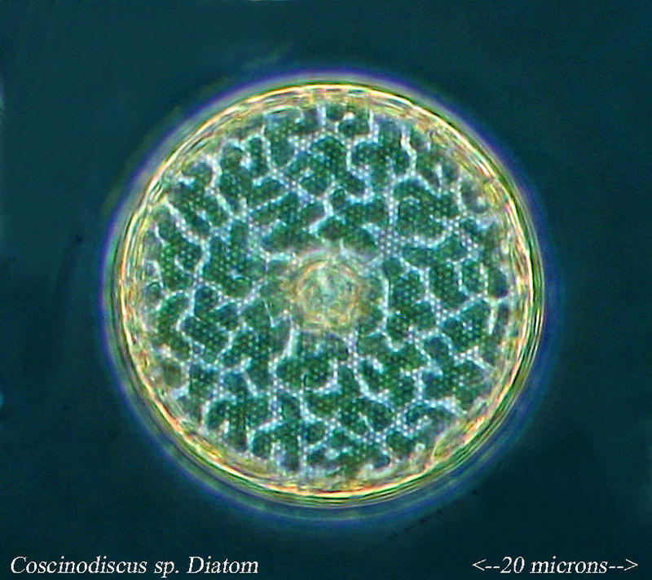
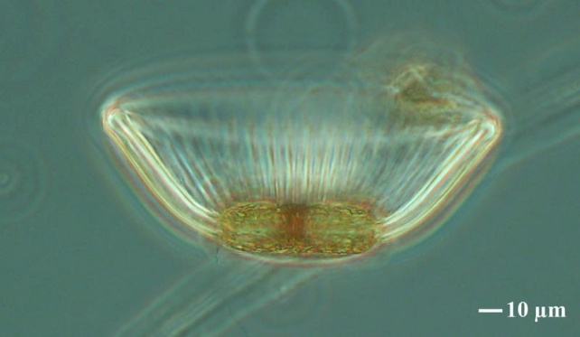
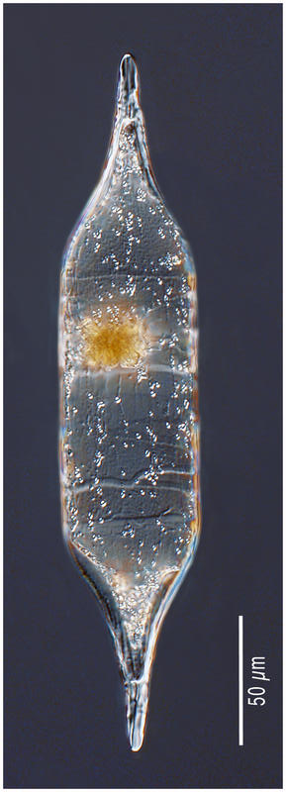
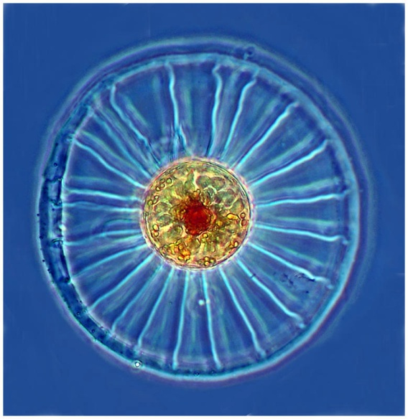
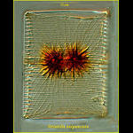
Single celled organisms have phenotypes too
Notes:
Student Slide: EXPLORE
INSTRUCTIONS:
-Describe the following to students:
Multicellular organisms (like critters) aren’t the only organisms with phenotypes.
Above image: Single celled organisms called diatoms which live aquatic environments and have cell walls made out of silica, which is similar to glass.
Emphasize the very different shapes, the cells look different, they have different phenotypes.
Will learn more about diatoms later in this unit.
Optional web quest:
Instruct students to go to the aquaparadox website (http://www.obs-vlfr.fr/gallery2/v/Aquaparadox/Marine-Diatoms/) and look around.
Many of the images are not of diatoms, but of other single celled organisms in the ocean. Be sure students are clear on this.
Have each student choose their favorite image and share it with their table.
This should be a quick activity but will emphasize the many different morphologies that can be found in single celled organisms.
SLIDE GOAL:
To make sure students relate the idea of phenotype to both “critters” as well as single celled organisms, this will be important later in the unit.
NOTES:
This is students first introduction to what diatoms look like up close, or first introduction to diatoms in general if this unit was not preceded by the Primary Production unit authored by Sarah Lerch and Felicia Ryder on SCC website. This is meant to be a first taste of the all that is to come with how diatoms are looked at in this unit.
The students will learn more about diatoms themselves later in the unit.
Background on diatoms:
Diatoms are single celled photosynthetic organisms typically found in aquatic environments.
They account for approximately 20% of global primary production and 40% of primary production in the ocean so they are incredibly important ecologically.
One of diatoms unique traits are their cell walls which are made of silica, which is chemically similar to glass.
For more readings on diatoms refer to these websites:
http://earthguide.ucsd.edu/diatom/d1.html (Great website, discusses topics in ways that could be explained to students as well)
http://www.ucl.ac.uk/GeolSci/micropal/diatom.html (More detailed than necessary but has good information and images)
PICTURE/ GRAPHICS CREDITS:
Diatom Images: Dolan, John (2009, December 5). Marine Diatoms. Galerie de l'Observatoire Océanologique de Villefranche-sur-Mer. Retrieved September 4, 2013, from http://www.obs-vlfr.fr/gallery2/v/Aquaparadox/Marine-Diatoms/.

Slide 16
Cellular construction zone overview
Activity: Matching
Construction workers and their jobs are used to represent proteins and their roles in a cell
Matching key
  House: A cell
  Frame of the house: Protein that determines cell shape
  Worker carrying board up ladder: Protein that transports the cell’s building blocks
  Worker building the brick wall: Protein that builds cell wall
  Worker with the megaphone: Protein that starts and stops processes
Notes:
Teacher Slide: EXPLORE
INSTRUCTIONS:
This slide can be used as a quick reference for the construction site analogy explore. More details will be provided in the comments for each slide.
Prior to Lesson: Print out copies of “1. Cellular construction zone-matching.docx” each sheet has enough images/ descriptions for 3 sets. Cut out sets of images and descriptions. Clip sets together, or put in envelopes.
ACTIVITY GOAL:
- The goal of this activity is for students to understand that proteins have a variety of functions within the cell and that these different functions affect the cell’s phenotype.
OVERVIEW:
A construction site and its workers will be used as an analogy for a cell and its proteins. Students will match workers/ proteins with their jobs/ functions.
Each worker and material has a specific job in determining what the house looks like, these workers and materials represent proteins which have specific jobs in determining what the cell looks like.
The house represents the cell itself.
The frame of the house gives it its shape. The frame represents the protein that determines a cell’s shape.
The worker carrying the board up the ladder is transporting the materials that are being used to build the house. This worker represents the protein that transports the building blocks used to build the cell.
The worker building the brick wall is building the wall of the house. This worker represents the protein which makes the cell wall.
The worker with the megaphone is the foreman who gives directions to the other workers. This worker represents a protein that starts and stops processes in the cell.
Describe the activity. First orienting students to the construction site, then explaining the analogy.
Hand out sets of matching images and protein descriptions for matching to each pair of students, pairs will work as a team to match the correct image and its descriptor.
Allow students to match in pairs and then as a class.
Reiterate concept that proteins are the link between genes and phenotypes.
Vocabulary.
MATERIALS:
- 1. Cellular construction zone matching-flipchart.flipchart
- 1. Cellular construction zone-matching.docx
NOTES:
These are simplified protein functions, this unit could be modified to make it more specific by defining redefining the proteins as follows.
The boards that make the frame of the house: Structural proteins
The worker carrying the board up the ladder: Transport proteins
The worker building the brick wall: Enzymatic protein
The worker with the megaphone: Signaling/ messenger protein
Additional protein information resources:
Website: http://www.nature.com/scitable/topicpage/protein-function-14123348
Website: http://ghr.nlm.nih.gov/handbook/howgeneswork/protein
Video: https://www.youtube.com/watch?v=g9G0zzdQx-M

Slide 17
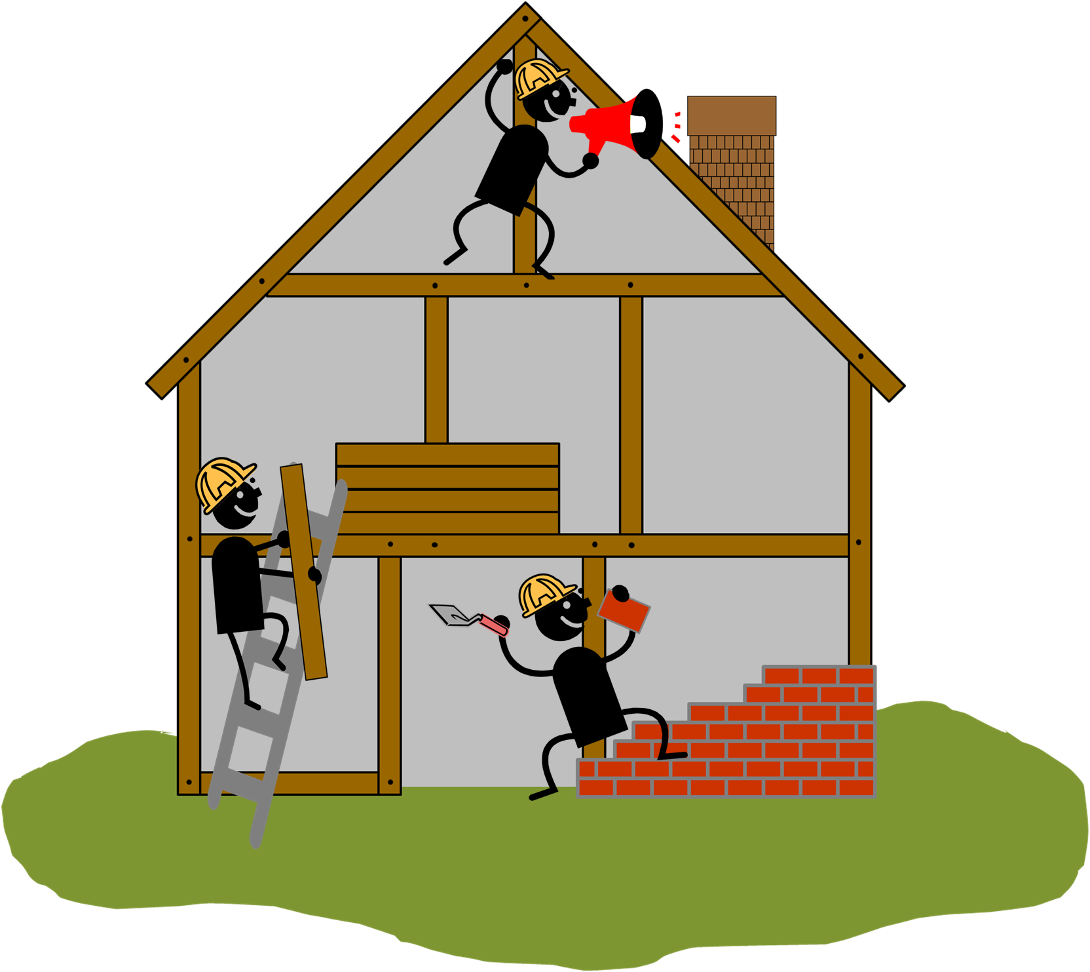
Notes:
Student Slide: EXPLORE
INSTRUCTIONS:
Show and describe construction site analogy:
We have been talking about genetics, proteins and phenotypes. But now I want everyone to take a moment to look at this image.
The image shows three different construction workers building a house. The worker with the megaphone is calling out directions to the other two workers, a name for his job is foreman. The worker on the ladder is stacking boards on the second floor. The worker with the brick and trowel is building the brick wall. And you can see the frame of the house is built out of boards.
These workers and the materials they are using will all end up determining what the house looks like.
We are going to use this house and the workers as an analogy for how proteins change a cell’s phenotype.
Each of the workers and materials in the image has a different job, similarly, different proteins have different jobs in the cell, we call these jobs functions.
Ask: How is a construction site is like a cell?
Students discuss at tables and then share out to the class
ESR: Cells have to be built, cells have things which make them, cells have “workers” in them with different jobs
SLIDE GOAL:
- Provide students with an image of a construction site and all its components to look at as the analogy is explained.
PICTURE/ GRAPHICS CREDITS:
- Construction site: Modified Microsoft Office 2007 clipart

Slide 18
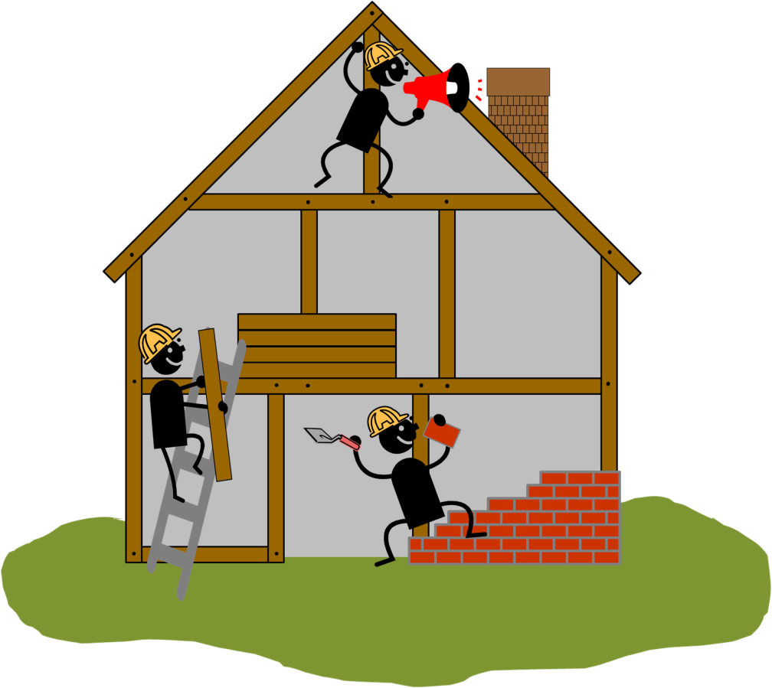
  Protein that determines the cell shape
  Protein that transports the cell’s building blocks
  Protein that builds the cell wall
  Protein that starts and stops processes
  A cell
Notes:
Student Slide: EXPLORE
INSTRUCTIONS:
Show and review the different protein functions which match the workers/ materials jobs at the construction site.
A-E are different types of proteins with different functions that can be found in a cell.
Today you guys are going to match these different protein descriptions with the worker or materials which they are similar to at this house’s construction site.
Hand out sets of cut out images and their matching proteins.
Pull up “1. Cellular construction zone matching-flipchart.flipchart” (or just bring up following slide if you do not have flipchart)
Have students match images with their descriptions in pairs.
Walk around and point out when a match is wrong (do not tell them correct answer)
Have students come up to the board and use flipchart to match, eventually coming to a consensus as a class.
Have students record the consensus in their notebooks.
Students can draw lines between images and functions provided in “1. Cellular construction zone-notebook.docx “or match letters and numbers
SLIDE GOAL:
- Provide students with a reference for what the entire construction site looks like as they are introduced to the different proteins/ protein functions they will need to match to its different workers/ materials.
PICTURE/ GRAPHICS CREDITS:
- Construction site: Modified Microsoft Office 2007 clipart

Slide 19


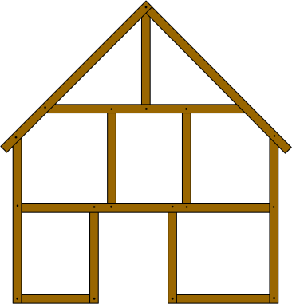

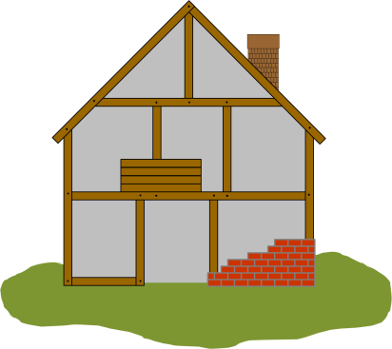
  Protein that determines the cell shape
  Protein that transports the cell’s building blocks
  Protein that builds the cell wall
  Protein that starts and stops processes
  A cell
1
2
3
5
4
Notes:
Teacher Slide: EXPLORE
NOTES:
This is an alternative slide to put up while students are working on the matching activity if flipchart is unavailable.
Students can record matches in notebooks using letters and numbers provided or by drawing lines between images and descriptors.
SLIDE GOAL:
- Provide students with larger versions of the elements they are matching at their tables.
PICTURE/ GRAPHICS CREDITS:
- Construction workers: Modified Microsoft Office 2007 clipart

Slide 20
3
A. Protein that determines the cell shape
D. Protein that starts and stops processes
5
B. Protein that transports the cell’s building blocks
2
E. A cell
4
C. Protein that builds the cell wall
1
Notes:
Teacher Slide: EXPLORE
NOTES:
This is the matching key for the activity and can be used to double check student matches.
Letter/ Number matches.
A, 3
B, 5
C, 1
D, 2
E, 4
PICTURE/ GRAPHICS CREDITS:
- Construction workers: Modified Microsoft Office 2007 clipart

Slide 21
Vocabulary:
Protein: Compounds made by organisms that are involved in almost every aspect of what happens in living organisms.
Function: What something does, or its job.
Notes:
Student Slide: EXPLORE
INSTRUCTIONS:
Have students enter these vocabulary words into their notebooks.
SLIDE GOAL:
- Give students a chance to write down key vocabulary from the lesson.
NOTES:
- It might be necessary to point out that you have been using the word function throughout the lesson. But its important for students to write it down in case they forget what it means in the future.

Slide 22
Explain Overview
Analysis questions, to be discussed at tables and recorded in notebooks
  What would happen to the building if the workers did their jobs differently?
  What is an example of a way a worker would change what they were doing?
  How would this change the way the building looked?
  How does a construction site represent a cell with proteins?
  What causes a mutant to look different?
Notes:
Teacher slide: EXPLAIN
NOTES:
This slide can be used as a quick reference for the Evaluate analysis questions. More details will be provided in the comments for each slide.
Each analysis question should be discussed at the student’s table or in pairs but each student should be sure to write down their own answer.
It may be helpful to provide a specific amount of time for students to discuss (1-2 min) and then switch to time devoted to the students writing down their own answers (1-3 min).
Possible examples and talking points to discuss with students or classes that get stuck are given on each slide.
EVALUATE GOAL:
- Give students the opportunity to synthesize what they have learned through writing and creative thinking. This also provides an opportunity for evaluation of student comprehension on the teacher’s part.
OVERVIEW:
- Students are asked to discuss analysis questions, share them with the class and record their final answers in their notebooks.
What would happen to the building if the workers did their jobs differently?
ESR: The house would look different, the house wouldn’t get built, the house would look better or worse
What is an example of a way a worker would change what they were doing?
ESR: The house would look different, the house wouldn’t get built, the house would look better or worse
How would this change the way the building looked?
ESR: They could start or stop, they could do something wrong
How does a construction site represent a cell with proteins?
ESR: Different jobs at a construction site are like different jobs proteins have in a cell, cells are built by proteins like construction workers build a house, multiple proteins (like workers and materials) come together to create a final product (building or cell), proteins determine the way a cell look the same way that construction workers determine the way a house looks
What causes a mutant to look different?
ESR: Proteins, changed/ abnormal DNA, mutations, genetics, disease, chemicals
Assign homework.
Students re-visit initial hypotheses and re-write using new evidence if they were incorrect.

Slide 23

What would happen to the building if the workers did their jobs differently?
?
?
Notes:
Student Slide: EXPLAIN
INSTRUCTIONS:
Ask: What would happen to the building if the workers did their jobs differently?
Students discuss at tables and share out when called on.
Students then record answers in notebooks.
ESR: The house would look different, the house wouldn’t get built, the house would look better or worse
If students are stuck have them move on to the next question and come back to this one, an example may help them better visualize the impacts of workers doing their jobs differently.
SLIDE GOAL:
Get students to think about what the affect on the final product would be if workers “i.e. proteins” did their jobs differently.
Later we will talk about mutant proteins so it is good to get them to start thinking about how if a protein isn’t working correctly, or is working differently the final project “i.e. phenotype” will change.
PICTURE/ GRAPHICS CREDITS:
- Construction site: Modified Microsoft Office 2007 clipart

Slide 24
What is an example of a way a worker would change what they were doing?
?
?
Notes:
Student Slide: EXPLAIN
INSTRUCTIONS:
Ask: What is an example of a way a worker would change what they were doing?
Students discuss at tables and share out when called on.
Students then record answers in notebooks.
ESR: They could start or stop, they could do something wrong
Encourage students to get creative! Here are a few fun questions that might get them thinking:
Ask these questions to the entire class or specific groups that need help:
What if the worker transporting the materials started bringing different materials like hay or steel or even string cheese or marbles?
What if the worker building the wall started using frosting or Elmers glue to hold the bricks together instead of mortar?
What if the frame were shaped differently? Or made of a different material like rubber?
What if the foreman (worker with the megaphone) told the other workers to only build the cell walls and not transport the materials or only transport the materials and not build the cell wall?
SLIDE GOAL:
- To get students to start thinking about the different way a worker “i.e. protein” might be able to change their job. They could start doing something differently (like a whole new job), start doing their job incorrectly or less efficiently, or they could stop doing their job all together!
PICTURE/ GRAPHICS CREDITS:
- Construction site: Modified Microsoft Office 2007 clipart

Slide 25
How would this change the way the building looked?
?
?
Notes:
Student Slide: EXPLAIN
INSTRUCTIONS:
Ask: What is an example of a way a worker would change what they were doing?
Students discuss at tables and share out when called on.
Students then record answers in notebooks.
ESR: Will vary with answer to pervious question, hopefully some interesting, extreme change
SLIDE GOAL:
Finally this question should hopefully lead the students to thinking how these changing jobs could specifically change the outcome/ phenotype.
PICTURE/ GRAPHICS CREDITS:
- Construction site: Modified Microsoft Office 2007 clipart

Slide 26
How does a construction site represent a cell with proteins?
?
?
Notes:
Student slide: EXPLAIN
INSTRUCTIONS:
Hand out small whiteboards to each student
Ask: How does a construction site represent a cell with proteins?
Give students time to write their answer on their personal whiteboard
Instruct students to share their answer with the person sitting next to them, the students must then collaborate to create a single answer between the two of them
Finally have pairs share their answers at their tables, collaborating to create one final answer
Allow each table to share their answer with the class
Give each student time to write down the answer they like best in their notebooks
ESR: Different jobs at a construction site are like different jobs proteins have in a cell, cells are built by proteins like construction workers build a house, multiple proteins (like workers and materials) come together to create a final product (building or cell), proteins determine the way a cell look the same way that construction workers determine the way a house looks
SLIDE GOAL:
Have students understand the analogy and why it made sense to describe a cell with various proteins using it.
NOTES:
- Use the next slide if students need sentence starters/ fill in.

Slide 27
How does a construction site represent a cell with proteins?
The worker who builds the walls on the house is like a ---------- that builds ---------- in the cell.
The frame of the house is like the ---------- of the cell.
Notes:
Student slide: EXPLAIN (Optional)
INSTRUCTIONS:
Bring up this slide if students need a sentence starter with more concrete examples to answer the question.
SLIDE GOAL:
Help give students a framework with more direct examples to answer the questions.

Slide 28
What causes a mutant to look different?
Notes:
Student Slide: EXPLAIN
INSTRUCTIONS:
Bridge between discussion of proteins impact on phenotype and mutants.
We started this lesson by talking about mutants and looked at these pictures. Then I asked you what do these pictures have in common?
Using the new information you have learned about how proteins impact phenotype have any of your answers changed?
Give students a moment to discuss at tables.
Allow students to share out to class.
ESR: They all have proteins, they are all animals, they all have cells
Well one thing these pictures all have in common is that they are all mutants or have something to do with mutation.
These are albino rats, that’s why they are white with red eyes. They don’t have pigments like normal rats to, this is considered a mutation and makes these rats mutants.
Similarly this lobster is blue, most lobsters are red or orange, there has been some mutation in this lobster changing its color.
this funny spiral, represents DNA and the yellow bar in the DNA represents a change in the DNA that’s not normal, normally that bar should be blue.
We are going to keep talking about mutants later this week but right now I want you guys to think about this question….
Ask: What causes a mutant to look different?
Students discuss at tables and share out.
ESR: Proteins, changed/ abnormal DNA, mutations, genetics, disease, chemicals
Assign homework:
Students go back to original 3 hypotheses they came up with at the beginning of the lesson. Are these hypotheses right? If not create new hypotheses using evidence learned in class and evidence recorded in notebooks. Students record new answers in notebook under initial questions.
SLIDE GOAL:
To keep students thinking about mutations and what they will be learning about next.
PICTURE/ GRAPHICS CREDITS:
- Lobster Image: Blue American Lobster by Steven G. Johnson- GFDL and CC-by-SA, http://en.wikipedia.org/wiki/File:Blue-lobster.jpg
- Albino Mouse Image: Laboratory Mice by Aaron Logan- CC, http://en.wikipedia.org/wiki/File:Lightmatter-lab-mice.jpg
- Modified DNA: Modified Microsoft clipart 2007

