Slide 1
Mutation Unit:
From Gene to Protein
Using models to look at genes as instruction for proteins
Notes:
Teacher Slide:
Authors: Sarah Lerch and Felicia Ryder
WHY :
Students often get a cursory overview of how genes and phenotype are related in their middle school science courses, but this often glazes over the processes which link genes and phenotype. This lesson will provide students with a deeper level of understanding concerning these processes by exploring the relationship between proteins (learned about in lesson 1: A Cellular Construction Zone) and genes. Understanding these processes will be essential as students continue to look at mutation throughout this unit. The concepts learned in this lesson will provide students with a framework which they can insert future knowledge into as they learn about more details about this relationship in high school courses.
This lesson is the second in a series of four looking at mutation. This lesson will introduce students to the basic way which genes and proteins are related to one another: through the pattern of base pairs on the gene itself. The cell has machinery which can read this pattern and can construct proteins from its instructions.
SUMMARY:
The lesson will begin by reviewing what students know and placing the question they will by hypothesizing about in context. After hypothesizing students will write down concrete things they know about genes and proteins before beginning the Protein Making activity. This activity will use paper snowflakes as a proxy for proteins, students will create their own “proteins” from a set of instructions on a “gene”. This gene will then be “mutated” by the teacher and the students will make an abnormal “protein” from these instructions. This activity should cement the idea that genes contain a genetic code which determines the structure of proteins, if this code is altered through mutation than the protein structure will change. This will then lead into the Protein to Phenotype activity where students can apply these concepts to specific proteins in a system. Finally the unit will end with analysis questions, solidifying all the concepts learned in the unit.
Unit learning goal: Students understand that the pattern of base pairs in a gene determines the structure of the protein which the gene codes for.
Key Question:
What is the relationship between genes and proteins?
Overview of the unit:
Engage
Goal: To highlight gaps of knowledge for students concerning the relationships of genes, proteins and phenotype and create interest in filling in those gaps.
Remind students of the connections they understand between genes, proteins and phenotype.
What is it that actually creates the different phenotypes?
Create connection between previously learned concepts and the upcoming lesson focusing on how genes determine proteins jobs, which then go on to determine phenotype.
Facilitate students recording hypotheses about the following question:
What is the relationship between genes and proteins?
Explore
Goal: Students understand that the pattern of base pairs in a gene determines the structure of the protein which the gene codes for.
Students record current knowledge about genes and proteins in notebooks.
Making proteins activity:
Students will use a key to read the instructions provided in the “base pair” patterns within their “genes”. These instructions will show them what cuts to make on their “protein templates” (snowflake templates) to create that “gene’s” unique “protein”(snowflakes).
The pattern of “base pairs” in the “gene” will then be changed, or mutated, by the teacher. Students will then make the unique “proteins” which go with this mutant gene.
Explain
Goal: Give students a chance to synthesize their ideas and the concepts they have learned from the lesson.
Protein to Phenotype activity
Four different protein examples with charts will be given, each on a different slide. This chart will provide space for students to determine the functions and ultimate phenotype of a normal and abnormal proteins.
This activity will be completed through a combination of class collaboration and individual work with personal versions of charts in notebooks.
Analysis questions, to be completed in notebooks
What determines a protein’s structure?
What happens to a protein if gene instruction change?
What causes a change in a protein’s function?
If a protein’s structure changes that will affect its-----.
How are genes used as instructions to make proteins?
Homework
Students go back to original hypothesis they came up with at the beginning of the lesson. Students record new answers in notebook under initial question.
PICTURE/ GRAPHICS CREDITS:
- Cited on each slide.
WEBSITES/ RESOURCES USED IN THIS PRESENTATION:
Science Education for Public Understanding Program, UC Berkeley. Science & Life Issues. Ronkonkoma: Lab Aids, 2001.
ADDITIONAL READING:
http://en.wikipedia.org/wiki/Base-pair
http://www.atascientific.com.au/blog/2010/10/15/uncovering-relationship-genes-proteins/
http://en.wikipedia.org/wiki/Central-dogma-of-molecular-biology (General transfers of biological sequential information)
http://www.ncbi.nlm.nih.gov/Class/MLACourse/Modules/MolBioReview/central-dogma.html (good visual)
http://www.accessexcellence.org/RC/VL/GG/central.php
http://www.dnalc.org/resources/3d/central-dogma.html (good video, but VERY detailed)
http://en.wikipedia.org/wiki/Translation-(biology)
Any high school level biology textbook would also be a good reference
CONTEXT FOR USE:
7TH grade life science
Second lesson in four lesson unit on genetic mutation
The Cellular Construction Zone
From Gene to Protein
Causes of Mutation
Modeling Mutants
EVALUATION TIPS:
Evaluation techniques used in this activity: Gauging class discussions, notebooks
Refer to 5E lesson plan, 2. From gene to protein-5E.docx
TEACHING NOTES:
ESR will be used as an acronym for Expected Student Response.
Each slide will have “Teacher slide:” or “Student slide:” at the top of the presentation notes. This indicates whether or not the slide should be used by the teacher (teacher slide) or shown to the students (student slide). Teacher slides can be hidden when presenting using the “Hide Slide” option.
Students will be required to record ideas and analysis in notebooks throughout the unit, a template for the student notebooks is provided in 2. From gene to protein-notebook.docx
Underlined text indicates a place where students should record something in their notebooks
Notebooks will always be divided into 4 sections: Questions, hypotheses, evidence and analysis.
This set up allows students to hypothesize about the questions looked at in the unit, gather evidence, analyze that evidence and compare their final answers to the problems to their original hypotheses.
VOCABULARY:
Previously introduced :
Protein: Compounds made by organisms that are involved in almost every aspect of what happens in living organisms.
Function: What something does, or its job.
MATERIALS PROVIDED:
2. From gene to protein-5E.docx
2. From gene to protein-activity instructions.docx
2. From gene to protein-activity key.docx
2. From gene to protein-flipchart.flipchart
2. From gene to protein.ppt
2. From gene to protein-notebook.docx
2. From gene to protein-notebook-key.docx
MATERIALS:
Required
Scissors (1 per pair of students)
Construction paper: Black, yellow, red, blue
White printer paper (1 piece for student)
Optional
Promethean interactive whiteboard and associated software
Colorful chalk/ whiteboard pens

Slide 2
Engage overview
Connect back to previous lesson using Skye and Poppy slide
  Remind students of relationship between proteins and phenotype
  Ask: What is it that actually creates the different phenotypes?
Hypothesizing:
  What’s the relationship between genes and proteins?
Notes:
Teacher Slide: ENGAGE
INSTRUCTIONS:
- This slide can be used as a quick reference for the ENGAGE section. More details will be provided in the comments for each slide.
ENGAGE GOAL:
To highlight gaps of knowledge for students concerning the relationships of genes, proteins and phenotype and create interest in filling in those gaps.
OVERVIEW:
Remind students of the connections they understand between genes, proteins and phenotype.
Ask: What is it that actually creates the different phenotypes?
ESR: Proteins, construction workers, things with jobs
- Create connection between previously learned concepts and the upcoming lesson focusing on how genes determine proteins jobs, which then go on to determine phenotype.
- Facilitate students recording hypotheses about the following question:
Ask: What is the relationship between genes and proteins?
ESR: Genes make proteins, genes tell proteins what to make, genes become proteins
NOTES:
PICTURE/ GRAPHICS CREDITS:

Slide 3
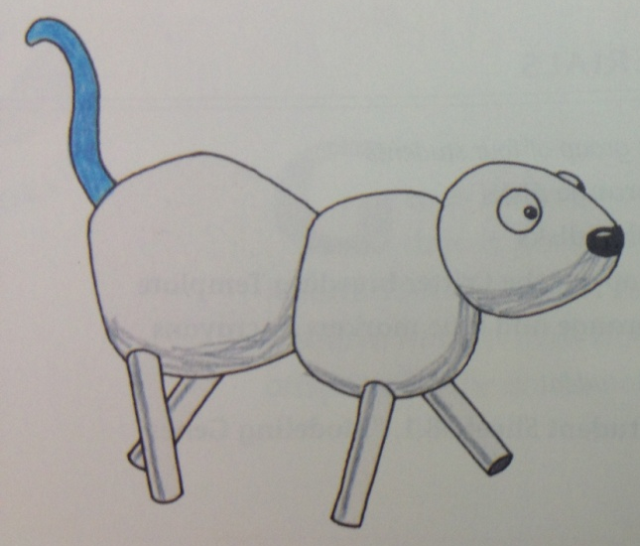

Genes determine phenotype
Tail Color Genes
??
? ? ?
Proteins
Proteins
Notes:
Student slide: ENGAGE
INSTRUCTIONS:
This is an animated slide, each frame will be paired with its description.
Remind students of the connections they understand between genes, proteins and phenotype.
Frame 1: Remember Skye and Poppy? And how they have different tail phenotypes? Skye’s tail is blue while Poppy’s is red.
Frame 2: We know that there are genes that determine their different tail color.
Frame 3: Ask: Think back to the last lesson, what is it that actually creates the different phenotypes?
ESR: Proteins, construction workers, things with jobs
Frame 4:Proteins that determine tail color in Skye and Poppy do their jobs a little differently, resulting in Skye’s blue tails and Poppy’s red tail.
Create connection between previously learned concepts and the upcoming lesson focusing on how genes determine proteins jobs, which then go on to determine phenotype.
Frame 5: But we never talked about how genes determine the job of their proteins did we?
For this lesson we are going to talk about how genes tell proteins what to do, resulting in different phenotypes.
SLIDE GOAL:
Connect students previous knowledge about genes and proteins with what they will be learning in the upcoming lesson.
NOTES:
PICTURE/ GRAPHOCS CREDITS:
Skye and Poppy images: Science Education for Public Understanding Program, UC Berkeley. Science & Life Issues. Ronkonkoma: Lab Aids, 2001.

Slide 4
Hypothesize
Tail Color Genes
Proteins
? ? ?
Proteins
What is the relationship between genes and proteins?
Notes:
Student slide: ENGAGE
INSTRUCTIONS:
- Facilitate students recording hypotheses about the following question:
Ask: What is the relationship between genes and proteins?
Allow students to discuss in groups and then write down hypotheses individually
Students should record hypotheses in notebooks
ESR: Genes make proteins, genes tell proteins what to make, genes become proteins
SLIDE GOAL:
Give students the opportunity to establish what they currently know and their misconceptions about the relationship between genes and proteins.
NOTES:
Students will later refer back to this hypothesis after the lesson is done, this will help to emphasize all that they have learned.
PICTURE/ GRAPHICS CREDITS:
- Skye and Poppy: Skye and poppy book

Slide 5
Explore overview
Review prior knowledge
  What do you know about genes?
  What do you know about proteins?
Making proteins activity
  Students make “proteins” (snowflakes) from “genetic code
    Students create both normal and abnormal proteins
Notes:
Teacher Slide: EXPLORE
INSTRUCTIONS:
- This slide can be used as a quick reference for the explore section. More details will be provided in the comments for each slide.
EXPLORE GOAL:
- Students understand that the pattern of base pairs in a gene determines the structure of the protein which the gene codes for.
OVERVIEW:
Students record current knowledge about genes and proteins in notebooks.
- Students use spaces provided in notebooks to write down what they know about genes.
ESR: Genes are made of DNA, genes are what determine phenotype, genes make tail colors, genes are made of base pairs, genes determine traits
- Students use spaces provided in notebooks to write down what they know about proteins.
ESR: Proteins are compounds made by organisms, proteins are involved in almost everything that happens in living organisms, proteins are involved in determining phenotype, proteins have different jobs in the cell
Making proteins activity
Students explore how structural changes in a protein would change its function and impact on phenotype using fill in charts.
NOTES:
PICTURE/ GRAPHICS CREDITS:

Slide 6
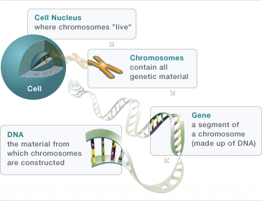
What do you know about genes?
Notes:
Student slide: EXPLORE
INSTRUCTIONS:
Allow students to record previous knowledge about genes.
Ask: What do you know about genes?
Have students consider what they know about genes, it may be helpful for them to look back at their “Cellular construction zone” notebook notes, specifically those taken from the Brainpop video.
Students may also discuss in groups if necessary
ESR: Genes are made of DNA, genes are what determine phenotype, genes make tail colors, genes are made of base pairs, genes determine traits
SLIDE GOAL:
Give students a chance to think about what they have learned about genes previous lessons (Cellular construction zone and other genetics lessons).
NOTES:
PICTURE/ GRAPHICS CREDITS:
Cell and DNA relationship image: Modified cell and DNA relationship image: Genzyme Corporation, a Sanofi company. “Understanding Genetics." Pompe Community . 28 August 2013. <http://www.pompe.com/patients/inheriting-pompe/genetics.aspx>
Skye and Poppy images: Science Education for Public Understanding Program, UC Berkeley. Science & Life Issues. Ronkonkoma: Lab Aids, 2001.

Slide 7



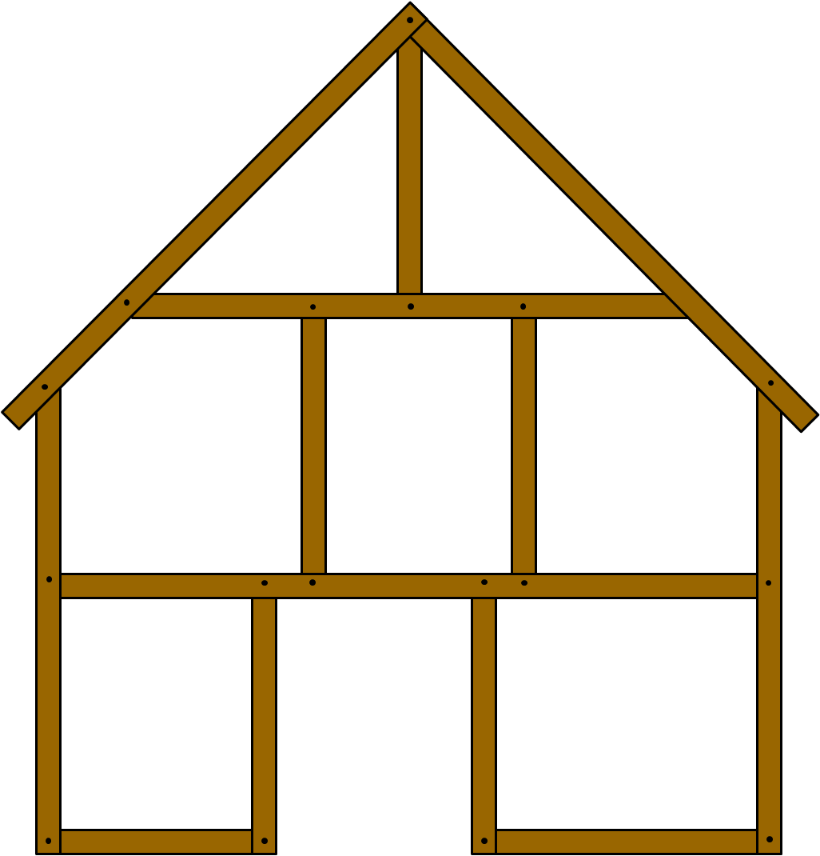
What do you know about proteins?
Notes:
Student slide: EXPLORE
INSTRUCTIONS:
Allow students to record previous knowledge about genes.
Ask: What do you know about proteins?
Have students consider what they know about proteins, they should draw information from what they have recorded in their “Cellular construction zone” notebook.
Students may also discuss in groups if necessary
ESR: Proteins are compounds made by organisms, proteins are involved in almost everything that happens in living organisms, proteins are involved in determining phenotype, proteins have different jobs in the cell
SLIDE GOAL:
Refresh students on what they learned about proteins in the previous Cellular construction zone lesson.
NOTES:
PICTURE/ GRAPHICS CREDITS:
- Construction workers: Modified Microsoft Office 2007 clipart

Slide 8
Proteins and their jobs
?
Transports the building blocks too slowly
?
The protein that transports the cell’s building blocks
Transports the wrong building blocks
Notes:
Student slide: EXPLORE
INSTRUCTIONS:
This is an animated slide, each frame will be paired with its description.
Give students an example of how a protein might change what they are doing.
We have talked about how different proteins have different jobs in the cell.
Frame 1: Like the protein this worker represented for example, this protein is responsible for transporting the building blocks to make the cell.
Frame 2: We also talked a little bit about what might happen if a protein did it’s job differently, like if this cell did its job too slowly…..
Frame 3: ….or transported the wrong building blocks.
Frame 4: The cell would probably be affected right?
- Start introduction to this lessons activity
It’s important that proteins be the right shape in order for them to do their jobs right, the same way this worker needs arms and ladder to transport the cells building blocks correctly. The protein’s structure and its function are directly linked.
Today we are going to talk about how genes determine what proteins do and their shapes and how sometimes that process can get messed up, resulting in proteins of different shapes that do their original jobs differently.
SLIDE GOAL:
Give students a connection between the last lesson and the activity they are about to do.
NOTES:
PICTURE/ GRAPHICS CREDITS:
- Construction worker: Modified Microsoft Office 2007 clipart

Slide 9
Making proteins activity overview
Activity: Students use the pattern of “base pairs” in a “gene” to create normal and abnormal “proteins”
  Paper snowflakes are used to represent proteins
Goal: Provide students with a concrete, physical example of how changing the instructions within a gene can change the structure of a protein.
Materials:
  “Genes” for each pair of students (teacher created)
  Two “protein templates” for each pair of students (teacher created)
  Activity instructions for each student (2. From gene to protein-activity instructions.docx)
  Scissors for each pair of students
Notes:
Teacher Slide: EXPLORE
INSTRUCTIONS:
- This slide can be used as a quick reference for the making proteins activity. More details will be provided in the comments for each slide.
ACTIVITY GOAL:
Provide students with a concrete, physical example of how changing the instructions within a gene can change the structure of a protein.
OVERVIEW:
Explanation:
Students will use a key to read the instructions provided in the “base pair” patterns within their “genes”. These instructions will show them what cuts to make on their “protein templates” (snowflake templates) to create that “gene’s” unique “protein”(snowflakes).
The pattern of “base pairs” in the “gene” will then be changed, or mutated, by the teacher. Students will then make the unique “proteins” which go with this mutant gene.
Students will complete activity in pairs
Four different “gene” options are provided in the lesson, giving a variety of “proteins” across pairs in the classroom.
Activity and protocol are explained to students
Each student is given a set of activity instructions. Each pair of students is given a “gene” and two “protein templates” as well as scissors.
Students then use the key provided on slide #13 to interpret the code in their genes, making the noted cuts, to create their “proteins”.
Proteins are then labeled Normal
Teacher then changes the base pair pattern of each gene using the template provided on slide #10.
Students now use key to interpret new instructions, making their second “protein”.
Proteins are then labeled abnormal
NOTES:
This lesson and activity will only focus on one piece of the relationship between genes and proteins, the fact that the pattern of base pairs determines the protein’s structure. Below is a general reading about base pairs that might be helpful:
http://en.wikipedia.org/wiki/Base-pair
- There are many other parts of this relationship and more details about their mechanisms than will be addressed in this lesson. The central dogma of biology is that DNA is transcribed into mRNA (messenger RNA) which is then captured by a ribosome and translated into a protein. This is a complex process involving many cellular components which students will learn about later as high school students. If you wish to familiarize yourself more with this more detailed process please refer to the readings below:
http://www.atascientific.com.au/blog/2010/10/15/uncovering-relationship-genes-proteins/
http://en.wikipedia.org/wiki/Central-dogma (General transfers of biological sequential information)
http://www.ncbi.nlm.nih.gov/Class/MLACourse/Modules/MolBioReview/central-dogma.html (good visual)
http://www.accessexcellence.org/RC/VL/GG/central.php
http://www.dnalc.org/resources/3d/central-dogma.html (good video, but VERY detailed)
http://en.wikipedia.org/wiki/Translation-(biology)
Any high school level biology textbook would also be a good reference
Possible activity expansion: Students will be making normal and abnormal proteins dictated by the teacher in this activity. It might be fun to allow students to come up with their own mutations, which will likely cause overlapping cuts and make the proteins fall apart. Sending home the message that if a protein is made incorrectly it might completely fail at its function since its structure would be so wrong.
MATERIALS:
Two “protein templates” for each pair of students (Supplies: white printer paper)
These are really just snowflake templates
You will need a single piece of white printer paper for each template
Here are instructions for making the templates: http://www.kinderart.com/seasons/snowflake9.shtml
Give yourself plenty of time to make these, it takes a while
A “gene” for each pair of students (Supplies: paper clips, black, yellow, green, red and blue construction paper)
Each “gene” is composed of a black strip of paper with colored rectangles (representing base pairs) either glued or paper clipped
The next slide has templates for each gene, base pairs with stars on them should be paper clipped on as they will either need to be removed or switched out when the gene is “mutated”
The base pairs that need to be changed also have letters on them to indicate their colors so that this sheet can be printed in black and white and still be used as a key by the teacher (Y=Yellow, B= Blue, R= Red, G=Green)
Label each gene A, B, C, or D
Copies of activity instructions for each student ( “2. From gene to protein-activity instructions”)
Scissors, one per pair of students
PICTURE/ GRAPHICS CREDITS:

Slide 10
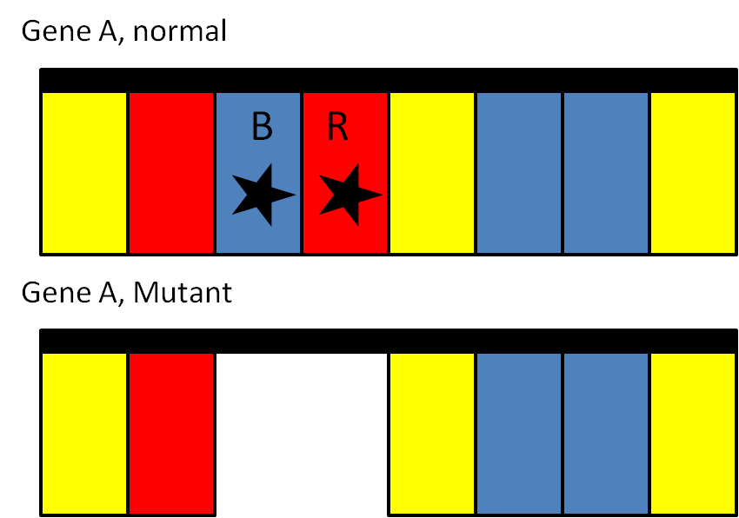
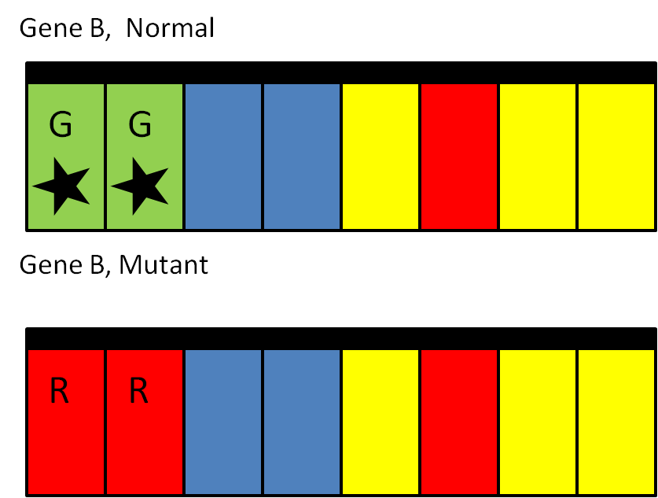
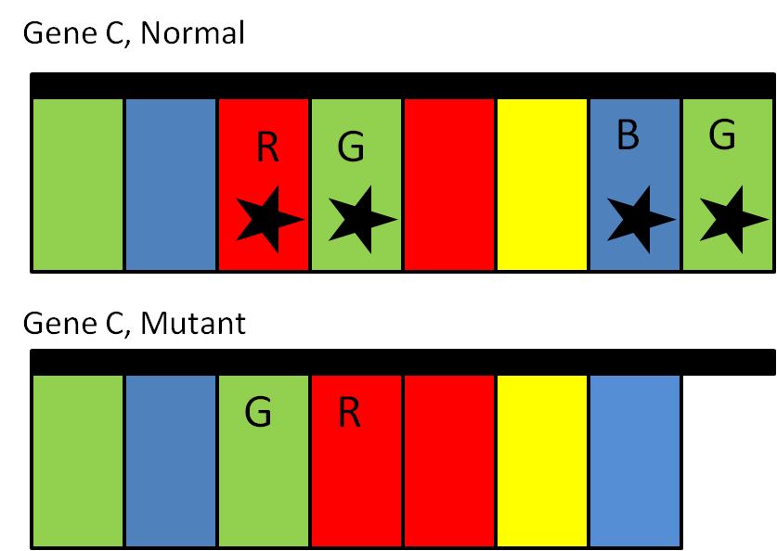
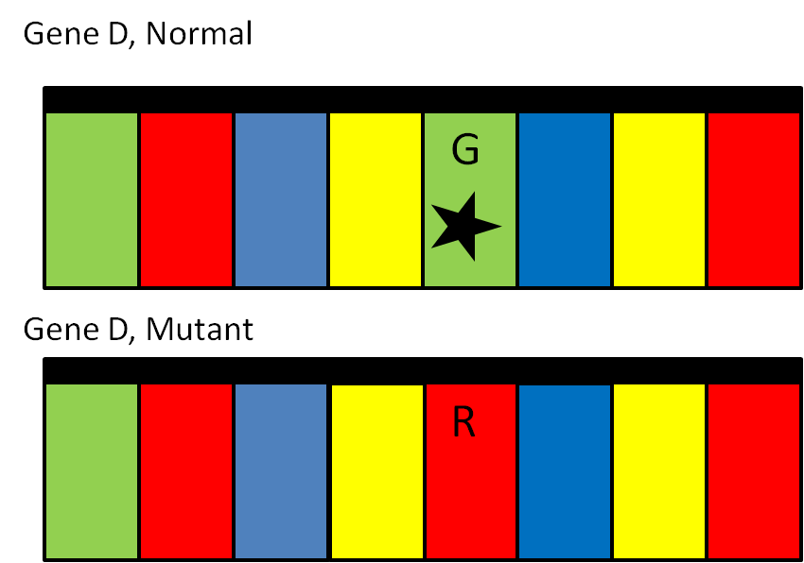
Gene templates
Gene A, Normal
Gene B, Normal
Gene A, Abnormal
Gene B, Abnormal
Gene C, Normal
Gene D, Normal
Gene C, Abnormal
Gene D, Abnormal
Notes:
Teacher Slide: EXPLORE
INSTRUCTIONS:
- Use this slide as a template to create normal genes and to make changes to those genes, making them abnormal.
Supplies to create “genes”: paper clips, black, yellow, green, red and blue construction paper.
Each “gene” is composed of a black strip of paper with colored rectangles (representing base pairs) either glued or paper clipped.
The next slide has templates for each gene, base pairs with stars on them should be paper clipped on as they will either need to be removed or switched out when the gene is “mutated”.
The base pairs that need to be changed also have letters on them to indicate their colors so that this sheet can be printed in black and white and still be used as a key by the teacher (Y=Yellow, B= Blue, R= Red, G=Green).
Label each gene A, B, C, or D.
SLIDE GOAL:
- Provide teacher with a template for creating and changing “genes” used in the activity.
NOTES:
Four separate genes are given so that there can be some variety of “protein” structures between pairs in the classroom.
PICTURE/ GRAPHICS CREDITS:

Slide 11
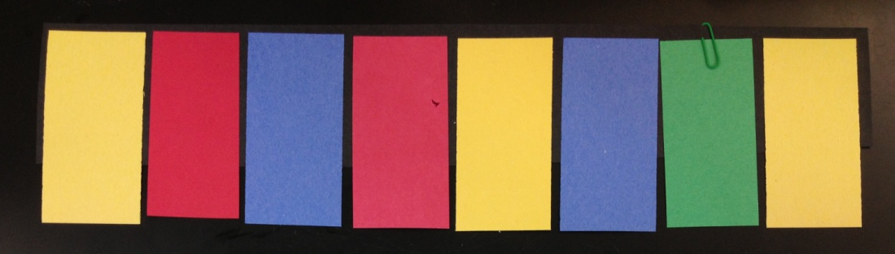
Genes and their instructions
Base pairs
Code with instructions
Protein
Notes:
Student slide: EXPLORE
INSTRUCTIONS:
This is an animated slide, each frame will be paired with its description.
Explain that genes contain base pairs in specific patterns, these patterns determine the protein’s shape which affects how well it can do its job.
Frame 1: This is a picture of a “gene” which we are going to use in this lesson’s activity.
Ask: Can anyone tell me what a gene is made of?
ESR: DNA, base pairs
Ask: If a gene is made of DNA does anyone know what these different colored rectangles represent?
Frame 3: ESR: Base pairs, don’t know
Frame 4: The base pairs on a gene create a specific pattern, or a code.
Frame 5:This code holds instructions on how to make a protein that looks and works a certain way.
Connect this information to the activity.
Today you guys are going to act like cells, reading the code in the gene and making proteins from its instructions.
SLIDE GOAL:
Make sure students have a clear understanding of the genetic basis of the activity they are about to do.
NOTES:
The fact that genes are made of DNA containing base pairs in a specific pattern is something the students have previously learned, this was touched on in the Brainpop video from the Cellular construction zone lesson. The hope is that this lesson serves as a reminder.
PICTURE/ GRAPHICS CREDITS:
- Construction worker: Modified Microsoft Office 2007 clipart

Slide 12
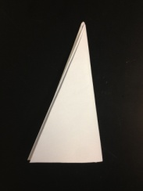
Activity instructions: Making proteins
Cut a shallow oval out of the folded edge
Look at the pair of base pairs on the left side of your gene
Find the matching pair on the key
Read the instructions next to it
Cut the blue shape in the picture out of your protein template
Move on to next base pair and repeat
When ALL cuts have been made label with:
Name
Notes:
Student slide: EXPLORE
INSTRUCTIONS:
This is an animated slide, each frame will be paired with its description.
Print out a copy of “2. From gene to protein-activity instructions” for each student
Hand out a “gene” and “protein template” to each pair of students
Frame 1: Walk students through the instructions for the activity
Frame 2:Take your genes and look at the first pair of bases, read the gene left to right .
Frame 3: In this example gene the first pair is yellow and red.
Frame 4: I will put a key up on the board you can use to interpret the code, you just need to find your pair and next to it will be a description of how to cut your protein template.
Frame 5: With each description will be an image showing you where to cut, cut out the blue section shown in the image from your protein template.
Frame 6: Move on to the next pair in your gene and make the cuts for that, repeat this with all four pairs.
Frame 7: Once you’ve finished write both partner names and the word “Normal” on the protein.
It might be helpful to write this step on the board
After you have completed all 6 steps unfold your proteins and take a look!
- Hand out printed “2. From gene to protein-activity instructions”
SLIDE GOAL:
Provide students with instructions for the making proteins activity.
NOTES:
- Each sheet has 18 separate instructions.
PICTURE/ GRAPHICS CREDITS:
Images taken and created by Sarah Lerch

Slide 13
Cut 2 half circles out of the bottom edge
Cut 2 half ovals out of the open edge
Cut a medium triangle out of the open edge
Make a curved cut at tip
Cut a shallow oval out of the folded edge
Cut 3 small triangles out of the open edge
Cut a long rectangle out of the open edge
Cut a triangle out of the bottom edge
Cut 2 small rectangles out of the bottom edge
Make a straight cut at tip
Make an angled cut at tip
Make a straight cut out of the open corner
Cut half an oval out of the folded edge
Cut a half circle out of the bottom edge
Cut 2 rectangles out of the open edge
Notes:
Student slide: EXPLORE
INSTRUCTIONS:
Leave this slide up while students make their proteins.
Print the “Gene template” slide to use as a key for “mutating” student genes.
Once students have finished making their first set of proteins “mutate” their proteins.
Remove the base pairs completely that have a gap in that space in the “abnormal”.
Swap out the base pairs for different ones when the color in that space changes.
- Give students time to create abnormal proteins.
SLIDE GOAL:
To provide students with a key for de-coding the base pair instructions for creating their proteins.
NOTES:
An important point to make clear to the students is the two different sides of the “protein template.” One side can open and the other side is closed, like a book where the pages edge is the open one and the spine is the closed edge. In the images of protein templates above the open edge is on the left and the closed edge is on the right.
While changing the “base pair” patterns on the “genes” let students know that you are mutating the genes. Although this will be discussed more in depth in the next lesson, this will provide students with a link to previous discussions about mutant organisms.
PICTURE/ GRAPHICS CREDITS:
- All images taken and created by Sarah Lerch

Slide 14
Explain overview
Protein to phenotype activity
  Students explore how structural changes in a protein would change its function and impact on phenotype using fill in charts.
Analysis questions to be discussed at tables and recorded in notebooks
  What determines a protein’s structure?
  What happens to a protein if gene instruction change?
  What causes a change in a protein’s function?
  If a protein’s structure changes that will affect its-----.
  How are genes used as instructions to make proteins?
Notes:
Teacher Slide: EXPLAIN
INSTRUCTIONS:
- This slide can be used as a quick reference for the Explain section. More details will be provided in the comments for each slide.
GOAL:
- Give students a chance to synthesize their ideas and the concepts they have learned from the lesson.
EXPLAIN OVERVIEW:
Protein to Phenotype activity
Explanation:
Four different protein examples with charts will be given, each on a different slide. This chart will provide space for students to determine the functions and ultimate phenotype of a normal and abnormal proteins.
A space is provided for the students to fill in the functions for the normal and abnormal proteins.
In proteins 1-3 the normal phenotype is given. The abnormal phenotype must be filled in by the student. For protein 4 the phenotypes must be filled in for both proteins.
The phenotypes will all be in reference to a single cell.
- This activity will be completed through a combination of class collaboration and individual work with personal versions of charts in notebooks.
Analysis questions
What determines a protein’s structure
ESR: The pattern of base pairs, the genetic code, genes
What happens to a protein if gene instruction change?
ESR: It looks different, its structure changes, it doesn’t work correctly, its function changes
What causes a change in a protein’s function?
ESR: A change in the genetic code on its gene, a change in its structure.
If a protein’s structure changes that will affect its-----.
ESR: Function, job, what it does, how well it works
How are genes used as instructions to make proteins?
ESR: Patterns of base pairs tell it what shape to be, there is a code in its pattern of base pairs
NOTES:
PICTURE/ GRAPHICS CREDITS:

Slide 15
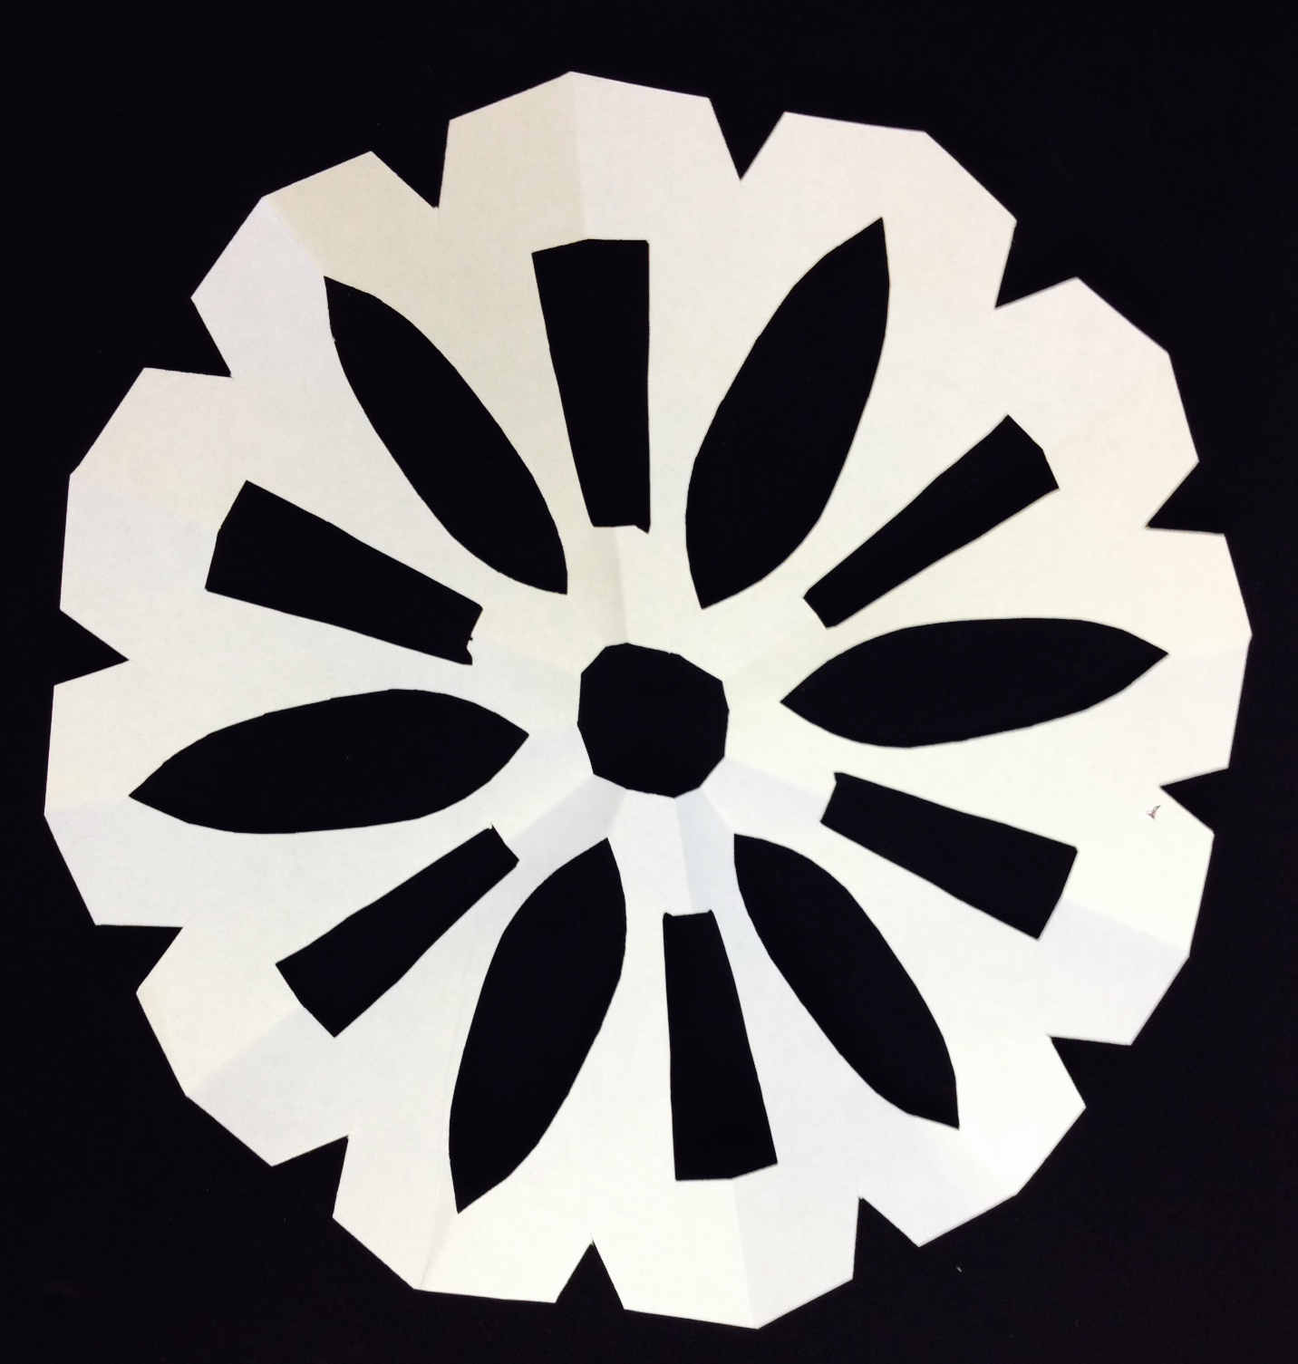

Compare your proteins, do they look different?
List the differences in your two proteins in your notebook
Notes:
Student slide: EXPLAIN
INSTRUCTIONS:
Have students lay their “proteins” side by side and compare the differences between the normal and mutant versions.
Students should identify all the specific differences between their proteins.
Ex: For the two proteins above there are three differences:
The left “protein” has more triangles cut out around the edges
The left “protein” has two separate rectangles cut out where the one on the right has a single long rectangle
The left “protein” has a solid center, the right “protein” has a hole in the center.
Students must then write down these differences in their notebooks
SLIDE GOAL:
Give students a chance to think about the specific differences between their two “proteins”, providing identifiable evidence that there are structural differences between their normal and mutant proteins.
NOTES:
Students will notice that there are differences between their “proteins” that have nothing to do with the genetic code and are due to differences in the students cutting techniques, or possibly differences in how well their protein templates are folded.
This is a great time to introduce a concept the students will learn about in the next unit. One way mutations can occur is through changes in the genetic code (as they saw when their genes were mutated). Another way mutations can occur is through mistakes made by the cell, in this instance they are analogous to the cell reading the genetic code and creating proteins. Sometimes the cell can mess up as its making these proteins, even if the genetic code is correct. The next unit will focus on causes of mutations and they will learn more about this.
PICTURE/ GRAPHICS CREDITS:
- All images taken and created by Sarah Lerch

Slide 16
Protein to Phenotype overview
Activity: Students explore how structural changes in a protein would change its function and impact on phenotype using fill in charts.
Four proteins from previous lesson will be explored:
Frame/ Protein that determines cell shape
Builds the brick wall/ Protein that builds the cell wall
Foreman/ Protein that stops and starts processes
Transports materials/ Protein that transports the cell’s building blocks
Notes:
Teacher Slide: EXPLAIN
INSTRUCTIONS:
- This slide can be used as a quick reference for the Protein to Phenotype activity. More details will be provided in the comments for each slide.
ACTIVITY GOAL:
- Give students an opportunity to create connections between protein structure, function and cell phenotype through writing and drawing.
ACTIVITY OVERVIEW:
Explanation:
Four different protein examples with charts will be given, each on a different slide. This chart will provide space for students to determine the functions and ultimate phenotype of a normal and abnormal proteins.
A space is provided for the students to fill in the functions for the normal and abnormal proteins.
In proteins 1-3 the normal phenotype is given. The abnormal phenotype must be filled in by the student. For protein 4 the phenotypes must be filled in for both proteins.
The phenotypes will all be in reference to a single cell.
This activity can be done two ways: With flipchart or with powerpoint, both ways are outlined below
In either version students should be provided with colored pencils/ markers
Flipchart (recommended)
Open the “2. From gene to protein-flipchart.flipchart” file
Each protein/ chart allows students to discuss the protein’s normal and abnormal functions and the phenotypes that these functions result in.
Students share ideas for functions, one is written in on the board by the teacher.
Students then come up to the board and draw in phenotypes when applicable.
Once information has been filled in on the promethean board, students enter information in their notebooks.
Powerpoint
Board should be set up with space for students to draw the phenotypes for each protein. There should be space to write the normal and abnormal functions below these as well.
Protein #1, a blank space
Protein #2, a blank circle
Protein #3, a blank circle
Protein #4, two blank spaces labeled normal and abnormal
Each protein/ chart allows students to discuss the protein’s normal and abnormal functions and the phenotypes that these functions result in.
Students share ideas for functions and one is written on the board.
Students then come up to the board and draw phenotype(s) that go with this function when applicable.
- Once information has been written/ drawn on the board, students enter information in their notebooks.
MATERIALS:
Optional:
Markers/ colored pencils
2. From gene to protein-flipchart.flipchart (version 1)
Colored whiteboard markers/ chalk (version 2)
NOTES:
PICTURE/ GRAPHICS CREDITS:

Slide 17
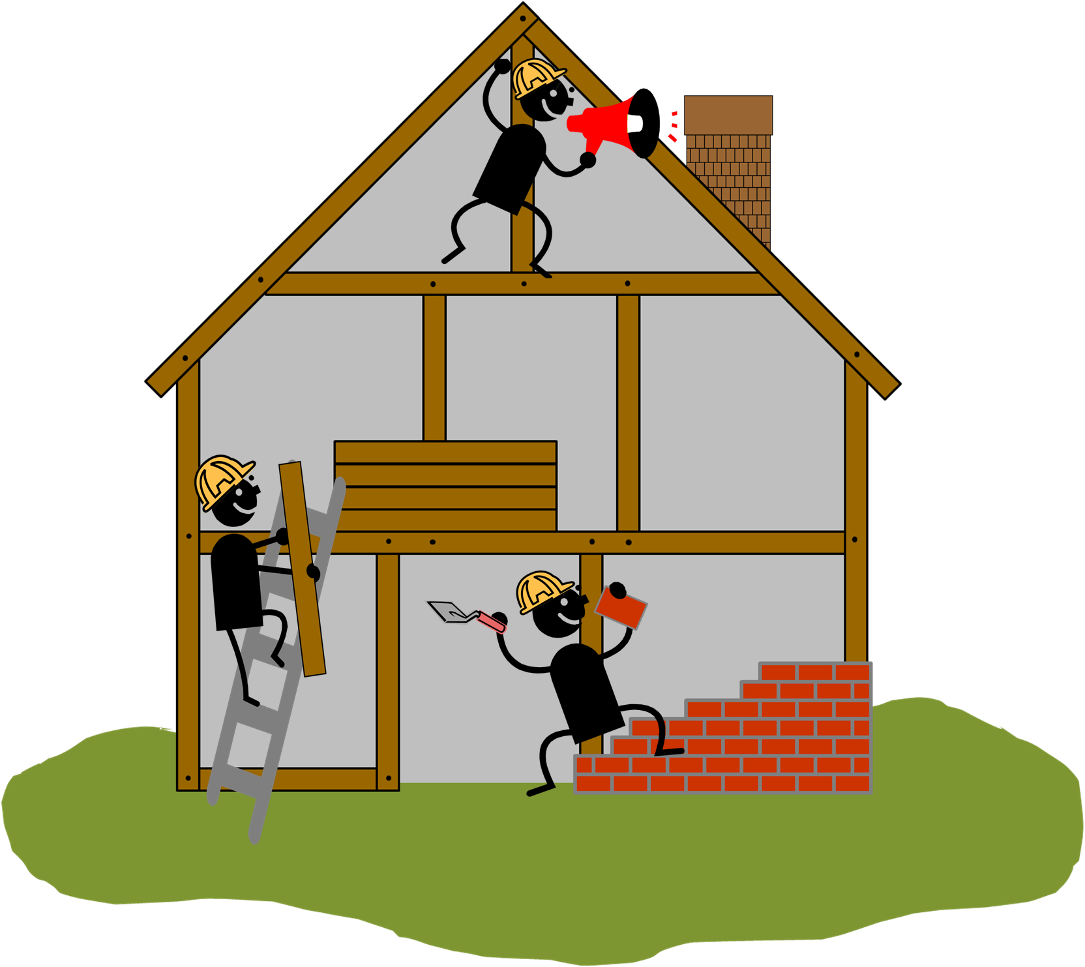
Consider how changes in proteins might change the cells they are in…
Complete the Protein to Phenotype activities in your notebook
Notes:
Student slide: EXPLAIN
INSTRUCTIONS:
This is an animated slide, each frame will be paired with its description.
Connect current activity back to the Cellular Construction Zone learned about in the last lesson.
Frame 1: You have all determined that the proteins generated from the mutated genetic code are different than the proteins generated from the normal genetic code.
Frame 2: Keeping that information in mind, think back to the construction workers and materials at the construction site we learned about in the last unit.
Frame 3:The next activity will give you the opportunity to think about these different protein’s jobs or functions, and ways they might change if the protein’s structure changes.
SLIDE GOAL:
Provide students with a chance to connect their new information about how protein structures can change to the examples they used to learn about protein functions.
NOTES:
PICTURE/ GRAPHICS CREDITS:
- Construction workers: Modified Microsoft Office 2007 clipart

Slide 18
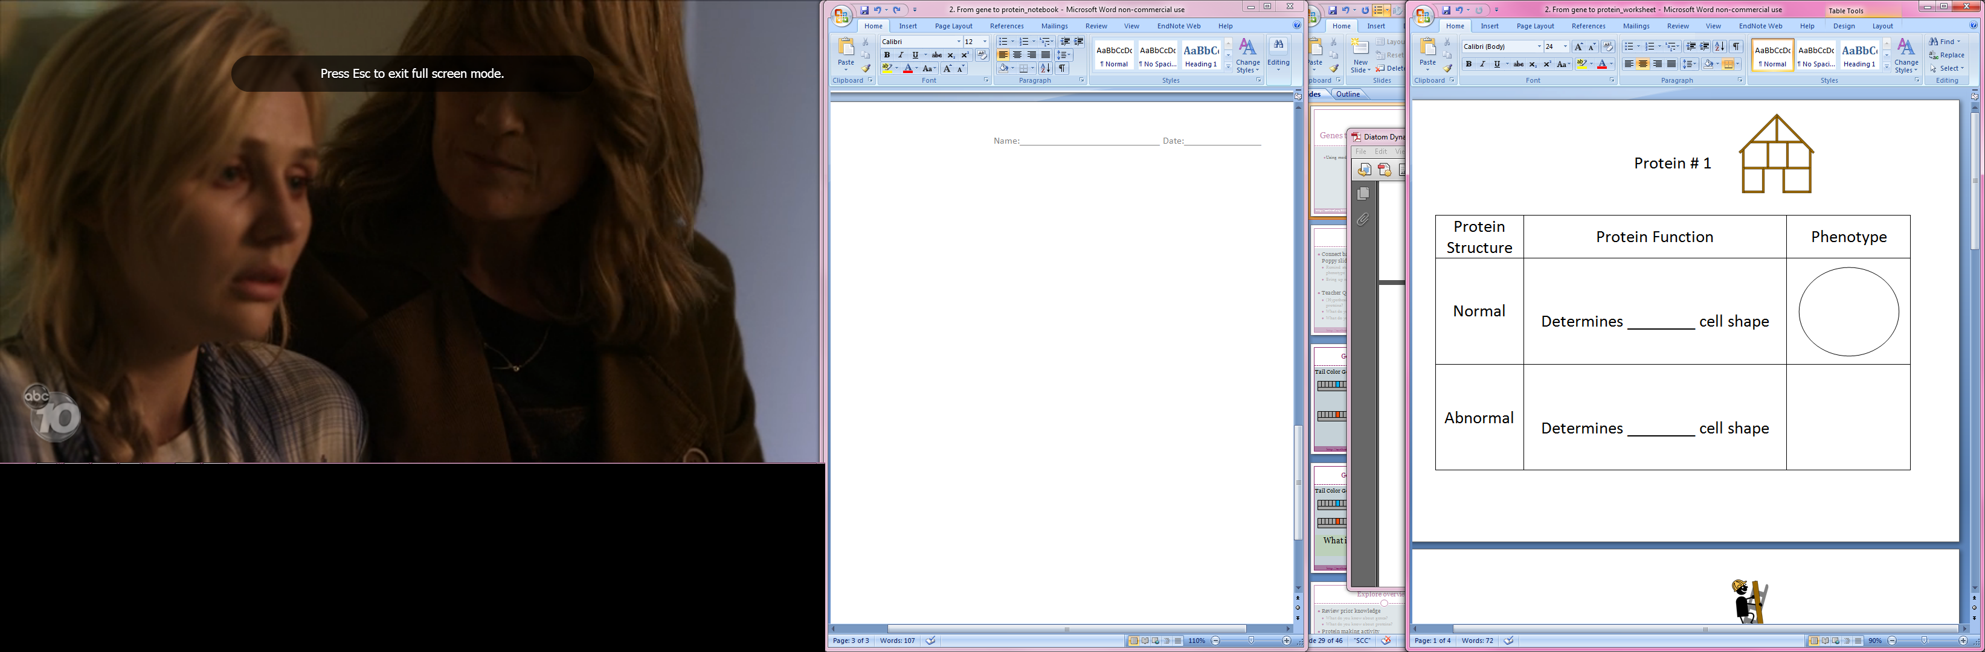
Notes:
Student slide: EXPLAIN
INSTRUCTIONS:
For teachers using the flipchart version of this activity this slide can be skipped although the instructions provided below can be used for the flipchart version as well.
Orient students to slide
For this activity we are going to be looking at each of the proteins we learned about in the last lesson.
For each section there will be an image of the part of the construction site which represented that protein in the lesson, here we are starting with the frame of the building and the protein that represented.
There are three columns. One for the protein structure, which can be normal or abnormal. One for protein function, there are spaces to fill in for the functions of the normal and abnormal proteins here. And a final one for the phenotypes of the normal and abnormal proteins. This chart is going to give us a chance to compare the functions and phenotypes of a protein when its structure changes.
It’s important to remember that structure and function are connected for proteins.
Prompt students to remember protein’s original function.
Ask: What is this protein’s job?
Allows students to refer back to their notebooks for this if necessary.
ESR: Determines the cell shape, makes the cell shape, holds the cell up
Ask for students to share, confirm it determines the cell’s shape (the slide should give them a strong enough hint that it’s not necessary to allow for discussion).
Guide students to fill in the Normal Protein Function blank.
For the normal protein you have been given the normal phenotype for the cell (indicate the circle).
The description of this phenotype must go into the blank under Protein Function.
Ask: What goes in the blank under Protein Function for the Normal protein?
ESR: Round, circle
Allows students to share out, write response on the board (into blank itself if using flipchart or on the board if using powerpoint).
Give students time to enter this response into notebooks (response shouldn’t deviate too much from ESRs).
Guide students to fill in Abnormal Protein Function blank and Phenotype.
Now this the time everyone should get creative.
Ask: What might the Protein Function for the abnormal protein be?
ESR: A different shape (square, triangle etc.)
Give students time to discuss in groups.
Allow multiple students to share out, write first response on the board (into blank itself if using flipchart or on the board if using powerpoint).
Give students time to enter their response into their notebooks. This response does not need to be the same as the one written on the board.
Some students may not need the fill in the blank answer, if a student wants to create their own answer that doesn’t fit with that sentence or expected ESRs that’s great.
Ask: What would your abnormal protein’s function do to the cell’s phenotype? Draw that phenotype in the box provided.
ESR: Drawings of shapes provided in the Protein Function column.
Allow a single student to come up to the board and draw the phenotype that would correspond with the already written change in function.
Give students time to draw their phenotypes into their notebooks. This response does not need to be the same as the one written on the board.
SLIDE GOAL:
- Give students a tool which enables them to create connections between protein structure, function and cell phenotype through writing and drawing.
NOTES:
The same amount of detail will be provided in the instructions for each of the Protein to Phenotype charts. For some classes this level of guidance and detail may not be necessary, some classes may not even need to go over each example together. This can be modified as needed for any classroom, the essential part is that students fill in the charts in their notebooks.
PICTURE/ GRAPHICS CREDITS:
- Frame: Modified Microsoft Office 2007 clipart

Slide 19
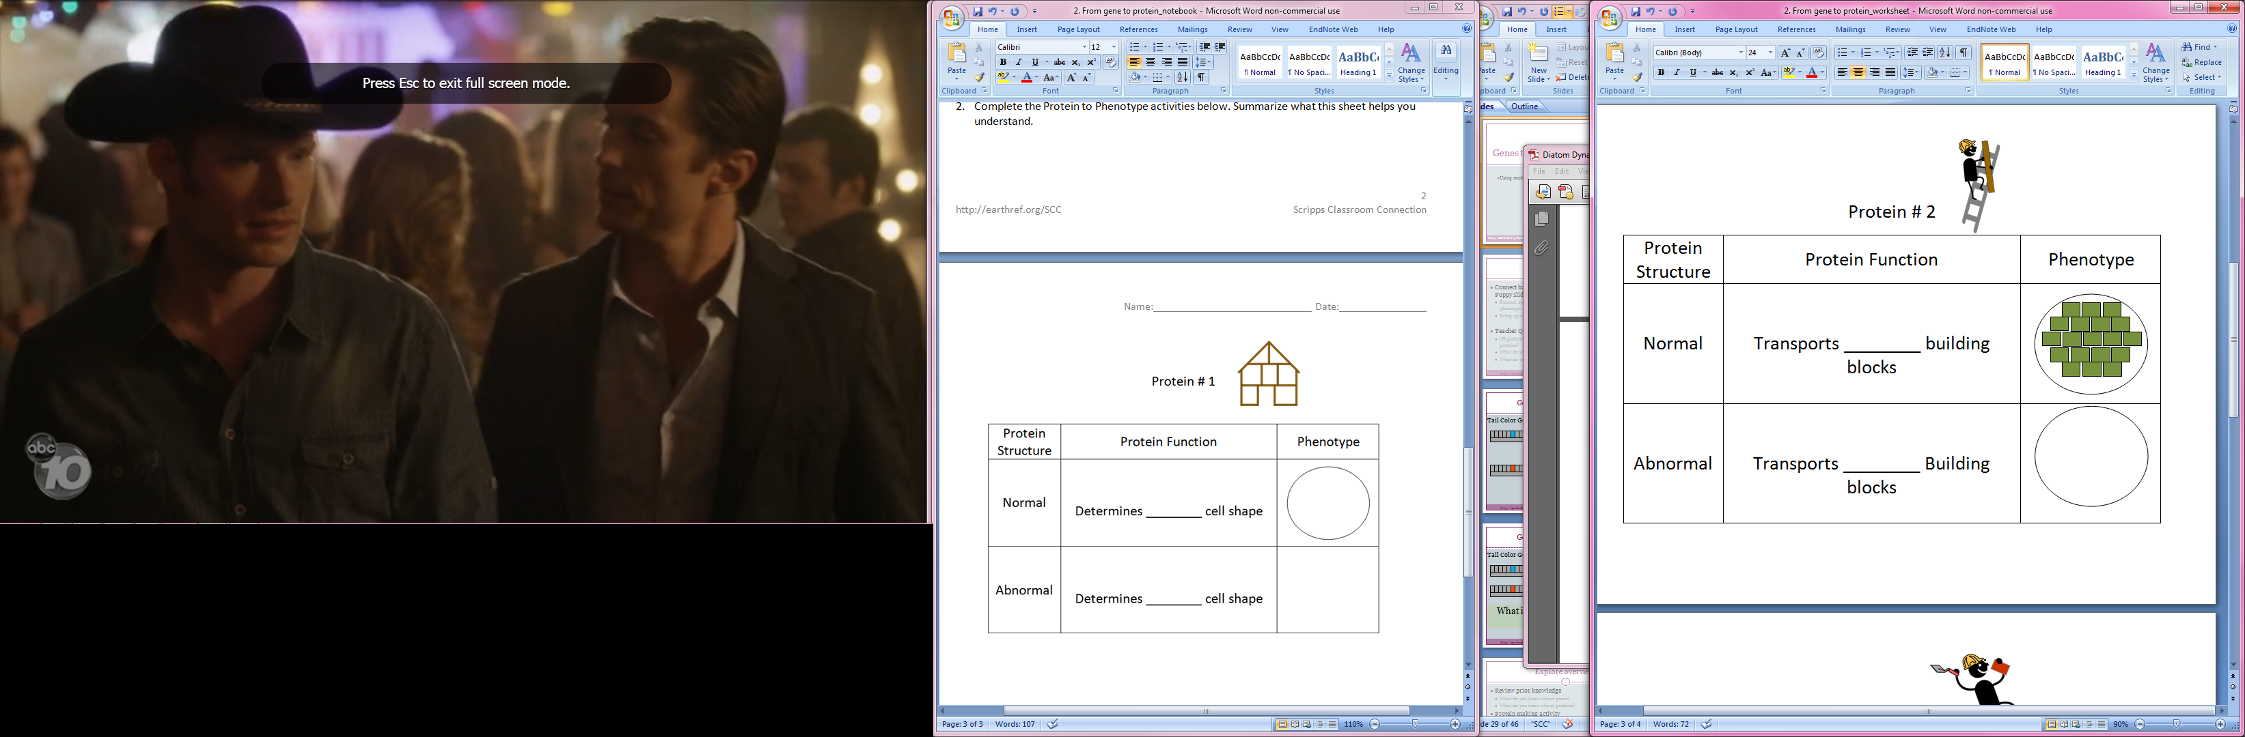
Notes:
Student slide: EXPLAIN
INSTRUCTIONS:
For teachers using the flipchart version of this activity this slide can be skipped although the instructions provided below can be used for the flipchart version as well.
Prompt students to remember protein’s original function.
Ask: What is this protein’s job?
Allows students to refer back to their notebooks for this if necessary.
ESR: Transports the cell’s building blocks, moves the building blocks for the cell
Ask for students to share, confirm it transports building blocks for the cell (the slide should give them a strong enough hint that it’s not necessary to allow for discussion).
Guide students to fill in the Normal Protein Function blank.
For the normal protein you have been given the normal phenotype for the cell. You can see that the cell’s shape is still round like before but now it is covered by these shapes.
The description of this phenotype must go into the blank under Protein Function.
Ask: What goes in the blank under Protein Function for the Normal protein?
ESR: Green rectangles, green squares, green shapes, squares, rectangles
Allows students to share out, write response on the board (into blank itself if using flipchart or on the board if using powerpoint). During this process encourage students to think about both the color AND the shape of the building blocks.
Give students time to enter this response into notebooks (response shouldn’t deviate too much from ESRs).
Guide students to fill in Abnormal Protein Function blank and Phenotype.
Now this the time everyone should get creative.
Ask: What might the Protein Function for the abnormal protein be?
ESR: A different shape (square, triangle etc.), a different color, a different shape and color
Give students time to discuss in groups.
Allow multiple students to share out, write first response on the board (into blank itself if using flipchart or on the board if using powerpoint). Make sure student responses are specific (students must say what shape and/ or color building blocks the protein transports).
Give students time to enter their response into their notebooks. This response does not need to be the same as the one written on the board.
Some students may not need the fill in the blank answer, if a student wants to create their own answer that doesn’t fit with that sentence or expected ESRs that’s great.
Ask: What would your abnormal protein’s function do to the cell’s phenotype? Draw that phenotype in the box provided.
ESR: Drawings of colored shapes (other than green squares) on cell surface.
Allow a single student to come up to the board and draw the phenotype that would correspond with the already written change in function.
Give students time to draw their phenotypes into their notebooks. This response does not need to be the same as the one written on the board.
SLIDE GOAL:
Give students a tool which enables them to create connections between protein structure, function and cell phenotype through writing and drawing.
NOTES:
PICTURE/ GRAPHICS CREDITS:
- Construction worker: Modified Microsoft Office 2007 clipart

Slide 20
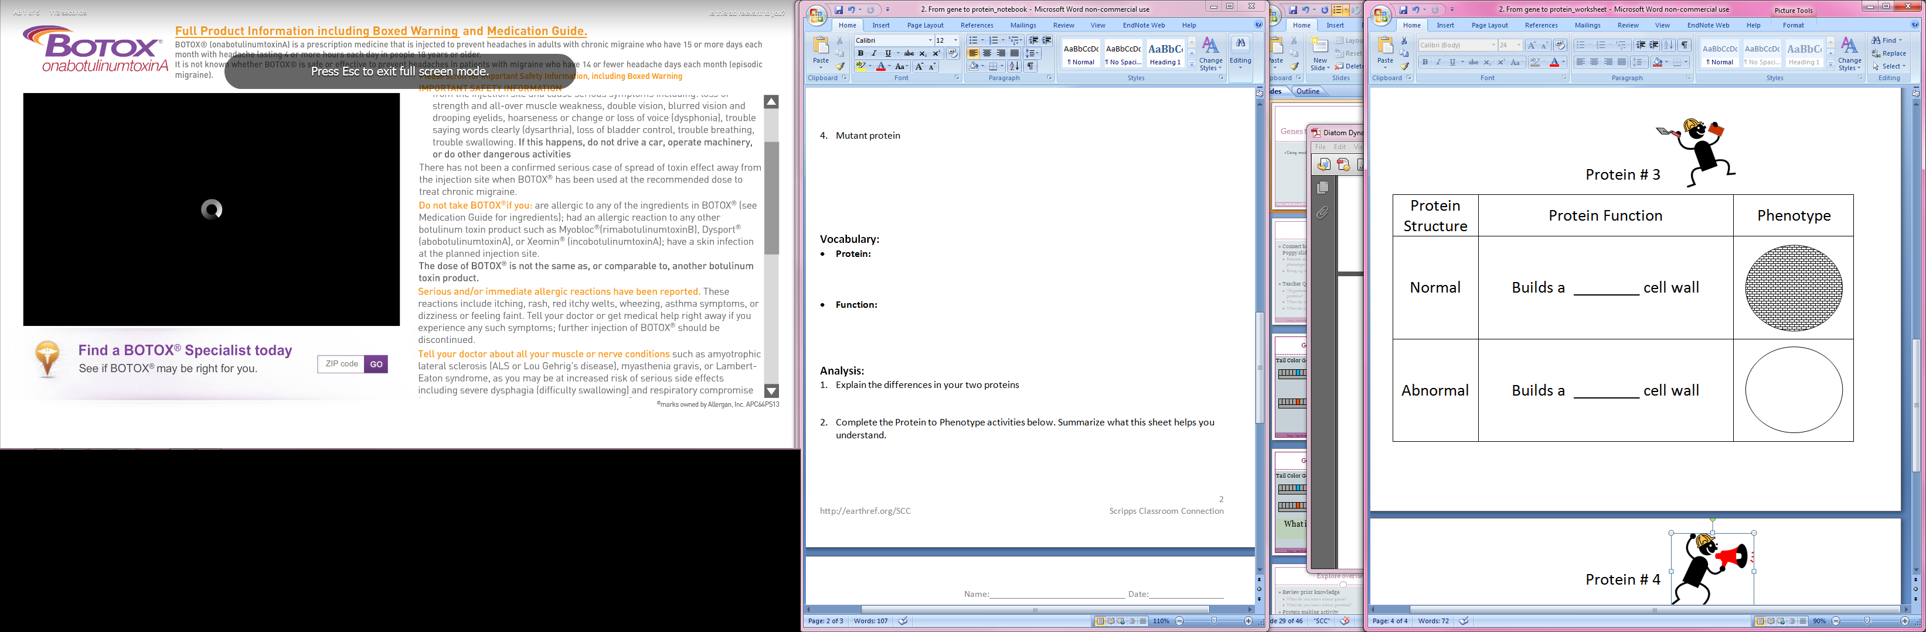
Notes:
Student slide: EXPLAIN
INSTRUCTIONS:
For teachers using the flipchart version of this activity this slide can be skipped although the instructions provided below can be used for the flipchart version as well.
Prompt students to remember protein’s original function.
Ask: What is this protein’s job?
Allows students to refer back to their notebooks for this if necessary.
ESR: Builds the cell wall, makes the cell wall
Ask for students to share, confirm it determines the cell’s shape (the slide should give them a strong enough hint that it’s not necessary to allow for discussion).
Guide students to fill in the Normal Protein Function blank.
For the normal protein you have been given the normal phenotype for the cell. You can see that the cell’s shape is still round but now it’s made of something specific.
The description of this phenotype must go into the blank under Protein Function.
Ask: What goes in the blank under Protein Function for the Normal protein?
ESR: Brick, mesh, tiny rectangles
Allows students to share out, write response on the board (into blank itself if using flipchart or on the board if using powerpoint).
Give students time to enter this response into notebooks (response shouldn’t deviate too much from ESRs).
Guide students to fill in Abnormal Protein Function blank and Phenotype.
Now this the time everyone should get creative.
Ask: What might the Protein Function for the abnormal protein be?
ESR: A different shape (square, triangle etc.)
Give students time to discuss in groups.
Allow multiple students to share out, write first response on the board (into blank itself if using flipchart or on the board if using powerpoint).
Give students time to enter their response into their notebooks. This response does not need to be the same as the one written on the board.
Some students may not need the fill in the blank answer, if a student wants to create their own answer that doesn’t fit with that sentence or expected ESRs that’s great.
Ask: What would your abnormal protein’s function do to the cell’s phenotype? Draw that phenotype in the box provided.
ESR: Drawings of shapes described in the Protein Function column.
Allow a single student to come up to the board and draw the phenotype that would correspond with the already written change in function.
Give students time to draw their phenotypes into their notebooks. This response does not need to be the same as the one written on the board.
SLIDE GOAL:
- Give students a tool which enables them to create connections between protein structure, function and cell phenotype through writing and drawing.
NOTES:
- Give students a tool which enables them to create connections between protein structure, function and cell phenotype through writing and drawing.
PICTURE/ GRAPHICS CREDITS:
- Construction worker: Modified Microsoft Office 2007 clipart

Slide 21
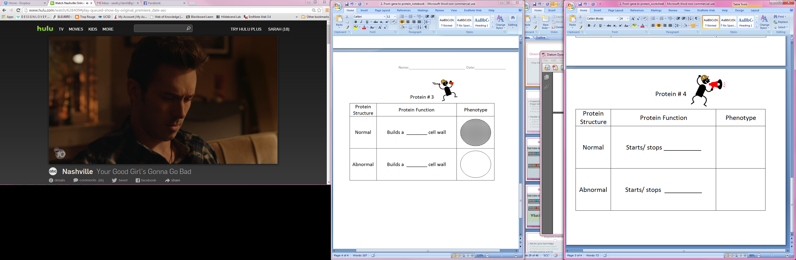
Notes:
Student slide: EXPLAIN
INSTRUCTIONS:
For teachers using the flipchart version of this activity this slide can be skipped although the instructions provided below can be used for the flipchart version as well.
This slide is particularly challenging, skip in lower functioning classes.
Prompt students to remember protein’s original function.
Ask: What is this protein’s job?
Allows students to refer back to their notebooks for this if necessary.
ESR: Starts and stops processes, tells other proteins what to do
Ask for students to share, confirm it determines the cell’s shape (the slide should give them a strong enough hint that it’s not necessary to allow for discussion).
Guide students to fill in the Normal Protein Function blank.
You can see this slide is a little different, you haven’t been given a normal phenotype. This means you need to come up with one on your own.
Ask: What are some possible processes this protein might be starting and stopping?
Allow for students to discuss the above question at their tables.
The description of this phenotype must go into the blank under Protein Function.
Ask: How would you describe the function of your normal protein? Fill this in.
ESR: The building of the cell’s frame, the building of the cell wall, the transport of building blocks, the growth of the cell, the cell being alive
Allows students to share out, write response on the board (into blank itself if using flipchart or on the board if using powerpoint).
Give students time to enter this response into notebooks .
Guide students to draw in their own Normal phenotypes
Ask: What would a cell normally look like when this protein was doing its job?
Have students circle if they want the normal function to start OR stop the process, this will be easier to think about once they reach the abnormal function.
ESR: provided for the three most likely normal functions
Normal function: Starts/ stops the building of the cell’s frame. A circular cell.
Normal function: Starts/ stops the building of the cell wall. A circular cell with a fully built cell wall.
Normal function: Starts/ stops the transport of the cell’s building blocks. A circular cell wall covered with green squares.
Allow students to draw these in the Normal/ Phenotype box
Guide students to fill in Abnormal Protein Function blank and Phenotype.
Ask: What might the Protein Function for the abnormal protein be?
ESR: provided for the three most likely normal functions
Abnormal function: Does not (start/stop) tops the building of the cell’s frame.
Abnormal function: Does not (start/ stop) the building of the cell wall.
Abnormal: Does not (start/ stop) the transport of the cell’s building blocks.
Give students time to discuss in groups.
Allow multiple students to share out, write first response on the board (into blank itself if using flipchart or on the board if using powerpoint).
Give students time to enter their response into their notebooks. This response does not need to be the same as the one written on the board.
Some students may not need the fill in the blank answer, if a student wants to create their own answer that doesn’t fit with that sentence or expected ESRs that’s great.
Ask: What would your abnormal protein’s function do to the cell’s phenotype? Draw that phenotype in the box provided.
ESR: provided for the three most likely normal functions
Abnormal function: Does not (start/stop) tops the building of the cell’s frame. A mis-shapen or shapeless cell.
Abnormal function: Does not (start/ stop) the building of the cell wall. A circular cell with a only partially built or over built cell wall.
Abnormal function: Does not (start/ stop) the transport of the cell’s building blocks. A circular cell wall with no green squares or too many.
Allow a single student to come up to the board and draw the phenotype that would correspond with the already written change in function.
Give students time to draw their phenotypes into their notebooks. This response does not need to be the same as the one written on the board.
SLIDE GOAL:
Give students an opportunity to get more creative in how they think of proteins and their functions in the cell. The fact that this protein can start or stop ANY process means it can impact phenotype in numerous ways. Many students will likely fall back on the proteins/ functions they know but some may be able to be more creative. This should challenge students critical thinking skills.
NOTES:
- This slide is particularly challenging, skip in lower functioning classes.
PICTURE/ GRAPHICS CREDITS:
- Construction worker: Modified Microsoft Office 2007 clipart

Slide 22
What determines a protein’s structure?
Notes:
Student slide: EXPLAIN
INSTRUCTIONS:
Transition into the rest of the analysis section
The Protein to phenotype activity helped us explore how changes in a protein’s structure (from normal to abnormal) result in changes in its function, and the cell’s phenotype.
But what would make a protein’s structure abnormal?
Ask: What determines a protein’s structure?
ESR: The pattern of base pairs, the genetic code, genes
It may be helpful to remind students that a protein’s structure is just what it looks like.
If students just say “genes” prompt them to reach an answer that includes the pattern of base pairs. Possible questions to prompt students with:
If genes are what determines a protein’s structure than how can different genes make different proteins?
What is different about genes that determine the structure of different proteins?
Give students time to discuss in groups and then write down answers in notebooks.
SLIDE GOAL:
Give students an opportunity to write down one of the main concepts learned in this activity.
NOTES:
At this point in the lesson answers to analysis questions may or may not need to be discussed as a class. The lesson is written for students to discuss answers at their tables but this can be adjusted if necessary.
PICTURE/ GRAPHICS CREDITS:
- All images taken and created by Sarah Lerch

Slide 23
What happens to a protein if gene instructions change?
?
Notes:
Student slide: EXPLAIN
INSTRUCTIONS:
Ask: What happens to a protein is gene instructions change?
ESR: It looks different, its structure changes, it doesn’t work correctly, its function changes
If students are stuck prompt them by reminding them of what happened when you “mutated” their genes, changing the arrangement of the base pairs.
Give students time to discuss in groups and then write down answers in notebooks.
SLIDE GOAL:
Flip the previous question in order to be sure students are solid on the concept that genes contain instructions in their base pairs, these instructions determine what the protein looks like/ it’s structure.
NOTES:
At this point in the lesson answers to analysis questions may or may not need to be discussed as a class. The lesson is written for students to discuss answers at their tables but this can be adjusted if necessary.
PICTURE/ GRAPHICS CREDITS:
- All images taken and created by Sarah Lerch

Slide 24

What causes a change in a protein’s function?
? ? ?
? ? ?
? ? ?
Notes:
Student slide: EXPLAIN
INSTRUCTIONS:
Orient students to slide
Here were have our worker who represents a protein that transports building blocks. What if this worker suddenly stopped using a ladder, or started transporting cheese instead of wood, or even just stopped transporting thing all together?
For a real life worker that could just be something they decide to do, but this worker represents a protein so…
Ask: What causes a change in a protein’s function?
ESR: A change in the genetic code on its gene, a change in its structure.
Give students time to discuss in groups and then write down answers in notebooks.
SLIDE GOAL:
This slide should continue to build on the previous two, and hopefully be pretty easy to answer. This should solidify the connection between a protein’s function and its structure and/or the genetic code of it’s gene.
NOTES:
At this point in the lesson answers to analysis questions may or may not need to be discussed as a class. The lesson is written for students to discuss answers at their tables but this can be adjusted if necessary.
PICTURE/ GRAPHICS CREDITS:
- Construction workers: Modified Microsoft Office 2007 clipart

Slide 25
If a protein’s structure changes that will affect its -------------------
Change in structure
Notes:
Student slide: EXPLAIN
INSTRUCTIONS:
Guide student through example
In the last slide it wasn’t easy to understand exactly WHY the worker would have changed what he was doing. But this should provide a better example.
(cue worker) We all know this worker transports things, but if he has a change in his structure (cute arrow) like this… (cue worker without arms) than you can see why he wouldn’t be able to do his job. He has no arms!
Similarly in proteins structure can affect how well they can do their jobs. Keeping that in mind….
Ask: What goes in the blank of this sentence? If a protein’s structure changes that will affect its --------------------.
ESR: Function, job, what it does, how well it works
Give students time to discuss in groups and then write down answers in notebooks.
SLIDE GOAL:
To provide the students with a concrete example of how the actual structure of a worker affects their function. The previous slide should send home this same concept, that structure and function are linked, but this example should clarify it for any students who are struggling.
NOTES:
At this point in the lesson answers to analysis questions may or may not need to be discussed as a class. The lesson is written for students to discuss answers at their tables but this can be adjusted if necessary.
PICTURE/ GRAPHICS CREDITS:
- Construction workers: Modified Microsoft Office 2007 clipart

Slide 26
How are genes used as instructions to make proteins?
Notes:
Student slide: EXPLAIN
INSTRUCTIONS:
Ask: How are genes used as instructions to make proteins?
ESR: Patterns of base pairs tell it what shape to be, there is a code in its pattern of base pairs
Walk students through image who are stuck: This gene makes a certain shape of protein, it does that because every pair of base pairs determined what cut to make, you can see each of the instructions below.
Give students time to discuss in groups and then write down answers in notebooks.
Assign homework:
Students go back to original hypothesis they came up with at the beginning of the lesson. Are these hypotheses right? If not create new hypotheses using evidence learned in class and evidence recorded in notebooks. Students record new answers in notebook under initial question.
SLIDE GOAL:
This question should send home the message for the entire lesson, and address the lesson’s learning goal: Students understand that the pattern of base pairs in a gene determines the structure of the protein which the gene codes for.
NOTES:
At this point in the lesson answers to analysis questions may or may not need to be discussed as a class. The lesson is written for students to discuss answers at their tables but this can be adjusted if necessary.
PICTURE/ GRAPHICS CREDITS:
- All images taken and created by Sarah Lerch

