Slide 1
Mutation Unit:
Causes of mutations
Using articles to explain possible causes of genetic mutation
Notes:
Teacher Slide:
Authors: Sarah Lerch and Felicia Ryder
WHY :
Many people have the misconception that genetic mutations are only caused by outside factors such as chemicals and radiation, this isn’t the case. There are also mutations caused by mistakes during DNA replication and cell division. This lesson will focus on introducing students to the different ways genetic mutations can be caused. This is an important concept for students to understand as they move forward in their education. Natural selection works off of mutations, often times ones which are generated through natural mistakes.
This lesson is the third in a series of four looking at mutation. In this lesson students will learn exactly what genetic mutations are and some of the different ways genetic mutations can be caused, through UV light, human produced carcinogens as well as DNA building mistakes in cells. Students will explore these ideas through reading, discussion and student presentations. In the previous lessons concepts have been centered around single celled organisms, in this lesson students will zoom back out and look at multi-cellular organisms. In the next lesson students will be able to apply these concepts to single celled organisms once again.
SUMMARY:
The lesson will open with some vocabulary and a chance for students to hypothesize about the key question for this lesson: what causes genetic mutations? Students will then watch a video that will introduce them to some of the concepts focused on in the rest of the unit and record vocabulary from that lesson. Students will then read five different articles on ways which genetic mutation can be caused. One table will work together reading a single article. Once the article has been read each group will present main points from the article to the class as a whole, giving time for students to take notes on the articles they did not read. The analysis questions will then give students time to synthesize some of the information they have learned.
Unit learning goal: Students learn what a genetic mutation is and ways which mutations can be caused.
Key Question:
What causes genetic mutations?
Overview of the unit:
Engage
Goal: Connect students back to previous lesson and get them interested in genetic mutations, which we will be discussing for the rest of this unit.
Enter in first vocabulary for this lesson; genetic mutation.
Students hypothesize about what causes genetic mutations.
Discuss in groups and then record hypotheses in notebooks
Brain Pop video on genetic mutation.
After watching the video the class goes through the quiz provided on the Brain Pop website.
Students enter the rest of the vocabulary learned from the movie.
Explore
Goal: Give students an opportunity to explore different ways mutations can be caused through reading, discussion and presentation. Students should end this activity with an understanding of some causes of genetic mutations.
Five articles are provided, each looking at a different cause of mutation.
Article 1- UV Light
Article 2- Smoking
Article 3- Benzene
Article 4- Progeria
Article 5- Ectrodactyly
Students will read articles in groups.
Students then give short presentations to the class covering the following points:
Article subject
The mutation that is caused
The cause of the mutation
The affect of the mutation
An interesting fact they learned
During the presentations other students take notes on the articles they did not read in their notebooks.
Explain
Goal:Give students the opportunity to synthesize what they have learned from their readings and class presentations.
Students record answers to the following analysis questions in notebooks
Have students record three different things that can cause mutation
What common thing occurs in each mutation?
Extend
Goal: Give students the opportunity to synthesize what they have learned from their readings and class presentations.
Students watch Brain Pop video on Antibiotic Resistance
Questioning and class discussion
Why is it important that these single celled bacteria are being influenced by genetic mutations?
Do mutations always negative or deleterious consequences for the organism?
Connect to next lesson
PICTURE/ GRAPHICS CREDITS:
- Cited on each slide.
WEBSITES/ RESOURCES USED IN THIS PRESENTATION:
Science Education for Public Understanding Program, UC Berkeley. Science & Life Issues. Ronkonkoma: Lab Aids, 2001.
ADDITIONAL READING:
Wikipedia article on mutation: http://en.wikipedia.org/wiki/Mutation
More detailed: http://www.nature.com/scitable/topicpage/genetic-mutation-441
CONTEXT FOR USE:
7TH grade life science
Second lesson in four lesson unit on genetic mutation
The Cellular Construction Zone
From Gene to Protein
Causes of Mutation
Modeling Mutants
EVALUATION TIPS:
Evaluation techniques used in this activity: Gauging class discussions, notebooks
Refer to 5E lesson plan, 3. Causes of mutations-5E.docx
TEACHING NOTES:
ESR will be used as an acronym for Expected Student Response.
Each slide will have “Teacher slide:” or “Student slide:” at the top of the presentation notes. This indicates whether or not the slide should be used by the teacher (teacher slide) or shown to the students (student slide). Teacher slides can be hidden when presenting using the “Hide Slide” option.
Students will be required to record ideas and analysis in notebooks throughout the unit, a template for the student notebooks is provided in 3. Causes of mutations-notebook.docx
Underlined text indicates a place where students should record something in their notebooks
Notebooks will always be divided into 4 sections: Questions, hypotheses, evidence and analysis.
This set up allows students to hypothesize about the questions looked at in the unit, gather evidence, analyze that evidence and compare their final answers to the problems to their original hypotheses.
VOCABULARY:
New:
Genetic mutation: Changes in the arrangement of base pairs in the DNA of an organism.
Beneficial mutation: A mutation that has positive effects on an organism.
Deleterious mutation: A mutation that has negative effects on an organism.
Neutral mutation: A mutation that has no effect on an organism.
Previously introduced :
Protein: Compounds made by organisms that are involved in almost every aspect of what happens in living organisms.
Function: What something does, or its job.
MATERIALS PROVIDED:
3. Causes of mutations.pptx
3. Causes of mutations-5E.docx
3. Causes of mutations-notebook.docx
3. Causes of mutations-Article1-UV light.pdf
3. Causes of mutations-Article2-Smoking.pdf
3. Causes of mutations-Article3-Benzene.pdf
3. Causes of mutations-Article4-Progeria.pdf
3. Causes of mutations-Article5-Ectrodactyly.pdf

Slide 2
Engage overview
Vocabulary
  Defining genetic mutation in notebooks
Hypothesizing: What causes genetic mutations?
  Students record answers in notebooks
Brain Pop video on genetic mutation
  Followed by quiz
  Students record 3 main points
Vocabulary
  Students record vocabulary learned from the video
Notes:
Teacher Slide: ENGAGE
INSTRUCTIONS:
- This slide can be used as a quick reference for the ENGAGE section. More details will be provided in the comments for each slide.
ENGAGE GOAL:
Connect students back to previous lesson and get them interested in genetic mutations, which we will be discussing for the rest of this unit.
OVERVIEW:
Enter in first vocabulary for this lesson; genetic mutation.
Students record vocabulary in notebook.
Students hypothesize about what causes genetic mutations.
Discuss in groups and then record hypotheses in notebooks.
Brain Pop video on genetic mutation.
After watching the video the class goes through the quiz provided on the Brain Pop website.
Students record their answers to quiz questions in their notebooks, correcting them when they are wrong.
Students enter the rest of the vocabulary learned from the movie.
Students record vocabulary in notebook.
NOTES:
PICTURE/ GRAPHICS CREDITS:

Slide 3
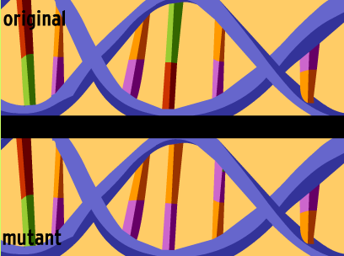
Vocabulary:
Normal
Abnormal/ Mutant
Genetic mutation: Changes in the arrangement of base pairs (nucleotides) in the DNA of an organism.
Notes:
Student Slide: ENGAGE
INSTRUCTIONS:
Connect upcoming lesson to the last lesson
(Cue DNA) Here is an image of two strands of DNA. Just like in the “genes” we used to make proteins in the last lesson, the different colored bars here represent different base pairs. This time we can see the base pairs partners on the other side of the DNA strand though.
You’ll notice that one strand is labeled Normal and the other is labeled Abnormal/ Mutant. (Cue rectangle) You can see that the base pair pattern in this Abnormal/ Mutant strand is different than in the normal strand.
In the last activity I told you guys I was mutating your genes before you made your abnormal proteins, but we didn’t really talk about mutation or how that happens.
In this lesson we will talk more about mutation.
Facilitate students recording vocabulary
Before we write our hypotheses for this lesson record the definition of genetic mutation in your vocabulary. (Cue definition)
Provide students with time to write down definition.
SLIDE GOAL:
To provide students with a concrete definition of genetic mutation before they begin to hypothesize about what might cause it.
NOTES:
PICTURE/ GRAPHICS CREDITS:
- DNA: Screenshot from Brain Pop video- Genetic Mutations (http://www.brainpop.com/science/cellularlifeandgenetics/geneticmutations/)

Slide 4
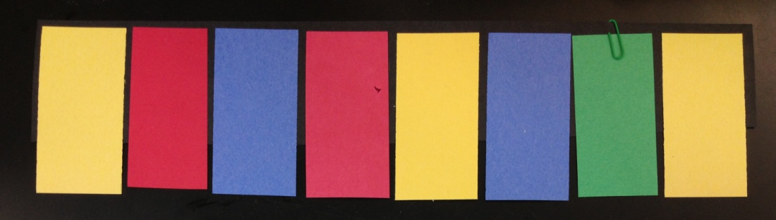
Hypothesize
?
What causes genetic mutations?
Notes:
Student Slide: ENGAGE
INSTRUCTIONS:
Prepare students to hypothesize
Now that everyone has a formal definition of what a genetic mutation is, I want us to start thinking about what might cause them.
When I went around an mutated your genes in the last lesson I took out and switched some peoples “base pairs”.
In a real cell there isn’t a teacher to go around and do that, so what might be happening?
- Facilitate students recording hypotheses about the following question:
Ask: What causes genetic mutations? (Cue question)
Allow students to discuss in groups and then write down hypotheses individually
Students should record hypotheses in notebooks
SLIDE GOAL:
Provide students with time to hypothesize about the topics covered in the upcoming lesson with the support of a visual from the previous lesson.
NOTES:
PICTURE/ GRAPHICS CREDITS:
- All images taken and created by Sarah Lerch

Slide 5
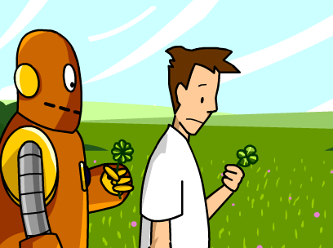
What is a Genetic Mutation?
Notes:
Student slide: ENGAGE
INSTRUCTIONS:
Introduce video and student responsibilities
We are going to watch a Brain Pop video about genetic mutation.
Everyone put their pencils/ laptops away and focus on the video.
Once the video is done we will review what we’ve learned by doing the quiz as a class.
http://www.brainpop.com/science/cellularlifeandgenetics/geneticmutations/
Go over Brain Pop quiz for video as a class
Click on the Quiz button, choosing the Review Quiz option
Allow students to quickly discuss each question.
Instruct students to then record their answer in the space provided in their notebooks.
Facilitate students sharing out answers, try answers until the correct one is chosen.
Give students time after each question to correct their answers in their notebooks.
Once students have finished quiz give them time two record three main points they learned from the video in their notebooks.
Provide them with time to discuss at their tables.
Once they have discussed have quiet time for students to record ideas.
SLIDE GOAL:
Introduce students to causes of genetic mutations and some of their implications for living organisms.
NOTES:
Screenshot has a hyperlink to the video embedded in it .
A Brain Pop subscription is required to watch this video, login before class to make the process smoother.
This video first introduces the concept that not all mutations are negative, this concept will be explored more fully in the next lesson from this unit.
PICTURE/ GRAPHICS CREDITS:
- DNA: Screenshot from Brain Pop video- Genetic Mutations (http://www.brainpop.com/science/cellularlifeandgenetics/geneticmutations/)

Slide 6
Vocabulary:
Beneficial mutation: A mutation with a positive effect.
Deleterious mutation: A mutation with a negative effect.
Neutral mutation: A mutation with no effect.
Notes:
Student Slide: ENGAGE
INSTRUCTIONS:
Give students time to enter the above vocabulary words in notebooks.
Beneficial mutations were mentioned in the video, these were the birds with the longer beaks that could reach the worms in the tree.
Deleterious mutations were also described as injurious in the quiz, negative is probably a better description though
Neutral mutations weren’t talked about in the video, the concept should be fairly straight forward though.
SLIDE GOAL:
Give students the opportunity to record these vocabulary words in their notes, some of these concepts were in the Brain Pop video but will not be addressed more fully until the next lesson. This will allow them to have this information later when we talk about the different types of mutation.
NOTES:
PICTURE/ GRAPHICS CREDITS:

Slide 7
Explore overview
Article review activity
  Activity: Students read articles about causes of mutations and present them to the class
    Students not presenting take notes on articles they haven’t read
  Goal: Students understand of some causes of genetic mutations.
  Materials:
    3. Causes of mutations-Article1-UV light.pdf
    3. Causes of mutations-Article2-Smoking.pdf
    3. Causes of mutations-Article3-Benzene.pdf
    3. Causes of mutations-Article4-Progeria.pdf
    3. Causes of mutations-Article5-Ectrodactyly.pdf
Notes:
Teacher slide: EXPLORE
INSTRUCTIONS:
- This slide can be used as a quick reference for the EXPLORE section. More details will be provided in the comments for each slide.
EXPLORE GOAL:
- Give students an opportunity to explore different ways mutations can be caused through reading, discussion and presentation. Students should end this activity with an understanding of some causes of genetic mutations.
OVERVIEW:
Five articles are provided, each looking at a different cause of mutation. The articles have different levels of difficulty, as noted next to them.
Article 1- UV Light (Low)
Article 2- Smoking (Low)
Article 3- Benzene (High)
Article 4- Progeria (Medium)
Article 5- Ectrodactyly (High)
Article 5 is a summarized version of an actual scientific article, it’s a little more difficult but could be good exposure to what a scientific paper looks like for a group who is ready for it.
Students will read articles in groups.
This can be done by taking turns reading each paragraph out loud or by each student reading silently depending on the reading level for the class.
Students then give short presentations to the class covering the following points:
Article subject
The mutation that is caused
The cause of the mutation
The affect of the mutation
An interesting fact they learned
During the presentations other students take notes on the articles they did not read in their notebooks.
NOTES:
For a low class it might be best to leave out the more difficulty (High) articles. That will still leave students with articles from each category.
Articles can be read on laptops or printed out, be sure to print out articles if computers are unavailable.
PICTURE/ GRAPHICS CREDITS:
MATERIALS:
- 5 Articles, print for class if computers are unavailable
3. Causes of mutations-Article1-UV light.pdf
3. Causes of mutations-Article2-Smoking.pdf
3. Causes of mutations-Article3-Benzene.pdf
3. Causes of mutations-Article4-Progeria.pdf
3. Causes of mutations-Article5-Ectrodactyly.pdf

Slide 8
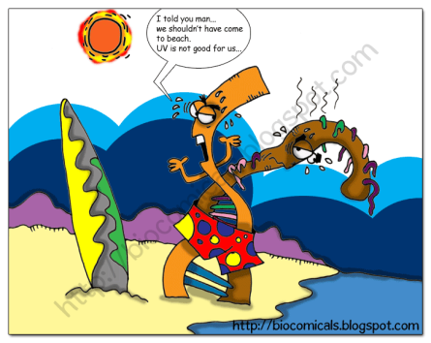
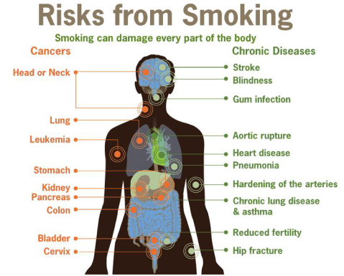

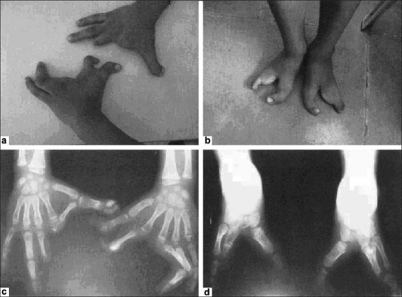
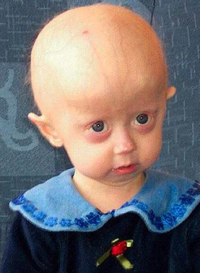
  Article subject
  The mutation that is caused
  The cause of the mutation
  The effect of the mutation
  An interesting fact you learned
What causes genetic mutations?
Notes:
Student Slide: EXPLORE
INSTRUCTIONS:
This is an animated slide, each frame will be paired with its description.
Frame 1: Introduce activity
Today we are going to be reading articles about how exactly genetic mutations can occur in the cell.
You may have heard a couple of ways mentioned in the video, but now you are all going to become experts on causes of mutation by reading some scientific articles.
Give activity instructions
I will hand out one article to each table group, read the article as a group.
This can be done by taking turns reading each paragraph out loud or by each student reading silently depending on the reading level for the class.
Each article will have a list of important vocabulary terms at the top that will be helpful in understanding the article
Frame 2: After reading the article as a table prepare a short presentation that includes the following points:
Article subject
The cause of the mutation
The effect of the mutation
An interesting fact you learned
If groups are nervous recommend they write down these points on a piece of paper and bring it up to the board
- Hand out printed articles or give students time to open up pdfs on their computers.
Give students time to read articles and prepare presentations.
SLIDE GOAL:
Give students main points to focus on for their presentations, they can then refer to this slide as they are reading.
NOTES:
Groups will likely have the same article, this isn’t a bad thing. Especially for the more difficult articles its helpful to hear multiple students interpertations.
PICTURE/ GRAPHICS CREDITS:
-Melting DNA image: Wikipedia Creative Commons
Dr. Alper Uzun; http://www.biocomicals.com/comics/2011/01/06/my-lovely-uv-light/
-Risks from smoking image: Public Domain
http://en.wikipedia.org/wiki/File:Risks-form-smoking-smoking-can-damage-every-part -of-the-body.png
-Skull image: Wikipedia Creative Commons
http://en.wikipedia.org/wiki/ File:Hazard-T.svg
-Progeria image: Wikipedia Creative Commons
http://en.wikipedia.org/wiki/File:Progeria.png
-Ectrodactyly image:
Geetanjali Jindal, Veena R. Parmar, and Vipul Kumar Gupta. Indian Journal of Human Genetics 2009 Sep-Dec; 15(3): 140–142. doi: 10.4103/0971-6866.60191. http://www.ncbi.nlm.nih.gov/pmc/articles/PMC2922631/

Slide 9
Presentation guidelines
Entire group must stand to present
Groups with similar articles go after one another
Students not presenting write down notes from others presentations
Notes:
Teacher slide: EXPLORE
INSTRUCTIONS:
- Use the following instructions when facilitating student presentations
Use the following slides with images from articles as backdrops when students are giving their presentations.
Be sure entire group gets up to present, even if only one student chooses to speak
Have groups with the same article go one after another, its ok that these may be somewhat repetitive. I’ve found some students explanations of the same topic can really vary from others. These variations can really benefit the class.
As students are presenting other students should be writing down the main points for all articles other than theirs in their notebooks in the space provided.
SLIDE GOAL:
To provide teacher with guidelines for student presentations.
NOTES:
PICTURE/ GRAPHICS CREDITS:

Slide 10
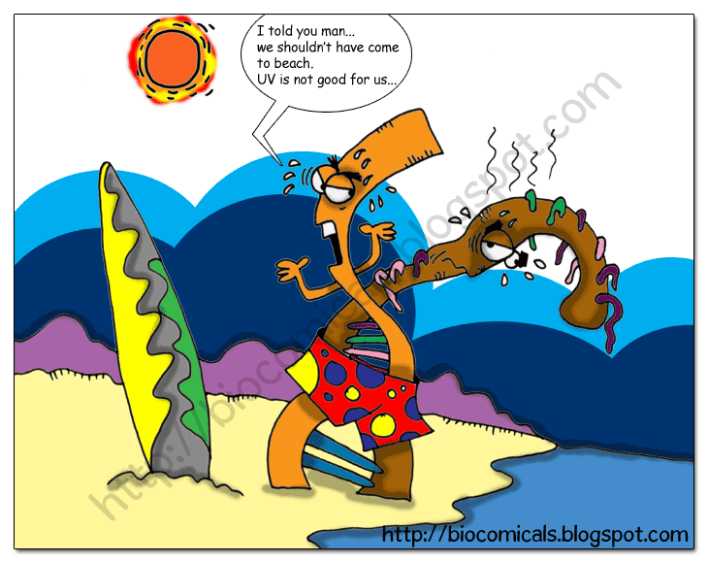
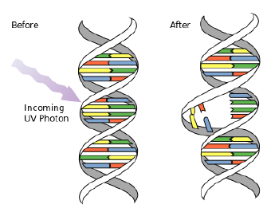
Article 1: Effects of Ultraviolet Light on DNA
Notes:
Student Slide: EXPLORE
INSTRUCTIONS:
Bring up this slide when the UV light group is presenting
Make sure students stay reasonably on topic for their presentations, use the following ESRs to asses if they understood the article and are presenting its subject matter correctly.
Article subject ESR
How UV light causes DNA damage
The mutation that is caused ESR
Two pyrimidine bases sitting next to each other on the same strand of DNA to bind to each other, instead of binding to their partner on the opposite strand
The cause of the mutation ESR
Exposure to UV light
The effect of the mutation ESR
Changes DNA shape
Causes changes in DNA code when DNA shape changes are being fixed
An interesting fact you learned ESR
The sun is a source of UV light
DNA absorbs UV light
UV light can create thousands of buldges along a strand of DNA and when cells try to fix them they substitute in random base pairs instead of what normally goes there.
SLIDE GOAL:
- Provide students with an engaging backdrop to give their presentations in front of and give the teacher expected ESRs to make sure the students understood the article.
NOTES:
PICTURE/ GRAPHICS CREDITS:
-Melting DNA image: Wikipedia Creative Commons
Dr. Alper Uzun; http://www.biocomicals.com/comics/2011/01/06/my-lovely-uv-light/
Damaged DNA image: Wikipedia Creative Commons
http://en.wikipedia.org/wiki/File:DNA-UV-mutation.svg

Slide 11
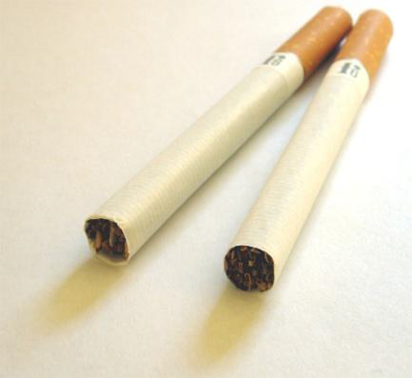
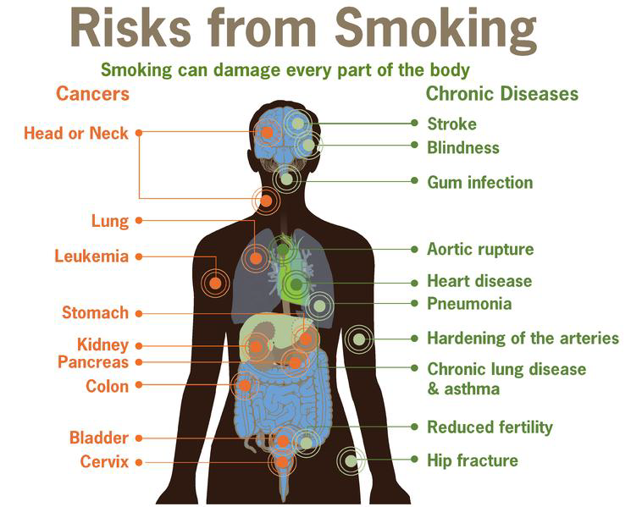
Article 2:
Human produced carcinogens: Smoking
Notes:
Student Slide: EXPLORE
INSTRUCTIONS:
Bring up this slide when the smoking group is presenting
Make sure students stay reasonably on topic for their presentations, use the following ESRs to asses if they understood the article and are presenting its subject matter correctly.
Article subject ESR
How fast cigarette smoke can hurt you
How smoking can cause genetic damage within minutes of inhaling smoke
The mutation that is caused ESR
Trashes DNA
The cause of the mutation ESR
Cigarette smoke
Chemicals in cigarette smoke
PAHS
The effect of the mutation ESR
Causes cancer
An interesting fact you learned ESR
Cigarette causes genetic damage within minutes of being inhaled
It only takes 15-30 minutes for bad chemicals from smoke to reach high levels
SLIDE GOAL:
- Provide students with an engaging backdrop to give their presentations in front of and give the teacher expected ESRs to make sure the students understood the article.
NOTES:
PICTURE/ GRAPHICS CREDITS:
-Cigarette image: Wikipedia Creative Commons
http://en.wikipedia.org/wiki/File:Zwei-zigaretten.jpg
-Risks from smoking image: Public Domain
http://en.wikipedia.org/wiki/File:Risks-form-smoking-smoking-can-damage-every-part -of-the-body.png

Slide 12

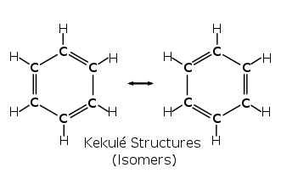
Article 3: Exposure to Benzene:
A Major Public Health Concern
Notes:
Student Slide: EXPLORE
INSTRUCTIONS:
Bring up this slide when Benzene group is presenting
Make sure students stay reasonably on topic for their presentations, use the following ESRs to asses if they understood the article and are presenting its subject matter correctly.
Article subject ESR
Benzene
An industrially produced chemical that causes cancer, Benzene
The mutation that is caused ESR
Changes in chromosomes
The cause of the mutation ESR
Exposure to benzene
Exposure to benzene in the air, vehicles, food and water
The effect of the mutation ESR
Many different cancers and diseases
Increased activity of immune system cells
An interesting fact you learned ESR
Most benzene exposure is through inhalation
Exhaust from cars is the biggest source of benzene
SLIDE GOAL:
- Provide students with an engaging backdrop to give their presentations in front of and give the teacher expected ESRs to make sure the students understood the article.
NOTES:
PICTURE/ GRAPHICS CREDITS:
-Fire image: Wikipedia Creative Commons
http://en.wikipedia.org/wiki/ File:Hazard-F.svg
-Skull image: Wikipedia Creative Commons
http://en.wikipedia.org/wiki/ File:Hazard-T.svg
-Chemical structure image: Wikipedia Creative Commons
http://en.wikipedia.org/wiki/File: Benzene-Representations.svg

Slide 13

Article 4:
What do we Know About Heredity and Progeria?
Notes:
Student Slide: EXPLORE
INSTRUCTIONS:
Bring up this slide when the Progeria light group is presenting
Make sure students stay reasonably on topic for their presentations, use the following ESRs to asses if they understood the article and are presenting its subject matter correctly.
Article subject ESR
Progeria
A disease that causes pre-mature aging in kids
The mutation that is caused ESR
A point mutation in the lamin A (LMNA) gene
A mutation in the gene that does for proteins that stabilize the inner membrane of the cell nucleus
The cause of the mutation ESR
A mutation in the sperm
A DNA building mistake
The effect of the mutation ESR
Premature aging
Baldness, aged-looking skin, a pinched nose, and a small face and jaw relative to head size, stiffness of joints, hip dislocations and severe, progressive cardiovascular disease
An interesting fact you learned ESR
The condition gets its name from the greek work “geras” which means age
It’s thought to affect 4 million newborns worldwide
Newborns normally appear normal
There is no treatment
SLIDE GOAL:
- Provide students with an engaging backdrop to give their presentations in front of and give the teacher expected ESRs to make sure the students understood the article.
NOTES:
PICTURE/ GRAPHICS CREDITS:
-Progeria image: Wikipedia Creative Commons
http://en.wikipedia.org/wiki/File:Progeria.png

Slide 14

Article 5:
Ectrodactyly/split hand feet malformation
Notes:
Student Slide: EXPLORE
INSTRUCTIONS:
Bring up this slide when the Ectrodactyly light group is presenting
Make sure students stay reasonably on topic for their presentations, use the following ESRs to asses if they understood the article and are presenting its subject matter correctly.
Article subject ESR
Ectrodactyly, a disease that causes splits in the middle of hands and feet
A disease called “lobster claw hand”
The mutation that is caused ESR
There are five different genetic mutations associated with it
Mutation on chromosome 7 in a region that contains two homeobox genes
The cause of the mutation ESR
DNA building mistake
Inherited
The effect of the mutation ESR
Split hands and feet
Fused fingers and toes
An interesting fact you learned ESR
It can be a dominant or recessive trait
It’s found in 1 in 90,000 babies
It can be treated with surgery and prosthetics
SLIDE GOAL:
Provide students with an engaging backdrop to give their presentations in front of and give the teacher expected ESRs to make sure the students understood the article.
NOTES:
PICTURE/ GRAPHICS CREDITS:
Ectrodactyly image:
Geetanjali Jindal, Veena R. Parmar, and Vipul Kumar Gupta. Indian Journal of Human Genetics 2009 Sep-Dec; 15(3): 140–142. doi: 10.4103/0971-6866.60191. http://www.ncbi.nlm.nih.gov/pmc/articles/PMC2922631/

Slide 15
Explain overview
Students answer two analysis questions in notebooks
  Name three things that can cause mutation
  What common thin occurs in each mutation?
  Answers to both analysis questions are recorded in notebooks
Homework
  Students must go back to initial hypothesis and formulate a new one if the old was incorrect
  Students record new hypothesis in notebooks
Notes:
Teacher Slide: EXPLAIN
INSTRUCTIONS:
- This slide can be used as a quick reference for the EXPLAIN section. More details will be provided in the comments for each slide.
EXPLAIN GOAL:
Give students the opportunity to synthesize what they have learned from their readings and class presentations.
OVERVIEW:
Have students record three different things that can cause mutation
ESR: Uv light, carcinogens, Benzene, cigarette smoke, DNA building mistakes
What common thing occurs in each mutation?
ESR: DNA is damaged, DNA is changed, DNA is mutated, the organism gets sick
- Students record answers to these analysis questions I their notebooks.
NOTES:
PICTURE/ GRAPHICS CREDITS:

Slide 16
Name three things that can cause mutation
Notes:
Student Slide: EXPLAIN
INSTRUCTIONS:
Have students record three different things that can cause mutation
Remind students they can reference their notes from the presentations to answer this analysis question
ESR: Uv light, carcinogens, Benzene, cigarette smoke, DNA building mistakes
Students should record their answers in the space provided in their notebooks
SLIDE GOAL:
Give students the opportunity to step back and look at what they have learned from the presentations about causes of mutation.
NOTES:
This shouldn’t take long, the answers should be directly written in their notes already.
PICTURE/ GRAPHICS CREDITS:
-Melting DNA image: Wikipedia Creative Commons
Dr. Alper Uzun; http://www.biocomicals.com/comics/2011/01/06/my-lovely-uv-light/
-Risks from smoking image: Public Domain
http://en.wikipedia.org/wiki/File:Risks-form-smoking-moking-can-damage-every-part -of-the-body.png
-Skull image: Wikipedia Creative Commons
http://en.wikipedia.org/wiki/ File:Hazard-T.svg
-Progeria image: Wikipedia Creative Commons
http://en.wikipedia.org/wiki/File:Progeria.png
-Ectrodactyly image:
Geetanjali Jindal, Veena R. Parmar, and Vipul Kumar Gupta. Indian Journal of Human Genetics 2009 Sep-Dec; 15(3): 140–142. doi: 10.4103/0971-6866.60191. http://www.ncbi.nlm.nih.gov/pmc/articles/PMC2922631/

Slide 17
What common thing occurs in each mutation?
http://earthref.org/SCC
Scripps Classroom Connection
Notes:
Student Slide: EXPLAIN
INSTRUCTIONS:
Facilitate students thinking about the final analysis question.
You have all read and heard about a lot of different ways mutations can occur. All of those different ways seem to have different consequences for the organisms they are happening in.
But they all still have one thing in common.
Ask: What common thing occurs in each mutation we discussed?
Give students time to discuss at tables, then share out
ESR: DNA is damaged, DNA is changed, DNA is mutated, the organism gets sick
If students respond with last ESR point out that although we know that is probably true, not all the articles mentioned what happens to organisms affected by those mutations. Prompt them to think about what WAS mentioned in all the articles and look back at what a genetic mutation is.
Students should record their answers in the space provided in their notebooks
Assign homework
Students go back to original hypothesis they came up with at the beginning of the lesson. Are these hypotheses right? If not create new hypotheses using evidence learned in class and evidence recorded in notebooks. Students record new answers in notebook under initial question.
SLIDE GOAL:
To make sure students are clear that all genetic mutations, no matter what causes them, affect and damage DNA.
NOTES:
PICTURE/ GRAPHICS CREDITS:
-Melting DNA image: Wikipedia Creative Commons
Dr. Alper Uzun; http://www.biocomicals.com/comics/2011/01/06/my-lovely-uv-light/
-Risks from smoking image: Public Domain
http://en.wikipedia.org/wiki/File:Risks-form-smoking-moking-can-damage-every-part -of-the-body.png
-Skull image: Wikipedia Creative Commons
http://en.wikipedia.org/wiki/ File:Hazard-T.svg
-Progeria image: Wikipedia Creative Commons
http://en.wikipedia.org/wiki/File:Progeria.png
-Ectrodactyly image:
Geetanjali Jindal, Veena R. Parmar, and Vipul Kumar Gupta. Indian Journal of Human Genetics 2009 Sep-Dec; 15(3): 140–142. doi: 10.4103/0971-6866.60191. http://www.ncbi.nlm.nih.gov/pmc/articles/PMC2922631/

Slide 18
Extend overview
Extend section is optional
Brain Pop video on Antibiotic resistance:
  http://www.brainpop.com/health/diseasesinjuriesandconditions/antibioticresistance/
Questioning and class discussion
  Why is it important that these single celled bacteria are being influenced by genetic mutations?
  Do mutations always negative or deleterious consequences for the organism?
Notes:
Teacher Slide: EXTEND
INSTRUCTIONS:
- This slide can be used as a quick reference for the EXTEND section. More details will be provided in the comments for each slide.
EXTEND GOAL:
Give students the opportunity to synthesize what they have learned from their readings and class presentations.
OVERVIEW:
Students watch Brain Pop video on Antibiotic Resistance
http://www.brainpop.com/health/diseasesinjuriesandconditions/antibioticresistance/
Ask: Why is it important that these single celled bacteria are being influenced by genetic mutations?
ESR: They can make us sick, they cause MSRA, they are resistant to antibiotics
Ask: Do mutations always negative or deleterious consequences for the organism?
ESR: No, sometimes they can make the organism stronger like in the antibiotic resistance bacteria but sometimes they can cause cancer or diseases like Progeria and Ectrodactyly.
Connect to next lesson
NOTES:
This extend is optional, it’s a great way to bridge into concepts discussed in the next lesson but can be skipped if the class is short on time.
PICTURE/ GRAPHICS CREDITS:

Slide 19
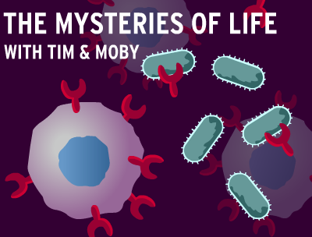
http://earthref.org/SCC
Scripps Classroom Connection
Notes:
Student Slide: EXTEND
INSTRUCTIONS:
Connect extend to the lesson
We have been talking a lot about what causes genetic mutations, but we haven’t talked about the consequences of those mutations very much.
We are going to watch a video about antibiotic resistance in bacteria and you’re going to see that this is an example of how genetic mutations can affect single celled organisms, not just multi-cellular ones like us.
Play Brain Pop video: Antibiotic Resistance (http://www.brainpop.com/health/diseasesinjuriesandconditions/antibioticresistance/)
Instruct students to focus on the video, they will not need to talk or take notes while it’s playing.
Ask: Why is it important that these single celled bacteria are being influenced by genetic mutations?
Students discuss at tables and share out to the class.
ESR: They can make us sick, they cause MSRA, they are resistant to antibiotics
Ask: Do mutations always negative or deleterious consequences for the organism?
Students discuss at tables and share out to the class.
ESR: No, sometimes they can make the organism stronger like in the antibiotic resistance bacteria but sometimes they can cause cancer or diseases like Progeria and Ectrodactyly.
Connect to next lesson
In the final lesson of our mutation unit we will be looking at mutations in single celled organisms and assessing when a mutation might be beneficial or deleterious.
SLIDE GOAL:
Give students the opportunity to think about mutations in a single celled organism that are actually beneficial to an organism and
NOTES:
-A Brain Pop account is required to watch this video, login before class to make the process smoother.
- Screenshot is a hyperlink to the video.
PICTURE/ GRAPHICS CREDITS:
- Brain Pop video, Antibiotic Resistance Screenshot: http://www.brainpop.com/health/diseasesinjuriesandconditions/antibioticresistance/

