Slide 1
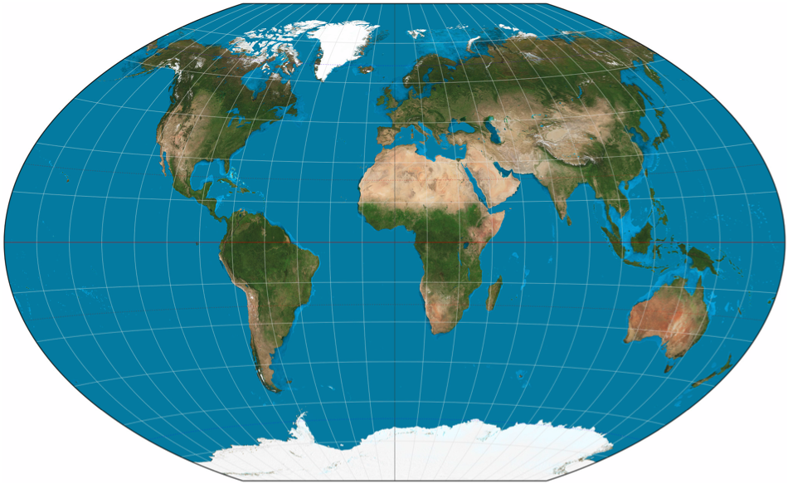
Continental Drift Mystery
Question of the day: Has the Earth’s surface always looked the same as it looks today?
Notes:
This slide is mainly for the instructor, but should also be shown to students for the “Question of the day”
PHOTO CREDIT: “Earth: portrait of a planet” by Marshak 2012
MAP CREDIT: http://en.wikipedia.org/wiki/World_map
AUTHORS: Erica Mitchell (Scripps Oceanography) and Jerry Ruiz (University City High School)
WHY: Earthquakes can become tremendously destructive natural disasters. The 1994 Northridge, CA earthquake alone caused 60 deaths, injured 8,700 people, and created $25 billion in property damage. Earthquakes are a very strong reminder that the planet we live on is dynamic and changing. In 1912, a scientist named Alfred Wegener published the theory of Continental Drift, in which he proposed the idea that the continents have moved over time to get to their current locations. This lesson is meant to present students with the kinds of evidence that Wegener used to support his theory of Continental Drift. Students should evaluate how each piece of evidence does or doesn’t support Wegener’s theory. Continental Drift was rejected by geologists at the time, because he couldn’t explain the mechanism that made such massive pieces of land move across the earth. It wasn’t until the 1960’s, (after his death) when seafloor spreading was discovered, that scientists could explain why the continents drifted. The theory of plate tectonics put all the pieces together. Plate tectonics is the idea that the outer, solid layer of the earth (the lithosphere) is broken into large tectonic plates that move due to their interactions with the convecting mantle below. Plate tectonics is so important because it can explain the shape of the sea floor, the fit of the continents, and the locations of large earthquakes and volcanoes. Plate tectonics can be used to reconstruct the way the solid earth looked hundreds of millions of years ago, and make predictions about what it will look like in the future.
SUMMARY: This activity is presented as a mystery that students are trying to solve. There are three main questions in this story
Why did Wegener believe the continents had drifted?
Why were his ideas initially rejected?
And why were they eventually accepted?
Groups of students will be given packets of “evidence sheets” that give a brief description of each of the pieces of evidence that Wegener used to support his theory. Students will take notes and answer questions in their “research notes” that encourage them to think about how each piece of evidence is (or isn’t) supportive of the theory of Continental Drift. The information in the last few evidence sheets (7-10) was discovered after Wegener’s death. It was the hard evidence that scientists needed to explain Plate Tectonics, which includes Continental Drift.
ADDITIONAL READING: USGS: http://pubs.usgs.gov/gip/dynamic/dynamic.html
And the textbook “Earth: Portrait of a Planet” by Stephen Marshak
CONTEXT FOR USE: This lesson is designed for a 9th grade Earth Science class. It is lesson 1 out of 6 in the unit “Earthquake hazards of Southern California”. It is best to present this lesson first, since it introduces plate tectonics on a global scale, and introduces the driving force on faults that causes earthquakes.
MISCONCEPTIONS:
M1) The continents (and islands) are floating on top of the water. A1) The continents are attached to the solid mantle below, just like the oceanic crust. Continental crust is less dense and thicker than oceanic crust, so continental crust has higher elevation than oceanic crust.
M2) The continents are in their final position. A2) The continents are still moving today (at a speed of a few centimeters per year, the speed at which your fingernails grow). The motion of tectonic plates is still moving the continents, and driving earthquakes along the plate boundaries.
EVALUATION TIPS:
Each student should fill out his/her own “research notes”. Encourage students to explain how each piece of evidence supports (or does not convincingly support) continental drift. At the end of the activity students should be able to answer the “Question of the day”.
TEACHING NOTES:
All of the information students need to answer the questions in their “research notes” is in the “evidence sheets”. Students learned some concepts quite easily, such as the “fit” of the continents and matching fossils across continents. Some of the concepts, however, are quite difficult (especially the paleomagnetic clues) and should be presented to the class so that everyone can hear answers to common questions. This activity took much longer than I had first expected. Plan on using at least two 50 minute periods to thoroughly explore all ten of the evidence sheets.

Slide 2
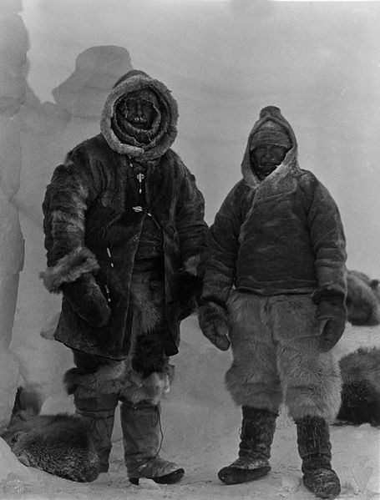
Alfred Wegener 1930
Greenland
Notes:
This slide is for students.
PHOTO CREDIT: http://en.wikipedia.org/wiki/File:Wegener_Expedition-1930_026.jpg
This photo should be shown to students to get them excited about Wegener’s extreme research adventures. The following story (below) should be told to the class orally to show that scientists can be adventurers, not just nerds in lab coats. Think of this as a campfire story, to get them interested in what motivated Wegener.
%%%%%%%%%%%%%%%%%%%% Text from (Marshak, 2012) %%%%%%%%%%%%%%%%%%%%%%
In September 1930, fifteen explorers led by a German meteor- ologist, Alfred Wegener, set out across the endless snowfields of Greenland to resupply two weather observers stranded at a remote camp (􏰘Fig. 3.1). The observers were planning to spend the long polar night recording wind speeds and tem- peratures on Greenland’s polar plateau. At the time, Wegener was well known, not only to researchers studying climate but also to geologists. Some fifteen years earlier, he had published a small book, The Origin of the Continents and Oceans, in which he had dared to challenge geologists’ long-held assumption that the continents had remained fixed in position through geologic time (the time since the formation of the Earth). Wegener proposed, instead, that the present distribution of continents and ocean basins had evolved. According to Wegener, the continents had once fitted together like pieces of a giant jigsaw puzzle, to make one vast supercontinent. He suggested that this supercontinent, which he named Pangaea (pronounced Pan-jee-ah; Greek for “all land”), later fragmented into separate continents that then drifted apart, moving slowly to their present positions (􏰘Fig. 3.2). This idea came to be known as the continental drift hypothesis.Wegener presented many observations in favor of the hypothesis, but he was met with strong resistance. Drifting continents? Absurd! Or so proclaimed the lead- ing geologists of the day. At a widely publicized 1926 geol- ogy conference in New York City, a phalanx of celebrated American professors scoffed: “What force could possibly be great enough to move the immense mass of a conti- nent?” Wegener’s writings didn’t provide a good answer, so despite all the supporting observations he had pro- vided, most of the meeting’s participants rejected conti- nental drift.Now, four years later, Wegener faced his greatest chal- lenge. As he headed into the interior of Greenland, the weather worsened and most of his party turned back. But Wegener felt he could not abandon the isolated observers, and with two companions he trudged forward. On October 30, 1930, Wegener reached the observers and dropped off enough supplies to last the winter. Wegener and one com- panion set out on the return trip the next day, but they never made it home.
%%%%%%%%%%%%%%%%%%%%%%%%%%%%%%%%%%%%%%%%%%%%%%%%%%%%%%
%%%%%%%%%%%%%%% Text from http://en.wikipedia.org/wiki/Alfred_Wegener %%%%%%%%%%%%%%%
On September 24, although the route markers were by now largely buried under snow, Wegener set out with thirteen Greenlanders and his meteorologist Fritz Loewe to supply the camp by dog sled. During the journey the temperature reached −60 °C (−76 °F) and Loewe's toes became so frostbitten they had to be amputated with a penknife without anesthetic. Twelve of the Greenlanders returned to West camp. On October 19, the remaining three members of the expedition reached Eismitte. There being only enough supplies for three at Eismitte, Wegener and Rasmus Villumsen took two dog sleds and made for West camp. They took no food for the dogs and killed them one by one to feed the rest until they could run only one sled. While Villumsen rode the sled, Wegener had to use skis. They never reached the camp. The expedition was completed by his brother, Kurt Wegener.
%%%%%%%%%%%%%%%%%%%%%%%%%%%%%%%%%%%%%%%%%%%%%%%%%%%%%%
Tell students that in this activity, they will get to decide if Wegener’s evidence for Continental drift is convincing. They will also learn about evidence discovered after Wegener’s death thanks to the invention of new technology. And they will figure out how that evidence is consistent with Continental Drift, and fits into the larger theory of Plate Tectonics.

Slide 3
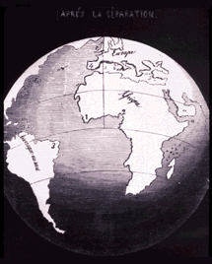
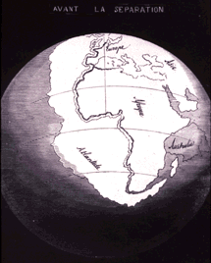
Clue #1: Continent shape
1858- Antonio Snider-Pellegrini
(1858 A.D.)
Notes:
This slide, and the following slides can be used in a whole-class discussion of each piece of evidence, if needed. All of the information that the students need should be included in the “Evidence Sheets” and in the “Research Notes” questions. These slides should only be used in case some concepts are difficult, and the class needs some extra explanation.
IMAGE CREDIT: USGS publications ‘This Dynamic Earth’ (online edition)
http://pubs.usgs.gov/gip/dynamic/historical.html
This map was created by the geographer Antonio Snider-Pellegrini in the year 1858. The idea that the continents may have once fit together was proposed well before Wegener’s time. Wegener was the first, though, to compile and thoroughly explain evidence for this idea in a “full-blown” scientific theory. http://pubs.usgs.gov/gip/dynamic/historical.html
MAIN THOUGHT: some continents look like they fit together. This piece of evidence is intuitive and appealing to the eyes, but not 100% convincing. Could it be a coincidence that the shapes of the continents look like they fit together?

Slide 4
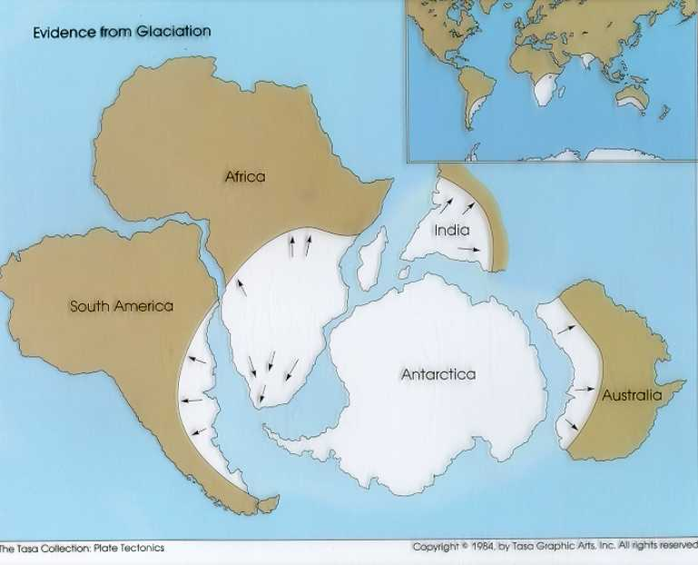
Clue # 2: Locations of past glaciers
Notes:
This slide, and the following slides can be used in a whole-class discussion of each piece of evidence, if needed. All of the information that the students need should be included in the “Evidence Sheets” and in the “Research Notes” questions. These slides should only be used in case some concepts are difficult, and the class needs some extra explanation.
PHOTO CREDIT:
Left: “Earth: portrait of a planet” by Marshak 2012
Right: http://blue.utb.edu/paullgj/physci1417/Lectures/Gondwanaland_Glaciations.JPG
MAIN THOUGHT: ancient glaciers used to exist where there are none today. Geologists know this based on discoveries of glacial till deposits and glacial striations near the equator. There are only two ways this could make sense: either the world was much much colder in the past, so cold that glaciers existed near the equator, or some continents used to be located near the south pole and when they migrated toward the equator their glaciers melted.

Slide 5
Clue #3: Locations of coal deposits
Notes:
This slide, and the following slides can be used in a whole-class discussion of each piece of evidence, if needed. All of the information that the students need should be included in the “Evidence Sheets” and in the “Research Notes” questions. These slides should only be used in case some concepts are difficult, and the class needs some extra explanation.
IMAGE CREDITS:
“Earth: portrait of a planet” by Marshak 2012
MAIN THOUGHT: Coal deposits can be found in regions that cannot produce coal today because they are not tropical jungles. There are only two ways this could make sense: either the earth used to me much warmer and tropical at high latitudes than it is now, or some continents migrated from the tropical equator to higher latitudes.

Slide 6
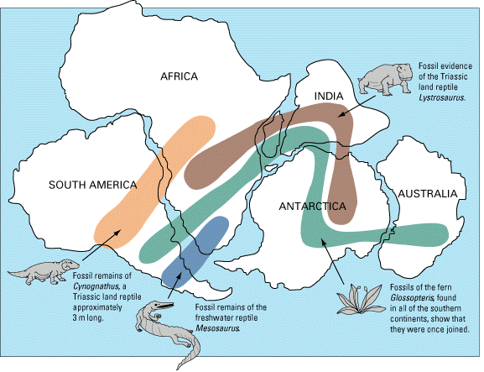
Clue # 4: Fossil distribution
Notes:
This slide, and the following slides can be used in a whole-class discussion of each piece of evidence, if needed. All of the information that the students need should be included in the “Evidence Sheets” and in the “Research Notes” questions. These slides should only be used in case some concepts are difficult, and the class needs some extra explanation.
IMAGE CREDIT:
USGS publications ‘This Dynamic Earth’ (online edition) http://pubs.usgs.gov/gip/dynamic/historical.html
or
http://www.geolsoc.org.uk/Plate-Tectonics/Chap1-Pioneers-of-Plate-Tectonics/Alfred-Wegener/Fossil-Evidence-from-the-Southern-Hemisphere
MAIN THOUGHT: Fossils from an animal species such as cynognathus (an extinct reptile with a dog-like jaw) can be found on two continents separated by an ocean. This piece of evidence suggests that a land-dwelling species evolved on a land mass that later separated into two continents. Alternative interpretations of this evidence include: The same animal coincidentally evolved on separate continents or the animal rafted across the ocean on a large piece of driftwood. It is important to note that paleontologists think that there is no way that this animal could have physically swam across the ocean.

Slide 7
Clue # 5: Matching Mountain belts
Notes:
This slide, and the following slides can be used in a whole-class discussion of each piece of evidence, if needed. All of the information that the students need should be included in the “Evidence Sheets” and in the “Research Notes” questions. These slides should only be used in case some concepts are difficult, and the class needs some extra explanation.
IMAGE CREDIT: “Earth: portrait of a planet” by Marshak 2012
MAIN THOUGHT: The same kind of rocks exist on the coastlines of continents that are separated by an ocean. The directions of folds within the rock layers (denoted by the black lines in figure (a)) also match up across the ocean. How likely is it that the same kind of geologic unit coincidentally ended up on either side of the Atlantic Ocean? Or is it possible that the unit was separated down the middle as the continents were pushed apart?

Slide 8
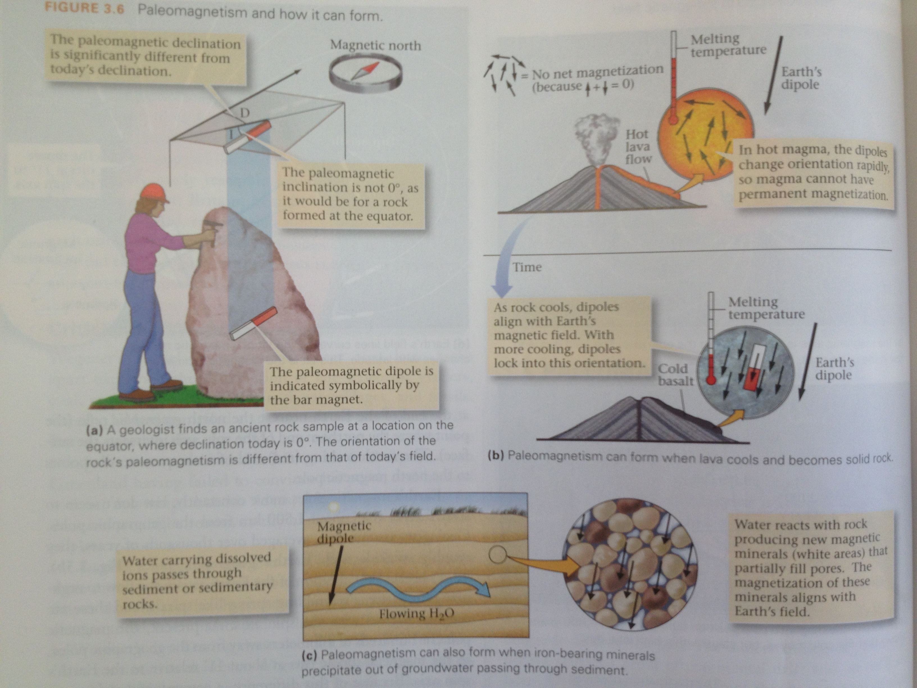
What is paleomagnetism?
Notes:
This slide should be shown to students. Paleomagnetism is a difficult concept for most to grasp the first time around. Learning how paleomagnetism can tell us about how tectonic plates moved in the past can be even more difficult.
1) EARTH’S MAGNETIC FIELD
We should first start out with the observation that the Earth has a global magnetic field. It is caused by circulating molten iron in the outer core of the Earth. The shape of the magnetic field is called a dipole. If you look at a drawing of the Earth’s magnetic field lines, you can see that they come out of the Earth’s geographic south pole and run up around the surface of the Earth and into the geographic north pole. If you stood somewhere on the Earth and held a compass, its needle would line-up with the magnetic field lines, which point roughly to the north pole. The magnetic north pole is not perfectly aligned with the geographic north pole. It moves around a little over hundreds of years, but doesn’t move farther than 1,500 km away. The angle between your horizontal compass needle and true geographic north is called magnetic declination. If you look at the drawing of earth’s magnetic field lines, you can see that they are parallel to the Earth’s surface near the equator, but they dive perpendicularly into the earth near the poles. This angle, which is zero degrees at the equator and 90º at the poles, is called magnetic inclination. Over millions of years, the Earth’s magnetic field has reversed its polarity many times. This means that the basic shape of the magnetic field is still a dipole, but the directions of north and south have switched. The different polarities are called “normal” and “reversed”. The magnetic field has not experienced a reversal in over 780,000 years.
2) PALEOMAGNETISM IN ROCKS
A record of the Earth’s magnetic field can actually be preserved in really old rocks. There are three different processes that can record the earth’s magnetic field in rocks: thermoremanent magnetization, detrial remanent magnetization, and chemical remanent magnetization. Let’s start with the first, thermoremanent magnetization. Think about a lava flow erupting from a volcano. The hot, molten lava has no crystal structure. As it cools, little crystals of a mineral called magnetite start to form and the rock becomes solid at the solidus temperature, about 900ºC. Because of the great heat energy of the rock, the magnetic dipoles within the crystals move around in all directions so that there is no net magnetic field of the rock. As the rock cools even more the magnetic dipoles slow down and start to become aligned with the direction of the Earth’s magnetic field. Once the rock cools to the Curie temperature, about 600 ºC, the magnetic dipoles become locked in to the rock in the direction of the Earth’s magnetic field. So the magnetic dipole of a rock that is created today should point toward the North pole. Geologists can find much, much older rocks and measure the direction of their paleomagnetic dipoles to learn about the ancient direction of the Earth’s magnetic field when that rock formed. This is the study of paleomagnetism. The second process, detrial remanent magnetisation, is a process by which grains in a newly deposited sediment acquire the Earth’s magnetic field. The third process, chemical remanent magnetization, happens when water flows through the pores of a rock. Magnetic minerals can precipitate out of the water and grow to align with the Earth’s magnetic field.
So... How does all this relate to motion of the continents and tectonic plates?
3) PALEOMAGNETISM AND TECTONIC PLATE MOTION
There are two different evidence sheets in this lesson that refer to paleomagnetic data.
3A) APPARENT POLAR WANDER
Geologists measured the paleomagnetic dipole of really old rocks. They discovered that it did not point toward today’s magnetic north pole- it was really far off. Then, they took measurements from older and older rocks in the same general area on that continent, and found that the paleomagnetic dipoles in the rocks pointed toward a north pole that seemed to move all around the globe over time. This is called an apparent polar wander curve. To test this theory, they decided to repeat the experiment on a different continent. If the pole really moved around, the two continents should produce the same apparent polar wander curve. Their results suggested otherwise! The other continent produced a totally different polar wander curve. Essentially, rocks from the two different continents seemed to be pointing to two different north pole locations at the same time in history. A third continent produced yet another different apparent polar wander curve. The only way to explain this is if the magnetic north pole stayed in roughly the same place, while the continents moved and rotated all around the globe. If a continent moved toward the north or south, its paleomagnetic inclination will be different than the magnetic inclination at that location today. If a continent rotated, its paleomagnetic declination will be different than the magnetic declination at that location today.
3B) MARINE MAGNETIC ANOMALIES
Geologists measured the paleomagnetic dipole of rock layers going far, far back in time. They used a technique called isotope dating to measure the ages of the rocks. They discovered that the dipole flipped its polarity at different times in geologic history, consistently across the globe. These are records of magnetic reversals, or changes in the direction of the whole earth’s magnetic field. Geologists came up with a timeline of magnetic reversals, from normal to reverse to normal to reverse, and so on. They had a theory that the ocean floor was being created by rising magma along mid ocean ridges, and spreading outward as it cooled, pushing the continents apart. They suggested that if that was true, then the paleomagnetic dipoles recorded in the ocean floor should match today’s magnetic field at the mid ocean ridge, and have a symmetric pattern on either side of the ridge or normal-reverse-normal-reverse. In the 1950s, geophysicists made measurements by towing a magnetometer behind a ship and driving over the mid ocean ridge. The magnetic anomalies that they recorded across the ocean floor matched the pattern predicted using the magnetic reversal timeline. This is proof that new ocean floor is created at mid ocean ridges and that the oceanic crust is spreading apart at mid ocean ridges. This is one important part of plate tectonics.
IMAGE CREDIT: “Earth: portrait of a planet” by Marshak 2012
WEBSITES USED:
http://en.wikipedia.org/wiki/Paleomagnetism

Slide 9
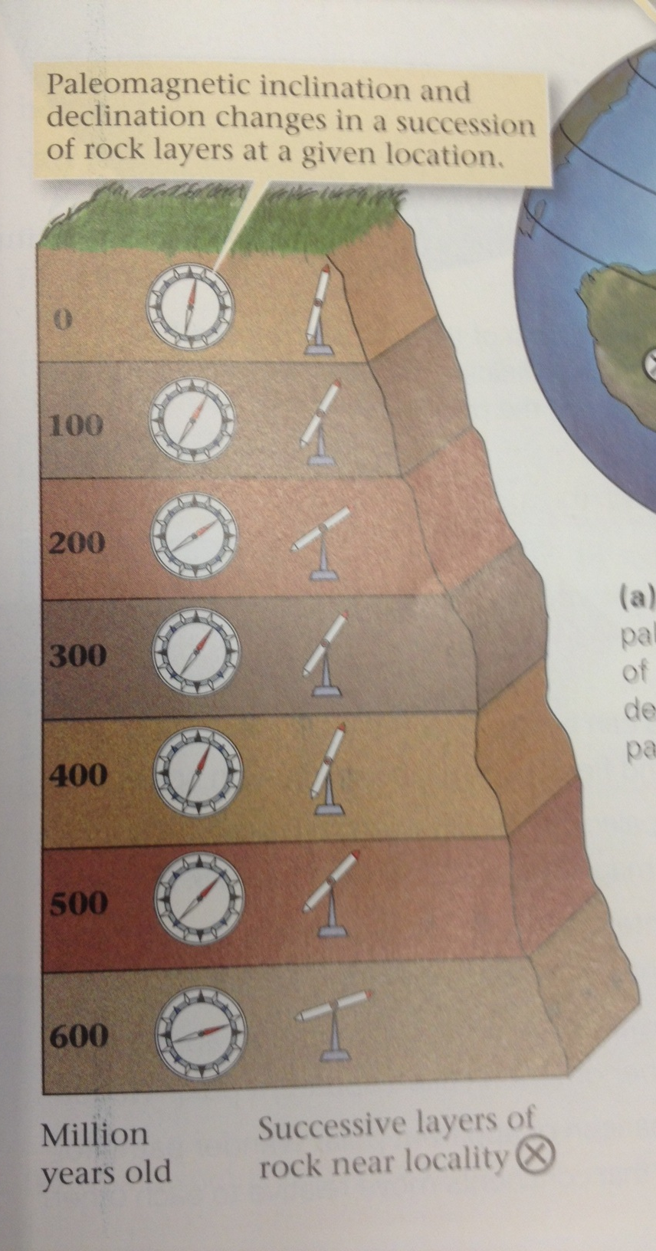
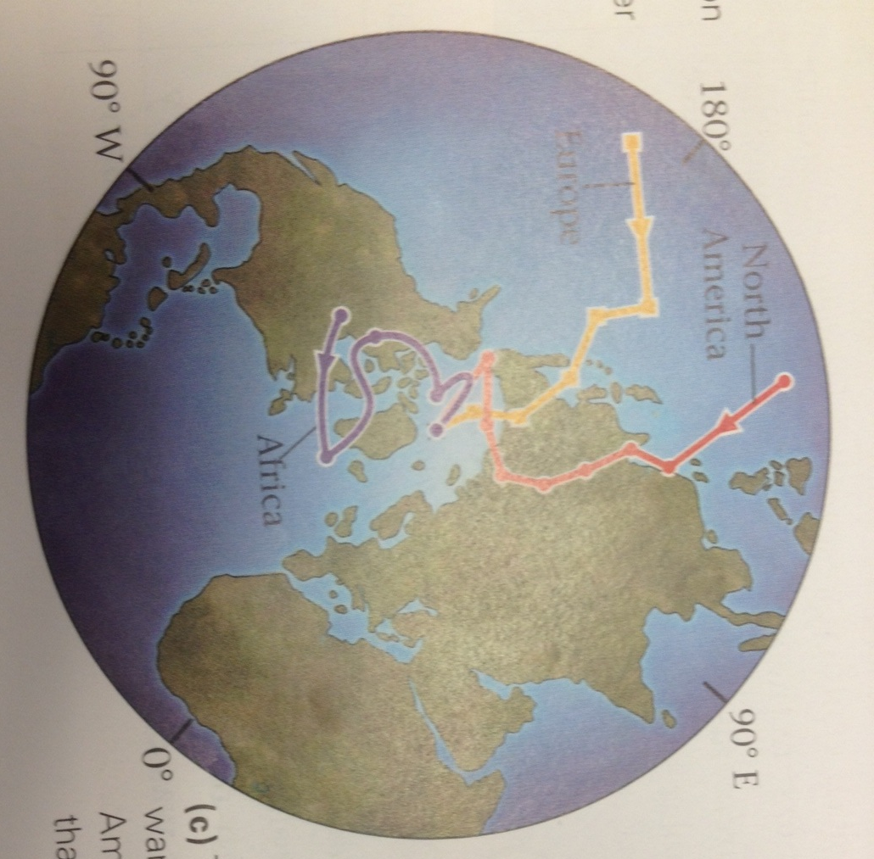
Clue #6: Paleomagnetism: Apparent polar wander
Notes:
This slide, and the following slides can be used in a whole-class discussion of each piece of evidence, if needed. All of the information that the students need should be included in the “Evidence Sheets” and in the “Research Notes” questions. These slides should only be used in case some concepts are difficult, and the class needs some extra explanation.
IMAGE CREDIT: all three from “Earth: portrait of a planet” by Marshak 2012
MAIN THOUGHT: The magnetic field recorded in rocks on different continents seem to suggest that in the past the Earth’s magnetic north pole existed in many places at one time. This isn’t possible. The continents containing these rocks must have moved around and rotated separately, so that the the locked-in magnetic field direction doesn’t point toward the north pole anymore.

Slide 10
Clue #7: Sea floor bathymetry
Notes:
This slide, and the following slides can be used in a whole-class discussion of each piece of evidence, if needed. All of the information that the students need should be included in the “Evidence Sheets” and in the “Research Notes” questions. These slides should only be used in case some concepts are difficult, and the class needs some extra explanation.
IMAGE CREDIT: “Earth: portrait of a planet” by Marshak 2012
MAIN THOUGHT: After Wegener’s death, new technology allowed scientists to see the shape of the sea floor. It is symmetric about the mid-ocean ridge in the middle. The brand new, warmer oceanic crust is less dense than the older, cooler oceanic crust. That’s why the bathymetry at the mid ocean ridge is higher than at the abyssal plains. This piece of evidence is consistent with sea-floor spreading, which moves the continents.

Slide 11
Clue #8: Heat flow measurements
Notes:
This slide, and the following slides can be used in a whole-class discussion of each piece of evidence, if needed. All of the information that the students need should be included in the “Evidence Sheets” and in the “Research Notes” questions. These slides should only be used in case some concepts are difficult, and the class needs some extra explanation.
IMAGE CREDIT: “Earth: portrait of a planet” by Marshak 2012
MAIN THOUGHTS: 1) There is more heat flow at mid ocean ridges than there is away from mid ocean ridges. This means that magma is rising at the mid ocean ridges. 2) Sediments take a long time to accumulate on the sea floor. Thicker sediments mean that the sea floor has been exposed for a long time. This means that the area near the mid ocean ridge is very young, and the area away from the mid ocean ridge is older.
These two pieces of evidence are consistent with the idea of “sea floor spreading”. Magma is rising at mid ocean ridges, creating new ocean floor, and pushing the ocean floor apart and moving the continents along with it.

Slide 12
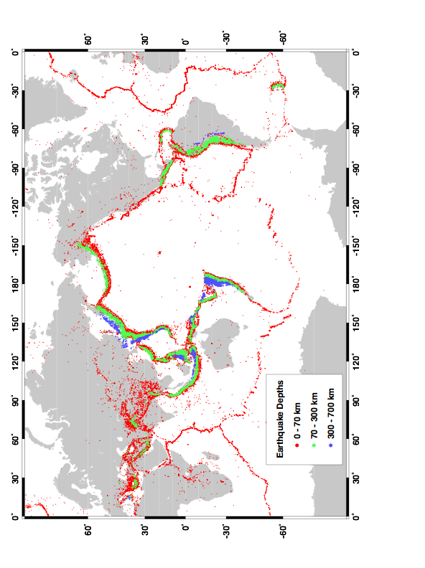
Clue # 9: Global earthquake distribution
Notes:
This slide, and the following slides can be used in a whole-class discussion of each piece of evidence, if needed. All of the information that the students need should be included in the “Evidence Sheets” and in the “Research Notes” questions. These slides should only be used in case some concepts are difficult, and the class needs some extra explanation.
IMAGE CREDIT: Prof. David Sandwell at SIO.
MAIN THOUGHT: earthquakes do not occur at random locations around the world. There are certain areas that have lots of earthquakes, and other areas that have few. Earthquakes occur when there is sudden motion on a fault, and faults often make up the boundary between tectonic plates. The earthquakes mostly occur along the boundaries of major tectonic plates.

Slide 13
Clue # 10: Paleomagnetism: marine magnetic anomalies
Notes:
This slide, and the following slides can be used in a whole-class discussion of each piece of evidence, if needed. All of the information that the students need should be included in the “Evidence Sheets” and in the “Research Notes” questions. These slides should only be used in case some concepts are difficult, and the class needs some extra explanation.
IMAGE CREDIT: “Earth: portrait of a planet” by Marshak 2012
MAIN THOUGHT: Over hundreds of millions of years the earth’s magnetic north pole has flipped back and forth between the north and south geographic pole many times. When magma cools at mid ocean ridges along the ocean floor, it captures the current direction of the Earth’s magnetic field.

Slide 14
Notes:
This slide, and the following slides can be used in a whole-class discussion of each piece of evidence, if needed. All of the information that the students need should be included in the “Evidence Sheets” and in the “Research Notes” questions. These slides should only be used in case some concepts are difficult, and the class needs some extra explanation.
IMAGE CREDIT: “Earth: portrait of a planet” by Marshak 2012
MAIN THOUGHT: Scientists can measure the magnetic field frozen in rocks on the seafloor by dragging an magnetometer behind a ship. The striped pattern of “normal-reverse-normal-reverse’ is locked into the spreading ocean floor. The pattern of magnetic anomalies is symmetric on either side of the mid ocean ridge. Note that at the center of the ridge, the polarity is normal. This is because the polarity of the earth’s magnetic field today is normal.

Slide 15
Notes:
This slide, and the following slides can be used in a whole-class discussion of each piece of evidence, if needed. All of the information that the students need should be included in the “Evidence Sheets” and in the “Research Notes” questions. These slides should only be used in case some concepts are difficult, and the class needs some extra explanation.
IMAGE CREDIT: “Earth: portrait of a planet” by Marshak 2012
MAIN THOUGHT: Magma must be rising at mid ocean ridges and cooling as the ocean floor spreads out away from the mid ocean ridge.
Based on what we have learned about seafloor spreading, can you predict the positions of South America and Africa far back into the past? What about the other continents? Geologists have used seafloor spreading, as well as the other pieces of evidence that we discussed, to create reconstructions of what the globe looked like in the past. This is what we will explore in the next slide.

Slide 16
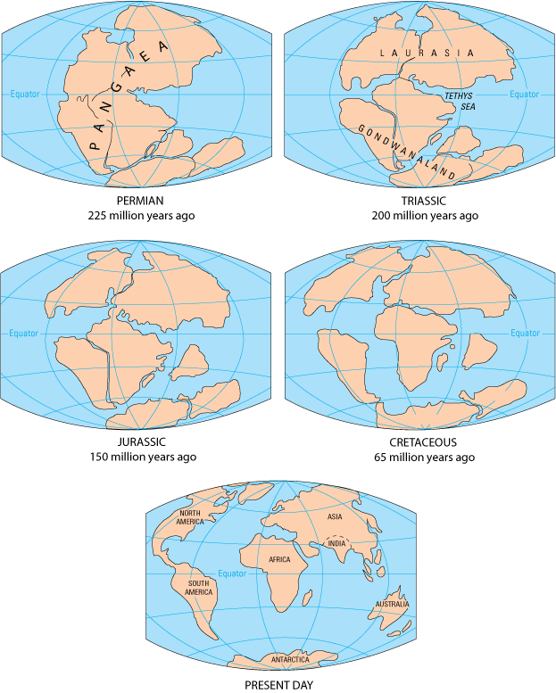
Moving
Continents
…Back in time…
Notes:
This slide may be shown to students at the end of the activity, to show them a reconstruction of locations of the continents in the past.
The maps in this slide show reconstructions of where the continents used to be at older and older times, starting with present day in the upper left. Notice that South America and Africa need to move closer together as we turn back time; we inferred this based on what we have learned about seafloor spreading along the Mid Atlantic Ridge. You can also track India back in time, and see that it came from much more southern latitudes and used to be part of Gondwanaland, one of two supercontinents, in the Triassic. The name of the other supercontinent from the Triassic is Laurasia. The oldest map in this slide shows what the continents looked like during the Permian. The land masses formed one giant supercontinent called Pangaea.
In the next slide we will look at a map of today’s tectonic plates, where we will be able to see which continents belong to which tectonic plates. The tectonic plates are still moving today- the map has arrows that show the relative motion between plates today.
IMAGE CREDIT:
http://pubs.usgs.gov/gip/dynamic/graphics/Fig2-5globes.gif

Slide 17
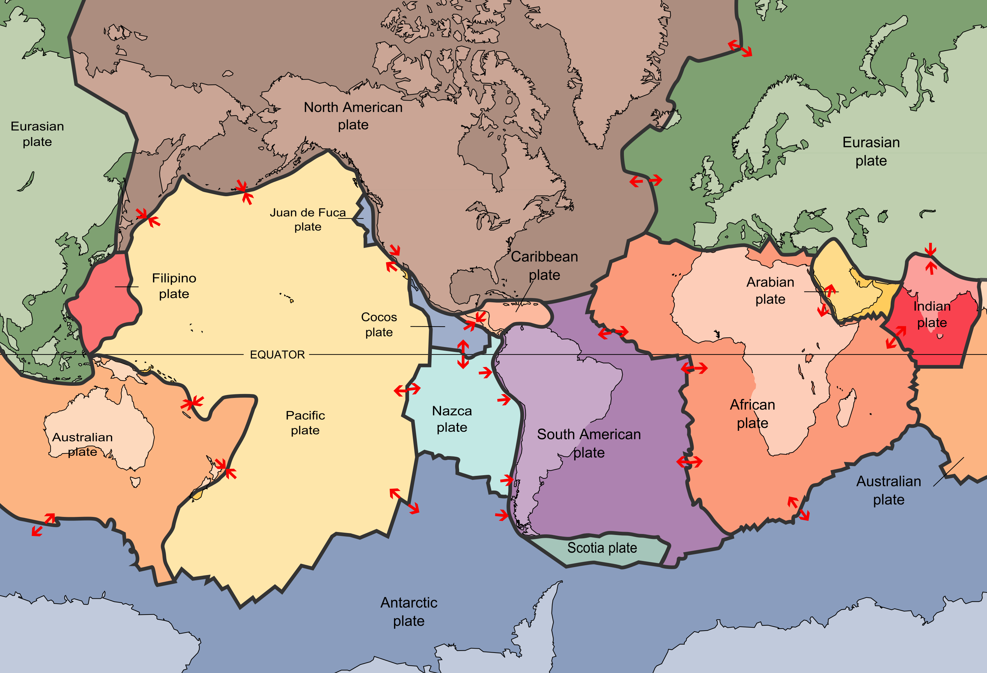
Present day tectonic plates
Notes:
This slide should be shown to students.
This is a map of today’s current tectonic plates, with arrows drawn to show their relative motions. The tectonic plates are big! Some of them contain whole continents. The seafloor spreading that we just learned about is represented by red arrows moving apart, for example along the Mid Atlantic Ridge between the Americas and the Eurasian and African plates in this map. This is called a divergent plate boundary. Spreading between tectonic plates along mid ocean ridges is one part of plate tectonics that moves the continents around. This is how plate tectonics explains continental drift. It may be instructive to show students that the plate boundaries don’t always line up perfectly with the boundaries of the continents. To make this map more personal, you can ask students which tectonic plate they live on, and which plate boundary they are closest to. For example, San Diego, CA is actually on the Pacific Plate, and it is moving northwest with respect to the North American plate. This type of plate boundary is called a transform boundary. The third type of plate boundary is called a convergent boundary, and that’s where two plates move toward each other. A great example of this is the Indian Plate moving toward the Eurasian plate. In the next lesson, we will explore the three types of plate boundaries in greater depth. We will use candy bars to represent tectonic plates, and discover that different kinds of geological features, such as mountains or offset stream beds, can be found at different types of tectonic plate boundaries.
IMAGE CREDIT: http://pubs.usgs.gov/gip/dynamic/slabs.html

Slide 18
Conclusions
Wegener used evidence such as fossils and glacier striations to support his theory of Continental Drift.
The theory was originally rejected because he couldn’t explain what force was making the continents move
Geologists used new evidence, such as seafloor magnetic anomalies, to explain that the continents did move (and are still moving today) because of Plate Tectonics.
Notes:
This slide is for the instructor only.
There is an important distinction between Continental Drift and Plate Tectonics.
Continental Drift is the idea that the continents had once fit together and have moved to their current location.
Plate Tectonics is a fleshed-out theory that describes how that happened. This includes seafloor spreading at mid ocean ridges and subduction at convergent boundaries, both of which are connected to convective processes in the mantle.

