Slide 1
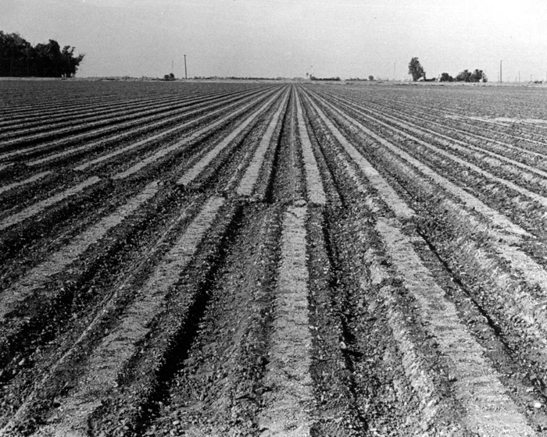
Measuring the speed of tectonic plates
Question of the day: how fast do tectonic plates move?
Notes:
This slide is for students.
Review:
Lesson 1) Ask students to recall some of Wegener’s evidence for continental drift. Ex: fossils, glaciers, and matching geological units.
Next ask students to recall some evidence discovered after Wegener’s death that made an extremely convincing argument for Plate Tectonics. Ex: magnetic “stripes” on the sea floor proved the seafloor was spreading at oceanic spreading ridges.
Lesson 2) Now that we know that the tectonic plates are moving, what are the three ways in which plates can move at a plate boundary? Divergent, transform and convergent. But how fast are the plates moving? Ask students for some estimations or guesses. (Answer: a few centimeters per year).
This brings us to today’s lesson. Today, scientists have a way to definitively prove that the tectonic plates are moving. The speed of tectonic plates can be measured using GPS technology. We will explore the basics of how GPS works, as well as look at some real GPS data from California in this lesson.
Let’s explore this picture before we move on:
First ask students to describe what they see. Ask them how often an agricultural field is re-plowed. A good guess is at least once per year, due to the growing season of the crop. Did the offset (the fault motion seen here) happen before or after the field was plowed? Answer: it must have happened after the field was plowed because it cuts through the rows. So how long ago did this motion on the fault happen? Answer: probably no less than a year before the photo was taken. Next, have students estimate the amount of offset caused by the fault. You can start by asking about how wide the rows are (about the width of a tractor tire, about 12 inches wide). You can see that the rows are offset by a little less than the width of one of the rows. The offset (otherwise known as the slip on the fault) was measured to be about 11 inches. You can also ask students which direction the fault slipped. Answer: right-lateral motion. Think of standing with each leg on one side of the fault. If you right leg moves backward, then it is right-lateral motion. If your left leg moves backward, then it is left-lateral. The observation that this was right-lateral motion is consistent with the relative plate motion of this region: right-lateral motion between the Pacific and North American tectonic plates.
Other info about the photo: Imperial Valley, California, Earthquake October 15, 1979. Furrows in a plowed field were offset about 11 inches by the magnitude 6.5 earthquake. Photo by D. Cavit. Back cover, Earthquake Information Bulletin, v. 13, no.3.
In the next slide we will look at some larger-scale offset features along the San Andreas Fault.
PICTURE/GRAPHICS CREDITS: http://libraryphoto.cr.usgs.gov/cgi-bin/show_picture.cgi?ID=ID.%20Earthquake%20Information%20Bulletin%20451
AUTHORS: Erica Mitchell (Scripps Oceanography) and Jerry Ruiz (University City High School)
WHY: We cannot feel the motion of the tectonic plates because they are moving so slowly, but we can measure their speed using GPS technology. The Plate Boundary Observatory (PBO) consists of about 1100 permanent GPS stations, the majority of which are located in the western united states. This allows scientists to measure the location of each station with millimeter accuracy, so that the motion and deformation of the land can be studied. This subfield of earth science is called geodesy. This information is absolutely crucial in determining whether a fault is sliding steadily and slowly, or whether a fault is stuck, and the rocks around it are accumulating strain energy. Strain is a change in length divided by the original length. It is exactly like stretching a spring. In this situation, the fault can eventually rupture, turning the strain energy into motion on the fault, frictional heat, and seismic waves that travel outward and can be felt as an earthquake. Geodetic data (such as that collected using super-precise GPS equipment) is a very important component of the information collected by scientists that is used to determine seismic hazard.
SUMMARY: The PowerPoint presentation starts off by explaining the basics of how GPS technology works. Then, students are introduced to the PBO website. They should look at the map of permanent GPS stations, and find the one closest to where they live. The website has a photo of each station, and a graph of its location over the past ~ 6 years. Next, students should complete the worksheet. Given an average plate speed of about 3 cm/year, students must calculate how far the plate has moved for certain periods of time, and then draw lines of that length using a ruler. The main objective of this exercise is to get students more familiar with how short/long a centimeter is, and how quickly/slowly tectonic plates move.
WEBSITES/RESOURCES USED IN THIS PRESENTATION:
http://pbo.unavco.org/station/overview/P475
ADDITIONAL READING: http://pbo.unavco.org/ and
http://earthquake.usgs.gov/monitoring/gps/about.php
CONTEXT FOR USE: This lesson was designed for a 9th grade Earth Science class, and is lesson 3 of 6 in a unit called “Earthquake Hazards of Southern California”. It is helpful to do lessons 1 and 2 before this, because the concepts of plate tectonics and relative plate motion are introduced.
MISCONCEPTIONS: M1) Since I can’t feel the tectonic plates moving, they must not be moving. A1) The tectonic plates are moving at a speed of a few centimeters per year. This is about the same speed at which your fingernails grow. Geophysicists can measure this speed by using super-accurate GPS equipment to measure locations of benchmarks over many months. It’s so slow that we don’t notice it, until an earthquake happens and seismic waves shake the ground.
EVALUATION TIPS: Evaluation in this exercise if very straight forward. Most of the answers to the worksheet questions are based on simple arithmetic.
TEACHING NOTES: When explaining triangulation, it may help to draw three dots on the board representing satellites. Then, draw a circle around one dot representing the distance between the satellite and the GPS benchmark. Then, draw a second circle around the second dot (maybe this one is closer to the benchmark, so the circle is smaller). Show that the first two circles meet in two locations. Adding the third circle around the third dot shows that all three circles must meet in one location only. That is where the GPS benchmark is located.
Try to take the time to get students to line up in front of the room with meter sticks to represent what 300 years of motion should look like on the fault. It is a great visual for how very slow motion adds up to a large distance over long times.

Slide 2
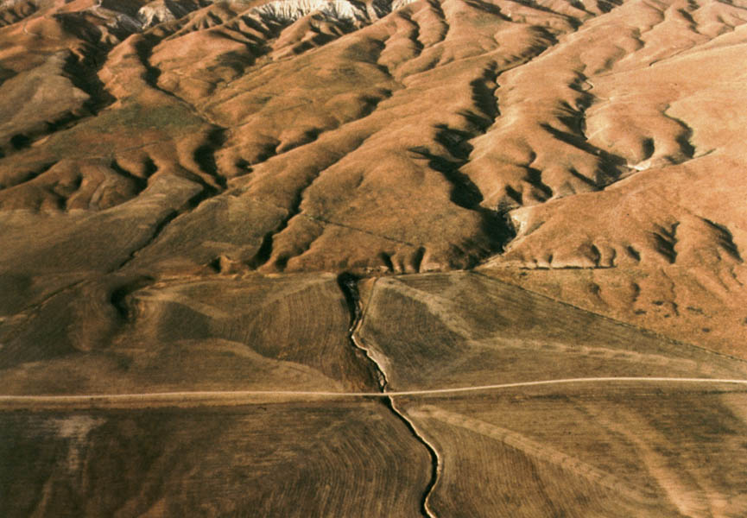
Carrizo plain section of SAF
Notes:
This slide is for students.
Ask students to describe what they see in this photo. This is a photo of the San Andreas fault cutting across streambeds and other erosional features. Be careful to not mistake the road in the foreground for a fault- there are no displaced features across the road. The fault is parallel to the road and just above the road in the photo. The most striking offset streambed is in the middle of the photo. It has been moved 130 meters in the right-lateral direction. There are also some smaller gulches to the right of the large streambed that have been offset by 9.5 meters in the right-lateral direction. You can ask students: how can this be? How can one streambed be offset by a larger distance than the others? Answer: The large streambed must have existed before the gulches did, so that the fault motion could displace it some distance before the gulches formed. Once the gulches formed, both the large streambed and the gulches were offset by the fault.
The dating and measuring of offset features such as streambeds is one way that geologists can measure the historic rate of motion along a fault. But this must be averaged out over many many years. With GPS technology, not only can we measure the precise amount of slip across a fault, we can also measure the slow straining of the rock around the fault when the fault is stuck. In the next slide we will explore how geodetic measurements of fault motion are made in a campaign-style GPS survey.
PICTURE/GRAPHICS CREDITS: http://geologycafe.com/california/pp1515/chapter2Album.html
“Stream offsets are well displayed along the Carrizo Plain reach of the San Andreas fault. Here, Wallace Creek, center (named by Sieh and Jahns, 1984) is offset about 130 m. To right (southeast) of the creek, small gulches are offset about 9.5 m as a result of fault slip accompanying the great Fort Tejon earthquake of 1857. See figure 2.4 for a detailed topographic map of this reach of the fault. “

Slide 3
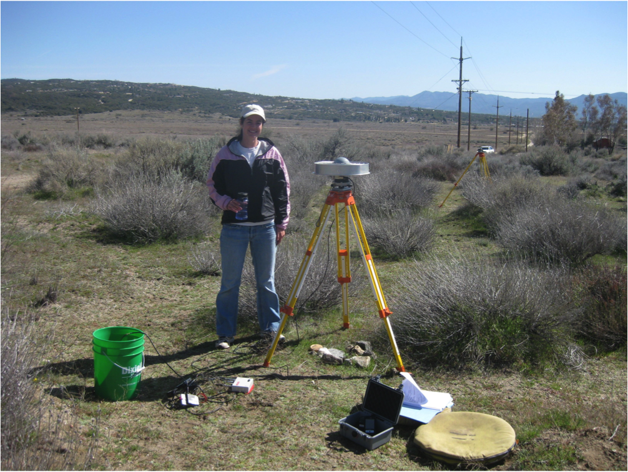
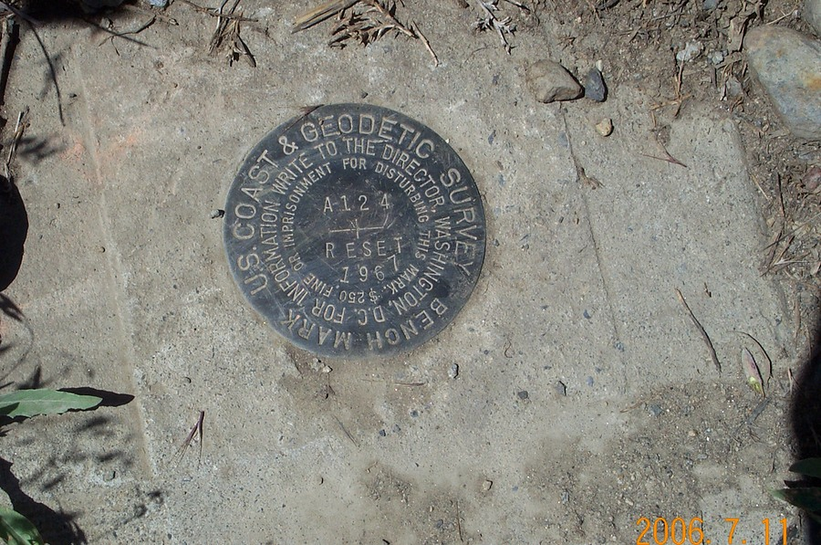
GPS field work
Notes:
This slide is for students.
PHOTO CREDIT: Erica Mitchell
PHOTO CREDIT: http://earthquake.usgs.gov/monitoring/gps/Mammoth_SGPS/a124/photos/
This is a photo of Erica with campaign GPS equipment at Anza, CA in 2010. In campaign GPS work, researchers bring out equipment for the day do measure the locations of benchmarks. Benchmarks can be official surveying markers left by utility companies or the USGS (see small photo). Another type of benchmark installed by geophysicists, like the one in the photo of Erica, is a piece of rebar that barely sticks out of a large buried chunk of concrete. It is one of about fifteen benchmarks that cross a section of the San Jacinto Fault. Researchers come back to the same benchmarks months later to measure their locations again. The motion of the earth can be calculated by dividing the change in location by the amount of time elapsed between measurements. This photo shows the tripod (which must be leveled perfectly), the antenna (looks like a flying saucer) on top of the tripod, the receiver (small box of electronics), a log notebook, and the heavy battery is inside the green bucket. Once set up, data should be collected for at least 20 minutes, but it is best to leave it for half a day (or longer), because satellites will be in a different configuration, and averaging can cancel out atmospheric noise.
In the next slide we will explore the basics of how GPS technology uses satellites to precisely locate a point on the Earth.

Slide 4
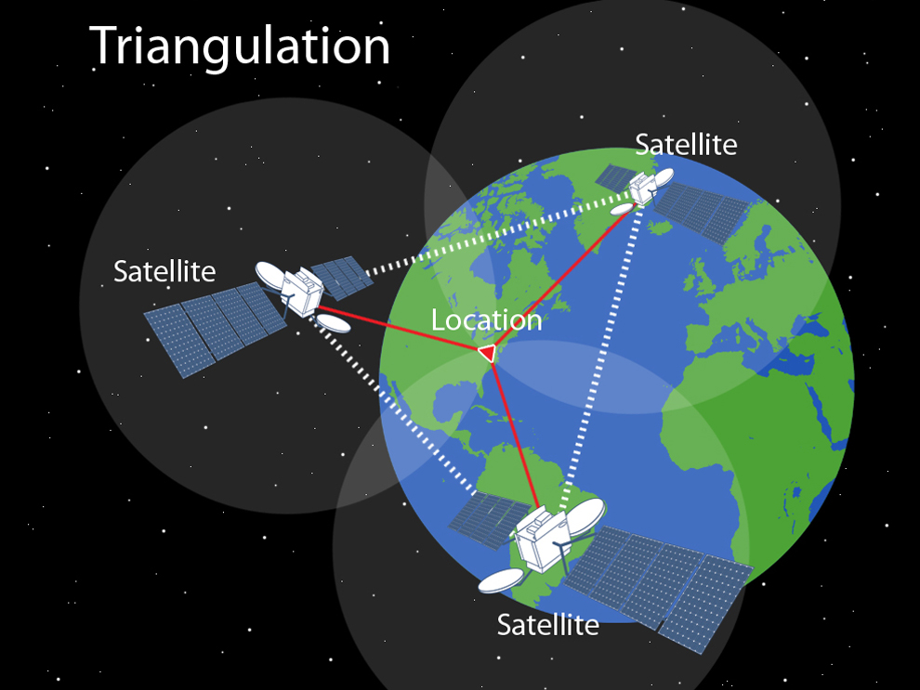
How does GPS technology work?
Notes:
This slide is for students.
IMAGE CREDIT: http://education.nationalgeographic.com/education/media/triangulation/?ar_a=1
This slide is meant to show students that GPS technology depends on satellites. There are a total of 30 GPS satellites orbiting the earth right now. To measure your location on the earth, you need to be able to be seen by four satellites at the same time.
Each satellite sends down a radio signal. The distance that the signal travelled can be drawn as a sphere around the satellite. The intersection of two spheres is a circle. The intersection of that circle with a third sphere is two points. And the intersection of those two points with a fourth sphere gives you a single point.
When explaining triangulation, it may help to draw three dots on the board representing satellites. Then, draw a circle around one dot representing the distance between the satellite and the GPS benchmark. Then, draw a second circle around the second dot (maybe this one is closer to the benchmark, so the circle is smaller). Show that the first two circles meet in two locations. Adding the third circle around the third dot shows that all three circles must meet in one location only. That is where the GPS benchmark is located. (Note that four spheres can intersect in one point, but when you draw on the chalkboard, you are living in two dimensions, so it only takes three circles to intersect in one point.)
Now that we covered the basics of how GPS technology works, let’s see where some permanent GPS stations are located in Southern California.

Slide 5
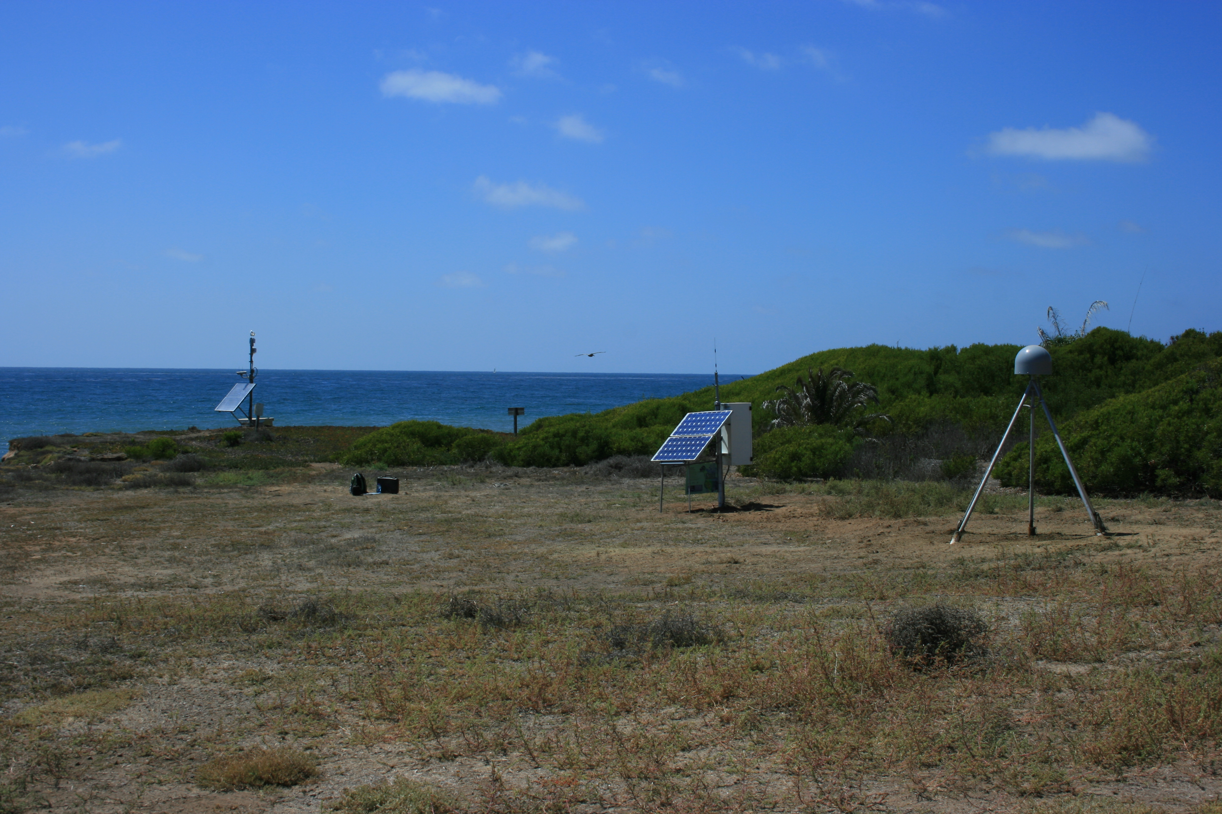
Plate Boundary Observatory
Notes:
This slide is for students.
PHOTO/MAP CREDIT: http://pbo.unavco.org/station/overview/P475
This slide is meant to introduce students to the Plate Boundary Observatory program. The map and photo are from the PBO website listed above. The map shows the locations of permanent GPS stations in Southern California. The one shown in yellow is the Point Loma station, and the photo shows what the equipment there looks like.
You may want to ask students how they would decide where to put permanent stations.
Some ideas to consider:
• Even distribution of stations across the map
• More stations closer to known faults, to get better coverage where the data is most interesting
• More stations closer to areas with high population density? Earthquakes are more dangerous when they are close to more people.
• Terrain- can the area be accessed by cars?
• Terrain- is it located on stable ground? Is the area subsiding due to human factors, like overwatering fields?
• Is the location on private or public land? Will a homeowner allow a station to be deployed on their property?
• Security- will vandals steal or tamper with equipment in this location?
So what does GPS data from a geodetic benchmark actually look like? In the next slide we will see actual data from the Point Loma permanent station.

Slide 6
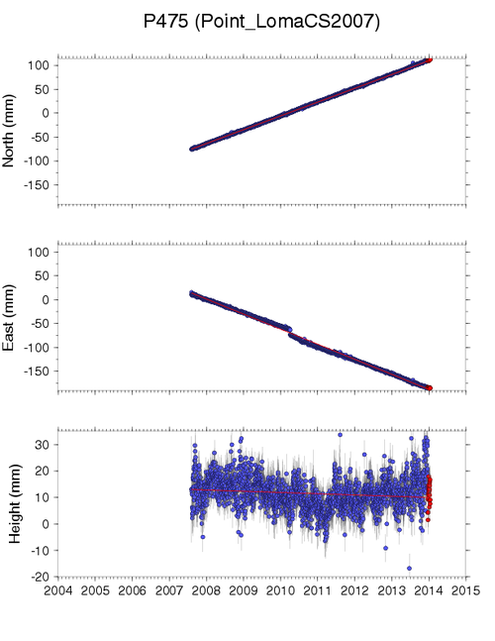
Location (North, East, Up) vs. Time (years)
Notes:
This slide is for students.
PHOTO/MAP CREDIT: http://pbo.unavco.org/station/overview/P475
This slide shows students what actual, local, GPS data looks like. These are graphs of the data from the Point Loma station. The x-axis of all three plots is time in years. The y-axis of the top plot shows the north component of the data in millimeters. The middle plot shows the East component of the data in millimeters. The bottom plot shows the vertical component of the data in millimeters. Blue dots are data points, and red lines are the best-fitting trend of the data.
Some questions to pose to students:
Q1) What direction is the station moving?
A1) NorthWest, and ever so slightly down.
Q2) Is the speed constant?
A2) Yes, the slope of the lines doesn’t change.
Q3) What is the little bump in around 2010 in the west direction?
A3) The El Mayor Cucapah (Easter Sunday) earthquake in Baja California, Mexico. It was a magnitude 7.2 near Mexicali, Mexico.
Q4) Why is the vertical graph so noisy?
A4) GPS technology is less accurate in the vertical direction than it is in the horizontal directions. This is because all of the satellites are above the station, whereas some satellites are to the east or north of the station and others are to the west or south of the station.
If students had a hard time interpreting these plots, you can show them the next slide, which depicts this motion in map-view.

Slide 7
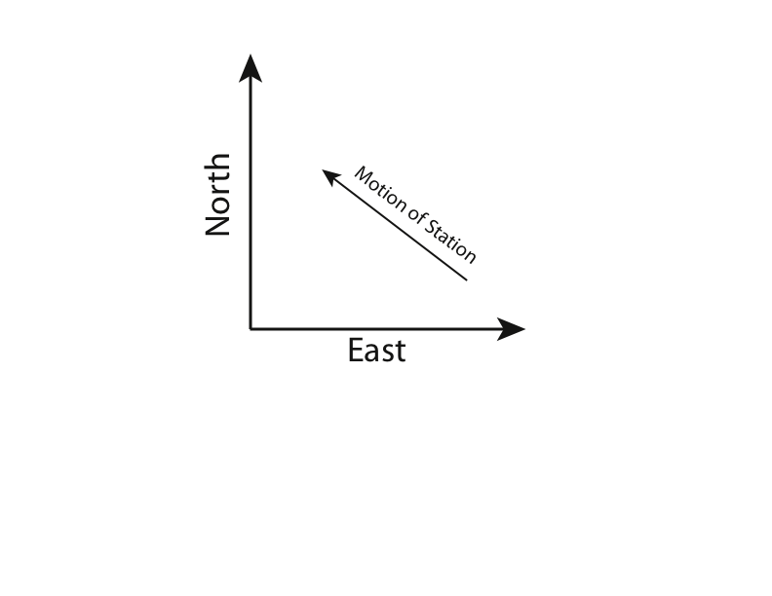
Motion components
Notes:
This slide is for students.
GRAPH CREDIT: Erica Mitchell
This slide is included to help students understand how motion on the map can be described in North/South and East/West components. This is basically a map view, with the arrow representing the velocity of the station. The direction of the arrow shows that the station is moving to the northwest.
In the next slide we will look at a map with many motion vectors (or arrows, just like the one above) at permanent and campaign GPS stations all across Southern California.

Slide 8
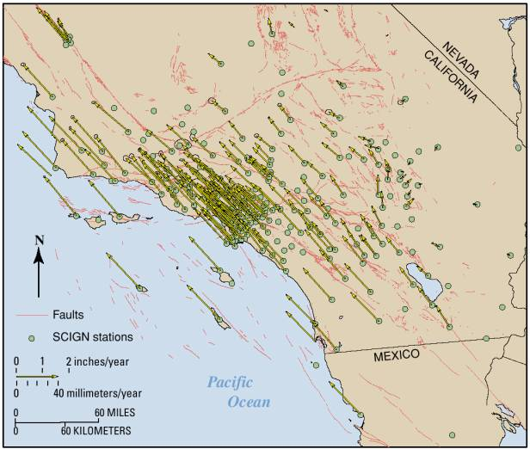
GPS velocity vectors
Notes:
This slide is for students.
GRAPH CREDIT: http://rincon.gps.caltech.edu/SCIGN/event/SCIGN_unveil_final_files/slide0146_image037.jpg
This slide is meant to show students how scientists look at GPS data. This is a map of Southern California with crustal velocity vectors presented by SCIGN (Southern California Integrated Seismic Network) in 2001. Each dot represents a GPS station. Each arrow represents the speed of the crust at that location. The direction of the arrow represents the direction of motion. The length of the arrow represents the speed of the motion. The legend in the lower left side of the map shows an arrow for scale- arrows of that length represent motion of 40 mm/year. Arrows that are longer mean faster motion than 40 mm/year. Arrows that are shorter mean slower motion. The legend has a scale for distances on the map- the bar represents 60 miles. Faults are represented by thin red lines. And finally, the legend has an arrow that shows which direction is North.
Now, let’s analyze the map.
You can ask students to locate themselves on the map. For example, where is San Diego? You can ask students where the longest arrows are, and where are the shortest arrows? How fast is the crust moving where you see the longest arrows? (about 50 mm/yr) How fast is the crust moving where you see the shortest arrows? (less than 5 mm/yr) And what is the overall direction of the arrows in this region? (Northwest). You can ask them to interpret what they think that means. Hint: look at the relationship between the faults and the arrows. Most of the arrows on the Pacific side of the San Andreas Fault Zone are pretty long The arrows on the North American side are much shorter. This means that there is some relative motion across the faults. This tectonic loading will either make the faults slide slowly and smoothly, or the faults can become stuck, build up strain energy, and release suddenly, producing an earthquake. The frictional properties of the rocks on the fault control which of these two scenarios will happen.
Lets review what we’ve learned in the next slide.

Slide 9
What have we learned?
What is the name of the technology that scientists use to measure location very accurately?
How do scientists know that they are coming back to the “same spot” each month?
How do scientists calculate the speed of tectonic plates?
Why is this kind of measurement important?
Notes:
This slide is for students
The instructor can use this slide to review and to evaluate whether the class understood the important concepts by asking the questions above.
A1) GPS Global Positioning System
A2) They bury a benchmark in the ground, so that if the ground moves, the benchmark moves with it.
A3) Change in location divided by change in time.
A4) It helps scientists learn about motion on faults. It also helps geophysicists more accurately determine the earthquake hazards of an area.

