Slide 1
Mapping Earthquakes
USGS real time earthquake map
Question of the day: where do most earthquakes occur?
Notes:
This slide is for the instructor.
IMAGE CREDIT: http://earthquake.usgs.gov/earthquakes/map/
AUTHORS: Erica Mitchell (Scripps Oceanography) and Jerry Ruiz (University City High School)
WHY: Geophysicists use data from seismographs to locate an earthquake and determine its magnitude. By studying the patterns of earthquake locations, scientists can map out today’s active faults. Knowing where the active faults are is so important because then we know how close they are to major cities (like Los Angeles or San Francisco, for example). If a city is closer to the hypocenter (the location where the earthquake initiates on the fault) of an earthquake, it is more likely to experience damage and destruction. The 1994 Northridge earthquake, for instance, happened almost directly under the city. 60 people were killed, 8,700 people were injured, and an estimated $25 billion in damage was caused. Damage was caused as far as 85 miles away, and peak ground accelerations were around 1g (the acceleration as that due to gravity). If students live anywhere near Los Angeles, this should be considered really important information. This earthquake happened relatively recently, and it happened in a relatively wealthy part of the world with decent building codes. The loss of life could have been much worse otherwise.
SUMMARY: This lesson consists of two parts:
The first part is an exercise in plotting a point on a map with a given Latitude and Longitude. Each student will be given a gridded map of California, as well as the coordinates of five real earthquakes. The student should mark the locations of each earthquake on the map with a star.
For the second part of the lesson, each student will need a computer with internet access. Students will answer questions in a worksheet that introduces them to the real-time earthquake map on the USGS (United States Geological Survey) website. Students will learn about features such as color coding earthquakes by date/time or by depth. They will also explore global and local trends in earthquakes.
WEBSITES/RESOURCES USED IN THIS PRESENTATION:
http://earthquake.usgs.gov/earthquakes/map/
http://en.wikipedia.org/wiki/1994_Northridge_earthquake
ADDITIONAL READING: NA
CONTEXT FOR USE: This lesson was designed for a 9th grade Earth Science class, and is lesson 4 of 6 in a unit called “Earthquake Hazards of Southern California”. This lesson can be done by itself, as a fun way to explore real-time earthquake data through the USGS website.
MISCONCEPTIONS: M1) Seismic hazard is the same all throughout the state of California. A1) Seismic hazard is highest in areas closest to active faults. It is especially high in Los Angeles, a densely populated sedimentary basin in which seismic waves are trapped and amplified.
EVALUATION TIPS: There is no need to collect the hand-plotted earthquake maps from the students. After giving them sufficient time to plot their earthquakes, put a large version of the map with earthquakes on the board so they can check their own locations. If any students maps didn’t look right, have them ask for help and address the issues. A common problem is that students don’t notice that the degrees West increase towards the left of the page.
TEACHING NOTES: Each student should have access to a computer with internet for the worksheet on the USGS real time earthquake map. It should be a self-led exercise. Students seemed to really enjoy the chance to independently explore the maps. The more familiar they are with the globe, the better!

Slide 2
Latitude and Longitude
Latitude
Parallel slices
Longitude
Like slices of an orange
How many degrees north or south of the equator.
Must be between -90º and 90º
How many degrees east or west of the prime meridian.
Must be between -180º and 180º
Notes:
This slide is for students
In order to understand how scientists map earthquakes, students must first learn how we can use coordinates of latitude and longitude to describe one unique place on the globe. There are two conventions for Latitude and Longitude.
Coordinates can be given in degrees North and degrees East. This is like the image above. This means that in the northern hemisphere longitude will go from 0ºN at the equator to 90ºN at the North Pole, and the southern hemisphere will go from 0ºN at the equator to -90ºN at the south pole. Similarly, lines of longitude will go from 0ºE at the prime meridian to 180ºE on the directly opposite side of the earth, and from 0ºE at the prime meridian to -180ºE in the other direction.
Or coordinates can be given in degrees North or South and degrees East or West. So in the northern hemisphere longitude will go from 0ºN at the equator to 90ºN at the North Pole, and the southern hemisphere will go from 0ºS at the equator to +90ºS at the south pole. Similarly, lines of longitude will go from 0ºE at the prime meridian to 180ºE on the directly opposite side of the earth, and from 0ºW at the prime meridian to +180ºW in the other direction.
So if you want to interchange between N and S or between E and W you need to multiply by -1. It is really just a matter of preference which you use. I prefer to work with all North and all East coordinates and just deal with the negative numbers. This makes it easier for me to do things like calculate distances between points.
It might be fun to ask students how many degrees are in a skateboarding trick where they spin half way around. (180º) This can help them remember how many degrees of latitude and longitude cover the globe.
In the next slide I switch to convention number (2).
IMAGE CREDIT: http://latitude-longitude.net/help.html

Slide 3
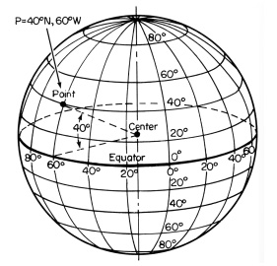
Coordinates
Location of a point on Earth
Two numbers:
Latitude (how far north/south) and
Longitude (how far east/west)
Example:
( 40 ºN, 60ºW)
Same as
(40 ºN, -60ºE)
Notes:
This slide is for students
Note that this globe is described in degrees North/South and degrees East/West. This is a slightly different convention than the previous slide, which is described in degrees North and degrees East. This is explained in the notes on the previous slide.
This slide is included to show students how a pair of numbers (coordinates in latitude and longitude) describe a unique location on the earth. The first number tells you which line of latitude to pick out (you can highlight it if that helps visually). The second number tells you which line of longitude to pick out (you can highlight that too). The single point where those two lines cross is the unique location of your coordinates.
When plotting a point, find out how many degrees per line on your globe. The image above shows 20º per line. Then, count number of degrees north of the equator and number of degrees west of the prime meridian. Where those two lines intersect is where you plot your point.
It may be helpful to let students play with a globe if you have one in the classroom.
In the next slide, we will briefly explore three different ways of writing coordinates that are more precise than a degree.
IMAGE CREDIT: http://cropwiki.irri.org/everest/index.php/File:Coordinates.jpg

Slide 4
Coordinates: notation style
Notation style Location of San Diego
1) Decimal Degrees: ( 32.7150º N, 117.1625º W )
2) Degrees, Minutes Seconds: ( 32º 42’ 54’’ N, 117º 9’ 45’’ W )
3) Degrees Decimal Minutes: ( 32º 42.9’ N, 117º 9.75’ W )
Calculation Symbol
360 degrees in a circle. Degree = º
60 minutes in a degree. Minute = ‘
60 seconds in a minute. Second = ‘’
Notes:
This slide is for students
This slide is included to show the three different ways of writing coordinates. Decimal Degrees is often preferred by scientists because the number only contains one unit (the degree) and that makes it easy to do calculations, such as calculating the distance between two points. With the other two notation styles you often have to convert between seconds, minutes, and degrees, which can be a bother. Here are some equations to switch back and forth between units:
Decimal degrees to degrees decimal minutes:
32.7150 degrees = 32 degrees + 0.7150 degrees x 60 minutes/degree = 32 degrees 42.9 minutes
Degrees decimal minutes to degrees minutes seconds:
32 degrees 42.9 minutes = 32 degrees + 42 minutes + 0.9 minutes x 60 seconds/minute = 32 degrees 42 minutes 54 seconds
Degrees minutes seconds to decimal degrees:
32 degrees 42 minutes 54 seconds = 32 degrees + 42 minutes x 1degree/60minutes + 54 seconds x 1minute/60seconds x 1degree/ 60minutes = 32 degrees + 0.7 degrees + 0.015 degrees = 32.715 degrees
Once students are familiar with converting between notation styles, you can show them how change the notation style setting on Google Earth.
In Google Earth, coordinates can be toggled between each of these different styles.
Go to the menu Google Earth → Preferences → 3D View → view Lat/Long
And click which you prefer.
Google Earth is a great tool for students to explore if there is any extra time. But it is not necessary for this lesson. In the next slide we will talk about the trouble with representing the three dimensional spherical earth with a map that is flat (two dimensional).

Slide 5
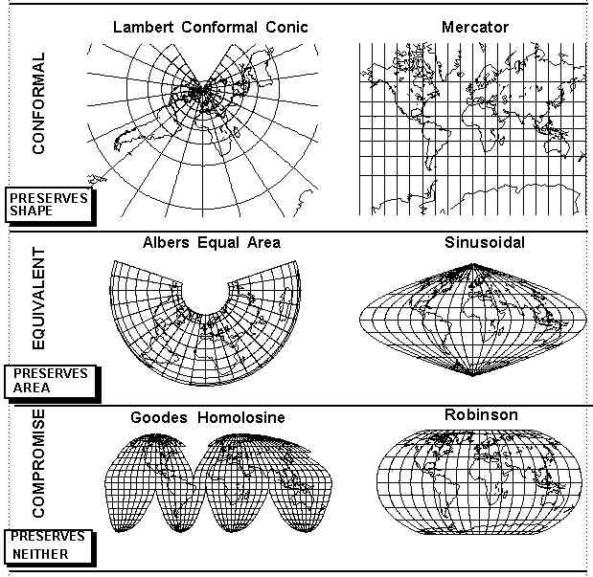
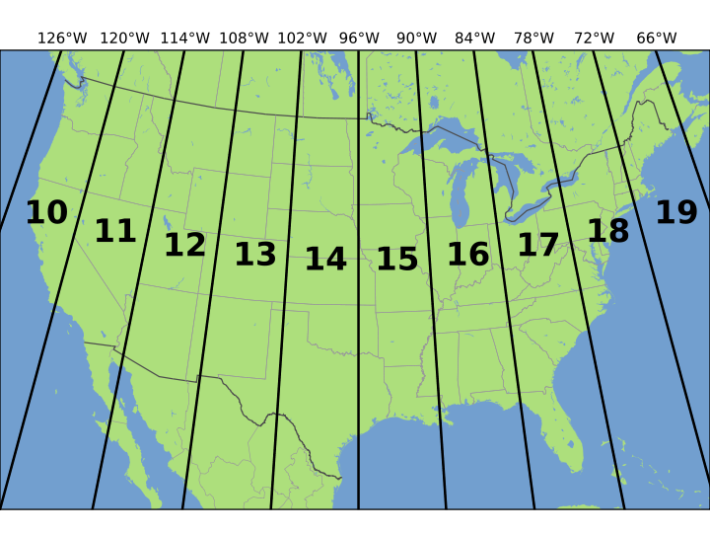
How to display spherical data on a flat piece of paper: Map projections
Universal Transverse Mercator (UTM)
Spherical Earth
Notes:
This slide is for students
The point of this slide is to introduce students to a fundamental issue in mapping: How to plot spherical things (like the Earth) on a flat paper or computer screen.
For a tangible analogy, you could ask students to think about peeling an orange, and flattening the peel on their desk. The point is that the rounded pieces of peel don’t flatten easily onto the desk.
You can focus on just Mercator and UTM if you want to simplify things.
IMAGE CREDIT:
http://cropwiki.irri.org/everest/index.php/File:Coordinates.jpg
http://www.geog.ucsb.edu/~kclarke/G176B/Lecture3.html
http://en.wikipedia.org/wiki/Universal_Transverse_Mercator_coordinate_system
There is no perfect map projection. A sphere cannot be flattened without distorting either (1) area or (2) shape. So different map projections were designed to preserve either area, shape, or make a compromise between the two.
Here are some common map projections:
• Robinson: a tradeoff is made between area and shape, so that the map kind-of “looks right”.
• Mercator: Originally developed for ship navigation. Shape is preserved, but locations near the poles become large. See how large Greenland looks in this projection? It isn’t really that big. This map is conveniently rectangular.
• Transverse Mercator (UTM for Universal Transverse Mercator): This is the one that students should spend the time to understand, since it is what most people use today. UTM is widely used in international mapping systems today.
In the next slide we will look at the details of a UTM map projection.

Slide 6
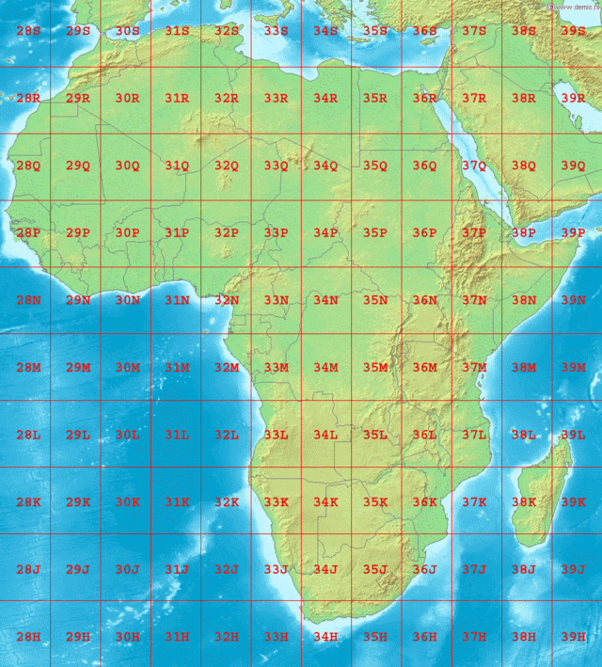
UTM
Zones
Zones and latitude bands
Notes:
This slide is for students
We want a convenient rectangular grid, like the Mercator projection, but we don’t want the distortion at the North pole and South pole. The solution to this problem is to split the globe into different zones and place a rectangular grid on each of those zones. To give the coordinates of a unique location on the globe you first specify the zone, then you specify the northing and easting of that location in meters within that zone’s grid.
A UTM projection splits up the Earth into 60 zones, which are long strips that run north-south and are 6 degrees wide. The zones are numbered from1 to 60. You can see the zones that cover the United States in the slide above. The edges of the zones will overlap a little, and that can even be convenient if you’re working near the edge of a zone. A grid with North and East components is placed on each zone. The central North-South line of each zone is set at 500,000 meters instead of zero meters, so that negative numbers don’t come into play. The central East-West line of each zone is the equator. In the northern hemisphere, northings count up from 0 m North at the equator to about 9,300,000 m North (which coincides with 84 ºN). In the southern hemisphere, northings count down from the equator, which is set at 10,000,000 m so that there are no negative numbers. You must specify whether your location is in the northern or southern hemisphere, since two locations will have the same coordinates. Example coordinates: CN tower in Ontario, Canada: 17N 630084 4833438. 17 is the zone. Note that the N stands for northern hemisphere. 630084 stands for how many meters east. 4833438 stands for how many meters north.
An alternative to specifying northern vs. southern hemisphere is to split up each zone into 20 latitude bands (that are 8 degrees high) that are numbered from “C” in the southern hemisphere (at 80º South) up to “X” in the northern hemisphere (at 84 º North), but the letters “I” and “O” are left out because of confusion with the numbers 1 and 0. (unfortunately, N and S were not left out, and can be confused with the designation for northern hemisphere vs. southern hemisphere). To give the coordinates of your location, you would first give the zone, then the band, then th easting and northing of the grid. Example coordinates: CN tower in Ontario, Canada: 17T 630084 4833438. Note that the T stands for the latitude band. Don’t confuse latitude band N with N for Northern hemisphere.
IMAGE CREDIT: http://en.wikipedia.org/wiki/Universal_Transverse_Mercator_coordinate_system
http://en.wikipedia.org/wiki/Universal_Transverse_Mercator_coordinate_system#mediaviewer/File:LA2-Africa-UTM-zones.png
WEBSITES USED:
http://en.wikipedia.org/wiki/Universal_Transverse_Mercator_coordinate_system
http://geology.isu.edu/geostac/Field_Exercise/topomaps/utm.htm
Now that students have a background of latitude, longitude, notation styles and map projections, we can dive into some geological material. In the next slide we will explore the USGS 2008 Seismic Hazard Map of the United States.

Slide 7
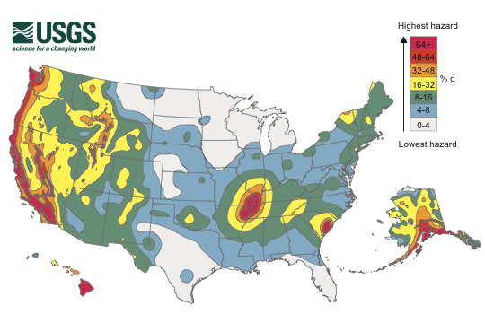
Seismic Hazard Maps
Notes:
This slide is for students
This slide shows students what the 2008 seismic hazard map looks like. The color represents the likely ground acceleration due to an earthquake, expressed as a percentage of gravity, g. If you go over this briefly in class then it will be more familiar to the students when they are completing their worksheets online.
Main components that go into calculating hazard:
• Previous measurements of ground shaking (data from accelerometers)
• Fault locations (data from seismographs, as well as field geologists)
• Seismicity on faults (earthquake data from seismographs)
• Geodesy (how much the ground is moving, as measured by GPS and other satellite methods).
• Geological maps (what kind of rock exists in certain places. Ex: soft sediments amplify shaking).
Features of the map:
• High seismic hazard along California due to the Pacific – North American transform plate boundary (San Andreas Fault Zone).
• High seismic hazard in Alaska due to the Pacific plate subducting under the North American plate.
• High seismic hazard in Hawaii. Hawaii is a perfect example of a Hot Spot, where magma rises to the surface in the center of a tectonic plate.
• High seismic hazard in New Madrid Seismic Zone. These are intraplate earthquakes- that means they occur within a plate rather than at a plate boundary. 750 million years ago, a continental rift started to break apart that area. The rift failed, and was covered by sediments. Today, the faults that are still down there have been reactivated.
• High seismic hazard in South Carolina due to similar geology as New Madrid.
IMAGE CREDIT: http://earthquake.usgs.gov/hazards/products/
FURTHER READING: http://en.wikipedia.org/wiki/New_Madrid_Seismic_Zone

Slide 8
Conclusions
The location of a point on the globe can be described by its Latitude and Longitude.
Coordinates can be written in different notation styles, such as Decimal Degrees or Degrees, Minutes, Seconds.
In making a flat map of the globe some distortion will happen.
UTM reduces distortion by putting grids on different zones around the globe.
Seismic hazard is high in California near the San Andreas Fault.
Notes:
This slide is for students.
For more information on how earthquakes are located, see the GK-12 lesson created by Deborah Kane:
http://earthref.org/SCC/lessons/2009/earthquakes/earthquake-location/

