Slide 1
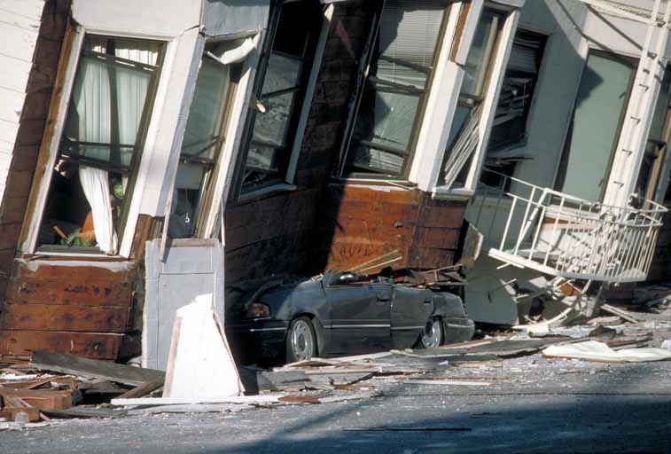
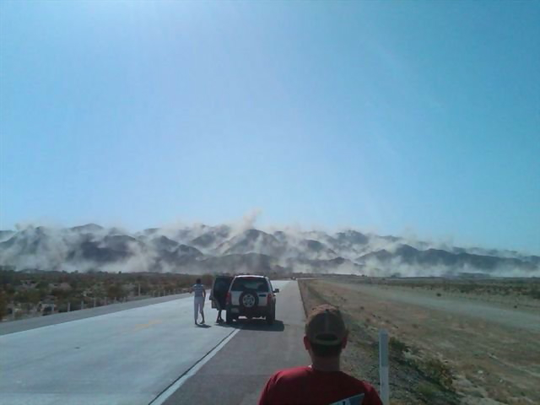
Stick-Slip: A lab activity on Earthquake mechanics
Question of the day: What causes an earthquake?
Do all faults have earthquakes?
M6.9 Loma Prieta, CA 1989
M7.2 Mexicali, Mexico 2010
Click images for movies
Notes:
This slide is for students.
The purpose of this slide is to engage students. It contains video footage of shaking during actual earthquakes.
AUTHORS: Erica Mitchell (Scripps Oceanography) and Jerry Ruiz (University City High School)
PHOTO CREDITS:
http://en.wikipedia.org/wiki/File:LomaPrieta-Marina-crushed-car.jpeg
http://www.mikesenese.com/DOIT/wp-content/uploads/2010/04/Mexicali-Earthquake-10.jpg
VIDEO CREDITS:
http://www.youtube.com/watch?v=JESaE_vFNKY
http://www.youtube.com/watch?v=FW-TkpvKPl0
WHY: Some natural hazards such as hurricanes and volcanic eruptions can be predicted by scientists, giving residents enough time to take shelter and protect themselves. The exact timing of Earthquakes, on the other hand, cannot be predicted. That is one reason why they’re so scary to some people. The probability of earthquakes can, however, be determined and people can prepare for them. For example, the Southern San Andreas Fault has not had a major earthquake in more than 300 years, while the Pacific and North American plates show a steady relative motion. The built-up stress on the San Andreas fault is likely to produce a magnitude 7.8, which will create tremendous damage in Los Angeles, within the next thirty years. Determining the seismic hazard of an area depends on basic knowledge of the seismic cycle, which we will explore in this lab exercise.
SUMMARY: In this stick-slip laboratory exercise, students will recreate the seismic cycle (including little earthquakes) using analogous materials. Each group of students will get a worksheet with instructions, a place to collect observations/data, and questions about the activity. The lab setup includes a block of wood that the students will pull across the table slowly using a weight scale. They can add weights to the block, and can change the material on which it slides. Slow steady pulling will either result in slow steady motion of the block, or jerky stick-slip motion, depending on the weight and sliding material used. The stick-slip motion is just like the seismic cycle on a fault. Stress builds up as the fault is stuck, and stress drops as it catches up to the tectonic plate motion, producing seismic (earthquake) waves.
WEBSITES/RESOURCES USED IN THIS PRESENTATION:
Credit given in notes of each slide.
http://sioviz.ucsd.edu/~fialko/research5-1.html
ADDITIONAL READING: http://earthquake.usgs.gov/regional/nca/1906/18april/reid.php
CONTEXT FOR USE: This lesson was designed for a 9th grade Earth Science class, and is lesson 5 of 6 in a unit called “Earthquake Hazards of Southern California”. It is helpful to do lessons 1-4 before this lesson, because the concepts of plate tectonics and global earthquake locations are explored before getting into the mechanics of earthquakes.
MISCONCEPTIONS:
EVALUATION TIPS: Make sure that students are filling out the data table consistently. This can save them lots of trouble in the rest of the exercise. For example, if sliding is jerky, then they should give a range of forces (in Newtons) between which the scale jumps, and a frequency of jerks. If sliding is smooth, then they should give a single force (in Newtons), and the frequency of jerks is not applicable.
TEACHING NOTES:
Make sure you test out the combination of sand paper, weights, and kitchen scale spring stiffness before you buy materials for the whole class. If the spring is too stiff, it won’t stick-slip. If the weights are too light, it won’t stick-slip. If the sand paper is too smooth, it won’t stick-slip. Many high school physics classrooms have access to all of these materials already.
The whole point of this lab is to get students to figure out the important parts of the seismic cycle on their own. They should be able to tell you, at the end of the activity, that slow motion of tectonic plates drives earthquakes, that rock elasticity and rock friction are necessary for earthquakes to happen, that small earthquakes happen more often than large earthquakes, and that not all faults have earthquakes.
Also, stress how important it is to pull the block slowly. If you pull too fast, the sliding will never become jerky.

Slide 2
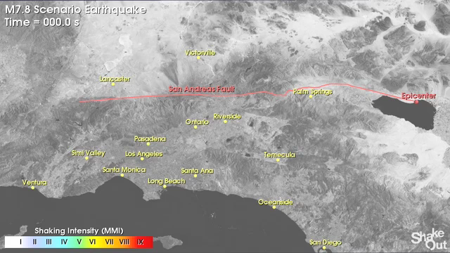
Scenario: M7.8 on San Andreas Fault (overdue!)
Click image for movie
Notes:
This slide is for students.
The purpose of this slide is to show students a possible rupture scenario on the San Andreas Fault. This is scientists best forecast of the intensity of shaking that will happen when this long overdue quake strikes.
Before showing the movie:
Have students find Los Angeles and San Diego on the map. Explain to them the shaking intensity scale at the lower left portion of the screen. Shaking intensity goes from I, which is color coded white, to IX, which is color coded red. Shaking intensity I is not felt. II to III is weak. V is moderate (green). VII is very strong (yellow). And IX is violent (red). The entire move takes about two and a half minutes, and this is what it would be like in real time (it is not sped up or slowed down). Have students look for where the rupture starts and what direction it goes.
Play the movie. After, you can have some discussion:
How long does it take weak shaking to reach Los Angeles? Answer: about a minute and a half. Even if an early warning system was perfect, that is not much time to react. How much time is there between the light shaking and violent shaking in Los Angeles? (91s - 42s = 49s). What is the distribution of shaking intensity? There is high intensity along the fault trace. There is also high intensity in the Los Angeles basin. Since Los Angeles is built on sediments (rather than hard rock), the shaking is both trapped and amplified in this area. What is the maximum shaking intensity in San Diego? Either V or VI. Why is is so much lower than Los Angeles? Farther from epicenter.
VIDEO CREDIT: http://earthquake.usgs.gov/regional/nca/simulations/shakeout/
Now that we have an idea of how fast and how strong shaking could be during this scenario, what should you do when you feel an earthquake? The video in the next slide explains “drop, cover, hold on”.

Slide 3
Earthquake hits! What should you do?
What are two likely ways to get injured during an earthquake?
What do you need to remember?
Click image for movie
Notes:
This slide is for students.
The purpose of this slide is to show students what to do when an earthquake happens.
Don’t run. Likely ways to get hurt during an earthquake are falling down while running, and large items falling down on you from shelves or the ceiling.
Drop, Cover, and Hold on.
VIDEO CREDIT: http://www.youtube.com/watch?v=M3WHIHgy75c
WEBSITES USED: http://www.shakeout.org/dropcoverholdon/
In the next slide we will explore the mechanics of earthquakes! We’ll start with a quick cartoon video of the seismic cycle.

Slide 4
Click image for movie
The Seismic Cycle
Notes:
This slide is for students.
This slide shows an animated movie of the seismic cycle. It is meant to give students a visual of the process that happens on a fault. We will break this video down into three important components in the next slide.
PHOTO CREDIT: http://en.wikipedia.org/wiki/File:Ressort_de_compression.jpg
WEBSITE USED: http://earthquake.usgs.gov/learn/animations/animation.php?flash_title=Elastic+Rebound&flash_file=elasticrebound&flash_width=300&flash_height=350

Slide 5
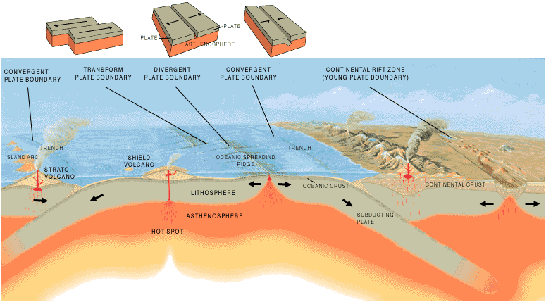
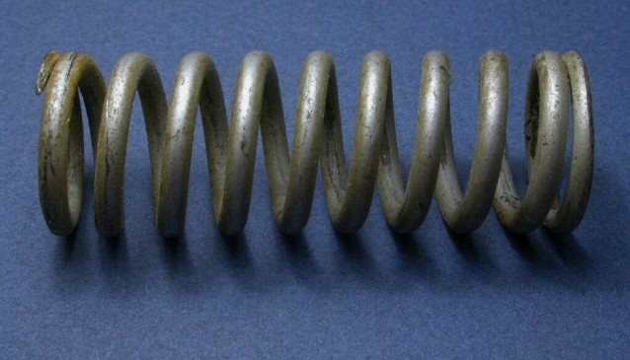
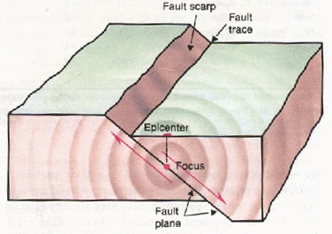
Motion of tectonic plates drives motion on faults.
When the fault sticks due to friction, the rocks deform like a spring
When the fault breaks (overcomes friction), the rocks snap back. This produces seismic waves (an earthquake).
Notes:
This slide is for students.
This slide breaks down the previous movie into its three basic steps:
The fault is pushed by motion of the tectonic plates. The image on the right hand side is meant to remind students of the motion of the tectonic plates.
If the fault sticks, the fault rocks deform, and bend due to the plate motion. The fault rocks deform elastically, the same way a spring stretches when you pull on it. The image on the right hand side is a spring, which is meant to represent the elastic deformation of the rocks.
The stress on the fault will finally become greater than its frictional strength. It will snap forward (rupture), catching up to the tectonic plate motion. When the fault ruptures it produces seismic waves that travel outward in all directions, and that you feel as an earthquake. The image on the right hand side shows a fault slipping, and seismic waves radiating from the hypocenter.
The process then repeats itself.
This is the basic seismic cycle. It can happen on faults at all three types of plate boundaries: divergent, transform, and convergent. The video shown represented a strike-slip fault, which is likely to be found in a transform plate boundary. The real earth is more complicated because faults can have complicated geometry- sometimes they branch out, sometimes they curve. Also, the rocks through which the fault cuts can be very heterogeneous- from solid granite, to soft sediments. And we don’t know the detailed seismic history of many faults. All of these factors make predicting earthquakes extremely difficult.
Scientists try to recreate this seismic cycle in miniature in the laboratory. The way that the miniature faults behave can help us learn more about how earthquakes work. There are some photos from our laboratory at Scripps Institution of Oceanography in the next slide.
IMAGE CREDITS:
Epicenter: http://earthquake.usgs.gov/learn/glossary/?term=fault%20plane
Spring: http://en.wikipedia.org/wiki/Spring_%28device%29
Tectonics: http://pubs.usgs.gov/gip/dynamic/Vigil.html
COMMON MISCONCEPTIONS:
M1) Rocks are so hard that they can’t bend. A1) Rocks do bend. In fact, they behave elastically, like a very stiff spring. When force is applied to them they deform. When that force is taken away, they snap back to their original shape. This is a critically important part of earthquake mechanics.
The reason we don’t see rocks bend much is because they are very stiff at short length scales. Think about trying to bend a very short chopstick- it’s possible, but hard! Now think about trying to bend a long chopstick- it’s much easier to see the deformation.

Slide 6
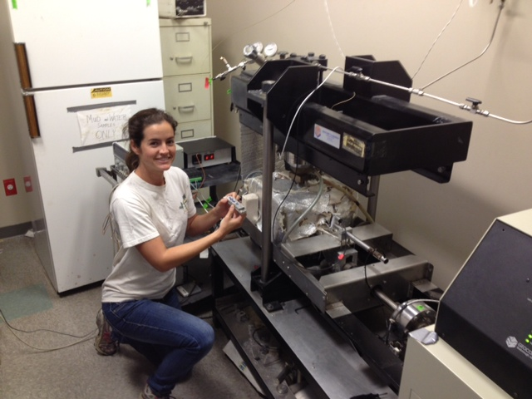
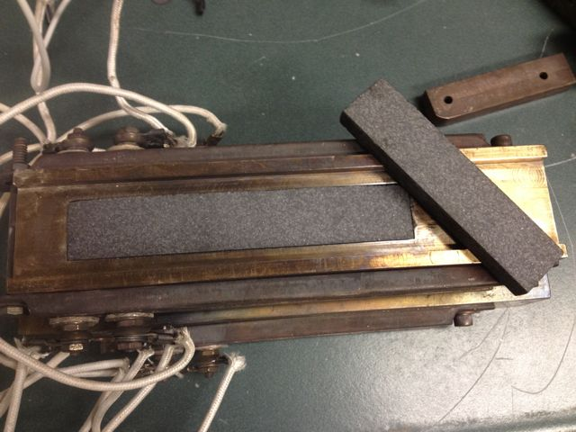
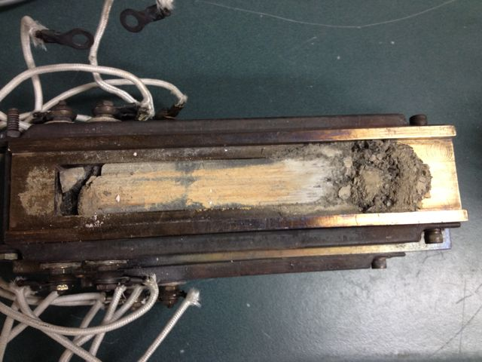
Stick-slip experiments: Miniature earthquakes in the laboratory
Before
After
Notes:
This slide is for students.
IMAGE CREDITS: Erica Mitchell
The purpose of this slide is to show students what a real rock friction laboratory looks like. In my research, I put blocks of rock under very high pressures and temperatures to mimic the conditions on a fault deep within the earth. Then, the machine drags one block across the other, like the motion on a fault. Depending on the laboratory conditions and rock type, we sometimes observe stable sliding motion, and sometimes observe unstable stick-slip motion. The degree of instability tells us about the potential for certain rock types to create earthquakes in the earth. We can create similar stick-slip experiments in the classroom. I’ll explain the classroom setup in the next slide.

Slide 7
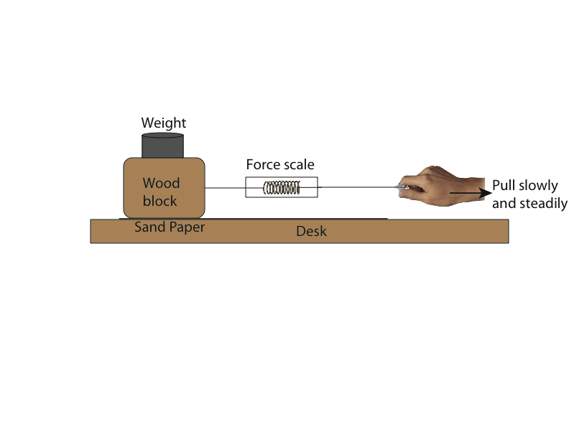
Stick-slip experiments: Miniature earthquakes in the classroom!
Notes:
This slide is for students.
IMAGE CREDIT: http://www.bgs.ac.uk/schoolSeismology/images/photo_of_day/simple_stick-slip_earthquake_machine.jpg
This slide shows students what their experimental setup should look like when they do the classroom exercise. They will actually be re-creating experiments that are very similar to those that we run in the rock friction lab at Scripps, just at lower pressure.

Slide 8
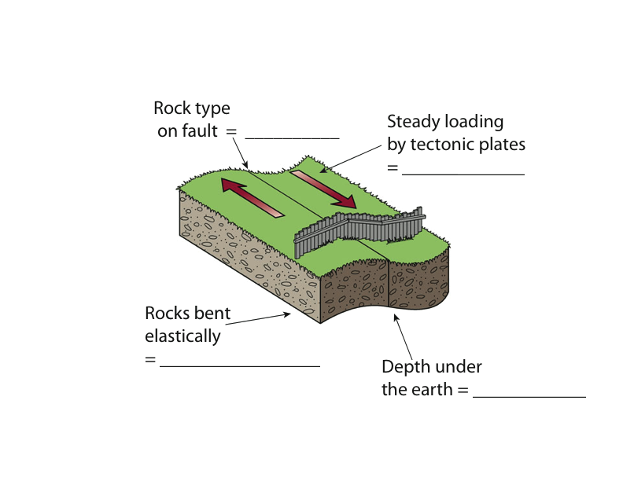
Connect experiments to natural faults
Notes:
This slide is for students.
Show this slide to students before they begin their experiments. Tell them that it’s their job to figure out the analogies between the classroom activity and the seismic cycle on faults.
Show this slide to students after the experiments, and ask them to share out which part goes where. Only show the next slide with answers after they figure it out.
IMAGE CREDITS:
© 2001 Brooks/Cole - Thomson Learning. Modified by Erica from http://archive.sciencewatch.com/ana/st/earthquakes2/10deceqRund/
And
Erica Mitchell

Slide 9
Connect experiments to natural faults
Sand paper
Pulling on scale
Spring stretching
Inside force scale
Weights
Notes:
This slide is for students.
The whole point of this lab is to get students to figure out the important parts of the seismic cycle on their own. They should be able to tell you, at the end of the activity, that slow motion of tectonic plates drives earthquakes, that rock elasticity and rock friction are necessary for earthquakes to happen, that small earthquakes happen more often than large earthquakes, and that not all faults have earthquakes.
IMAGE CREDITS:
© 2001 Brooks/Cole - Thomson Learning. Modified by Erica from http://archive.sciencewatch.com/ana/st/earthquakes2/10deceqRund/
And
Erica Mitchell

Slide 10
Conclusions
The earthquake cycle has three parts:
  Tectonic loading
  Elastic bending (stick)
  Elastic rebound (slip) Earthquake!
What to do during an earthquake
  Drop
  Cover
  Hold on
Notes:
This slide is for students.
This purpose of this slide is to review the basics of the seismic cycle, and what to do during an earthquake.

