Slide 1
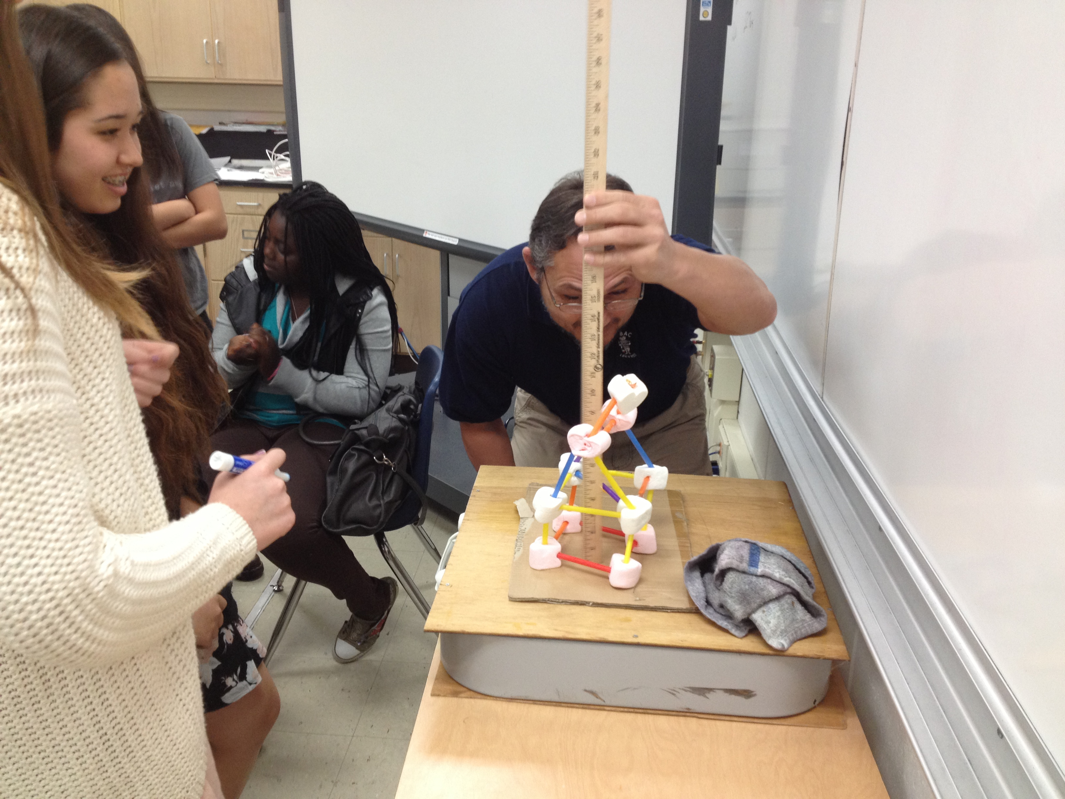
Shake Table!
Earthquake Resistant marshmallow structures
Question of the day: how would you design a building to withstand an earthquake?
Notes:
This slide is for students.
This slide can be shown to students to raise the question of the day and to show them an example of a marshmallow structure that they will be creating. In the next slide we will see a video of how a 7 story building performs on a shake table test.
AUTHORS: Erica Mitchell, Scripps Oceanography and Jerry Ruiz, UCHS
WHY: Earthquakes are a tremendous force of nature that can destroy infrastructure and lives. Many major cities, such as San Francisco, CA, are located very close to seismically active faults. Some cities fare much better than others when shaking hits. Good building designs, plus enforcement of smart seismic engineering codes are the difference between life and death in the event of major earthquake.
SUMMARY: This shake table classroom activity is meant to mimic the large-scale shake table tests that UC San Diego structural engineers use to test new building designs and materials. It should allow students to be creative in their designs, to analyze what parts work well and what parts don’t, and to construct solutions to the flaws in their original designs. It can be made into a competition- the tallest building to not collapse wins! You can even ask students to choose a location for their building in Southern California and justify that choice of location, based on what they learned about seismic hazard maps in Lesson 4.
PHOTO CREDIT: Jerry Ruiz
WEBSITES/RESOURCES: CSAV (Center for Study of Active Volcanoes) at University of Hawaii, Hilo.
https://www.facebook.com/video/video.php?v=1138318878296
ADDITIONAL READING: NA
CONTEXT/USE: This lesson was designed for a 9th grade Earth Science class, and is lesson 6 of 6 in a unit called “Earthquake Hazards of Southern California”. This lesson can be done by itself, as an investigation of building design.
MISCONCEPTIONS: M1) When an earthquake hits, you should run out of the building because it will collapse on you. A1) NO! Trying to run will only get you injured. It’s better to drop, cover, and hold on. Most buildings in earthquake prone areas of the United States are designed and build quite well, and will not collapse. It is better to protect yourself from objects that fall off of shelves.
EVALUATION TIPS: Students should be evaluated on how they improve their original design, incorporating earthquake engineering principles that they learn along the way.
TEACHING NOTES: The marshmallows were too good as a building material- none of the structures failed by shear collapse. I suggest experimenting with other building materials before you do this activity with the class. Try out gumdrops and toothpicks, raw spaghetti and scotch tape, etc...

Slide 2
What does an earthquake feel like?
What makes an earthquake dangerous?
How do engineers test if their building design is safe?
https://www.youtube.com/watch?v=D2Mrq0ioeT8
Notes:
This slide is for students.
The purpose of this slide is to show students how engineers test large scale building designs. The link shows a video of a 7 story building being tested on UCSD’s shake table. To get an idea of scale, you can see cars driving by on the freeway in the background. In the video, the shake table shakes underneath the building and you can see the building move with it. You can also see the building bend and shake a little too. It’s good that this design is strong but also flexible, so that it can bend under the acceleration without breaking. The one thing that this shake table can not do is move vertically. Real earthquakes have a component of motion in the vertical direction. If engineers don’t take this into account their buildings will perform poorly in the event of an actual earthquake.
Some questions to ask students:
Q1) Is it better to have a flexible or rigid building? A1) flexible.
Q2) How is the shaking from the shake table different to that of a real earthquake? A2) Real earthquakes also move the ground vertically.

Slide 3
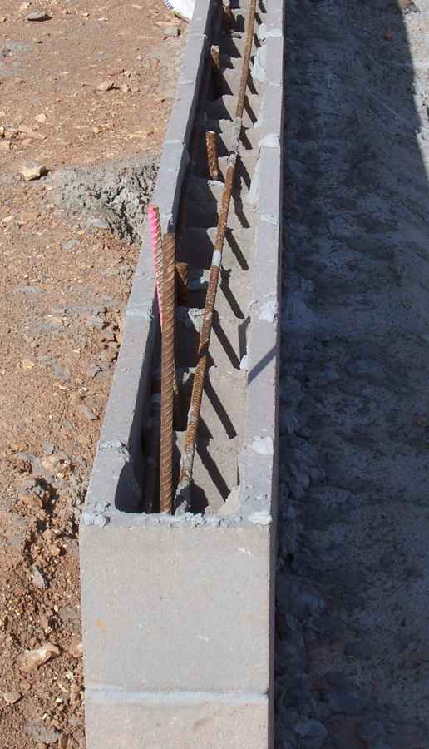
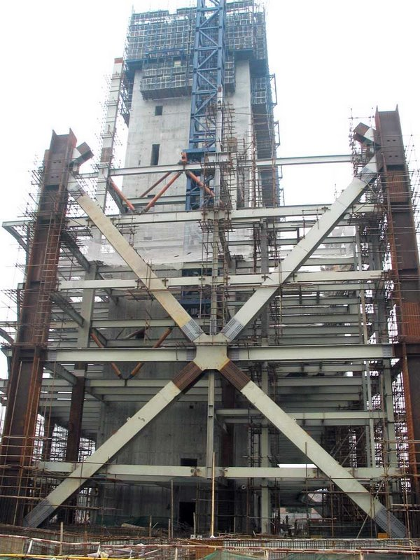
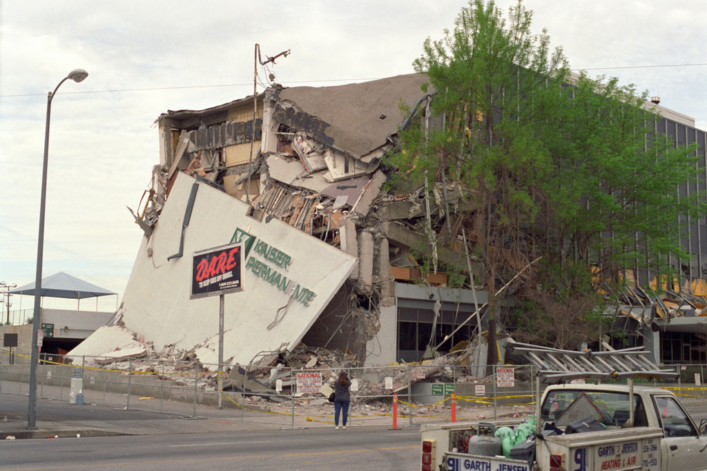
Earthquake engineering principles
(2)
(1)
Strong, flexible materials handle deformation better than brittle materials (reinforced masonry)
Buildings must be anchored to the foundation (or “isolated” from it)
Shear protection: cross bars provide vital stability within the building as it undergoes shear stresses
Protection against the building splitting open- steel ties
(3)
(4)
Notes:
This slide is for students
This slide can be shown to students to introduce them to four basic earthquake engineering principles. They may want to include these ideas in their structure designs. Upon sharing their shake test video or photo, they may want to refer to these principles to point out what went wrong.
Image number (1) shows an example of reinforced masonry. Concrete is very strong under compression, but very weak under tension. It is also brittle without reinforcement, and can crumble in the event of violent shaking due to an earthquake. Adding rebar reinforcements to the concrete gives both flexibility and tensile strength to the concrete structure. Image number (2) shows an example of base isolation. This is a photo taken during a shake table test at UCSD’s facility. The material being tested is called a “lead rubber bearing”. It is placed between the base of the building and the ground. So when the ground shakes due to an earthquake the rubber material can stretch, which dampens (lessens) motion of the building itself. Image number (3) shows an example of shear protection. The large strong bars that go across the building at an angle provide it with an incredible improvement in shear strength compared to a simply rectangular design. Finally image number (4) shows an example of a building that failed during an earthquake. Since the different floors of the building were not held together with strong enough through-ties, the floors sheared against each other, the joints shattered, and the building essentially “peeled apart”.
PHOTO CREDITS:
Reinforced masonry: http://en.wikipedia.org/wiki/File:Bond-beam.JPG
Base isolation: http://en.wikipedia.org/wiki/File:LRBtest.jpg
Cross bracing: http://en.wikipedia.org/wiki/File:2009_03_03_Pearl_River_Tower.jpg
Ties: http://en.wikipedia.org/wiki/Earthquake_engineering#mediaviewer/File:Kaiser_Permanente_Building_After_Northridge_Earthquake.jpg
The next few slides don’t need to be shown to students- they are just directions on how to make a classroom shake table from a box fan. You can skip forward to conclusions for the students.

Slide 4
Making the shake table
1)
1)
1) Start with a box fan. Remove the front and back screens, as well as the blade.
2) Add lock washers to the motor mount screws.
3) Add a regular washer to the spindle.
2)
3)
Notes:
This slide is not meant to be shown to students. It contains instructions for building the shake table prior to the lesson.
Open up a box fan. Remove the fan blade.
Credit: Still shots from instructional video from: CSAV (Center for Study of Active Volcanoes) at University of Hawaii, Hilo.
On their facebook “for teachers” page
https://www.facebook.com/video/video.php?v=1138318878296

Slide 5
Making the shake table
4) Cut a 1x2 to the length of the diameter of the fan blade.
5) Drill a hole 2/3 of the way along the 1x2.
Notes:
This slide is not meant to be shown to students. It contains instructions for building the shake table prior to the lesson.
Credit: Still shots from instructional video from: CSAV (Center for Study of Active Volcanoes) at University of Hawaii, Hilo.
On their facebook “for teachers” page
https://www.facebook.com/video/video.php?v=1138318878296

Slide 6
Making the shake table
6) Place the 1x2 on the spindle,
7) Place a wood screw near the flat side of the spindle to lock the board in place.
Notes:
This slide is not meant to be shown to students. It contains instructions for building the shake table prior to the lesson.
Replace the fan blade with an off-center piece of wood.
Credit: Still shots from instructional video from: CSAV (Center for Study of Active Volcanoes) at University of Hawaii, Hilo.
On their facebook “for teachers” page
https://www.facebook.com/video/video.php?v=1138318878296

Slide 7
Making the shake table
8) Attach flat boards to the back and front of the fan.
Shake away on multiple settings!
Notes:
This slide is not meant to be shown to students. It contains instructions for building the shake table prior to the lesson.
Attach a sturdy cover to the “shake table”.
Credit: Still shots from instructional video from: CSAV (Center for Study of Active Volcanoes) at University of Hawaii, Hilo.
On their facebook “for teachers” page
https://www.facebook.com/video/video.php?v=1138318878296

Slide 8
Conclusions
Building safety = location + design
Earthquake design principles:
  Strong and flexible materials
  Base isolation
  Shear protection (cross braces)
  Stop building from splitting open (steel ties)
Notes:
This slide is for students
To sum things up: In previous lessons we focused on what causes earthquakes, how they work, and where are they likely to occur. These things are important because a major factor in earthquake hazard is your proximity to an active fault. In this lesson we looked at the human side of earthquake hazards. The main danger in an earthquake is heavy items falling off of shelves and onto you during an earthquake. Another danger is people trying to walk during shaking and falling down. If shaking is extremely violent and the building is not constructed well, then building collapse could be a hazard too. All of these hazards can be mitigated by having an informed public (drop, cover and hold on!), and well designed buildings with strictly enforced building codes. In this lesson we learned about four design principles that make buildings safer during an earthquake. The first is to use strong and flexible materials, such as reinforced masonry, so that the building can flex instead of crumble during shaking. The second is to isolate the base of the building from the ground so that not all of the shaking is transferred up into the building. The third design principle is shear protection, such as cross bracing. This greatly improves the shear strength of a building. And finally, adequate steel ties should be used to stop the building from splitting open.

