Slide 1
Food Webs and Primary Production
Using diatoms to look at growth and primary production in the context of food webs
Notes:
Teacher Slide:
Authors: Sarah Lerch and Felicia Ryder
WHY :
This lesson combines two concepts which will be important for students to have a foundation in as they grow older: connections in food webs and limiting factors. By exploring one example of an essential part of the food web in depth, primary production, students will be able to connect what they experiment on in the classroom to a larger environmental picture. Another important concept that will arise later in the sciences, especially chemistry, is the idea of a limiting factor (or reagent in chemistry). This experiment will create a foundation for the concept that many different factors are involved in different processes, such as growth in primary producers. This concept will be essential as they move on to thinking about more complex chemical and ecological systems.
SUMMARY:
This lesson begins by allowing students to hypothesize about the relationship between primary producers and nutrients. This is followed by a video which will highlight the importance of primary producers in food webs. This will be followed by a week long experiment in the classroom where students will grow diatoms in three different nutrient treatments and collect data on their growth. Finally students will analyze the data from their experiments, discovering how growth in the diatom cultures changes under different nutrient conditions.
Lesson learning goals:
Student understands the importance of primary producers to food webs.
Student understands that primary producers occur on land as well as in marine environments.
Students understand that nutrients are one factor which determines how much primary producers can grow.
Key question:
How does nutrient availability impact primary production?
Overview of the lesson:
Engage:
- Goal: Allow students to establish their ideas about nutrients and primary producers, then keep their interest by using a video to connect these concepts back to primary production.
Hypothesizing
How does nutrient availability impact primary production?
What graph’s pattern do you expect to see in each different treatment?
Brain pop video Food Chains: http://www.brainpop.com/science/ecologyandbehavior/foodchains/
Watch video.
Do review quiz as a class.
Explore:
- Goal: Allow students to explore the impacts of nutrients on primary producers by growing diatoms in three different experimental treatments and collecting data on their growth over time.
Introducing nutrients.
What things do primary producers need to grow?
Review what primary producers need to grow.
Relate nutrients back to fertilizer.
Introducing the experiment.
Diatoms: primary producers in the ocean.
Experimental setup: Three different treatments with different amounts of nutrients.
Vocabulary.
Cell counts.
Final questioning
What limits the number of a specific organism in a food web?
What would the consequences be of changes at the base of food webs?
Explain:
Goal: To allow students to analyze the data collected over their week long experiment, concluding that primary production is limited by the available nutrients.
Data collection and graphing
Students record class cell count data.
Students create 3 graphs in Excel and paste in notebooks.
Review of slope and how it applies to class data.
General review of what slope is.
Review of how slope relates to the growth of diatoms in the class cultures.
Review a more complicated example of diatom growth data.
How factors other than nutrients can affect diatom growth
***(only necessary if data looks different than data in notebook key)
What growth patterns we expected to see in the treatments and why.
What might have affected diatom growth other than nutrient availability?
PICTURE/ GRAPHICS CREDITS:
- Cited on each slide.
WEBSITES/ RESOURCES USED IN THIS PRESENTATION:
www.superteacherworksheets.com
www.brainpop.com
ADDITIONAL READING:
- Website with phylogenetic tree including algae and plants: http://5e.plantphys.net/article.php?id=399
CONTEXT FOR USE:
This lesson should be taught after students have learned about photosynthesis and are introduced to the concept of primary production
Lesson length: This lesson is designed to last 7 days. One for experimental set up and data collection, four for continued data collection and two for data analysis. This lesson must be started on a Monday.
Data analysis may take more or less time depending on class
Data collection will take a minimal amount of class time
This lesson is meant to be used in conjunction with a Genetic Mutation unit which would fill in the majority of class time during data collection but any other lessons could be done during this time as well.
EVALUATION TIPS:
Evaluation techniques used in this activity: Gauging class discussions, notebooks
Refer to 5E lesson plan, Primary production_5E.docx
TEACHING NOTES:
ESR will be used as an acronym for Expected Student Response.
Each slide will have “Teacher slide:” or “Student slide:” at the top of the presentation notes. This indicates whether or not the slide should be used by the teacher (teacher slide) or shown to the students (student slide). Teacher slides can be hidden when presenting using the “Hide Slide” option.
Students will be required to record ideas and analysis in notebooks throughout the unit, a template for the student notebooks is provided in Primary production_notebook.docx
Underlined text indicates a place where students should record something in their notebooks
Notebooks will always be divided into 4 sections: Questions, hypotheses, evidence and analysis.
This set up allows students to hypothesize about the questions looked at in the unit, gather evidence, analyze that evidence and compare their final answers to the problems to their original hypotheses.
VOCABULARY:
Primary Producer: Organisms in an ecosystem that grow using sunlight and nutrients
Treatment: A level a variable is tested at. Ex: Different levels or concentrations of nutrients (low, medium, high)
Diatom: A unicellular primary producer found in the ocean
MATERIALS PROVIDED:
Cell count worksheet.docx
Food web worksheet and key.pdf
Primary production_lab.docx
Primary production.pptx
Primary production_5E.docx
Primary production_notebook key.docx
Primary production_notebook.docx
LABORATORY MATERIALS:
- See Primary production_lab.docx document

Slide 2
Engage overview
Homework to be given for the night before:
  Webquest: http://www.ducksters.com/science/ecosystems/food_chain_and_web.php
  Super teacher worksheet, Food Web: http://www.superteacherworksheets.com/food-chains/food-web-worksheet_WMNRM.pdf
Hypothesizing
  With words: How does nutrient availability impact primary production?
  With graphs: What graph’s pattern do you expect to see in each different treatment?
Play Brainpop video, Food Chains
  Brainpop quiz
  A subscription to Brainpop is required for this video
Notes:
Teacher slide: ENGAGE
INSTRUCTIONS:
This slide can be used as a quick reference for the engage section. More details will be provided in the comments for each slide.
ENGAGE GOAL:
Allow students to establish their ideas about nutrients and primary producers, then keep their interest by using a video to connect these concepts back to primary production.
OVERVIEW:
Hypothesizing
Goal: Allow students to establish current ideas about nutrients and primary producers using words and graphs.
Hypothesis 1, using words: How does nutrient availability impact primary production?
Overview of experimental setup.
Hypothesis 2, using graphs: What graph’s pattern do you expect to see in each different treatment?
Brain pop video Food Chains: http://www.brainpop.com/science/ecologyandbehavior/foodchains/
- Goal: Introduce students to food webs, this will give context to the importance of primary producers and nutrient availability later on in the lesson.
Watch video.
Do review quiz as a class.

Slide 3
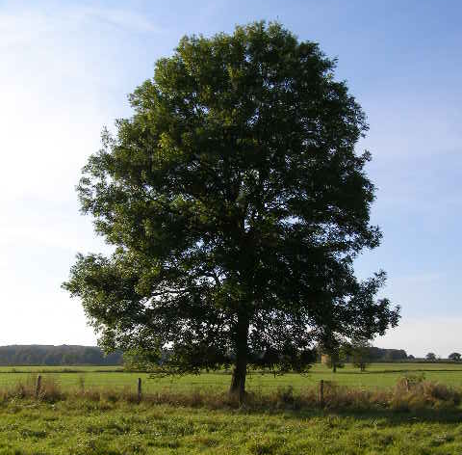

Hypothesizing:
How does nutrient availability impact primary production?
Notes:
Student slide: ENGAGE
INSTRUCTIONS:
Orient students to slide
Here are images of two different types of primary producers, a flower and a tree, both use photosynthesis to get the energy they need to grow.
We will use this image of a tree to represent a primary producer in the next few slides, but keep in mind that there are many different kinds of primary producers.
First I want you to hypothesize about this question in your notebooks though.
Give students time to hypothesize about the key question for the lesson.
Give students time to record answers in notebooks.
ESR: Plants need nutrients to grow, more nutrients mean plants can grow bigger and faster, plants will die without nutrients
SLIDE GOAL:
Give students a chance to record their current ideas about why nutrients are necessary for primary producers.
NOTES:
PICTURE/ GRAPHICS CREDITS:
Flower: Microsoft Office Clipart, 2007
Tree: Wikipedia; http://en.wikipedia.org/wiki/Tree

Slide 4
Nutrients =
If we set up and experiment and give a primary producer different amounts of nutrients:
Low
Nutrients
Medium
Nutrients
High
Nutrients
Notes:
Student slide: ENGAGE
INSTRUCTIONS:
This is an animated slide, each frame will be paired with its description.
Describe general experimental setup to students
In this lesson we will be looking at how growth in plants is related to the amount of nutrients available to them.
Frame 1: During this unit we will set up an experiment in order to test the affects of nutrients on growth in primary producers by giving them different amounts of nutrients.
Frame 2: We will use these red dots to represent nutrients for now.
Frame 2: One treatment in our experiment will have a low amount of nutrients.
Frame 3: The second treatment in our experiment will have a medium amount of nutrients.
Frame 4: The third treatment in our experiment will have a high amount of nutrients.
SLIDE GOAL:
Provide students with a general experimental setup which will give them enough information to hypothesize about nutrients and primary production using graphs.
NOTES:
PICTURE/ GRAPHICS CREDITS:
Tree: Wikipedia; http://en.wikipedia.org/wiki/Tree

Slide 5
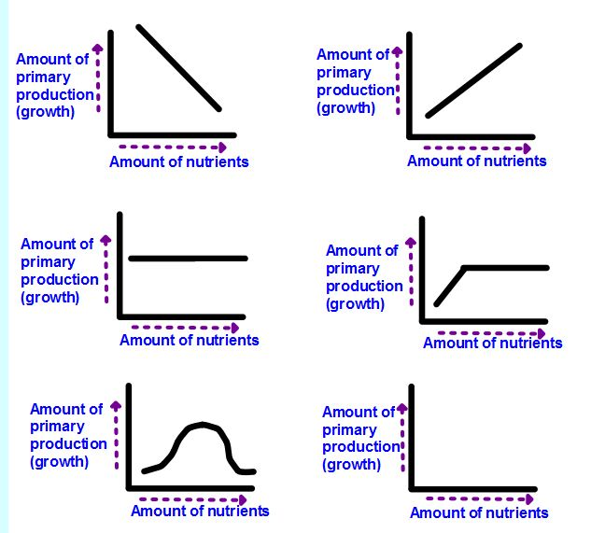
Hypothesizing:
What graph’s pattern do you expect to see in each different treatment?
Low Nutrients
Medium Nutrients
High Nutrients
Notes:
Student slide: ENGAGE
INSTRUCTIONS:
Orient students to the X and Y axes of the graphs: The Y axes of the graph represent growth, larger numbers on the Y axis represent increased growth in that treatment. The X axes represent time.
Over time after a primary producer is given a specific amount of nutrients (low, medium or high) they will use those nutrients up. How much they grow will change over time as they use up their nutrients.
Think about this and choose one graph for each different experimental treatment.
Pull up the next slide while students are hypothesizing.
SLIDE GOAL:
Provide students with an opportunity to hypothesize about how nutrient availability will affect growth in primary producers using graphs.
NOTES:
PICTURE/ GRAPHICS CREDITS:
Tree: Wikipedia; http://en.wikipedia.org/wiki/Tree

Slide 6
What graph’s pattern do you expect to see in each different treatment?
Time
Time
Time
Time
Low, Medium, High
Time Time
Notes:
Student slide: ENGAGE
INSTRUCTIONS:
Pull up this slide while students are hypothesizing so that they can see the graphs better.
It may be a good idea to go back over the axes at this point as well.
Give students a chance to record their hypotheses in their notebooks.
ESR: Possibly positive linear growth for all treatments.
Larger images graph options are provided in notebooks.
SLIDE GOAL:
Give students a larger image of the graphs that they will be able to see better.
NOTES:
PICTURE/ GRAPHICS CREDITS:

Slide 7
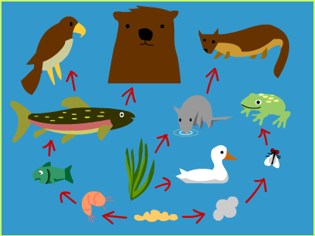
Food webs
Notes:
Student slide: ENGAGE
INSTRUCTIONS:
Introduce the theme of this upcoming lesson.
In the upcoming lesson we will be looking at the impact of nutrients on primary producers.
First we are going to look at how important primary producers are to food webs, so we can better understand why nutrients are important.
Play the brain pop video: Food Chains http://www.brainpop.com/science/ecologyandbehavior/foodchains/
This video will go over the general aspects of food webs and chains.
Do the quiz which goes with the video once the it’s over.
This will allow students to review what they have learned, important concepts will also be emphasized later on.
Allow students to discuss each question at their tables, and then give students time to share out until the correct answer is reached.
SLIDE GOAL:
Introduce students to food webs, this will give context to the importance of primary producers and nutrient availability later on in the lesson.
NOTES:
This should build on the information students would have gotten from their homework; food web worksheet and web quest.
A Brainpop subscription is necessary to view this video.
PICTURE/ GRAPHICS CREDITS:
- Image from brain pop video: http://www.brainpop.com/science/ecologyandbehavior/foodchains/

Slide 8
Explore overview
Questioning:
  Ask: What things do primary producers need to grow?
Review things necessary for primary production:
  Water, light, carbon dioxide and nutrients
Using fertilizer as an explanation for nutrients
Primary producers in the ocean
Experimental setup and vocabulary
Questioning:
  What limits the number of a specific organism in a food web?
  What would the consequences be of changes at the base of food webs?
Notes:
Teacher slide: EXPLORE
INSTRUCTIONS:
- This slide can be used as a quick reference for the Explore section. More details will be provided in the comments for each slide.
EXPLORE GOAL:
- Allow students to explore the impacts of nutrients on primary producers by growing diatoms in three different experimental treatments and collecting data on their growth over time.
OVERVIEW:
Introducing nutrients.
Goal: Introduce students to the idea that primary producers need nutrients.
What things do primary producers need to grow?
ESR: Food, water, light, dirt, air.
Review what primary producers need to grow.
Relate nutrients back to fertilizer.
Introducing the experiment.
Goal: Introduce students to the primary producer used in the experiment and the experimental setup.
Diatoms: primary producers in the ocean.
Experimental setup: Three different treatments with different amounts of nutrients.
Vocabulary.
Cell counts.
Final questioning
Goal: Relate the discussion of primary producers and what’s necessary for their growth back to food webs.
What limits the number of a specific organism in a food web?
ESR: There isn’t enough space for it, there isn’t enough food for it, other things eat the foxes
What would the consequences be of changes at the base of food webs?
ESR: More primary producers at the base of the food web would give the animals above more food, so there would be more animals in the higher levels, less would have the opposite affect.

Slide 9
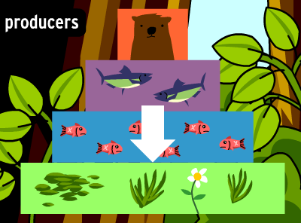
What things do primary producers need to grow?
Notes:
Student slide: EXPLORE
INSTRUCTIONS:
Make sure students understand the central concepts from the video.
Ask: What things do primary producers need to grow?
Allow students to discuss at tables and then share out
ESR: Food, water, light, dirt, air.
SLIDE GOAL:
Give students a chance to define what plants need to grow.
NOTES:
PICTURE/ GRAPHICS CREDITS:
- Food web roles image: Screen shot from Brainpop Food Chains video http://www.brainpop.com/science/ecologyandbehavior/foodchains/

Slide 10
CO₂
CO₂
CO₂
CO₂
CO₂
CO₂
NUTRIENTS
NUTRIENTS
NUTRIENTS
Notes:
Student slide: EXPLORE
INSTRUCTIONS:
This is an animated slide, each frame will be paired with its description.
Make sure all students are clear on what is necessary for primary producers to grow. They have probably missed the nutrients in the dirt, what this lesson will focus on.
Frame 1: Water, sun and carbon dioxide are the common things we think of when we think of what plants need. You guys can see the plants roots are already in dirt though.
Ask: Why do the plants need dirt though?
Allows students to share out answers.
Facilitate students coming up with answers beyond the first ESR.
ESR: To stand up, to get food.
Frame 2: There are important things in the dirt, called nutrients. These can be thought of as food that plants need to grow.
Connect nutrients back to food webs.
Changing the things primary producers need to grow will affect how well they can grow. You guys know that primary producers are important to food webs so that means that these things, like water, sun and nutrients are important too.
SLIDE GOAL:
- Link students current knowledge about what primary producers need to grow, to nutrients.
NOTES:
PICTURE/ GRAPHICS CREDITS:
Flower: Microsoft Office clip art 2007

Slide 11
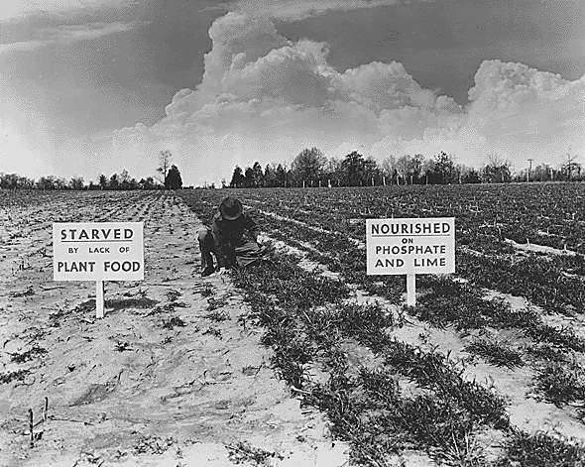
Fertilizer = nutrients
Plants with fertilizer
VS.
Plants without fertilizer
Notes:
Student slide: EXPLORE
INSTRUCTIONS:
Relate nutrients back to a situation students are familiar with.
Some of you guys might have parents who garden, something your parents might do to help things grow in their gardens is use fertilizer.
Fertilizer is concentrated nutrients. Sometimes people need to use fertilizer when the soil doesn’t naturally have enough.
This picture shows two sides of a farm field, the left side wasn’t fertilized and the right was. You can see that the plants on the right grew a lot better.
You can see the sign on the right says phosphate on it, that is an example of one nutrient primary producers need.
SLIDE GOAL:
- Relate nutrients back to a situation students are familiar with.
NOTES:
- The image shown was taken in Tennessee when a farm was demonstrating that when they treated land with phosphate and lime they could increase the amount of ground cover, this would in turn help to build up the soil fertility. Lime is a basic substance that is created from heating limestone, it is made of calcium oxide.
PICTURE/ GRAPHICS CREDITS:
- Fertilizer image: Wikimedia Commons; http://en.wikipedia.org/wiki/File:TVA_Results_of_Fertilizer.gif

Slide 12
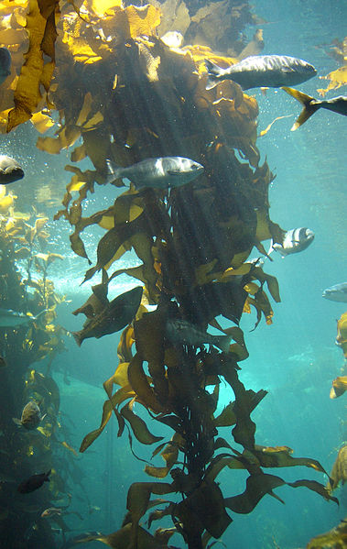
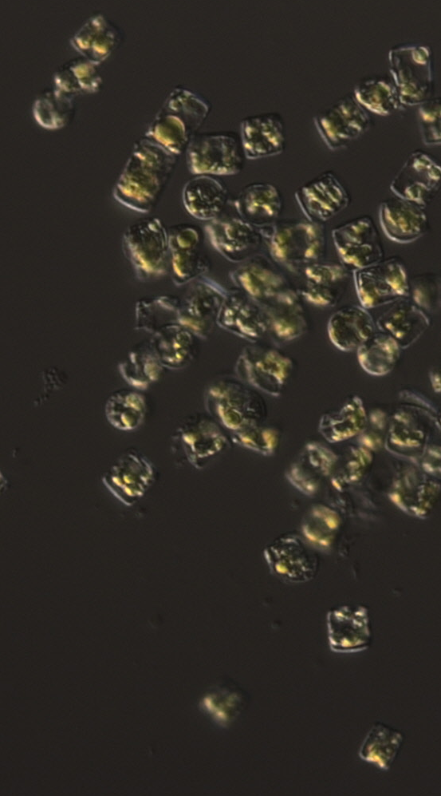
Primary production in the ocean: Multicellular and single cellular
Plants aren’t the only primary producers:
Algae
Seaweed
Kelp
Notes:
Student slide: EXPLORE
INSTRUCTIONS:
This is an animated slide, each frame will be paired with its description.
Transition from discussing primary producers on land to discussing primary producers in the ocean.
So far we have only looked at food webs on land, but they exist in the ocean too.
That means that there must be primary producers in the ocean as well.
Introduce algae.
You guys may have heard of multiple different words for the things that do primary production in the ocean. Like seaweed, kelp and algae.
Frame 1: We are going to be using one main word when we talk about all primary producers in the ocean, algae.
- Overview how algae are different from land plants.
Algae photosynthesize like plants on land but have some important differences, the easiest one to remember is that algae are typically found growing in water.
Another important difference is that plants are all multi-cellular, some algae are too, like this kelp (image on left). But lots of algae are unicellular, like these diatoms (image on right).
We are going to be doing an experiment with diatoms starting in class today.
SLIDE GOAL:
- Help students transition from discussing primary producers on land to primary producers in the ocean, which are the ones we will look at in this lesson.
NOTES:
Students may want to know more about the differences between plants and algae. See the reference chart on the next page to answer their questions.
PICTURE/ GRAPHICS CREDITS:
Kelp forest photo: Wikepedia Creative Commons, http://en.wikipedia.org/wiki/File:Kelp-forest-Monterey.jpg
Diatoms photo: Jesse Traller, Scripps Institution of Oceanography

Slide 13
Algae vs plants
Algae | Plants | Characteristic
X | X | Photosynthetic
X | X | Multicellular
X |  | Single celled
 | X | Vascular tissue
X | X | Sessile
X |  | Motile
 | X | Terrestrial
X |  | Aquatic
Notes:
Teacher slide/ supplemental: EXPLORE
INSTRUCTIONS:
Use this slide to help answer any student questions about differences between plants and algae.
SLIDE GOAL:
Provide teacher with a resource for discussing algae.
NOTES:
Above is a chart that has differences and similarities between algae and plants. These are all applicable in MOST situations but not all, there are few absolutes in biology. For example there are algae that grow in the fur of land animals or in snow, these are good general rules though.
The distinctions between plants and algae are not quite as cut and dry as you might like, partially because algae are a somewhat haphazard group and aren’t necessarily linked evolutionarily. But algae are not plants. One easy way to see this distinction is by looking at a phylogenetic tree. Phylogenetic trees can be made in different ways but the link below will lead you to one that was put together by looking at changes in highly conserved DNA sequences.
http://5e.plantphys.net/article.php?id=399
You can see when you look at this tree that plants are on their own branch completely. While green and red algae are fairly closely related to plants you can see that diatoms, brown algae haptophytes, apicomplexa and euglenoids (all algae) are not closely related (their branches are far away) to plants at all.
PICTURE/ GRAPHICS CREDITS:

Slide 14
Experimental setup
Growing diatoms in the classroom
3 nutrient concentration treatments
Low
Medium
High
Notes:
Student slide: EXPLORE
INSTRUCTIONS:
Introduce experimental set up.
So now that we talked all about primary producers in the ocean and algae I am going to give you guys the chance to grow some here in the classroom.
We are going to be growing one of the single celled primary producers, called diatoms, that were in that image I just showed you. You can’t see individual ones with your eye but we will be able to look at them through a microscope.
We are going to grow the diatoms in some artificial sea water. This is sea water that is made in a lab, its made so that is has the same elements and salts that are found in natural seawater.
There are going to be three different experimental treatments where the amount of nutrients in the artificial seawater is different. We are growing them in “low” “medium” and “high” concentrations of nutrients.
Over the next week we will see how well they grow.
SLIDE GOAL:
- Give students a chance to visualize the experimental setup.
NOTES:
PICTURE/ GRAPHICS CREDITS:

Slide 15
Vocabulary
Primary Producer: Organisms in an ecosystem that grow using sunlight and nutrients
Treatment: A level a variable is tested at.
Ex: Different levels or concentrations of nutrients (low, medium, high)
Diatom: A unicellular primary producer found in the ocean
Notes:
Student slide: EXPLORE
INSTRUCTIONS:
- Give students time to record the above vocabulary in their notebooks.
SLIDE GOAL:
- Give students the chance to record new vocabulary they have gotten so far.
NOTES:
PICTURE/ GRAPHICS CREDITS:

Slide 16
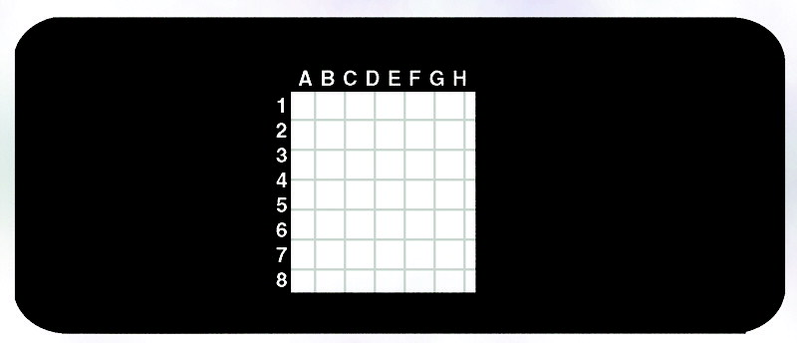
Experimental setup
How to do cell counts
Notes:
Student slide: EXPLORE
INSTRUCTIONS:
Provide students with an overview of how we will be collecting data during the experiment.
We are going to measure how these diatoms grow over the week, starting today!
We are going to do this by counting the number of cells in a certain volume of the cultures using a slide with a grid on it. That will allow us to see how the number of cells in a set area of the grid changes over time.
This is what a grid slide looks like, this grid will help us count how many cells have grown in each treatment since the last time we did our cell counts.
Some scientists use a slide called a hemocytometer to do this, but those slides are very expensive (~$100.00 each!). We will be using grid slides the same way, here is a video showing how scientists use hemocytometer slides.
Play start through 55 Seconds then skip to 2:34- 3:12.
It will be even easier for us because we wont have to worry about cell viability, it will be obvious if a cell is alive or dead.
We are also just going to count the number of cells in one square that I have outlined in sharpie. This square will be divided into 25 smaller squares to make counting easier.
SLIDE GOAL:
- Help students understand how cell counts work and what it will be like when they are doing them.
NOTES:
PICTURE/ GRAPHICS CREDITS:
Grid slide: Frey Scientific; https://store.schoolspecialty.com/OA_HTML/ibeCCtpItmDspRte.jsp?minisite=10029&item=45704&gclid=CjwKEAjw0ueeBRCmhozc-_DRrlUSJABihBEEkNj0Bl9l__S-gP5dbbPfXxsLaiY7Z-cSrPS2TUdJdBoC4Azw_wcB
Link to video: http://www.youtube.com/watch?v=WWS9sZbGj6A

Slide 17
Experimental setup
Diatoms
Shaped like a cylinder, can be rectangular or round depending on angle
Notes:
Student slide: EXPLORE
INSTRUCTIONS:
Show students what diatoms might look like under the slides.
This is a close up of the grid you guys will see under the microscope.
The diatoms will be small and greenish brown in color.
Diatoms are shaped like a cylinder so depending on what orientation they are, on their side or on their top, they will be rectangular OR circular in shape.
Shapes other than that probably aren’t diatoms! They may be bits of dirt or dust that have gotten on the slide.
SLIDE GOAL:
Give students an idea of what the diatoms will look like on the slides.
NOTES:
PICTURE/ GRAPHICS CREDITS:

Slide 18
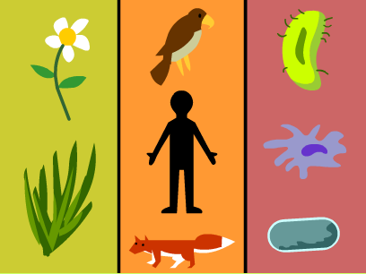
What limits the number of a specific organism in a food web?
Notes:
Student slide: EXPLORE
INSTRUCTIONS:
Between the video we just watched, and the homework you guys did last night, you guys know a lot about food webs by now. I want you guys to take the information you’ve learned and think about this:
Ask: What limits the number of a specific organism in a food web?
May need to re-state with an example: why isn’t the whole world covered with foxes running around?
Give students a chance to discuss at tables and then share out.
ESR: There isn’t enough space for it, there isn’t enough food for it, other things eat it
Acknowledge student answers, emphasizing the concept studied in this lesson.
There are a lot of different things which limit the number of students in any given ecosystem.
One important thing is the amount of food available to that organism. Foxes eat smaller mammals as well as berries and grasses. The smaller mammals it eats are usually vegetarians (this means they eat primary producers!). SO if there are fewer primary producers that will limit the amount of food available to a foxes, limiting how many foxes there are.
The amount of primary production or amount of plants is an important regulator of the abundance of different animals.
SLIDE GOAL:
- Relate the importance of primary production back to food webs.
NOTES:
PICTURE/ GRAPHICS CREDITS:
- Food web roles image: Screen shot from Brainpop Food Chains video http://www.brainpop.com/science/ecologyandbehavior/foodchains/

Slide 19
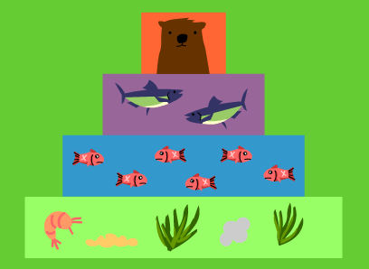
What would the consequences be of changes at the base of food webs?
Notes:
Student slide: EXPLORE
INSTRUCTIONS:
Give students the opportunity to solidify the concept that primary producers are the base of the food web, something which makes them especially important.
Ask: What would the consequences be of changes at the base of food webs?
Allow students to think, discuss with a partner and share out.
ESR: More primary producers at the base of the food web would give the animals above more food, so there would be more animals in the higher levels, less would have the opposite affect.
Some students might even make the connection that this would increase competition between animals in the upper levels of the food web.
SLIDE GOAL:
Give students a chance to connect the fact that primary producers are at the base of food webs and that this makes them especially important.
NOTES:
PICTURE/ GRAPHICS CREDITS:
- Food web roles image: Screen shot from Brainpop Food Chains video http://www.brainpop.com/science/ecologyandbehavior/foodchains/

Slide 20
Explain overview
Students create graphs for each treatment in excel
Discussion of slope
Discussion of outside factors affecting growth
  Only necessary if class data isn’t similar to expected
Analysis: exploring growth rate three different ways
  Independent work or work done in groups at tables
  Qualitative
  Number of new cells produced per day
  Number of times more cells per day
Questioning (questions 4-10)
  Independent work or work done in groups at tables
Notes:
Teacher slide: EXPLAIN
INSTRUCTIONS:
- This slide can be used as a quick reference for the Explain section. More details will be provided in the comments for each slide.
EXPLAIN GOAL:
- To allow students to analyze the data collected over their week long experiment, concluding that primary production is limited by the available nutrients.
OVERVIEW:
Data collection and graphing
Goal: Give students time to record and graph data from the experiment.
Students record class cell count data.
Students create 3 graphs in Excel and paste in notebooks.
Review of slope and how it applies to class data.
Goal: Give students an opportunity to review what slope is and connect this back to how slope is related to growth rate in this experiment.
General review of what slope is.
Review of how slope relates to the growth of diatoms in the class cultures.
Review a more complicated example of diatom growth data.
How factors other than nutrients can affect diatom growth
***(only necessary if data looks different than data in notebook key)
Goal: Make sure students understand the main point of the lesson and give them tools to explain deviations in their data from the expected.
What growth patterns we expected to see in the treatments and why.
What might have affected diatom growth other than nutrient availability?
Bacterial/ fungal contamination
Irregular growth conditions
Inaccurate data collection

Slide 21
Class data collection and graphing
Go over the final cell counts for the entire experiment for each treatment as a class.
  This can be done on a document cam or on the board.
Be sure all students have the opportunity to record the class data.
  Students should record data in excel and may need to be walked through the procedure for doing this.
Have each student make a graph of the data for each treatment.
  It may be necessary to walk through creating graphs in Excel as a class.
Notes:
Teacher slide: EXPLAIN
INSTRUCTIONS:
Give students the opportunity to record the cell counts for each treatment. This should be done at the end of the experiment.
The easiest way to do this will be to show the cell count page for each treatment to the class on a document cam (values could also be written out on the board).
Students can then record this data in Excel spreadsheets.
Facilitate students creating graphs for each treatment in Excel.
Student experience with creating graphs in Excel can vary a lot, some classes may need you to walk through how to create a graph with them.
Students should end up with three different graphs, one for each treatment. Each graph should have the appropriate axes (Y= Primary production (cells) and X= Time (Days)).
Students can print graphs and paste into notebooks if they are using printed notebooks, if creating their notebooks on computers they can just paste these graphs in.
SLIDE GOAL:
Give students time to record and graph data from the experiment.
NOTES:
PICTURE/ GRAPHICS CREDITS:

Slide 22
Slope= Positive
Slope = Negative
What is slope?
Time
Time
Slope= Zero
Time
Time
Cells/ Day
Time Time
Notes:
Student slide: EXPLAIN
INSTRUCTIONS:
Review what slope is and what it means for this experiment.
One way to think of slope is to think of a hill and to think of how steep or flat it is, the slant of the hill is its slope.
We can apply this same type of thinking to the lines on our graphs.
If the line is slanted downwards it has a negative slope.
If the line is slanted upwards is has a positive slope.
A flat line has a slope of zero.
In this experiment the slope represents the change in the number of cells over the number of days we collected data.
SLIDE GOAL:
Give students an opportunity to review what slope is and connect this back to how slope is related to growth rate in this experiment. This will help them answer their first analysis question.
NOTES:
PICTURE/ GRAPHICS CREDITS:

Slide 23
Different slopes: What do they mean?
No Growth
Dying!
Fast
Growth
Notes:
Student slide: EXPLAIN
INSTRUCTIONS:
This is an animated slide, each frame will be paired with its description.
Help students interpret how slope relates to how the diatoms in their cultures are growing.
So now we need to connect this idea of slope, back to how well our diatoms are growing.
Here is an example of what one of your graphs might look like.
Frame 1: Over the first few days there is a very large (or steep) positive slope, this means that the diatoms are growing really quickly.
Frame 2: In the middle here the line is flat, which means it has a slope of zero. This means the diatoms aren’t growing at all. There are the same number of cells in the grid over the cell counts for this entire span of time.
Frame 3: At the end of the experiment there is a large negative slope, this means the diatoms are dying. So from one cell count to the next there are actually fewer cells.
SLIDE GOAL:
Help students connect the concept of slope to what it means for the growth rate of the diatoms in their respective treatments.
NOTES:
PICTURE/ GRAPHICS CREDITS:

Slide 24
It’s usually a little more complicated….
Very Fast
No Growth
Dying
Faster
Slow
Notes:
Student slide: EXPLAIN
INSTRUCTIONS:
This is an animated slide, each frame will be paired with its description.
Give students a more realistic idea of what their graphs might look like.
Unfortunately, as is usually the case in science, our graphs might look a little more complicated; like this.
Can anyone tell me anything about how fast or slow the diatoms are growing at different times in this graph?
Point out different areas of the graph, allow students to share out.
Lets review what this graph is telling us.
Move from frame 1- frame 6, pausing to read description of each.
After this slide has been completed there are two options:
If class data looks similar to expected results in the notebook key allow students to answer analysis questions independently or in groups. It may be helpful to review the slide 27 with the class in order to send home the message for the lesson.
If class data looks different than expected results in notebook key use the next slides to explain differences before moving on to independent analysis.
SLIDE GOAL:
- Prepare students for the more complicated patterns they may see in their graphs.
NOTES:
Following this slide students can start to answer analysis questions in groups or independently.
PICTURE/ GRAPHICS CREDITS:

Slide 25
Analysis: Supplemental slide
Hopefully student data will look similar to the data presented in the notebook key
If not use the following slides to discuss:
  What we expected to see
  Why that is what we expected
  Why we ended up seeing something different
Notes:
Teacher slide: EXPLAIN
INSTRUCTIONS:
Use this and the following slides if experimental results come out differently from the results seen in the notebook key.
These slides should help students with their analysis if their data does not come out as expected.
SLIDE GOAL:
- Give teacher appropriate tools to explain deviations in data from what was expected.
NOTES:
PICTURE/ GRAPHICS CREDITS:

Slide 26
Expected results
When a treatment runs out of nutrients its growth slows and stops (slope= 0)
Eventually the diatoms will then start to die off
Growth is limited by the available nutrients
Notes:
Teacher slide: EXPLAIN
INSTRUCTIONS:
This is an animated slide, each frame will be paired with its description.
Walk students through the graphs we expected to see.
Sometimes scientists don’t get the results they expect to see in an experiment. This is what happened to me in our experiment. We are going to take some time to discuss my hypotheses for the experiment right now.
Low nutrients: The diatoms in this treatment grow quickly over the first few days then quickly level off around 12 cells per slide after the second day and start dying on the third day.
Medium nutrients: The diatoms in this treatment grow quickly over the first 3 days and then level off around 25 cells, finally starting to die by the 5th day.
High nutrients: This diatoms in this treatment grow quickly over the entire growth period but start to slow on the 4th day around 50 cells per slide.
Explain hypotheses.
The reason I had these hypotheses is that the diatom’s grow is limited by how many nutrients they have available.
At first all of the treatments had all the nutrients they needed, but the low and medium treatments eventually used up all their nutrients stopping growth and leading to the cells eventually dying.
The high nutrient treatment did not run out of nutrients in the course of our experiment, but may have been starting to towards the end when its growth slowed.
Walk through common points.
Frame 1: Growth in the treatments slows down when they run out of nutrients, the slope then goes to zero. You can see this happens earlier in the low nutrient culture (day 2) than in the medium culture (day 3).
Frame 2: After growth slows down the diatoms eventually begin to die, if no new diatoms are being made than the old diatoms will all eventually die off.
Frame 3: The take away to this is that growth, or primary production, is limited by the available nutrients!
Transition to why class results were different.
BUT as you guys can see my hypotheses weren’t quite right, so nutrients must not have been the only thing to affecting growth….
SLIDE GOAL:
Make sure students understand the take home to the experiment (nutrients are a limiting factor to growth in primary producers) even if their data don’t demonstrate that concept.
NOTES:
PICTURE/ GRAPHICS CREDITS:

Slide 27
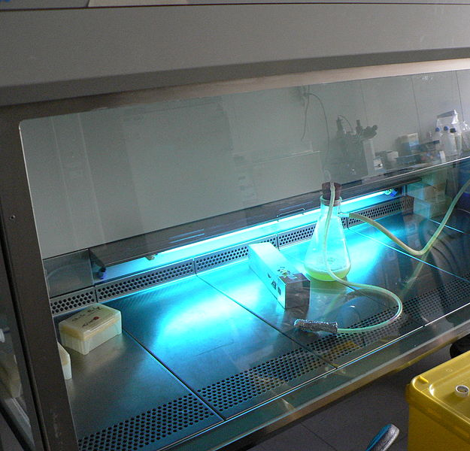
Why might our graphs look different?
Bacterial or fungal contamination
  No sterile conditions available
Irregular growth conditions
  Changes in temperature from day to night
  Too warm or too cold?
Inconsistent data collection
  Learning to do cell counts accurately takes time
Notes:
Teacher slide: EXPLAIN
INSTRUCTIONS:
This is an animated slide, each frame will be paired with its description.
Discuss different factors which can affect diatom growth
Frame 1: One factor which may have affected our cultures was bacterial or fungal contamination.
Frame 2: Usually in the lab we are able to keep our cultures completely sterile. This means that we work with them in special parts of the lab called hoods. This is an image of a hood. What hoods do is continually suck air away from our algal cultures, preventing bacterial or fungal spores from getting in our cultures.
Since we didn’t have access to these in the classroom bacterial or fungus might have gotten into our cultures when we were doing cell counts.
Bacteria and fungus compete with algae for nutrients and space in the flasks, changing their growth rates.
Frame 3: Another factor is that we couldn’t keep the growth conditions in the classroom completely consistent.
Frame 4: Normally in the lab we grow diatoms under very consistent temperatures, in the classroom though we can’t maintain the temperatures consistently from day to night, during the day the temperatures are kept comfortable but they are not necessarily maintained at night.
Frame 5: That being said we usually grow diatoms at 18 degrees C in the lab, it’s quite a bit warmer in the class room which might be causing the diatoms to grow more slowly. This means it would take them longer to use up their nutrients.
Frame 6: Something else we have to consider is error in how we collected our data.
Frame 7: It takes a long time for scientists to become good at doing cell counts, you guys haven’t gotten very much practice yet. When we are learning new techniques in the lab it’s good to remember we might not be perfect at what we are doing yet. One way to tell this would be to look at how similar the cell counts are that we averaged for each day, if they are very different than perhaps there is a lot of error in our data.
SLIDE GOAL:
Give students possible explanations for why their class data deviates from the expected results. They can use these explanations when answering their analysis questions.
NOTES:
There are also a lot of other things that are done to maintain sterile cultures. Here is a list if you are interested in discussing this topic more fully.
Glassware is usually autoclaved (heated in an oven at 121+ degrees for ~10 minutes) before it’s used.
Media is usually autoclaved before it is used.
Culture top is only opened in a hood.
Whenever the culture top is removed the top of the flask is exposed to a flame, this kills any bacteria that might have been at the flask edge. This is also done when placing the foam top back in.
Gloves are used when handing the culture.
Ethanol is used to wipe down any surfaces the culture is opened near, including gloves.
PICTURE/ GRAPHICS CREDITS:
- Laminar flow hood: Wikipedia, http://en.wikipedia.org/wiki/Laminar_flow_hood#mediaviewer/File:UV-ontsmetting_laminaire-vloeikast.JPG

