Slide 1
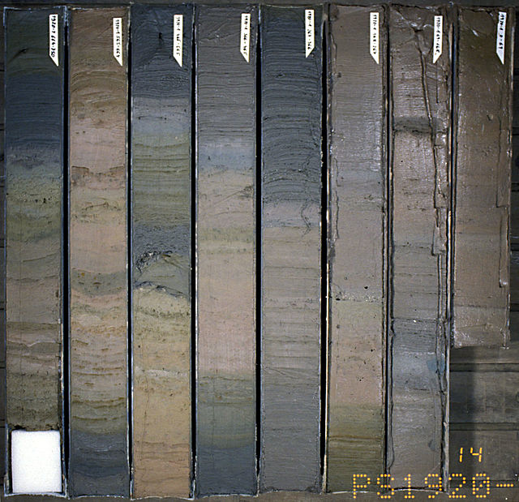
Introduction to Sediments
.
Notes:
AUTHORS:
Rachel Marcuson, Ph.D Student, Scripps Institution of Oceanography
Tara Howell, University City High School
CONTEXT FOR USE:
This lesson was designed for a senior marine science class (gr.11/12) and is the first lesson in a series of lessons on sediments. The colouring activity is most useful if students already have knowledge of plate tectonics and seafloor features, either from previous material covered in the course, or from another course (such as Earth Science).
WHY :
In a marine science class, students are too often excited only about the biology aspects of the course, but it is just as important to understand the environment in which the animals live. Sediments play an important role in this, and additionally are extremely useful to humans both from a scientific perspective and an economic perspective. In science, sediments can be useful for paleoclimate and relative dating, and economically, sediments are important because of the sources of energy found within them (hydrocarbons)
SUMMARY:
In this lesson, students will learn what sediments are and how they are formed. Through an activity they will be able to relate sediment locations to plate tectonics. They will also learn that there are different types of sediment that occur in different proportions in the ocean. They will have an understanding that there are multiple ways we classify sediments- including size, location, and source.
PICTURE/GRAPHICS CREDITS:
http://commons.wikimedia.org/wiki/Category:Sediments#mediaviewer/File:PS1920-1_0-750_sediment-core_hg.jpg
WEBSITES/RESOURCES USED IN THIS PRESENTATION
Garrison, Tom. Oceanography : an invitation to marine science. Belmont, CA: Thomson Brooks/Cole, 2007. Print.
https://www.wardsci.com/store/catalog/product.jsp?catalog_number=332436
MISCONCEPTIONS:
Sediments only come from rocks that have been eroded.
EVALUATION TIPS:
Use discussion questions found throughout as a way of evaluating whether students are making connections between previously taught concepts of tectonics and margins. Ensure that students have grasped important definitions from the lesson by checking their vocabulary sheet. After the classifying sediments by source activity choose students at random to explain to you one of the sediment types that they didn’t research.
TEACHING NOTES:
Print off activity sheets ahead (Classifying Sediments by Source and Sediment Unit vocabulary Sheet). Ensure there are also blank maps available if your students have not been keeping an ongoing map. http://commons.wikimedia.org/wiki/Maps_of_the_world#mediaviewer/File:BlankMap-World6.svg
Or here for purchase
https://www.wardsci.com/store/catalog/product.jsp?catalog_number=332436
Depending on how your marine science course is structured (or what you’re using this lesson for) you may need to give some background or refresher on plate tectonics or margins.

Slide 2
What are Sediments
Sediment is made of particles of organic or inorganic matter that accumulate in a loose, unconsolidated form.
Sedimentary Rocks are formed when the originally loose sediments are consolidated
Notes:
PURPOSE:
This slide is designed to provide students with a definition of sediment- they need to know WHAT we’re talking about before they can begin to explore the idea. This is one of the words on the vocabulary sheet provided for this unit and students should be able to fill it in.
CONTENT:
Definition of sediment is the bullet point, there is lots of additional information that will be provided but first students are expected to think about how we get sediment and where we find it.
Asks students to brainstorm where in the ocean we might find a lot of sediment or just a little?

Slide 3
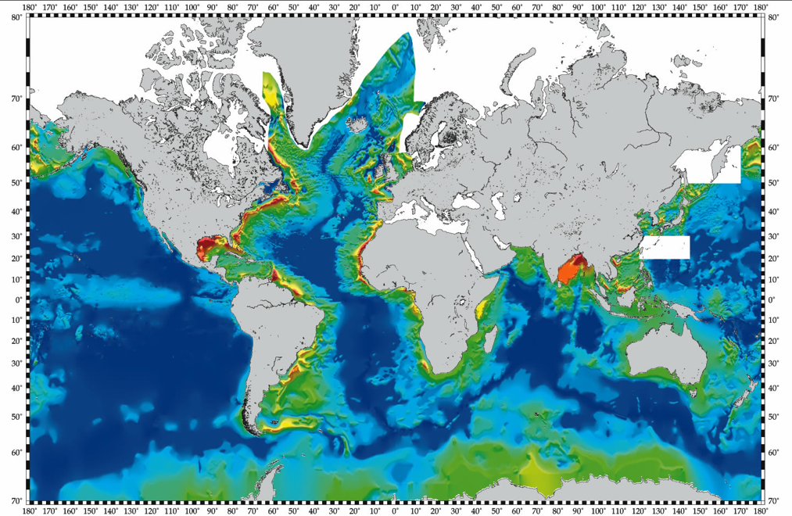

Sediment Thickness of World’s Oceans
Notes:
PURPOSE:
This slide is to show the various sediment thickness on the ocean floor and to be used for students to colour in their tectonic and seafloor features map.
ACTIVITY:
Students in our classroom have an ongoing map used throughout the course to highlight plate tectonic boundaries and seafloor features and in this activity they will be adding to it.
If your students do not have an ongoing map, provide them with a blank map (a link to one is below) to use. Some discussion/brief review of major tectonic and coastal features may be necessary.
http://commons.wikimedia.org/wiki/Maps_of_the_world#mediaviewer/File:BlankMap-World6.svg
Or here for purchase
https://www.wardsci.com/store/catalog/product.jsp?catalog_number=332436
Have students choose three colours of pencil/crayon/marker and ask them to highlight on their map thicknesses of 0-200m (dark blue on this map), 1000-1200m (green on this map), and 15000-20000m (red on this map).
CONTENT:
Ask students if certain thicknesses correspond with certain tectonic features? certain coastal features? certain types of margins?
The important points that discussion should lead to are
-mid ocean spreading ridges have minimal sediment, and the more rapidly it spreads the less sediment it’s likely to have
-passive margins have more sediment than active margins (compare coast of the United States as an example)
-extremely high sediment thicknesses are found near large rivers
-difference between location of the sediments (near the coast vs deeper ocean) is one way we classify sediments
Provide them with the following definitions and information (which can be added to their vocabulary sheets)
Neritic Sediments: are found on continental shelves and in shallow-water near islands – coarser
Pelagic Sediments: are found in deep ocean basins-finer
SOURCES/IMAGES:
http://www.ngdc.noaa.gov/mgg/sedthick/sedthick.html
http://commons.wikimedia.org/wiki/Maps_of_the_world#mediaviewer/File:BlankMap-World6.svg

Slide 4
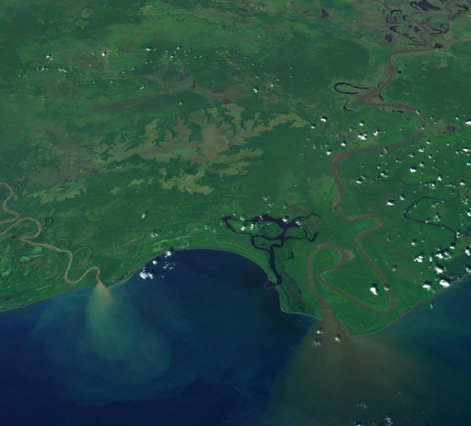
Classifying sediment by location
How can we classify sediments?
Location
?
?
Notes:
PURPOSE: The purpose of this slide is to show a near shore deposit of sediment, and provide visual confirmation of why we see the thick sediments near coasts and especially river outflow
CONTENT:
The image is a satellite image of the Sepik river (on the right), the longest river in Papua New Guinea, and third largest by volume in Papua New Guinea. On the left is the Ramu river.
Although just mentioned on the last slide, confirm with students what type of sediment this would be if classified by location (it would be neritic). Ask if this sediment would be coarser or finer than that found in the deep ocean (it would be coarser). Ask if they think we can classify sediments any way besides location.
SOURCES/IMAGES:
http://commons.wikimedia.org/wiki/File:Sepik-sediment-new.png

Slide 5
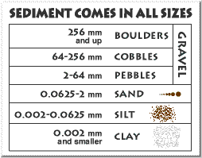
Classifying sediment by size
How can we classify sediments?
Location
Size
?
Notes:
PURPOSE: The purpose is to show that we do also classify sediments by size
CONTENT:
This contains an image for a typical size classification for sediment.
Ask students why we have different sizes of sediment and how it gets to where it settles in the ocean? Extend question: How might we conduct an experiment to find out what factors affect settling rate?
Important points that should come out of the discussion are
-we find larger particles closer to high energy environments (takes a lot of work to move boulders!)
-finer particles are much easier to transport so they can be found even in quiet waters
-think about a beach- the sand is relatively coarse (high energy with waves crashing) but if you go out into the water the bottom gets less coarse (finer grained particles)
-rocks are broken down by erosion (wind, wave, rivers)
Ask students if they think all sediments are just rocks? If a shelled creature dies what happens to its shell (also becomes part of the sediment). This leads into the next slide.
SOURCES/IMAGES:
http://geomaps.wr.usgs.gov/parks/rxmin/sediment.html
The USGS home page is http://www.usgs.gov.

Slide 6
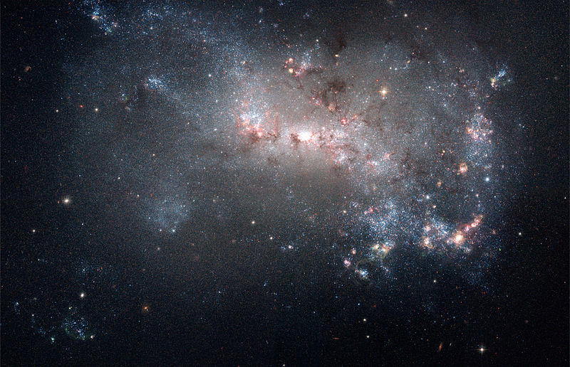
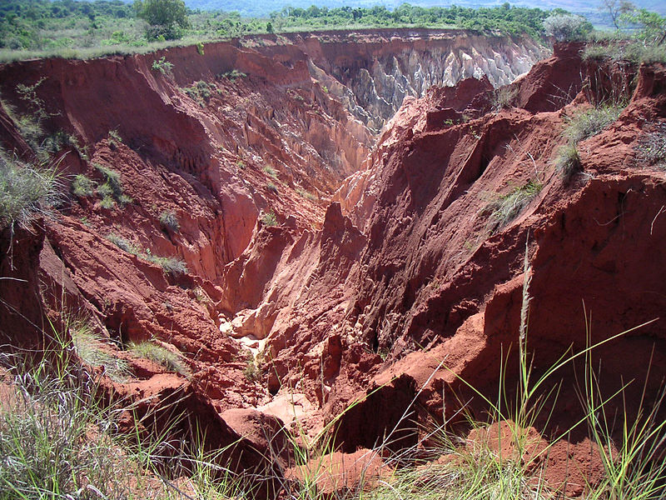
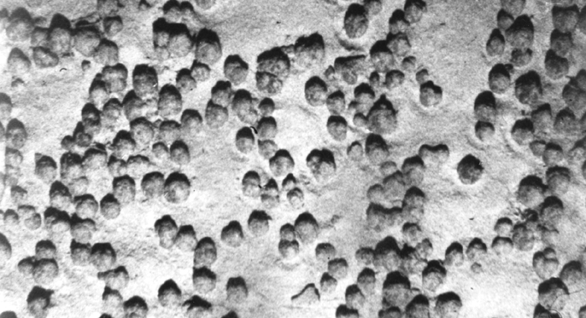
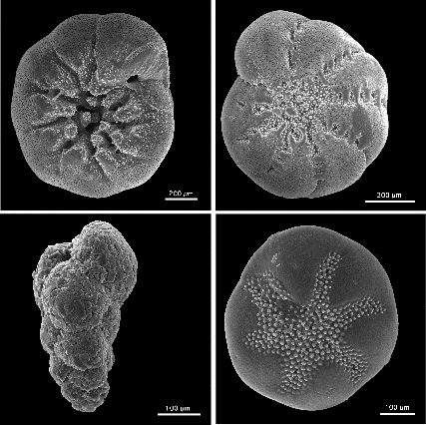
Classifying sediment by source
Where does it all come from?
How can we classify sediments?
Location
Size
Source
Notes:
PURPOSE:
This slide is to show students that sediments come from various sources.
CONTENT:
These slides indicate the origin of the four main sediment sediment sources.
There are four images for four different types of sediment sources.
First image is a Hubble picture of space (cosmogenous)
Second image is river cut erosion (terrigenous)
Third image is manganese nodules (hydrogenous)
Fourth image is foraminifera (biogenous)
ACTIVITY: Pass out the Classifying Sediments by Source Activity sheet. Put students in groups of four, with one person in each group assigned to a different type of sediment. Using your classroom textbook, a suggestion is here (Garrison, Tom. Oceanography : an invitation to marine science. Belmont, CA: Thomson Brooks/Cole, 2007. Print) or reliable internet sources have students research their sediment type.
At a minimum they should find out
-the sediment source
-an example
-the amount of it in the ocean (either by volume or area)
And fill in the appropriate section on the activity sheet.
Once every student has found the information they will teach it to the other three students in their group, so that by the end of the activity every student will have all four boxes filled in.
A ‘key’ has been provided, but note that it contains the minimum amount of required information. Additional information that students find, or think is interesting to add is always encouraged.
SOURCES/IMAGES:
http://commons.wikimedia.org/wiki/File:Starburst_in_NGC_4449_(captured_by_the_Hubble_Space_Telescope).jpg
http://commons.wikimedia.org/wiki/File:Madagascar_erosion.jpg
http://commons.wikimedia.org/wiki/File:Manganese_nodules.gif
http://commons.wikimedia.org/wiki/File:Benthic_foraminifera.jpg

Slide 7
Conclusions
What have we learned about sediments?
          Distribution in the oceans
          Grain size and energy
          Source types
Notes:
PURPOSE: Highlight the important points from the lecture
CONTENT:
Key points:
Location systematics: Sediments are found in varying thicknesses on the ocean floor and thickness is related to margin type, tectonic features and coastal features. Thick sediments are found at passive margins and at major river deltas, thin are found in the middle of the ocean and at subduction zones. We can classify sediment by location (Neritic and pelagic)
Grain size systematics: Sediment size can tell a lot about how it was transported and how much energy there is/was in the environment. High energy environments can transport larger sediment. The further sediment has been transported, the smaller and more rounded it will become. We can classify sediment by size (Boulder, cobbles, pebbles, sand, silt, clay)
We can classify sediment by source, review the four types: Terrigenous, Biogenous, Cosmogenous, Hydrogenous
Having an understanding of sediments and where they are found now will be important for understanding different marine environments later.

