Slide 1
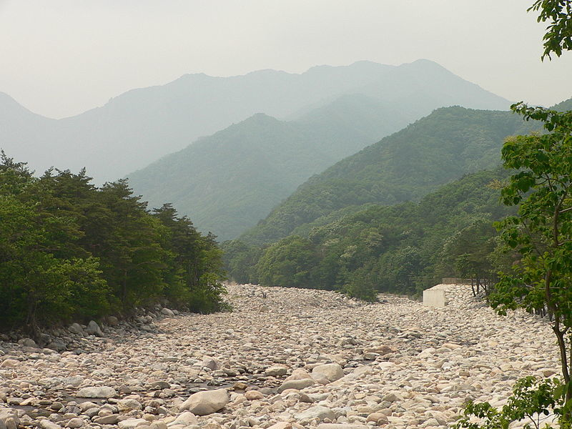
Settling Rates and Sedimentation Lab
.
Notes:
AUTHORS:
Rachel Marcuson, Ph.D Student, Scripps Institution of Oceanography
Tara Howell, University City High School
CONTEXT FOR USE:
This lesson was designed for a senior marine science class (gr.11/12) and is the second lesson in a series of lessons on sediments. It is best used if students have had the first lesson, or if they have some knowledge of sediments- especially how sediments are classified (particularly size) and where they are found. Slides 1,2, 4 and 5 in this powerpoint can be shown to students, but all teaching notes on them are directions for the teacher on how to set up and run the lab.
WHY : In the first lesson, students learned that sediments come in different sizes, and that the different sizes of sediments are found in different places. In this lesson they will explore through a lab two factors that affect settling rate (density and size), and also see how these factors show up in natural environments.
SUMMARY: This lesson will introduce important concepts, especially the effect of size on settling rate, and the idea of graded bedding. Students will also see using the sediment tube how differences in size of sediment comes into play in natural settings, like in quiet water settling, or sediment outflow at the mouth of a river.
PICTURE/GRAPHICS CREDITS:
http://commons.wikimedia.org/wiki/File:Dry_river_bed_in_Korea.jpg
WEBSITES/RESOURCES USED IN THIS PRESENTATION:
ADDITIONAL READING:
Garrison, Tom. Oceanography : an invitation to marine science. Belmont, CA: Thomson Brooks/Cole, 2007. Print.
MISCONCEPTIONS:
EVALUATION TIPS:
Evaluation can be done by collecting students’ lab sheets and checking how they answered the analysis questions. The major objectives of the lab are
1) For students to understand that size, density and aspect ratio all affect settling rate
2) Different sizes of sediment will travel different distances away from a river mouth
3) Distinct patterns (like graded bedding) can occur based on principles of settling rate
TEACHING NOTES:
Ask students about what type of energy environment is needed to deposit boulders (this was learned in the first lesson). Have them look at the image on the slide and make observations. What grain size do they see in the image above? Is there fine grained material? Was there fine grained material when the boulders here were being deposited? What happened to the fine grained material? If it was all carried away, would this river have been a good place to go swimming at the time sediment was being deposited?

Slide 2
Settling Rate Lab
What factors affect the settling rate of sediment?
Notes:
PURPOSE: This slide can be shown to the class, but all notes in here are directions for the teach to set up the lab.
CONTENT:
For this lab you will need modeling clay, corn syrup, water, large cylindrical vessels, stopwatches, steel balls (like those found here http://www.salemballworldwide.com/ or on Amazon) and tape/markers. The directions on the lab handout are very clear for students, but the teacher needs to test out their own vessel/corn syrup/water mixture before hand! Basically, the teacher needs to make a large quantity of a corn syrup and water mixture. The exact proportions depend on the size of vessels you are providing to your students. A narrower vessel will need more water (otherwise the edge effects of the container slow down the settling too much) a wider vessel will do best with more corn syrup to slow down the settling to a rate the students can time.
We used a clear plastic container for our vessel, with a 3 inch diameter and 8 inch height and a 4:1 corn syrup to water mixture.
The smallest size container that would work is a 1.5 inch diameter and no less than 10 inch height, with a 3:2 corn syrup to water mixture.
If you have trouble obtaining steel ball sizes the same as the sizes listed, modify the lab and change the size of the clay pieces to match the size of steel balls that you have.
Also ensure that there is enough space at the bottom of the vessel for the modeling clay pieces to collect without interfering with the rest of the settling experiments. When students have to return their corn syrup and modeling clay pieces be warned that it is a little messy.

Slide 3
Can rocks float?
Settling Rate Lab Conclusions
As sediments increased in size, settling time decreased
The steel ball settled more quickly than the modeling clay particle.
Check this out!
Notes:
PURPOSE: This slide can be shown to the class to summarize the important conclusions from the settling rate lab.
CONTENT: The video link examines density of rocks
Teacher should discuss the analysis questions
Which size particle had the fastest settling rate?
The larger particles settled faster
Which material had the faster settling rate?
The more dense (steel) ball settled faster
Pose the question: What property caused the steel balls to settle more quickly?
This should lead to discussion where you reach the conclusion that the steel balls were more dense. Senior students should know what density is, but you can give a quick refresher. Density is a quantity of mass per unit volume. If we wanted to find the density of the two materials in this case we would need the mass (use a scale) and the volume (knowing the diameter of the particles and the equation for volume of a sphere this can also be determined). Ask whether we see density variations in nature, than show the video linked above. Explain the porous nature of pumice and how that changes its density.
As an extension question ask
What factors did we not test for? Could we design a test for them?
One answer could be the shape of the particle. This could be tested by making more angular particles to compare to spherical particles, or by comparing flattened clay pieces (change aspect ratio) to rounded ones.
SOURCES/IMAGES:
https://www.youtube.com/watch?v=-__PyL1rJj0

Slide 4
Sedimentation Lab
How do different sediment types settle out in natural environments?
Notes:
PURPOSE: This slide can be shown to the class, but all notes in here are directions for the teach to set up the lab.
CONTENT:
For this lab sedimentators that have been purchased (for example here https://www.enasco.com/product/SB27465M) can be used, or the teacher can create their own. To create a sediment tube you will require multiple clear, water bottle sized containers (we used old powerade/gatorade bottles), and a variety of sizes of sediment. Some potential options that we used are gravel, beach sand, aquarium sand, ground up coloured chalk, animal/plant material (could come from soil). Fill the containers with about a two inch mixture of all materials, then fill the remaining space with water, close the containers and seal. If it’s not entirely clear what size each of your components is you may have to tell your class just for clarity when they draw their illustrations. For example, specify that their tube contains gravel, clay, sand and silt so they know they are only labeling those four components.
SOURCES/IMAGES:

Slide 5
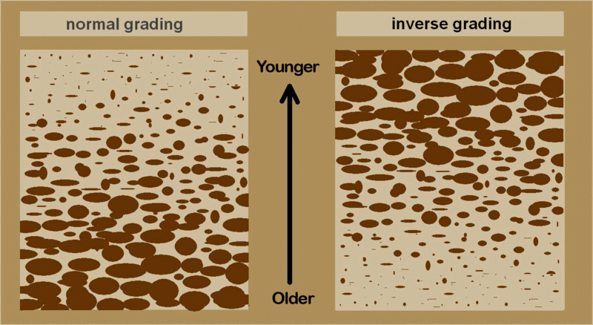
Graded Bedding
How do these images compare with what you saw in your sediment tube?
Notes:
PURPOSE: The purpose of this slide is to illustrate graded bedding (shown in the image) which is what students should have observed in their sediment tube.
CONTENT: This slide should be used while discussing the results of the sedimentation portion of the lab, and the two major points should be addressed. Pose the question on the slide. Students should have seen (and drawn) the image on the left.
How does a mixture of sediment settle out of suspension? Is there a pattern?
Larger particles settle out first, with the smaller ones settling on top.
Does this pattern have a name?
Graded bedding
Extension: Why might it be useful?
Discussion can lead to recognizing multiple layers of sediment flow – for example seeing multiple sets of graded bedding stacked on top of each other can indicate several separate events of increased sediment flow. Why might this be? Distinct flooding events could lead to multiple layers of deposits.
How might the pattern on the right be formed?
To help students understand how the pattern on the right can form, utilize your candy jar that you prepared with a mixture of sizes of candies. Ask students what they think will happen to the fireballs (largest candy) when they shake the jar. Pass the jar around and let everyone shake it (keeping it upright). They will notice that the fireballs slowly make their way to the top, while the small candies make their way to the bottom of the jar.
This inverse pattern can be caused by a debris flow, or an increase in depositional energy.
SOURCES/IMAGES:
http://commons.wikimedia.org/wiki/File:Inverse_grading.gif

Slide 6
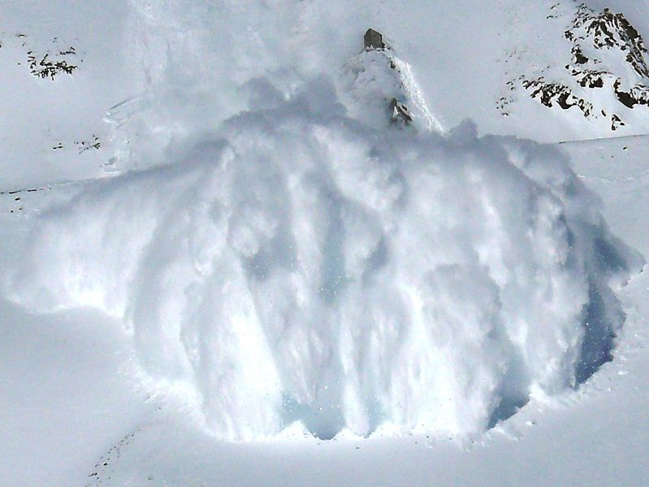
The smallest particles tend to move in suspension
It require A LOT of energy to move large boulders far from the mouth of a river
Notes:
PURPOSE: This slide should be shown to discuss results of the sedimentation portion of the lab, particularly regarding river sediment transport.
CONTENT:
This video can be shown to illustrate actual sediments moving due to water movement and should help students understand energy in an environment that can transport large sediment.
http://www.youtube.com/watch?v=jpexS4-9IF0
The two bullet points on the left should be emphasized, they are brought up in the analysis questions below.
When tilting the sediment tube which sizes of particles tended to move in suspension?
The smallest ones (silts and clays, maybe some plant material)
Which sizes rolled on the bottom or didn’t move at all?
The largest ones
Do we typically find large sediments far from the river mouth? Why?
No, it would require an extremely powerful river to move large boulders.
The image on the slide is an avalanche. Compare the avalanche to a turbidity current, and discuss turbidity currents as a way that particles end up in suspension. Ensure students have a definition of turbidity current for their vocabulary sheets.
Turbidity Current: is a current of rapidly moving, highly turbulent, sediment-laden water moving down a slope. The amount of the suspended sediment in the water increases the density allowing the current to flow down slope.
Extension: If we did find a large boulder far from a river, how might it have gotten there?
Some possibilities that discussion can lead to are dropstones (transported by glaciers), and catastrophic events caused by earthquakes. Discussion can go further into turbidity currents, emphasizing that they have the potential to carry sediment very far from the shelf and at very high rates.
SOURCES/IMAGES:
http://commons.wikimedia.org/wiki/File:2007-02-15-CLB-Couloir2-1c.JPG

Slide 7
Conclusions
What factors affect settling rate?
-Size
-Density
Distinct patterns of sedimentation result from differences in settling rate
Notes:
Notes:
This slide should emphasize the most important points from the lab activity
Large particles settle more quickly than smaller ones
-More dense particles settle more quickly than less dense ones of the same size
-Other factors, like particle shape can also affect settling rate
-Different sizes of particles settling out of solution will result in graded bedding
-Large particles settle first with progressively smaller ones following. This pattern can be used to recognize multiple layers of sediment flow which could be related to multiple flood events.
-Small particles require less energy to be transported therefore we will find finer grained sediment further from its source. Smaller particles are also more easily transported in suspension.

