Slide 1

The Value of Sediment
.
Notes:
AUTHORS:
Rachel Marcuson, Ph.D Student, Scripps Institution of Oceanography
Tara Howell, University City High School
CONTEXT FOR USE:
This lesson was designed for a senior marine science class (gr.11/12) and is the third lesson in a series of lessons on sediments. Students likely have some idea of valuable resources we get from the ocean, but this lesson will introduce new uses for seafloor sediments they hadn’t thought of.
WHY:
Students may not be too excited to be doing a unit on sediments because it’s hard for them to understand why they’re important, but this lesson provides a compelling argument for why they should care. Billions of dollars a year are generated from products coming from sediments, including many things we use and rely on daily without even thinking about. Additionally, students should be thinking about the huge environmental impacts the energy industry has.
SUMMARY:
Sediments are important to scientists for unraveling Earth’s history, and they play an important role in marine environments for ecosystems, but what much of society is concerned with is MONEY! As it turns out, sediments are economically valuable too! Most people are aware of the role they play with oil and gas, but there are other energy sources and products that come from sediments as well.
PICTURE/GRAPHICS CREDITS:
http://commons.wikimedia.org/wiki/File:Money_Cash.jpg
WEBSITES/RESOURCES USED IN THIS PRESENTATION
Garrison, Tom. Oceanography : an invitation to marine science. Belmont, CA: Thomson Brooks/Cole, 2007. Print.
ADDITIONAL READING:
Additional reading is listed throughout the powerpoint.
MISCONCEPTIONS:
Sediments have no value to people other than scientists.
Crude oil and petroleum are the same thing.
EVALUATION TIPS:
The evaluation for this lecture should be done through discussion, and completion of the extension activity. Breaks should be taken during the slideshow where the activity/extension is listed for students to complete the questions. Teacher can provide time and resources to their liking, depending on how long is desired for this lesson to take. To spend more time on this lesson, have students do the research independently, to spend less time, provide students with some of the listed resources.
TEACHING NOTES:

Slide 2
Why are sediments important?
Well, what do you think?
Notes:
PURPOSE: Use this slide to initiate brainstorming, have students come up with reasons why they think sediments are important.
CONTENT:
Have student think of as many ways that they can for why sediments are ‘important’ . The image on the cover slide may have given them a hint, but encourage any and all ideas. Fill the blackboard/whiteboard with their ideas. If they don’t think of economic resources on their own, ask questions to lead them to it.
SOURCES/IMAGES:

Slide 3
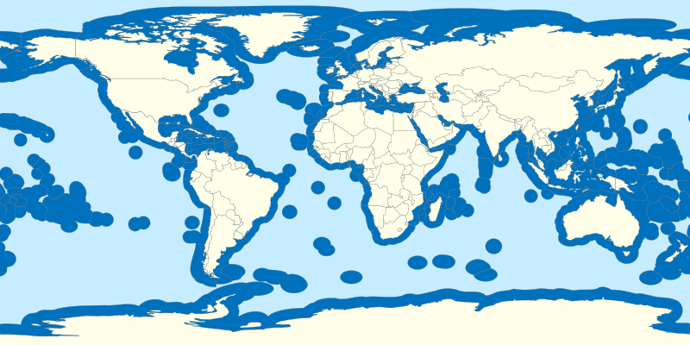
World’s Territorial Waters
Territorial waters extend 200 miles from the coast, and for most countries also represent the Exclusive Economic Zone
Zone prescribed by the United Nations Convention
Notes:
PURPOSE: This slide illustrates the world’s exclusive economic zones, a zone prescribed by the United Nations Convention that extends 200 nautical miles from shore
CONTENT:
Ask students what this Exclusive Economic Zone might be for. The name should give a hint. Discussion should lead to explaining what the EEZ is
-gives a state special rights over the exploration of marine resources
-this can be energy like fossil fuels, but also wind and wave energy
Make the connection back to the first lesson where students looked at sediment thickness- how thick are sediments within the EEZ?
SOURCES/IMAGES:
https://commons.wikimedia.org/wiki/File:Territorial_waters_-_World.svg
https://www.un.org/depts/los/convention_agreements/texts/unclos/part5.htm

Slide 4
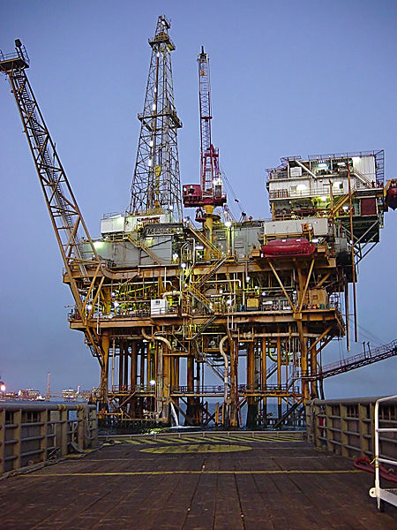
Crude Oil
Petroleum
Natural Gas
Methane Hydrate
Notes:
PURPOSE: The purpose of this slide is to introduce students to some of the major energy sources found in sediments.
The image on the slide is and offshore oil platform in the Gulf
CONTENT:
Students should be provided with the following definitions which they can add to their vocabulary sheet. Although it may seem tedious, it is important to know what you’re talking about before actually talking about it, which requires that certain terms be defined. Generally, people don’t actually know the difference between the first three definitions on the list and as a result use them incorrectly/interchangeably.
Crude Oil: liquid mixture of hydrocarbons, found in natural underground reservoirs
Petroleum: Liquid mixture of hydrocarbons, includes crude oil as well as any refined liquid hydrocarbon mixture
Natural Gas: naturally occurring hydrocarbon gas, consisting mostly of methane
Methane Hydrate: solids composed of rigid cages of water molecules that enclose methane.
SOURCES/IMAGES:
http://commons.wikimedia.org/wiki/File:Gulf_Offshore_Platform.jpg
Garrison, Tom. Oceanography : an invitation to marine science. Belmont, CA: Thomson Brooks/Cole, 2007. Print.
Keith A. Kvenvolden, Methane hydrate — A major reservoir of carbon in the shallow geosphere?, Chemical Geology, Volume 71, Issues 1–3, 15 December 1988, Pages 41-51, ISSN 0009-2541, http://dx.doi.org/10.1016/0009-2541(88)90104-0.(http://www.sciencedirect.com/science/article/pii/0009254188901040)

Slide 5
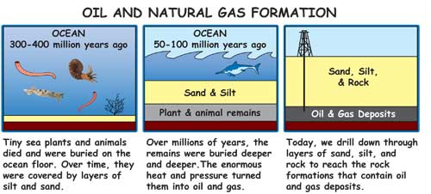
Formation of
Crude Oil
Natural Gas
Notes:
PURPOSE: This slide shows how crude oil and natural gas are formed with an illustration of the process described
CONTENT:
Crude oil is formed when dead organic material accumulates and gets mixed into mud and sand (sediment)
As more sediment is piled on top, the material is transformed to kerogen.
Kerogen does not have specific chemical formula, rather, it is just a name for the mixture of organic material.
The kerogen breaks down as heat and pressure increase and forms lighter molecules- specific temperatures and pressures will dictate whether oil or natural gas is formed.
Explain that natural gar and crude oil are formed in essentially the same way, but different temperature and pressure conditions (those that form lighter molecules from the kerogen) are what cause natural gas to be formed instead of crude oil.
SOURCES/IMAGES:
http://www.britannica.com/EBchecked/topic/454269/petroleum/50709/From-kerogen-to-petroleum
http://climatekids.nasa.gov/carbon/

Slide 6
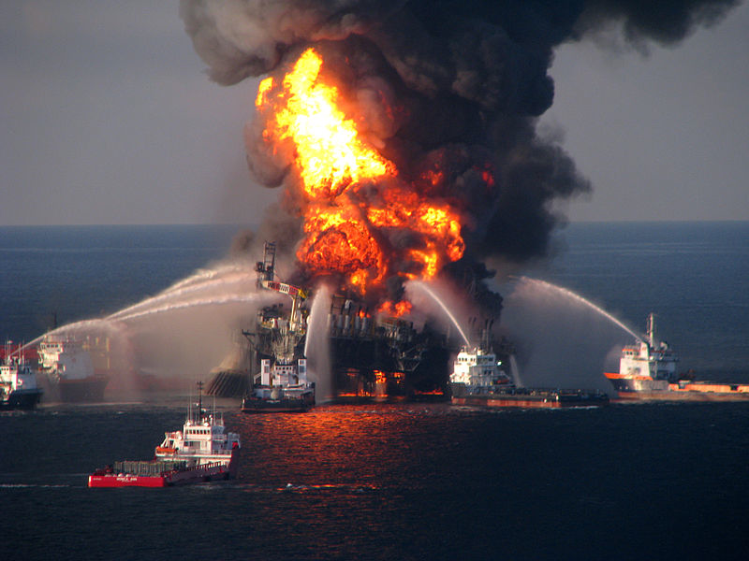
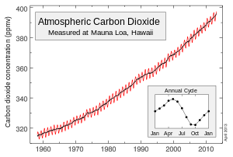
Part 1
Notes:
PURPOSE: To have students think about some of the environmental impacts that come with using fossil fuels
CONTENT: The top image is from the Deepwater Horizon oil spill, one of the worst oil spills in history, leaking 4.9 billion barrels of oil into the Gulf.
The bottom image is the Keeling curve, showing the increase in atmospheric carbon dioxide from 1960 to present.
Activity/Extension:
Have students answer the first two questions on the extension activity sheet (Part 1). You may need to provide them with the name of the above oil spill, as well as a brief explanation on the Keeling curve. Also, depending on how much time you spend on this lesson, you can give them time to do some quick research (especially if you have access to ipads or computers). Some useful sources given below.
SOURCES/IMAGES:
http://commons.wikimedia.org/wiki/File:Deepwater_Horizon_offshore_drilling_unit_on_fire.jpg
http://commons.wikimedia.org/wiki/File:Mauna_Loa_Carbon_Dioxide_Apr2013.svg
http://scrippsco2.ucsd.edu/
http://ocean.si.edu/gulf-oil-spill
http://response.restoration.noaa.gov/deepwaterhorizon

Slide 7
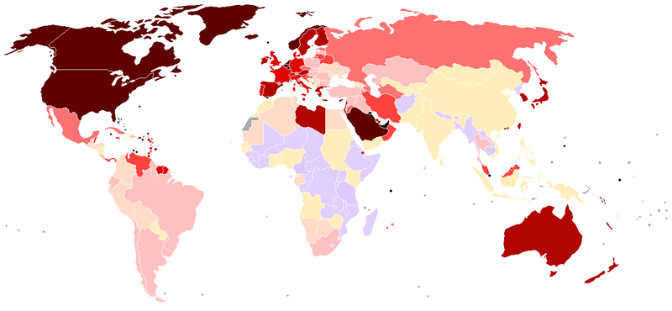
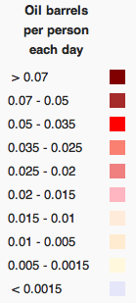
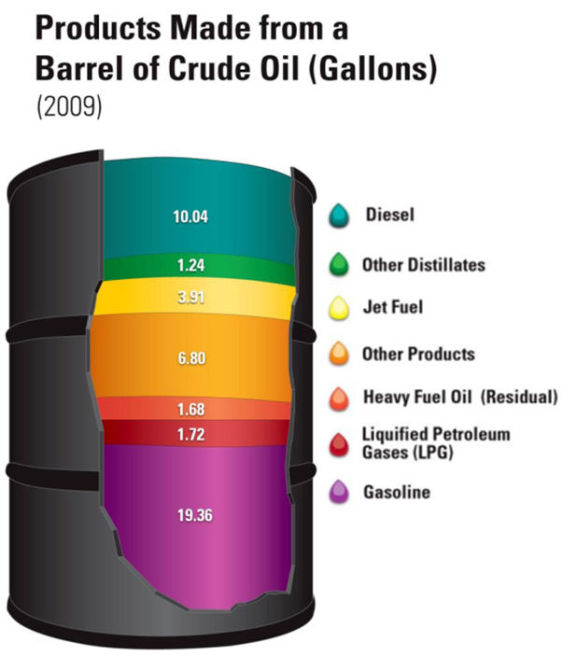
Part 2
Notes:
PURPOSE:
This slide is to be used for the Natural Gas and Oil part 2 questions
CONTENT:
The top image shows number of barrels of oil used per person each day around the world (based on data prior to 2007) and the second image shows what products come from a barrel of oil. The purpose of the picture is to show students just how much oil we use. There are a number of interesting aspects to this map, but for this activity, the emphasis should be on how we in North America use a very large amount of oil. Even if we know there are negative effects, it’s is not feasible for us to eliminate our reliance on fossil fuels.
Activity/Extension: The part 2 question is designed to help students realize that even though we acknowledge the negative effects that fossil fuels have on the environment, as a society we are reliant on them. Students should try to be thinking of ways to reduce our fossil fuel consumption, but realize that we can’t eliminate their use entirely. Some ways to guide students thinking is to mention renewable resources- this can be tied into the slide about the exclusive economic zone and the fact that countries have rights to renewable resources within that zone as well.
SOURCES/IMAGES:
http://energy.gov/articles/hows-and-whys-replacing-whole-barrel
http://commons.wikimedia.org/wiki/File:OilConsumptionpercapita.png

Slide 8
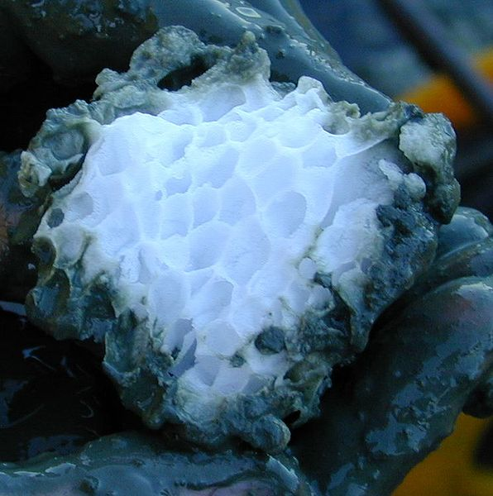
Methane Hydrate
Occurs in continental shelf, permafrost, and marine sediments
When warmed up, a very small amount of methane hydrate produces a very large amount of natural gas
Notes:
PURPOSE: The purpose of this slide is to introduce students to methane hydrates, the image is of methane hydrate.
CONTENT:
Show this video : https://www.youtube.com/watch?v=U46XOoU0DrM
Discuss methane hydrates with the students after watching the video
They occur in continental shelf, permafrost and marine sediments of the world and are formed by organic material in the hydrate stability zone. The hydrate stability zone is the area where the temperature and pressure are such that these hydrates can stay frozen, even though the temperature may be higher than the melting point of ice.
One point to make is to ask why they think these occur on the continental shelf. You have told them already that these hydrates require methane, so that should be a clue to them that they can only form where there is methane.
Activity/Extension:
The extension question for methane hydrate asks students to think about the pros and cons of using methane hydrate as an energy source. You must provide them with some resources to answer this question. Some suggestions
Your marine science textbook, which will likely have a small amount of information about methane hydrates
This short read: http://energy.gov/fe/science-innovation/oil-gas-research/methane-hydrate
The following longer articles: http://www.netl.doe.gov/File%20Library/Research/Oil-Gas/methane%20hydrates/MH-Primer2011.pdf
http://geology.com/articles/methane-hydrates/
SOURCES/IMAGES:
http://commons.wikimedia.org/wiki/File:Gashydrat_mit_Struktur.jpg
http://energy.gov/fe/science-innovation/oil-gas-research/methane-hydrate
http://energy.gov/fe/science-innovation/oil-gas-research/methane-hydratehttp://www.youtube.com/watch?v=Bi9xK8jmXzc
http://www.netl.doe.gov/File%20Library/Research/Oil-Gas/methane%20hydrates/MH-Primer2011.pdf
http://geology.com/articles/methane-hydrates/

Slide 9
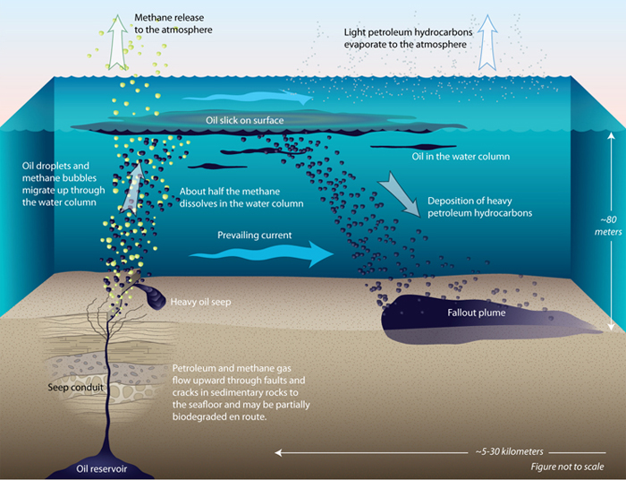
Natural Seeps
Natural oozing of oil and gas through cracks in overlying rock
Rises to surface, natural gas escapes into the air
Notes:
PURPOSE:
The purpose of this slide is to show students what a methane seep is
CONTENT:
This slide shows how natural seeps occur and what happens to the fossil fuels that are released. Oil reservoirs deep below the sediment can leak out once cracks are created in the overlying rock. When the oil and gas escapes, some is released to the atmosphere, some forms oil slicks on the surface or remains in the water column, and heavy petroleum is redeposited.
Activity/Extension:
The activity and extension questions are on the worksheet. Part a students (especially if they live on a coast) should be familiar with tarballs. Typically these come ashore after an oil spill, but natural seeps are just natural oil spills. Part b ties in with this, because these natural oil spills are actually releasing very large amounts of oil into the water, particularly in areas like Santa Barbara, that cause problems for seabirds, and methane into the air (greenhouse gas). To relate the seeps in California to its tectonic setting, students should reason that the increased tectonic activity on this active margin might be responsible for the cracking of the overlying rock.
SOURCES/IMAGES:
http://www.whoi.edu/oilinocean/page.do?pid=51880&tid=441&cid=139413&ct=61&article=97109
(Illustration by Jack Cook, Woods Hole Oceanographic Institution)
http://aoghs.org/offshore-history/california-oil-seeps/

Slide 10
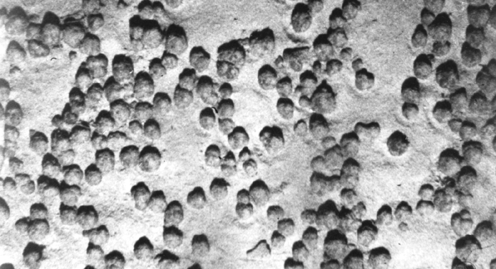
Manganese Nodules
Rock concretion on seafloor composed of iron and manganese
Can be very small, or up to 20 cm in diameter
Found in abyssal plains
Notes:
PURPOSE: The purpose of this slide is to introduce students to manganese nodules.
CONTENT:
Manganese nodules are a type of hydrogenous sediment found on abyssal plains in the ocean. They can be very small (when they first form) or up to 20cm in diameter. Manganese nodules contain nickel, iron and cobalt as well as other rare-earth minerals that have commercial and military applications. Applications include magnets, lasers, fiber optics, computer disk drives, fluorescent lamps, rechargeable batteries, catalytic converters, computer memory chips and xray tubes. Obtaining these nodules would require seabed mining.
Activity/extension:
The extension questions given are for students to realize that it can take a long time for a manganese nodule to form, and to start to think about how mining of the seafloor is done.
SOURCES/IMAGES:
http://commons.wikimedia.org/wiki/File:Manganese_nodules.gif
http://www.iisc.ernet.in/currsci/feb102000/OCEANRESEARCH4.pdf
http://www.nytimes.com/2010/11/09/science/09seafloor.html?_r=0

Slide 11
Economic Value of Marine Sediments
Components of building materials for roads and structures, toothpaste, and paint
38% of world’s crude oil and 33% of natural gas will come from offshore deposits
Hydrocarbons generate revenues in excess of $200 billion
Over $500 million worth of sand and gravel were taken from the ocean in 2005
Notes:
PURPOSE: The purpose of this slide is just to drive home the fact that there is a lot of money in sediments!
CONTENT: Some BIG numbers for impact!
SOURCES/IMAGES:
Garrison, Tom. Oceanography : an invitation to marine science. Belmont, CA: Thomson Brooks/Cole, 2007. Print.

Slide 12
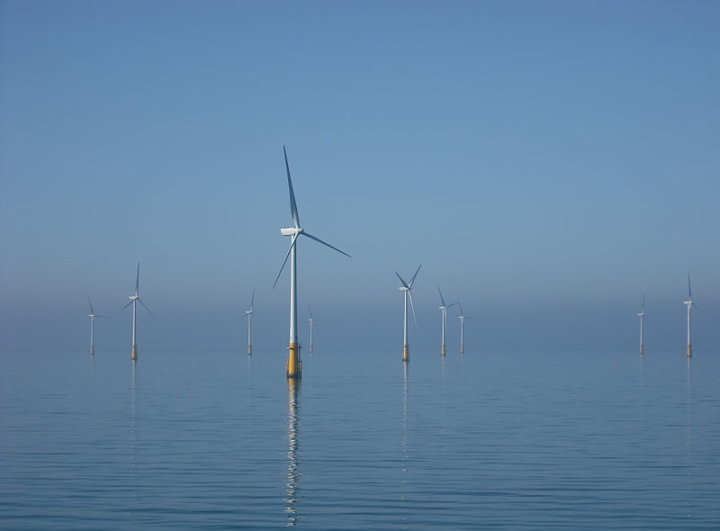
Conclusions
Sediments are valuable!
There are a large number of useful resources in marine sediments, but they must be used carefully to help preserve our environment.
Notes:
Through this lesson, students should have gained a better understanding of the many resources found within marine sediments. They have learned that there are advantages and disadvantages to each resource, and that there are a large number of potential negative environmental impacts. At the same time however, we use these resources constantly and there is a huge demand for them, so a balance must be found.
The image above is an offshore wind farm in the Irish Sea- one way of utilizing the exclusive economic zone to harness [renewable] resources.
http://commons.wikimedia.org/wiki/File:Barrow_Offshore_wind_turbines_NR.jpg

