Slide 1
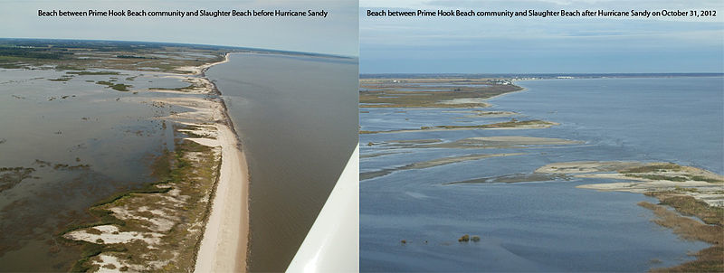
Coastal Erosion and Human Impacts
.
Notes:
AUTHORS:
Rachel Marcuson, Ph.D Student, Scripps Institution of Oceanography
Tara Howell, University City High School
CONTEXT FOR USE:
This lesson was designed for a senior marine science class (gr.11/12) and is the fourth lesson in a series of lessons on sediments. The second slide of this powerpoint is instructions for the teacher to set up the lab. The rest of the slides are a supplement to the lab to provide some additional information about human impacts, along with some specific examples.
Most of the lab is explained clearly on the lab handout, but the teacher will need to ensure they have working stream tables (can be purchased here http://www.amazon.com/American-Educational-Economy-Stream-Table/dp/B005QDU5ME). As well they need a large amount of sand, modeling clay, toothpicks, aluminum foil and a fairly large number of rocks.
WHY :
Erosion is the reason why we have sediments, but coastal erosion has a huge impact on the way humans live. It is an advantage to be near a coast (easy for transportation of goods) and public beaches are a popular form of recreation, but they are always being altered and eroded by natural causes. In an effort to combat this, humans have designed coastal defenses to try and prevent erosion. It is important to realize 1) that erosion is natural and happens at small and large scales and 2) humans have a huge impact on coastal processes when they try and prevent erosion
The image on the slide shows an extreme example of natural erosion after Hurricane Sandy (October 22-October 31, 2012)
SUMMARY:
In this lesson, students will utilize stream tables to see how erosion alters coastlines. They will also observe the effects of human-made structures on coastal erosions, and identify some advantages and disadvantages of various coastal defenses.
PICTURE/GRAPHICS CREDITS:
http://commons.wikimedia.org/wiki/File:Hurricane_Sandy_impacts_Prime_Hook_National_Wildlife_Refuge_(DE).jpg
WEBSITES/RESOURCES USED IN THIS PRESENTATION
Garrison, Tom. Oceanography : an invitation to marine science. Belmont, CA: Thomson Brooks/Cole, 2007. Print.
ADDITIONAL READING:
Additional reading is listed throughout the presentation.
MISCONCEPTIONS:
EVALUATION TIPS:
The analysis questions at the end of the lab can be used as evaluation, but also listening to discussion during the lab and while presenting real life examples of breakwaters and seawalls.
TEACHING NOTES:
Beware that this lab might get messy, and you may have students accidentally or intentionally generating tsunami sized waves.

Slide 2
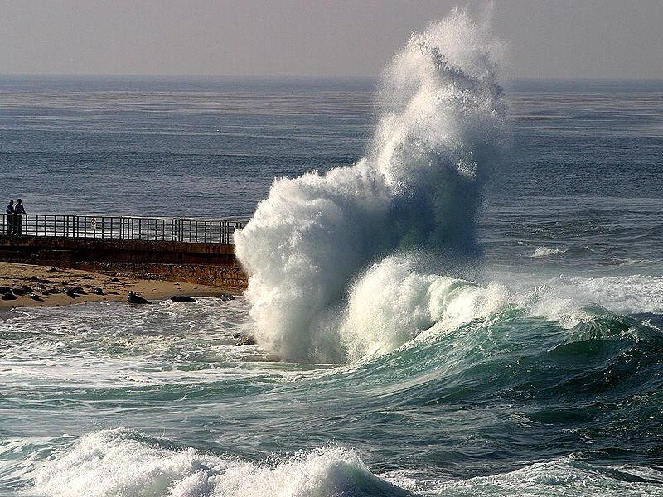
Breakwater in La Jolla, California
Breakwater
A wall that is built out into the sea to protect a harbor ro beach from the force of waves
Notes:
PURPOSE: This slide is to show students an example of a breakwater and provide them with a definition
CONTENT:
Breakwater: a wall that is built out into the sea to protect a harbor or beach from the force of waves.
The image is of the Children’s Beach in La Jolla..
Have students add this definition to their vocabulary sheet
SOURCES/IMAGES:
http://commons.wikimedia.org/wiki/File:Waves_lajolla.jpg
http://hilo.hawaii.edu/academics/hohonu/documents/Vol06x06DefineBreakwater.pdf
http://www.merriam-webster.com/dictionary/breakwater

Slide 3
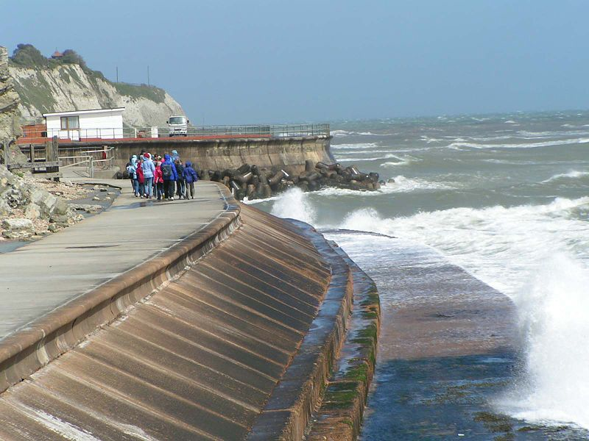
Seawall in England
Seawall
a form of coastal defense constructed where the sea and associated coastal processes impact directly upon the landforms of the coast
Notes:
PURPOSE: This slide is to provide students with a definition of seawall
CONTENT:
Seawall: is a form of coastal defense constructed where the sea and associated coastal processes impact directly upon the landforms of the coast.
A good seawall will form a strong coastal defense, and prevent damage to property caused by erosion. As shown in the image, they can also be used for recreation/tourism.
Have students add this definition to their vocabulary sheet
SOURCES/IMAGES:
http://commons.wikimedia.org/wiki/File:Seawallventnor.jpg

Slide 4
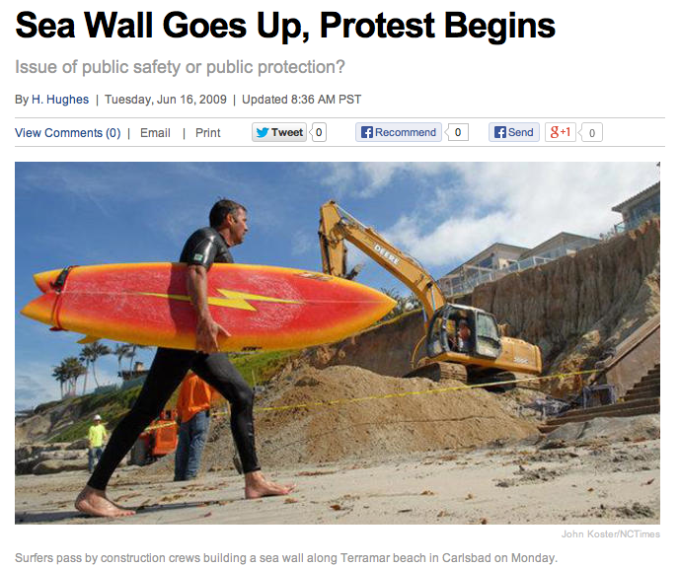
Seawall Construction in Carlsbad, California
There are a number of disadvantages
Placement Loss
Passive Erosion
Active Erosion
End-around effect
Prevent natural erosion
Not everyone wants a seawall!
Notes:
PURPOSE: This slide is to provide students with some disadvantages of seawalls
CONTENT:
The image on the slide is from seawall construction in Carlsbad, California. The purpose of the image is to highlight the “protest begins” title. Although property owners are in favor of seawalls, many other goers recognizes the negative impacts of seawalls and protest their construction.
Discuss with students some of the disadvantages of seawalls
Placement Loss: Basically, the seawall occupies space that was previously beach. This means less beach area for people to enjoy
Passive Erosion: If there is a hard structure build along a shoreline with long term erosion, eventually the erosion will move landward of the structure. If the structure were not there this would be okay, the beach would just move, but still exist. With the seawall however, the public beach will be lost, since it is not allowed to migrate landward.
Active Erosion: In some cases, the addition of a structure actually speeds up the rate at which erosion occurs (students may have observed this during their lab)
End-around Effect: waves diffract around the end of seawalls and actually worsen the wave erosion there. Sea walls are only designed to protect what is directly behind them.
Prevent Natural Erosion: Beach sand often comes from nearby cliffs or bluff, so although some sand is carried out to the ocean, it is replenished by wind erosion of cliffs. Seawalls can prevent this, and may lead to an increased cost when a beach has to be replenished with sand.
Discussion for students should reach a point where it must be pointed out that there is some advantage to seawalls. What is that advantage? Typically it is that it protects and expensive building or piece of real estate that was built too close to the ocean.
After showing this slide, students can finish their analysis questions for the lab.
SOURCES/IMAGES:
http://www.nbcsandiego.com/news/local/Sea-Wall-Goes-Up-Protest-Begins.html
http://ri.surfrider.org/wp-content/uploads/2012/04/Matunuck-Reclassification-Young.pdf

