Slide 1
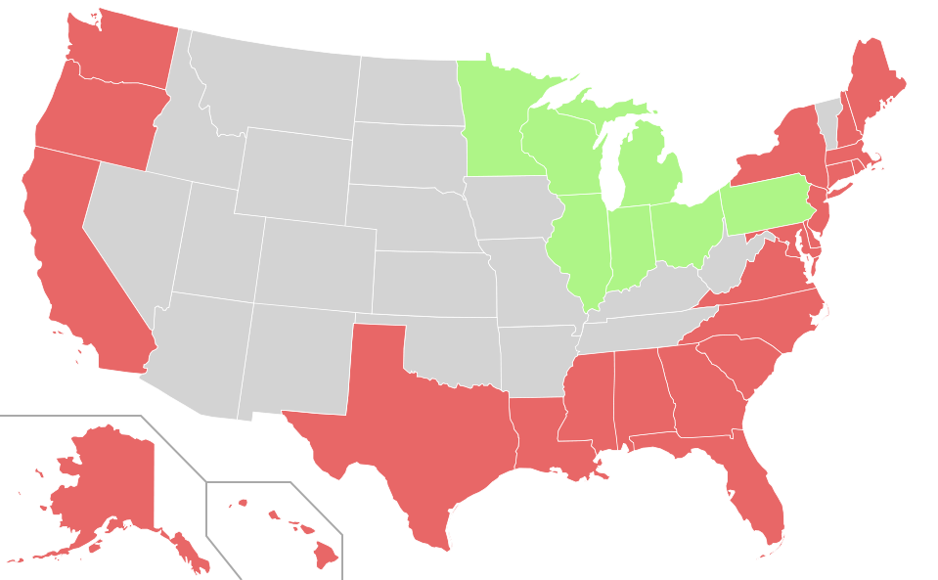
Sediment Unit: Final Evaluation
.
Notes:
AUTHORS:
Rachel Marcuson, Ph.D Student, Scripps Institution of Oceanography
Tara Howell, University City High School
CONTEXT FOR USE:
This lesson was designed for a senior marine science class (gr.11/12) and is the final lesson in a series of lessons on sediments. This “lesson” is actually a final evaluation for the students, designed to tie in concepts from the sediments unit, as well as previously learned concepts like plate tectonics and active/passive margins.
WHY :
The marine science course can be taught so that all important concepts build upon each other. In the course this final evaluation was used in, students learned about earth formation, plate tectonics, margins and seafloor features before reaching the sediment unit. This final evaluation will not only remind students of the concepts learned earlier in the unit, but will tie the concepts together so that they can begin understanding the ocean environment as a system. By the end of the course, the marine biology and ecology concepts will also be built on this foundation of knowledge.
The image on the slide is of the United States- all states in red have an ocean/gulf coast, those in green have a Great Lakes coast. You can ask students to explain what the image is before you tell them. You can also ask more specific questions about which oceans the United States has coastline with.
SUMMARY:
In this final evaluation students will carry out internet research on the sedimentary and geological environment at a particular assigned state. The research will lead to a poster that describes all key elements of the state’s shore line in terms of the type of continental margin, types and thicknesses of sediments, particular geological hazards on their coasts, problems of erosion, human impacts on the coastline, and economic resources available
PICTURE/GRAPHICS CREDITS:
http://commons.wikimedia.org/wiki/File:Map_of_USA_highlighting_coastal_states.svg
WEBSITES/RESOURCES USED IN THIS PRESENTATION
A number of resources are provided as suggestions for students to use to complete their poster.
ADDITIONAL READING:
MISCONCEPTIONS:
EVALUATION TIPS:
Students should design a poster that has a large clear title, with ideas organized so that there is a flow to the poster. Students should address each of the main concepts from the sediments unit, as well as main concepts from tectonics/margins/seafloor features. All sources should be cited.
In the marine science class this was designed for, main concepts include:
Tectonic setting and Hazards
Margin type
Seafloor Features
Sediment Type
Sediment Source
Economic Value (marine resources, fossil fuels etc)
Causes of Erosion
Human coastal defenses/impacts
TEACHING NOTES:
You will want to adjust this evaluation to fit into your own teaching plan and overall layout for your marine science course. Design it to include important, interrelated concepts that have already been taught- it will keep concepts fresh in students’ minds and help them understand connections between different sections of the course.

Slide 2
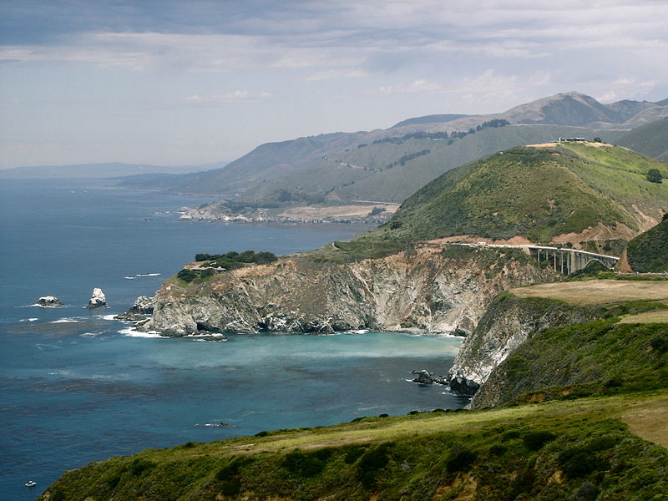
A cross between a clown and a bird
Coastal States
Atlantic Ocean
Gulf of Mexico
Pacific Ocean
Arctic Ocean
Notes:
PURPOSE:
This slide can be shown while you describe the assignment to students
CONTENT:
The image is Big Sur in California.
Describe the assignment to students, you can use the “key” provided to help. It is easiest to assign students to small groups (about 4 people)- this will allow them to get more research done in less time, but it also means that you can avoid assigning the less interesting coastal states. You can have students brainstorm some recent news items that are related to the main concepts, and might be relevant for certain states. Some possibilities
Any recent offshore earthquakes (this depends on what background students have- if they have previously taken earth science, or if this was discussed earlier in your class this is worth mentioning)
Tsunamis- due to underwater avalanche or earthquake ((this depends on what background students have- if they have previously taken earth science, or if this was discussed earlier in your class this is worth mentioning))
Offshore oil issues
Offshore renewable energy issues
Hurricanes that have cause significant erosion
Coastal defenses (seawalls, breakwaters) in use
Underwater volcanoes
SOURCES/IMAGES:
http://commons.wikimedia.org/wiki/File:Big_Sur_June_2008.jpg

