Slide 1
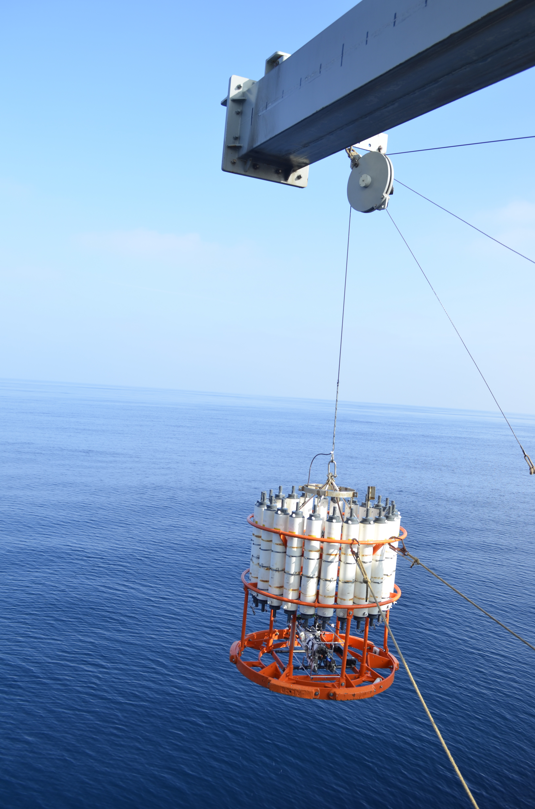
Water Column Properties
Notes:
Authors: Amanda Netburn, Scripps Institution of Oceanography; Danny Blas, Kearny High School
Why:
The mesopelagic zone harbors great diversity and abundance of animals in the oceans. Despite this, because it is too deep to observe without special equipment (“out of sight, out of mind”), it is poorly studied, and many people do not even know that this environment exists. The mesopelagic environment has very different physical and chemical properties than surface waters, in particular it has very low light levels that cannot support photosynthetic algae that form the base of the food web near the surface. The animals that live in the mesopelagic zone are specialized for life there- they look and behave quite differently from their counterparts in shallower waters. This lesson provides an overview of the physical and chemical properties that change with depth in order to prepare the students for understanding the adaptations of mesopelagic animals that are introduced later in the unit.
Summary:
This lesson provides an overview of the physical properties of the ocean that change with depth as well as the tools that are used for sampling these properties. Material presented includes: (1) What a CTD is and how it is used to sample water column properties, (2) temperature decreases with depth (students draw on prior knowledge that cold water sinks, and warm rises), (3) oxygen decreases with depth as a result of both physical and biological forcings, (4) Nutrient concentrations increase with depth because they are used up by photosynthetic organisms near the surface and released at depth as waste. After the presentation, students plot data and answer questions provided on a handout.
The mesopelagic environment has quite different physical and chemical properties than surface waters, in particular it has low
Image Credit: Amanda Netburn
Context for Use:
This is the first in a 5-lesson unit “Mesopelagic environment, adaptations and human impacts.” The unit was developed for a 9th grade Earth Science class, but would be applicable for any Marine Science of Environmental Science courses.
Misconceptions:
The ocean environment is the same at all depths
Evaluation Tips:
The final activity requires a handout, Lesson1_Handout.
The answer key to the handout is at Lesson1_Handout_KEY
Graph paper is required for this activity. It may be found at: http://incompetech.com/graphpaper/plain/
The graphs and worksheets should be collected for evaluation.

Slide 2
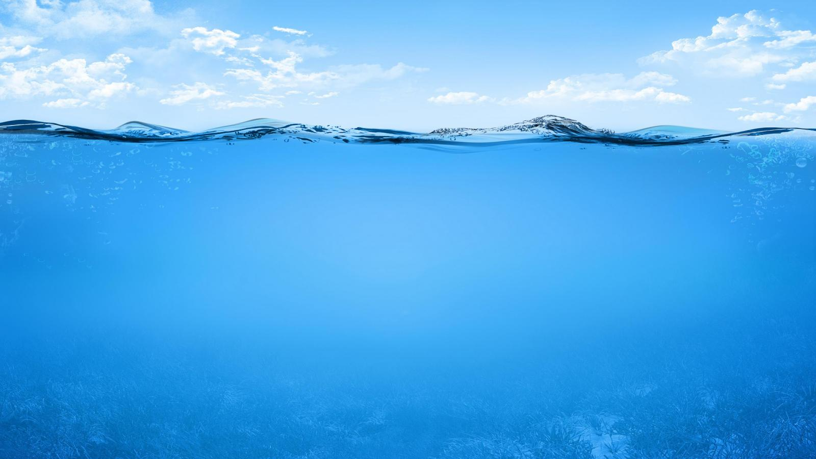
What do we mean “water column”?
Water column: conceptual column of water from surface to bottom
“WATER COLUMN”
Notes:
This slide defines the term “water column.” Measurements of seawater properties are typically collected through up and down sampling, effectively sampling a column of water. The ocean is considered to be stratified, it has distinct layers with different characteristic properties. By conducting vertical sampling in different places, oceanographers are able to compare properties of these layers throughout the world’s oceans.
Many properties of seawater change with depth, such as density, temperature, salinity, light and oxygen concentration.
Image Credit: http://hqwallbase.com/113884-beautiful-water-photography/

Slide 3
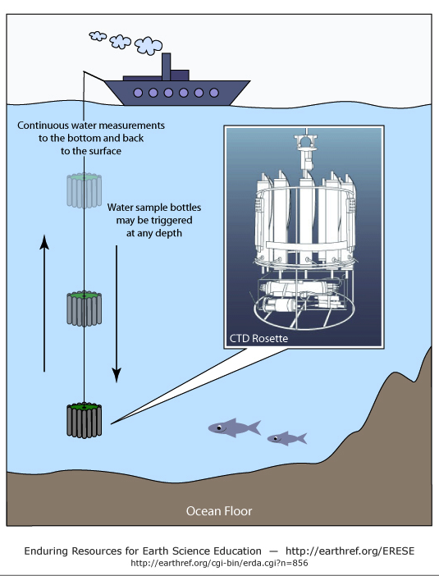
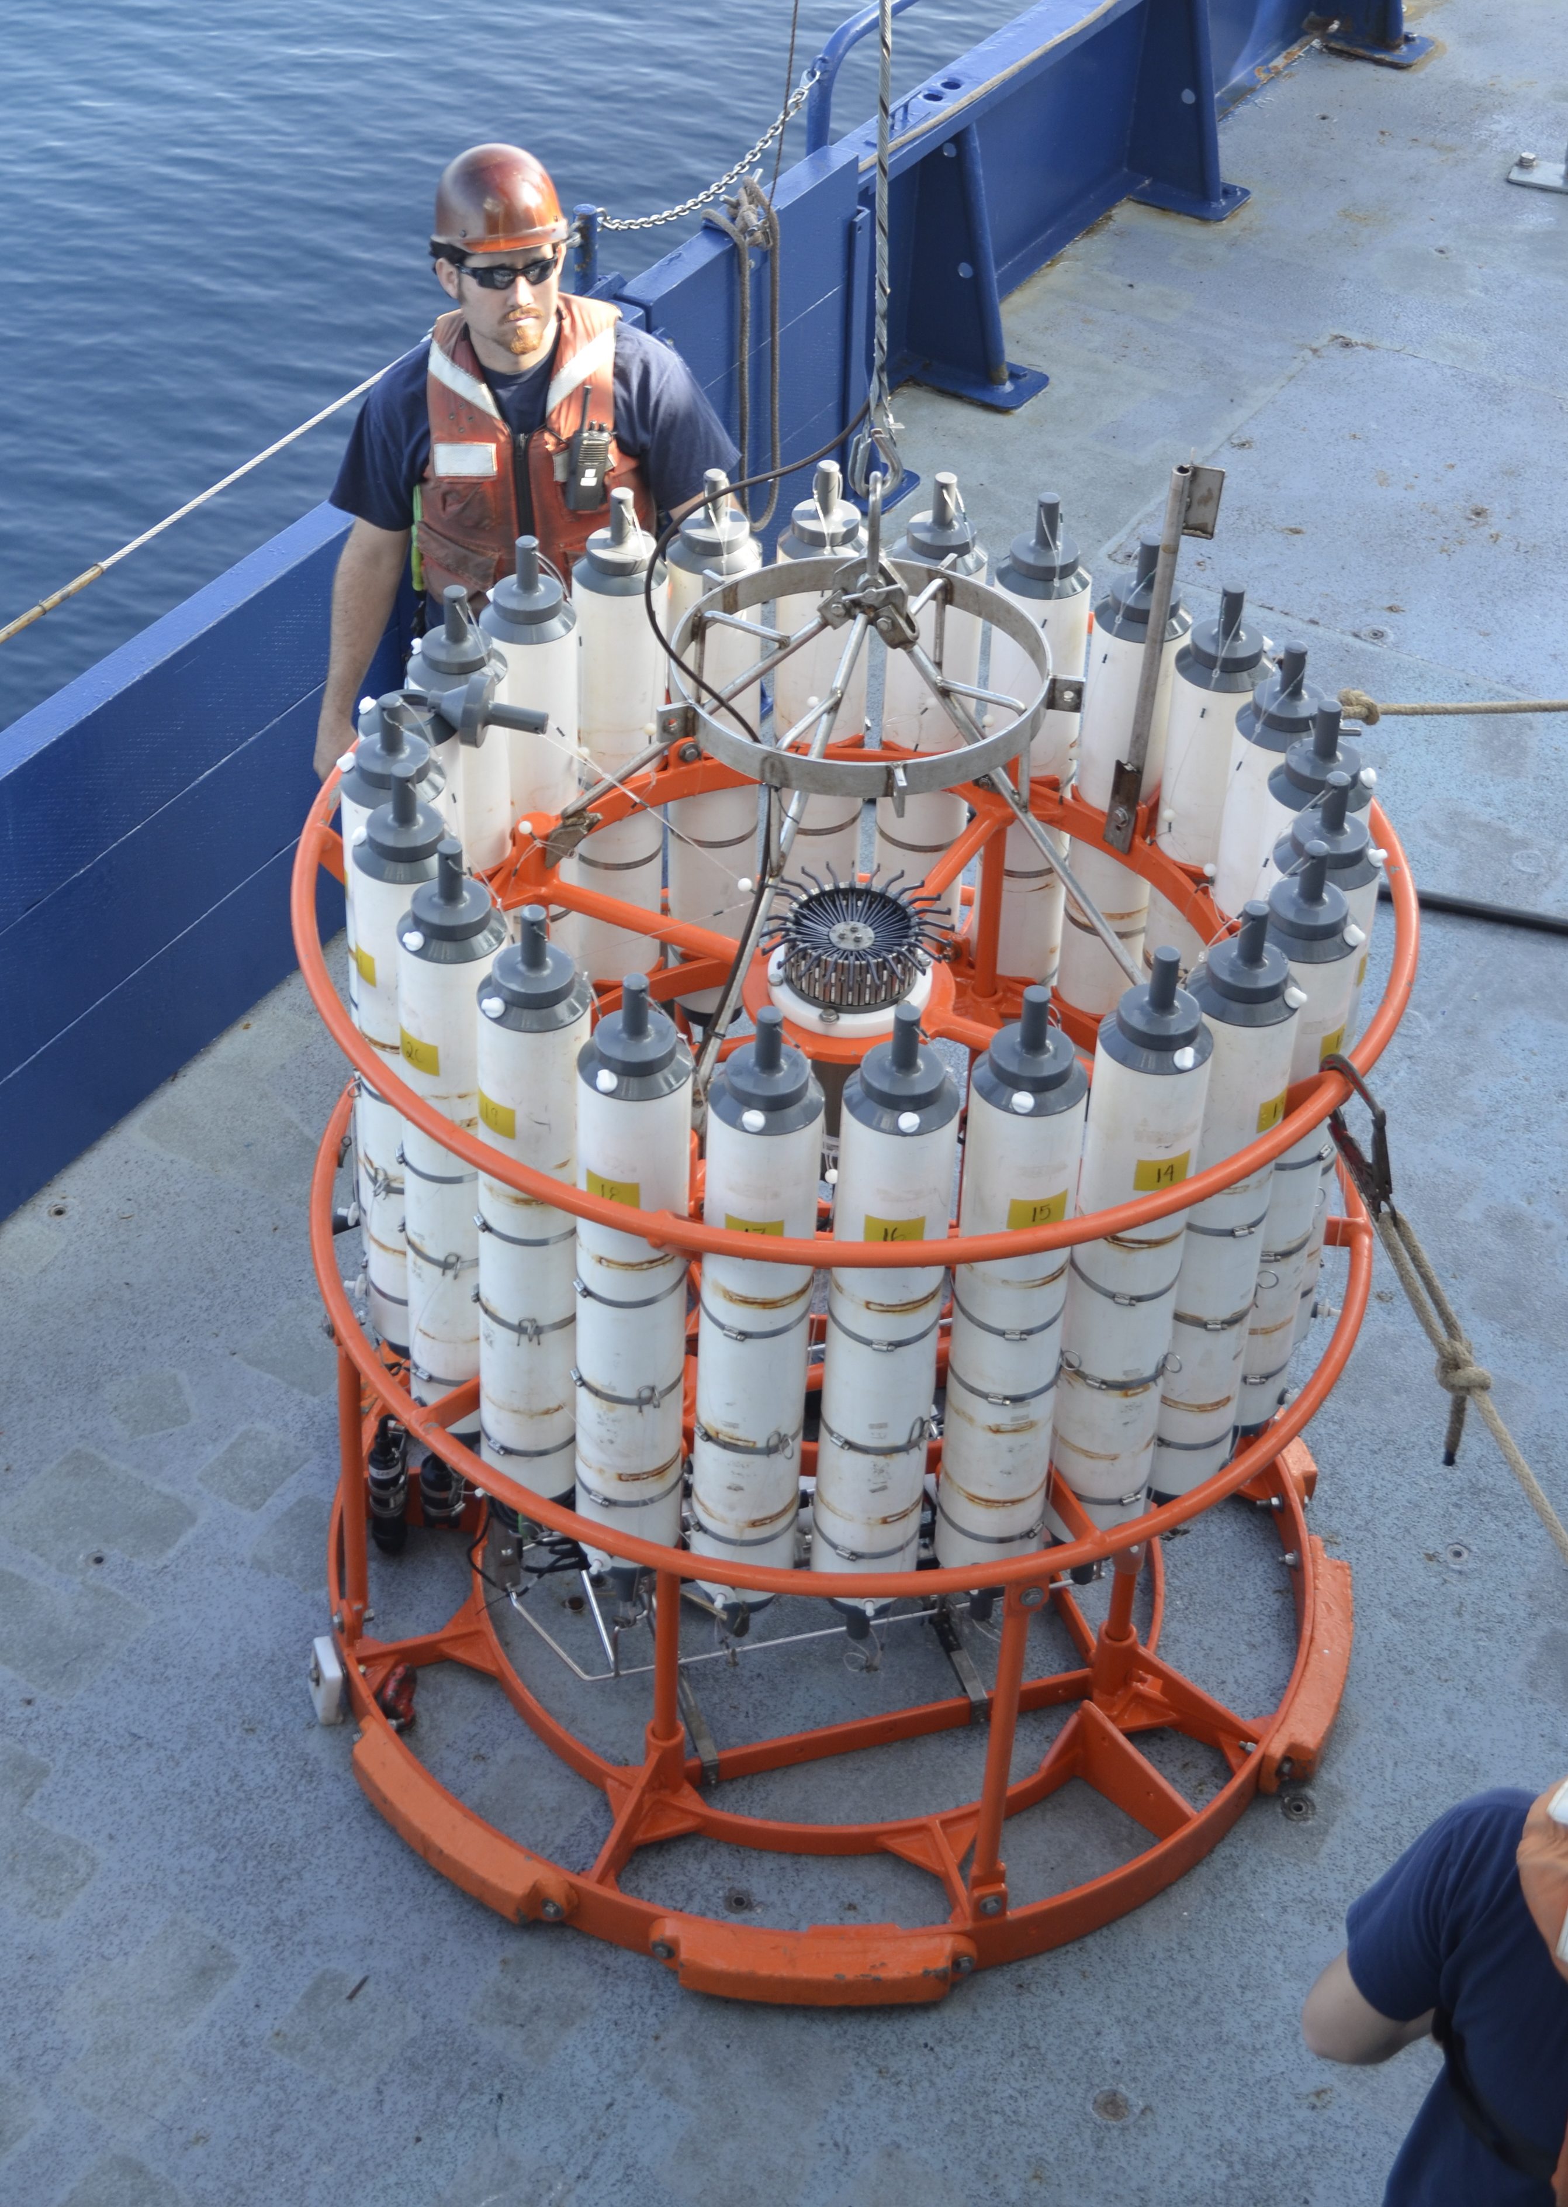
How to survey the water column
CTD
Conductivity (as a way to measure salinity)
Temperature
Depth
equipped with other sensors
ability to collect seawater from different depths
Notes:
The standard instrument for sampling water column properties is called a CTD, which stands for Conductivity Temperature Depth. Conductivity is used as a way of measuring salinity. The CTD is lowered and raised off the side or back of the research vessel. Modern CTDs may be equipped with a number of different sensors depending on the scientists’ needs, such as oxygen, nutrients, pH, light transmission, and fluorescence (a way to measure chlorophyll concentration). CTDs are typically fitted with a rosette of bottles that collect water at chosen depths, and can be used to take measurements on bacteria, algae, microzooplankton (single-celled animals), salinity, oxygen and other properties.
In the image on the right, the CTD (and other) sensors can be seen mounted at the bottom of the rosette frame, and the bottles all around the frame. The CTD itself cannot be seen in the image on the left, it is in the center of the bottles.
Image credits:
Left: Amanda Netburn
Right: http://earthref.org/cgi-bin/erda.cgi?n=856

Slide 4
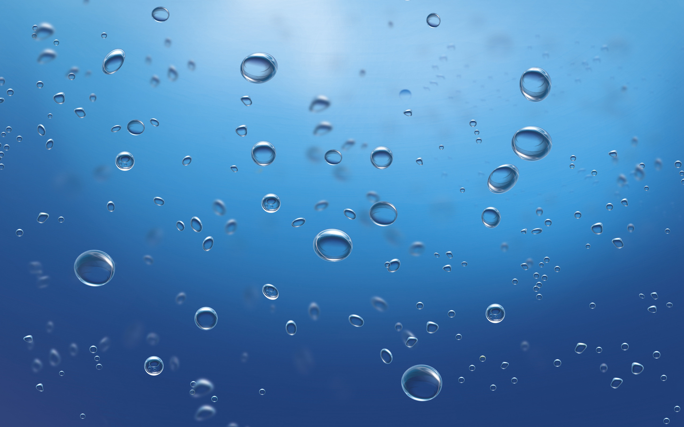

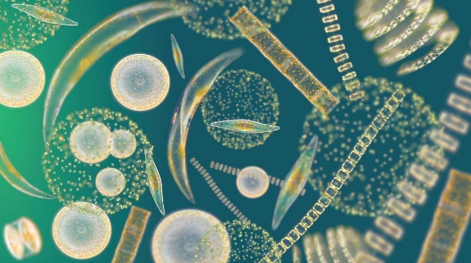
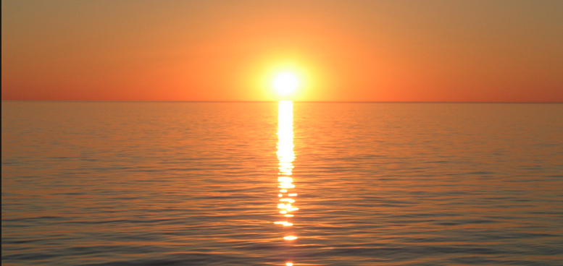
A lot of properties change with depth!
Oxygen
Temperature
Nutrients
Chlorophyll
Light
Notes:
This is an overview of some of the properties of the water that change with depth.
Image credits:
Oxygen: http://www.mrwallpaper.com/Water-Bubbles-wallpaper/
Chlorophyll: Richard Kirby (accessed from http://firstlook.pnas.org/seeking-sailors-to-help-measure-phytoplankton-populations/)
Light: http://wallfoy.com/sunset-pictures-41-174976-wallpapers-HD.html
Temperature: http://www.freevectors.net/download/9212

Slide 5
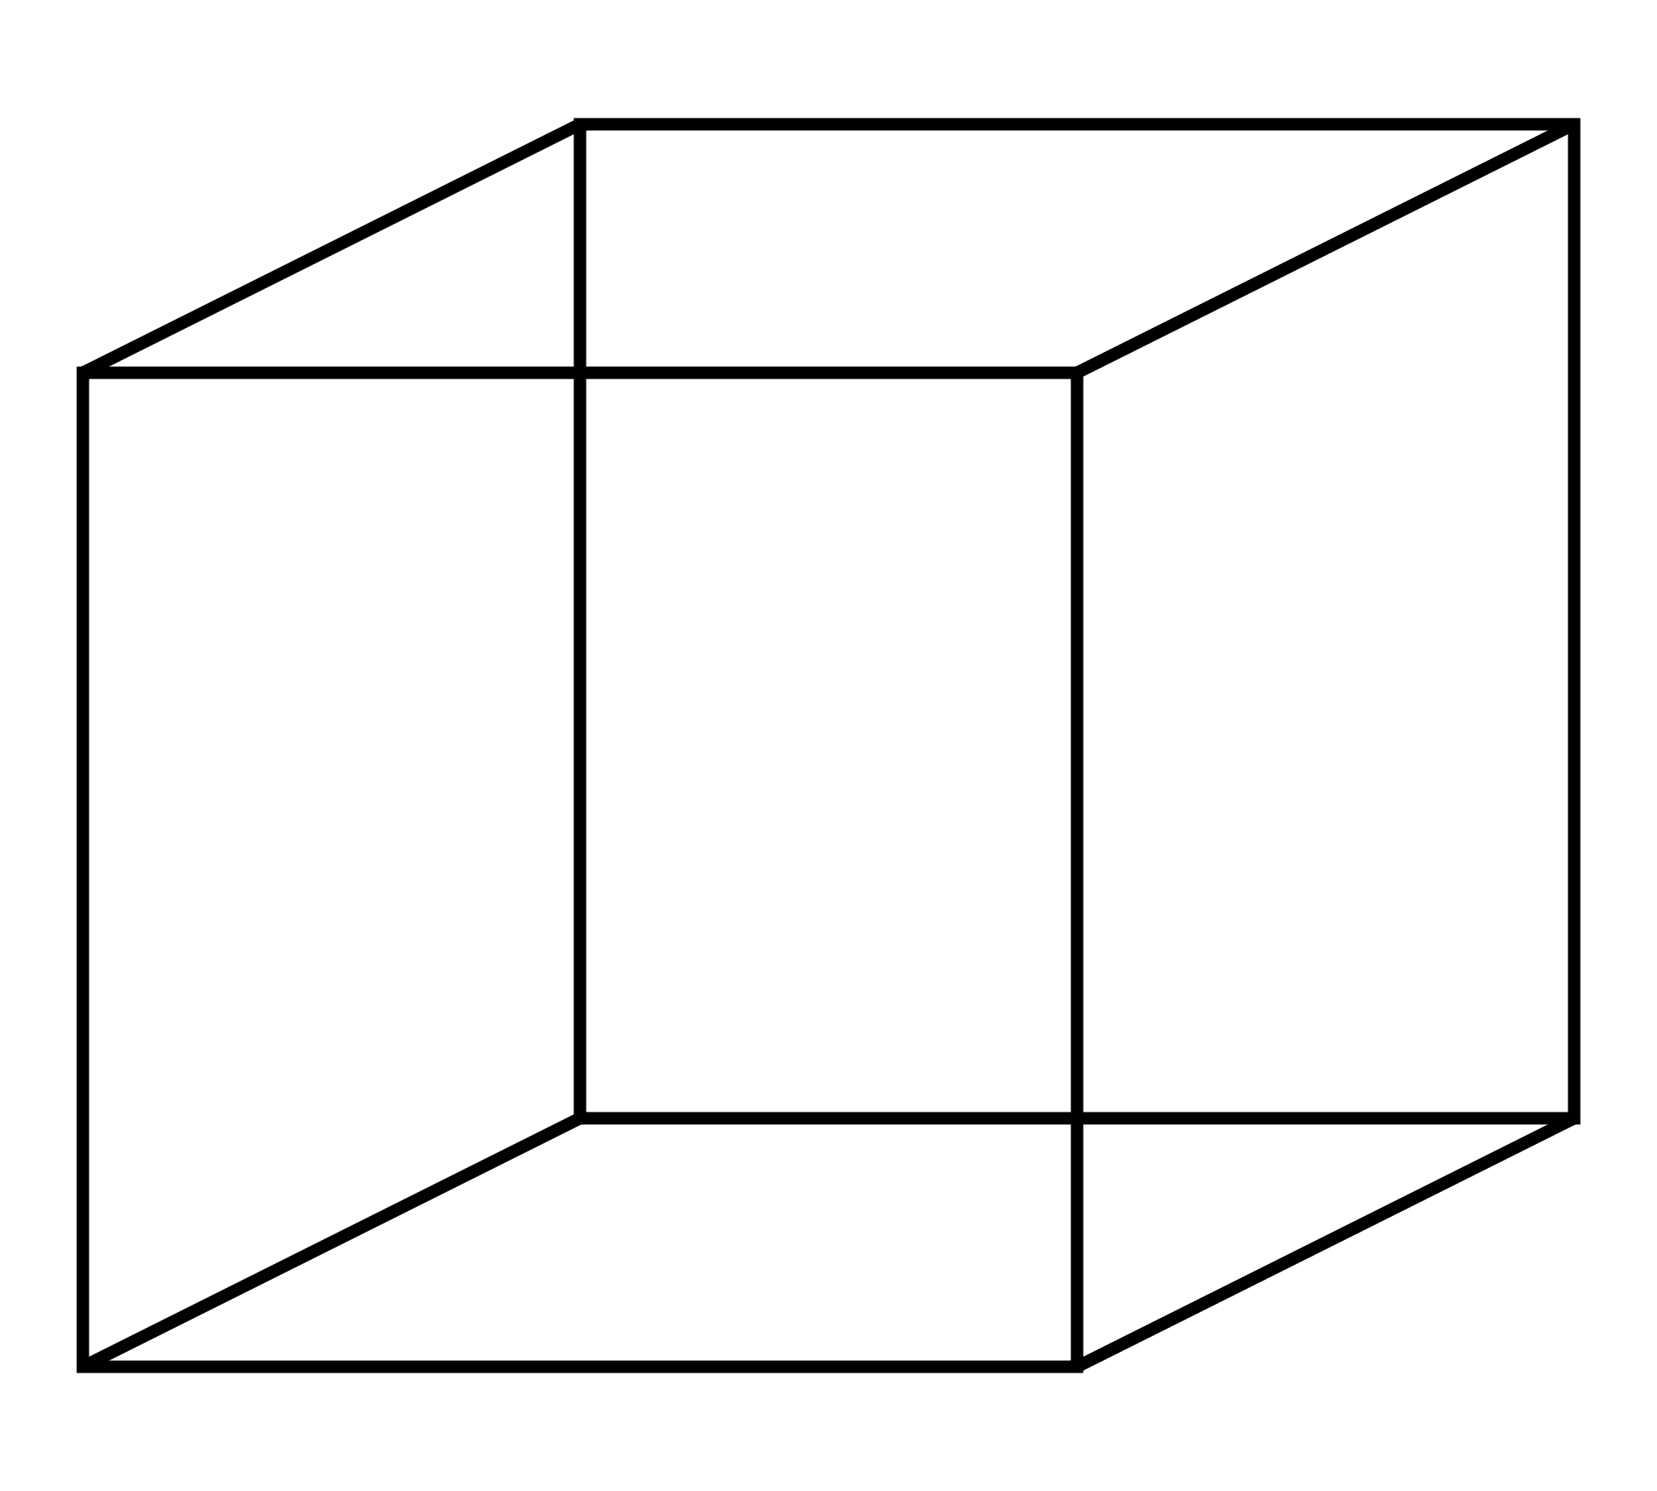
Density
Density = mass/volume
Density
Heat
Salinity
Warmer, fresher water is less dense
& floats
Colder, saltier water is more dense
& sinks
Notes:
The ocean is stratified, with the densest water sinking to the bottom, and the least dense water at the top.
Temperature and salinity contribute the most to the density of water.
Most substances expand when heated, so the the same mass takes up more volume, decreasing the density.
Cold water is denser than warm water, so the coldest waters tend to be in the bottom of the ocean.
Saltier water is heavier (this is because there are more substances dissolved in the water), so denser than freshwater.
The top image demonstrates the changes to density with temperature and salinity. Arrows point in the direction of an increase in each of the properties. Orange circles represent mass in each of the figures.
Questions: If it rains on the ocean, does that water sink or float?
Image Credit: http://hqwallbase.com/113884-beautiful-water-photography/

Slide 6
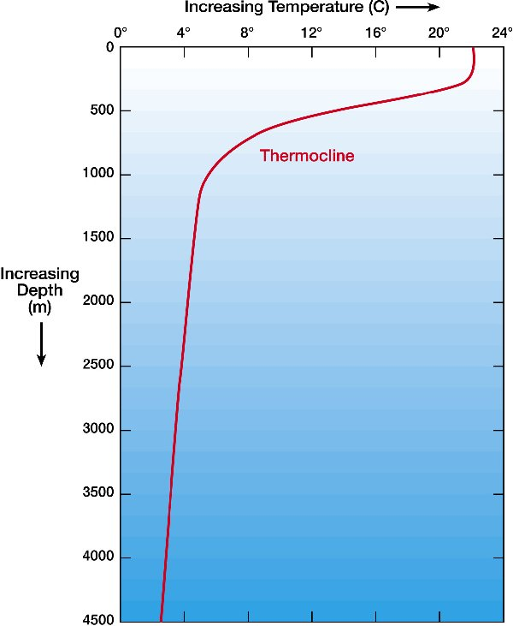
Temperature Profile
Notes:
y-axis is depth and the x-axis is temperature in °C.
Temperature declines with depth because the coldest water sinks to the bottom while the warmest water rises to the top. The layer near the surface has relatively even temperature due to wind-driven mixing near the sea-air interface. The thermocline is the layer of water with the strongest gradient in temperature (i.e., temperature changes a lot over the depth of the thermocline).
Image credit:
http://www.windows2universe.org/earth/Water/temp.html&edu=high

Slide 7
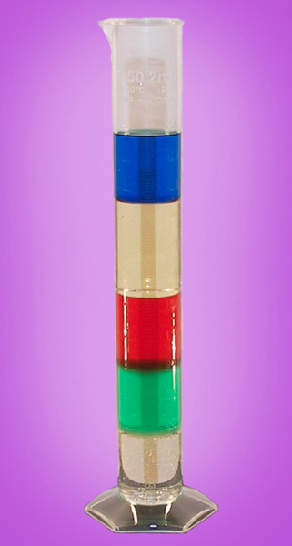
Temperature
If the only difference between these layers is temperature, which is coldest?
Which is the warmest?
Notes:
Ask the students: Which of these layers of water is the coldest? Which is the warmest? Why?
The purpose of this slide is to engage the students’ prior knowledge on how different temperature water would stratify (hotter fluids rise, colder sink).
You can also ask: If the only difference between the layers is salinity, which is the saltiest layer?
Image credit: https://www.sciencelabsupplies.com/Density-of-Liquids-The-Color-Column.html

Slide 8
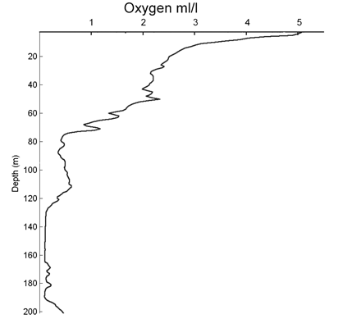
Oxygen
Notes:
y-axis is depth; oxygen concentration (in ml/L) is on the x-axis.
Oxygen declines with depth for the reasons explained in the next slide.
Image credit: http://www.oceannetworks.ca/ocean-properties

Slide 9
Oxygen
Phytoplankton near the surface produce oxygen
Mixing from the air also brings oxygen into surface waters
Animals use the oxygen for respiration in deeper waters
Notes:
This slide explains the mechanisms that lead to the oxygen profile that is shown on the following screen.
(1) Using the sun as an energy source, phytoplankton convert CO₂ (carbon dioxide) into sugars, and release O₂.
(2) Oxygen is also introduced into the surface layers of the ocean through mixing caused by wind and waves and direct diffusion at the sea surface.
(3) Heterotrophic animals convert oxygen into carbon dioxide through the process of respiration. In deeper waters, where there is little replenishment of oxygen through the phytoplankton and surface processes, oxygen becomes depleted through respiration.
Suggestion: Before showing the next slide, the teacher could prompt the students to sketch what they think a typical oxygen profile (oxygen on x-axis, depth on y) would look.

Slide 10
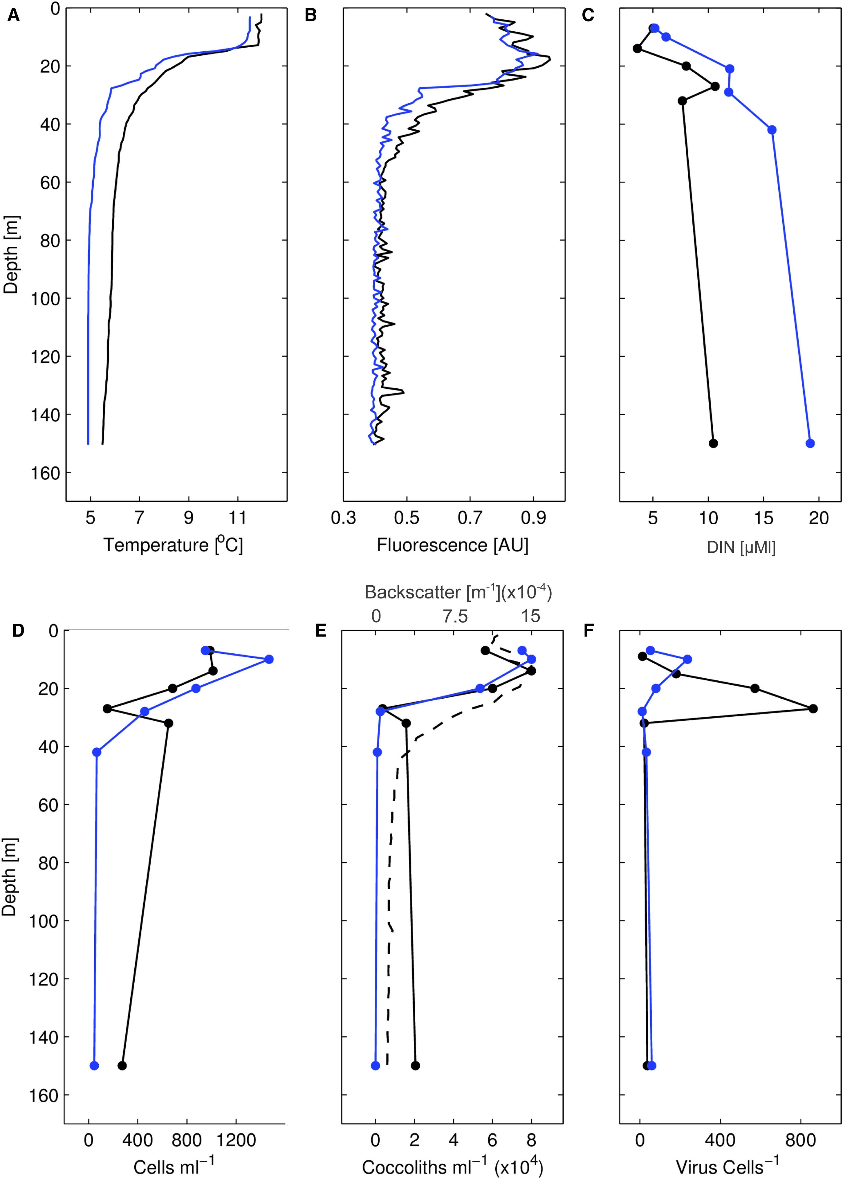
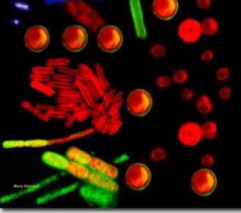
Chlorophyll
Why is peak chlorophyll below the surface?
Notes:
Chlorophyll is a pigment that is needed for photosynthesis (the conversion of sunlight and carbon dioxide into energy by plants) and its concentration is used as a proxy for primary productivity (or amount of phytoplankton in the water). Chlorophyll is fluorescent, meaning if you shine light on it at a given wavelength, it re-emits light at a different wavelength (this is how “glow-in-the-dark” toys work). Concentrations of chlorophyll are estimated by using a fluorometer, which can measure the amount of returned light. The image on the left shows fluoresce of cyanobacteria (photosynthetic bacteria that are common in the oceans). The plot is of chlorophyll fluorescence plotted against depth (in m).
Ask students:
(1) Where do you expect the most fluorescence to be? Why? (expectation: the surface, because it has the greatest amount of sunlight)
(2) Where is the fluorescence the highest? (~20-25 m).
(3) Why? (No one knows for sure. Some possibilities include: phytoplankton get “sunburnt” near the surface, there is too much wind/waves near the surface, and phytoplankton survive better without all of that movement, phytoplankton get eaten too quickly at the surface, the phytoplankton are there, but they are not fluorescing (called “quenching”).
Image Credit: Left: http://phys.org/news12068.html Right: Lehahn et al. (2014), http://www.sciencedirect.com/science/article/pii/S0960982214009099

Slide 11
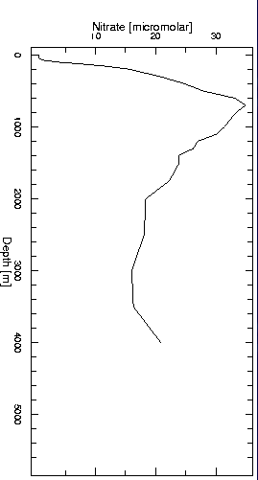
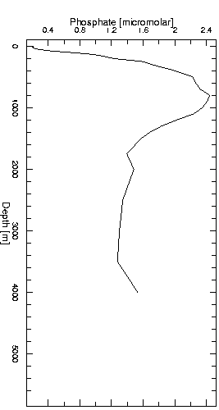
Nutrients
taken up by phytoplankton near the surface
Notes:
When we talk about “nutrients” in the water, we are talking about dissolved nutrients that can be taken up by phytoplankton. These nutrients are NOT available to consumers that need to feed on other organisms for nutrition (e.g., zooplankton that feed on algae, fish, etc) .
The y-axes for these plots is depth in meters. The x-axes are different nutrients (nitrate on the left, phosphate on the right). The two profiles are very similar, because both are necessary nutrients for photosynthesizing organisms. The nutrient levels are extremely low in near-surface waters because the nutrients are taken up by photosynthetic organisms. When it is too deep for photosynthesis to occur, nutrient levels rise again.
Image Credits: http://oceansjsu.com/105d/exped_ecosystems/7.html

Slide 12
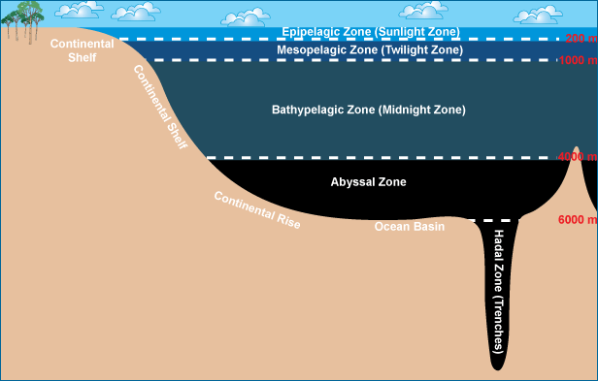
Zones in the ocean
Notes:
Recall from earlier slides that the ocean is stratified. Scientists have given names to different layers, or zones, of the pelagic (open water) ocean based on their characteristic properties. This image shows the major zones, and their depths (in red).
The epipelagic zone (0-200 m) is well-lit with relatively warm waters, and contains photosynthetic organisms.
The mesopelagic zone (200-1000 m) is called “The twilight zone,” because although it is very dark, some light does make into the mesopelagic zone and animals are able to use vision to hunt and search for mates.
Below the mesopelagic zone, virtually no light penetrates at all.
The Bathypelagic Zone is from 1000-4000 m, the abyssal zone from 4000-6000, and the Hadal Zone is the trenches, below 6000 m.
Image credit: http://evolution.berkeley.edu/evolibrary/article/fishtree_05

Slide 13
Conclusions
  The ocean is stratified
  Temperature decreases with depth
  Oxygen concentration decreases with depth
  Chlorophyll has a maximum a little below the surface
  Nutrient levels increase with depth
Notes:
The water column is a conceptual column of water from the surface to depth. Physical and chemical properties of the water column are commonly measured with a CTD, which stands for Conductivity, Temperature, and Depth.
Many properties change with depth, including:
Temperature – decreases with depth
Oxygen concentration – decreases with depth
Chlorophyll – has a maximum a little below the surface
Nutrients- increase with depth

Slide 14
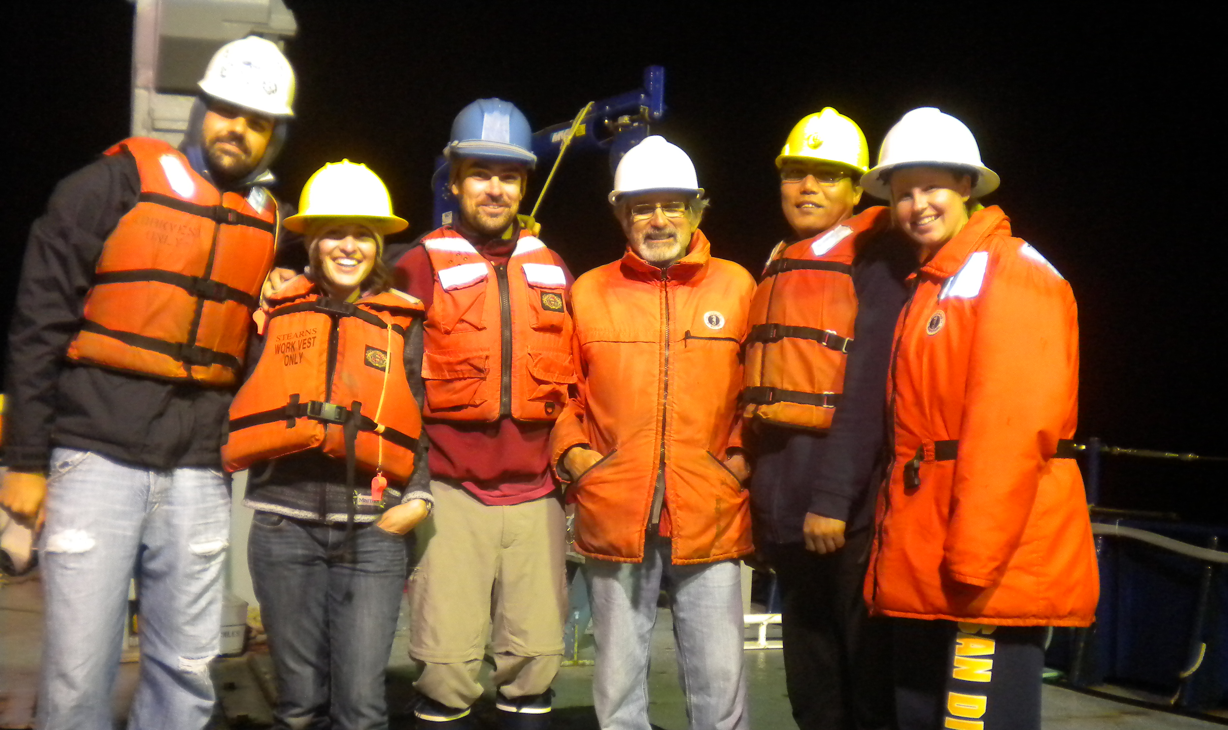
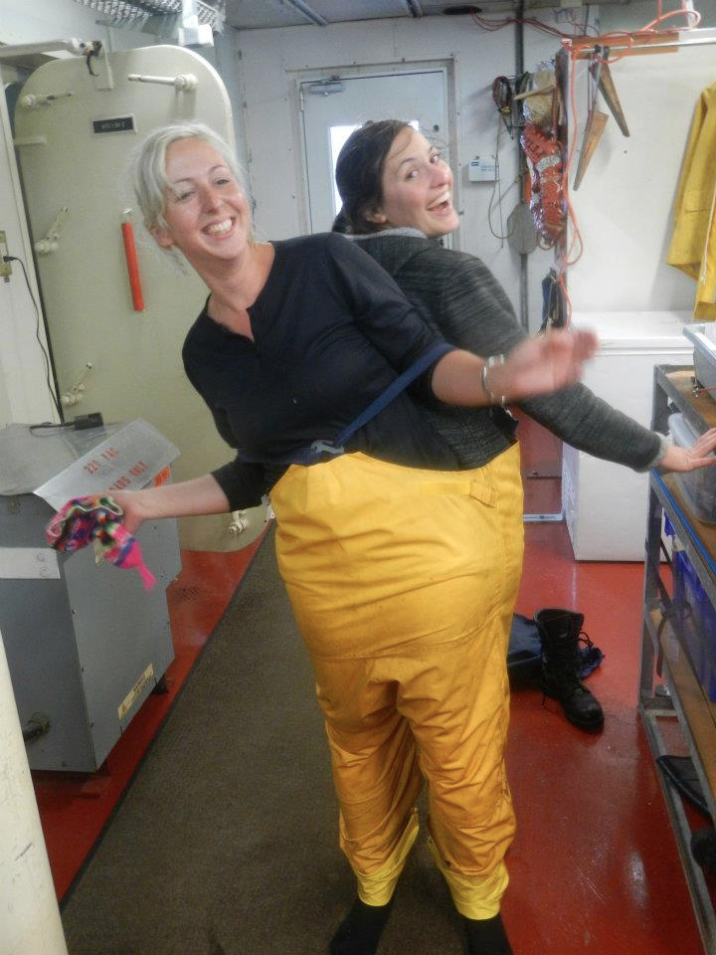
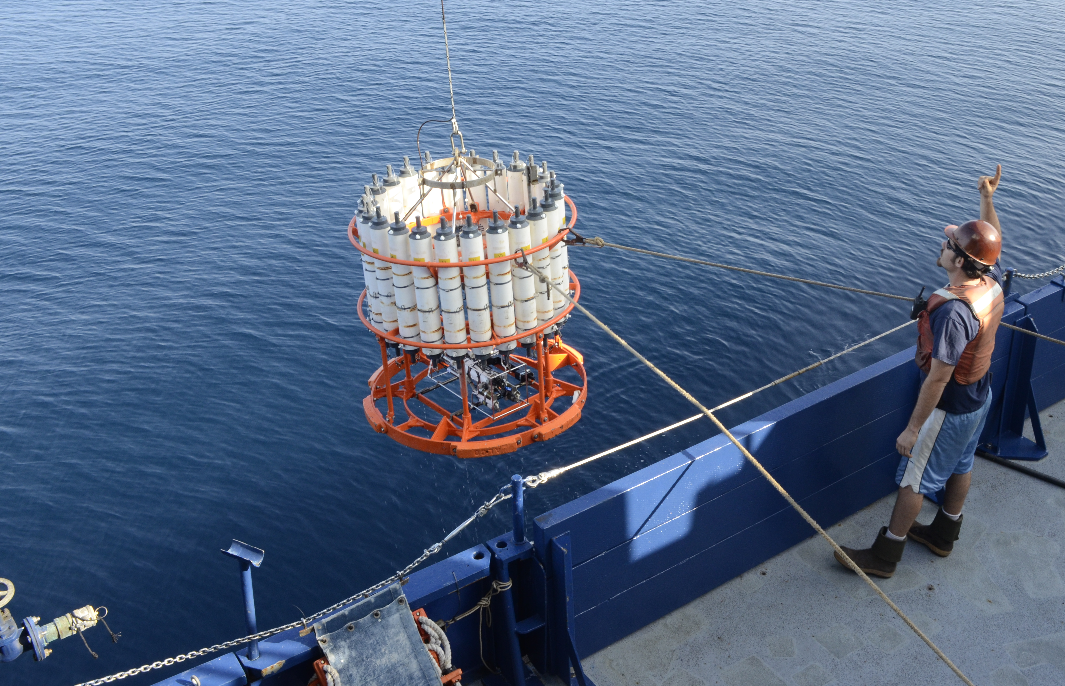
Your assignment: Be an Oceanographer
Notes:
Oceanography can not be done alone. It requires a team of people working around the clock to run the CTD other instruments, and work up all the samples. When equipment goes overboard, you need to wear hard hats and safety vests to protect yourself, and if it’s going to be a rough day, you wear rainsuits (occasionally built for two)!
Image credits: Amanda Netburn

Slide 15
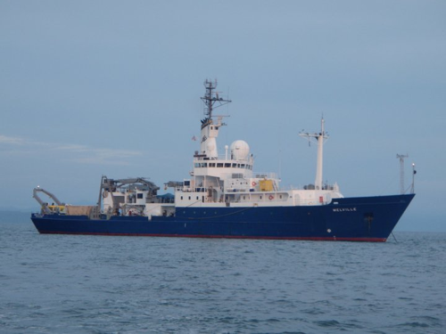
Assignment
Plot real data to see how temperature, nitrate (an important nutrient), chlorophyll, and oxygen all change with depth
Notes:
Assignment filename: Lesson1_Handout
Key: Lesson1_Handout_KEY
graph paper may be found online at: http://incompetech.com/graphpaper/plain/
The data to be plotted was all collected off the coast of California as part of a long-term oceanographic study, called the California Cooperative Oceanic Fisheries Investigation (see www.calcofi.org for more information).
Image credit: https://scripps.ucsd.edu/ships/melville

