Slide 1
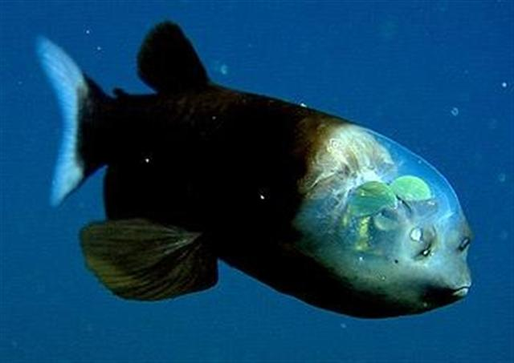
Adaptations of Mesopelagic Animals
Notes:
Authors: Amanda Netburn, Scripps Institution of Oceanography; Danny Blas, Kearny High School
Why:
The mesopelagic environment is a very unique place filled with cool and unusual life forms. The mesopelagic zone is a cold and dark place, with limited food source due to the lack of photosynthetic algae to form the base of the food web. The animals that live there have therefore evolved specialized features to allow them to cope with these extremes. This lesson focuses on mesopelagic fishes, which look really different than the marine fishes with which the students may already be familiar. Many have the ability to produce light with specialized organs, have large eyes to be able to see in the very dim environment, are relatively small so that they don’t require a lot of food, and have large mouths compared to their body size so that they can take advantage of what prey are available to them. This lesson prompts students to make connections between the mesopelagic environment that they learned about in lesson 1, and the adaptations of the animals that live there.
Summary:
This lesson introduces some of the key adaptations that mesopelagic animals have for living in the deep open ocean. These include: (1) Large mouths in order to effectively catch what little prey is available, (2) the ability to produce light and (3) camouflaging by being transparent, black, red or silver. The lesson is followed by an activity in which students look at images of different mesopelagic animals and observe the different adaptations.
Image Credit: Wiki Commons (http://commons.wikimedia.org/wiki/File:Pez_Cabeza_Transparente.jpg)
Context for Use:
This is the third in a 5-lesson unit “Mesopelagic environment, adaptations and human impacts.” The unit was developed for a 9th grade Earth Science class, but would be applicable for any Marine Science of Environmental Science courses.
Additional Resources:
MBARI has some really neat video of live animals that was recorded using ROVs.
These are some of my favorites:
http://www.youtube.com/watch?v=dFhoIu4VKms (Eerie Critters from the Deep)
http://www.youtube.com/watch?v=RM9o4VnfHJU (Barreleye footage)
http://www.youtube.com/watch?v=3HzFiQFFQYw (There’s no such thing as a jellyfish)
Misconceptions:
There are no or few animals living in the deep open ocean
Most animals in the oceans live close to the surface
All fish are big
Evaluation Tips:
The following materials are required to complete the activity for this lesson:
Lesson3_FishCards.pdf
Lesson3_MesoAdaptationAsst
The fish cards need to be prepared by the instructor before the start of the class. They are set up to be printed 2-sided, so that the appropriate information matches up with the appropriate pictures.
The assignment sheet should be reviewed, and used for assessment of students understanding of the concepts in this lesson.

Slide 2
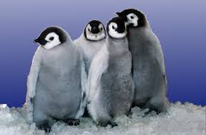
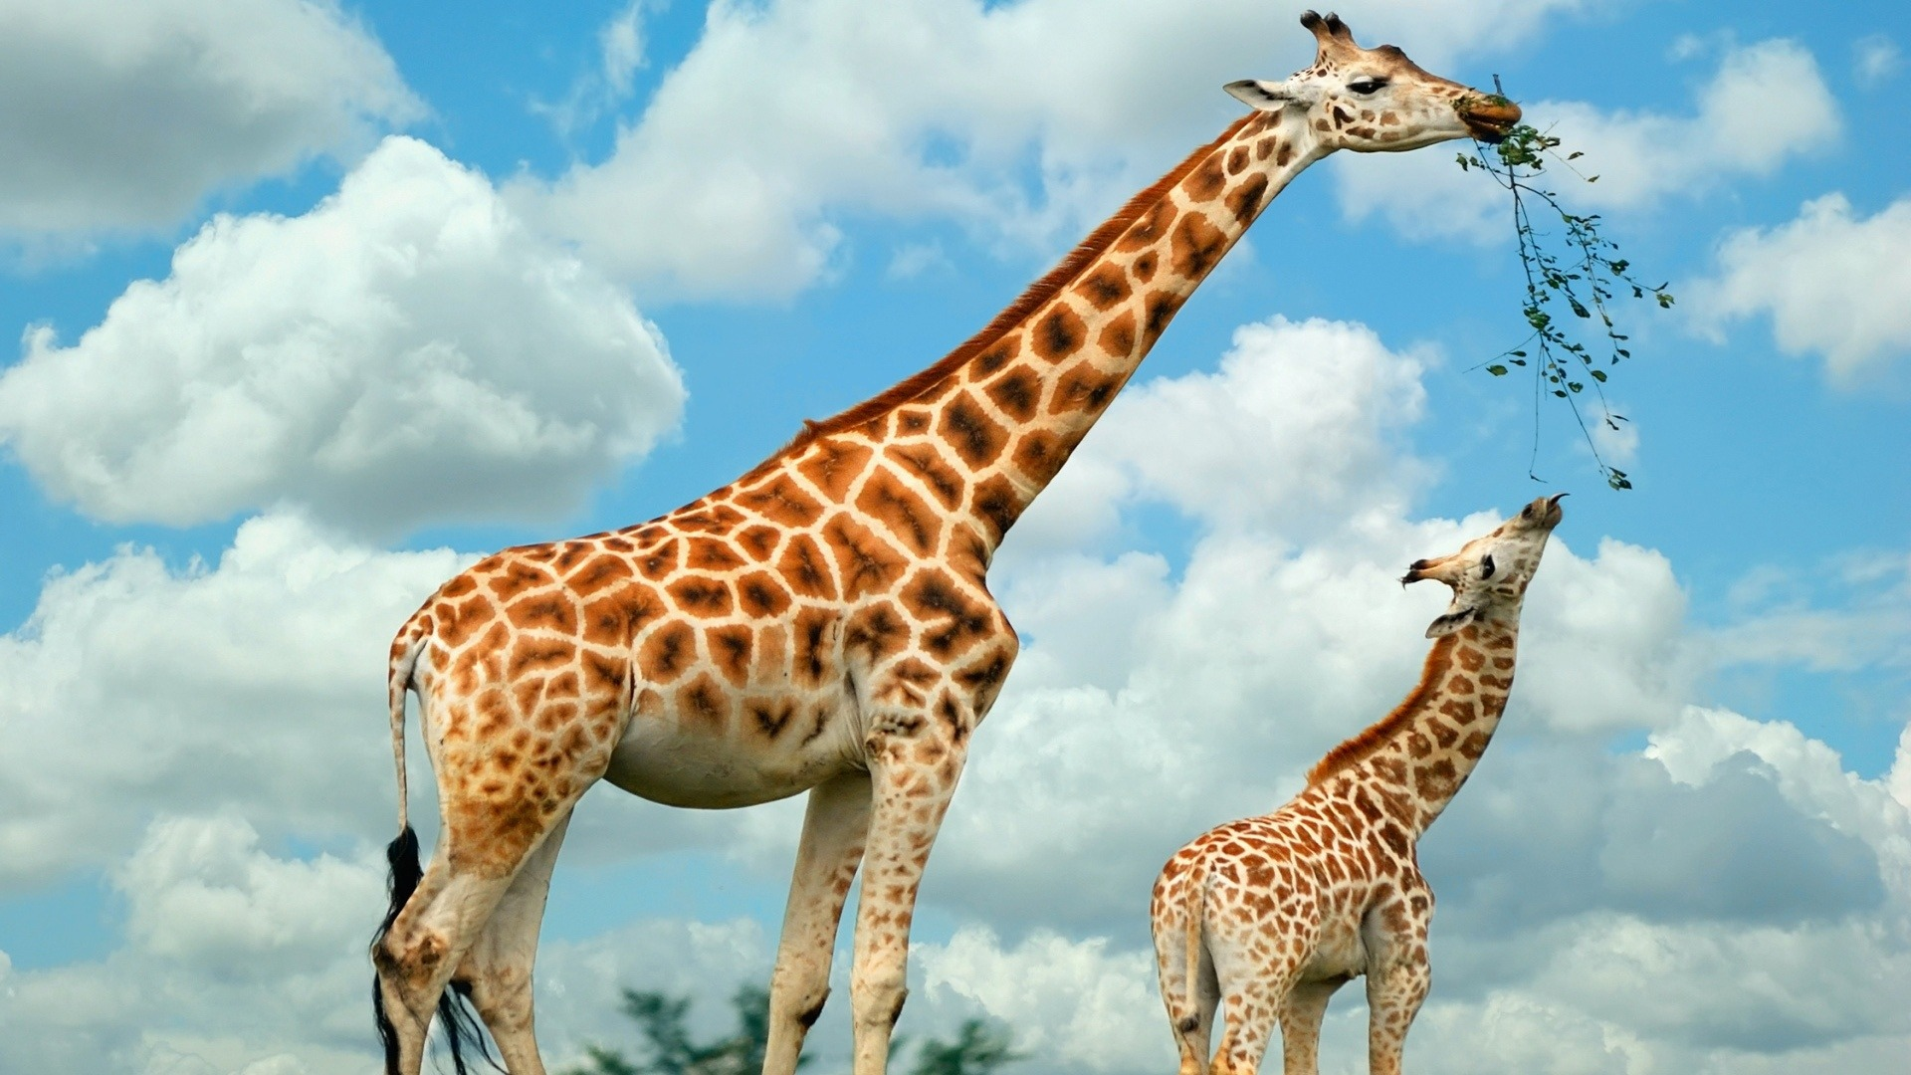
Adaptation
trait that evolved to allow the animal to survive and reproduce in its environment
Notes:
The definition of Adaptation is:
structure or function of an organism that results from natural selection and by which the organism becomes better fitted to survive and multiply in its environment.
The link between the environment and the adaptation is very important. You can use these images as prompts to ask the students about how penguins and giraffes are suited for their environment (e.g., penguins are chubby and have very thick feathers to stay warm, giraffes have long necks to be able to eat the leaves, above where most other animals can reach).
To lead into the next set of slides, you can ask the students here to describe the mesopelagic environment, and hypothesize what kinds of adaptations that animals may have evolved for living there.
Image Credit:
Left: http://fourwallsonly.com/baby-emperor-penguins-pictures/
Right: http://www.hdwallpaperscool.com/wp-content/uploads/2014/03/Giraffe-high-definition-wallpapers-free-download-marvelous-hd-wallpapers-of-giraffe.jpg

Slide 3
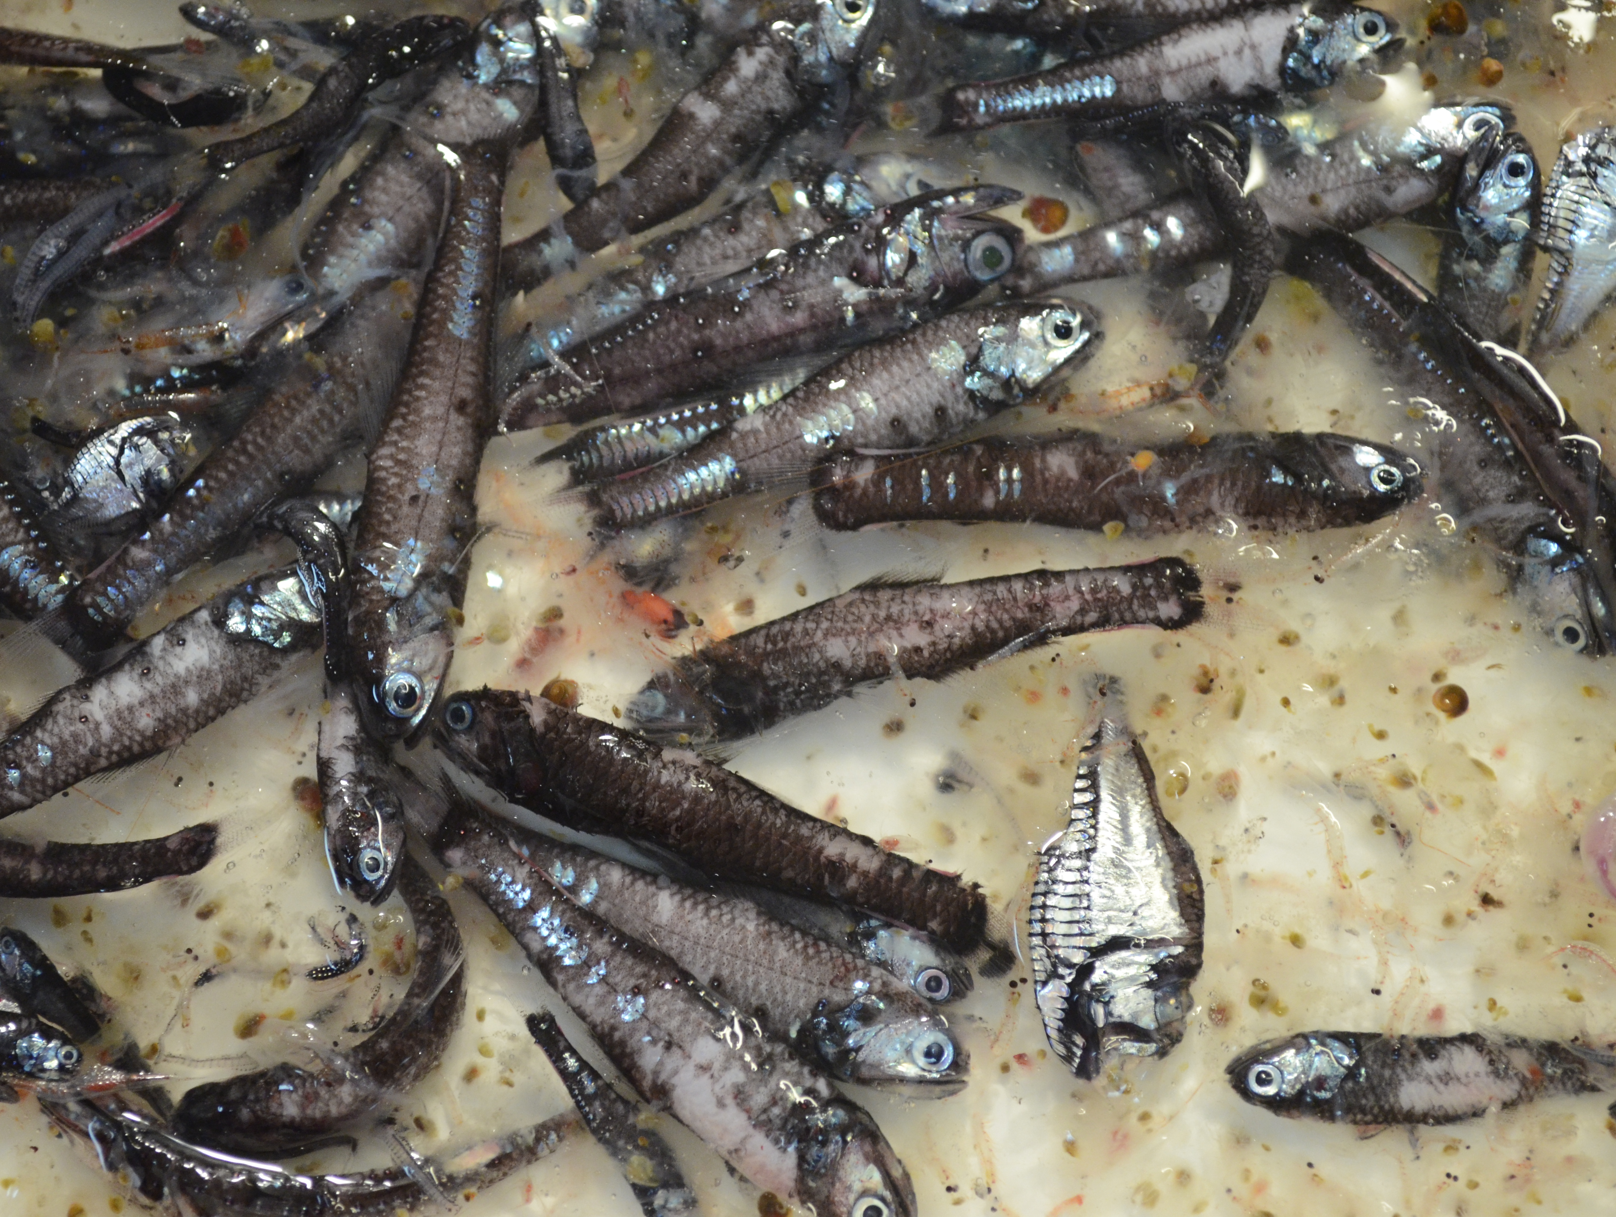
Notes:
This is a typical catch of mesopelagic fishes with a midwater trawl.
Ask students: What kinds of things do you notice about the fish in here? (some things: silver/reflective, black/dark, large eyes, relatively small fish, have photophores.)
Note: Most of these fishes are myctophids/lanternfish. There is a hatchetfish in the image (silvery one toward the bottom left corner). The gelatinous animals that are in the backround are salps.
Image Credit:
Amanda Netburn

Slide 4
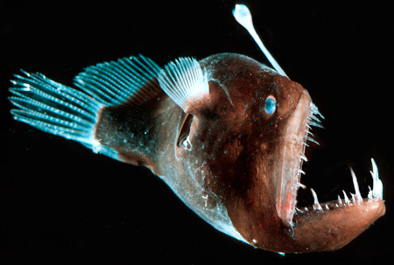
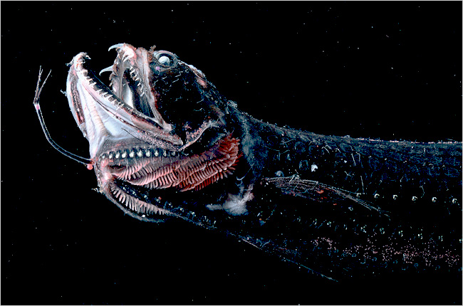
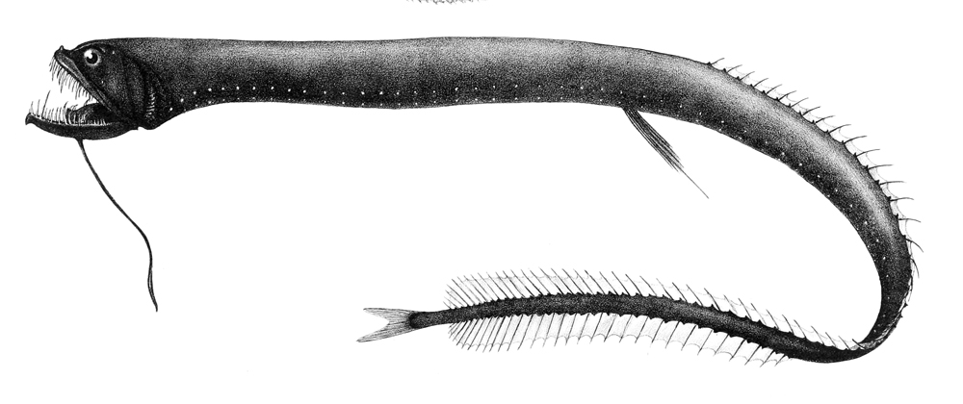
Large mouths/Big Teeth
- can eat anything smaller than their mouth
Anglerfish
Dragonfish
Dragonfish
Notes:
The following slides provide an overview of some of the traits of these animals.
Many mesopelagic fishes have very large mouths compared to their body sizes. This because their environment does not have a lot of food, and they need to be be opportunistic feeders, and be able to feed on any prey that comes their way.
Image credits:
Anglerfish: http://nature.ca/explore/di-ef/dsfe-3_e.cfm
Dragonfish: (top) http://fishindex.blogspot.com/2008/06/scaly-dragonfish.html (bottom) Wikipedia

Slide 5
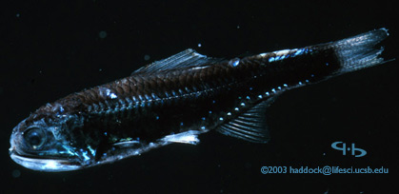
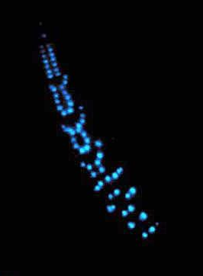
Bioluminescence
Most mesopelagic animals produce light for:
camouflage
recognition
to see
Notes:
The small light-producing organs on the skin of these fish are called photophores.
Countershading: Most of the photophores on most of the fish species are on the bottom (ventral) side of the animal. In this case, if a predator looks at them from below, the light emitted from their bellies will help them camouflage with the weak light coming down from above (from the sun). with few or no photophores on top, from above these animals will blend in with the darkness below them.
(2) The animals in these photos are both lanternfish (aka myctophids). There are ~250 species of myctophids in the world, each of which has a different pattern of photophores on their bodies. It is believed that they are able to recognize other members of their species by the arrangement of photophores on each other. This is important for finding appropriate mates for reproducing.
(3) Some fish have photophores near their eyes, that shine light ahead of the animal in order to help them see what is ahead of them, like a flashlight.
Image credits: Left: Steve Haddock (http://biolum.eemb.ucsb.edu/organism/pictures/myctophid.html), Right: http://www.naturamediterraneo.com/forum/topic.asp?TOPIC_ID=65062

Slide 6
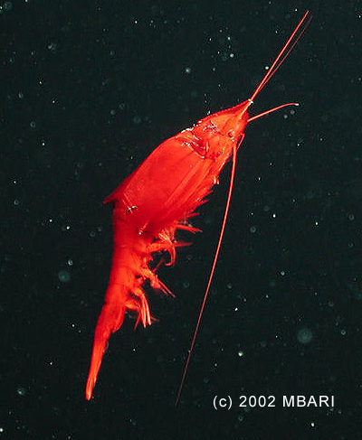
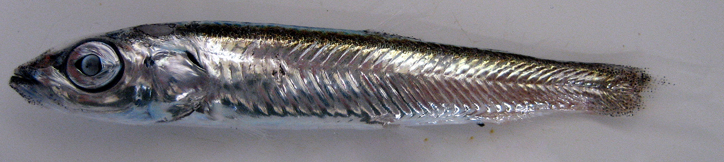
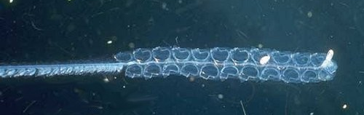
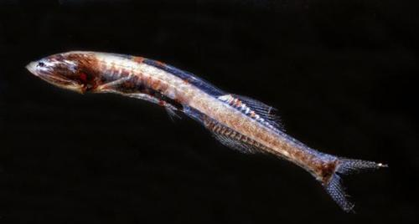
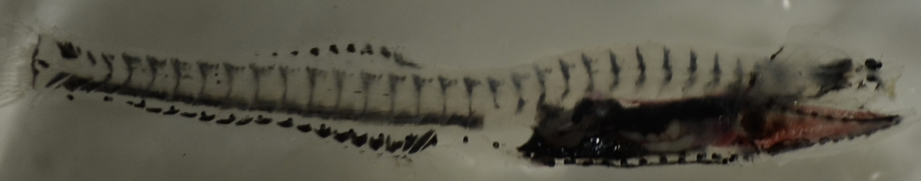
Colors – black, silver, red, transparent
Deep sea smelts
Deep Sea Mysid
Siphonophore
Bristlemouth
Notes:
There are no places, like rocks, coral reefs, or kelp, for the mesopelagic animals to hide from their predators, so many use camouflage. Being transparent (see-through) is one way to hide. Others are colored either black or red. Because red light is absorbed quickly near the surface, red appears black in the mesopelagic zone. Silver-colored animals act like mirrors to reflect light at certain angles and confuse their predators.
Image Credits:
Deep sea smelt: Pete Davison (Farallon Institute)
Mysid: http://www.mbari.org/news/feature-image/gnath.html
Bristlemouth: (top) Dabid Wrobel (http://www.wrobelphoto.com/gallery/main.php?g2_itemId=1256), (bottom) Amanda Netburn
Siphonophore: MBARI (courtesy of Bruce Robison)

Slide 7
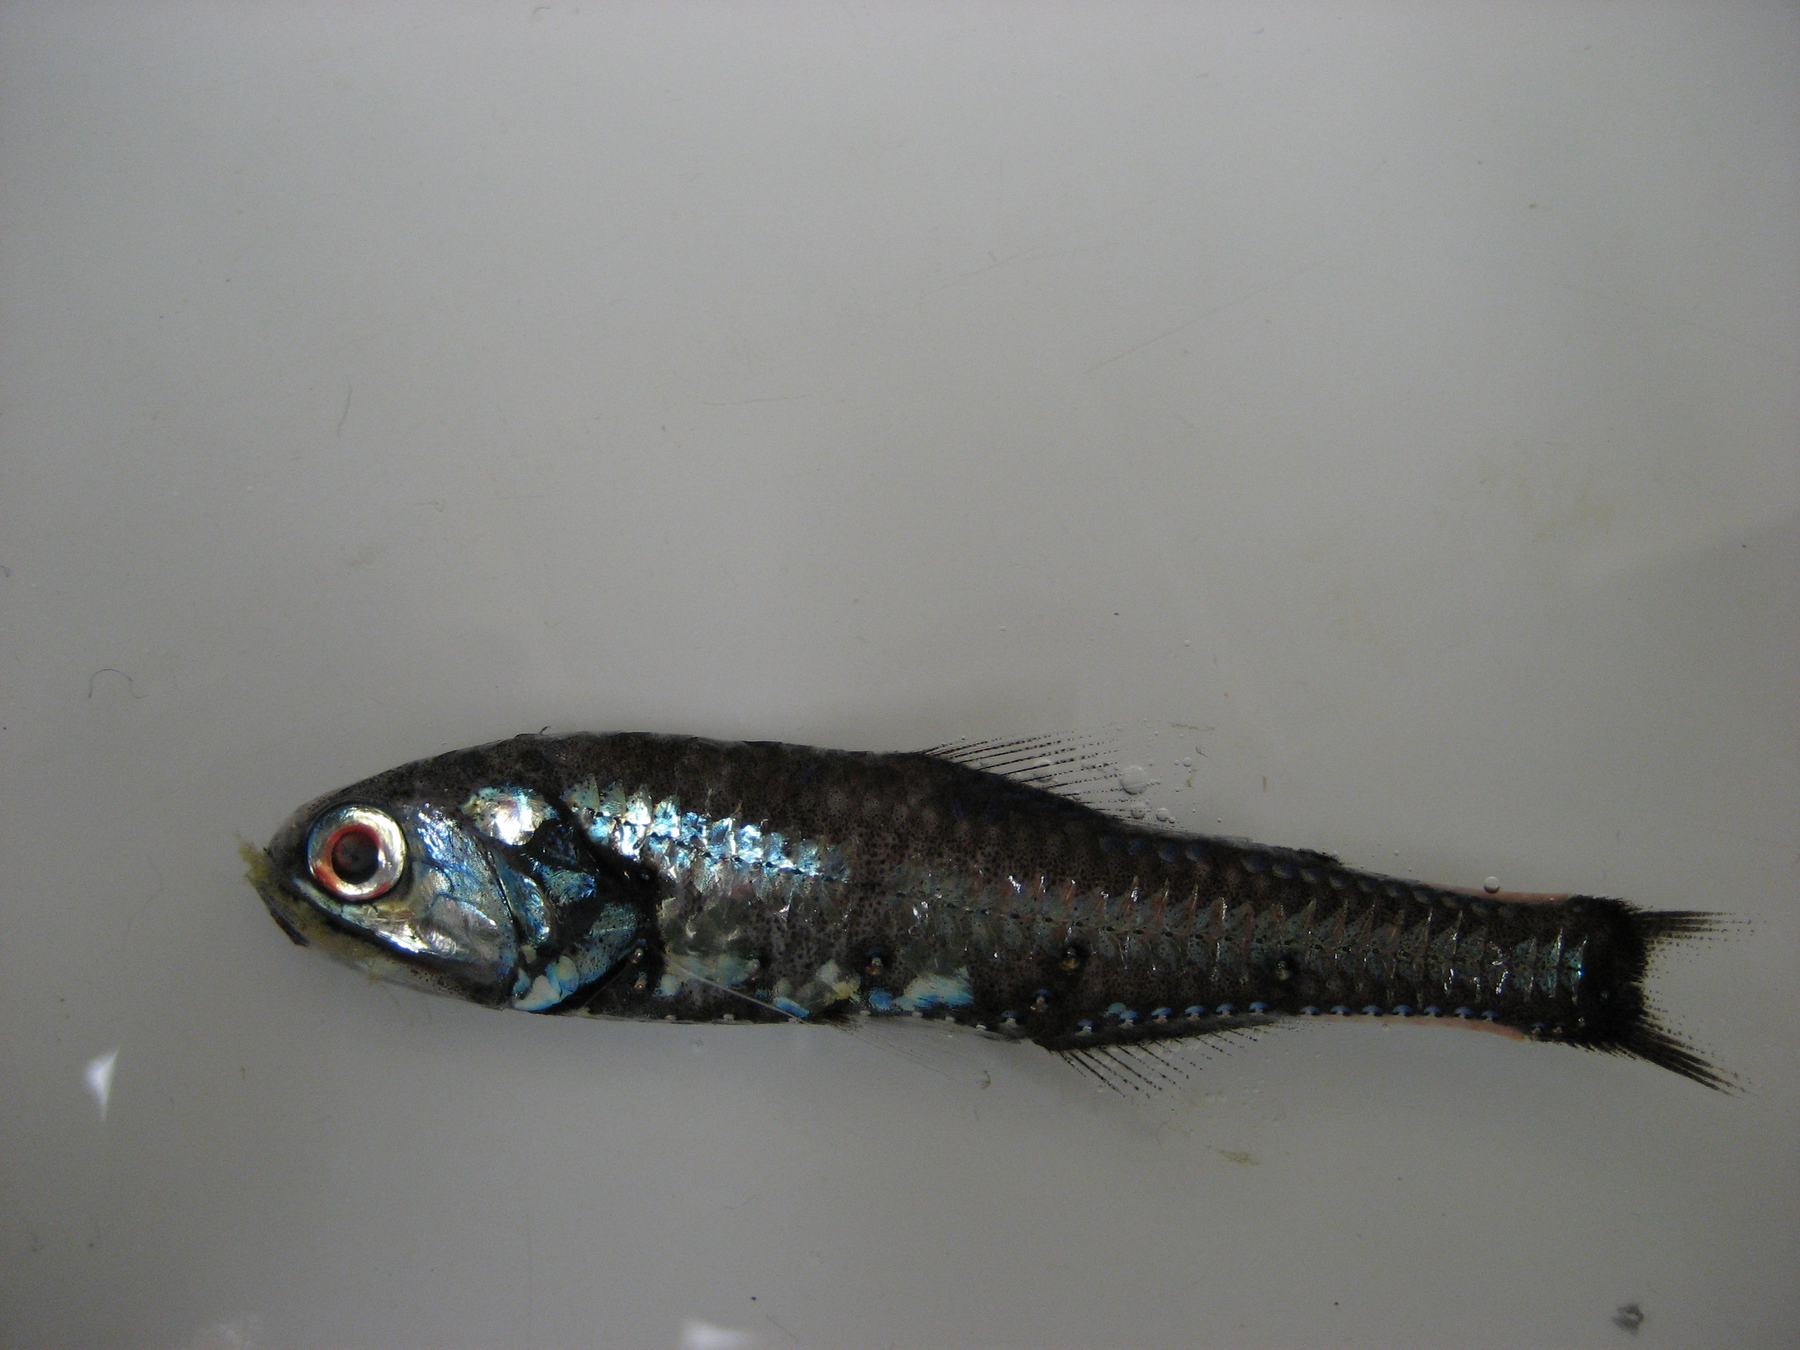
Large Eyes
- to collect as much as light as possible
Deep Sea Smelt
Lanternfish
Barreleye
Notes:
Many of the animals in the mesopelagic have extremely large eyes compared to the size of their bodies. These large eyes allow them to collect as much light as possible in order to see in the very dim environment of the mesopelagic zone. Note that the barreleye’s head is transparent, and the eyeballs are actually the green spheres that are facing upward. What looks like eyes facing forward are actually nostrils.
Image Credits:
(Clockwise from top) Pete Davison (Farallon Institute), Pete Davison (Farallon Institute), Wiki Commons (http://commons.wikimedia.org/wiki/File:Pez_Cabeza_Transparente.jpg)

Slide 8
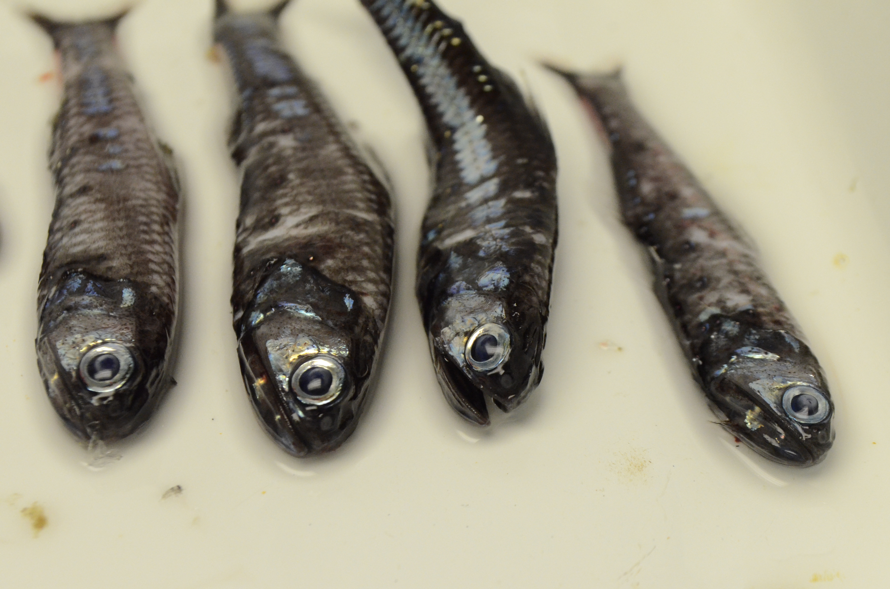
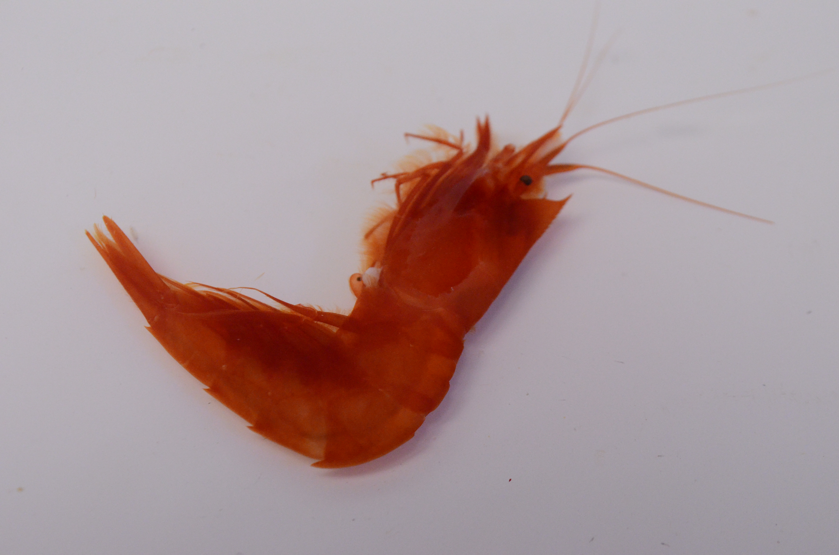
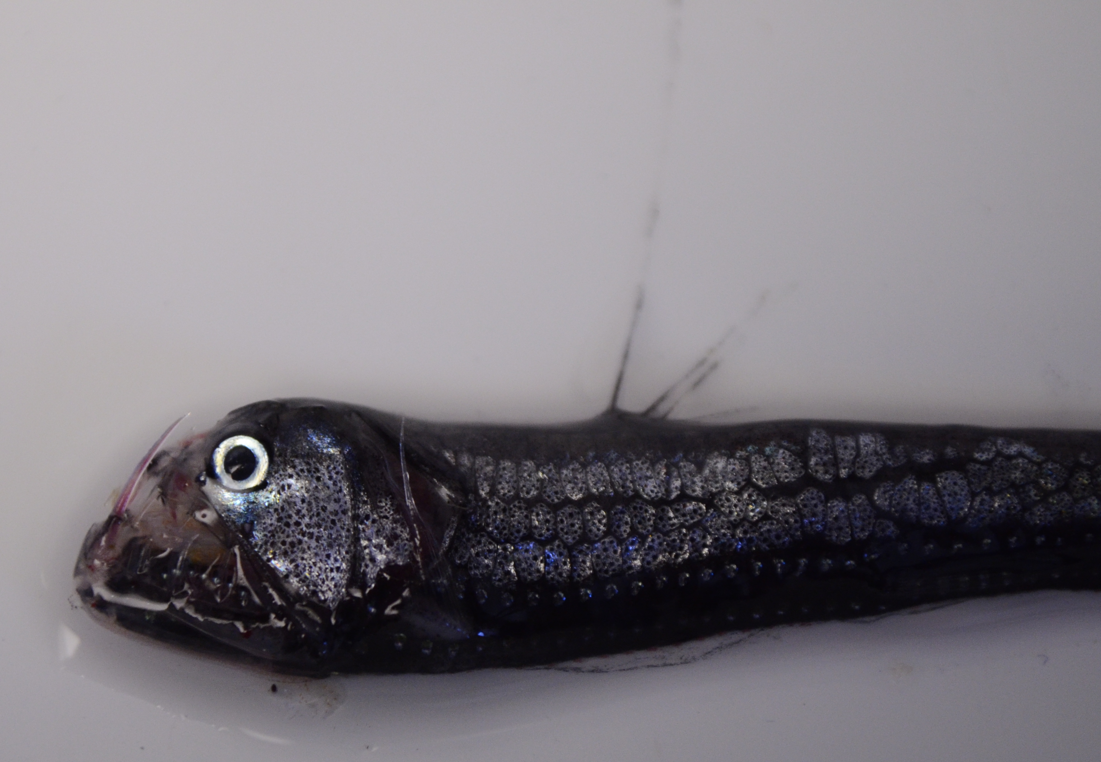
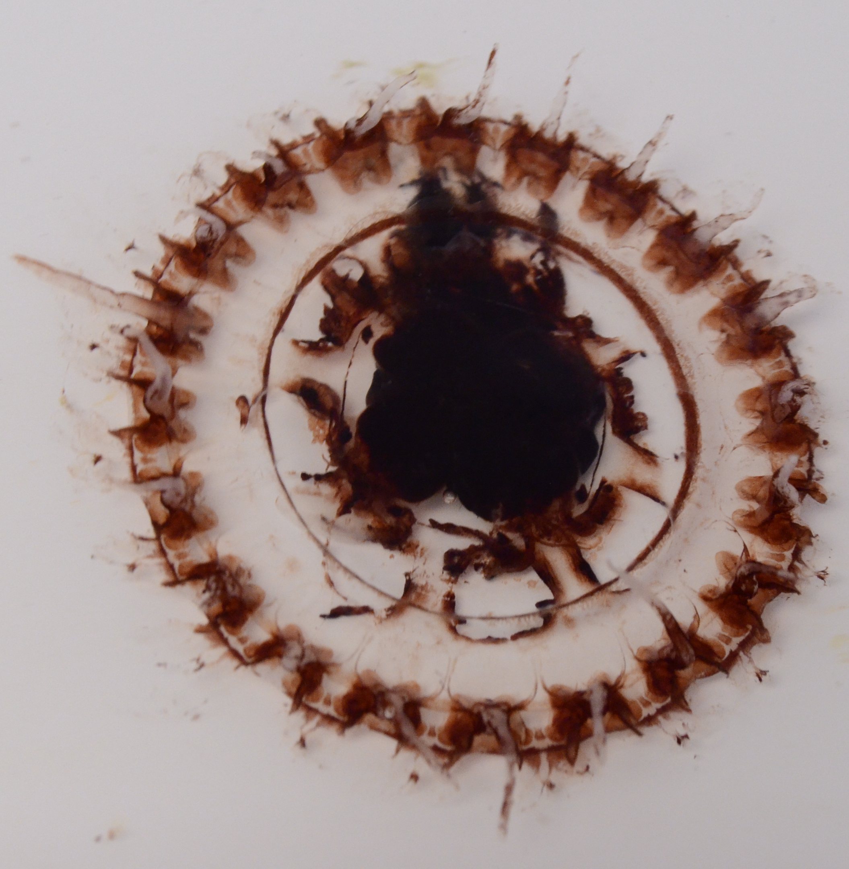
Summary- Mesopelagic Adaptations
Large mouths
Bioluminescent
Coloration- red, silver, black
Large eyes
Notes:
Prompt the students to elaborate on each of these traits, and explain why they are special adaptations to the mesopelagic environment.
Image Credits: Amanda Netburn

Slide 9
Assignment
Observe and sketch mesopelagic fish specimens (and other mesopelagic animals), and describe their adaptations to the environment.
Notes:
Distribute the fish cards and the worksheet. Fish cards need to be prepared by the instructor before the start of class.
The following materials are required to complete the activity for this lesson:
Lesson3_FishCards.pdf
Lesson3_MesoAdaptationAsst

