Slide 1
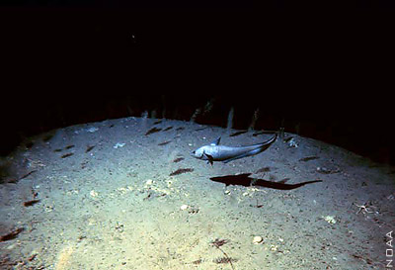
Human Impacts in the Deep Sea
Notes:
Authors: Amanda Netburn, Scripps Institution of Oceanography; Danny Blas, Kearny High School
Why: Human activity has an important impact on all submarine environments, including the mesopelagic zone. This lesson introduces students to the different impacts that humans have on deep sea environments, challenging them to connect the link between human actions on land to remote deep-sea environments. The deep sea is hard to see and study, and therefore commonly overlooked or ignored, but is increasingly impacted negatively by human actions. The students are further called upon to develop their own creative solutions to address human impacts in the deep sea.
Summary:
Previous lessons in this unit have focused on the mesopelagic environment only, which is only one part of the deep sea. This lesson expands on this, focusing on a number of deep sea environments, including the benthos (the bottom), where many of the human impacts are evident. This lesson dispels the common misconceptions that the deep sea is the same everywhere and that it is far enough removed from human activities to be impacted by them. The following impacts are then introduced: (1) pollution (2) fishing, (3) mining, (4) oil and gas exploration, and (5) climate change.
Image Credit: Deep East 2001, NOAA/OER (accessed via http://oceanexplorer.noaa.gov/)
Context for Use:
This is the fourth in a 5-lesson unit “Mesopelagic environment, adaptations and human impacts.” The unit was developed for a 9th grade Earth Science class, but would be applicable for any Marine Science or Environmental Science courses.
Misconceptions:
The deep sea is so far removed from human impacts that we do not negatively affect deep sea environments.
Evaluation Tips:
The assignment for this lesson is to create a blog post (this could instead be a written essay) that addresses the following:
(1) How has scientists’ understanding of the deep sea changed since the first deep sea expedition?
(2) In what ways are the deep seas being impacted by humans?
(3) Choose three impacts. Suggest a solution for each, and explain why you think it will be effective.
These should be read and evaluated for understanding.

Slide 2
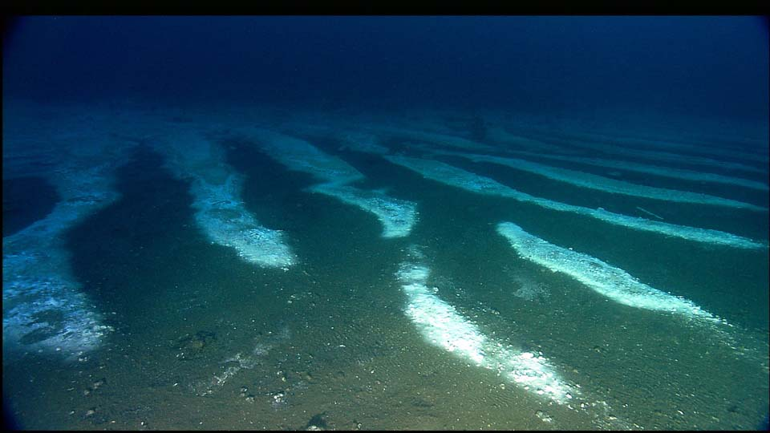
Deep Sea Environment
People used to think there was nothing in the deep sea
But…
Notes:
Before the late 1800s, scientists thought the deep sea had no life, and was just a flat bottom with no structure, and no variation
Image Credit: http://flowergarden.noaa.gov/image_library/brineimages.html
(Note: This image is from a brine seep. the white in the image is from salt encrustation and bacteria at the Flower Garden Banks in the Gulf of Mexico. For more information on this unique habitat, check out this website: http://flowergarden.noaa.gov/welcome.html)

Slide 3
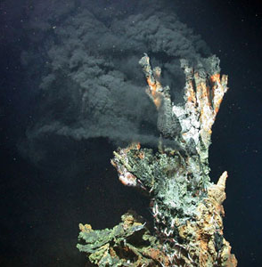
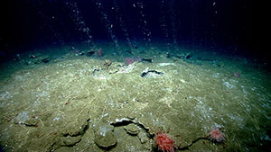
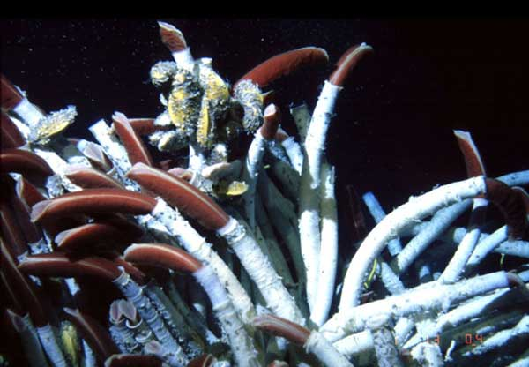
Distinct Deep Sea Environments
That is not true! There are a lot of different kinds of environments in the deep sea
like…
Hydrothermal Vents
Methane Seeps
Notes:
Methane seeps are places at the bottom of the ocean where methane and other chemicals seep out of the ground.
Hydrothermal vents are areas where hot water (up to 400 degrees C) and gases seep out of the seafloor.
Both environments are home to bacteria that are able to convert energy from the chemicals to support the base of the food web (unlike most food webs that use sunlight as their energy source through the process of photosynthesis).
Because of this input, there is large amount of life living at these environments. A common animal are tube worms, such as those shown on the right. They actually have chemosynthetic bacteria living inside of them to get their food.
Image credit:
Left: http://oceanexplorer.noaa.gov/okeanos/explorations/ex1304/background/coldseeps/welcome.html
Center: http://archive.noc.ac.uk/chess/education/edu_htv.php
Right: http://oceanexplorer.noaa.gov/explorations/06mexico/logs/may16/media/riftia_600.html

Slide 4
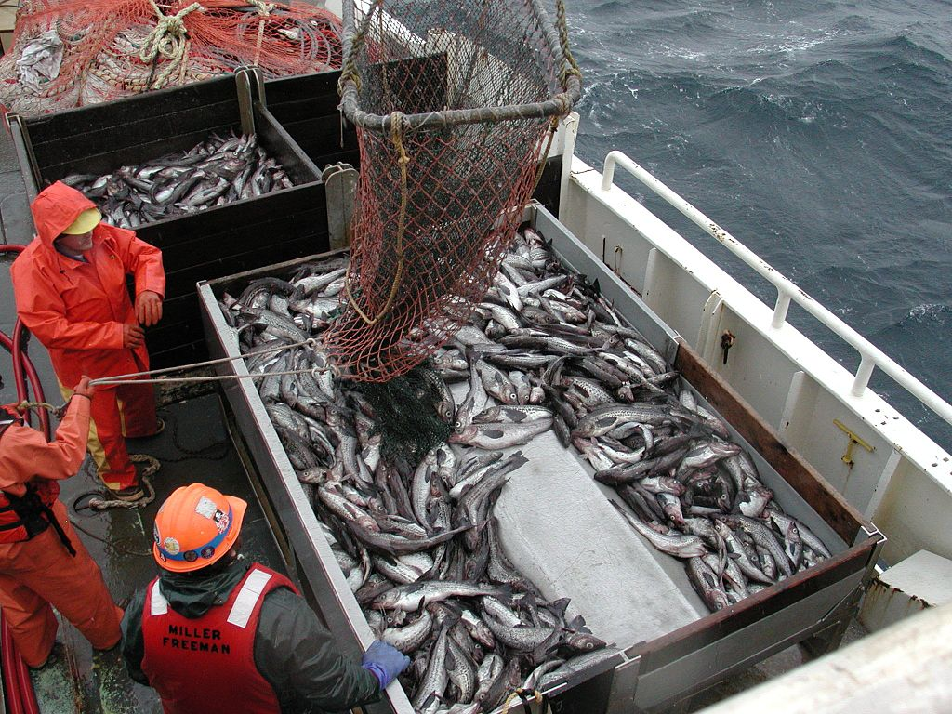
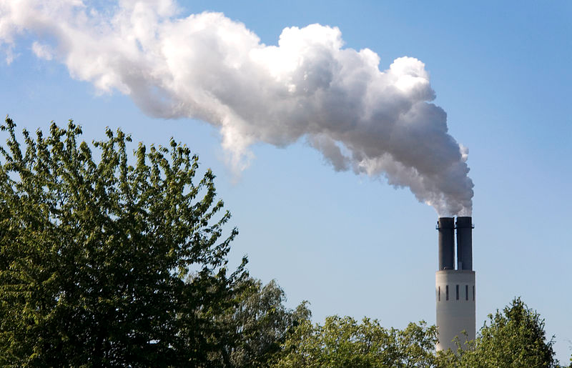
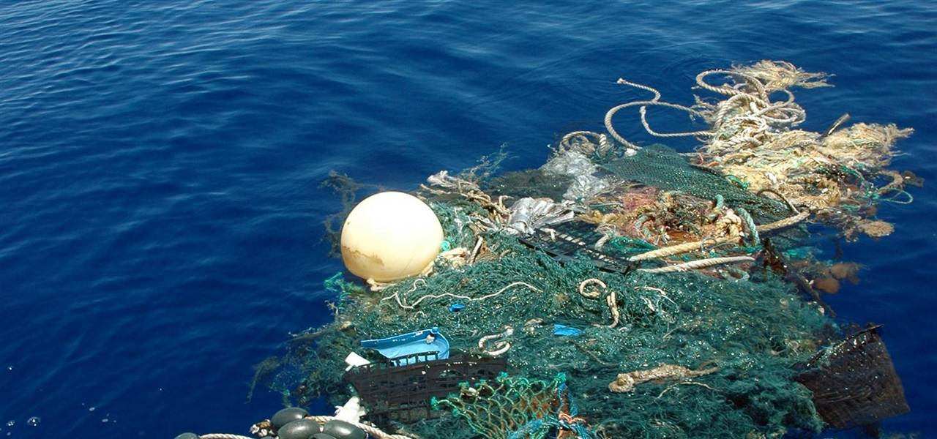
Human Effects Overview
People thought that the deep sea was not affected by human activities
BUT… we pollute,
fish,
mine,
drill for oil,
and emit CO₂
Notes:
Until about 10 years ago, people thought that the deep sea was not affected by human activities. The deep sea environment has typically been “out of sight, out of mind”. But, we do in fact affect the deep oceans through pollution, fishing, mining, drilling for oil and causing climate change.
Image Credits: (Left) Mario Aguilera/Scripps Institution of Oceanography/AP Photo, Right: Wiki Commons (http://commons.wikimedia.org/wiki/File:Berlin-_An_electricity_power_plant_smokestack_in_-_3982.jpg)

Slide 5
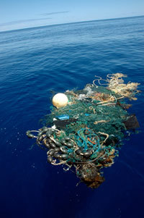
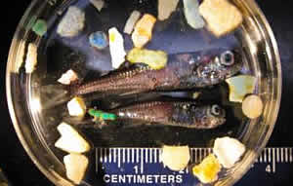
Pollution
plastics, fishing gear, sewage
animals eat plastic
Notes:
Plastics are introduced into the ocean from garbage deposited on land, but also a lot comes from fishing gear that has been abandoned at sea, as in the photograph to the left. Plastics break down over the years into small particles called “microplastics”. Mesopelagic fish, such as the myctophids on the right have been found with plastics in their stomachs; they were probably mistaking them for the similarly-sized zooplankton that they feed on. The plastic fill up their stomachs without providing any nutrition, and could therefore cause the fish to starve to death.
Image Credit:
(Left) Mario Aguilera/Scripps Institution of Oceanography/AP Photo
(Right) Pete Davison (Farallon Institute)

Slide 6
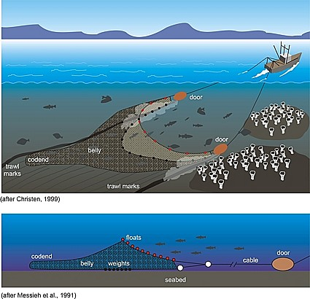
Fishing
Bottom trawling is like clear-cutting a forest- it takes everything!
Fishing for mesopelagic fishes
is brand new- we don’t even know the effects yet!
Notes:
Different kinds of fishing occurs in the deep ocean. Bottom trawls collect everything that are on the seafloor, including slow-growing deep sea corals and sponges. It can take decades for an environment to recover from the damage from bottom trawler. The image here is of a bottom trawl.
Fishing for mesopelagic species, particularly for lanternfish, is a relatively new industry. They are primarily fished to be turned into fish feed and not for human consumption.

Slide 7
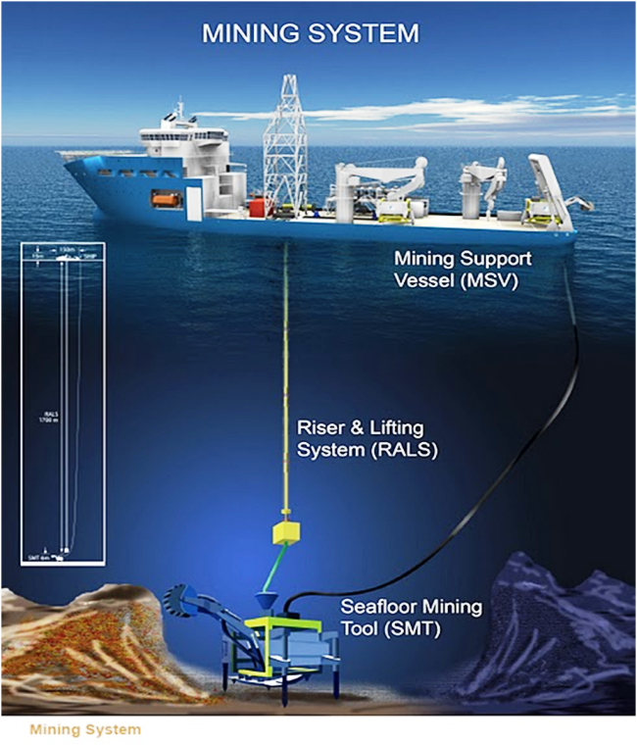
Mining
creates pollution
occurs in sensitive areas
Notes:
In the deep sea, there are deposits of various metals such as silver, gold, copper, manganese, cobalt, and zinc. Technologies for mining the deep sea floor are in development, and permits have been granted for leases of mining sites in the oceans. Deep sea mining operations will likely begin in the next few years. These operations create a lot of pollution and disturb sensitive deep sea environments.
Image credit: http://oilprice.com/Metals/Commodities/Tapping-The-Oceans-Mineral-Wealth-With-Deep-Sea-Mining.html
More information: www.nautilusminerals.com/s/Home.asp

Slide 8
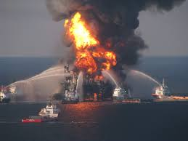
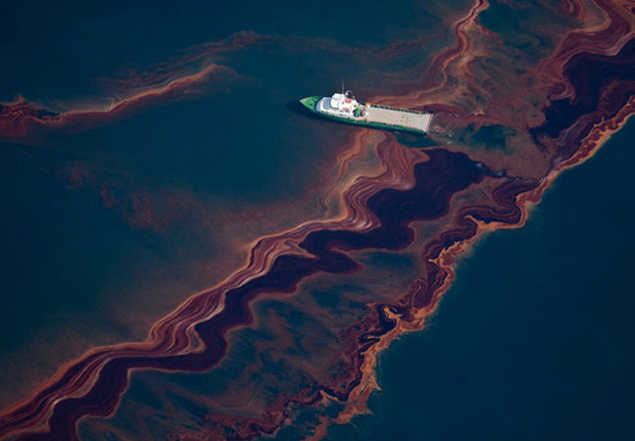
Oil and Gas exploration
Notes:
Prompt: Ask students what is going on in this picture (it is the Deepwater Horizon oil spill). Prompt the students to discuss what types of impacts this had on ocean life and in the deep sea.
Some possible responses:
suffocated birds, marine mammals
suffocated fish by smothering their gills
oil droplets mistaken as food and eaten by animals
oil dropped to deep sea and smothered animals living on the bottom
Oil and gas extraction is moving into increasingly deeper waters, and also into the Arctic for the first time. The deeper the site, the harder it is to access for maintenance and repairs, increasing the likelihood of disaster like the Deepwater Horizon oil spill. It took months to plug up the leak at that spill.
Image credits:
Left: https://www.hsdl.org/blog/newpost/view/u-s-chemical-safety-board-releases-final-investigative-report-on-2010-deepwater-horizon-oil-spill
Right: http://www.nature.com/news/specials/deepwater/index.html
For more information on the Deepwater Horizon oil spill and response, see the links at : http://response.restoration.noaa.gov/deepwaterhorizon

Slide 9
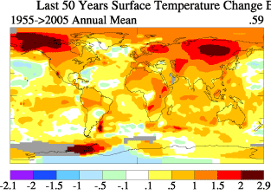
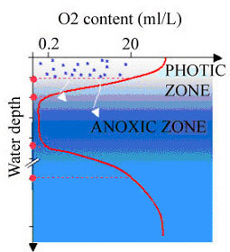
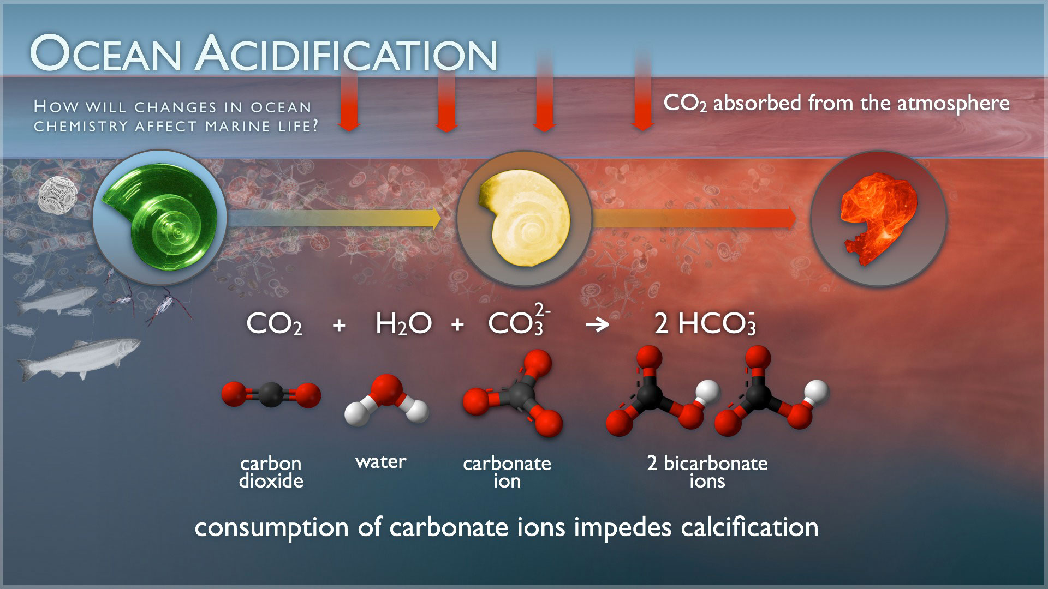
Climate Change
Notes:
Climate change impacts in the ocean include warming, ocean acidification, and ocean deoxygenation. The effects of acidification and deoxygenation especially strong in mesopelagic zone.
Warming: The image on the upper right shows the changes in surface temperature across the globe from 1955 to 2005 (difference from long-term average temperature) in recent decades. The change is given in degrees Celsius, indicated on the colorbar at the bottom of the image.
Ocean Acidification: The image shows the following: (1) CO2 is absorbed from the atmosphere at the sea surface (2) It is converted into bicarbonate through a chemical reaction with carbonate, (3) The loss of carbonate in seawater means reduces material for shelled animals to build their shells, and they start to dissolve. The shell in this image is a pteropod, which is a kind of zooplankton.
Oxygen: This figure shows a typical plot of oxygen content (x-axis) against depth (y-axis). In the mesopelagic zone there is generally a zone of hypoxic (low oxygen) waters, which in some places is completely anoxic (no oxygen). This pattern is natural, however climate change impacts cause these hypoxic areas to expand because warmer water holds less oxygen, is harder to mix, and ocean circulations are changing due to climate change.
Image credits:
Ocean Acidification: http://www.pmel.noaa.gov/co2/story/Ocean+Acidification
Warming: http://data.giss.nasa.gov/gistemp/2005/
Oxygen content: http://earthguide.ucsd.edu/virtualmuseum/climatechange1/06_2.shtml

Slide 10
Conclusions
Human impacts:
  Pollution
  Fishing
  Mining
  Oil and gas exploration
  Climate change

Slide 11
Assignment: Create a blog post that addresses the following:
How has scientists’ understanding of the deep sea changed since the first deep sea expedition?
In what ways are the deep seas being impacted by humans?
Choose three impacts. Suggest a solution for each, and explain why you think it will be effective.
Notes:
The assignment for this lesson is to create a blog post (this could instead be a written essay) that addresses the following:
(1) How has scientists’ understanding of the deep sea changed since the first deep sea expedition?
(2) In what ways are the deep seas being impacted by humans?
(3) Choose three impacts. Suggest a solution for each, and explain why you think it will be effective.

