Slide 1
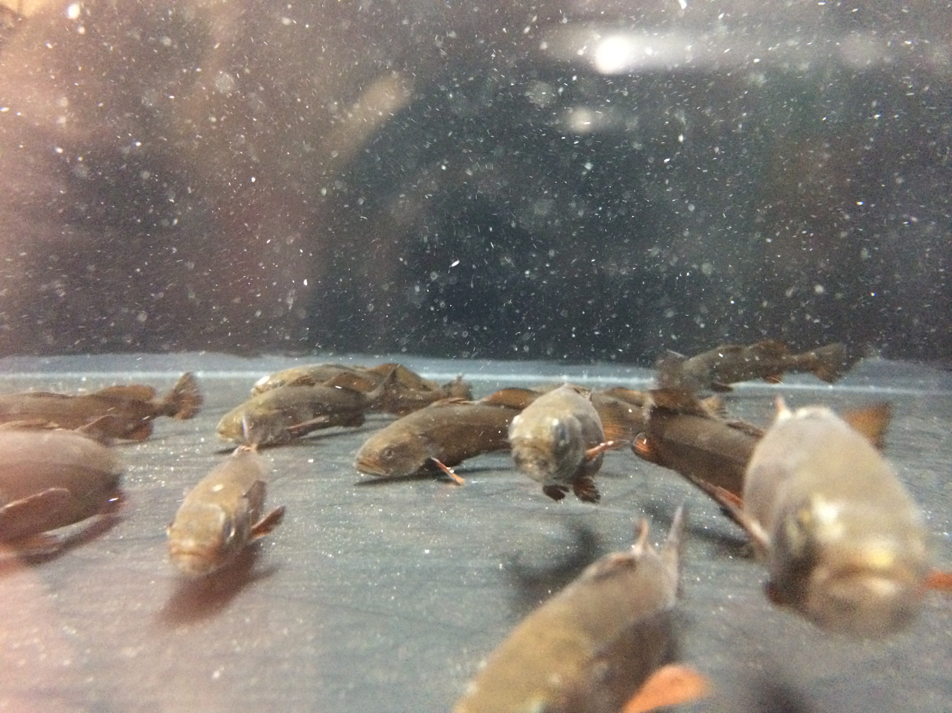
White Seabass Lesson
Notes:
William Jones - Graduate Student, Scripps Institution of Oceanography
Steve Walters - Teacher, Mission Bay High School, San Diego, CA
This power point is for the teacher to use as an introduction to the White Seabass lesson (lesson 1).
All slides presented to class by the teacher.
1. WHY: Fish is an important food worldwide, providing billions of people with essential nutrients, including high quality protein and a wide variety of vitamins and minerals. Fatty acids in fish have been found to be vital to normal brain development of unborn and infants. Up until the early to mid-1900s, many people considered the world’s oceans to be limitless. They believed the oceans would be able to produce enough fish to feed the growing human population. Today, however, we know the opposite to be true. The oceans are not limitless, but instead are very vulnerable to overfishing.
Overfishing is the act of removing fish from the environment at a rater faster than the species can naturally replace themselves. One of the earliest and most devastating occurrences of overfishing took place in the 1800s, when humans decimated the whale populations. By the mid-1900s, overfishing contributed to the catastrophic declines in Atlantic cod, herring and California’s sardine (to name a few). This was followed by the collapse of many more highly desirable species like orange roughy, Chilaean sea bass, and Bluefin tuna. By 2003, a scientific report estimated that industrial fishing had reduced large ocean fish to just 10 percent of their pre-industrial population sizes. Yet, there is hope. There are success stories and high school students can do something to help!
This lesson uses the white seabass as a lens to help high students gain an understanding of overfishing and what can be done to counter it. Through a role-playing activity, the students will get introduced to the science and processes behind making responsible fisheries management decisions and developing sustainable fisheries. Additionally, if pursued by the teacher/school, the students will become part of the solution by raising white seabass in their own classroom through the Hubbs-Seaworld Research Institute stock enhancement program.
2. SUMMARY:
Students will be doing group research projects on the California white seabass fishery. They will present their research to the rest of the class in the form of a poster. Students will also have a chance to get involved with raising white seabass in the classroom. The main concepts of the lesson are (1) overfishing has endanger many fish species across the worlds oceans threatening the livelihood and health of millions of people, (2), fisheries management is not always easy or straight forward (they will find this out in their role-play research project), (3) fishery hatcheries and stock enhancement programs have been developed to as one method to help mitigate overfishing (it should be noted, however, that it is not the silver bullet) (4) high school students become part of the stock enhancement efforts and help counter overfishing by raising white seabass in their classroom.
3. PICTURE/GRAPHICS CREDITS: Images in this PPT all from W. Jones unless otherwise noted.
4. WEBSITES/RESOURCES USED IN THIS PRESENTATION:
-California white seabass. FISHERIES REVIEW, CalCOFI Rep., Vol. 50, 2009.
-White seabass Fishery Management Program from the California Department of Fish and Game, 2002.
-White Seabass Enhancement Plan, California Department of Fish and Game, 2010.
-White seabass information brochure provided by California Department of Fish and Game.
-White seabass fishery Management Plan, 2007-2008 Annual review, California Department of Fish and Game.
5. ADDITIONAL READING: See “Additional Resources” folder on the website. The folder contains 6 additional readings.
1. A brief review of the California white seabass from the 2009 CalCOFI reports (FISHERIES REVIEW, CalCOFI Rep., Vol. 50, 2009).
2. White seabass Fishery Management Program from the California Department of Fish and Game, 2002.
3. White Seabass Enhancement Plan, California Department of Fish and Game, 2010.
4. White seabass information brochure provided by California Department of Fish and Game.
5. White seabass fishery Management Plan, 2007-2008 Annual review, California Department of Fish and Game.
6. 1 page brief description of the Hubbs-Seaworld “Seabass in the Classroom” program.
6. CONTEXT FOR USE: This is meant for a 9th grade marine science / introductory biology classroom, but could easily be adopted for advanced biology. This lesson is designed for 90min periods. The lesson is divided into two main activities. The first activity is a role-playing activity, where students act as “Fisherman”, “Fisheries Scientists”, or “Concerned Citizens”, assess the current management plan on the white seabass, and make recommendations based on their role on whether they think that current management is effective and should be changed. The second activity is raising juvenile white seabass in the classroom in collaboration with Hubbs-Seaworld Research Institute.
The first activity in lesson 1: Fisheries management role-playing activity
Activity 1 will likely take 2-3 full days (90min periods).
Day 1 – Teacher introduces the topic with the Lesson 1 White Seabass PowerPoint presentation. Next, students read “White Seabass Background Information” (pages 2-4 in “Student_Resources.pdf”) and answer the associated questions (“White Sebass Reading Questions”). The teacher should also introduce the poster presentation guidelines and requirements. If students finish the reading questions, the class can be divided up into groups of 4-5 students per group and assigned to role-play as “Fisherman”, “Fisheries Scientists”, or “Concerned Citizens”. Each group has specific requirements for their presentation based on their role as noted in “Lesson 1 Activity Student Roles.” Once they are assigned to a group and a role, they can begin their ‘research’, which involves reading and taking notes on the provided resources. Each group gets a specific set of resources outlined in the “Lesson 1 Activity Student Roles”. All the resources can be found in the “Student_Resources.pdf”. If the students do not finish the questions, it is homework due the next class period and they will begin work on their presentation on day 2.
Day 2 – Students continue their research and begin working on their poster presentation. Before students begin working on their poster, they must have a clear group consensus on what think about the current management of the white seabass and what changes (if any) they want to make. They must support their opinion with information they found in the resources provided to them.
Day 3 – Student groups give their poster presentations as a group. Each student in the group is required to participate in the presentation. Presentations should be ~3-5 minutes per group. Day 2 and 3 may be combined if students are efficient at making posters.
Activity two: Raising white seabass in the classroom.
Many additional days will need to be planed if pursuing the “White Seabass in the Classroom” project with Hubbs-Seaworld Research Institute. See the “HSWRI_Seabass_inthe_Classroom.pdf” for information provided by HSWRI about the program. The estimated costs are $5000-6000 (mainly for building the tank), which is one reason not all classrooms will be able to raise seabass. For complete lesson instructions about raising white seabass in the classroom, see the “Seabass_in_the_Classroom_Guide.docx” document. Major activities of the white seabass in the classroom lesson include;
1) Fundraising money to build the tank,
2) Building/setting up the tank,
3) fish arrival day,
4) daily feeding and water quality measurements,
5) fish tagging day
6) Hubbs-Seaworld Hatchery visit in Carlsbad (please coordinate with Mike Shane)
7) Student projects
8) fish release day.
For the student projects, the teacher will have to help students decide on a topic.
7. MISCONCEPTIONS:
There are no regulations for fisheries
All fisheries are overfished
The oceans are limitless
8. EVALUATION TIPS: Students are evaluated on the white seabass worksheet, poster, lesson 1 poster presentation, seabass project/presentation
9. TEACHING NOTES:
- Read entire activity and review all background materials and resources
- Determine amount of time you would like to dedicate to this activity.
- Determine the best assessment strategy for your class based on suggestions provided (worksheet, poster, poster presentation).
- Determine of your school has the resources to raise white seabass in the classroom. For details on what is involved with raising white seabass read through the “Seabass_in_the_Classroom.docx” document.
- This lesson can be done without actually raising white seabass.
Vocabulary:
Stock Assessment: collecting, analyzing, and reporting demographic information for the purpose of determining the effects of fishing on fish populations
Total Allowable Catch (TAC): The amount of fish that can be sustainably harvested from a fishery.
Sustainable Seafood: A fishery that is managed in a way to minimize the impact on the environment (method of fishing, bycatch, transporting/fuel etc) and leaves enough fish for the population to sustain itself.
Stock Replenishment: A management practice of enhancing a population (‘stock’) by releasing reared young or juvenile fish into the wild.
Fisheries science: Science focused on determine the amount of fish to harvest that minimizes environment harm and leaves enough fish in the water for the population to renew itself.

Slide 2
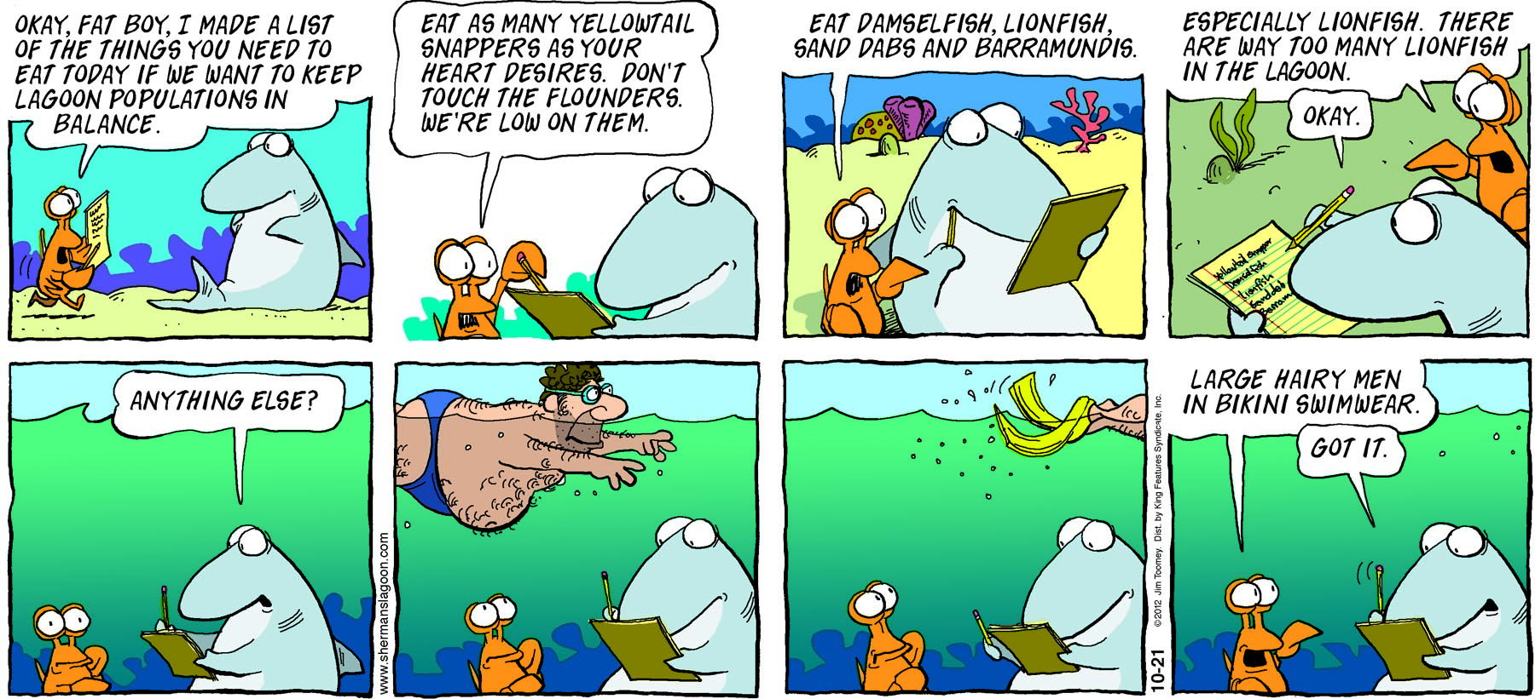
Notes:
Teacher: Engage. Present this comic on the front board to the students as they are entering the classroom. Have them read it. Ask the students to explain what is going on.
(notes for teacher to present to students)
Main concept for students to grasp: The shark (“Fat Boy”) is the ‘fisherman’, while the lobster is the ‘fisheries managers’. The managers are telling the fisherman that they can and cannot catch. Since fish species reproduce at different rates, they require different catch regulations. The main concept of this comic for the students to grasp is that fishing must be regulated. However, regulations must be set with proper science.
The goal of fishery science is to determine the amount of fish to harvest that does little to no harm to the environment and leaves enough fish in the water for the population to renew itself. This is no easy task. It will take many different types of scientists to conduct the research to have the scientific knowledge necessary to responsibly manage a fishery. A mathematician will work on estimating fish population size; a biologist will find out things like how old a fish gets, or how many eggs survive to adulthood during a fish’s life cycle and a group of scientists including oceanographers, mathematicians and biologists work together to determine what influences an ecosystem.

Slide 3
Journal Question
What is sustainable seafood?
Do your best to brainstorm some answers – there is no wrong or right!
Notes:
Engage activity; After they have time to answer the question, have the kids shout out answers. Write answers on the board.
(notes for teacher to present to present to students)
Introduction to Sustainable fisheries:
Seafood is good for your health. The U.S. is the third largest consumer of seafood in the world. Americans consume 15 pounds of seafood per person per year, which is good news because seafood is a healthy source of protein, vitamins and minerals. That’s why the USDA recommends eating it twice a week.
It’s healthy for the economy. Commercial, sport and subsistence fisheries contribute significantly to the local and national economy. In 2011 seafood harvested by U.S. fishermen at ports in the 50 states were valued at $5.3 billion. The U.S. is the largest importer of seafood in the world, valued at over $16.6 billion, and the fifth largest exporter of seafood in the world, valued at over $5.4 billion. The seafood industry provides employment opportunities for many people, especially in coastal regions like San Diego/California.
Sustainable Seafood: It’s all about balance
Conserving our natural resources, whether on land or at sea, is something we are all concerned about. For this reason, laws were created that ensure these resources are available for future generations. The Magnuson-Stevens Fishery Conservation and Management Act (MSA) is the principle law governing U.S. marine fisheries. The MSA mandates that NOAA Fisheries limit the amount of fish harvested to prevent or end overfishing. Limiting the amount of fish harvested may sound easy but it is a challenging balancing act. Factors like the need for jobs and food are considered as well as ensuring healthy fish populations and ecosystems.
Fortunately, there is a process that brings in a team of people such as scientists, fishermen, resource managers, tribes and citizens to work together in what are called Fishery Management Councils. At Council meetings scientists give their recommendation for a harvest limit and then others can discuss whether that number should be lowered based on economic, social or environmental factors. If any one of these things is out of balance, then a fishery could be considered unsustainable.

Slide 4
Why do you think we should raise white seabass in our classroom?
Discussion Questions
Notes:
This slide is design to generate a discussion of why the student’s think we should raise white seabass. There are no right or wrong answers.
This discussion may bring out some possible misconceptions (e.g. “so we can eat them”).
(notes for teacher to present)
Fish is an important worldwide for food and providing jobs in coastal regions. Billions of people, especially in developing coastal regions, rely on fish for essential nutrients, including high quality protein and a wide variety of vitamins and minerals. Fatty acids in fish have been found to be vital to normal brain development of unborn and infants. Up until the early to mid-1900s, many people considered the world’s oceans to be limitless. They believed the oceans would be able to produce enough fish to feed the growing human population. Today, however, we know the opposite to be true. The oceans are not limitless, but instead are very vulnerable to overfishing.
Overfishing is the act of removing fish from the environment at a rater faster than the species can naturally replace themselves. One of the earliest and most devastating occurrences of overfishing took place in the 1800s, when humans decimated the whale populations. By the mid-1900s, overfishing contributed to the catastrophic declines in Atlantic cod, herring and California’s sardine (to name a few). This was followed by the collapse of many more highly desirable species like orange roughy, Chilaean sea bass, and Bluefin tuna. By 2003, a scientific report estimated that industrial fishing had reduced large ocean fish to just 10 percent of their pre-industrial population sizes. Yet, there is hope. There are success stories and high school students can do something to help!
Raising white seabass in the classroom is one of these success stories. This powerpoint will help to explain why.

Slide 5
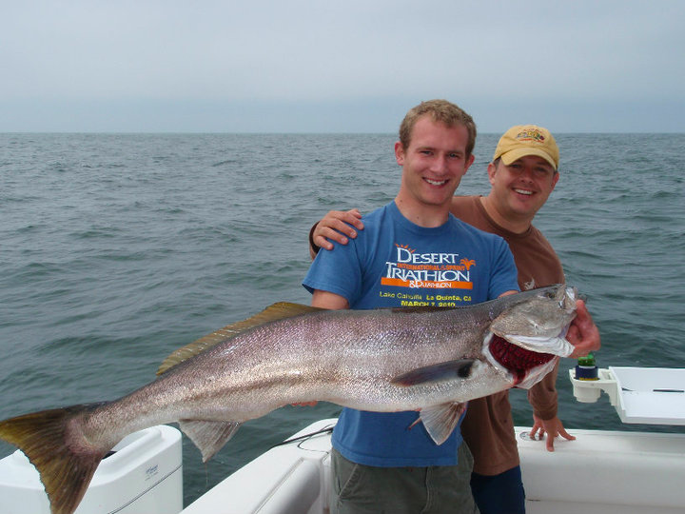
White Seabass caught off the shore of San Diego
White Seabass
Max Size: 5ft / 90 lbs
Max age: 27 yrs
Range: Pacific coast - Baja to Alaska.
Notes:
This is an introduction to the “target species” being used in this lesson.
Image: W. Jones
(notes for teacher to present)
\White Seabass are a highly desirable sport fish caught off the coast of California. Teacher can ask the students if anyone has ever fished for or eaten white seabass.
The white seabass (Atractoscion nobilis) is the largest member of the Sciaenid (croaker) family found in California waters. Seven species of croakers (Family Sciaenidae) are native to the West Coast of the United States and off Baja California (Collins 1981). As a group, croakers exhibit strong estuarine ties during all or part of their lifecycle (Weinstein 1981). Most croakers emit sounds, which have been variously described as ‘drumming’, ‘croaking’, ‘grunting’, ‘snoring’, ‘bellowing’, ‘purring’, ‘buzzing’ and ‘whistling’ (Welsh and Breder 1923). These sounds are produced by vibrations of the swim bladder. The adult sea bass spends most of its life traveling in schools in the open ocean. It returns to shallow coastal regions in the spring to spawn in the kelp beds off the western coast of the United States. : White seabass range over the continental shelf of the Eastern North Pacific Ocean from Juneau, Alaska, to Magdalena Bay, Baja California, Mexico

Slide 6
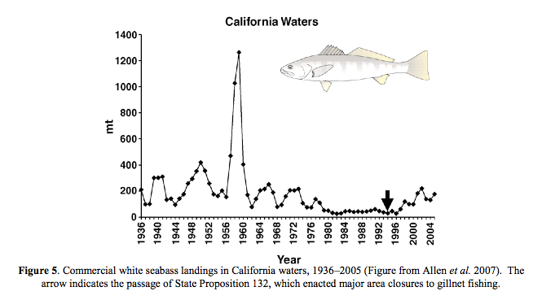
White Seabass commercial catch off the California coast.
Notes:
This slide is an introduction to the general “problem” with the white seabass fishery. This problem is that they have been overfished in the past and, currently, it is difficult to determine whether or not current fishing is at sustainable levels.
(note for teacher to present)
Commercial white seabass landings in California waters from 1936 – 2005. Year on the x-axis and metric tons of fish caught (mt) on the y-axis. White seabass catches peaked during the 1940-1960s and declined through the 1970s, 1980s and most of the 1990s due to changing ocean conditions and overfishing. Although a current stock assessment has not been done for white seabass there are indications that the white seabass population in California is recovering from low levels seen in the 1970s, 1980s, and most of the 1990s. It appears that white seabass may be entering a pattern similar to the 1940s, where abundance increased following a shift from a period of warmer to colder ocean waters, which white seabass prefer. In addition to increased catches of white seabass, there has been a steady increase in the size of fish taken. For example, the weight of white seabass caught by the recreational fishery averaged about 2.4 kilograms (5 lbs) in the 1980s but increased to 6.2 kilograms (14 lbs) in the 1990s. The arrow represents the first real regulations on the commercial fishery. The point of showing this is to illustrate that the white seabass was overfished and the only after regulations were put in place did the population start to increase again.
Additional information for the teacher to present:
White seabass, which are targeted by both recreational and commercial fisheries, have great economic and intrinsic value to the people of California. The fisheries for white seabass have existed since the late 1800s, but increased fishing pressure, oceanographic fluctuations, and habitat degradation have resulted in reductions of white seabass populations (see graph above – major decline from the 1960s to 1980s).
During the late 1980s and early 1990s, concern over the decline in white seabass landings and conflict between recreational and commercial fishermen over this resource lead concerned citizens to ask the Legislature for management improvements. The resulting legislation required the development of a white seabass fisheries management plan (WSFMP), which was developed in 1995. The plan was adopted by the Fish and Game Commission (Commission) in 1996; however, no regulations were adopted at that time, so the plan was not implemented.
In 1998, the Marine Life Management Act (MLMA) was enacted and changed the way in which recreational and commercial fisheries are managed in the State of California. Under MLMA, the Commission was granted authority to regulate specific commercial fisheries, including the white seabass fishery.
In the 1980s, a stock enhancement program also started, where Hubbs-Seaworld Research Institute started releasing juvenile white-seabass that had been reared from eggs back into the wild (more details on this later).
Problem Statement
Our knowledge of white seabass population dynamics and the role this species plays in the nearshore ecosystem is limited. Further, there is an urgent need to acquire essential fisheries information, which can only be obtained gradually, over a period of several years, and at a considerable cost. As a result, management decisions have lagged behind the development of the fishery and it is difficult to determine whether or not current fishing is at sustainable levels.
Information and graph from:
California Department of Fish and Game. White Seabass Fishery Management Plan. 2002. State of California Resources Agency.

Slide 7
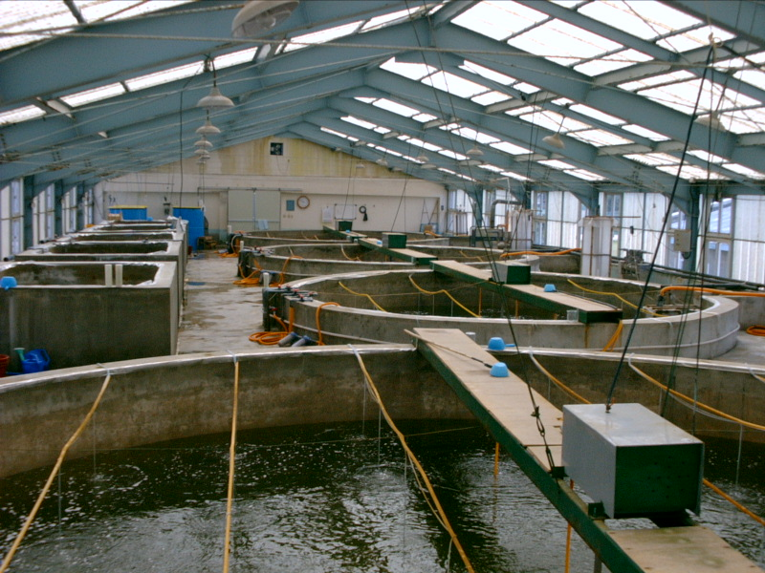
What can be done to help the white seabass?
Hatchery; where fish species such as salmon, white seabass, trout, bass, and catfish are hatched, raised and then released to enhance natural populations.
HUBBS-Seaworld
Research Institute (HSWRI)
Notes:
Introduction to hatchery slide.
The connection with previous slides is that hatcheries can help fish populations that are in trouble, such as the white seabass.
(Notes for teacher to present)
What is a hatchery?
A hatchery is where fish species such as salmon, white seabass, trout, bass, and catfish are hatched, raised and then released to enhance natural populations.
Why are hatcheries important?
Fisheries managers nationwide acknowledge hatcheries as valuable tools for the preservation of our nation’s fish resources. Fish are stocked for several reasons. Some are stocked to enhance recreational or commercial fishing, to restore native species to waters they formerly occupied, or to help a declining population. Hatcheries can counter overfishing by by enhancing natural populations.

Slide 8

HSWRI Aquaculture Program
Ocean Resources Enhancement and Hatchery Program (OREHP)
Releases ~350,000 juvenile white seabass annually.
Started in the 1980s, when white seabass populations were at an all time low.
Notes:
This slide is to illustrate the efforts being made to help the white seabass population recover. HSWRI started a stock enhancement program in the 1980s to raise white seabass and release them in the wild to increase the population size.
HSWRI contact for white seabass in the classroom program: Mike Shane - MShane@hswri.org
Also see the “Raising White Seabass” word document for additional information.
(Notes for teacher to present)
Stock enhancement is the rearing of aquatic organisms during part of their life cycle for subsequent release in open waters to replenish natural populations. It is an important tool for sustainable fisheries management. The most famous stock enhancement program is that of Salmon, however, hundreds exist world-wide. Stock enhancement of both inland and coastal fisheries is a complex undertaking and requires significant scientific knowledge in a diverse array of fields, high levels of several technological skills, and finally sensitive application to put it into practice.
Aquaculture research projects at HSWRI all have the highest goal in common - to feed people by making the best use of ocean resources and to replenish those resources. Raising white seabass helps achieve this goal.
The program got started in the early 1980s, when white seabass catches fell to less than 1000 fish per year (down from 50,000 in the 1950s). Each fish is tagged with a metal chip the size of a pin head. The chip contains a small ID number and goes inside of the cheek muscle. Hubbs scientists collect commercially caught white seabass adults and scan them (with a magnetic sensor) to find fish that were raised in the stock enhancement program.
At present, fish are released when they are 200 to 250 mm (8 to10 in.) total length (TL), based on the results of the bioeconomic model (Section 1.2.9), which suggests that this size yields the greatest return for the investment. Additionally, fish of this size are less vulnerable to disease when stressed than smaller fish.
The Carlsbad hatchery was designed and constructed to support the production of more than 350,000 tagged juveniles per year if they have a breeding population of 200 adult fish (fewer juvenile can be raised and released if the breeding population is smaller than 200).

Slide 9
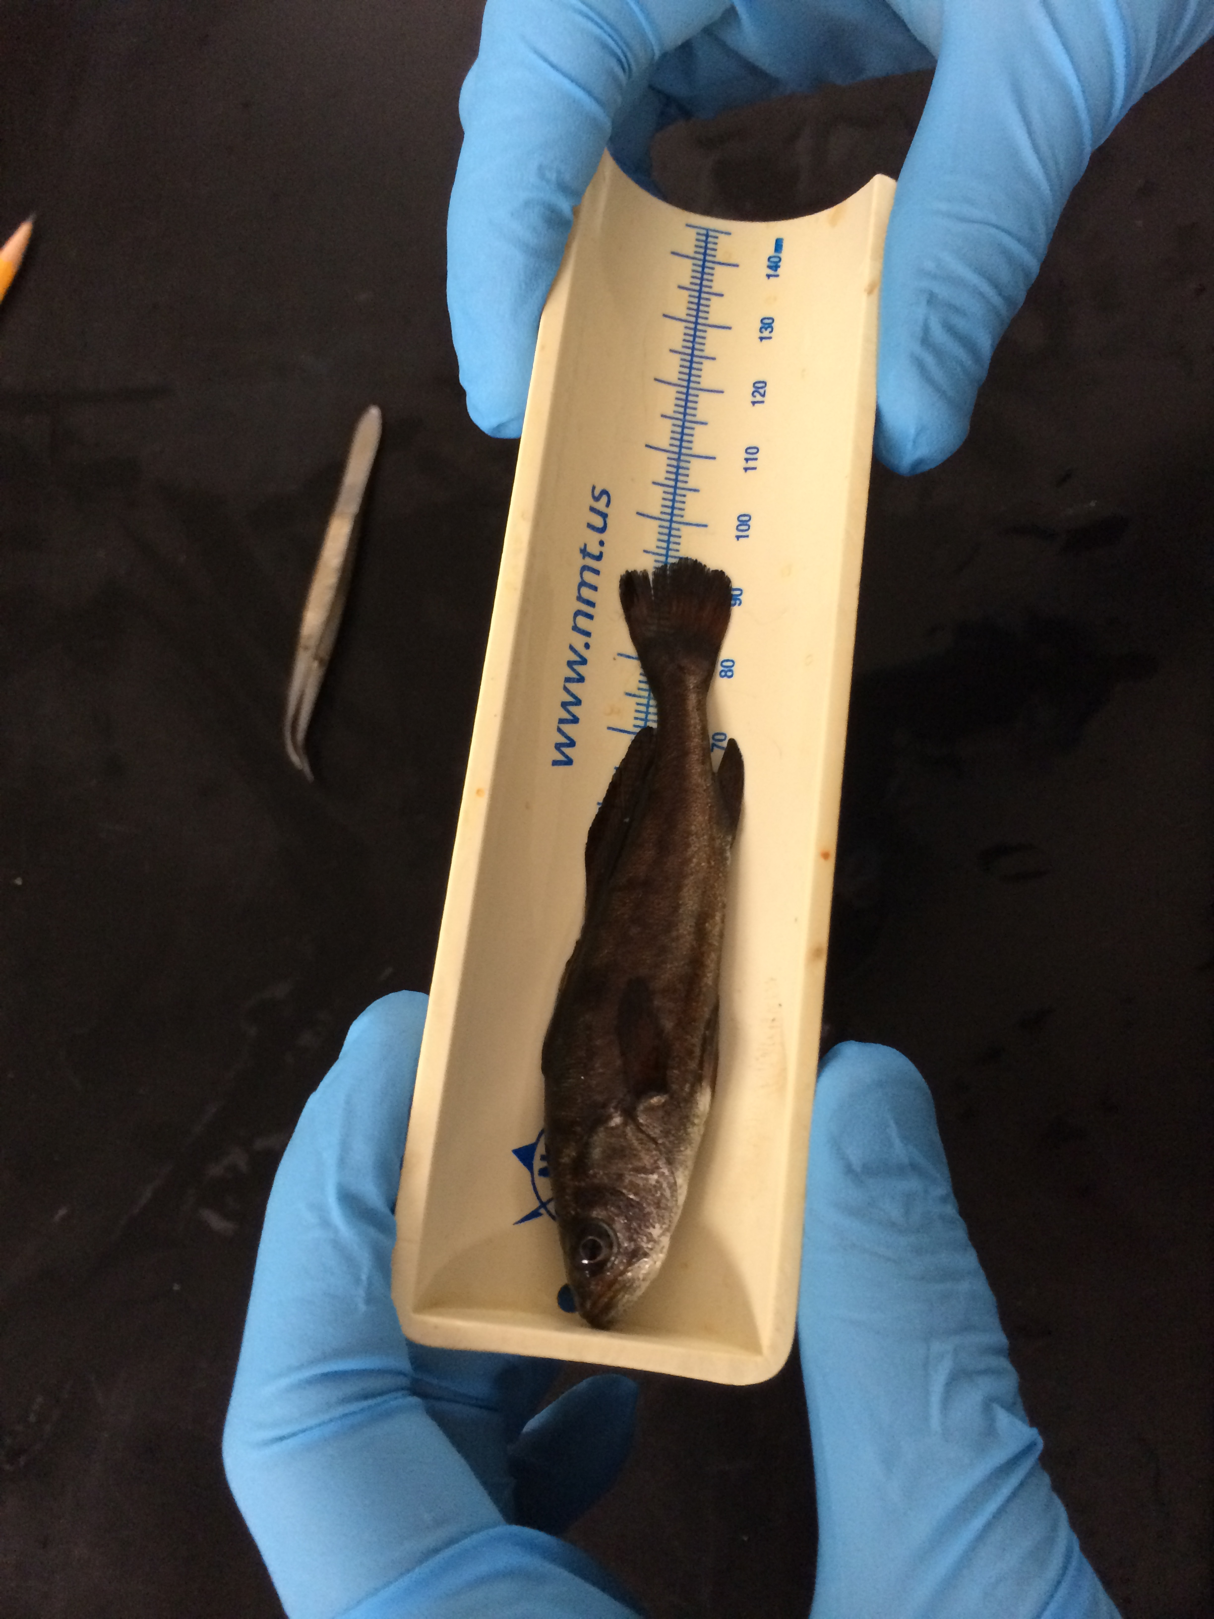
Raising White Seabass in OUR classroom
Tank set-up
Measuring / tagging fish
Monitoring the fish/water quality
Student presentations
Releasing the fish
Notes:
Introduction to raising white seabass in the classroom! These are the major tasks/steps involved.
Mike Shane will provide the teacher with all the necessary instructions for raising white seabass. This lesson can still be taught without actually raising the white seabass. Picture shows a juvenile white seabass being measured.
The information below is from the “Seabass_in_the_Classroom.docx” document.
Raising White Seabass In the Classroom Instruction Guide
Getting Started
Contact Mike Shane at Hubbs-Seaworld Research Institute. He is the coordinate of their white seabass in the classroom program (see HSWRI_Seabass_inthe_classroom.pdf). MShane@hswri.org
The biggest obstacle with getting started is getting the fish tank built. The cost is not insignificant at ~$6,000. Teachers should talk to their administrators about raising this money.
Mike Shane will provide close guidance throughout the entire program. He has been helping several schools in San Diego and Orange County raise white seabass for several years now.
Setup
Mike Shane hires a contractor to build the 100-gallon fish tank. The itemized cost of each of the components is listed at the bottom of this document. This is a rough estimate, however, as the actual cost is now closer to $6,000. Setting up the tank may provide an opportunity to get students interested in engineering involved. Several student projects can be designed around the tank building process. For example, students could diagram on a poster the entire tank, researching and labeling the function of each main component. It would be important for the students to understand how each main component (“bio-balls, sump tank, protein skimmer, nitrogen de-gaser, filter, temperature regulator, etc) is important to the fish. Students can also label each of the components on the actual tank set-up with index cards describing their function and importance (this would be useful when other non-science teachers or administrators view the tank).
Once the tank is built, it must run for approximately two weeks before the fish arrive. Mike will provide direction on this. Daily measurements of the water quality will be required to make sure the environment is stable before the fish arrive. This would be the best time to get students trained on taking water quality measurements. Mike will set up a google document were the students will record water quality measurements (temperature, nitrogen, oxygen, etc). This is a great opportunity to get students thinking about the chemistry aspect of the project. Student projects range from organic nitrogen/nutrient cycling within the tank system or inorganic compound cycling (salinity, oxygen, pH, nitrogen gas), to the relationship between the daily measurements of nutrient/pH/oxygen etc and the health or activity levels of the fish (Hopefully the fish stay healthy!). Mike will also provide a list of tools/instruments needed to make the necessary water quality measurements.
Water temps will be kept between 17-18 C, salinity between 33-35 ppt, dissolved oxygen 90-100% saturation (8-9 mg/L), and pH 7.5-8. Nitrogen and ammonia will be monitored daily to make sure they do not exceed certain values (see “Water_Quality_parameters.pdf”). Water exchanges and cleaning of the tank must also be performed.
Fish Arrival Day
The approach we took for raising/monitoring the seabass was getting a group of 25-30 of the most interested / highest achieving students together. We picked out a couple of students from each of the 6 class periods. We called them our “seabass students” and, in general, they were in charge of the entire seabass operation – from helping with arrival day, daily measurements, water exchanges, to release day. It would have been very chaotic to have 200 students all trying to take care of the fish.
Arrival day will take approximately 90 minutes and requires the group of ~25-30 ‘seabass’ students. Mike will bring the fish in, give the students a short talk and show them how to measure and weigh the fish, which the students will do before releasing the fish into the tank. During this time, he will also go over measuring water quality, feeding of the fish, and recording all information in an online google document.
Feeding
The fish will be trained to eat pellets before they arrive to the classroom. Mike will provide the food for the fish. Generally, they will consume 3-5% of their own body weight per day. A scale for measuring out the food will be needed. It is recommended to slowly hand feed the fish 5-10 pellets at a time. If too many pellets are placed in the tank at once, they will fall to the bottom. The fish generally do not eat off the bottom. It is important that excess food be removed from the tank so that ammonia levels rise.
Daily Monitoring
As describe above, students will be required to make daily measurements and record these measurements in an online google document. Our experience is that having one or two students who record the measurements into the google doc works effectively. Students will note all the water quality parameters, any interesting notes about the fish (such as deaths, ones that appear sick, or how well they fed). They will also record the amount of food given to the fish each time they are fed. Also see “Water_Quality_parameters.pdf”.
Exchanging water
The teacher and/or students must have a way to transport large carboys of water. We used 2-3 x 100 gallon plastic garbage bins (with lids) and a pick-up truck. We obtained our water from Scripps Institution of Oceanography (free seawater available near the base of the Pier). Water can also be obtained at Hubbs-Seaworld Research Institude in Mission Bay.
The amount and frequency of water exchanges will depend on the measured nutrient/nitrogen levels. Mike will provide assistance with this. Also see “Water_Quality_parameters.pdf”.
Tank Cost Estimates (this is a low estimate – out tank at Mission Bay HS cost closer to $6000.

Slide 10
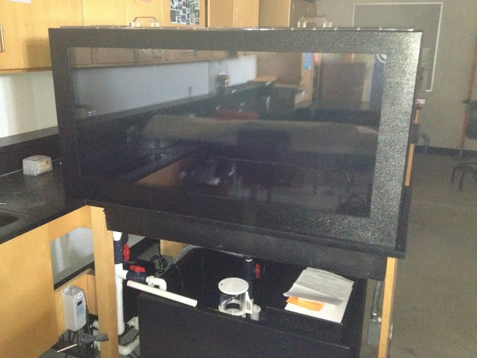
The Fish Tank – 100 gallons
Notes:
Picture of 100gallon white seabass tank. Estimated cost ~$6,000. HSWRI has a contractor that will build the tank specific to each classroom.
The tank is extremely important because it will be the home of the juvenile white seabass for several months. The tank must be monitored daily and regulated to ensure the environment for the fish is optimum. Water temps are kept around 17-18 C. Students will measure the dissolved oxygen, temp, nitrogen, and pH of the tank daily. We will also perform water changes and feed the tank. All the tanks are seeded with “bio-balls”. These are small plastic balls that house bacteria which break down the excess nitrogen (from fish poop and left over food). These are extremely important components of the nitrogen cycle in the semi-closed tank system. It is only semi-closed because we’ll be exchanging water weekly and if nitrogen levels become too high.

Slide 11
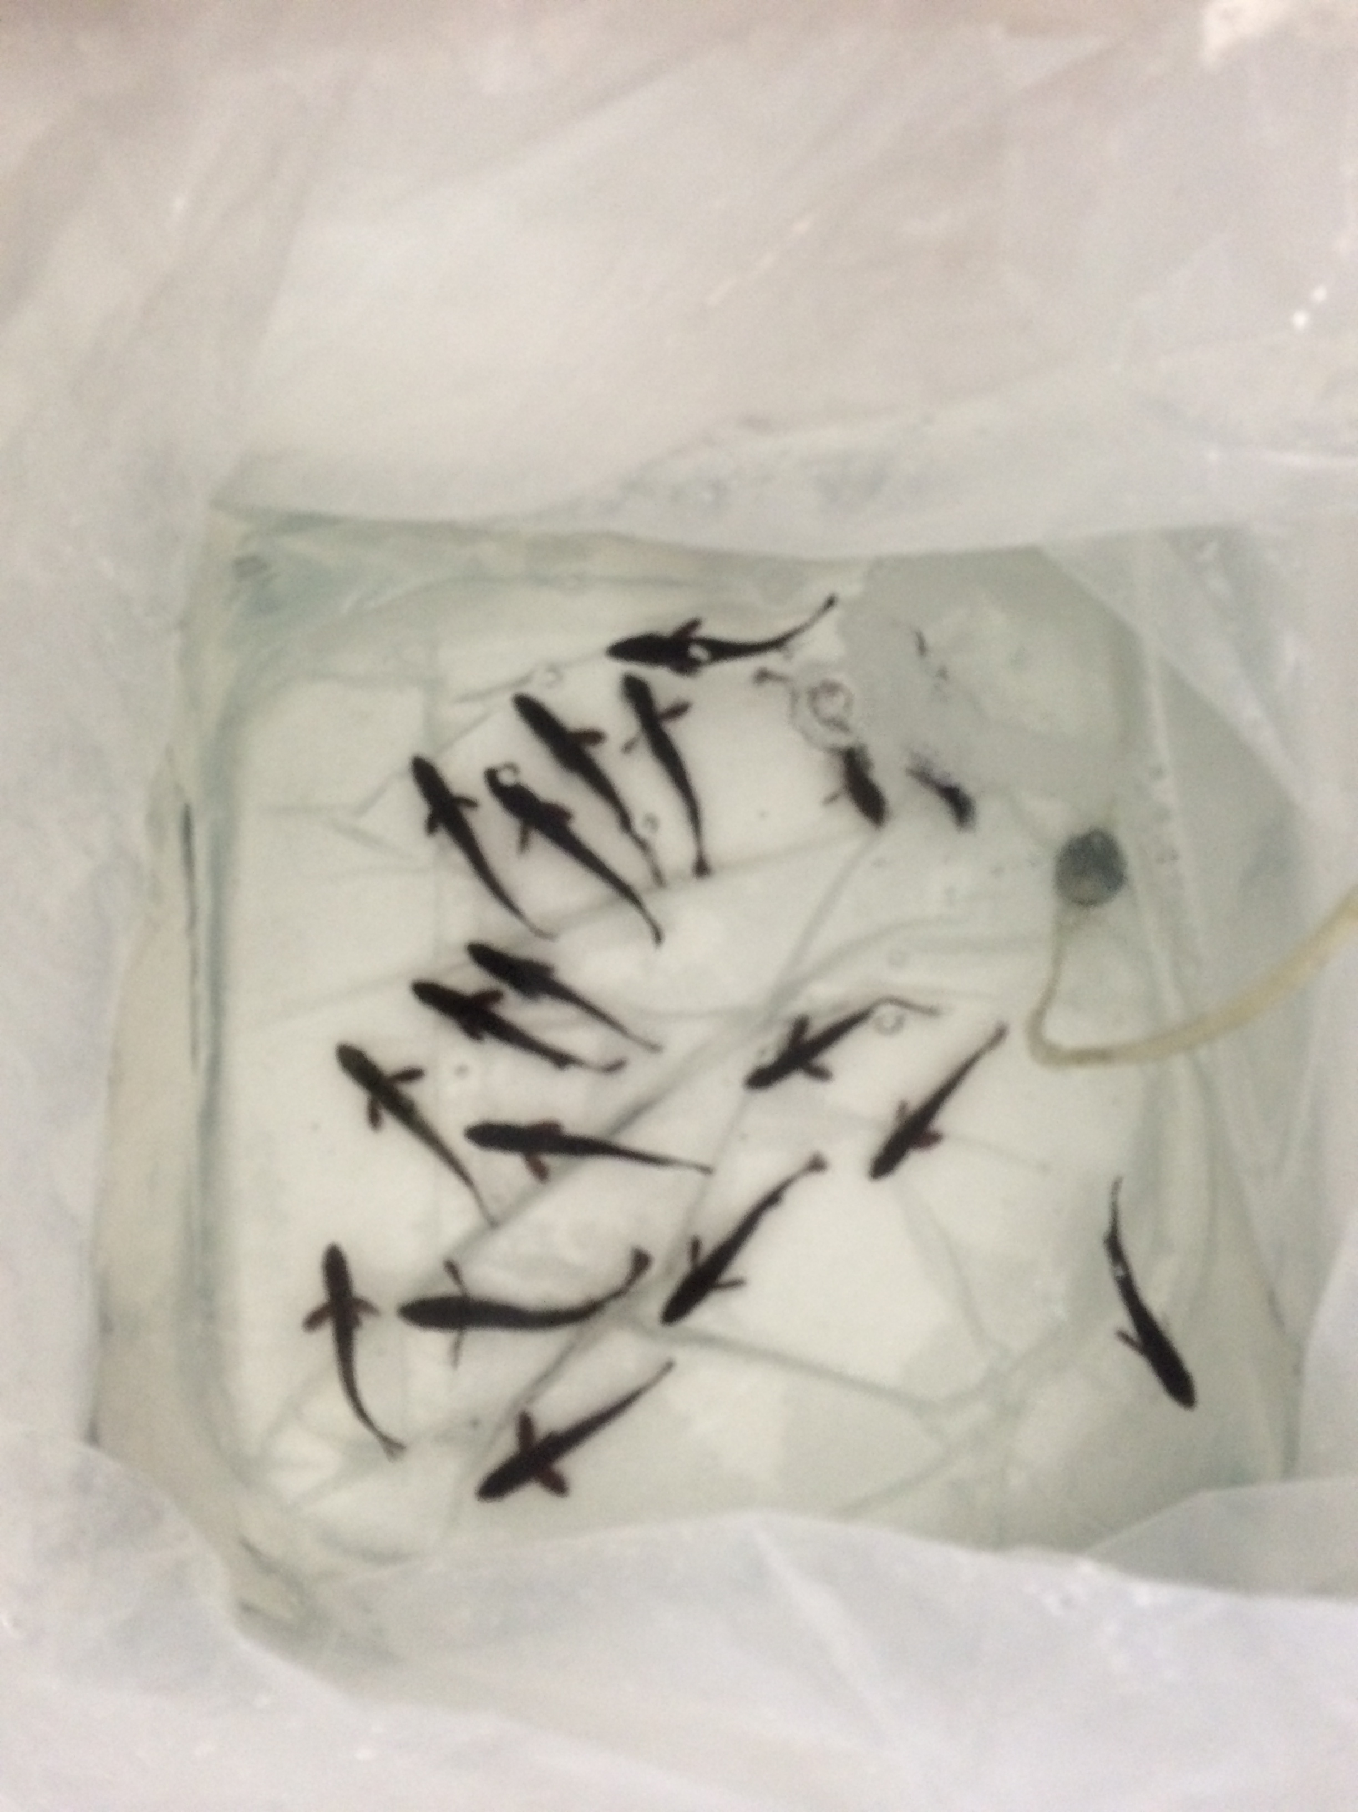
Monitoring water quality
DO – Dissolved oxygen in water
pH – acidity or alkalinity of water
Nitrogen (NO2, NO3, NH3, NH4+) – Waste and excess nutrients
Temperature
Notes:
DO, salinity, water tempurature, total ammonia nitrogen (TAN), alkalinity, pH, and nitrate/nitrite measurements will be done by the students. All of these parameters must be monitored before the fish enter the tank and each day the fish are in the tank. They will record these values in an online google doc that HSWRI can monitor. They will let us know if values fall outside of the desired range and advise us on how to mitigate the issue.

Slide 12
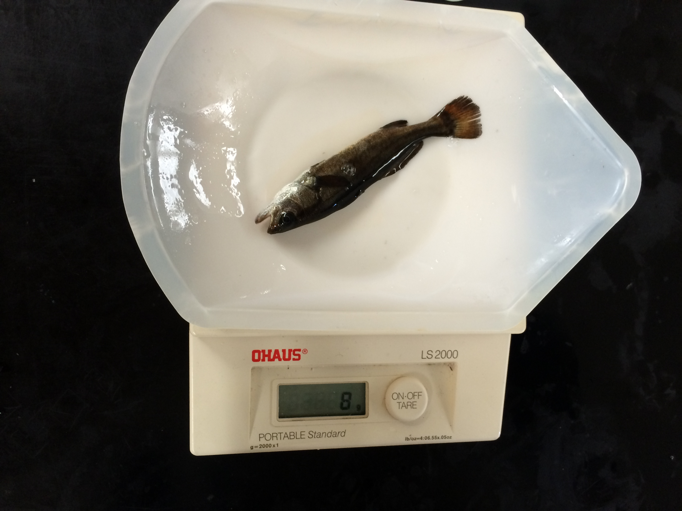
Monitoring the Fish
Notes:
About 1 month before release, the students will tag the fish. Tagging day will take approximately 90 minutes and requires the group of ~25-30 ‘seabass’ students. Mike will show the students how to insert a small metal chip into the cheek muscle of the fish. The students will also measure and weight the fish again. The chip will allow HSWRI researchers to determine if an adult fish has come through the stock enhancement program. The researchers collect the adult heads from commercial fisherman – and can even scan live fish.

Slide 13
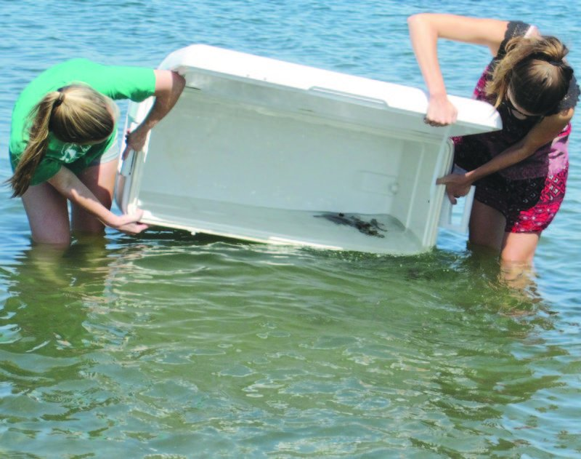
Releasing the Fish / Student Projects
Notes:
At the end of the school year, the fish are released into the wild!
The fish will be kept for several months (generally 3-6mo). The total duration depends on the fish arrived, the age of the fish upon arrival, and the target release age set by HSWRI. We released our fish in to Mission Bay after school the first week of June. Mike will ultimately determine where and when the seabass get released. Our ‘seabass students’ release the fish.
Note to teacher: The teacher should mention to the students that they will have to do presentations on the white seabass in the classroom project. This is separate from the white seabass management poster/presentation. The teach will likely want to save the fine details about the presentations for a later date. A good timing for doing the projects would be after tagging day – when the students have a second series of weight/length measurements. The students should think about possible topics (in addition to the ideas provided by the teacher) throughout the duration of the program.
Student Projects Topics
Toward the end of the year, students will wrap up the seabass unit by doing a poster project on one aspect of the seabass project. Students can analyze and graph the data recorded (fish/water measurements) or focus one particular aspect of the project (e.g. tank). A list of potential ideas is described below. Teachers/students are encouraged to come up with other projects centered on the seabass unit. The number of possible topics is limitless. Students should be broken up into groups of 2-3 students per group assigned a research topic (or they can choose depending on their interest level). Students should get at least 2 full class periods to work on their poster, depending on how often and efficient they are with making posters. The first day should be primarily analyzing the data or system (like the tank), while day two should be constructing the poster. Presentations should be ~3-5min long on the third day.
Feeding assimilation: How much of the food that was given to the fish was actually assimilated into biomass? Students will know the beginning weight of each of the fish, their final weight, as well as the total amount of food that was fed to the fish.
Diet Analysis: what is in the fish food and why? Students can investigate what is in the fish food pellets provided by HSWRI and why each component is important to the fish. They can also investigate what juvenile seabass would traditionally eat in the wild.
Growth rates: Measuring the fish every 3-4 weeks would allow the students to monitor the growth rates over time. Students can also investigate if all the fish grow at the same rate.
Chemistry: Water quality measurements – temperature, pH, nitrogen gas, oxygen, nitrates, salinity.
Nutrient cycling: nitrogen cycle within the tank.
Engineering: Diagraming the fish tank and the function of each main component.
Life cycle: Diagram, in fine detail, the life cycle of the white seabass.

Slide 14
Research and Poster Project
Fisherman– Recreational and Commercial fisherman.
Concerned Citizens - You are a group of concerned citizens representing various non-profit/non-governmental organizations (NGO). Concerned about the environment.
Scientists - Analyzed scientific data and came up with a science-based regulations for the fishery.
Notes:
The purpose of this slide is to introduce lesson one activity: Fisheries management role-playing activity.
First, students will answer a series of questions about the white seabass using the “White Seabass Background Information” handout found in the “Student Resources” PDF.
The class will then be divided up into groups of 4-5 students per group and assigned to role-play as “Fisherman”, “Fisheries Scientists”, or “Concerned Citizens”. Groups will each perform a research project and do a presentation. Each group has specific requirement sand resources for their presentation based on their role.
Multiple groups may exist of the same category (e.g. two groups of concerned citizens) – these groups may have different opinions, but they must back it up with research support.

Slide 15
Major question for each group
Should the current regulations be changed to allow for more or fewer white seabass to be caught (or should they remain the same)?
Notes:
The major question each group will try to answer is: Should the current regulations be changed to allow for more or fewer white seabass to be caught (or should they remain the same)?
They must do research and come up with a position this question. Everyone in the group must agree with the same position. During the final presentation, they will state their position and provide evidence for their position based on their research and what they put on their posters.
The position of the group should reflect their role (fisherman, citizens, scientists).
The main question above requires (at minimum) students to understand the current status of the California white seabass fishery as well as the current regulations.

Slide 16
Project Steps
Step 1: Research
Step 2: Group consensus on white seabass regulations
Notes:
Once they are assigned to a group and a role, they can begin their ‘research’, which involves reading and taking notes on the provided resources. Each group gets a specific set of resources outlined in the “Lesson 1 Activity Student Roles”. All the resources can be found in the “Student_Resources.pdf”.
During their ‘research’ the group should come to a consensus on what they if they want to make changes to the current management of the white seabass. If they want to make changes, they should be able to explain what changes they want to make. The students should use their research to support and explain why they choose their position (providing evidence for their reasoning).

Slide 17
Poster Presentation
Step 3: Poster Preparation
Step 4: Presentation
  graded on the content of poster as well as your group’s position and reasoning.
Notes:
(Notes for teacher to present)
Students will construct a poster, which will be presented to the class. Each group has specific requirements for their poster (these are the minimum requirements – the can put more on their poster if they want). The poster will contain research that backs up their position on the current management. They must present their position in a clear and concise manor using evidence from their research as support.
Step 3: Poster Preparation
Each team will create a poster with the specific details outline for your group. This will help you ‘research’ your position on the current regulations.
Step 4: Presentation Preparation
Each home team will work on a presentation of their findings to present to the rest of the class.
Presentation will graded on the content of poster as well as your group’s position and reasoning.
It is the responsibility of each team to make sure that all of its members understand the material thoroughly and are prepared to teach it.

